Slide 1

Strategic Queries Session: What does it mean to be a Quaker-founded institution?
10/28/2023 @ Guilford College Wess Daniels, David and Nancy Haines, Ione Taylor

Slide 2
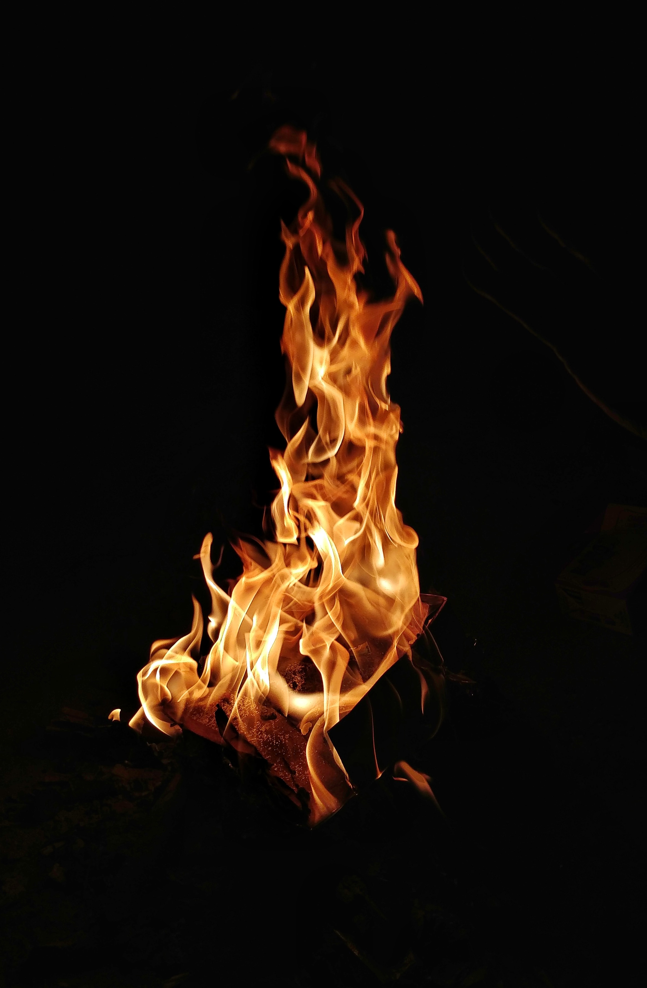
Fire - by Judy Brown
When we are able to build
open spaces
in the same way
we have learned
to pile on the logs,
then we can come to see how
it is fuel, and absence of the fuel
together, that make fire possible.
We only need to lay a log
lightly from time to time.
A fire
grows
simply because the space is there,
with openings
in which the flame
that knows just how it wants to burn
can find its way.
What makes a fire burn
is space between the logs,
a breathing space.
Too much of a good thing,
too many logs
packed in too tight
can douse the flames
almost as surely
as a pail of water would.
So building fires
requires attention
to the spaces in between,
as much as to the wood.
Notes:
From Ione Taylor after Kyle’s Installation

Slide 3
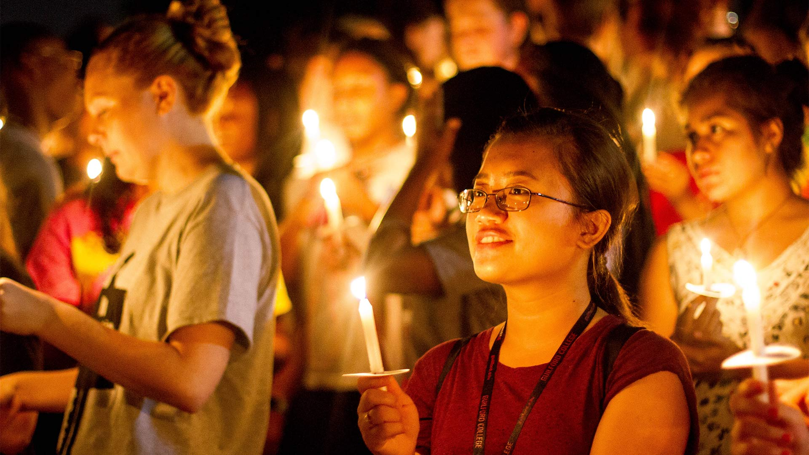
Someone Read The Mission:
Guilford’s longstanding mission is clear and distinctive: To provide a transformative, practical, and excellent liberal arts education that produces critical thinkers in an inclusive, diverse environment, guided by Quaker testimonies of community, equality, integrity, peace and simplicity and emphasizing the creative problem-solving skills, experience, enthusiasm, and international perspectives necessary to promote positive change in the world.
Notes:
Tradition is a whole (eco)system. You don’t have a tradition without all the pieces working together.

Slide 4
The Goal: To be in conversation with what it means for Guilford to be (and remain) connected to the Quaker tradition.
Notes:
What does it mean for us, for you, to be in conversation with the Quaker tradition?
Personal work?
Learning? A theory or a method and applying.
Is it good enough to be interested in it?

Slide 5

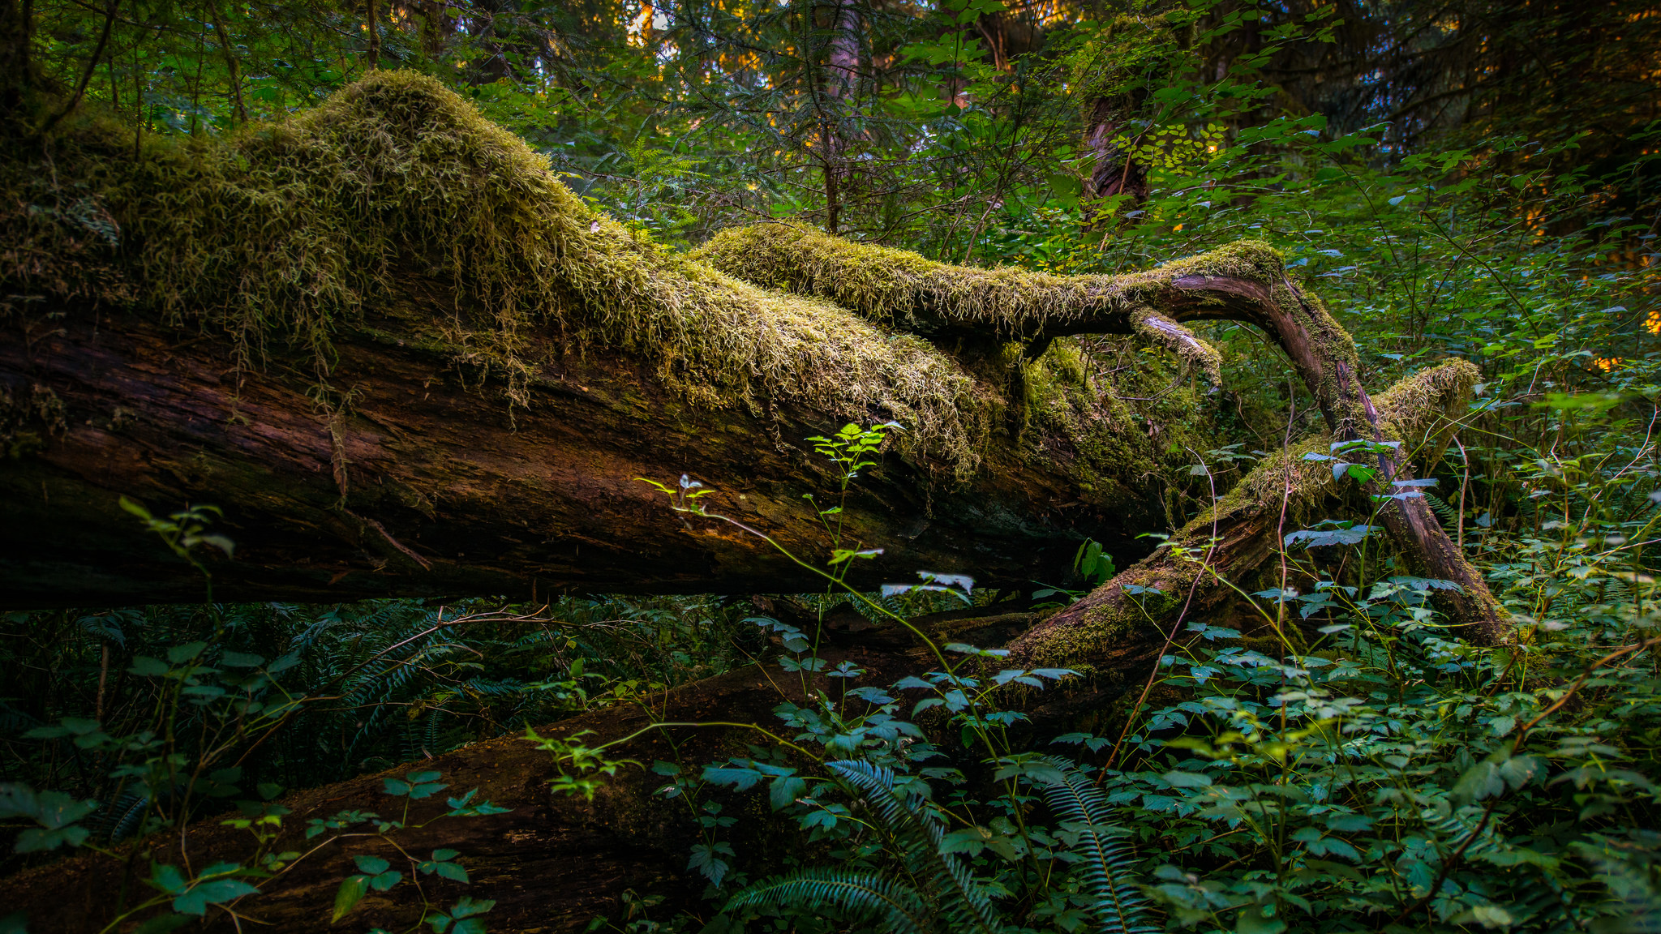
“…tradition is the living faith of the dead, traditionalism is the dead faith of the living. And, I suppose I should add, it is traditionalism that gives
tradition such a bad name.”
Jaroslav
Pelikan
WRITE SOMETHING HERE
MEET OUR
TEAM

Slide 6

The Perennial Question: Is Guilford a Quaker School?
Notes:
This brings us to an easily recycled question.
But if you keep asking the same question and you cannot get a satisfactory answer than maybe we’re asking the wrong question.
How does it usually go: we count quaker bodies; we say we are not because of some mistake that was made or because a decision was made that some disagree with; we debate “values”

Slide 7
The Perennial Question: Is Guilford a Quaker School?
How does this question usually go?
Is it someone’s responsibility to keep Guilford Quaker? Who?
How do we want to answer this question?
Are we putting too much on a question?
Creating new questions.
Notes:
This brings us to an easily recycled question.
But if you keep asking the same question and you cannot get a satisfactory answer than maybe we’re asking the wrong question.
How does it usually go: we count quaker bodies; we say we are not because of some mistake that was made or because a decision was made that some disagree with; we debate “values”

Slide 8
Framing: Where Have We Been? And Where Can We Go?
Campus changes in commitments (and how we understand them): for example, Integration and equality.
Campus changes in who we are: from Quaker to non-Quaker, from PWI to Minority serving, from Quaker leadership to mostly non-Quakers steeped in Guilford ethos.
Campus changes in culture: from a focus on birthright and legacy to a shift towards diversity, openness, less sectarian, and more inclusive rooted in more of an ethos/feeling.
Campus changes in what it means to be Quaker: from a more policing of the Quaker tradition (as less and less Quakers on campus) to a more participatory approach, it takes all of us.
These campus changes are not necessarily good or bad, but they do mean regularly needing to reinterpret and reinterrogate what it means for us as a college to be “Quaker.”
Notes:
Where do we find ourselves in this relationship/stream of the Quaker tradition and the college? Where we have been and where we are going in terms of the Quaker tradition? Ways of thinking about this connection?

Slide 9
The Guilford Quaker Ethos / Ecosystem
Tradition is a whole (eco)system. You don’t have a tradition without all the pieces working together.
Willingness to hear and respond to the “small truth” or quiet whispers among us. Whose is the furthest voice that needs to be paid attention to?
Deep and active listening as a primary posture in life. The importance of the practice of silence.
Living into Questions - allowing for questions to guide exploration.
Our understanding of truth and practice evolves over time.
The relationships we have and those we seek. Who we are connected to. Who are we supported by, visited by, and challenged by?
Importance of Communal Discernment: There is truth and wisdom in the community. We have everything we need to do what this community was created for.
A participatory community is one that shares responsibility, learning, and acting together.
The dignity of all people and the importance of nonviolence as a way of life.
We are to come to every situation as a “Opportunity” with open expectancy
Notes:
What would be some of the pieces of wisdom that you can think of?
A narrative that provides inspiration and guidance
What did I miss?

Slide 10

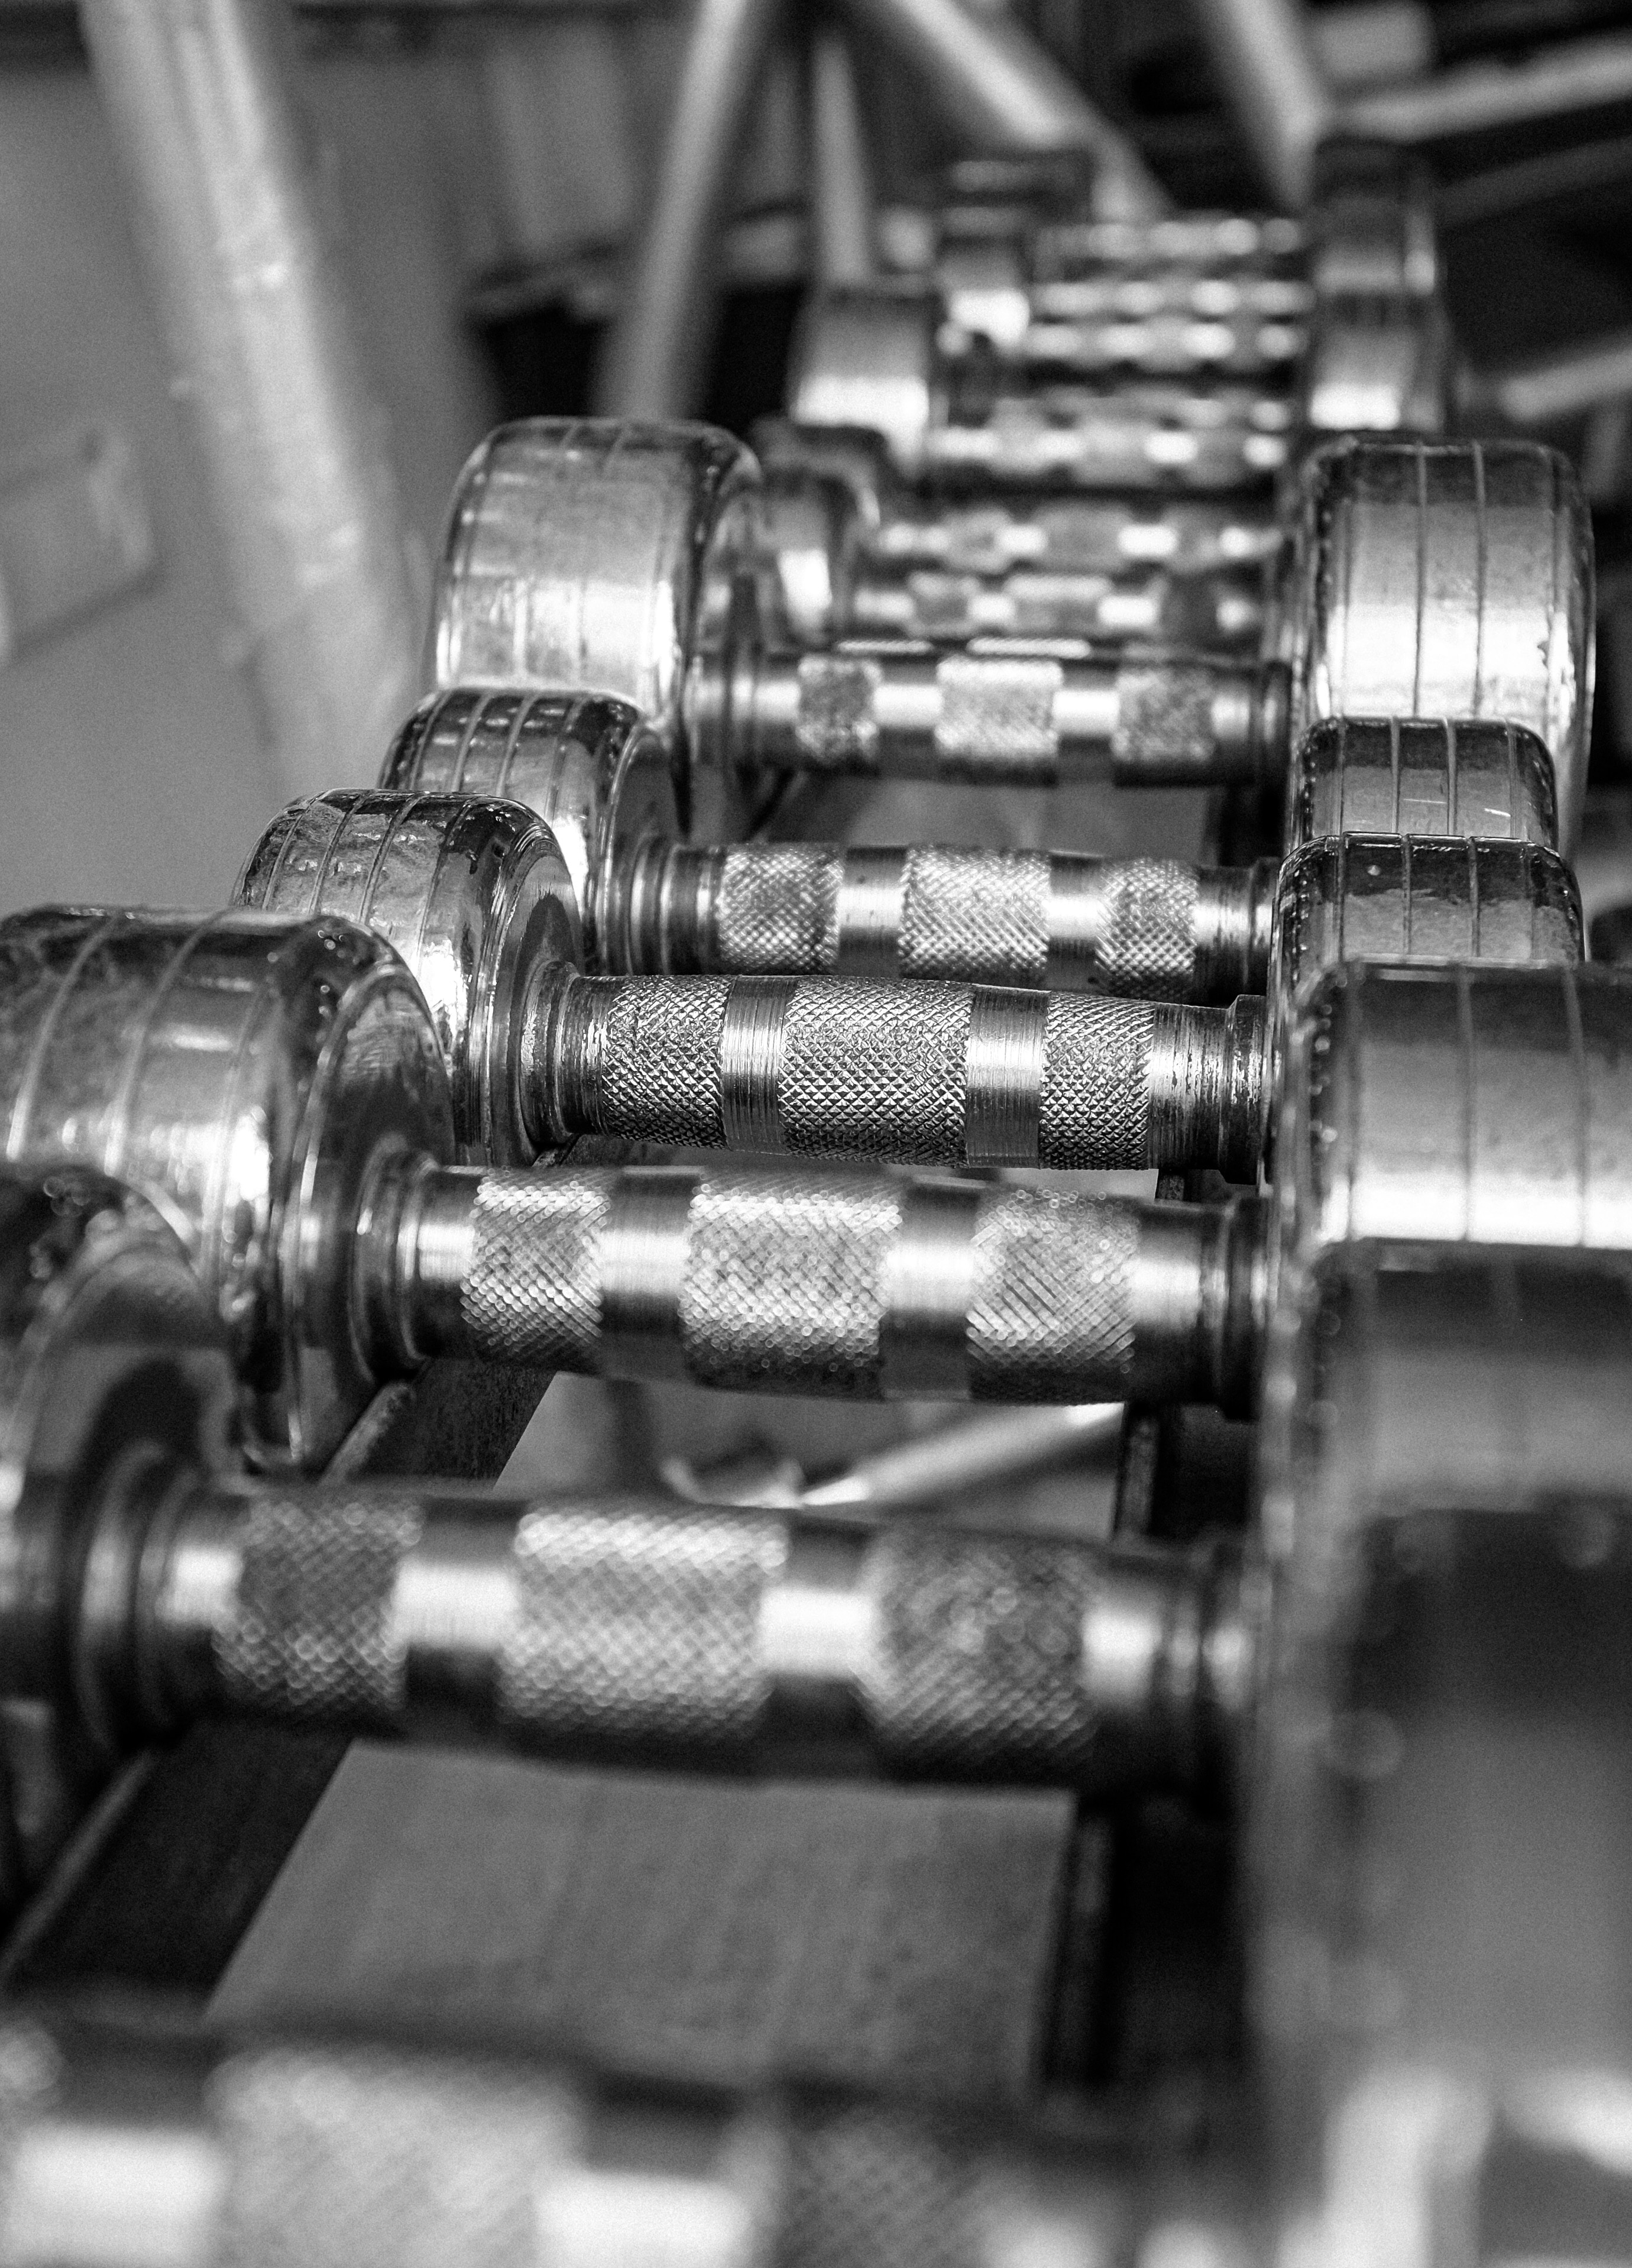
Invitation into Discussion: How do we build on and strengthen what we have (when it comes to the Quaker ethos of the college)?
Notes:
Small groups - 4-5 people:
What does it mean for us, for you, to be in conversation with the Quaker tradition?

Slide 11

Today’s Process
30 Mins - Queries at Small Group Tables
25-30 Mins - Reporting back from small groups
30 Mins - Reflective listeners: What are you hearing and not hearing?
Closing question
Next Steps
Notes:
What does it mean for us, for you, to be in conversation with the Quaker tradition?

Slide 12

Small Group Questions
30 Mins - Queries at Small Group Tables
What are my gifts/what do I bring to the college?
What support or need do I have in order to thrive here?
What have I received from this community thus far?
What does the Quaker tradition have to do with this?
Notes:
What does it mean for us, for you, to be in conversation with the Quaker tradition?

Slide 13
Reflective Listeners: What are you hearing (and not hearing) in what is being shared?
Notes:
This brings us to an easily recycled question.
But if you keep asking the same question and you cannot get a satisfactory answer than maybe we’re asking the wrong question.
How does it usually go: we count quaker bodies; we say we are not because of some mistake that was made or because a decision was made that some disagree with; we debate “values”

Slide 14
Closing Question:
Given our discussions today, how do you think the Quaker tradition and ethos enables the movement in the direction we hope to/need to go?
Notes:
This brings us to an easily recycled question.
But if you keep asking the same question and you cannot get a satisfactory answer than maybe we’re asking the wrong question.
How does it usually go: we count quaker bodies; we say we are not because of some mistake that was made or because a decision was made that some disagree with; we debate “values”

Slide 15

Next steps: Are there Next steps that come out of this that we need or want to take?
Notes:
What does it mean for us, for you, to be in conversation with the Quaker tradition?

Slide 16
gatheringinlight.com
Notes:
What does it mean for us, for you, to be in conversation with the Quaker tradition?

