Slide 1

2026 Economic and financial outlook
tim@accessmacro.com

Slide 2
Consumer spending continues to improve

Slide 3
The pace of core PCE inflation is easing

Slide 4
Profits are a big reason tariff inflation is muted

Slide 5
Without a recession, we may not hit 2% in 2026

Slide 6
The labor market is balancing on one leg

Slide 7
Monetary policy may be approaching neutral

Slide 8
Policymakers are very unsure where they’ll stop

Slide 9
Is a structural shift in the 10-year under way?

Slide 10
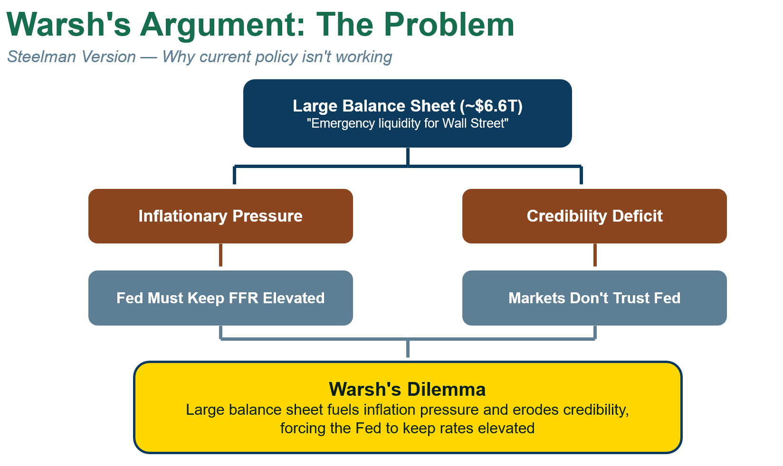

Slide 11
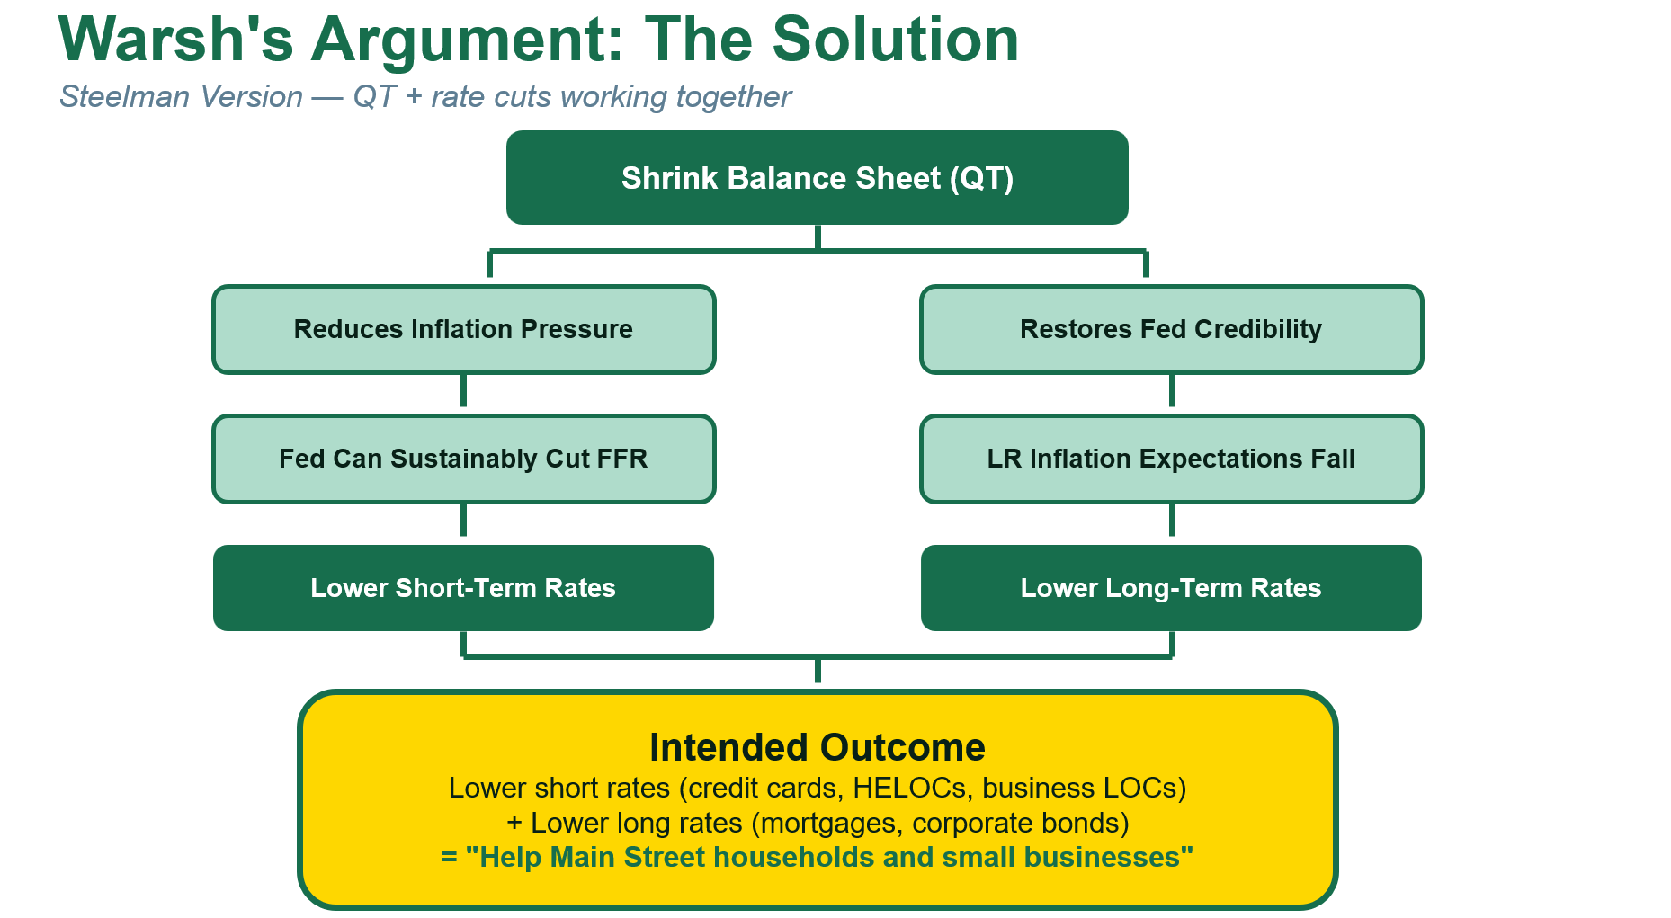

Slide 12
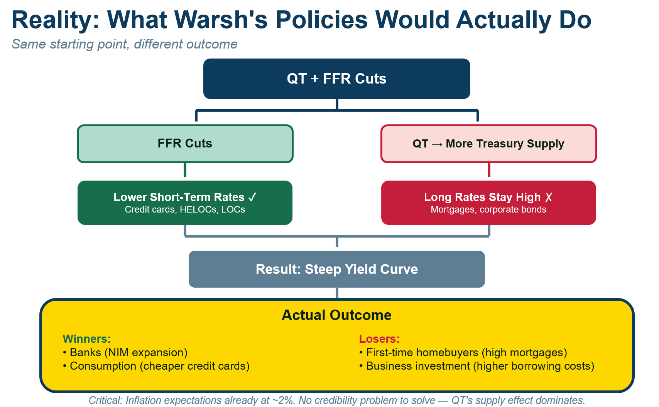

Slide 13
Mortgage spread almost back to “normal”

Slide 14
How to leverage volatility
Better Decisions
Be a storyteller
Focus on the right stats
Nurture a growth mindset
Innovate with macro data

Slide 15

Follow us on Substack for the latest

