Slide 1
The City of Philadelphia’s
Digital Equity Plan

Slide 2


Digital Equity Plan
GOAL #2: CONNECTIVITY
GOAL #3:
TRAINING & WORKFORCE
GOAL #3:
TRAINING & WORKFORCE
GOAL 1: DEVICES
Philadelphians can access appropriate and affordable devices
Philadelphians can access and afford the internet connectivity they need
Philadelphians develop the digital skills necessary for work and life
Philadelphia grows and sustains the infrastructure and ecosystem to increase digital equity
Goals

Slide 3
Datasets
2021 Household Internet Assessment
Randomized phone survey to understand the number of households that are currently without internet or relying on unstable, low bandwidth options
N = 2503, 373 do not subscribe to broadband
Representative sample
38% white
37% African American
13% Hispanic
3% Asian
Survey provided in 5 languages
2023 Voices Survey: Digital Access
5 question survey asking 1) I have affordable, reliable internet 2) I am confident using computers, 3) I want to join classes to improve tech skills, 4) what types of programs should the city invest in 5) how I want to be engaged in digital equity
N = 800
Survey modes: IVR calls to landlines, SMS text-to-web to cell phones, and recruited online panels.
The survey offered in English and Spanish.
Infrastructure and Assets
All Facilities
Libraries
Firehouses
Police stations
Schools
Rec Centers (type of internet, wi-fi)
Other data:
Poles
Streets/City-owned fiber
Railways
Illegal Dumping locations
Camera locations
ACS data
2021 Assessment data
Demographics
Poverty
Race
Density

Slide 4

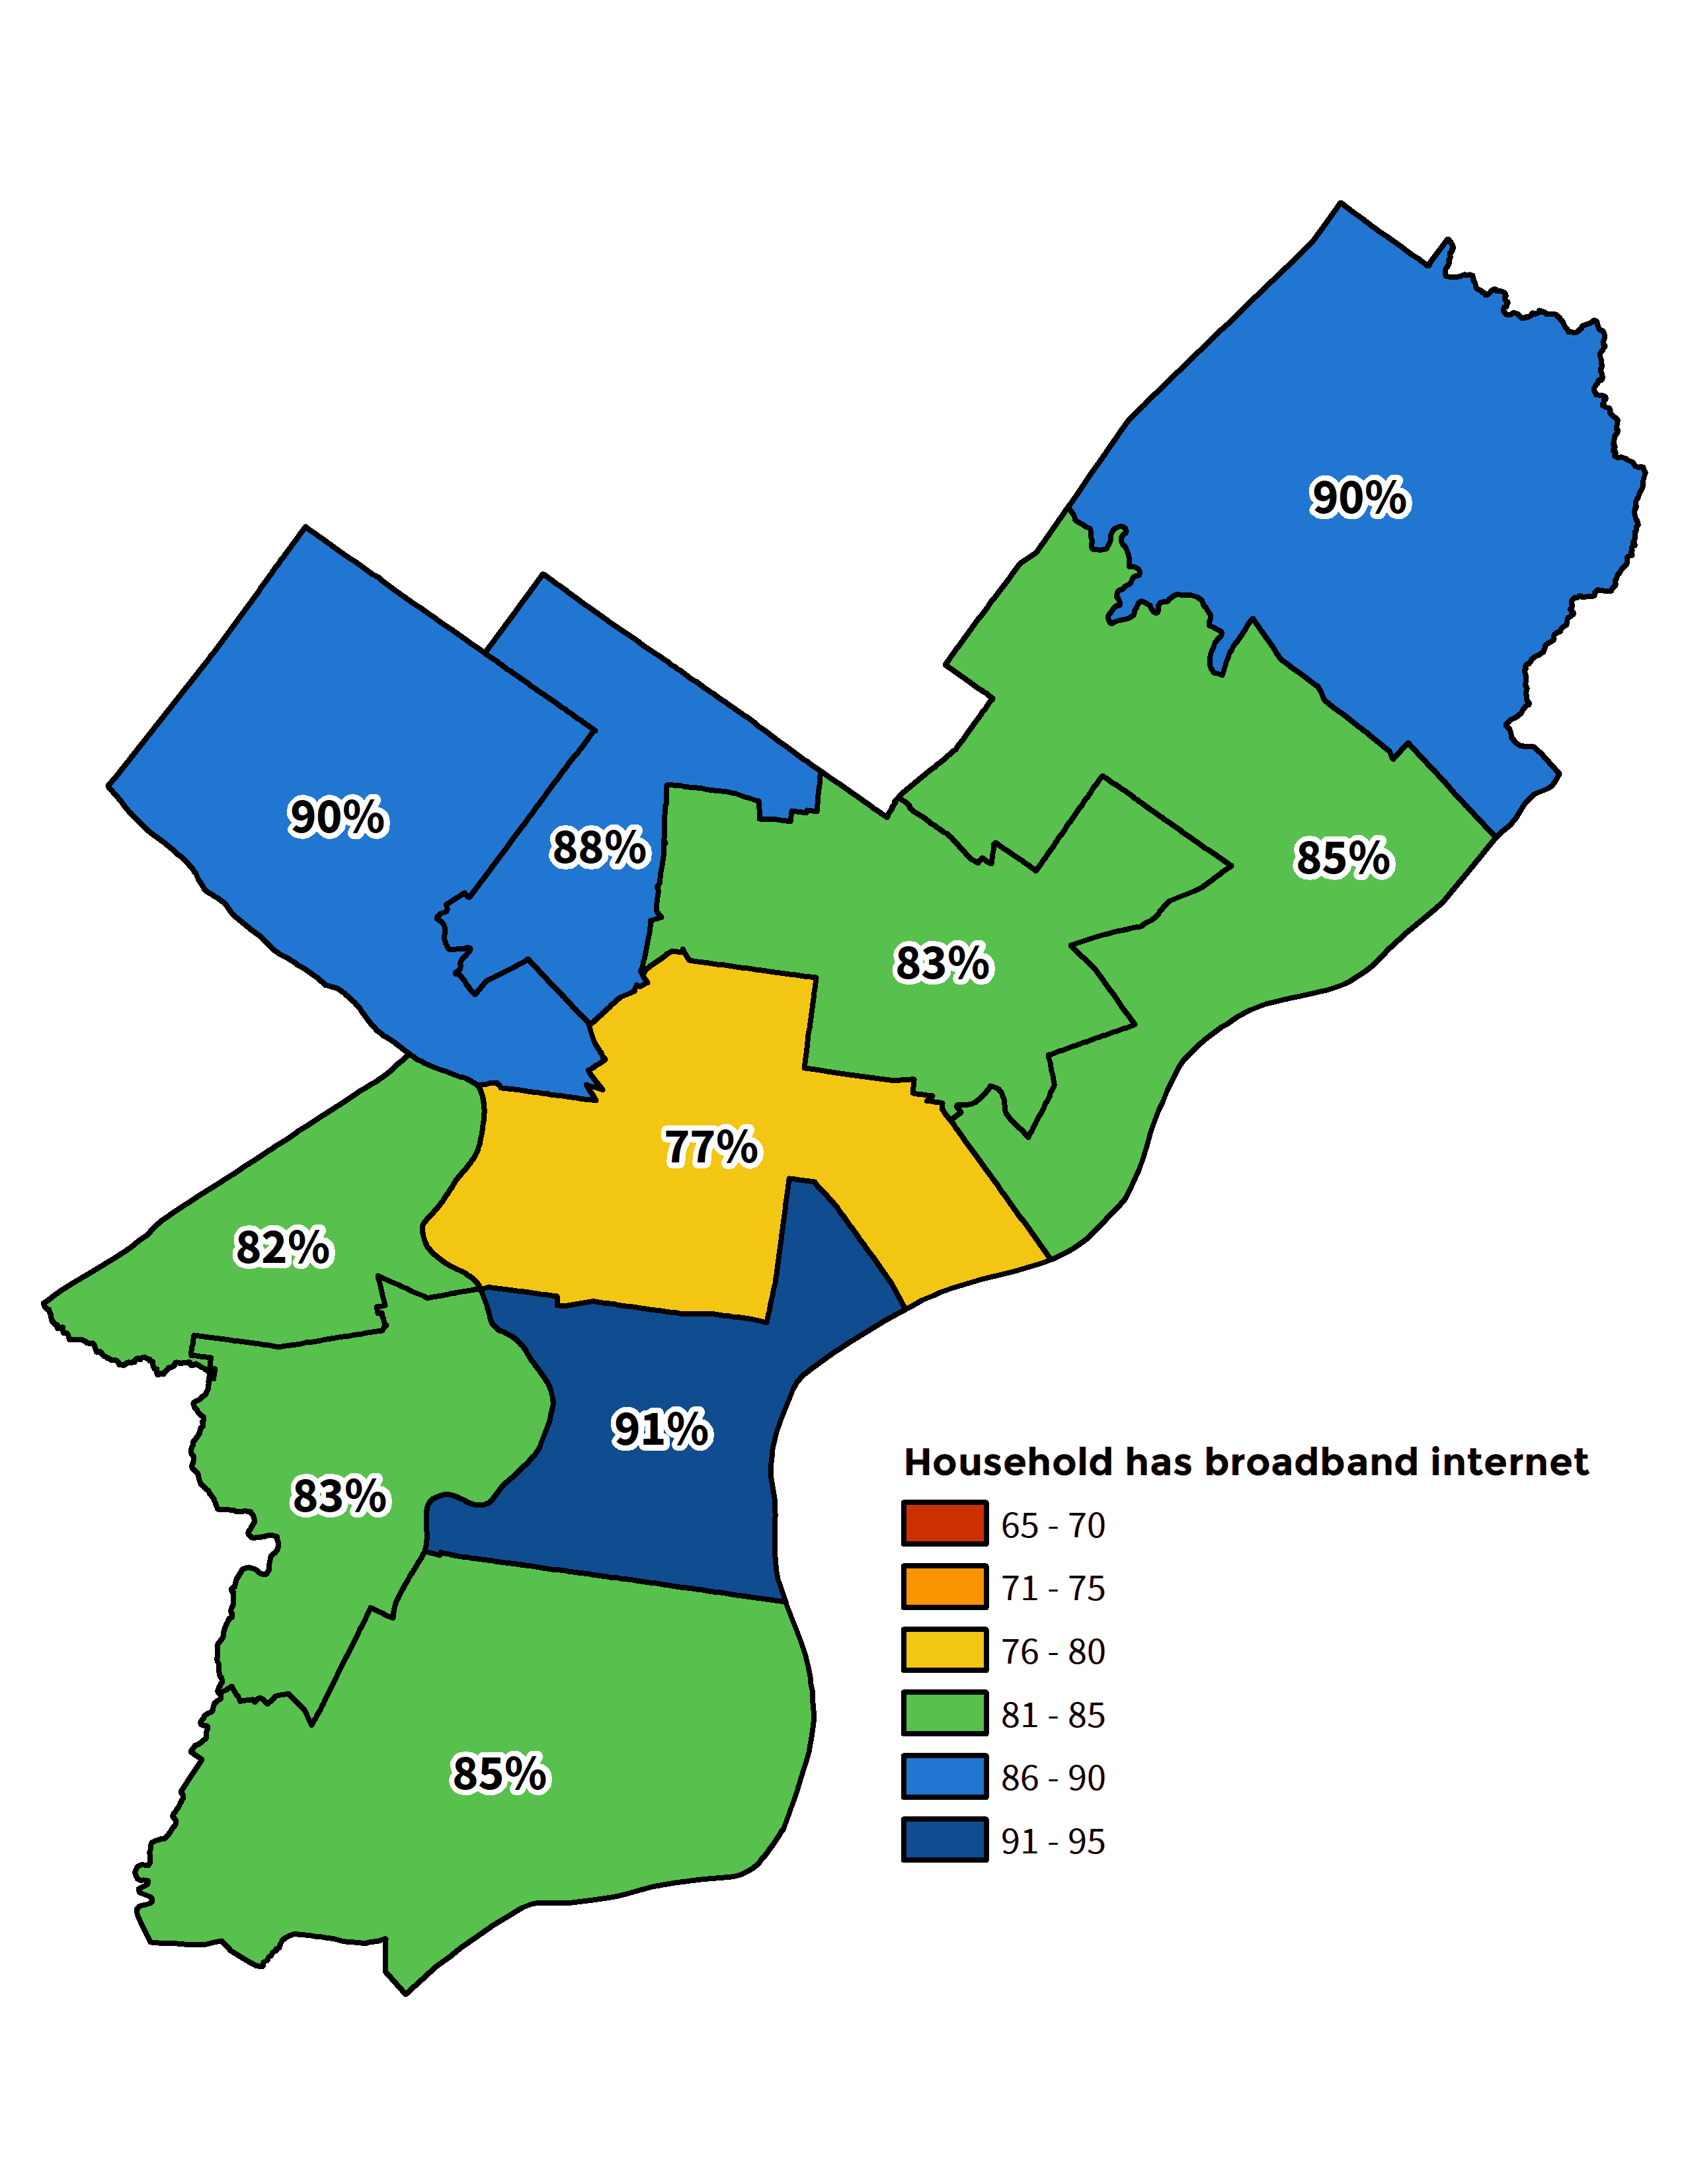
Philadelphia has infrastructure BUT….
24% of all ACP enrollments in PA are in Philadelphia!
14.7%
32%
183K
of Philadelphia households have no internet subscription.
of Philadelphia households are considered “subscription vulnerable.”
Philadelphia households currently enrolled in ACP.
31% of these households have an annual income of below $20,000.
33% of seniors lack home broadband internet.
345K total Philadelphia households eligible for ACP.
It would cost Philly $65M/year if current ACP enrollees received the maximum
benefit.
Discount programs account for a 17% increase in adoption for low-income households
75% of low-income residents say more than $21/month for broadband is too expensive
Concerning Challenges in Addressing Equity

Slide 5
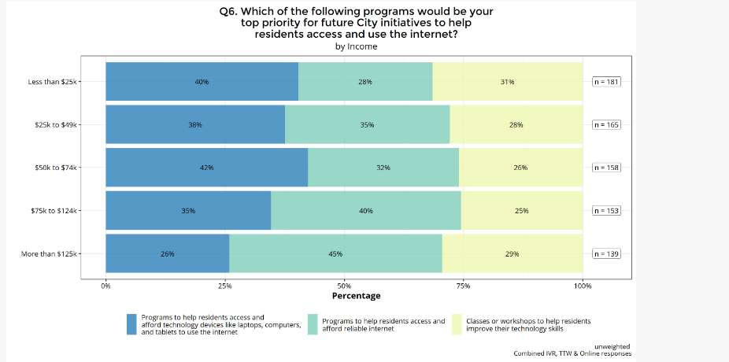
Which program would be your top priority for future city investments? By Income
Takeaways:
Those with low income are more likely to want the City to put funds toward helping residents get access to devices.
Those with higher income think the city should put funds toward helping residents access internet.

Slide 6
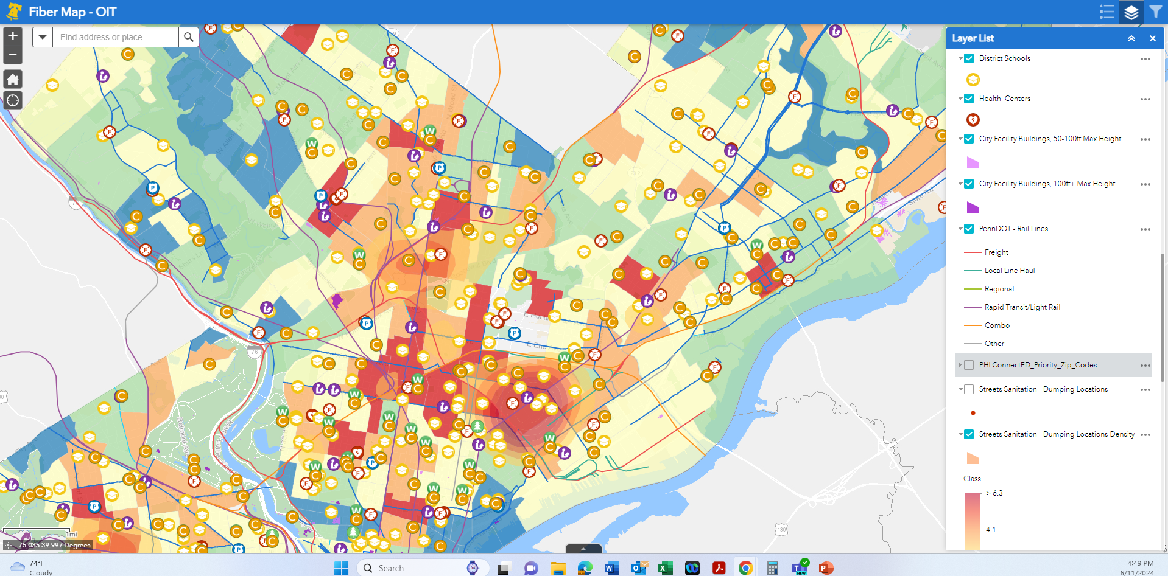
Mapping Assets

Slide 7
Digital EquityPHL
01
02
03
04
PHLConnectED
Program providing free internet and digital access resources for pre-K-12 families in need.
Digital Literacy Alliance
Cross-institutional grantmaking group to seed innovation in the digital equity space.
Device Refurbishment and Tech Support
Partnership with PCs for People to refurbish and redistribute computers and provide technical support for those in need.
Digital Navigator Network
1:1 remote or in-person support to households for access and use of technology. Dial 2-1-1 to make an appointment with a Digital Navigator. Hotline operates 24/7 and is available in 150+ languages
Office of Innovation & Technology
PROGRAMS
For More Information: https://www.phila.gov/programs/digitalequityphl/

Slide 8
Digital Equity
01
02
03
Leveraging Public Assets
Expand low-cost and free internet access in low-income communities by allowing City-approved ISPs to place their communication equipment on City-owned properties.
Addressing Affordability
Transition from the Affordable Connectivity Program to new models for subsidizing internet and devices in high-need communities
Building city fiber backbone
Provide gigabit fiber and wi-fi to 186 recreation centers. Create a long-term broadband infrastructure plan for the city.
NEXT

