Slide 1
How Will FirstNet Improve Public Safety Communications?
The FirstNet Nationwide Network is intended to be a wireless, interoperable nationwide communications network.

Slide 2
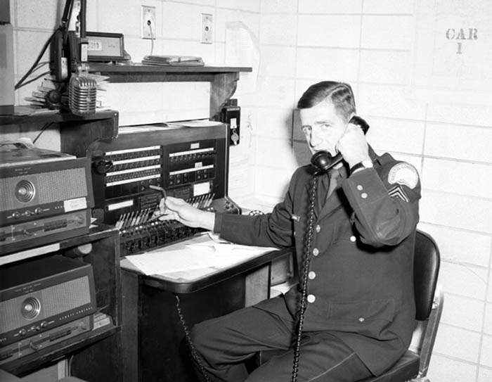
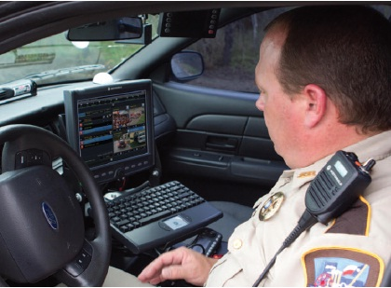
The FirstNet project is the last recommendation of the 9/11 Commission Report to be implemented.
The public safety community has made significant strides toward strengthening national preparedness and improving emergency communications capabilities.

Slide 3
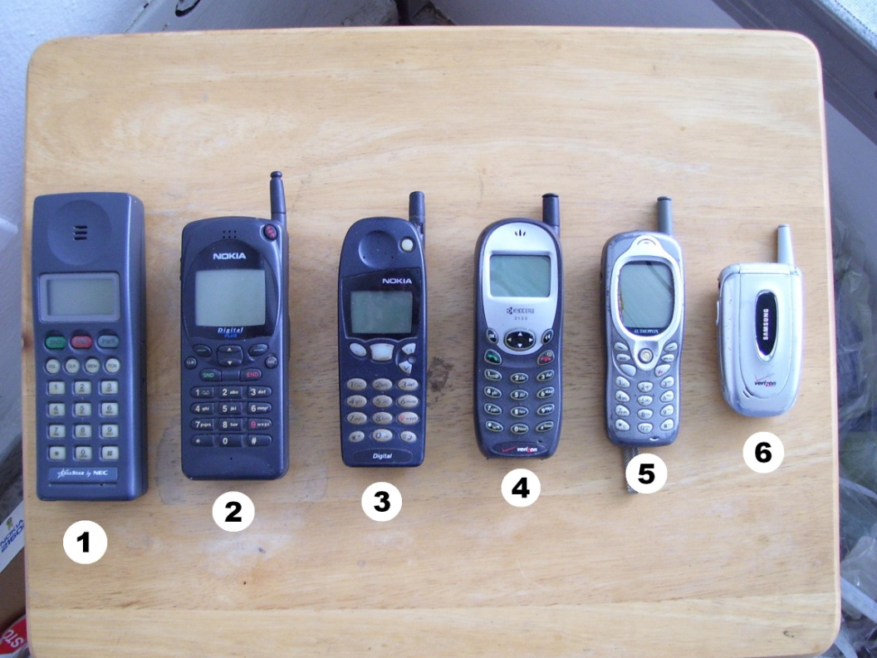
The majority of current broadband data solutions have limited ability to support emergency responders because most are not interoperable or built to public safety standards.

Slide 4
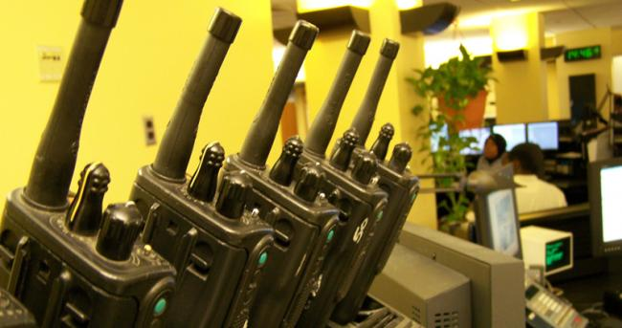
Currently, the public safety community relies on traditional LMR systems to support mission critical communications.
First responders, however, continue to be limited by fragmented networks and decades-old wireless technologies.

Slide 5

As LMR systems evolved over many decades, there are a number of varying, often incompatible systems in use nationwide.

Slide 6
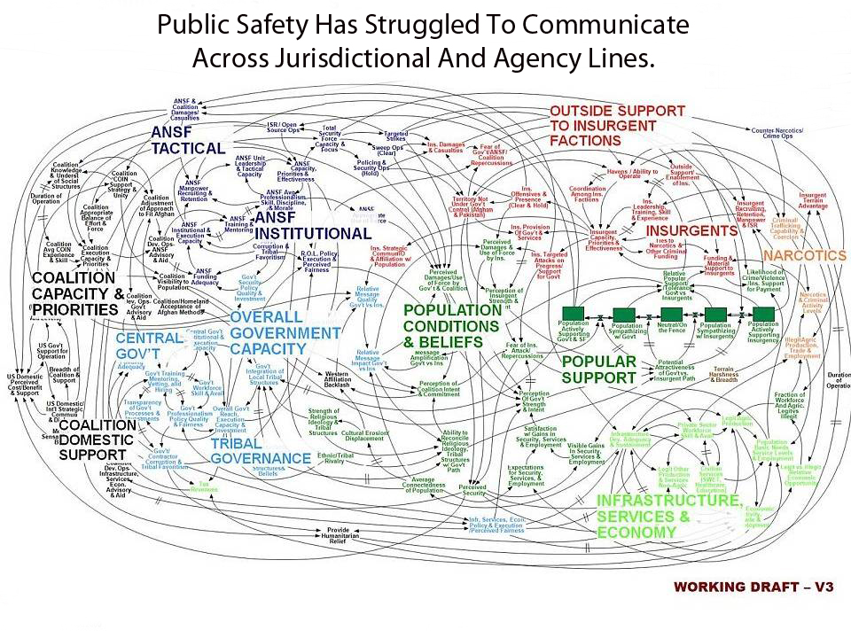

Slide 7
In the next three to five years,
Public Safety will encounter challenges relating to -- operability, interoperability, geography, aging equipment/systems, emerging technologies, changing project champions, and sustainable funding.

Slide 8
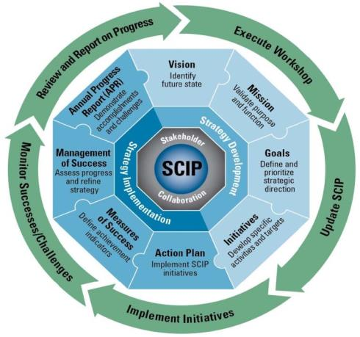
Statewide Communication Interoperability Plan (SCIP) is a stakeholder driven, multi-jurisdictional, and multi-disciplinary statewide strategic plan to enhance interoperable and emergency communications.

Slide 9
The SCIP will empower the state:
To provide the strategic direction and alignment for those responsible for interoperable and emergency communications at the State, regional, and local levels.
To explain to leadership and elected officials the vision for interoperable and emergency communications and demonstrate the need for funding.
To develop and provide training, education, and outreach for interoperable communications that can be used by all entities statewide.

Slide 10
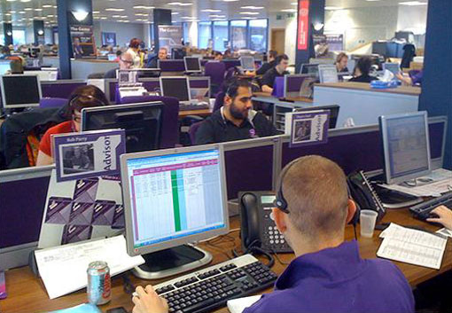
Just as smartphones have changed the way businesses operate, new wireless technology advancements will dramatically advance communications for emergency responders.

Slide 11
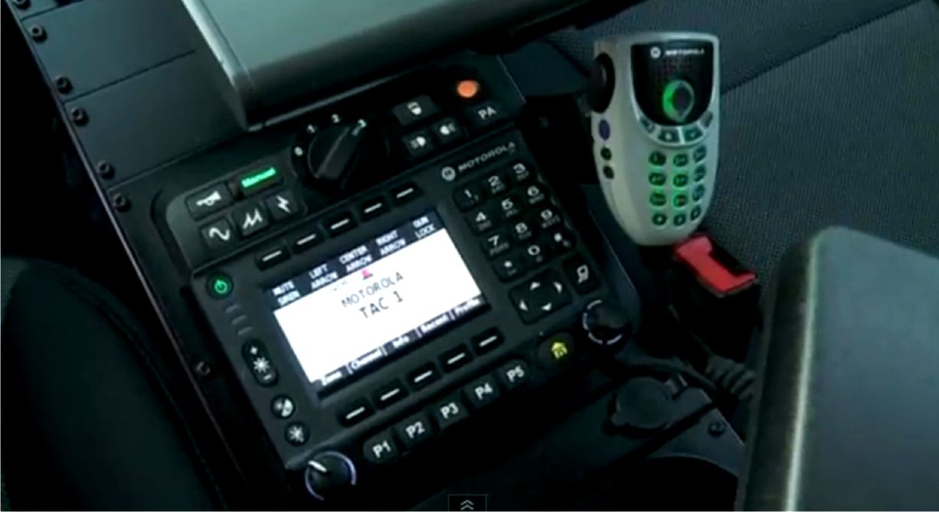
Wireless broadband provides high-speed data communications in a mobile environment.
Because of public safety’s unique mission,
emergency responders require :
Wireless broadband services and devices with guaranteed access and a high level of reliability, coverage.
And security not likely
  to be offered by
  commercial systems.

Slide 12
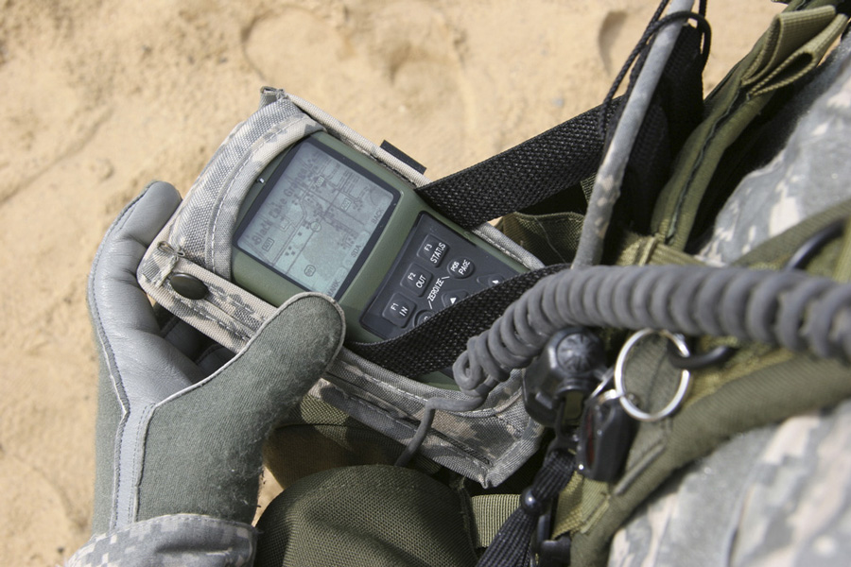
Public Safety Will Be Able To
  access video images of a crime in progress,
  download building plans of a burning building to a handheld device, or
  connect rapidly and securely with personnel from other towns and cities.
Integrating capabilities such as broadband provides an unparalleled opportunity for the future of interoperable communications in the US.
It may result in a secure path for:
  information-sharing initiatives,
  Public Safety Answering Points (PSAP),
  Next Generation 9-1-1 integration.

Slide 13
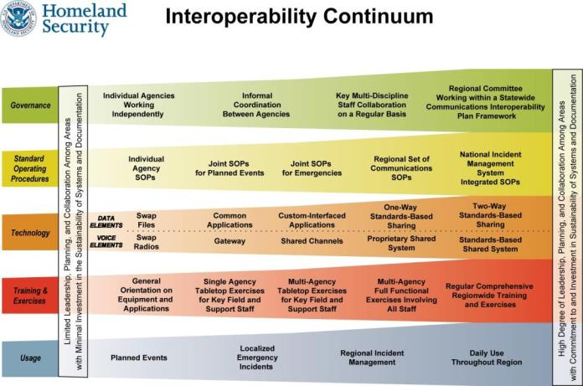
SCIP Strategic Plan and
Implementation Components

Slide 14
Statewide Interoperability
Executive Committee (SIEC)
A governance body through legislation to oversee and administer the Statewide Interoperable Radio Network (SIRN) and other technologies.

Slide 15
Statewide Interoperability Coordinator (SWIC)
Member of FirstNet Public Safety Advisory Committee
(2 from CT- 40 assigned, 38 currently assigned)
  NCSWIC National Council of Statewide Interoperability Coordinators (NCSWIC) – CT SWIC
  National Association of Regional Councils (NARC) - State Sen. Steve Cassano

Slide 16
The job for all of us involved on the state level with the FirstNet project will include:
1) help educate the public safety community and elected and appointed officials about the future of emergency communications;
2) describe the evolution of emergency communications and how traditional land mobile radio (LMR) communications used today may converge with wireless broadband in the future if specific requirements are met; and
3) develop the most important requirements that must be met to achieve the desired long-term state of convergence.

Slide 17
States need to stand up a
“Broadband and Training Subcommittee” of the SIEC
This group will focus on the outreach program;
plan for potential uses of emerging technologies that will be generated by the establishment of the FirstNet Network.
  CT must establish an outreach and information sharing program for all 169 towns and 5 public safety regions to inform stakeholders and solicit feedback for SIRN and FirstNet activities.
  CT’s 5 Homeland Security regions are mirrored by the electric and telephone disaster response regions.

Slide 18
In 2010, Connecticut received a Broadband Technology Opportunities Program (BTOP) grant
- which created an open-access statewide fiber network
- the Nutmeg Network
the State was able to establish at least four broadband nodes in each of the 169 towns in the state
  a police, fire, education, and municipal facility node in each town.
All 618 cell towers in CT have fiber backhaul.
Plus commercial entities, some purchasing 10 gigabit per second service.

Slide 19
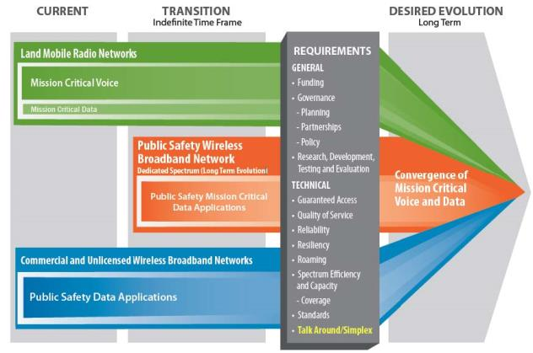
Public safety communications will evolve only by a long-term transition toward a desired converged future.

Slide 20
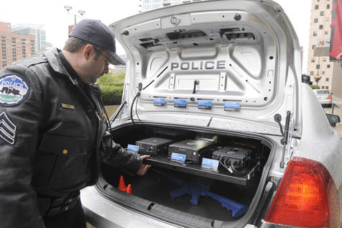
Public safety is using broadband today for data applications, but not for mission critical emergency response voice communications.
In the near term, wireless broadband will complement LMR, not replace it.

Slide 21
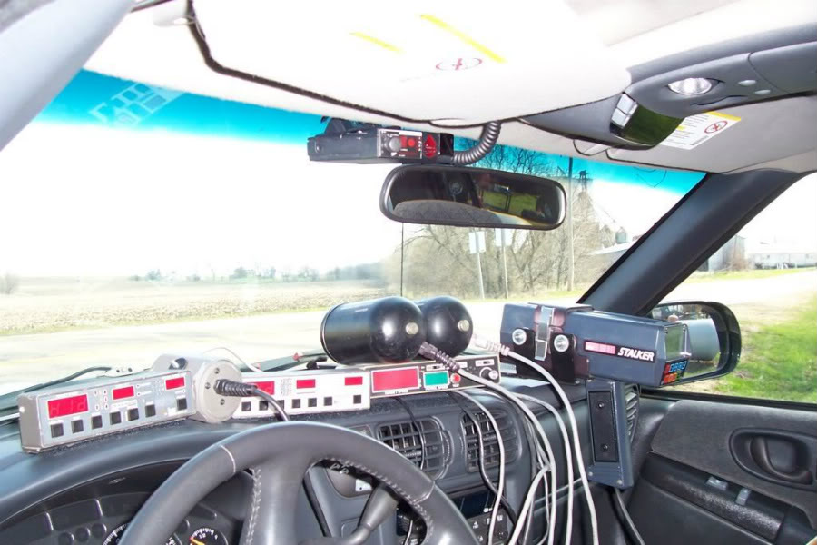
During the transition period, public safety will begin building out a dedicated public safety wireless broadband network
Public safety organizations will begin to transition from commercial broadband services to the public safety dedicated network.

Slide 22
In the current state of communications, LMR networks, commercial broadband networks, and a nationwide public safety wireless broadband network are evolving in parallel.
As communications evolve, public safety will continue to use the reliable mission critical voice communications offered by traditional LMR systems;
at the same time, agencies will begin to implement emerging wireless broadband services and applications.

Slide 23
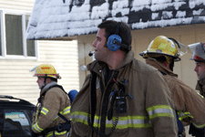
Investments in LMR will continue to be necessary now and well into the future.
Wireless broadband does not currently meet the requirements for emergency response voice communications, therefore LMR will be around for years.

Slide 24
Since FirstNet will take many years to totally integrate across the country, this will be an evolutionary program, not a fast cutover.
There are enormous sunk costs invested by towns across the Nation in LMR equipment and staff that must be amortized prior to abandonment and reinvestment in new equipment.
Therefore, robust requirements and innovative business practices must be developed for broadband initiatives prior to any implementation.

Slide 25
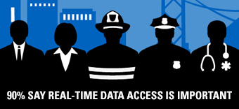

Any questions?
Office of Consumer Counsel
10 Franklin Square
New Britain, CT 06051
860-827-2905
Cell 860-716-7177
Thanks,
Bill Vallée
State of Connecticut
Broadband Policy Coordinator

