Slide 1
Governor’s Office of Rural Broadband
State Broadband Authorities
- The next Chapter

Slide 2

ARRA Stimulus Maryland NTIA BTOP Awards
Grantee | Total Award | Type
Communication Service for the Deaf, Inc. | $14,988,657 | Sustainable Adoption
Coppin State University | $932,116 | Public Computer Centers
Mission Economic Development Agency | $3,724,128 | Public Computer Centers
Maryland Broadband Cooperative | $4,755,768 | Broadband Data & Development
Maryland Department of Information Technology | $115,240,581 | Infrastructure
One Economy Corporation | $28,519,482 | Sustainable Adoption
2
March 31, 2021

Slide 3
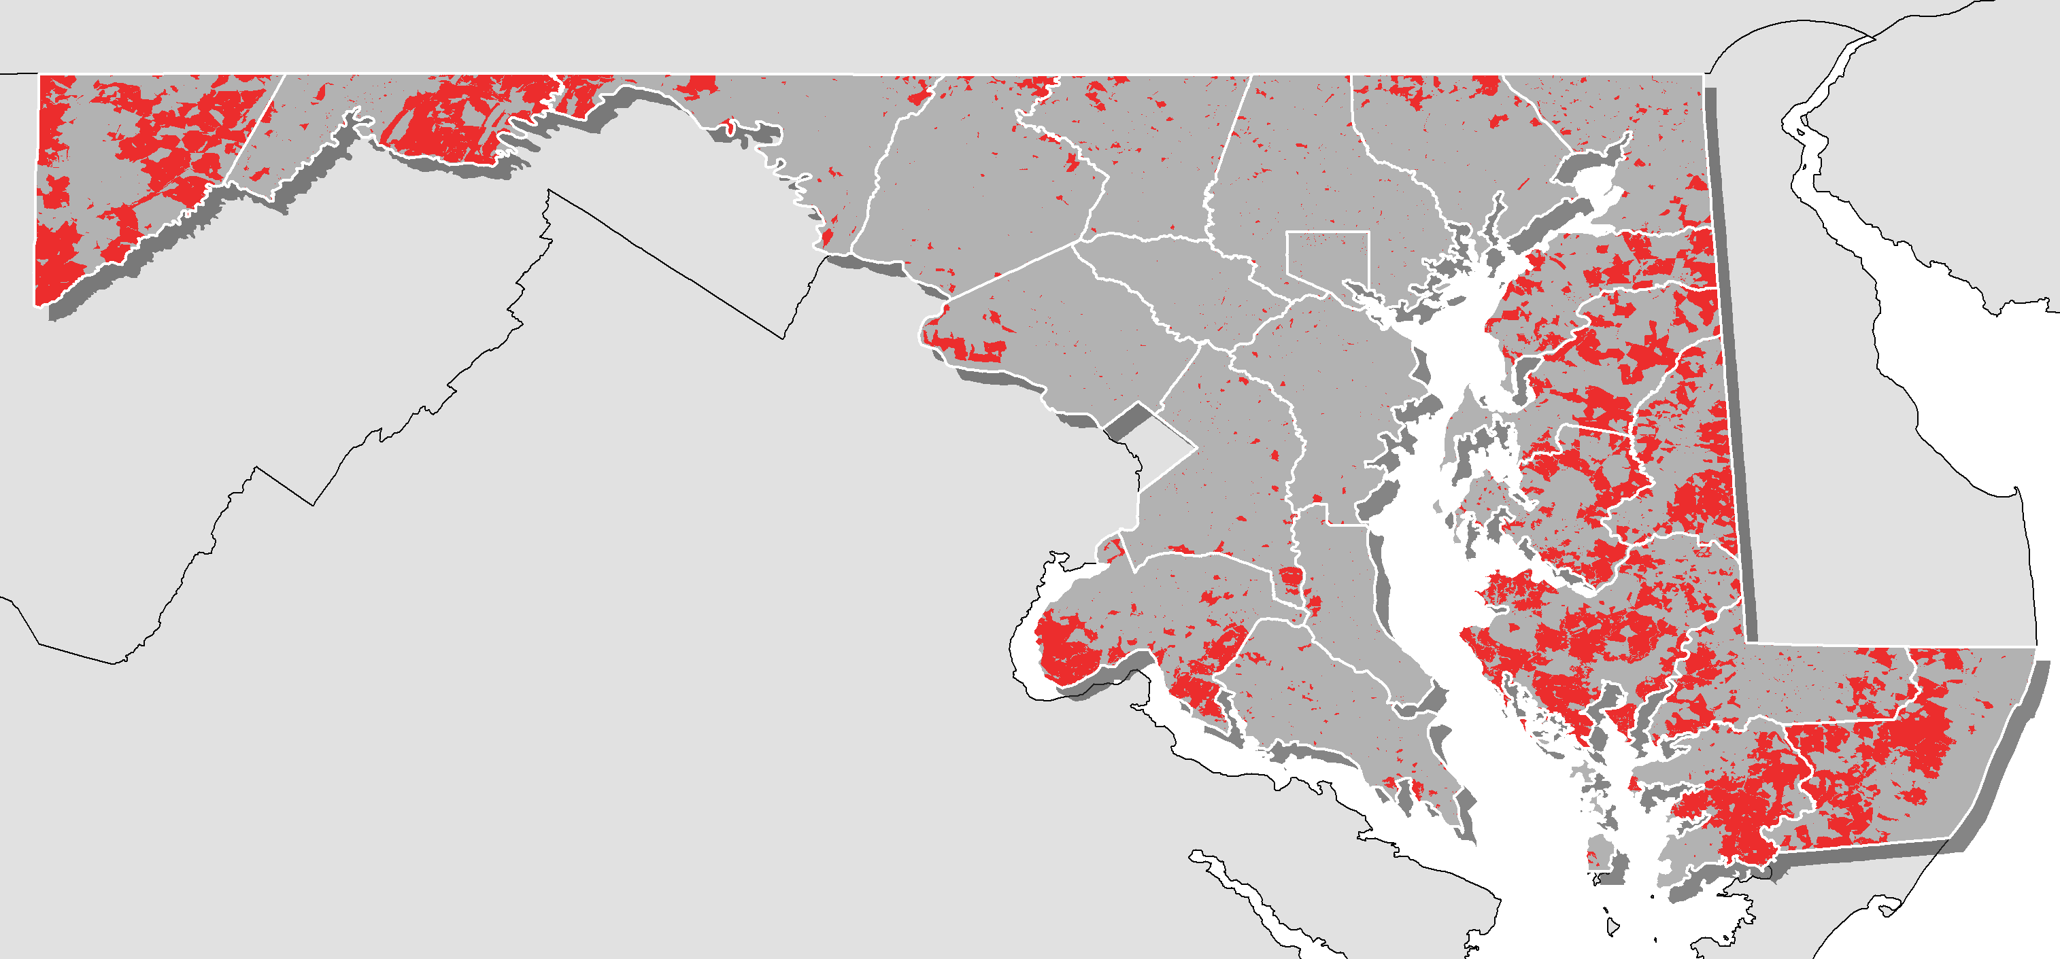
Maryland locations with <25x3 advertised speeds From FCC Form 477 data
3
March 31, 2021

Slide 4
Last Mile Service
Why is this so hard
Return on Investment (ROI)
As little as 3 years for public companies
8-10 years for smaller private companies
Cost of Construction
$35,000 to $70,000 per mile
Cost per premise past
$3,500 to $7,000
4
March 31, 2021

Slide 5
Last Mile Service
What can we do
Grants
In order to encourage private expansion, reduce the capital costs to the ISP and increase the ROI.
Digital Literacy
Show potential subscribers the benefits of a broadband connection.
More subscribes = sustainability
Digital Equity
Enable all households to connect
5
March 31, 2021

Slide 6
Maryland Broadband Grant Programs
Expansion of Existing Broadband Networks
Maximum $200,000 grant
100% match required
Broadband Infrastructure Grant Program
$1 Million to $3 Million grant
100% match required
Digital Literacy and Equity
Coming soon
6
March 31, 2021

Slide 7
Questions

