Slide 1

Information ( and resources 🙂)

Slide 2
Dys, dys, & dys
Dyslexia, dyscalculia, and dysgraphia can overlap, yet they are all distinct.
Dyslexia is a “learning disorder that involves difficulty reading due to problems identifying speech sounds and learning how they relate to letters and words (decoding)” (Mayo Clinic, 2022).
Dyscalculia is a “learning disorder that affects a person’s ability to understand number-based information and math” (Cleveland Clinic, 2023).
Dysgraphia is a “neurological disorder characterized by writing disabilities. Specifically, the disorder causes a person's writing to be distorted or incorrect.” (NIH, 2023).
Each disorder can exist alongside or be worsened by ADHD or environmental factors (stress, the materials required/available for use, presentation of information, etc.).
^ Noodle of learning

Slide 3
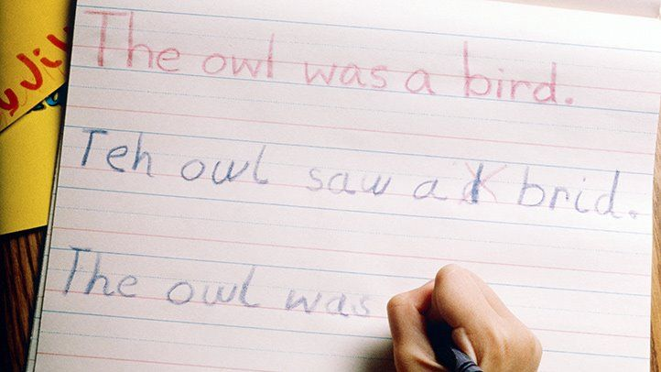
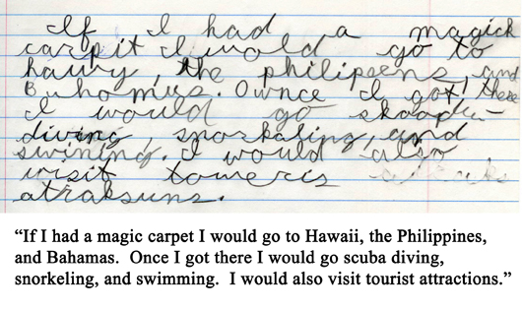
Everdayhealth.com
Learningabledkids.com
Examples of dyslexia

Slide 4
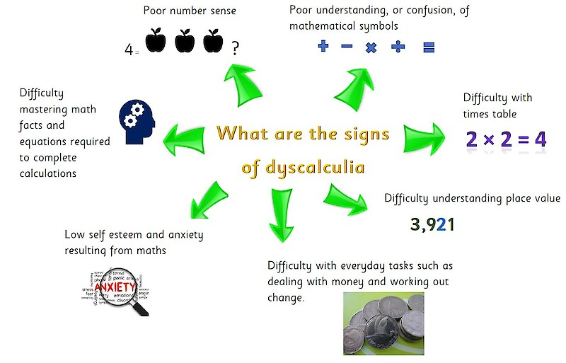
Dyslexia Support South, 2023

Slide 5
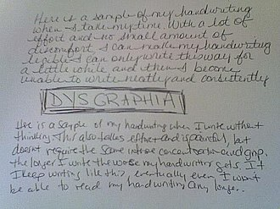
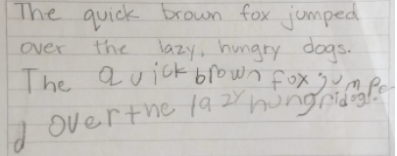
Wikipedia.org
Occupationaltherapy.com
Examples of dysgraphia

Slide 6
More on dysgraphia
“Dysgraphia is a term used to describe difficulties with putting one’s thoughts on to paper. Problems with writing can include difficulties with spelling, grammar, punctuation, and handwriting” (APA, 2023).
According to Sharma, “In later grades, [students with dysgraphia] may have difficulty with writing fluency, floating margins, writing mathematics (equations, fractions, exponents, etc.), and legible writing” (Sharma, 2019).
Because it is considered a specific-learning disability (SLD), dysgraphia is characterized by persistent impairments in written expression that lead to difficulties in other areas.

Slide 7
This doesn’t mean that symptoms associated with dysgraphia can’t be observed and managed in one’s life. If symptoms persist and impede function, that’s enough to pursue ways to manage the issue.

Slide 8
What is an SLD?
An SLD is “a disorder in one or more of the basic psychological processes involved in understanding or in using language, spoken or written, that may manifest itself in the imperfect ability to listen, think, speak, read, write, spell, or to do mathematical calculations” (CT.gov, 2023).
SLDs are “persistent [impairments] in . . . reading, written expression, and/or math” (APA, 2023). They are classified as mild, moderate, or severe.
Those with mild SLDs have “some difficulties with learning in one or two academic areas, but may be able to compensate” (APA, 2023).
SLDs are largely diagnosed by medical doctors, psychologists, and language-speech pathologists.

Slide 9
Diagnosing an SLD (APA criterion one)
Issues must persist in at least one of the following areas for at least six months despite targeted help:
Difficulty reading (e.g., inaccurate, slow and only with much effort)
Difficulty understanding the meaning of what is read
Difficulty with spelling
Difficulty with written expression (e.g., problems with grammar, punctuation or organization)
Difficulty understanding number concepts, number facts or calculation
Difficulty with mathematical reasoning (e.g., applying math concepts or solving math problems)

Slide 10
Diagnosing an SLD (APA criteria two - four)
Have substantially below age-level academic skills that cause problems in school, work or everyday activities.
The difficulties start during school-age even if some people don’t experience significant problems until adulthood (when academic, work and day-to-day demands are greater).
Learning difficulties are not due to other conditions, such as intellectual disability, vision or hearing problems, a neurological condition (e.g., pediatric stroke), adverse conditions such as economic or environmental disadvantage, lack of instruction, or difficulties speaking/understanding the language.

Slide 11
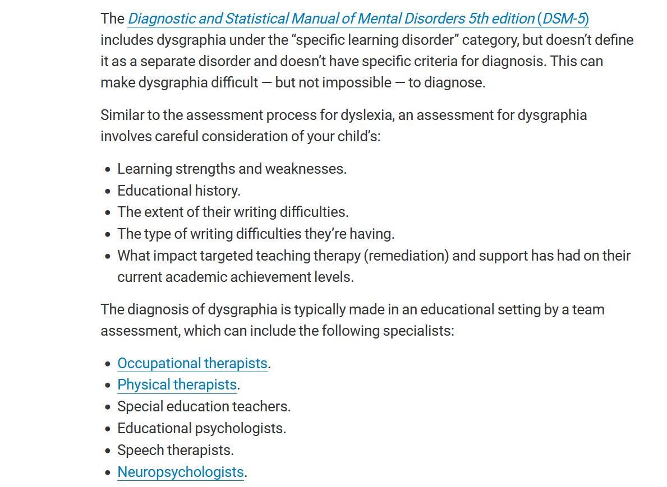
Cleveland Clinic, 2023

Slide 12
Potential ways to manage symptoms
Using different styles of pen/writing utensils (i.e., different styles of ink, grip, weight).
My thinking here is that maybe the change in the physical sensation of writing or in the visual processing of what you wrote could help you more accurately recall the numbers you need.
Switching from print to cursive
Trying to picture the numbers as words instead of symbols
Typing instead of writing (or using paper with raised lines or segmentation)
Consider your feelings towards math and how those might have developed
Taking additional time to complete math-related tasks
This may not always be possible in the workplace. You’d have to decide if you’re likely to qualify for a diagnosis (if you want one) and whether that would be accommodated at Penguin.

Slide 13
Further Reading
Fantastic database on learning disabilities, homeschooling, and best practices
https://learningabledkids.com/articles_about_homeschooling/overcoming_learning_disabilities_through_homeschooling.htm
Various software and recommendations for managing dysgraphia
https://www.dysgraphia.life/resources
https://www.dysgraphia.life/resources-adults
Succinct summary on dysgraphia and its variants
https://learninglabfl.com/the-abcs-of-slds-a-primer-on-dysgraphia/
Thorough breakdown of dysgraphia in terms of learning and educational development
https://mathlanguage.wordpress.com/2019/11/30/mathematics-for-all/
Source on SLDs and dyslexia
https://portal.ct.gov/SDE/Special-Education/Specific-Learning-Disability-and-SLD---Dyslexia

Slide 14
References
APA
https://www.psychiatry.org/patients-families/specific-learning-disorder/what-is-specific-learning-disorder
Cleveland Clinic
https://my.clevelandclinic.org/health/diseases/23949-dyscalculia
CT.gov
https://portal.ct.gov/SDE/Special-Education/Specific-Learning-Disability-and-SLD---Dyslexia

Slide 15
References
Mayo Clinic
https://www.mayoclinic.org/diseases-conditions/dyslexia/symptoms-causes/syc-20353552
NIH
https://www.ninds.nih.gov/health-information/disorders/dysgraphia
Sharma
https://mathlanguage.wordpress.com/2019/11/30/mathematics-for-all/

