Slide 1
An Understanding of Math Anxiety
How Emotional Realities Affect Student Learning

Slide 2
Contents
How Anxiety Develops
Anxiety, Needs, and Maladaptive Coping
How Math Anxiety Can Develop
Maladaptive Coping in the Classroom
How Math Anxiety Can Affect Learning Outcomes
What Can Educators Do to Account for Math Anxiety?
References, Resources, and Further Learning
Practices That Exacerbate Math Anxiety

Slide 3
Key Terms
Anxiety
Stress
Needs
Safety
Conditioning
Trauma
Maladaptive coping strategies

Slide 4



How Anxiety Develops
Math anxiety is one in a subset of anxiety disorders (aka - anxiety).
Anxiety is borne from a “complex interaction of social, psychological, and biological factors” (WHO, 2022).
The greatest, consistent contributor to anxiety is stress.
The presence of stress induces a neurobiological stress response.
Ultimately, stress serves as a means of meeting one’s needs, especially the need for safety.

Slide 5
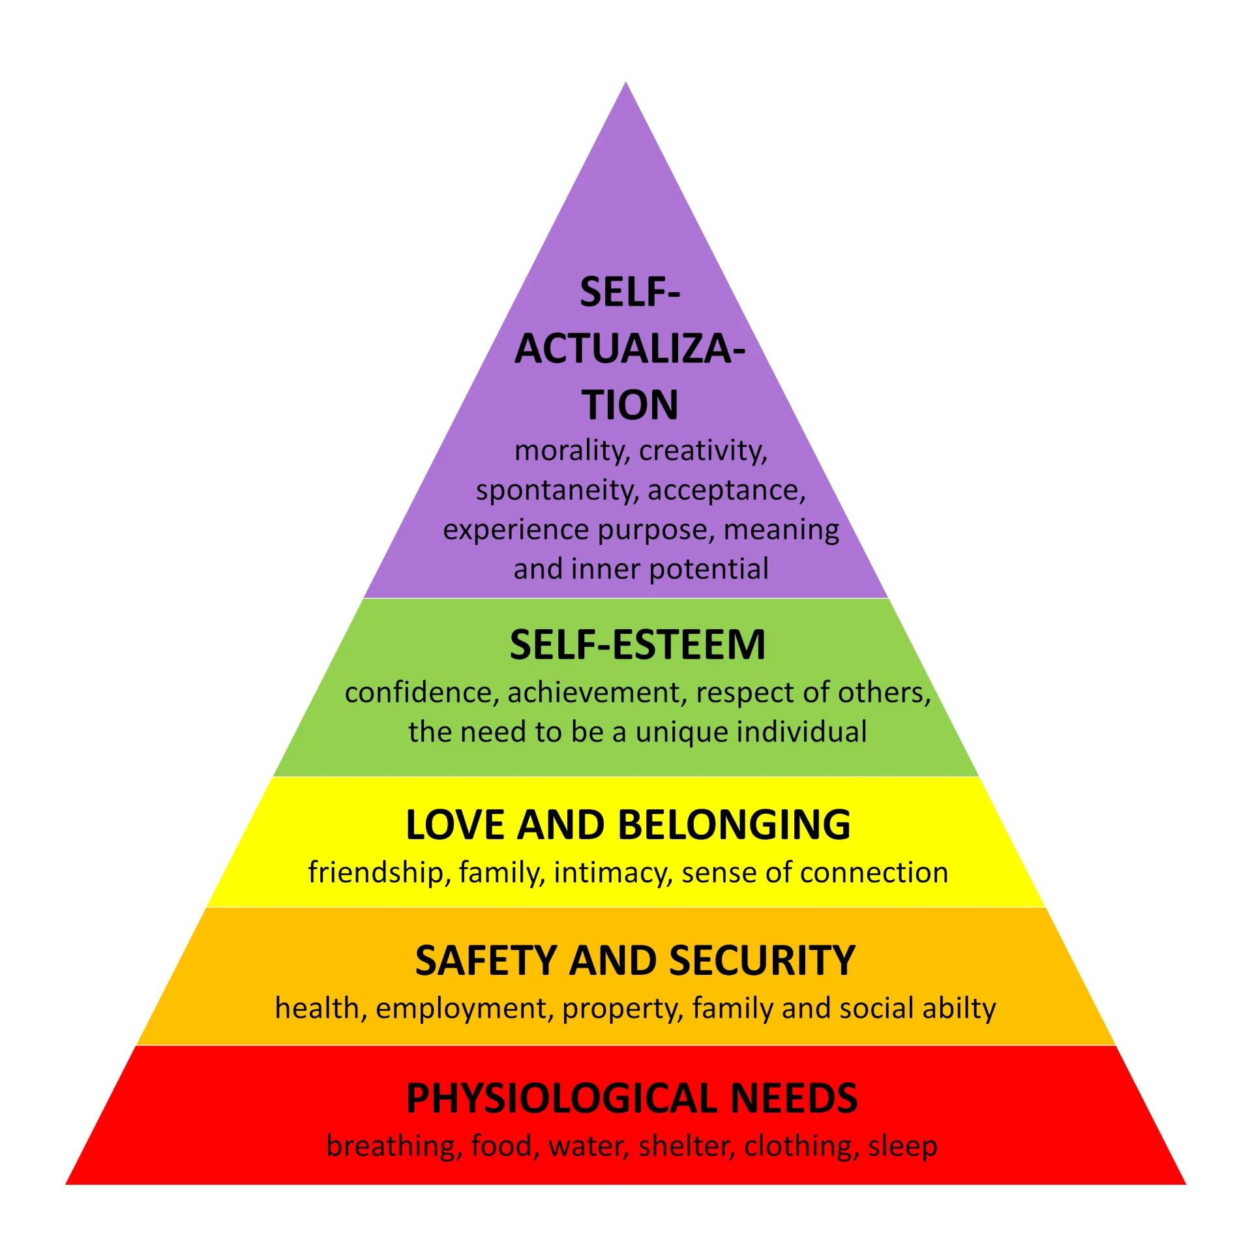
Simply Psychology

Slide 6


Anxiety & Needs
Needs can be defined as the “physiological or psychological [requirements] for the well-being of an organism” (Merriam Webster, 2024).
These needs are well explored in Abraham Maslow’s “A Theory of Human Motivation” (Maslow, 1943).
Maslow organizes needs into basic needs and psychological needs.
Humans organize their behavior around meeting their needs.
An individual’s every capacity is increasingly dominated by trying to meet unmet needs.

Slide 7


Anxiety, Stress, & the Need for Safety
Safety can be defined as “a desire for freedom from illness or danger and for a secure, familiar, and predictable environment” (APA, 2018).
Common threats to safety include poverty, war, violence in the home or the community, sudden disasters, shame, and abuse.
A lack of safety induces a stress response and disrupts homeostasis.
When the stress response outlasts its stressors, the response can become conditioned, making individuals feel as though they’re living in a constant survival state.

Slide 8
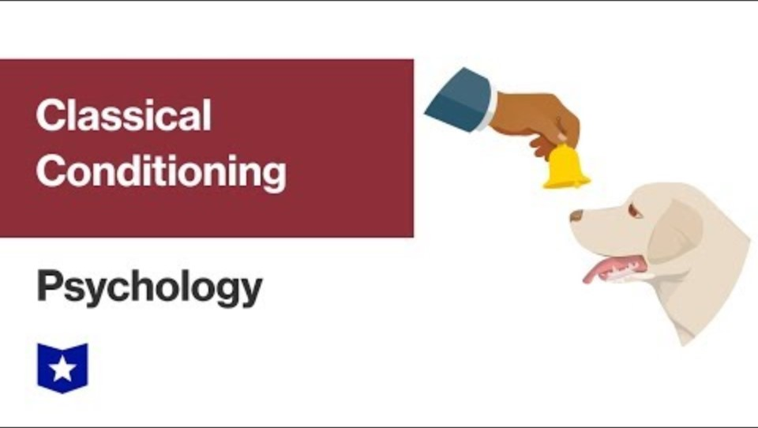
Classical Conditioning – Course Hero

Slide 9
Stress, Trauma, & Coping
Psychological trauma can be defined as “a person’s experience of emotional distress resulting from an event that overwhelms the capacity to emotionally digest it” (Psychology Today, 2024).
Being routinely overwhelmed by stress and stress responses can become a traumatic experience.
Stress exacerbated by traumatic associations can prime an individual towards maladaptive coping strategies.

Slide 10
Maladaptive Coping Strategies
Maladaptive coping strategies are born from the need to escape stressful, unforgiving realities.
These strategies do not address the circumstances that necessitate coping.
While these strategies do numb the effects of stress, it is at the expense of an individual’s capacity to improve their circumstances through self-advocacy and stress management.
Some of the most common maladaptive coping strategies are procrastination, maladaptive daydreaming, social withdrawal, negative self-talk, dissociation, binge behaviors, and substance abuse.

Slide 11
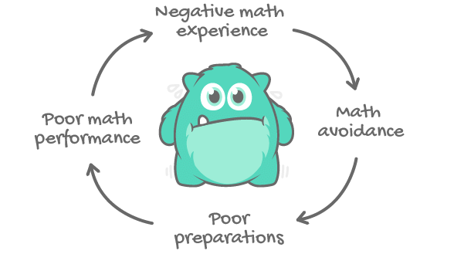
Math Anxiety Cycle of Failure
PC: Mawusi Ohipeni-Ablode via ResearchGate

Slide 12
Maladaptive Coping in the Classroom
In the classroom maladaptive coping strategies might be missed or incorrectly interpreted by the instructor as malicious or intended to offend.
These strategies disrupt learning because they fix the student to their internal stress, preventing them from focusing on their lessons.
These strategies are also disruptive because they reinforce the stress responses and negative associations a student has with math.
Educators must understand how practices can worsen or relieve the stress underlying math anxiety.

Slide 13
Practices that Exacerbate Math Anxiety
Any practices that are like a student’s past, negative math experiences can exacerbate math anxiety.
Practices that impose authority, create negative public exposure, and/or that don’t account for gaps in a student’s knowledge.
Pressing for student self-disclosure, cold calling, having struggling students work out problems in front of others, and failing to remediate gaps in knowledge can increase student stress and worsen math anxiety.

Slide 14
Practices That Alleviate Math Anxiety
Practices that alleviate the stress of anxiety can also be effective in alleviating math anxiety. These practice include, but are not limited to:
Approaching students with curiosity and compassion
Appropriate self-disclosure
Validating student feelings
Normalizing mistakes and asking for help
Teaching mindfulness practices like deep breathing or body scans,
Paired work with students strong in math
Having clear expectations, routines, and scaffolding.

Slide 15
Instructions for Our Discernment Exercise
Read the scenario
Reflect and discuss
Share thoughts
You’re free to free to engage with other people’s responses as well as your own!

Slide 16
Math Anxiety Scenario #1
Scenario
Questions
Mrs. Smith loves using exit tickets as formative assessment. She often gives students two problems to finish in the last five minutes of class. While Miriam always stays until the end of class, she has yet to submit a single exit ticket.
What maladaptive coping strategy might Miriam be using?
How might that strategy help Miriam feel “safe”? What about this situation might make her feel unsafe?
What are some appropriate ways to broach the subject with Miriam? What makes them appropriate?
What are some inappropriate ways to broach the subject with Miriam? What makes them inappropriate?

Slide 17
Math Anxiety Scenario #2
Scenario
Questions
Mr. Jones frequently cold calls students when reviewing concepts. John always leaves for the bathroom at the start of the review period and returns much later. Sometimes John returns to class high.
What maladaptive coping strategy might John be using?
What about this scenario may be stressful for John, and why might it be stressful?
Why might John be leaving? Why might John be returning to class intoxicated?
What would be an appropriate course of action and why?
What would be an inappropriate course of action and why?

Slide 18
Math Anxiety Scenario #3
Scenario
Questions
Mrs. Mack has noticed a change in Warren’s behavior. One day Mrs. Mack notices him mumbling to himself as he struggles to work through a problem.
When she asks Warren what’s wrong, he replies that he’s “never been good at math” and that he “just needs to suck it up and figure it out”. Mrs. Mack leaves Warren to his thoughts, afraid to make him feel worse by asking more questions. Warren almost rushes from the room once class ends.
What maladaptive coping strategy might Warren be using?
Why might Warren be feeling agitated?
How can Mrs. Mack share her observations with Warren appropriately? What would make it appropriate?
What things should Mrs. Mack consider before approaching Warren?

Slide 19
Math Anxiety Scenario #4
Scenario
Questions
Mr. Cruz regularly uses breakout rooms for group practice in his online class. Usually, things go well, but recently students have been complaining about the lack of mutual participation. Students say that Sarah joins the group but refuses to say anything or work on the assignment. Mr. Cruz had already noticed that Sarah attends class and turns in her work regularly. Now he realizes that Sarah works well individually, but not when she’s assigned to a group.
What maladaptive coping strategy might Sarah be using?
How might that strategy help Sarah feel “safe”? What about this situation might make her feel unsafe?
How can Mr. Cruz appropriately acknowledge and account for Sarah’s aversion to group work?
How can Mr. Cruz approach group work now that he knows about the lack of participation?
What could be the benefits and drawbacks of that new approach?

Slide 20
Takeaways
Every day, students struggling with math anxiety go to class knowing that it could be one of the most grueling, humiliating experiences of their lives.
These associations lock the body and mind into a near constant state of stress and survival.
These conditions incentive maladaptive coping which keeps students locked into a perpetual cycle of anxiety and poor outcomes.
When we approach math anxiety as an emotional response to overwhelming stress, we can help students build the skills they need to overcome their obstacles.

Slide 21

Resources

Slide 22

References
Questions? Comments?
Keyona Shabazz
kshabazz@carrollcc.edu

