Slide 1

Digital Literacies Enhance Planning
#RUNEU
Notes:
Enhancing digital literacies while planning RUN-EU Blended Programmes

Slide 2

This collaborative work traces the evolution of a set of projects that is aided by clever application of digital literacies.
Several AI tools were used to amalgamate the work packages. The core material is generated by three people presenting this work.
Authenticity Statement
Notes:
Work by Frances O’Donnell, Filipe Santos, and Bernard Goldbach.

Slide 3
Four-P Framework
Purpose | programs | People | Protocols
Collaborative Planning | Common Toolsets | ATU-Fran IPLEIRIA-Filipe TUS-Bernie | MSFT OneDrive
RUN-EU Blended Intense Programme | Moodle | Regional University Network | Zoom AI Otter AI
Triple Helix Ethos | Google Workspace | Skillnet Ireland | Smart Vectoring

Slide 4
Purpose
Collaborative Planning​
Three partners discovered common digital tools enhanced collaboration.
RUN-EU BIP
The Regional University Network of Europe offers several forms of academic programmes, including Blended Intensive Programmes.
Triple Helix Ethos​
Academics, Subject Matter Experts, and Industry follow a triple helix model with Skillnet Ireland.

Slide 5
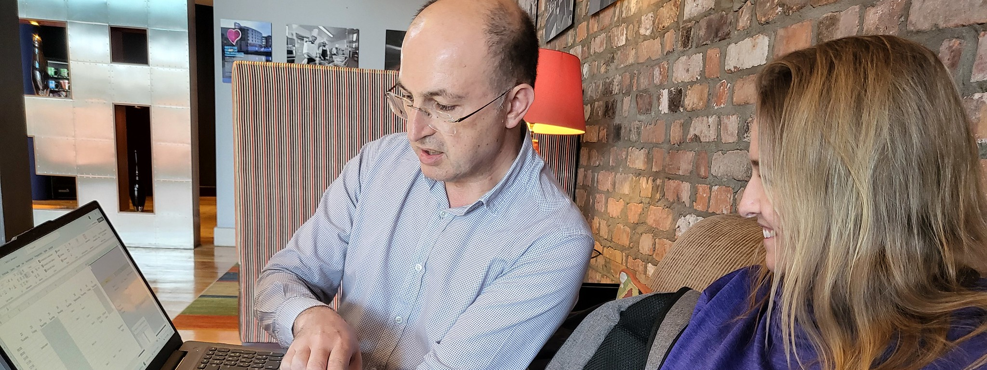
Collaborative Planning
Filipe Santos and Frances O’Donnell discuss a workshop
Notes:
Snapped before a day-long training session with business educators.

Slide 6
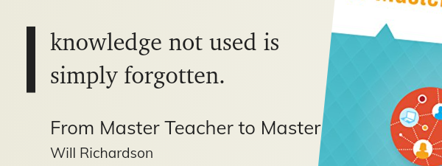
RUN-EU Blended Intensive Programme
Five ECTS Practical Education Workflows with AI

Slide 7
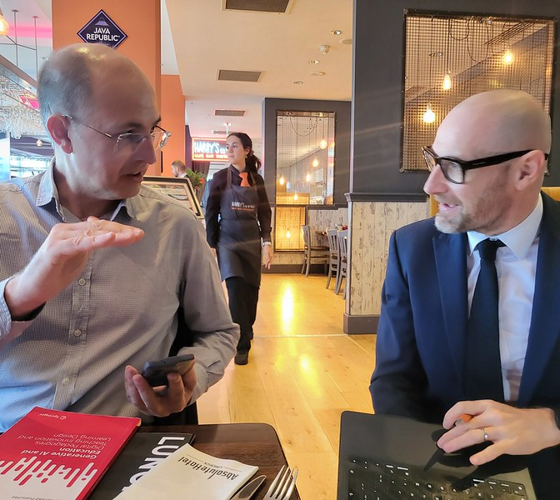
Triple Helix Ethos
Subject Matter Experts + Academics + Business

Slide 8
Programs
Common Toolsets​
One Drive. Then Google Drive..
Moodle
Primarily for quality standards and accreditation
Google Workspace​
Preferred by many students. Easy to use with Notion and Obsidian.

Slide 9

Started with OneDrive
Both institutional and personal accounts.

Slide 10
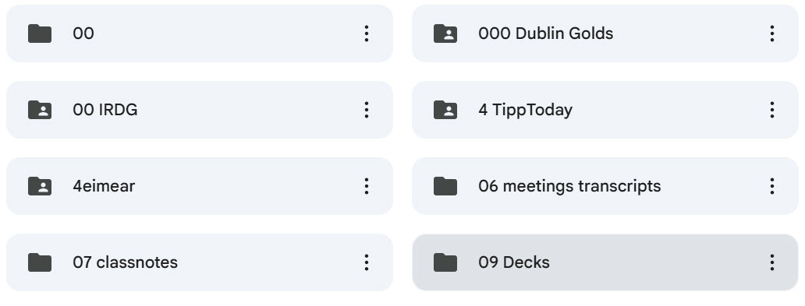
Evolved to Google Drive
Notes:
We used shared Drive Workspaces

Slide 11
People
Fran, Filipe, Bernie​
Instructional Designer
MBA Course Lead
DX Lecturer
RUN-EU Students
10 Universities.
Past students from 12 countries.
Skillnet Ireland​
Irish Innovation Skillnet

Slide 12
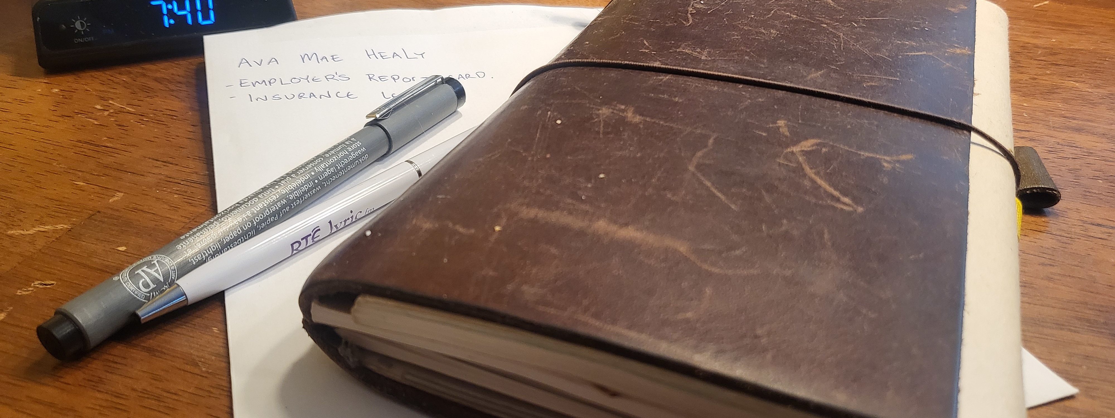
Filipe, Frances, Bernie
Core to the blended ethos

Slide 13
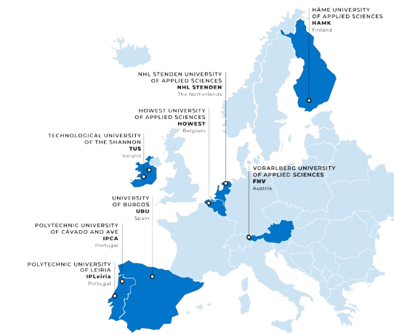
RUN-EU Partners
Three key partners in current project

Slide 14
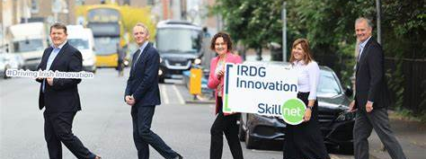
Skillnet Ireland
Irish Innovation Skillnet is an industry partner

Slide 15
Protocols
OneDrive​
Master Records kept inside shared OneDrive
Meeting AIs
Zoom AI
Otter AI
Smart Vectoring​
Inside Obsidian and Notion

Slide 16
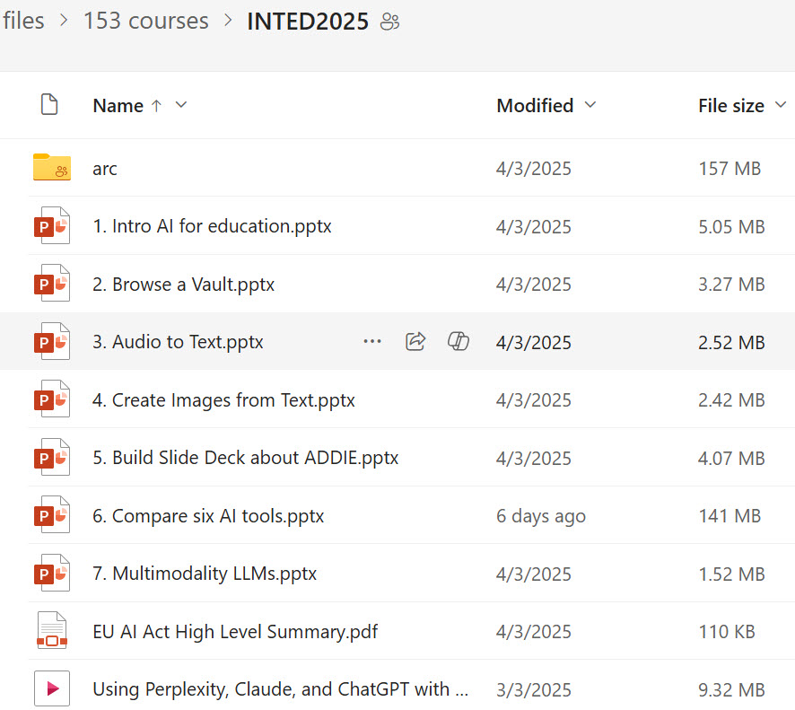
OneDrive
Master Record Set kept inside OneDrive.

Slide 17
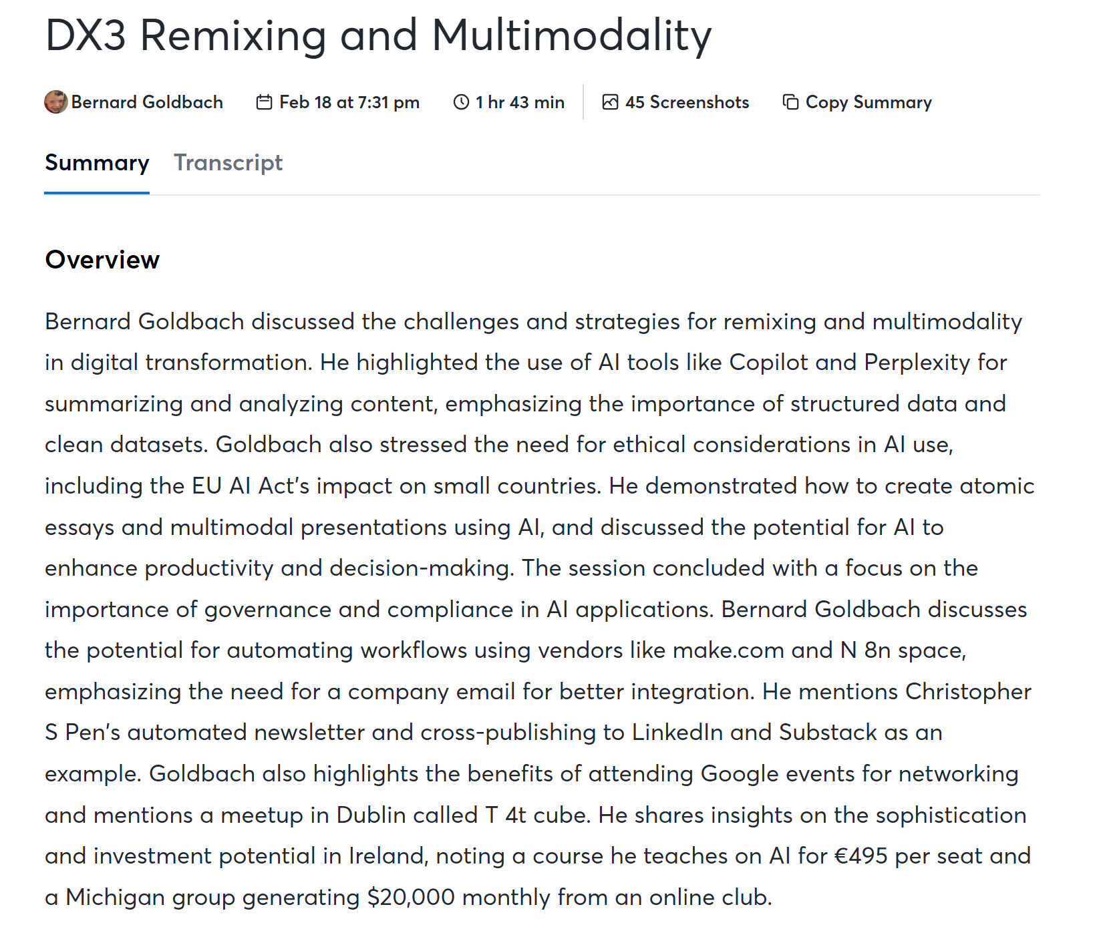
Meeting AIs
Used Zoom AI and Otter AI.
Notes:
Sample from Otter.ai

Slide 18
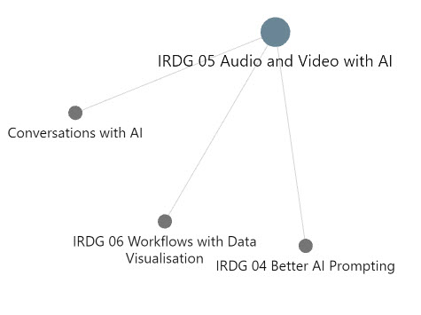
Smart Vectoring
Using Markdown with course materials to leverage semantic links quickly.
Notes:
Sample from Otter.ai

Slide 19
Questions?
Bernie is topgold on good social networks.
Find Frances @educatefran on LinkedIn and Bluesky.
Contact Filiple Santos about RUN-EU.
Notes:
Use https://qr.codes/pe2md8 to access this deck.
Contact the author https://linkedin.com/in/topgold for corrections and collaboration.

Slide 20
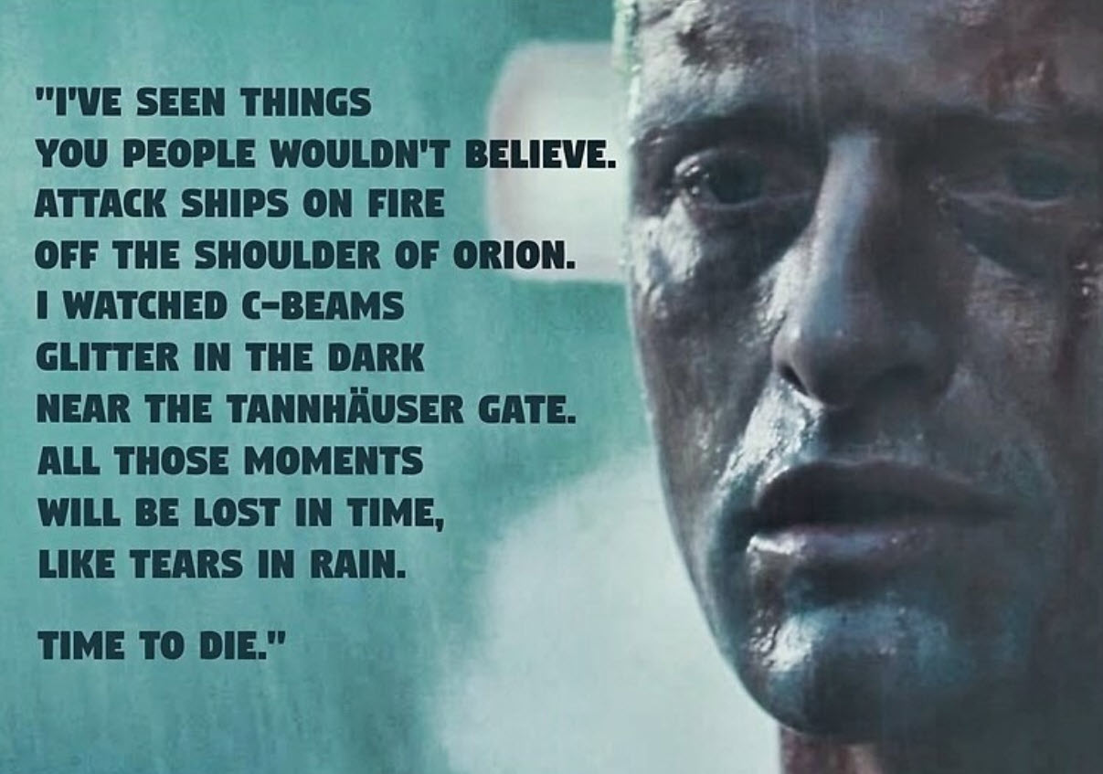
Challenging Times Ahead
Inspired by the final monologue from Bladerunner

Slide 21
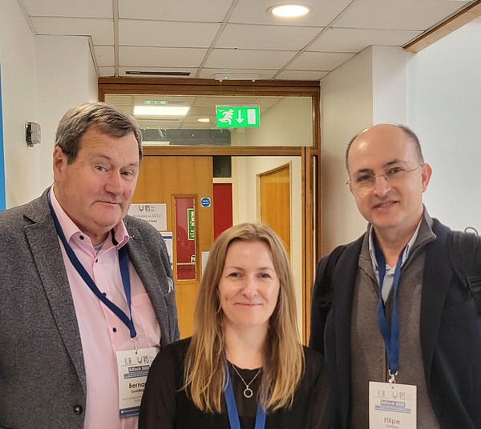
Enhancing Digital Literacies
While planning a RUN-EU Blended Programme
Notes:
A year-long collaboration that began after the Gasta at edtech24 in Sligo.

