Slide 1


Slide 2

WINDFALL PROFIT TAX
The opposing arguments between
taxation and Constitutionality
Rovigo
10 marzo 2023

Slide 3

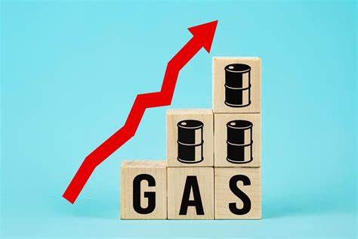
Introduction
→ENERGY CRISIS AND
RENEWABLE ENERGY

Slide 4
Causes and
solutions
« A country that does not have a minimum of energy sovereignty is a country that does not have even have political sovereignty»
Chicco Testa
→This crisis is connected with
Putin’s political use of gas
→A possible solution:
to focus on renewable energy
sources
LESS POLLUTING

Slide 5

Monti’s government
→To obtain tax revenue from the extra
profits of energy companies
→As the government planned to get around
10 billion, it got just over one billion instead
Energy companies deprived households and businesses
of the money they needed to fight against the high energy prices

Slide 6

Monti and Meloni’s
legislation
WHAT IS A TAX?
It is a compulsory contribution
to state revenue, levied by the
government on workers’ income and
business profits, or added to the cost
of some goods, services and
transactions
WINDFALL PROFIT TAX AND
BUDGET MANOEUVRE FOR 2023
SIMILAR CRITICISM

Slide 7

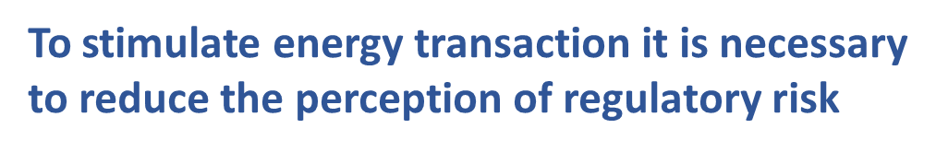
Objections of
energy companies
→Punitive and unfair
→Unbalanced
→As a tax on turnover rather than
on extra profits
It is necessary to set up price stabilisation
sistems for renewable energy production
that take into account the wide dynamics
of green-inflation

Slide 8
Other criticism
WINDFALL PROFIT TAX:
→Tax base does not capture windfall profits
generated by energy and oil price spikes
→In some cases**, the tax would not
capture the exceptional profitability
**if operators want to protect themselves against price fluctuations, the associated financial advantage will be transferred to financial counterparties, reducing the remaining profit of the energy operator

Slide 9
Limits to the power
of taxation
Art. 53 Italian Constitution: “ Every person shall contribute to public expenditure in accordance with their capability.
The tax system shall be progressive”.
→Taxes should be applied to facts that
represent actual and real contributory capacity
→The index to which the legislator refers must
be reasonably related to an economic
strenght.

Slide 10
Taxes on extra profits
*An extra profit is an exceptional profit generated by special situations*
RHT AND WPT
→Only affect companies operating in the energy sector,
in the production and trade of gas, electricity and
petroleum products
→They are intended to finance energy cost mitigation measures
→They aim to restore fairness and social justice
→They use revenue in a redistributive way
EXCLUDING ALL THE
OTHER COMPANIES

Slide 11
In terms of reasonableness and equality
To choose the extra profits to tax, it must be adequately demonstrated:
The achievement of greater profits;
The undeserved character of these gains,
which must be attributable to exceptional
situations, resulting in a kind of windfall gains.
C.cost. «a formally discriminatory
treatment of these companies can be justified by the oligopolistic nature of the sector and the relative anelasticity of demand, which make a higher profitability than in other
commercial sectors».

Slide 12
The contribution on the extra profits of energy enterprises is contrary to Article 3 and 53 as it does not achieve “solidarity purposes”.
FAILURE
→An easily fooled rule;
→Antitrust Authority is exempt from monitoring for activities after 31st
December 2022;
→Consumers will be the ones actually affected by the levy;
→Taxpayers could intentionally fail to pay the tax; as it was verified by the
failure to pay the tax advances placed by the Monti’s government.

Slide 13
The most critical issues
→The rule does not distinguish between
producers of raw materials and distributors
→There is an inside and outside discrimination
→It derogates, tacitly and not expressly
from the principle of non-retroactivity
→It was proved as unsuitable to ensure the
estimated revenue.
THE GREATER ECONOMIC BURDEN
IS PASSED ON TO CONSUMERS
The choice of the tax base is considered
inconsistent with the objectives of the
tax and its justifing ratio

Slide 14
Possible solutions to save the levy
→Perhaps, It could be based on its exceptional and temporary nature
→The measure of the levy seems to ensure
access to scrutiny bt the Strasbourg judges,
who agree to guarantee that revenue
requirements are reconciled with respect for
taxpayers’ property rights.
Constitutional jusges; «the temporary nature of the levy is not sufficient to provide justification for a tax, which could in any case be disjointed from constitutional principles».

Slide 15
Final considerations
WINDFALL PROFIT TAX:
→It is contrary to the principles of taxation, equality, reasonableness, proportionality
→The positive discipline differs from its function and fails to perform the due
balancing of the values concretely involved
→It is considered to be devoid of «justificatory
rationale» and based on arbitrary choices.

Slide 16
Thank you for your attention
Merci pour Votre attention
ANNA SCARAZZATI

