Slide 1
Windfall tax in Croatia - a new illusion about fair redistribution of income?
Made to Last ? Windfall Profit Taxation in Europe (and Beyond)
Seminar
Ferrara, 9 March 2023
Jasna Bogovac
Faculty of Law, University of Zagreb

Slide 2
Schedule
Croatian legislation
Calculation of windfall tax in Cro
Arguments for and against
Concluding remarks

Slide 3
Windfall tax in Croatia (Additional CIT)
Croatian legislation
Calculation of windfall tax in Cro
Arguments for and against
Concluding remarks
Applies to all CIT payers who in 2022:
Realised revenues of more than ≈ 40 M€
Have taxable profit which exceeds for more than 20% average taxable profit in the previous four tax periods
If a taxpayer recorded zero profit or tax losses in any of previous four tax periods, these period shall not be included in the calculation of the average taxable profit for the purpose of the additional tax base calculation
Tax losses carried forward in 2022 are not included
Rate = 33%, deadline and payments = CIT

Slide 4
Windfall tax in Croatia (cont.)
Croatian legislation
Calculation of windfall tax in Cro
Arguments for and against
Concluding remarks
Not a taxpayer:
New company
Taxpayer w/o the tax basis in all 4 periods
Taxpayer who terminates business
Beneficiaries of incentive measures for investments
Rate reductions will be used the same as for profit tax
SAAR
Administrative agreement

Slide 5
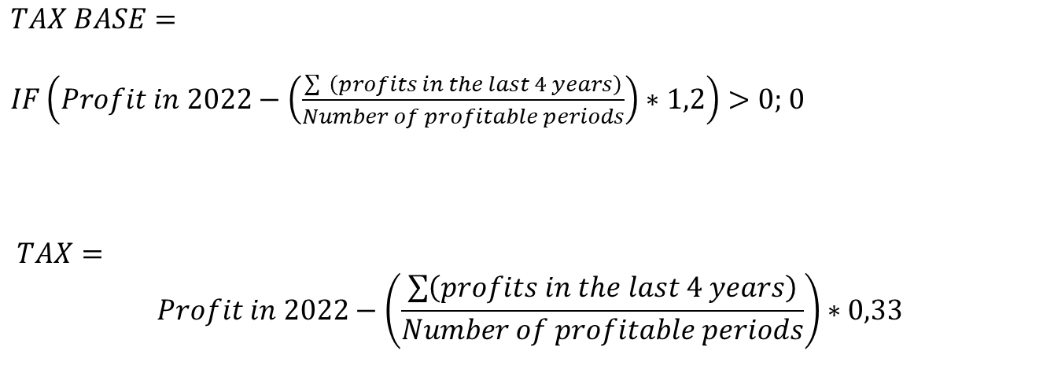
Calculation
Croatian legislation
Calculation of windfall tax in Cro
Arguments for and against
Concluding remarks
$$TAX BASE=$$
$IF\left(Profit in 2022−\left(\frac{\sum{ \left(profits in the last 4 years\right)}}{Number of profitable periods}\right)∗1,2\right)>0;$ 0
$$TAX=$$
$$Profit in 2022−\left(\frac{\sum{\left(profits in the last 4 years\right)}}{Number of profitable periods}\right)∗0,33$$

Slide 6
Full progression
Croatian legislation
Calculation of windfall tax in Cro
Arguments for and against
Concluding remarks
Redistribution of wealth?
Full progression already exists
Rates
10% if, during the taxation period, revenue has been generated up to EUR 995.421,06
18% if, during the taxation period, revenue has been generated greater than EUR 995.421,06
Revenue / Profit

Slide 7
Opposed perspectives – pros
Croatian legislation
Calculation of windfall tax in Cro
Arguments for and against
Concluding remarks
Government’s perspective
Unfavourable economic circumstances, the principle of fairness, equality and proportionality, payment of public expenses in accordance with economic strength, … Resale, financial sector & construction industry
Entirely focused on measures to help socially disadvantaged citizens, including pensioners and vulnerable groups...
Approx 200 M€ income ≈ 13% increase of CIT revenue
Positive experiences with crisis tax
R&D and education incentives included
Some gains from M&A, liquidation, bankruptcy, financial assets … until 31 Oct 2022

Slide 8
Opposed perspectives – cons
Croatian legislation
Calculation of windfall tax in Cro
Arguments for and against
Concluding remarks
Retroactivity; legal uncertainty
All taxpayers, regardless of EC proposal (targeted by purpose, e.g. EC Recomm 2021 on tax losses)
Large companies in tourism, hospitality and transport who had barely survived the pandemic lockdowns and restrictions (penalty for success)
Additional tax on full progression
Variable size under the influence of one-time circumstances or investment cycles
Discriminating, threatens fair economic recovery
„Practical” reasons (no such taxpayers in Cro?)
Negative experiences with crisis tax

Slide 9
Fiscal policy
Croatian legislation
Calculation of windfall tax in Cro
Arguments for and against
Concluding remarks
Jeopardized by
Inefficient and excessive public administration
(Weak) non-acceptance and general public opinion on pervasive corruption
(Low) trust in fiscal measures
Fiscal illusion

Slide 10
Concluding remark(s)
Croatian legislation
Calculation of windfall tax in Cro
Arguments for and against
Concluding remarks
Provisional conclusions
Additional income tax in Croatia is discriminatory to some taxpayers
It harms economic growth and progress
It is unlikely to contribute to social justice
However, it contributes to state budget
Recommendation(s)
Do not cut the branch you are sitting on!

Slide 11

Q & A
Croatian legislation
Calculation of windfall tax in Cro
Arguments for and against
Concluding remarks
„Well, let’s just hope the money gets to the people who need it.”
Thank you!

