Slide 1



2.2 Conflict with property rights and article 1 first protocol ECHR
“Every useless tax is an infringement to property rights” Benjamin Constant
Seminar in Ferrara, March 2023
WEALTH TAX
Group 2.2 : CHIBANE Rayan, MORIAU Julien, EMORINE Tancelin & CHABANNES Marie

Slide 2
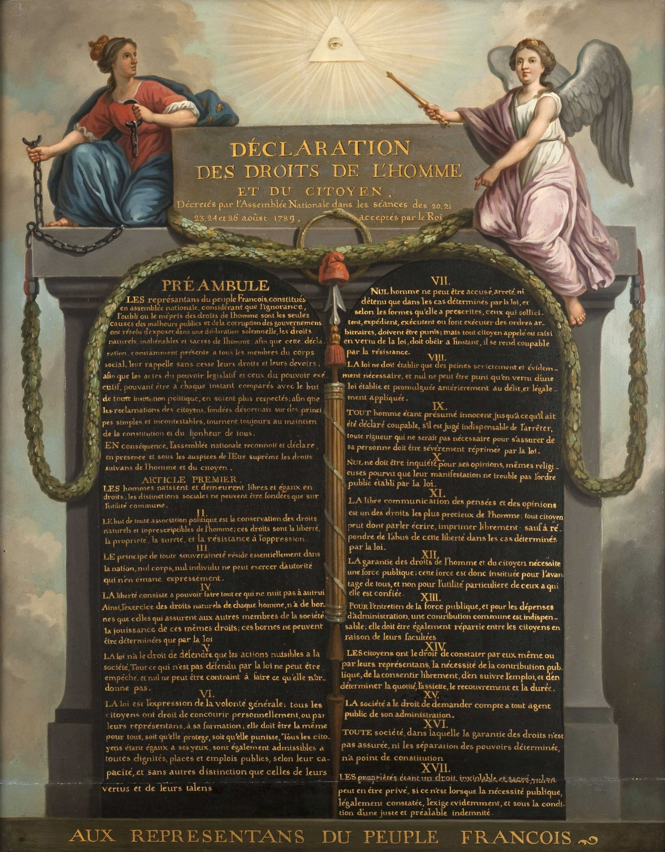
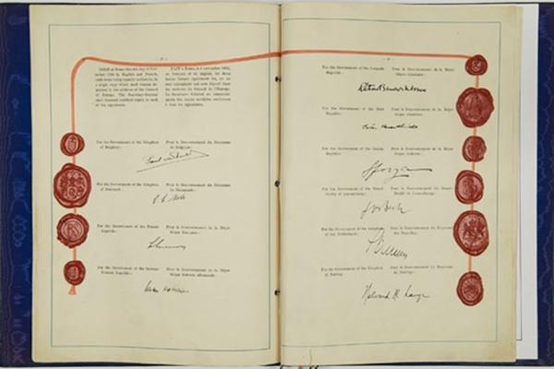
Declaration of the rights of man and citizens (1789)
European convention on Human Rights opened to signature in Rome on 4th of November 1950
Article 14 : “ All citizens have the right to ascertain, by themselves, or through their representatives, the need for a public tax, to consent to it freely, to watch over its use, and to determine its proportion, basis, collection and duration ”

Slide 3
Summary
Part I: Property rights and taxation, two mandatory notions in European law systems
  Subpart 1: Area of application of property rights and first additional protocol to the European convention for Human Rights (ECHR)
  Subpart 2: Regulating the use of property through wealth taxation
Part II: The balance between protecting individual interest and the requirements of public interest
  Subpart 1: Justified infringements to property rights
  Subpart 2: Unjustified infringements to property rights
Opening

Slide 4
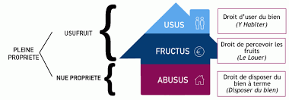
Part I: Property rights and taxation, two mandatory notions in European law systems
  Subpart 1 : Area of application of property rights and first additional protocol to the European convention for Human Rights (ECHR)
French law :
*In a decision regarding a law on nationalisation in 1982, and following questions about the real constitutional value of these rights, the French Constitutional Court said “principles created by the Human and Civil Rights Declaration have full constitutional value, including the fundamental character of property rights, on the same level as freedom and safety”
*Article 544 of the French Civil Code defines property as “the right to enjoy and dispose of things in its most absolute way, as long as this use is not forbidden by laws or regulations”.
*The 3 attributes of property rights are as follows :
The “usus”
The “fructus”,
The “abusus”

Slide 5
European Law :
*Article 17 of the European Convention of Human Rights : “1. Everyone has the right to own, use, dispose of and bequeath his or her lawfully acquired possessions. No one may be deprived of his or her possessions, except in the public interest and in the cases and under the conditions provided for by law, subject to fair compensation being paid in good time for their loss. The use of property may be regulated by law in so far as is necessary for the general interest.
2. Intellectual property shall be protected.”
*Article 1 of the Additional Protocol reads as follows:
"Every natural or legal person has the right to respect for his property. No one shall be deprived of his property except in the public interest and in accordance with the law and the general principles of international law.
The foregoing provisions shall not affect the right of States to enact such laws as they deem necessary to regulate the use of property in accordance with the public interest or to secure the payment of taxes or other contributions or penalties.”
*Marckx v. Belgium judgement of 13 June 1979: "[...] By recognising that everyone has the right to respect for his property, Article 1 guarantees in substance the right to property.
Through this decision, natural or legal persons are protected against possible arbitrary interference with their property by the State, since the European Court affirms that the right to dispose of one's property constitutes "a fundamental element" of the right to property. »

Slide 6

Part I: Property rights and taxation, two mandatory notions in European law systems
  Subpart 2 : Regulating the use of property through wealth taxation
*It should be recalled that the European Commission of Human Rights recognised that the principle of the right to property (Art. 1 of the Additional Protocol) applies to tax matters in an opinion of 13 May 1976.
*The French 1982 Finance Act created a wealth tax targeting people with the most valuable assets, which was then suppressed in 1987, before being re established in 1989 as a solidarity wealth tax, named ISF.
Regarding these flaws, ISF was finally suppressed and was replaced by a wealth tax on immovable assets named IFI in 2018.
*In application of article 223 sexies of the French tax code, the richest taxpayers must pay, in addition to income tax, an exceptional contribution calculated on their reference tax income. This contribution was created in 2011.
*Regarding inheritances, tax hits the deceased's wealth. However, depending on the link between the beneficiary and the deceased, many tax arrangements exist to make the tax burden smaller. Without a close enough link between the two, the tax rate can reach 60%, which creates a significant influence of public authorities on the deceased’s property.

Slide 7
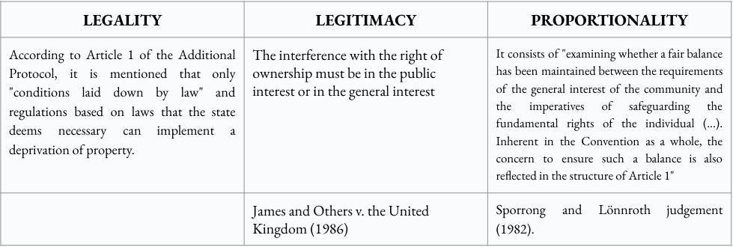
Part II : The balance between protecting individual interest and the requirements of public interest
  Subpart 1 : Justified infringements to property rights
*Taxation is a form of interference with the right to property, which may be justified in terms of regulating the use of goods in order to ensure the payment of taxes, contributions or fines. The second paragraph of Article 1 of the First Additional Protocol to the ECHR, provides an exception “for the payment of taxes or other contributions” (Gasus Dosier- und Fördertechnik GmbH v. the Netherlands ; Christian Religious Organisation of Jehovah's Witnesses v. Armenia).

Slide 8
Part II: The balance between protecting individual interest and the requirements of public interest
  Subpart 2 : Unjustified infringements to property rights
*The European Commission of Human Rights in a case of 11 December 1986, Svenska Managementgruppen v. Sweden recognise that the collection of a tax by the state is contrary to respect for property only if it imposes on the taxpayer who must pay it an "intolerable burden". In another decision, the Commission specified that there is a violation of the right to respect for property when the taxpayer is subject to "an excessive burden or is fundamentally affected by his financial situation" (Ferretti v. Italy, Commission decision).
*Decision of 30 December 1981 and decision of 29 December 1998 : "the purpose of the solidarity tax on wealth is to tax the taxpaying capacity conferred by the ownership of a set of assets[…] in fact, because of its rate and its annual character, the solidarity tax on wealth is normally paid on the income of the taxable assets.” In other words, the ISF must be paid according to and in proportion to the taxpayer's disposable income.
The court recalled that it results from "the sovereign appreciation of the judges of the court of first instance as to the reality of this confiscatory or discriminatory character, or even disproportionate of the tax burden borne by the taxpayer".

Slide 9

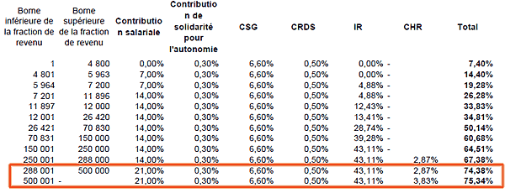
CONFISCATORY TAX THRESHOLD

Slide 10
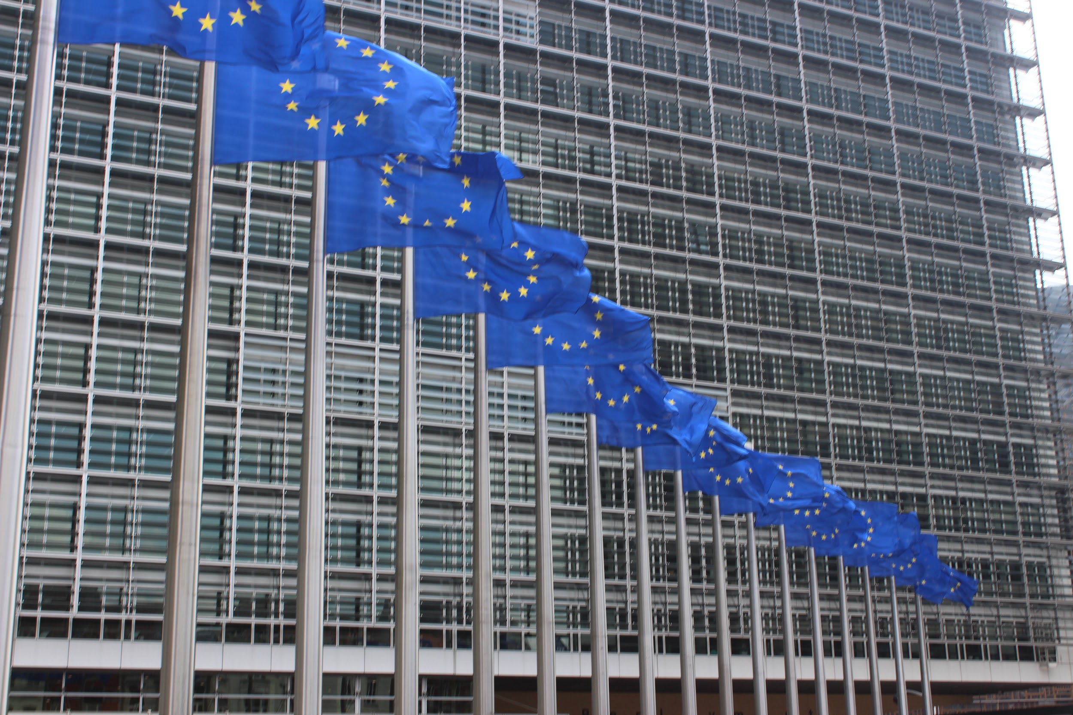
Opening

Slide 11
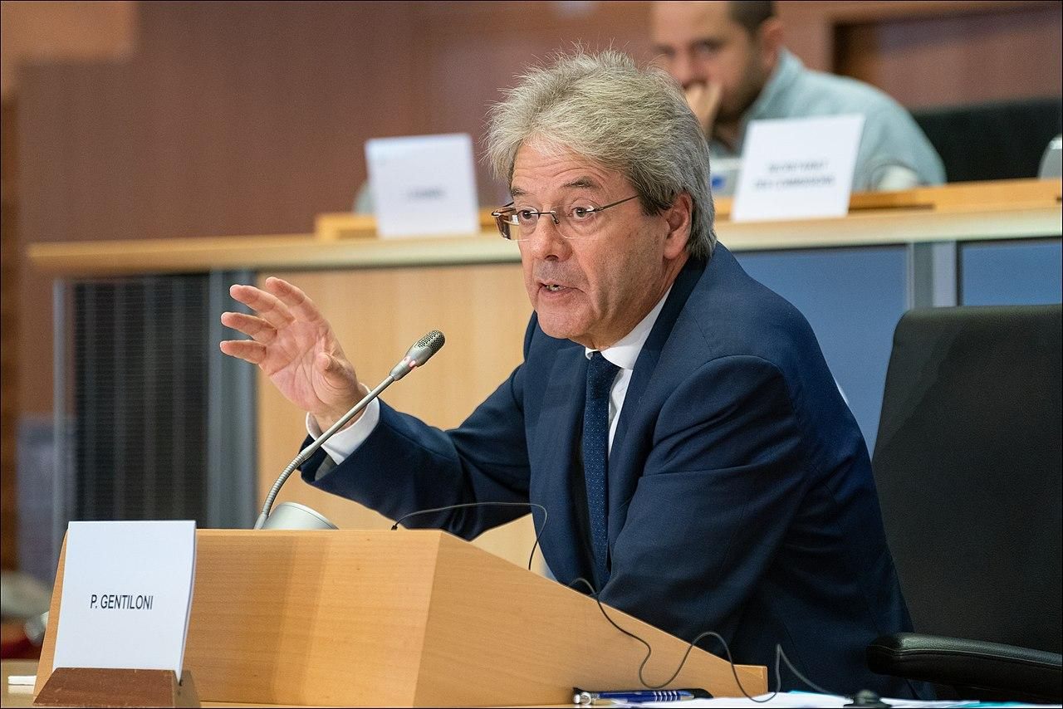
The European wealth tax proposal was presented in 2020 by the European Commission as part of its economic recovery plan to address the consequences of the COVID-19 pandemic. The proposal aims to strengthen fiscal solidarity between EU Member States and reduce social inequalities.
The proposed wealth tax would apply to individuals whose net wealth exceeds EUR 1 million. Member States would have the possibility to set a higher threshold if they so wish. The rate of the tax would be 1% for wealth between €1 million and €10 million and 2% for wealth above €10 million.
Which MEP (member of parliament) created this proposal?
The European wealth tax proposal was put forward by the European
Commission, the executive body of the European Union, and not by
a specific MEP.
The wealth tax proposal was presented by the European Commissioner for
Economic Affairs, Paolo Gentiloni (former President of the Italian
Council), on behalf of the European Commission.

Slide 12




Thank you !
Grazie !
Merci !
Danke !

