Slide 1


Slide 2

Quirinal Treaty Seminar
“Windfall Profit Tax”
“General overview on the WPT and comparison between legislations”
Rovigo
10/03/2023

Slide 3
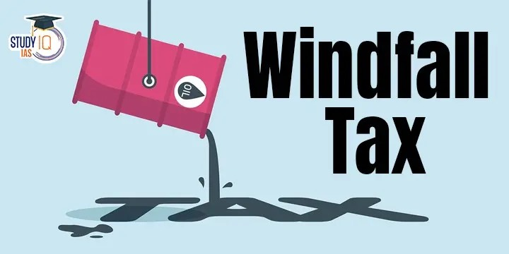
Definition of “windfall profit tax”:
Excess profit tax
Target: extra, additional, unexpected profits due to a windfall
Energy, oil and gas industries ➜ raw materials
Ukranian war ➜ sale of raw materials and energy at extremely high prices

Slide 4

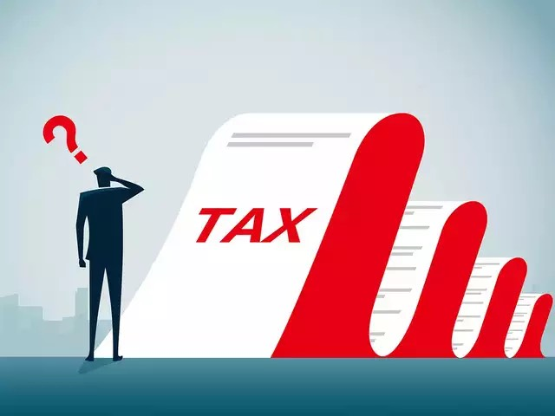
WPT Tax base:
Tax base = value on which the rate is applied to determine the tax or levy that is due
Direct taxes: net income = the amount subject to tax (- deductions and reductions)
Indirect taxes ➜ taxable amount = value of the transfer and the provision of the service for VAT, by the value of the asset or by the right transferred for registration tax purposes

Slide 5

Is the "windfall tax" an income tax or not?
Income = "the profit that comes from trade, exerting a profession, from industry, or from any utilisation of capital. In economics, it is the flow of money, goods or services, received by individuals, communities, businesses or by the national economy as a whole, in a given period of time […]"
USA: Sudden and extraordinary increases in wealth, deriving from donations, inheritance or through winnings of prize games, gambling or lotteries ➜ taxable

Slide 6

EU legislation on WPT:
European Council Regulation 2022/1854
Temporary and mandatory tax on extraordinary and excess profits of fossil fuel companies for the financial years 2022 and 2023 = “Temporary solidarity levy”
Headquarters and branches must be in EU Member States
Turnover: extraction, oil refining or the manufacture of fossil fuel products for at least 75%
Minimum rate: 33% on excess profits
The tax must always be applied, regardless of the distribution of profits
Yes to national measures if compatible with the regulation objectives and if they generate at least a comparable revenue

Slide 7
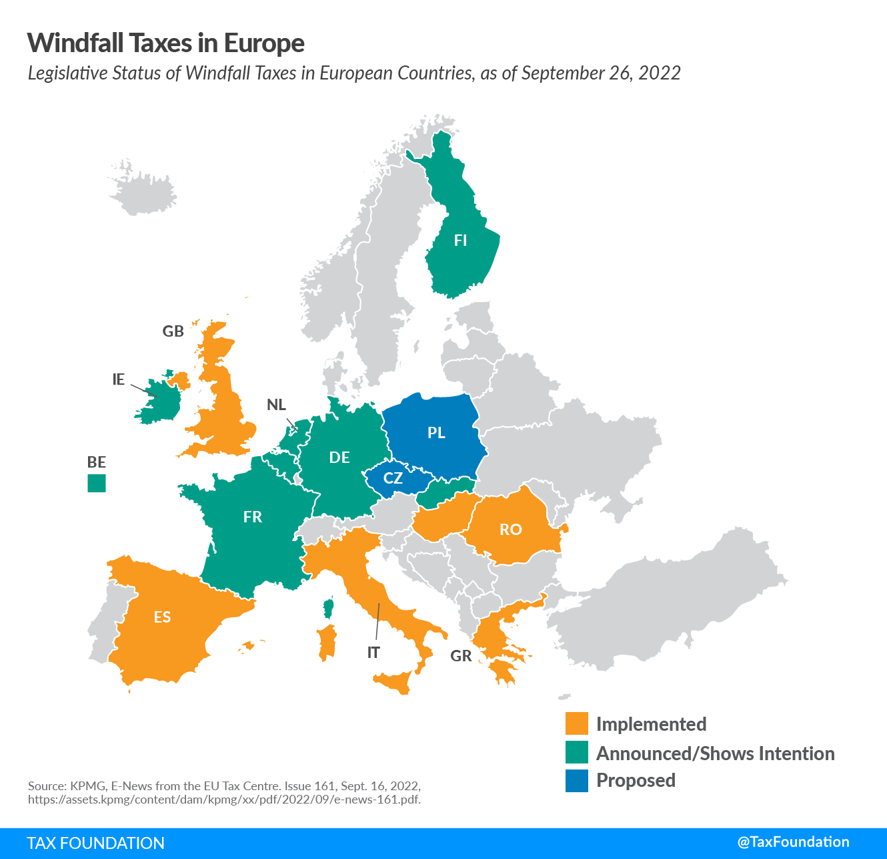

Slide 8
CHAPTER III
“Measure concerning the crude petroleum, natural gas, coal and refinery sectors”
Article 15
“Base for calculating the temporary solidarity contribution”
“The temporary solidarity contribution for Union companies and permanent establishments with activities in the crude petroleum, natural gas, coal and refinery sectors, including those that are part of a consolidated group merely for tax purposes, shall be calculated on the taxable profits, as determined under national tax rules, in the fiscal year 2022 and/or the fiscal year 2023 and for their full duration, which are above a 20 % increase of the average of the taxable profits, as determined under national tax rules, in the four fiscal years starting on or after 1 January 2018. If the average of the taxable profits in those four fiscal years is negative, the average taxable profits shall be zero for the purpose of calculating the temporary solidarity contribution.”
Article 16
“Rate for calculating the temporary solidarity contribution"
“1. The rate applicable for calculating the temporary solidarity contribution shall be at least 33 % of the base referred to in Article 15.
2. The temporary solidarity contribution shall apply in addition to the regular taxes and levies applicable according to the national law of a Member State.”

Slide 9


WPT in Italy:
2022: 25% levy calculated on the VAT
2023: 50% levy, calculated on the taxable IRES and on the average increase above 10% (four previous years).
7 thousand companies affected: sale of goods, electricity or methane gas production or the extraction of natural gas
Resellers, producers and ditributers of electricity and natural gas and petroleum product traders will also be involved
Importers of electricity, natural gas or methane gas, petroleum products from other EU states into Italy will also have to pay the levy.
Goal: 2.5 billion euros

Slide 10

WPT in the UK:
“Energy (Oil and Gas) Profits Levy Act 2022”
“Energy Prices Act 2022”

Slide 11
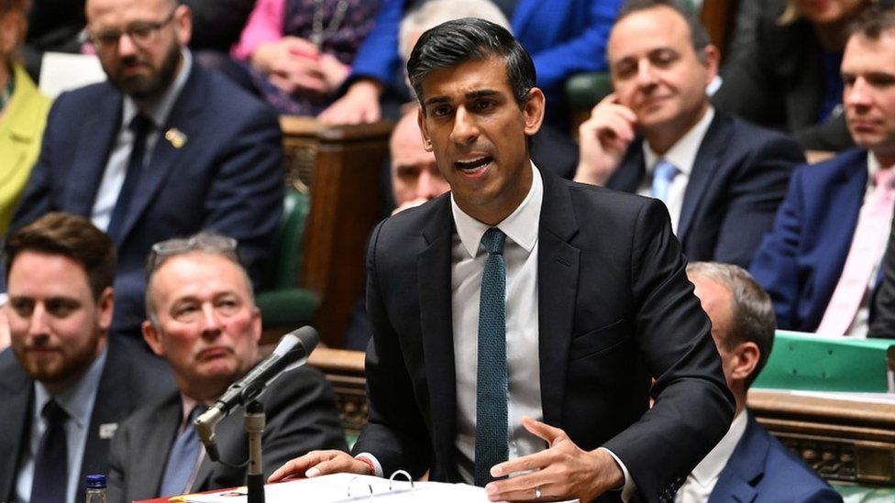
“Energy (Oil and Gas) Profits Levy Act 2022”
Extraordinary tax regime for oil and gas
25% surcharge on extraordinary profits of the oil and gas sector
25% might increase to 30% ➜ additional 8 billion pounds/year ➜ uncertainty

Slide 12
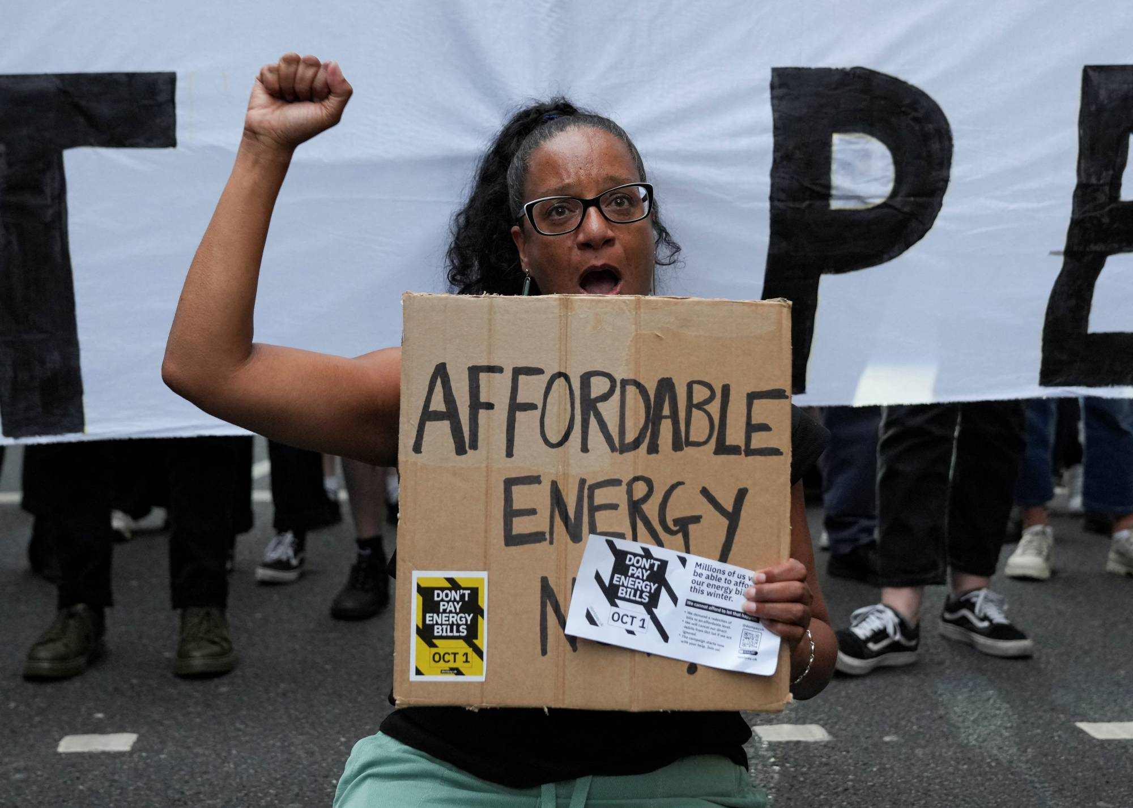
"Energy Prices Act 2022”
"Revenue cap" regime on low carbon electricity generators = "Cost Plus Revenue Limit”
Does not regulate the operation of the revenue cap scheme
Authorises the government to pass regulations in order to implement such a scheme
It is unclear how far the revenue cap regime will extend
It is not clear what form the "revenue cap" will take: hard cap or 25-30% tax on excess profits?

Slide 13

WPT in Spain:
Law 38/2022
1.2% rate on the net turnover of large energy companies operating in Spain
4.8% rate on the net interest and commission income of large Spanish credit institutions.
Subjects: “major operators” in the energy sector and natural or legal persons carrying out activities in Spain for the production of crude oil or natural gas, coal mining, or petroleum refining
75% of their total revenues from economic activities in the field of extraction, mining, petroleum refining or of the manufacture of fossil fuel products in the year preceding the tax year
Exemption if the amount of the net turnover for 2019 is less than 1 billion euros or if the amount of the net turnover does not exceed 50% of the total turnover in 2017, 2018 and 2019.
If part of a tax group, the net turnover is calculated with reference to the group.
Deposit of 50%: February 20th and balance: September 20th
Temporary solidarity tax: weighs on the net assets of natural persons exceeding 3 million euros

Slide 14
We thank you for your cooperation
Merci pour votre collaboration
Rebecca Pavan

