Slide 1


Slide 2

Conflict with property rights and art 1 first protocol ECHR
Rovigo 10/03/2023

Slide 3
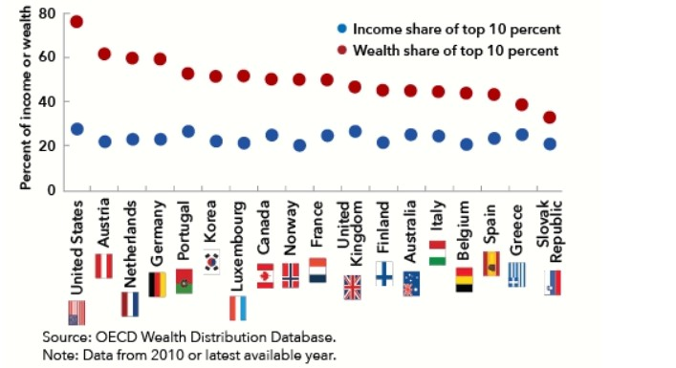
Why using wealth tax ?
Diminution of the rising wealth
inequality
Revenue raising for debts or deficit
Concerns
Middle tax relief

Slide 4
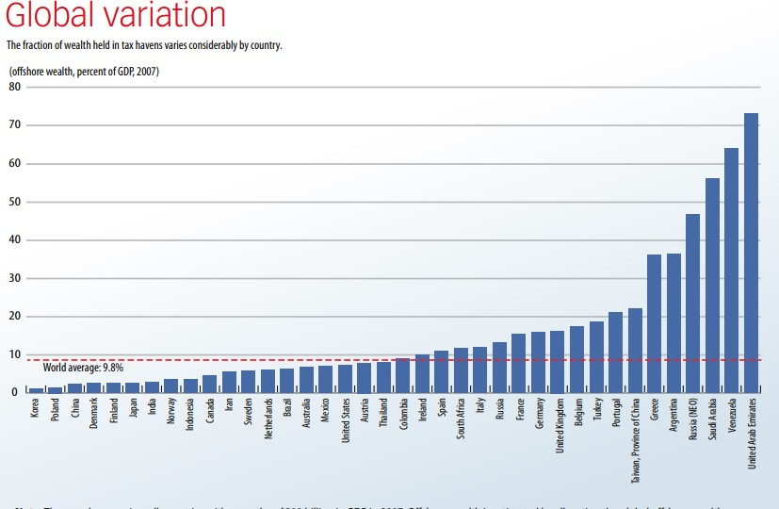
Has it always been useful ?
Due to the revendication of their own
property ,and of a accusation of
double taxation , tax heaven became a
solution for the wealthiest

Slide 5

Article 1 First Protocl ECHR
"Every natural or legal person is entitled
to the peaceful enjoyment of his
possessions"
Possession = existing possessions + assets
Peaceful enjoyment of these possessions

Slide 6


Typology of taxes
The main distinction is between
Taxes on corporate income wich is levied
on the earnings income
Taxes on wealth levied on
net wealth , property, real
estate ...

Slide 7
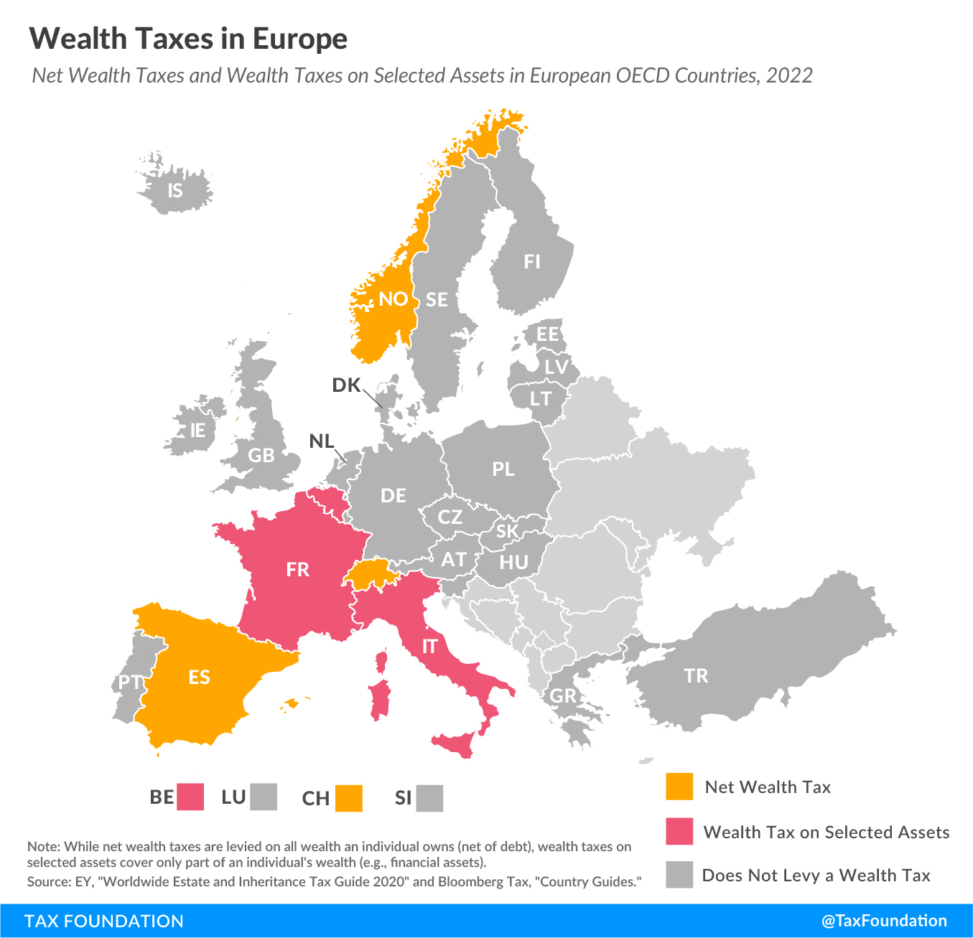
Net wealth tax
Annualy imposed
Paid on the value of assets
- Death duties
Capital levy
More productive use of capital

Slide 8
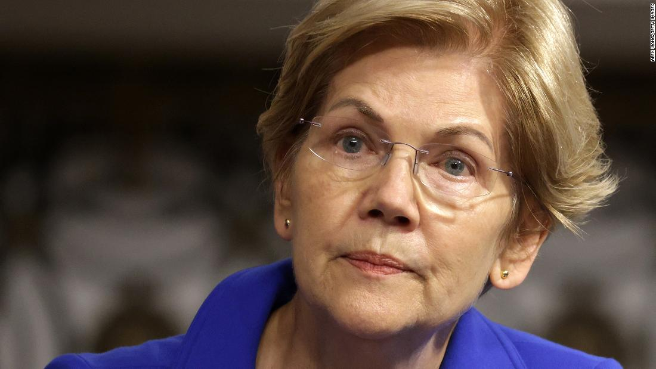

Property taxes
-Form of wealth tax based on the value of
real estate and land even if some would also like a
Taxation on tangible personal property ( yachts , jewellery... )
-Regressive tax
-Imposed by the local government where stands
the property
-Imposed annualy or during a transaction
( real estate transfer tax ) applied for example during a change
of ownership

Slide 9

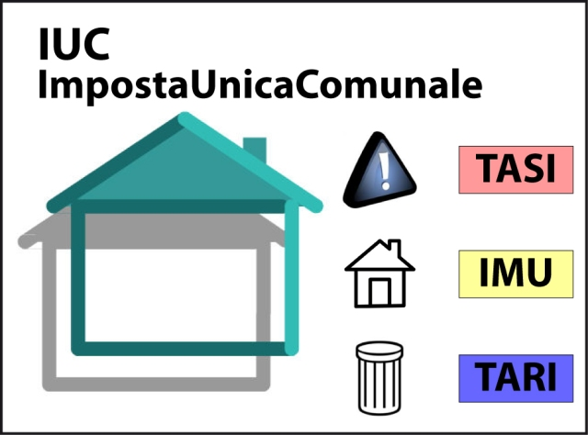
Property tax in Italy
Called IUC for ( imposta unica communale)
Composed by:
IMU = sul possesso degli immobili
TASI= useful for the " servizi indivisibili "
TARI = for the waste collection
Due two times a year
Current italian transfer tax is up to 9%

Slide 10
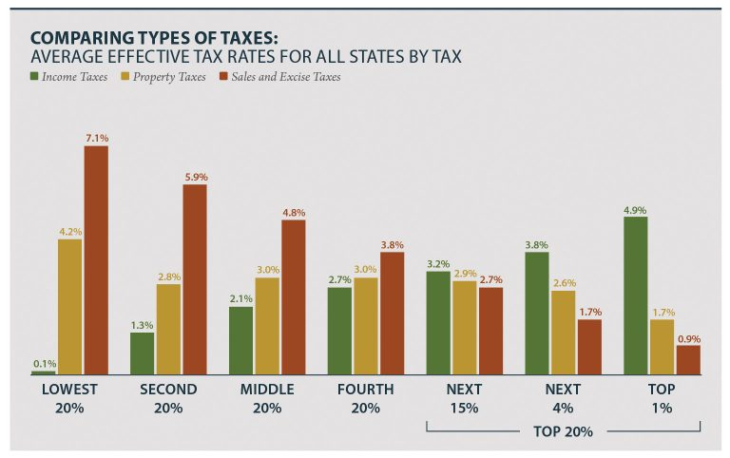
Difference between income and property taxes
Judged effortless and permanent
Wealth not yielding any income is not
subject to tax
The idea would be a combination of
separate taxes ( even if contested by
the wealthiest )

Slide 11
Si ringrazia
per la collaborazione

