Slide 1



WEALTH TAX
What is wealth ? Movable ? immovable ?
How expensive is “Dolce Vita”?
Akkaoui Sana
Bouton Élise
Kazado Sasha

Slide 2
Summary Introduction Section 1 : The scope of application of the real estate wealth tax Paragraph 1 : Taxable persons Paragraph 2 : Taxable assets A. Determination of taxable assets B. Evaluation of taxable property. Section 2 : asset assigned to the professional activity Paragraph 1 : Real estate and real estate rights assigned to a sole proprietorship Paragraph 2 : Real estate and real estate rights assigned to a company Section 3 : the payment of the real estate wealth tax

Slide 3
Introduction
In 1982
The tax on large wealth (IGF) appeared under the Mitterrand presidency. The idea was the following: to involve more those who have a substantial fortune.
In 1986
The abolition of the IGF was voted on. In 1988, this tax came back as the "solidarity tax on wealth" (ISF), in order to finance the minimum insertion income.
In 2018
President Macron decided to transform the ISF into a tax on real estate wealth (IFI) by excluding from its scope movable assets, savings and financial investments.
The objective is to encourage investment in companies rather than in real estate. Real estate assets are assessed for each tax household on January 1st of the tax year, and trigger the IFI if they exceed the threshold of 1.3 million euros.

Slide 4
Section 1: The scope of application of the real estate wealth tax IMMOVABLE

Slide 5
Paragraph 1: Taxable persons Article 980 CGI The tax on real estate wealth (IFI) is only applicable to individuals: -Namely those who are tax resident in France on January 1st of the tax year. -Individuals not domiciled in France for tax purposes on January 1st of the tax year for assets located on the French territory, the net value of which exceeds the tax threshold. When the legal entities are representative of real estate assets or rights, the shares will be taxed in the hands of the individual partner. As for taxpayers who are French tax residents, all their real estate is included in the scope of the IFI, whether it is located in France or abroad (principle of globality) However, in order to avoid double taxation: implementation of a tax credit Beware of international tax treaties! Concerning the IFI, the tax household is composed of the following members: -the taxpayer -his or her spouse, civil union partner or common-law partner -their minor children. ⚠️ The child of full age should not be taken into account in the calculation of the IFI A small special feature of the IFI is that notorious cohabitants are subject to joint taxation.

Slide 6
A. Determination of taxable assets In the past, the solidarity tax on wealth was assessed on any property, right or value forming the taxpayer's assets. Henceforth, subject to exemptions, the basis of assessment for the IFI is the real estate assets held by the taxpayer and by the members of his or her tax household on January 1st of the tax year. The term "real estate assets" must be understood in a broad sense: in the context of the IFI, it is not limited to real estate as defined by the Civil Code. 1- Real estate assets and rights The IFI applies to -All built -Unbuilt property -Property under construction, as well as to all real estate rights held by persons subject to this tax.
General Tax Code ≠ Civil Code

Slide 7
2- Corporate rights The IFI includes the shares of companies and organizations established in France or outside that belong to the taxpayer. In principle, these are taxable up to the fraction of value representing real estate assets or rights held directly or indirectly by the company. Article 965 2° CGI: "2° units or shares of companies and organizations established in France or outside France belonging to the persons mentioned in 1° of this article, up to the fraction of their value representing real estate assets or rights held directly or indirectly by the company or organization". To do this, a specific calculation method is used: 1- determine the net value of the taxable securities by taking into account the real value of the company held in proportion to the percentage held by the partner ; 2- determine the gross value of the taxable properties; 3- determine the gross value of the other assets of the company; 4- calculate the real estate coefficient by calculating the ratio of the gross value of the taxable properties/(gross value of the taxable properties + gross value of the other assets of the company) 5- apply the real estate coefficient to the value of the shares held by the partner. As regards the real estate coefficient applicable to the value of the shares, it is necessary to determine the applicable ratios for each level of the chain.

Slide 8
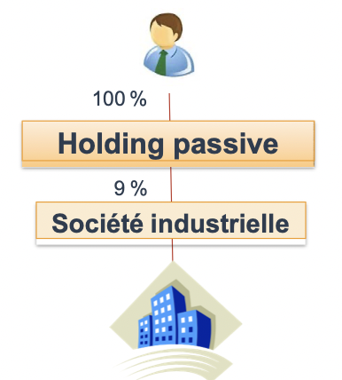
3- Property and real estate rights excluded from the determination of the taxable value In a general way, the legislator wished to exclude real estate used in the context of a professional activity; >Article 965 2° paragraph 3 of the CGI thus excludes from the tax base the shares of a company or organization carrying on an industrial, commercial, craft, agricultural or liberal activity in which the taxpayer and the members of the tax household hold less than 10% of the capital and voting rights. >Similarly, article 965 2 paragraph 6 excludes the operational activity of the company holding it or with the operational activity of one of the companies in the group. >Article 966 CGI: "is not considered as an industrial, commercial, artisanal, agricultural or liberal activity the exercise by a company or an organization of an activity of management of its own real estate assets". >Also real estate assets or rights held by an operating company in which the taxpayer holds shares, and allocated to its own operating activity or to the operating activity of a group company are excluded.

Slide 9
4 - Property subject to dismemberment of ownership who declares between usufructuary and bare owner ? In principle, only the usufructuary must declare the full market value of the real estate held directly or indirectly of which he has the usufruct, while the bare owner does not have to declare the property. However, there are several exceptions to this rule: -The usufruct is constituted by determination of the law -or as a result of a transfer of bare ownership In these cases, the assets are included in the assets of the usufructuary and the bare owner respectively, in the proportions set by article 669 of the CGI (scale depending on the age of the usufructuary). For example, for a property valued at 500.000€, the usufructuary is 75 years old and will have to declare 30% of the value of the property (150.000€), while the bare owner will have to declare the balance (350.000€).

Slide 10
B. Valuation of taxable property The value used as a basis for the tax is determined by the taxpayer, subject to the control of the administration. The value to be declared is the market value determined on the date of the taxable event, on January 1st of each year. However, the principal residence benefits from a 30% allowance if the property is owned by a member of the tax household and is occupied by the taxpayer (CGI, art. 973). The liabilities related to the acquisition of the real estate or real estate rights are deducted from the market value. →It is therefore the net value of the real estate assets that will be taken into account as a basis for the tax.

Slide 11
B. Valuation of taxable property 1-Deductible debts Debts on taxable property are deductible from the value of such property. However, this deductibility is excluded by law if the debts are not related to the taxable real estate assets. Logically, debts are deductible "where applicable, in proportion to the fraction of the taxable value (of the assets)".. For example, if a sole trader owns a building in which a business is located on the ground floor and his personal residence is located on the first floor, only the part corresponding to his residence is taxable (provided that it reaches the tax threshold), so that the loan contracted for the acquisition of the building will be deductible in proportion to the surface area that is not used for the business activity The law further limits the reductions in the IFI base by providing for special deduction terms for debts : -In particular when their term is specific. This applies to so-called bullet loan contracts. -Loan contracted without a term are therefore treated as loan contracted with a term of 20 years and a linear repayment.

Slide 12
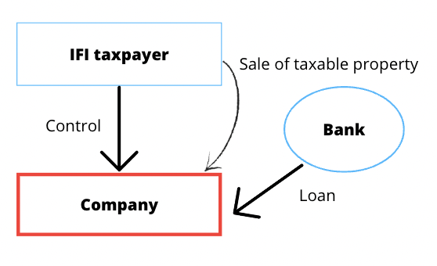
B. Valuation of taxable property 2-Non-deductible debts In cases in which there is little economic interest and their objective is mainly fiscal. These anti-abuse mechanisms, also known as safeguard clauses, are aimed in particular at self-selling transactions and intra-group or intra-family financing transactions. In other words, the law prevents the deduction of the liability generated in the context of a sale to oneself. The debt is also disallowed when it is contracted with -A member of the taxpayer's tax household -A member of his extended family circle -A company directly or indirectly controlled by the taxpayer (or his household). These anti-abuse clauses do not apply, however, if the taxpayer can prove that the loan was not taken out with a primarily tax-related purpose.

Slide 13
B. Valuation of taxable property 3-The deduction limit for holders of substantial assets (CGI, art. 974, IV) When the market value of the taxable assets exceeds 5 million euros and the amount of the debts exceeds 60% of this value, the amount of the debts exceeding this threshold is deductible only up to 50% of this excess. However, this ceiling does not apply to debts for which the taxpayer can prove that they were not incurred primarily for tax purposes. Example A taxpayer owns taxable real estate with a gross value of 8 millions euros, and has incurred debts for their acquisition in the amount of 5 millions euros, thus representing more than 60% of the value of the property (4.8 millions euros). The excess of 200,000 euros is only 50% deductible (100,000). The amount of deductible debts is therefore limited to 4.9millions euros.

Slide 14
Section 2 : Assets assigned to the professional activity

Slide 15
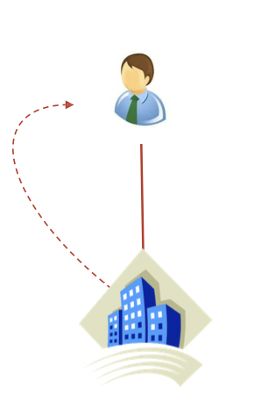
Section 2 : Assets assigned to the professional activity Real estate used for the taxpayer's main professional activity or for the activity of the company in which the taxpayer carries out his main professional activity, is exempt from IFI (article 975 CGI). There are therefore two cases of exemption: - For real estate allocated to the taxpayer's main professional activity. Here, the real estate is held directly by the taxpayer (§1). - For real estate that is held indirectly by the taxpayer because it is held by a company. The real estate must be used for an industrial, commercial, agricultural, artisanal or liberal activity and the taxpayer carries out his main professional activity in this real estate (§2).

Slide 16
I/ In an individual business Real estate assets or rights and the shares representing these same assets, when they are assigned to a main industrial, commercial, craft, agricultural or liberal activity, are exempt from wealth tax. The exemption concerns professional property or real estate rights. To be considered as professional, the property must be used by the taxpayer or his spouse for the exercise of his professional activity. As the wealth tax is a household tax, if the owner and the person working on the property are different but belong to the same household, the exemption will apply. The value of these professional assets must be reduced by the professional debts, which will reduce the exempted amounts. Thus, only the excess of these debts can be deducted from the taxable base. The exercise of a real profession is the exercise of a usual and permanent activity that generates income to live on.

Slide 17
II/ In a society A) For companies subject to income tax Real estate or rights and shares representing the same property are exempted when they are assigned to the industrial, commercial, artisanal, agricultural or liberal activity of a company subject to income tax in which the taxpayer or the head of the family carries out his or her main professional activity.
B) For companies subject to corporation tax
The exemption is authorized if several conditions are met:
- The taxpayer performs a management function in the company, and is normally remunerated for this. This remuneration must be subject to normal income tax. In addition, this remuneration must represent more than half of the income on which the taxpayer is subject to income tax in the same categories.
- The taxpayer must hold at least 25% of the voting rights of the company, directly or with his or her spouse, their ascendants or descendants or their brothers and sisters.
The second condition does not have to be met if, after a capital increase, the taxpayer meets all the following conditions:
- He has respected this condition (25% of the voting rights) during the 5 years preceding the capital increase.
- He holds at least 12.5% of the voting rights, directly or with his husband or wife, their ascendants or descendants or their brothers and sisters.
- He has signed a partnership agreement with persons who hold at least 25% of the voting rights and who have management power in the company.

Slide 18
Section 3: The payment of the wealth tax

Slide 19
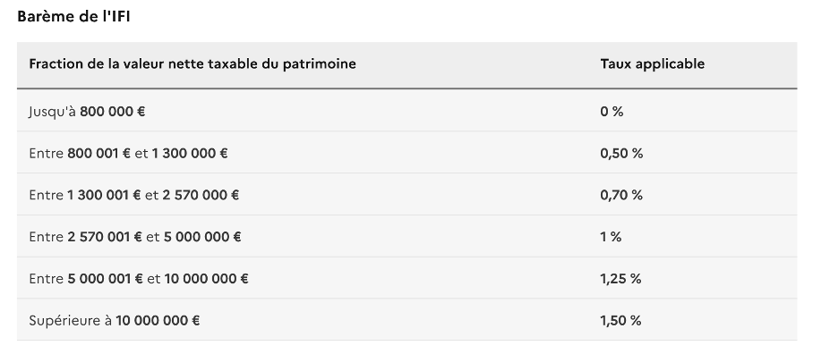
There are tax credits when the taxpayer invests in a small or medium companies or if he donated to an organization of general interest. In addition, there is a ceiling that takes into account the amount paid for wealth tax and income tax. Indeed, the taxpayer cannot be taxed on more than 75% of his income.
Movable
Since the abolition of the ISF in 2017, movable assets are not taxed directly.
Since the replacement of the ISF by the IFI, there are new additional taxes that have been created or reinforced by targeting certain categories of assets that can be considered as signs of wealth such as boats, luxury cars, private jets....
Then, they had the idea to create other taxes.
Finally, in some cases, the tax authorities may assess the taxable income on a lump-sum basis due to lifestyle elements (household employees, yachts, race horses...). The taxable base will not correspond to the reality but to a presumed income.
Be careful: If the scope of the wealth tax begins at 1 300 000€, we are imposed from 800 000€.

Slide 20


Comparative law and current issues > Germany Germany has a much lower level of property taxation than Italy. > Italy
IMU (Imposta municipale unica)
IVIE (Imposta sul Valore degli Immobili Situati all’estero)/ IVAFE (Imposta
sul valore delle Attività Finanziarie detenute all’Estero)
Stamp duty on financial assets
Other activity-based duties (inheritance, land registry tax, etc...) - not
covered in this presentation

Slide 21


Comparative law and current issues >SWITZERLAND Firstly established during the XIX century, the federal wealth tax was abolished in 1959 for individuals (1998 for corporations), but a wealth tax is levied in each of the 26 cantons: • Currently under scrutiny, in favor of a tax targeting capital gains • Generally speaking, different types of assets are included to calculate the base value • Household items are generally excluded >SPAIN General wealth tax levied at the national level, however regional governments can • Solidarity Tax introduced as a temporary measure for FYE 2022 (to complement the already existing wealth tax) In force for two years

Slide 22
thank you for your attention Merci pour votre collaboration Grazie per la vostra collaborazione

