Slide 1


Slide 2

QUIRINAL TREATY ON TAXATION
EXERGY TAXATION:
THE FAILURE OF ENERGY UNION AND ELECTRICITY IN THE ITALIAN DIMENSION
Rovigo
11/03/2023

Slide 3


The failure of Energy Union
•June 2014 European Council established the creation of an Energy Union
Provide energy at affordable prices
Ensure energy to all EU countries → reducing energy dependence
More green energy
•December 2014: leaders of EU requested the EU Commission
To propose a plan to link energy networks at the cross-border level
To reduce emissions
•2015 European Commission Published: Energy Union strategy for “coordinating and integrating the energy policies of the EU and its state”
6 year after Commission’s intentions have remained just intentions
increasing of the cost of electricity

Slide 4



The causes of rising electricity prices
Russia’s aggression
Covid emergency
Higher cost for permits to emit carbon dioxide into the atmosphere

Slide 5


ELECTRICITY IN THE ITALIAN DIMENSION

Slide 6
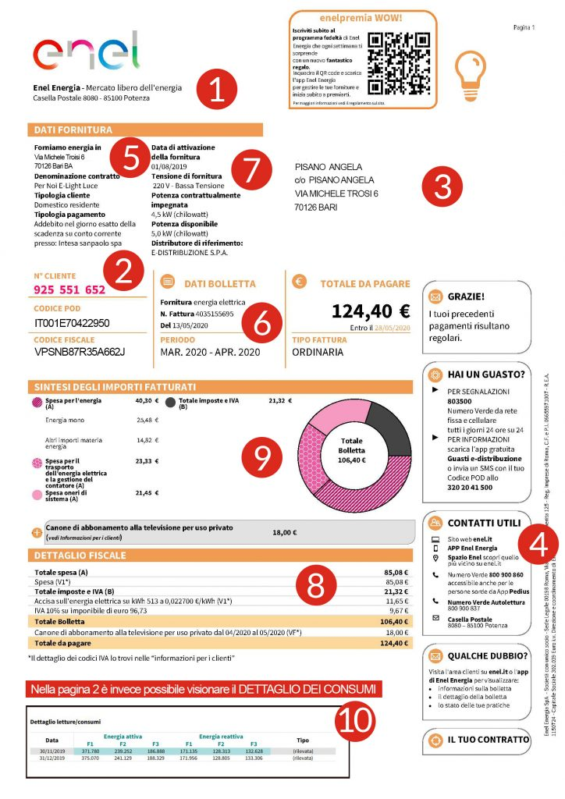
Fiscal dimension
Excise tax:
-Indirect tax
-Placed by the state on the production/sale of certain products
-The value depend on the quantity of product consumed
Value-added tax (VAT):
-Indirect tax
-It strakes the value added to production and exchange of
goods/service
-It is paid by the consumer
-D.L. 633/1972: 10% for domestic use; 22% for non-domestic use
•VAT depends on the economic value of the service, while excise tax depends on the quantity of the purchased goods
•IVA is paid on the total amount of electricity bill → Internal Revenue Agency (No.910-11/2017)

Slide 7


Electricity market
L.D. 79/1999: market liberalisation → choice
Protect regime → The price of electricity/gas is established by ARERA
Until domestic user switches to the free market
2) Free market → The price is freely decided by the seller and it reflects as much as possible the law of supply and demand

Slide 8

Measures adopted to face the raising of electricity price
Art.13 Code of Business Conduct for the sale of electricity and natural gas to customers: the electricity supplier has the option to unilaterally change the supply contract
Article 3 of the Aiuti bis Decree (9 August 2022 No.115) suspends until 30 April 2023 the effectiveness of any contract clause that allow the supplier company to unilaterally change the contract condictions
This legislation has not fully complained with
Competition and Market Authority (AGCM)

Slide 9


The president of AGCM and the President of ARERA met in Rome in order to discuss the situation
•Unilateral variations of contract conditions
During the period of contract’s validity, due to justified reasons, in accordance with specific clause → in contrast with Article 3
•Automatic evolutions of economic conditions
They are provided by the both parties → no contrast with Article 3
•Proposed renegotiation due to supervening imbalance in performance due to price increase
Not supervening impossibility but excessive onerousness →
Cessation of contract but only with juridical pronouncement

Slide 10
CASE LAW:
Prevision No.30339 adopted by AGCM against Iren Mercato S.p.A
Violation of Article 3 of Aiuti Bis Decree so AGCM established:
-Suspension of the application of any variation of the economics conditions
-The Company is required to notify to AGCM the implementation of this suspension misuse (within 5 days the reception of the measure)
-In case of non-compliance: fine administrative penalty (€10.000-5000000)
-If the Company does not comply with the penalty: AGCM may order the suspension of business activities (no more than 30 days)

Slide 11
Thank you
for your collaboration
SARAH CORSO

