Slide 1


Slide 2

National tax law and policy making April 28th and 29th - Università degli studi di Ferrara
Perini Lorenzo
Law student
Università degli studi di Ferrara

Slide 3
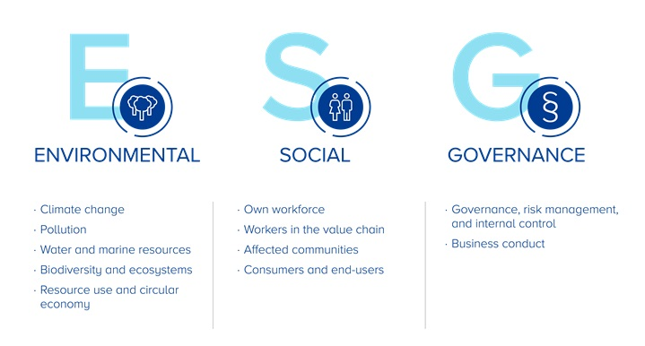
What are ESG criteria?
ESG shifts investment focus from profit-only to sustainability alignment
ESG standards are increasingly becoming legally binding

Slide 4
National timeline
2019 Budget Law (145/2018)
2020: Superbonus 110% and the Relaunch Decree
2019: art. 2086 c.c. amended
Future challenges
2021: PNRR
Legislative Decree 199/2021
Legislative Decree 254/2016
Legislative Decree 125/2024

Slide 5
From EU Law to National Policy: ESG in Italy
Italy gradually adapts national law, focusing on:
Corporate governance
Non-financial reporting
Green tax incentives
The EU has progressively integrated ESG principles into binding legal acts, especially through:
- Directive 2014/95/EU (NFRD)
- Directive 2022/2464/EU (CSRD)
- Upcoming CSDDD (2024)
Italy has transposed these norms gradually and sectorally, using:
- Legislative decrees for legal alignment
- Tax measures (credits, deductions)
- Public programs (like PNRR)

Slide 6
The First Milestone: Legislative Decree 254/2016
Transposition of Directive 2014/95/EU (NFRD)
Introduction of “Dichiarazione Non Finanziaria” (DNF) for large public interest entities such as banks, listed companies and insurances.
No direct tax rules, but:
Article 3: relevance of environmental indicators (e.g. renewables) → key for accessing tax credits and incentives.
Pre-fiscal function: creates data for ESG-based tax policy

Slide 7
Green Fiscal Incentives: from Ecobonus to Superbonus
2019 Budget Law (145/2018): strengthens ecobonus and sismabonus.
Superbonus 110% (established by the «Relaunch Decree» i.e. 34/2020):
Full tax deductions for energy efficiency in housing
Mainly focused on individual citizens BUT indirect corporate impact (construction, energy, real estate sectors)
Environmental performance is now rewarded through tax benefits

Slide 8
Governance and ESG Risk: Italian Civil Code & PNRR
Art. 2086 Civil Code, as amended in 2019:
Companies must adopt governance systems that identify and manage environmental and social risks.
ESG is now a strategic and legal obligation, not only a compliance matter
National Recovery and Resilience Plan (PNRR):
Tax credits and accelerated depreciation for green investments.
ESG compliance required to access fiscal benefits.
This marks a shift: corporate responsibility aligns with sustainable tax governance

Slide 9
From Green Energy to ESG Reporting: Key Legislative Decrees
Legislative Decree 199/2021: implements EU Directive 2018/2001 on renewable energy:
Introduces tax deductions for investments in renewable energy and energy efficiency
Aligns green fiscal policy with ESG objectives, incentivizing sustainable corporate behavior
Legislative Decree 125/2024: implements EU Directive 2022/2464 (CSRD):
Expands ESG disclosure requirements for large companies.
No direct tax provisions but greater transparency and standardization.
New sanctioning system

Slide 10
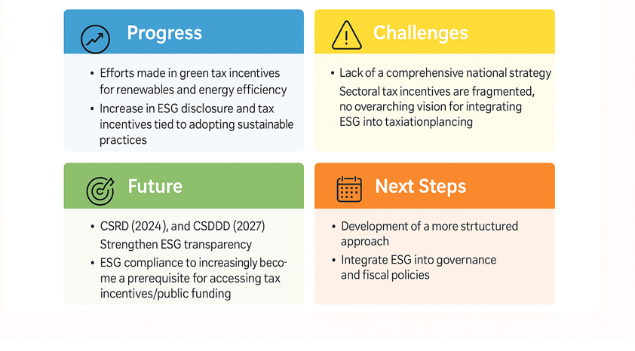
What about the future?

Slide 11
PwC: «a growing body of evidence shows that companies with strong ESG credentials tend to outperform»
From a business perspective…

Slide 12
Thank You!

