Slide 1
Nudges and Rules: The limits to a purposive fiscal intervention. The case of housing. Tax history and experience in incentivising and disincentivising residential building.
Jan Papajanovský
28 and 29 April 2025, Ferrara

Slide 2
Content
reasons for incentives? – case of housing in Czechia
housing incentives
income tax
VAT
property acquisition tax
property tax
“Green for Savings” programme
effectivity of the above measures?

Slide 3
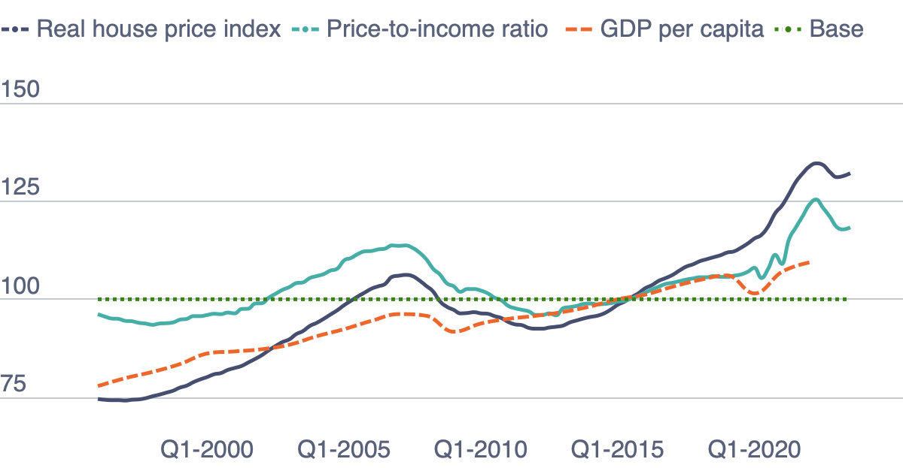

Slide 4
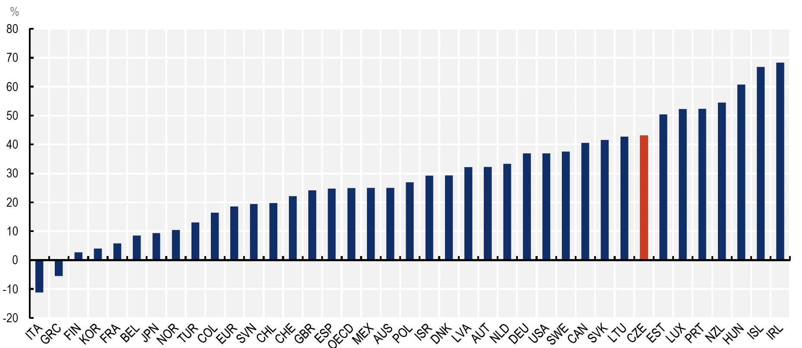

Slide 5
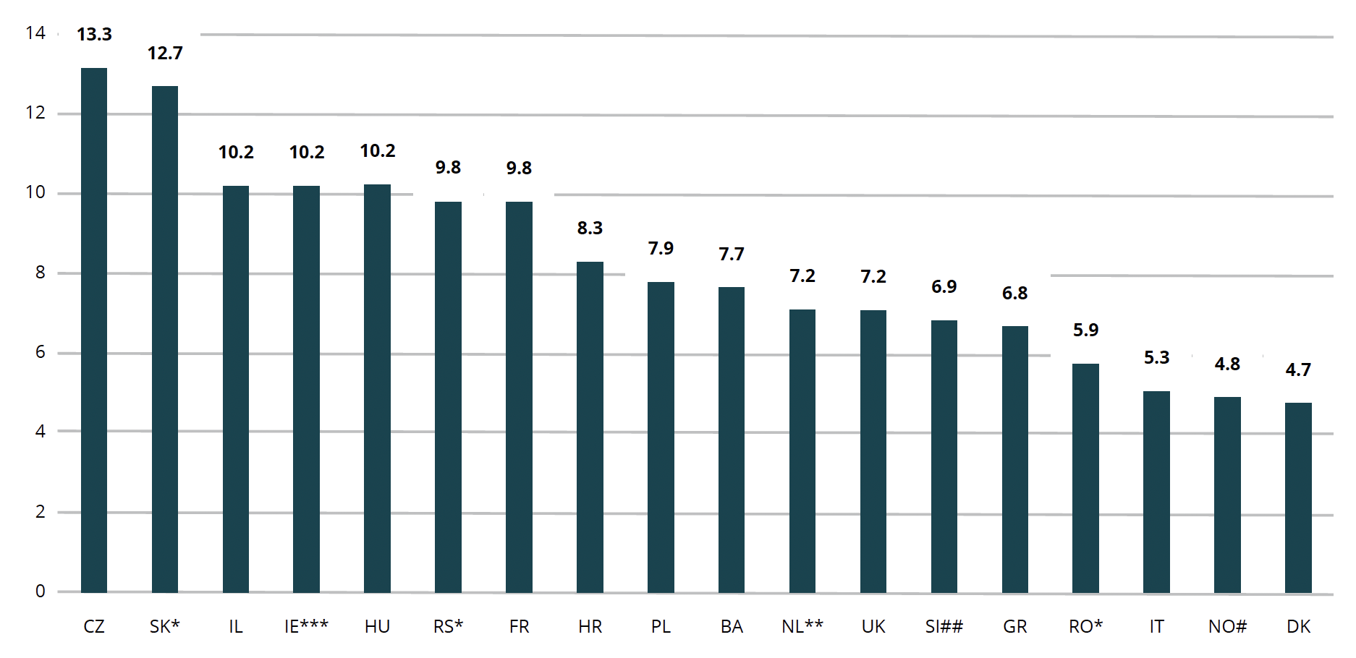

Slide 6
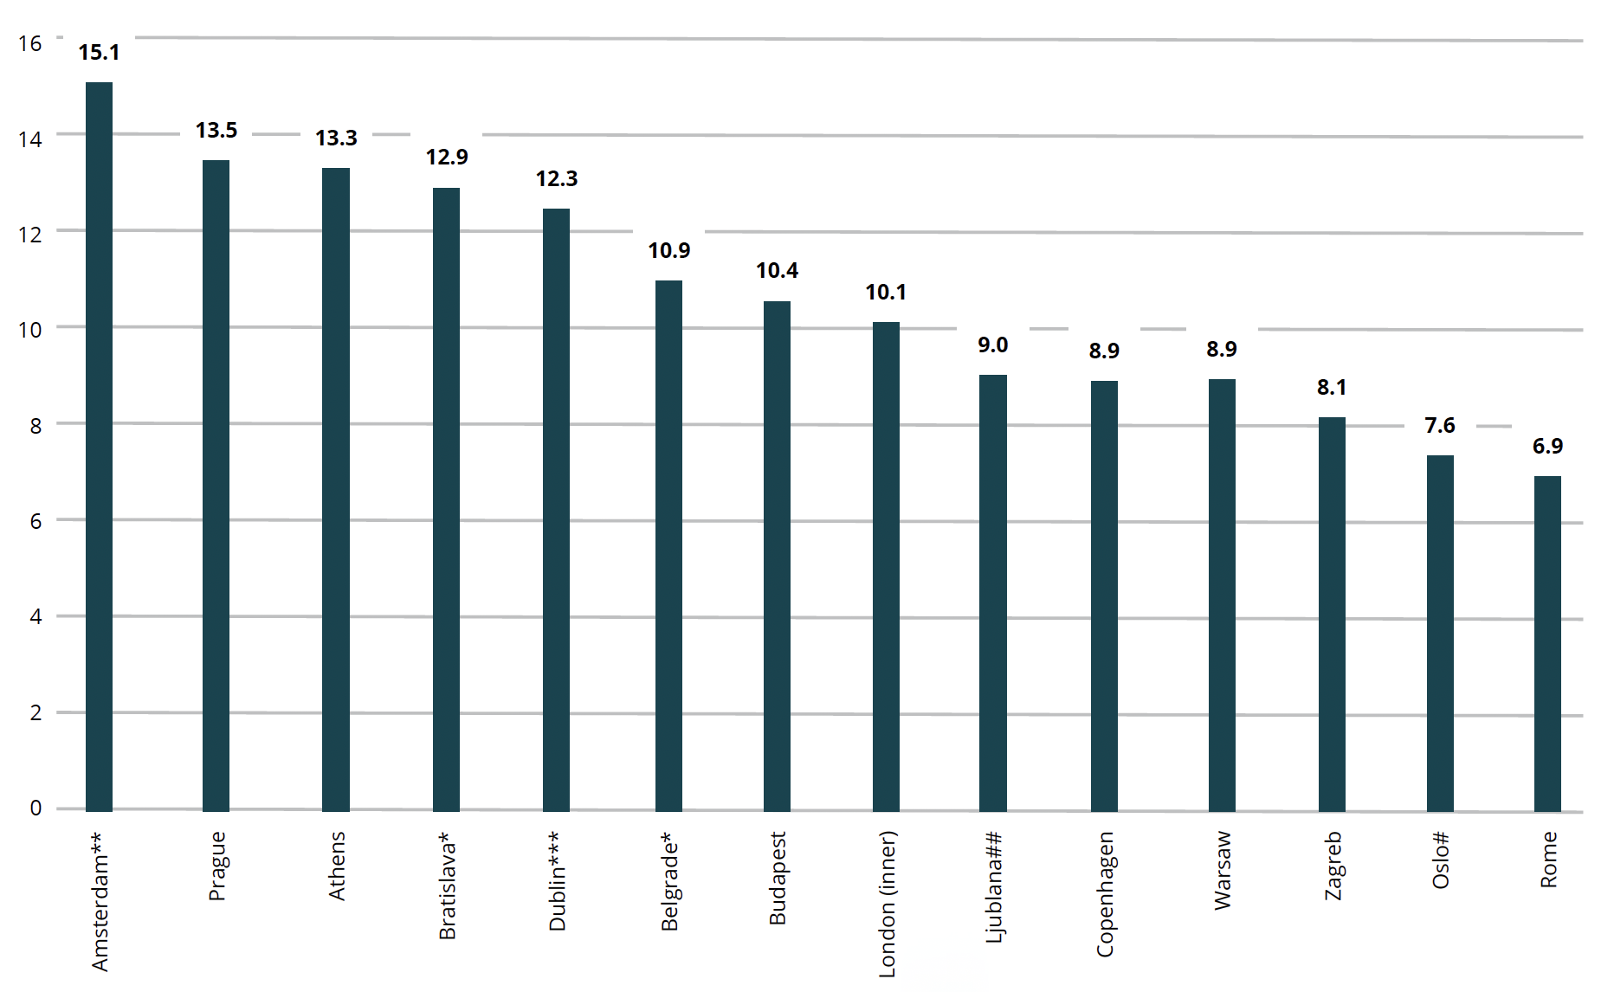

Slide 7
Income tax & VAT
mortgage tax credit – 6 000 EUR/year (x 12 000 EUR)
only 13 % for building new homes
income from sales – largely exempt (time test)
12 % x 21 % VAT
“social housing”
flats up to 120 m²
single family houses up to 350 m²

Slide 8
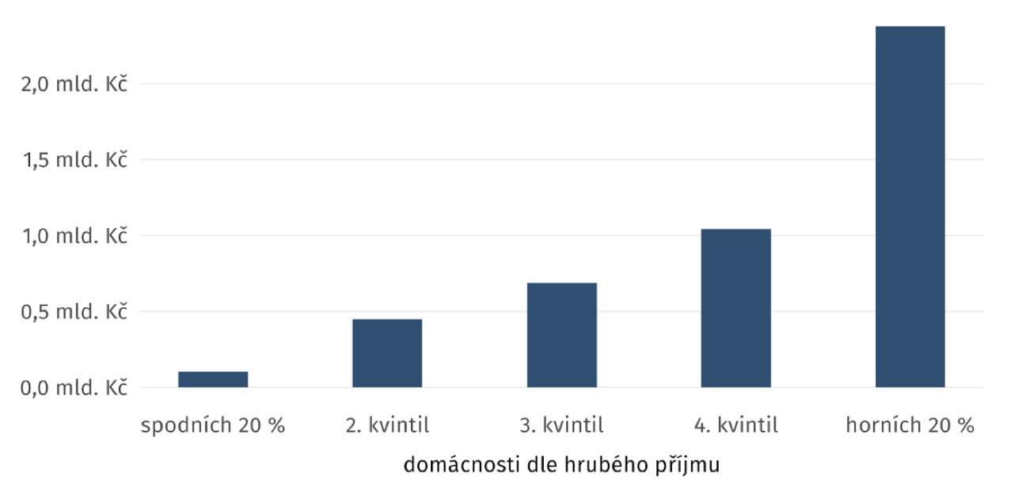

Slide 9
Property acquisition tax & property tax
property acquisition tax – abolished in 2021
4 %, value of the property, buyer
property taxes – reform in 2024
square metres x value of property
second and third houses?

Slide 10
“Green for Savings” programme
housing renovation subsidies programme – energy savings
statistics
484 162 applications
billions of EUR
poorer x richer households
“Green for Savings light”
“Fix up Grandma’s House”

Slide 11
demand x supply

Slide 12
Conclusion
housing crisis in many places including Czechia
various tax incentives x limited effect
in some cases countraproductive!
economy, economy, economy

