Slide 1
EU legal framework and policy
Lorenzo Perini, Dániel Biró-Markovics, Petr Milichovský and Petra Kerndlová

Slide 2


Slide 3
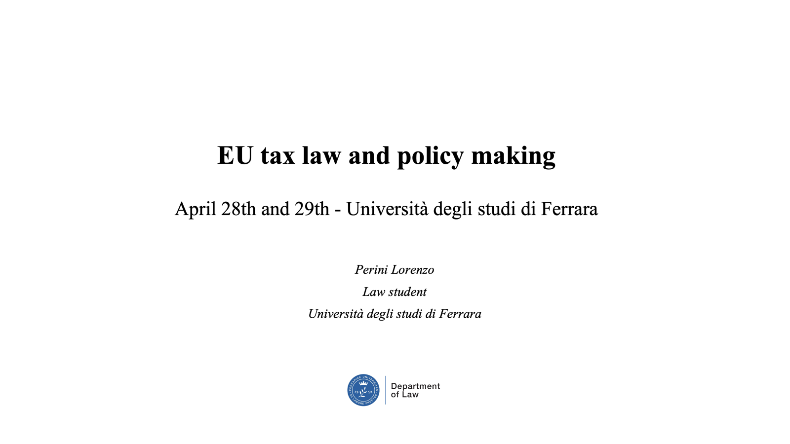

Slide 4
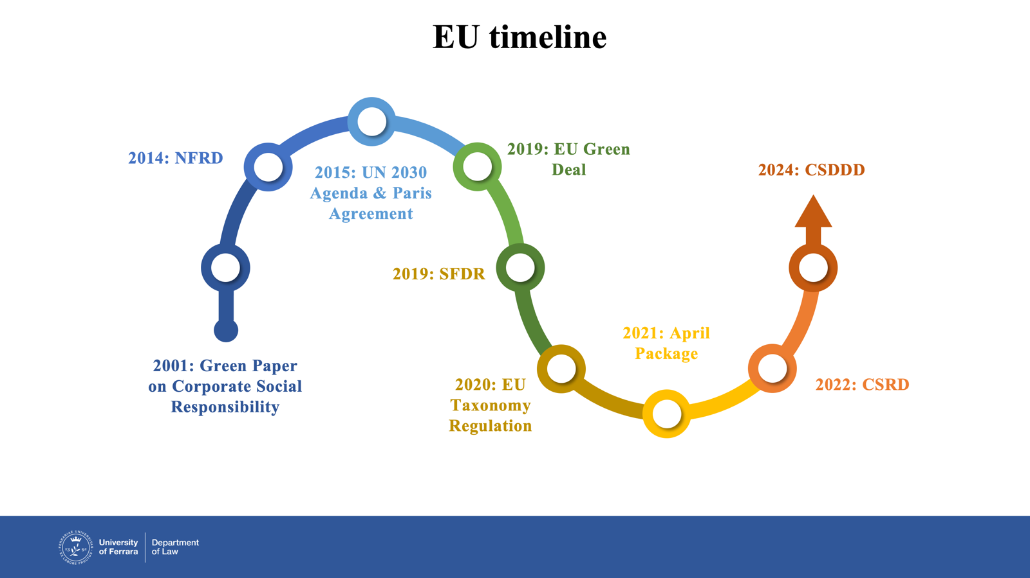

Slide 5
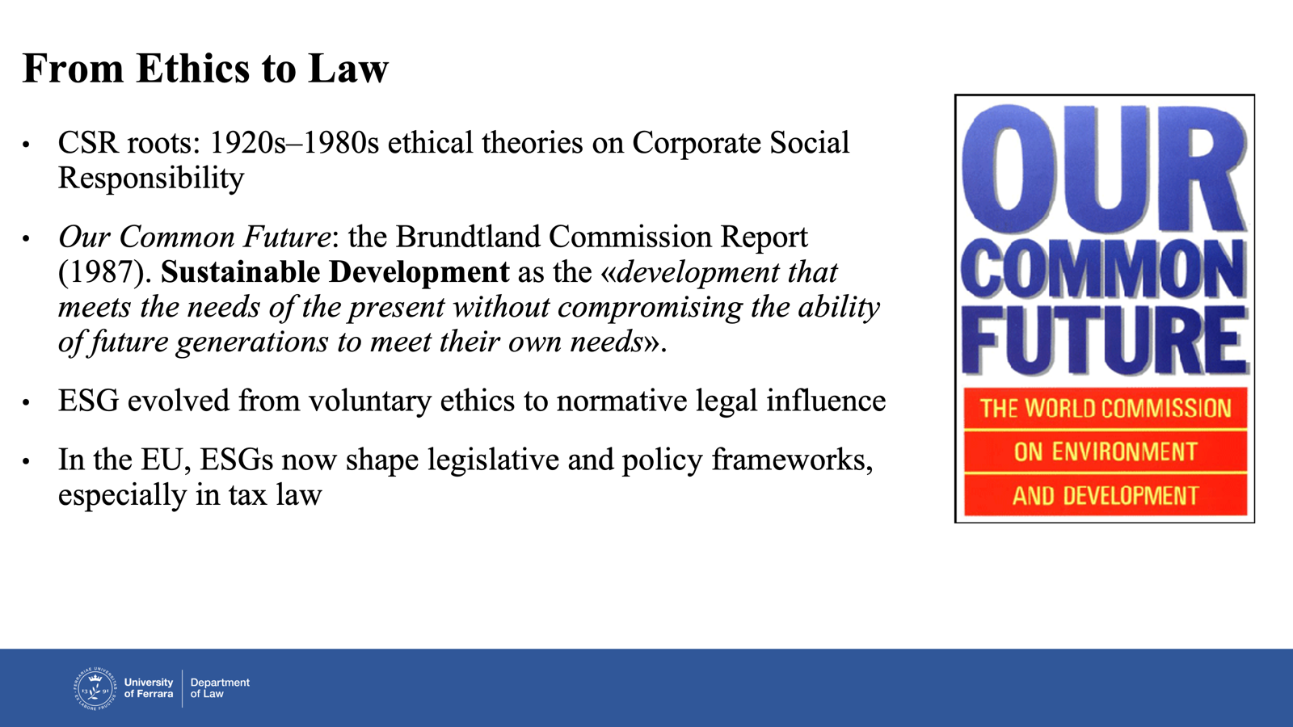

Slide 6
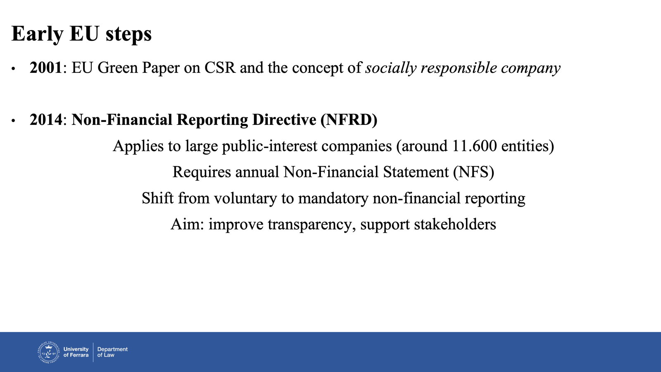

Slide 7


Slide 8
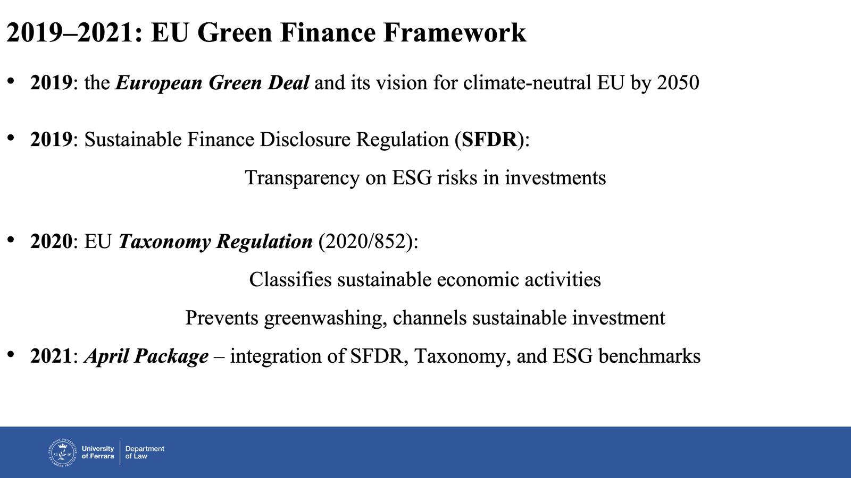

Slide 9
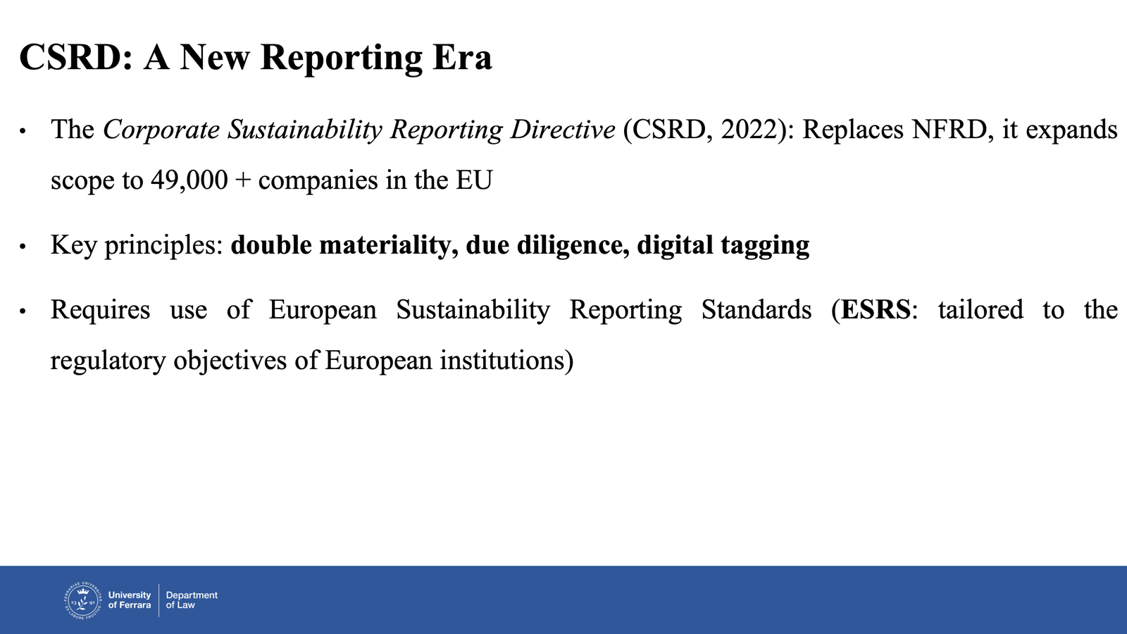

Slide 10
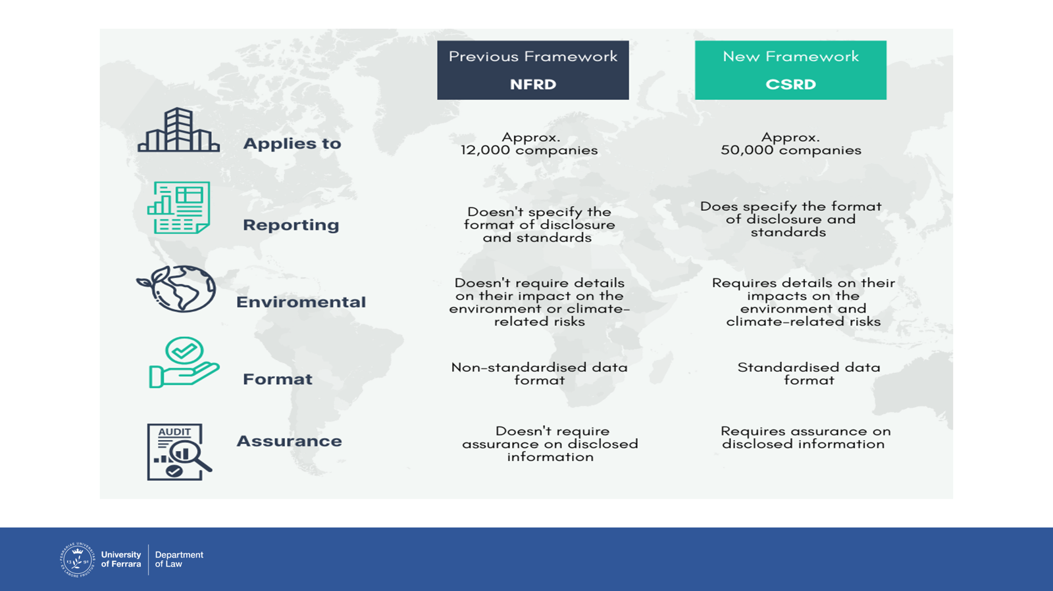

Slide 11
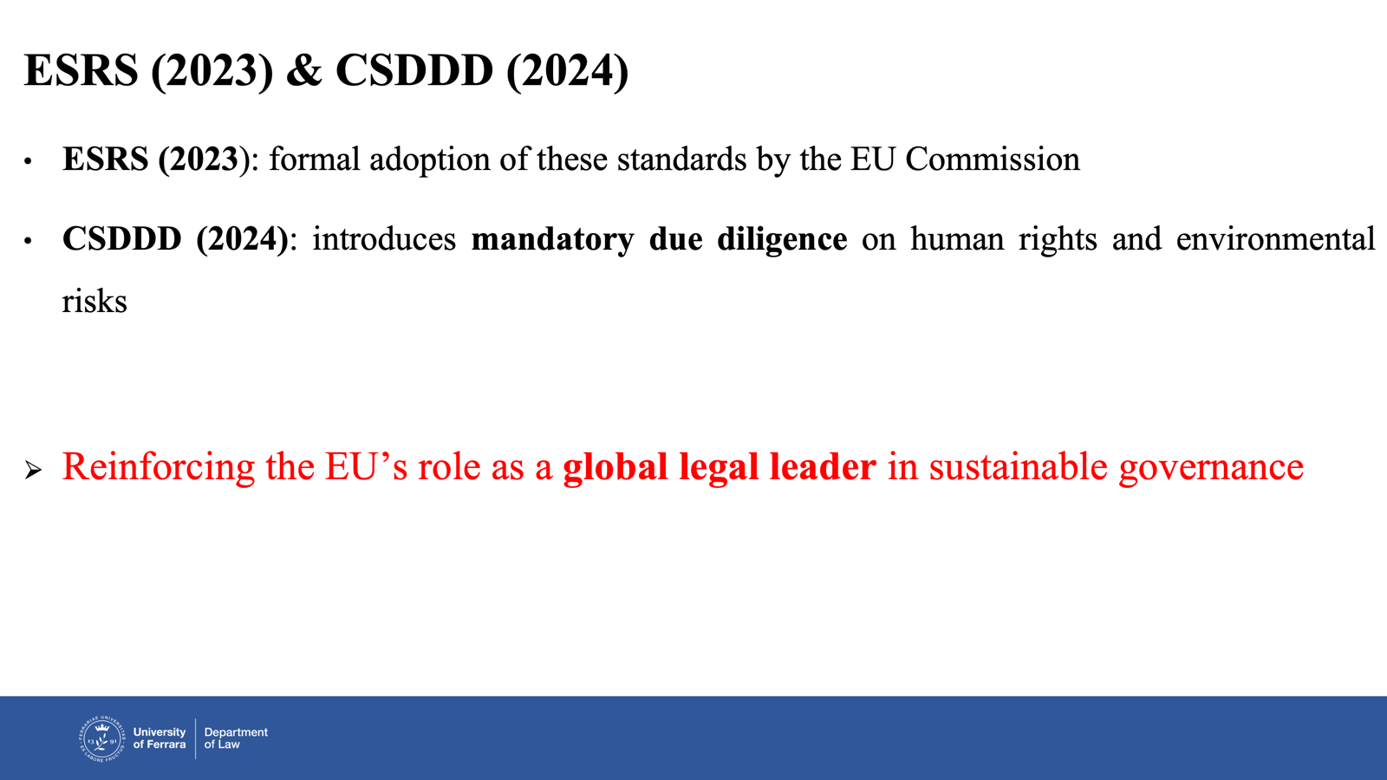

Slide 12


Slide 13
1.2. EU tax law & policy making Aligning ESG policy-making with SDG goals
Dániel Biró-Markovics
28th of April 2025, Ferrara

Slide 14
I. Introduction: The Role of Taxation in Achieving SDGs
1
Taxation is central to achieving the United Nations Sustainable Development Goals (SDGs).
The EU explicitly committed to the 2030 Agenda in its 2016 Communication (COM(2016) 739 final), promising to integrate SDGs across all policy areas, including taxation.
2
3
Fair taxation (governance and inequality, SDG 10 and 16), green taxation (environmental sustainability, SDG 13 and 12), and fostering sustainable investment (economic growth and innovation, SDG 8 and 9).
4
Fiscal policies are increasingly designed not just for revenue but to support sustainability, reduce inequality, and encourage responsible investment.

Slide 15
II. Linking Tax Policy to Sustainable Development in the EU
The Council of the EU emphasized in 2017 the need for a "comprehensive and integrated" implementation of the SDGs across EU activities (Council Conclusions, 20 June 2017).
The EU strategy combines binding legislation and soft-law coordination to realign fiscal policy with sustainability imperatives: | Combatting aggressive tax avoidance (SDG 16: Peace, Justice, and Strong Institutions). Promoting fair and transparent taxation (SDG 10: Reduced Inequalities). Steering investments towards green innovation and low-carbon economy (SDG 13: Climate Action).

Slide 16
III. Fair Taxation and Good Governance
Fair taxation is essential for financing public goods and reducing inequalities. Focus primarily on large corporations; SMEs are generally exempt.
EU legislative instruments include:
Directive (EU) 2016/1164 (Anti-Tax Avoidance Directive – ATAD I) and Directive (EU) 2017/952 (ATAD II) to combat base erosion and profit shifting (OECD BEPS). | Global Minimum Tax (Pillar 2): directive to ensure large multinational groups (turnover above €750m) pay at least a 15% effective tax rate in each jurisdiction they operate, as agreed by the OECD/G20 Inclusive Framework.
Directive (EU) 2021/2101 (Public Country-by-Country Reporting) imposes disclosure obligations on multinational enterprises with revenues over €750 million. | Relieving medium-sized enterprises (Directive (EU) 2022/2464 as amended).

Slide 17
IV. Tax Transparency as an ESG Governance Factor
1
Transparency initiatives such as Public Country-by-Country Reporting contribute to the “G” (Governance) in ESG.
Companies must publicly disclose income, taxes paid, and business activities in each EU Member State and specified third countries (Directive (EU) 2021/2101, Art. 48c of Directive 2013/34/EU as amended).
2
3
CSRD (Directive (EU) 2022/2464) and ESRS further embed tax responsibility into mandatory corporate sustainability reporting.
4
Tax behavior is now considered material for sustainability reporting under the double materiality principle (CSRD, Art. 19a and Recital 26).

Slide 18
V. Green Taxation and Environmental Sustainability
Fiscal measures are crucial for environmental policy and achieving SDG 13 (Climate Action).
Objective:​ | Correct price signals, incentivize decarbonization, and prevent carbon leakage.
Key initiatives:​ | Proposal for a revised Energy Taxation Directive (COM(2021) 563 final): Links minimum tax rates for energy products to their environmental performance; ETD (Directive 2003/96/EC) rates restructured based on energy content and environmental impact​ (carbon fuels <-> renewables) Carbon Border Adjustment Mechanism (CBAM) (Regulation (EU) 2023/956): Applies a carbon price on imports of carbon-intensive goods (e.g. steel, cement, fertilizers).

Slide 19
VI. EU Taxonomy and Sustainable Investment Incentives
Regulation (EU) 2020/852 (EU Taxonomy Regulation) establishes criteria for environmentally sustainable activities.
Companies investing in green activities benefit from lower tax burdens or financial advantages if aligned with Taxonomy criteria.
Indirect impact on taxation: | Governments can design tax incentives (e.g., tax credits, accelerated depreciation) for Taxonomy-aligned investments. Public subsidies and tax benefits must comply with the Taxonomy’s “substantial contribution” and “no significant harm” principles (Art. 3 and Art. 17).

Slide 20
VII. Impact on SMEs vs Large Corporations
Principle: Large companies lead sustainability reporting and fair taxation practices, SMEs are supported and protected to maintain competitiveness.
Heavier compliance duties on large corporations | Omnibus Package (2025 Proposal)
Large MNEs must comply with BEPS-related anti-avoidance rules and public reporting obligations. | Proposal to raise the CSRD reporting threshold to companies with more than 1000 employees.
CSRD obligations apply to large and listed companies; SMEs often enjoy deferred timelines or voluntary standards (Art. 29c CSRD). | Aims to relieve medium-sized enterprises (Directive (EU) 2022/2464 as amended).

Slide 21
Q&A

Slide 22
Tax competition in the environment of ESG and sustainable development

Slide 23
Can tax competition be used to shape corporate behaviour towards sustainability?

Slide 24
Europe’s sustainable prosperity and competitiveness
one of the goals for 2024-2029
includes the pillars of
green and digital transition
promoting innovations
supporting investments
How to achieve this goal?
need to encourage businesses to adopt sustainable practices

Slide 25
How to influence competitiveness
Instruments to attract or retain investment
business friendly environment, labour force and costs, geopolitical exposure, financial restrictions,... and
Tax landscape
negative stimulus
Pigouvian taxes, exit tax, withholding tax, higher tax rates, decreased depreciation,...
positive stimulus
tax incentives; super (double) deductions, tax credits, lower tax rates, increased depreciation, tax exemptions,...

Slide 26
Harmful tax competition and new forms of tax competition
Harmful tax competition
1998 OECD: Harmful Tax Competition, An Emerging Global Issue-Forum on Harmful Tax Practices
tax havens or harmful preferential tax regimes
BEPS – global minimum tax
New form of tax competition
among geopolitical blocks (or regulatory environments) rather then countries
environmental taxation

Slide 27
How taxes may change behaviour towards sustainability?
Pigouvian taxes vs. tax incentives
Key areas
innovation incentives (R&D tax credits)
green investment tax reliefs
environmental tax competition and green tax incentives
capital gains deferrals for reinvestment in startups
environmental tax competition and border adjustments: preventing relocation and carbon leakage

Slide 28
Green deal and Fit for 55
Mix of policy based and market based policies (such as taxes)
Main tax policies
align taxation with green priorities
removing harmful subsidies
Energy Taxation Directive
VAT rates
Inflation Reduction Act 2022
focus on tax incentives for clean energy x Green deal: CBAM and ETS II
but Trump ordered to resume IRA funding

Slide 29
Competitiveness Compas
Competitiveness Compass
trend of decluttering
main areas = innovation, decarbonisation and security
taxation harmonization
Omnibus Package
consolidation of regulation
simplification of sustainability reporting

Slide 30
Future considerations
Possible impact on corporate taxable income calculation
expansion or reduction of costs
transfer pricing
EU needs to remain competitive to have a ripple effect in relation to sustainable development
Do we need to lower environmental standards or increased coordination to remain competitive?

Slide 31
Discussion and Q&A

Slide 32
Impact of Global Minimum Tax on the ESG Incentives
Petr Milichovský
28th-29th of April 2025, Ferrara

Slide 33
Content
1.0 Legislative Framework
1.1 Global Minimum Tax
1.2 ESG Incentives
1.2.1 Framework of ESG Incentives
1.2.2 Types of ESG Incentives
2.0 The Clash
3.0 What can be done?
4.0 Discussion

Slide 34
1.1 Global Minimum Tax
OECD/G20 Inclusive Framework and EU Implementation
OECD/G20 Inclusive Framework agreement (October 2021) – "Pillar Two" of this global deal on international tax reform
The European Union formalized this through a Directive (approved December 2022)
This rapid adoption demonstrates the EU's commitment to addressing tax avoidance and ensuring large corporations pay a fair share regardless of where they operate.
Key Mechanisms and Scope
minimum effective tax rate of 15% for multinational enterprise groups with combined annual revenues exceeding €750 million
This should ensure that large corporations cannot use tax planning strategies to reduce their effective tax rates below the 15% threshold
The Undertaxed Payments Rule (UTPR): serves as a backstop when the IIR cannot be applied
The Income Inclusion Rule (IIR): allows a parent company's jurisdiction to impose top-up taxes when a subsidiary pays less than the minimum rate
The Undertaxed Payments Rule (UTPR): serves as a backstop when the IIR cannot be applied

Slide 35
1.2.1 Framework of ESG Incentives
EU Sustainable Finance Framework: The Taxonomy Regulation; The Sustainable Finance Disclosure Regulation (SFDR), The Corporate Sustainability Reporting Directive (CSRD) and European Sustainability Reporting Standards (ESRS)
Tax Incentives for Sustainability
Tax policy has become a powerful tool to drive investment in environmentally sustainable outcomes
Governments use tax measures to change the relative prices of sustainable versus unsustainable activities, thereby incentivizing market responses to achieve ESG objectives.
These incentives generally fall into three categories:
Incentives to reduce natural resource consumption Incentives to switch to renewable energy sources
Incentives to innovate low-carbon products and processes
1
2
3

Slide 36
1.2.2 Types of ESG Incentives
Incentive
Description
Examples
Accelerated Depreciation
Allows companies to deduct a higher percentage of asset costs in early years for qualifying green technologies (e.g., renewable energy infrastructure).
A solar farm operator might write off 40% of equipment costs in Year 1 instead of standard 20% depreciation, reducing taxable income
R&D Tax Credits
A company might apply super-deduction of 150% of R&D expenses
Super-deductions (e.g., 150% of R&D expenses) for sustainable innovation, such as carbon capture or circular economy technologies.
Concessionary Tax Rates
Reduced corporate tax rates for activities aligned with the EU Taxonomy (e.g., 10% rate for green hydrogen production vs. standard 25%).
Directly impacts ETR calculations under GMT.
10 % rate for green hydrogen production vs. standard 25 %
Tax Exemptions for Green Bonds
Interest income from EU Green Bonds is exempt from corporate tax, incentivizing sustainable capital markets
Regulatory Drivers
Corporate Sustainability Reporting Directive (CSRD): Mandates disclosure of tax incentives linked to ESG activities, increasing transparency
Revised Energy Taxation Directive: Aligns energy tax rates with carbon content, penalizing fossil fuels while subsidizing renewables

Slide 37
2.0 The Clash
The GMT has been specifically designed to eliminate rate-based tax competition between jurisdictions, regardless of the objective behind the tax incentives.
Under the Global Anti-Base Erosion (GLoBE) rules, if a tax incentive reduces a multinational's effective tax rate below 15% in a particular jurisdiction, a top-up tax will be applied
🡪 This effectively dilutes or neutralizes the financial benefit of many sustainability-focused tax incentives
According to the EY Green Tax Tracker, there are more than 1,850 sustainability tax incentives globally that could be affected by the GMT
This creates significant challenges for:
EU policymakers who have relied on tax incentives as a key tool to catalyze private sector investment in sustainability
Companies that have built their ESG and tax strategies around these incentives
The overall achievement of climate neutrality goals by 2050

Slide 38
3.0 What can be done?
Redesigning ESG Incentives to be GMT-Compatible
The OECD framework does provide for certain exceptions – the main one = Qualified Refundable Tax Credits
EU member states could reformulate their existing tax incentives to fit within these exceptions, maintaining their effectiveness while complying with GMT requirements.
Alternative Non-Tax Incentive Mechanisms
To address the clash, the EU could shift focus from tax-based incentives to:
Direct grants and subsidies
Preferential access to financing through sustainable finance instruments
Regulatory incentives such as fast-track permitting for sustainable projects
Preferential treatment in public procurement processes

Slide 39

Discussion
How might the EU best redesign existing ESG tax incentives to maintain their effectiveness while complying with GMT requirements?
What alternative non-tax incentive mechanisms could prove most effective in driving sustainable investment in the post-GMT landscape?
Should certain types of sustainability investments receive special treatment or exemptions under the GMT framework, and if so, how would this be justified?
How might the tension between GMT and ESG incentives affect the competitiveness of EU businesses compared to those in regions with different approaches?

