Slide 1


BUILDING FOR ALL:
Connecting Inclusive Practices To Improve
the Built Environment and Beyond
EMMA WINISKI, Oklahoma City Government
AME SANDERS, State of Inclusion

Slide 2
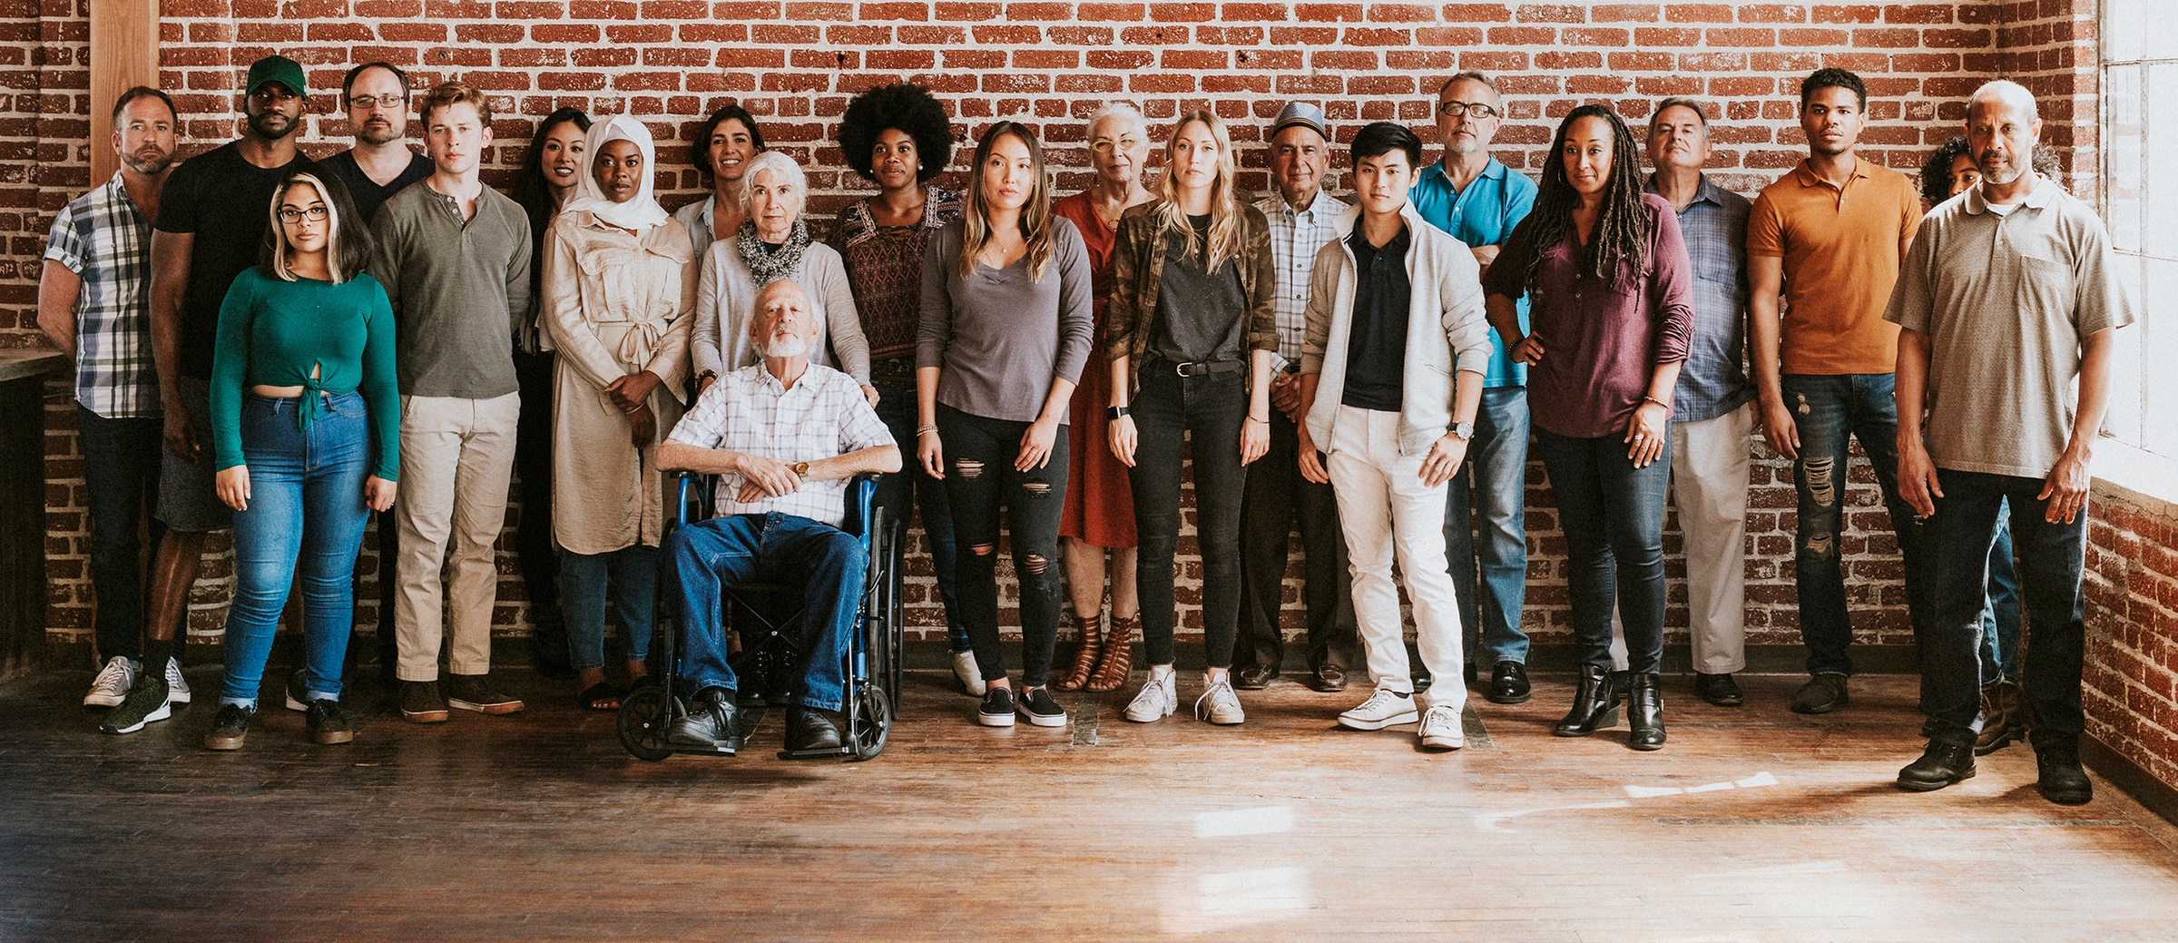
What are communities doing to address these staggering inequities?

Slide 3
What Did We Find?
Uncovered beautiful and bountiful equity work happening in communities all across our country
Recognized building a more inclusive and equitable community is in every way an inside job
Confirmed there is no recipe or formula or best way

Slide 4
Identified six practices for building a more inclusive community

Slide 5
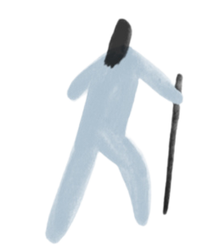

PRACTICES
SELF WORK
Look inward before looking outward.
Cycle:
Wake Up
Listen Up
Open Up
Speak Up
Step Up
Get Back Up
Rest Up

Slide 6
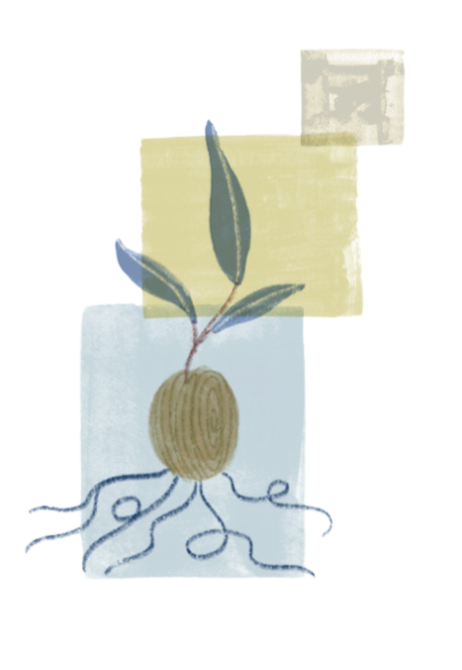
PRACTICES
SELF WORK
Look inward before looking outward.
GROUNDWORK
Prepare the community soil for the work of equity and inclusion to take root.
Includes:
Community Learning
Preparing the Heart
Shifting the Culture
Emergence

Slide 7
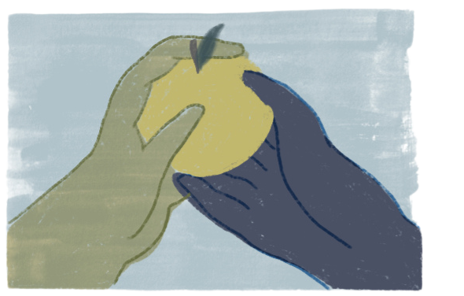
PRACTICES
SELF WORK
Look inward before looking outward.
GROUNDWORK
Prepare the community soil for the work of equity and inclusion to take root.
PROGRAM WORK
Includes:
Measuring, Analyzing, Diagnosing
Mobilizing for Action
Building Momentum
Communication & Change Management
Stimulating, Advocating, Demonstrating
Catalyze systemic change to advance progress toward equity and inclusion.

Slide 8
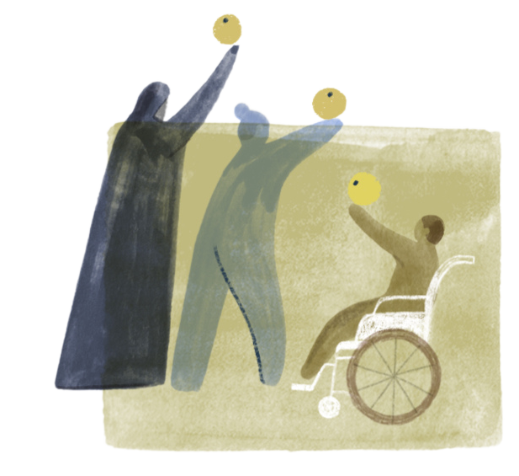
PRACTICES
COALITION WORK
SELF WORK
Look inward before looking outward.
Weave institutions and initiatives together to strengthen equity outcomes.
GROUNDWORK
Includes:
Engaging
Aligning
Working together across disparate structures, organizations, and teams
Prepare the community soil for the work of equity and inclusion to take root.
PROGRAM WORK
Catalyze systemic change to advance progress toward equity and inclusion.

Slide 9

PRACTICES
COALITION WORK
SELF WORK
Look inward before looking outward.
Weave institutions and initiatives together to strengthen equity outcomes.
GROUNDWORK
SYSTEMS WORK
Prepare the community soil for the work of equity and inclusion to take root.
Create lasting change from
the inside out.
Changing:
Policies
Practices
Structures
Incentives
PROGRAM WORK
Catalyze systemic change to advance progress toward equity and inclusion.

Slide 10

PRACTICES
COALITION WORK
SELF WORK
Look inward before looking outward.
Weave institutions and initiatives together to strengthen equity outcomes.
GROUNDWORK
SYSTEMS WORK
Prepare the community soil for the work of equity and inclusion to take root.
Create lasting change from
the inside out.
PROGRAM WORK
ECOSYSTEM WORK
Catalyze systemic change to advance progress toward equity and inclusion.
Build equity fascia for the community.

Slide 11

Oklahoma City Government
Equity Practices at Work

Slide 12
GENERAL OBLIGATION (GO) BOND
Funded by property taxes
Wide range of capital improvement projects
Every ~10 years

Slide 13
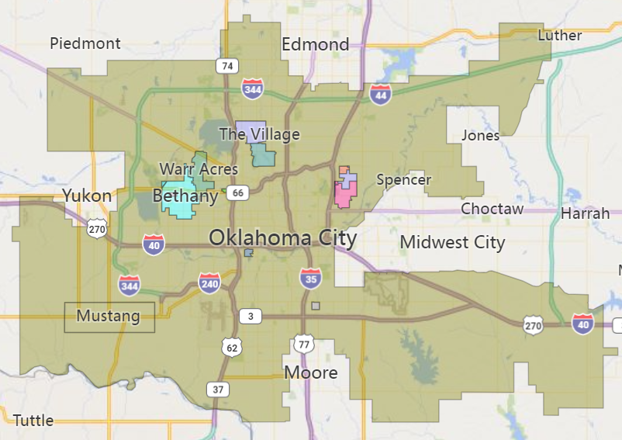

Slide 14
Planning
Public Engagement
Preparing for the Vote
TIMELINE:
Months:
0-9
10-18
18-24

Slide 15
Vision.
okc.gov
Pop-up Events
Survey
Neigh-borhood Meetings
Ward
Open House
Virtual Town Hall
Flyers with QR Codes
General City Commun-ications
ACTIVITIES:

Slide 16
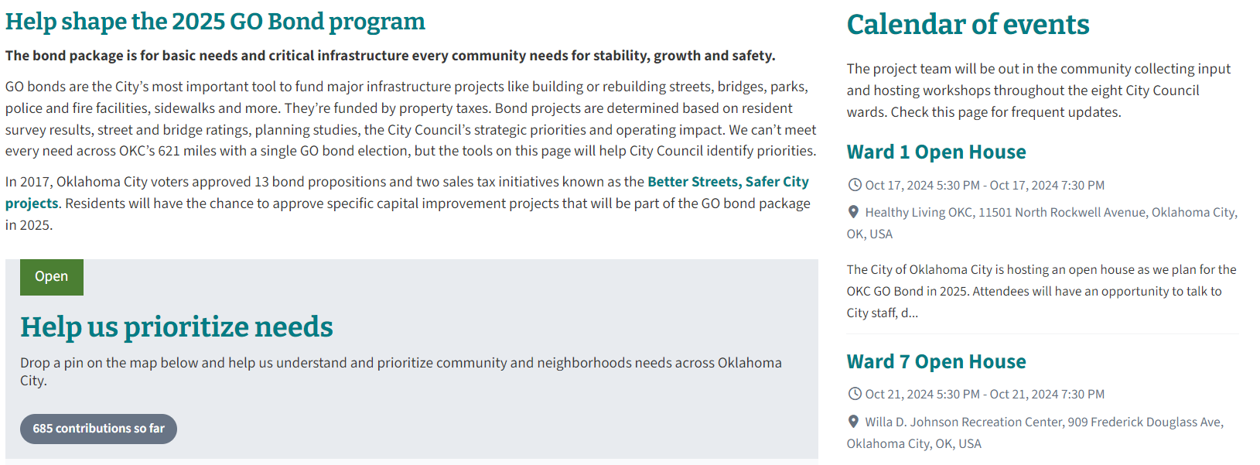

Slide 17
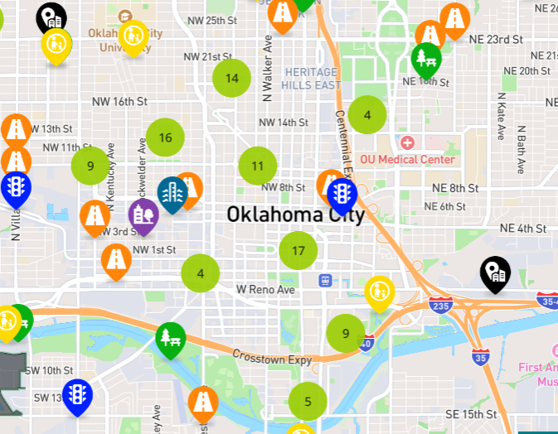

Slide 18
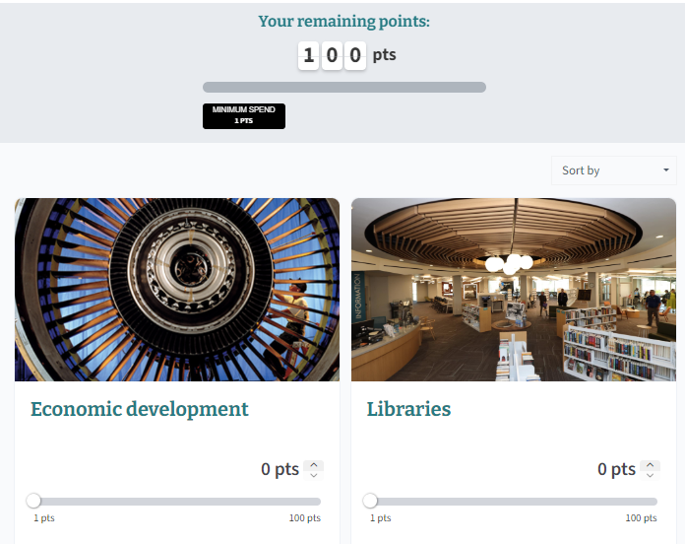

Slide 19
IMPROVEMENT AREAS:
Streets and Sidewalks
Traffic Control
Drainage
Bridges
Parks and Recreation
Fire and Police
Libraries
Transit
Economic Development

Slide 20
PRIORITIZATION METHOD (example):
Fire Department:
Determine Needs and Projects
        Provides List of Projects to Go Bond Program
Prioritize Projects
        Director (Chief) Prioritizes Projects
        Sends to Public Works

Slide 21
PRIORITIZATION CRITERIA:
Functional Need (25%)
Equity (15%)
Projected population served (15%)
Policy considerations (10%)
Funding availability (5%)
Prior funding (5%)
System Enhancement (10%)
Current population served (15%)

Slide 22
OVERALL GOALS:
Broaden view of capital projects
Include context of communities around projects’ physical locations

Slide 23
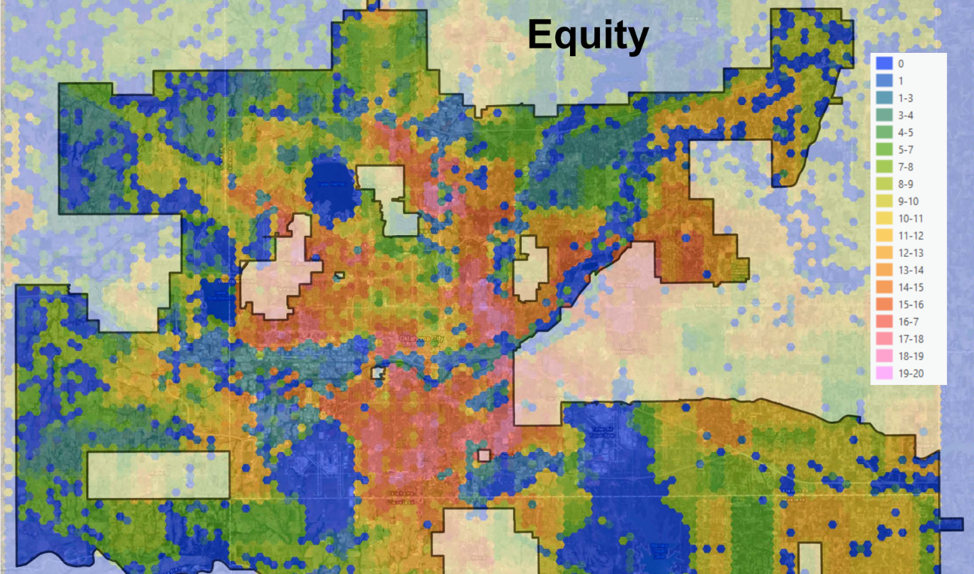

Slide 24
SCORING (EXAMPLE):
Fire Department & Logistics Facility – Rebuild/Expansion
Consideration | Score Range | Score | Weight Factor | Total Points
Responsive Populations and Equity: Project Serves Disadvantaged
High Equity Score: Greater than 10 | 5 | 5 | 2 | 10
Medium Equity Score: 5-10 | 5
Low Equity Score: Less than 5 | 1

Slide 25
PRIORITIZATION CRITERIA:
Functional Need (25%)
Equity (15%)
Projected population served (15%)
Policy considerations (10%)
Funding availability (5%)
Prior funding (5%)
System Enhancement (10%)
Current population served (15%)

Slide 26

Community Engagement Strategic Plan

Slide 27
SPECTRUM OF PUBLIC PARTICIPATION
(IAP2)
Empower
Consult
Inform
Collaborate
Involve

Slide 28
PRACTICES
COALITION WORK
SELF WORK
Look inward before looking outward.
Weave institutions and initiatives together to strengthen equity outcomes.
GROUNDWORK
SYSTEMS WORK
Prepare the community soil for the work of equity and inclusion to take root.
Create lasting change from
the inside out.
PROGRAM WORK
ECOSYSTEM WORK
Catalyze systemic change to advance progress toward equity and inclusion.
Build equity fascia for the community.

Slide 29
Breakout (15 min)
Topic 1: Are you using an equity lens in your community to prioritize and direct funding for the built environment? In other types of community planning? How so?
Topic 2: Which of the six practice areas do you feel is most relevant to your work? How can you better integrate across practice areas to strengthen your work?

Slide 30
DEBRIEF

Slide 31
Q&A

Slide 32
CONCLUSIONS
Act creatively: See roadblocks as redirections.
Act strategically: Use the Six Practices together to effect change.
Act collaboratively: Build community and take care of each other.

Slide 33

THANK YOU!!
Please share your feedback with us:
Reach Out To:
Learn more or get help using the Six Practices Framework
Create an Equity Ecosystem Map
Conduct a Team Self Work Assessment & planning session
Recommend a guest for the podcast

