Slide 1


Cybersecurity Canvas
by Vincent van Dijk
Created in collaboration with

Slide 2
Steps
1
Use the premade basic canvas or build your own
canvas based on the needs of your company
2
Use workshops to collect the thoughts of decision- makers, and the people that implement controls
3
Fill in the canvas
Good luck managing Cyber Risks
For questions or support, contact me at vincent@securityscientist.net

Slide 3

Cybersecurity Canvas — BASIC
Company
Measures
Business context
Protective technology
Why did the company start the initiative to improve cybersecurity?​
Which protective technology does your company have? (ex. antivirus, firewalls, etc.)​
Context
Implemented Measure
Company-risks
Which risks, which are not cyber-related, might hurt your company? (ex. failure to acquire funding, completion risks, etc.)​
Identity and access
How are roles and permissions implemented in your company? (ex. role based access, quarterly check-up)​
Cyber-risks
Not
implemented
Which most important cyber-risks might hurt your company?​

Slide 4

EXAMPLE — Small Online Retailer
Company
Measures
Business context
Why did the company start the initiative to improve cybersecurity?
Protective technology
Which protective technology does your company have? (ex. antivirus, firewalls, etc.)
Shareholders are afraid that money is stolen
Customers expect a safe and secure online store
Creditcard processing through secure third party
Firewalls
Ant-virus
Web Application Firewall
Company-risks
Which risks, which are not cyber-related, might hurt your company? (ex. failure to acquire funding, completion risks, etc.)
Backups
Suppliers are unable to transport our products
Identity and access
How are roles and permissions implemented in your company? (ex. role based access, quarterly check-up)
Loss of reputation due to low customer ratings
Cyber-risks
Which most important cyber-risks might hurt your company?
Access to the production environment is restricted
Supplier's access is restricted
Admin access is restricted and regurally reviewed
Losing resources through ransomware
Customer's creditcard detailsbeing stolen

Slide 5

CUSTOM EXAMPLE — Small IT Service Provider
Company
Measures
Business context
Why did the company start the initiative to improve cybersecurity?
Protective technology
Which protective technology does your company have? (ex. antivirus, firewalls, etc.)
Other IT Service providers have suffering extensive cyber incidents
Customers are demanding higher security standards
Firewalls
Ant-virus
Company-risks
Which risks, which are not cyber-related, might hurt your company? (ex. failure to acquire funding, completion risks, etc.)
Identity and access
How are roles and permissions implemented in your company? (ex. role based access, quarterly check-up)
Employees mistakes result in claims
Unable to recruit new people to support growth
Access to the production environment is restricted
Admin access is restricted and regurally reviewed
Cyber-risks
Which most important cyber-risks might hurt your company?
Awareness and training
The company personal has admin access to customer's sensitive data, the access is required and cannot be further restricted. Training is required.
Mistakes of employees
Loss of customer data
On-demand cybersecurity training
Montly cyber training

Slide 6
Catalog
The catalog provides you with pre-defined components you can use in your canvas.
Company
Components you can use to organize the business side of the canvas. These components are examples. It is promoted to create your own components if it helps you better express the business's context.
Business context
Company-risks
Customer demands
Cyber-risks
Regulations
Industry requirements
Measures
The measure categories are sorted based on the perceived effectiveness and ease of implementation from research among experts. You can use these categories or create your own. All the categories are based on the NIST Cybersecurity Framework.
1.
2.
3.
4.
5.
Protective Technology
6.
7.
8.
9.
10.
Data security
11.
12.
13.
Risk Management Strategy
Identity & Access
Incident Management
Detection processes
Awareness & Training
Maintenance
Governance
Asset Management
Events and Anomalies
Supply Chain
Information Processes

Slide 7
Copy & Paste
Empty components you can use to really customize your cybersecurity canvas.
<company>
< description>​
<measure>
< description>​
<note>
<note>
<note>
1
1
<step>
<step>

Slide 8
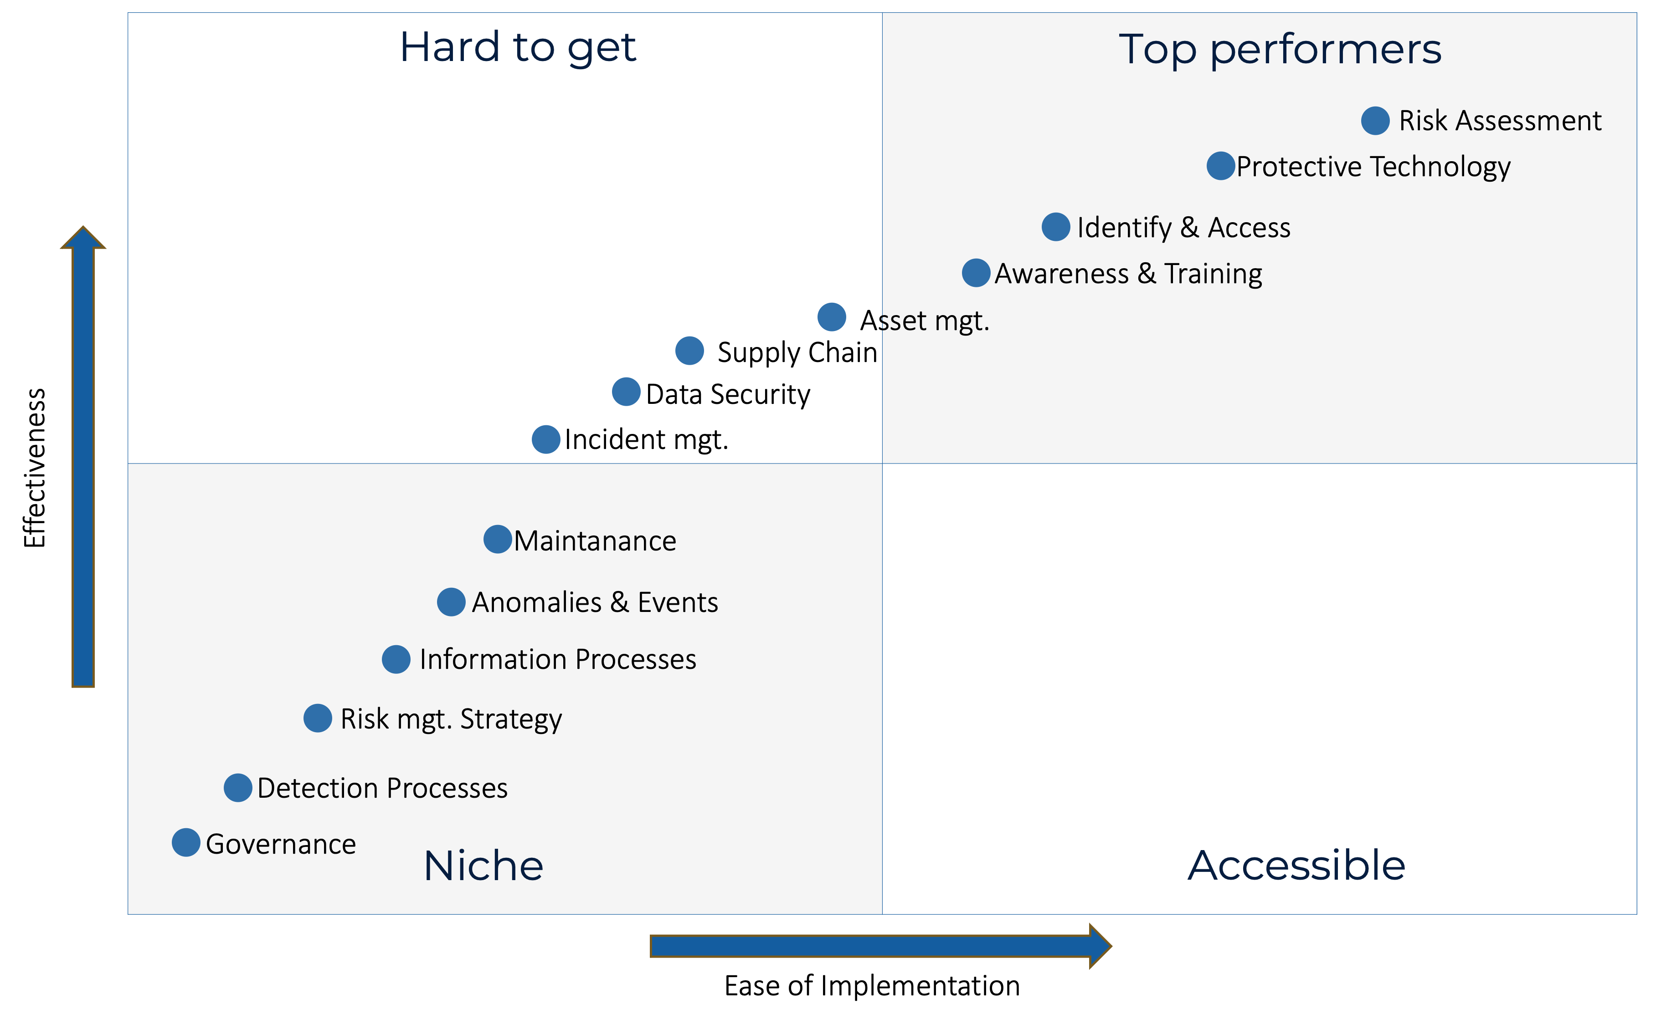
BONUS - SMB Cybersecurity Quadrant
The SMB Cybersecurity Quadrant shows you which categories are most effective to manage cybersecurity risks for SMB.

Slide 9
Good luck managing Cyber Risks
For questions or support, contact me at vincent@securityscientist.net

