Slide 1

How To Bring Memes Into Your Classrooms
PD session
With support from

Slide 2
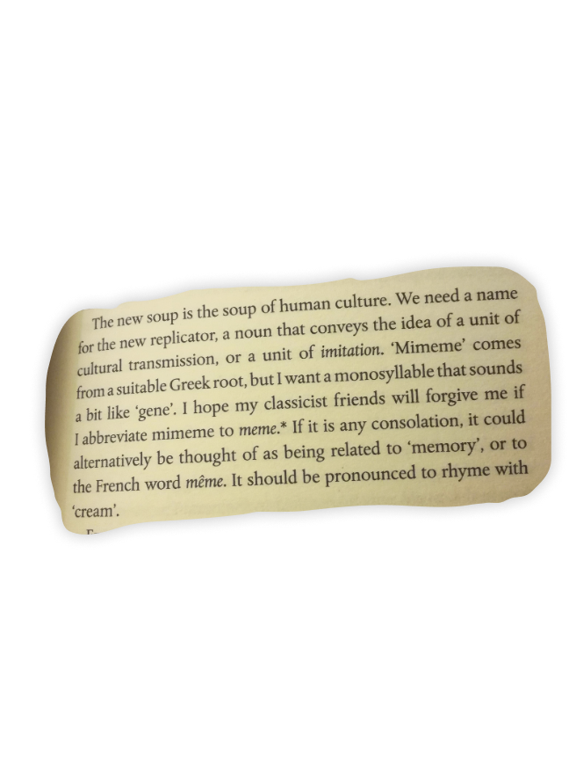
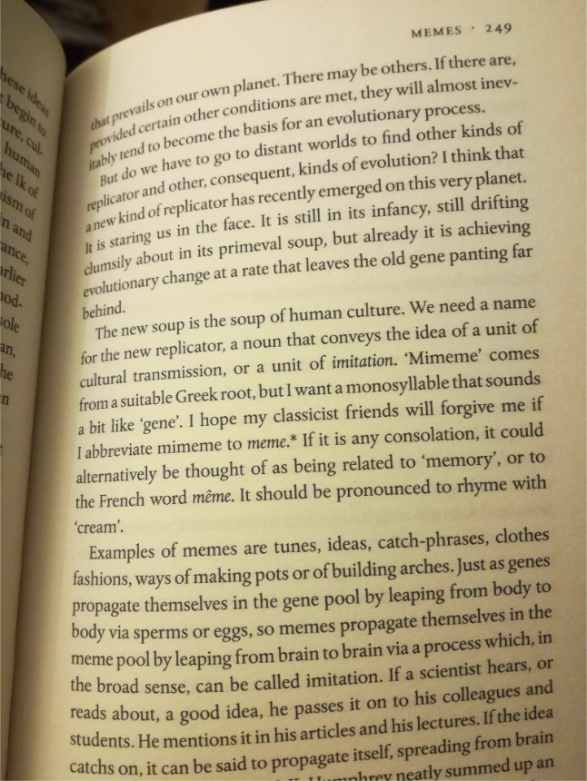

Fun fact!
The term “meme” was coined by biologist Richard Dawkins in The Selfish Gene

Slide 3

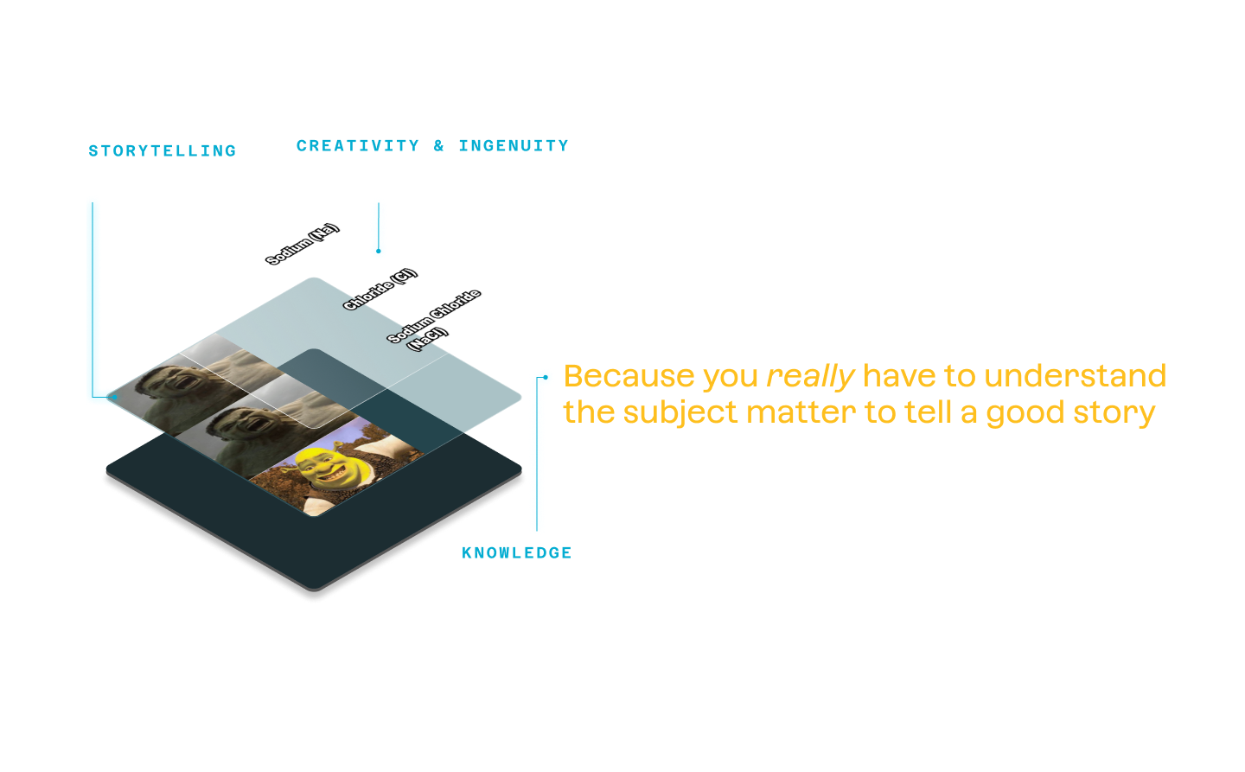
Memes aren’t just a gag. They’re puzzle-like stories.
Image Source: Antimatter

Slide 4
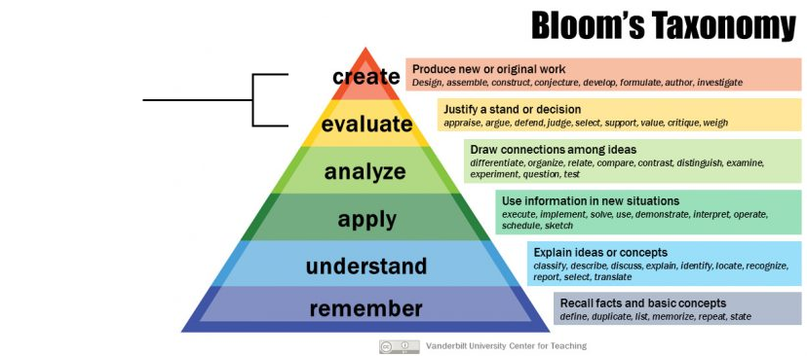
Bloom’s Taxonomy & Memes
Teachers ask their students to create memes for formative assessment
And because memes are puzzles, they prompt a rich discussion

Slide 5


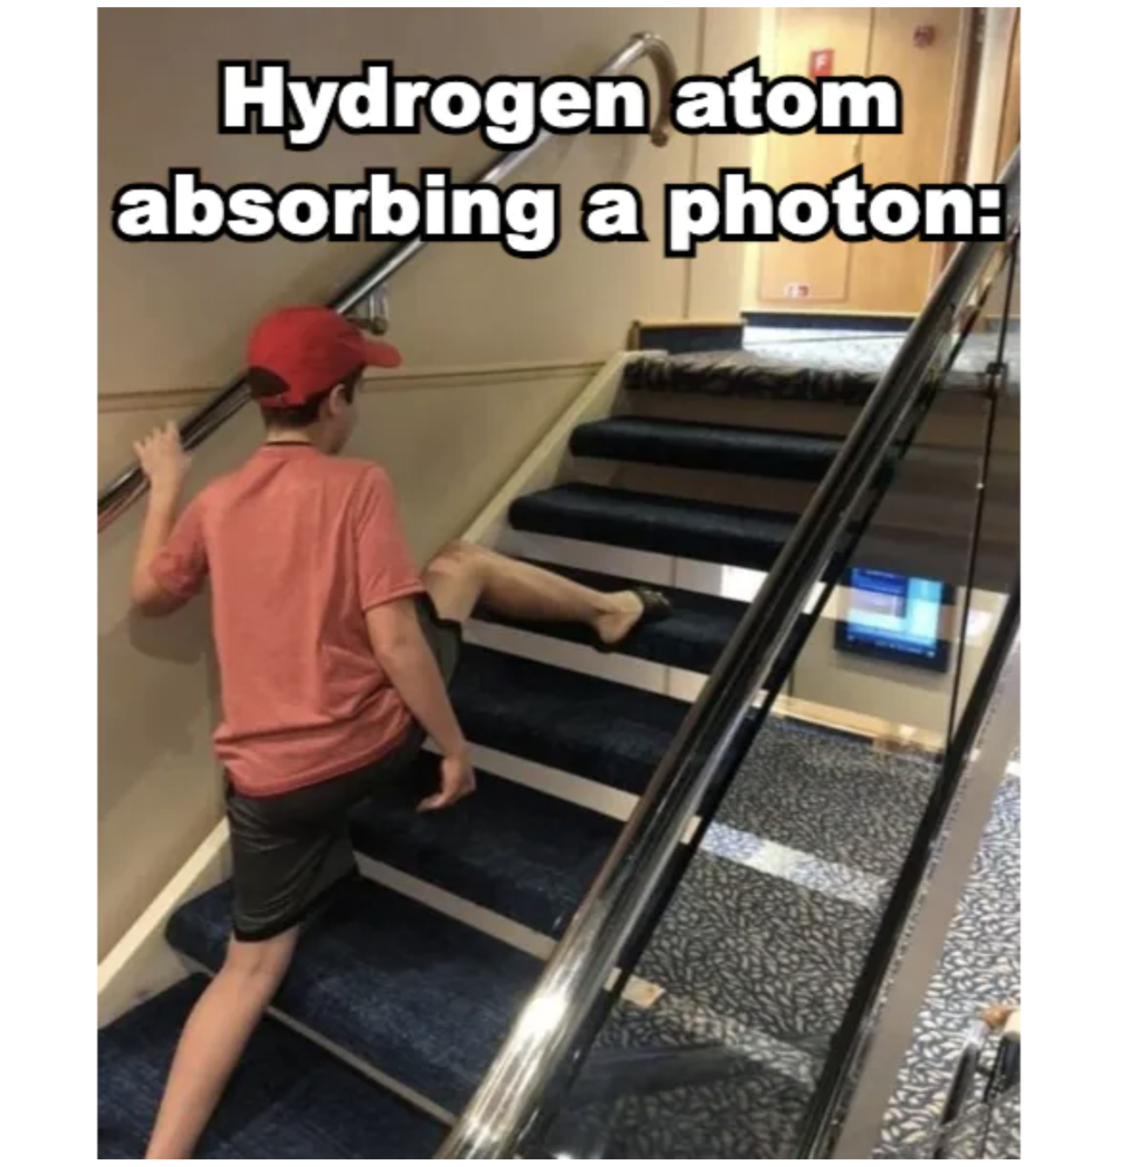
The three types of learning memes
Camaraderie
Knowledge/terms
Storytelling
Fostering camaraderie among students enhances engagement and participation
Memes are memorable, making them ideal for test review and building foundational knowledge
Memes possess a magnetic storytelling capacity that captivates students' attention and interest. They have the power to convey concepts in concise and engaging manner.

Slide 6
How to use memes in the classroom
Classroom Ideas
Teacher Tips
Ask students to “teach an idea with memes”
Ask students to “ruin a meme” by explaining why it’s funny
Put a meme on the board as students walk in
Review activity
Homework assignment
Meme competitions
Discuss content expectations
Give specific instructions
Use moderation tools
Have students attach resources where one could go if they don’t “get” a meme

Slide 7
Thank you for listening! Any questions so far?

Slide 8
Antimatter Activities

Slide 9
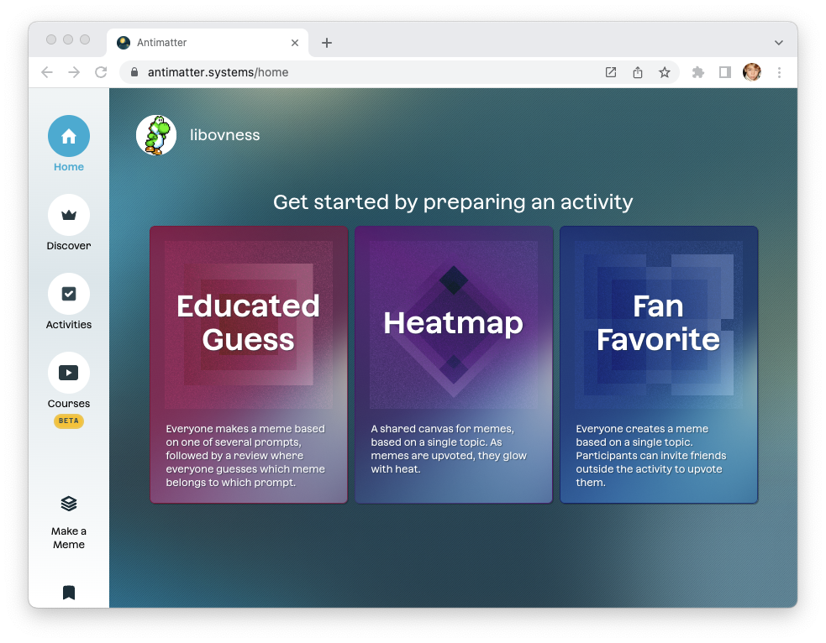
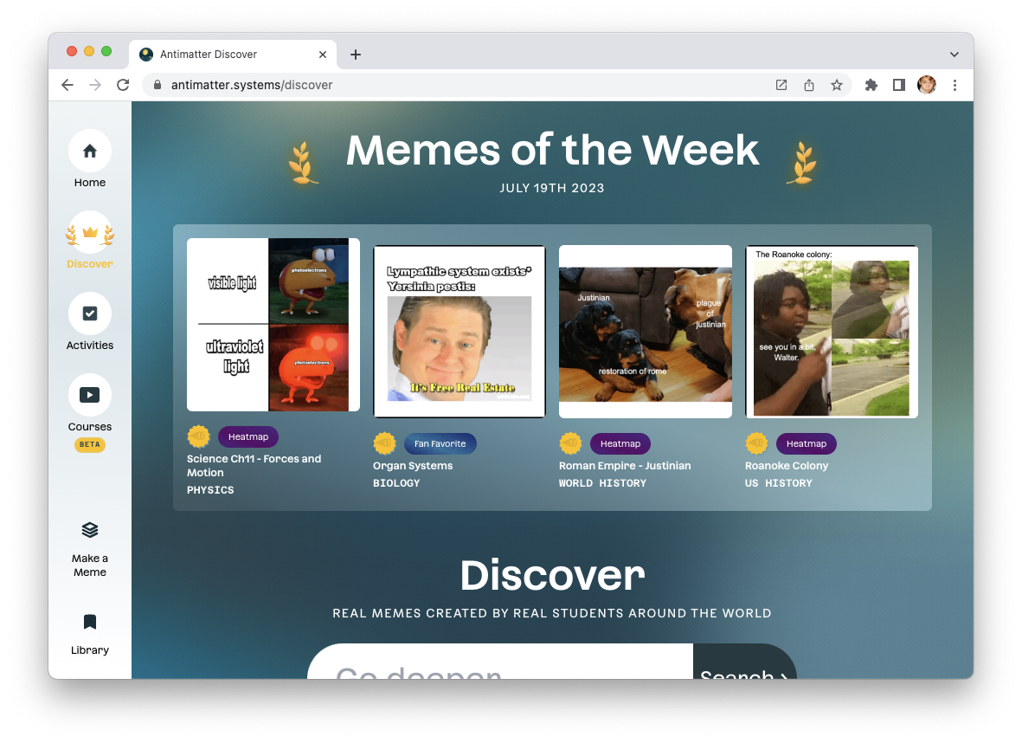
Antimatter is a platform for teaching and learning through memes

Slide 10
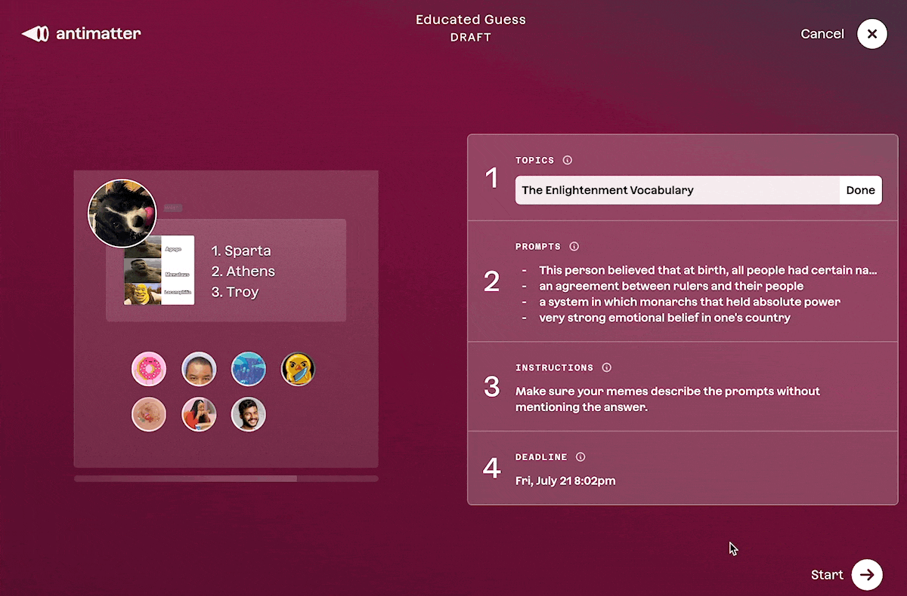
Setup is quick & easy

Slide 11
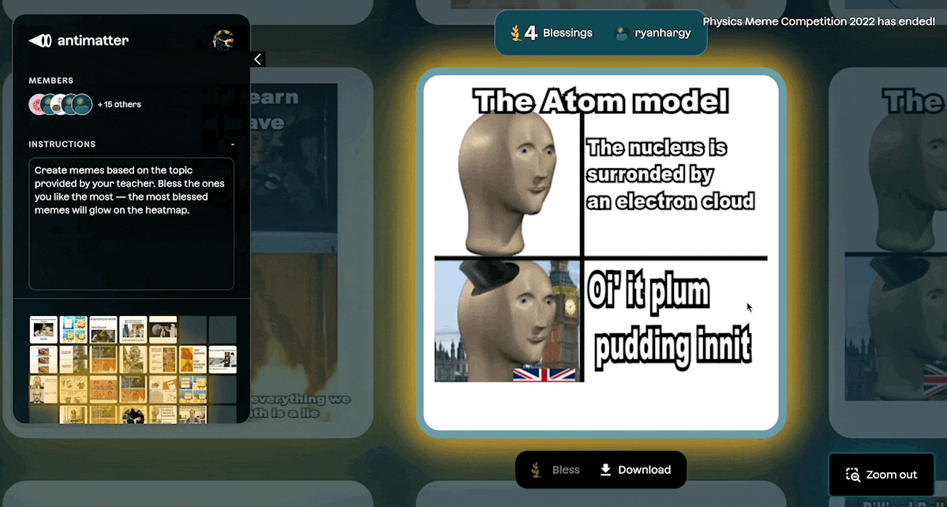
Students love to compete and compare

Slide 12
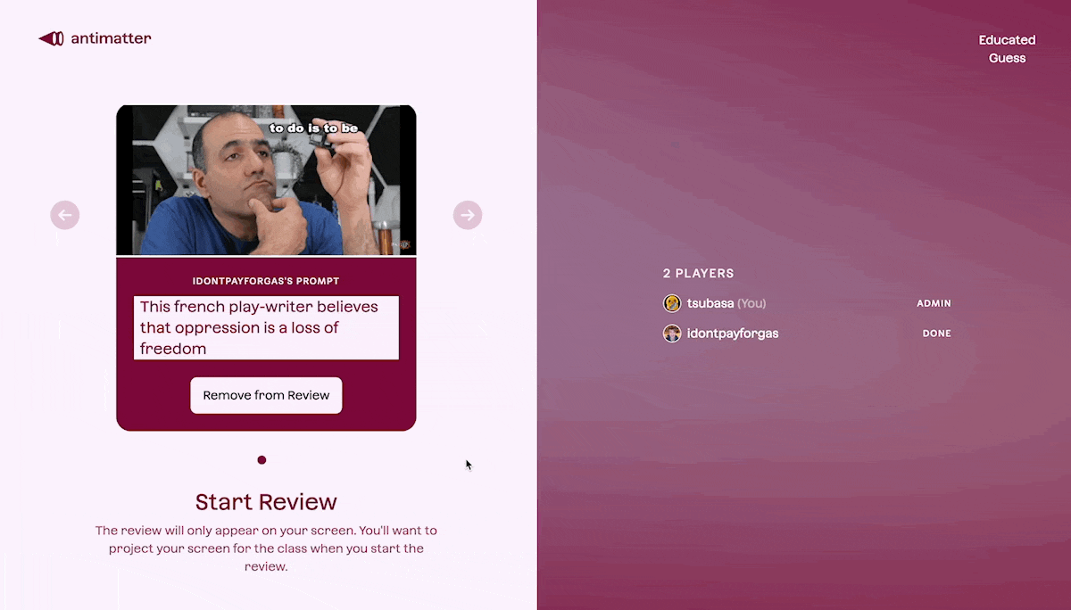
At the end of activities, the classroom reviews

