Slide 1
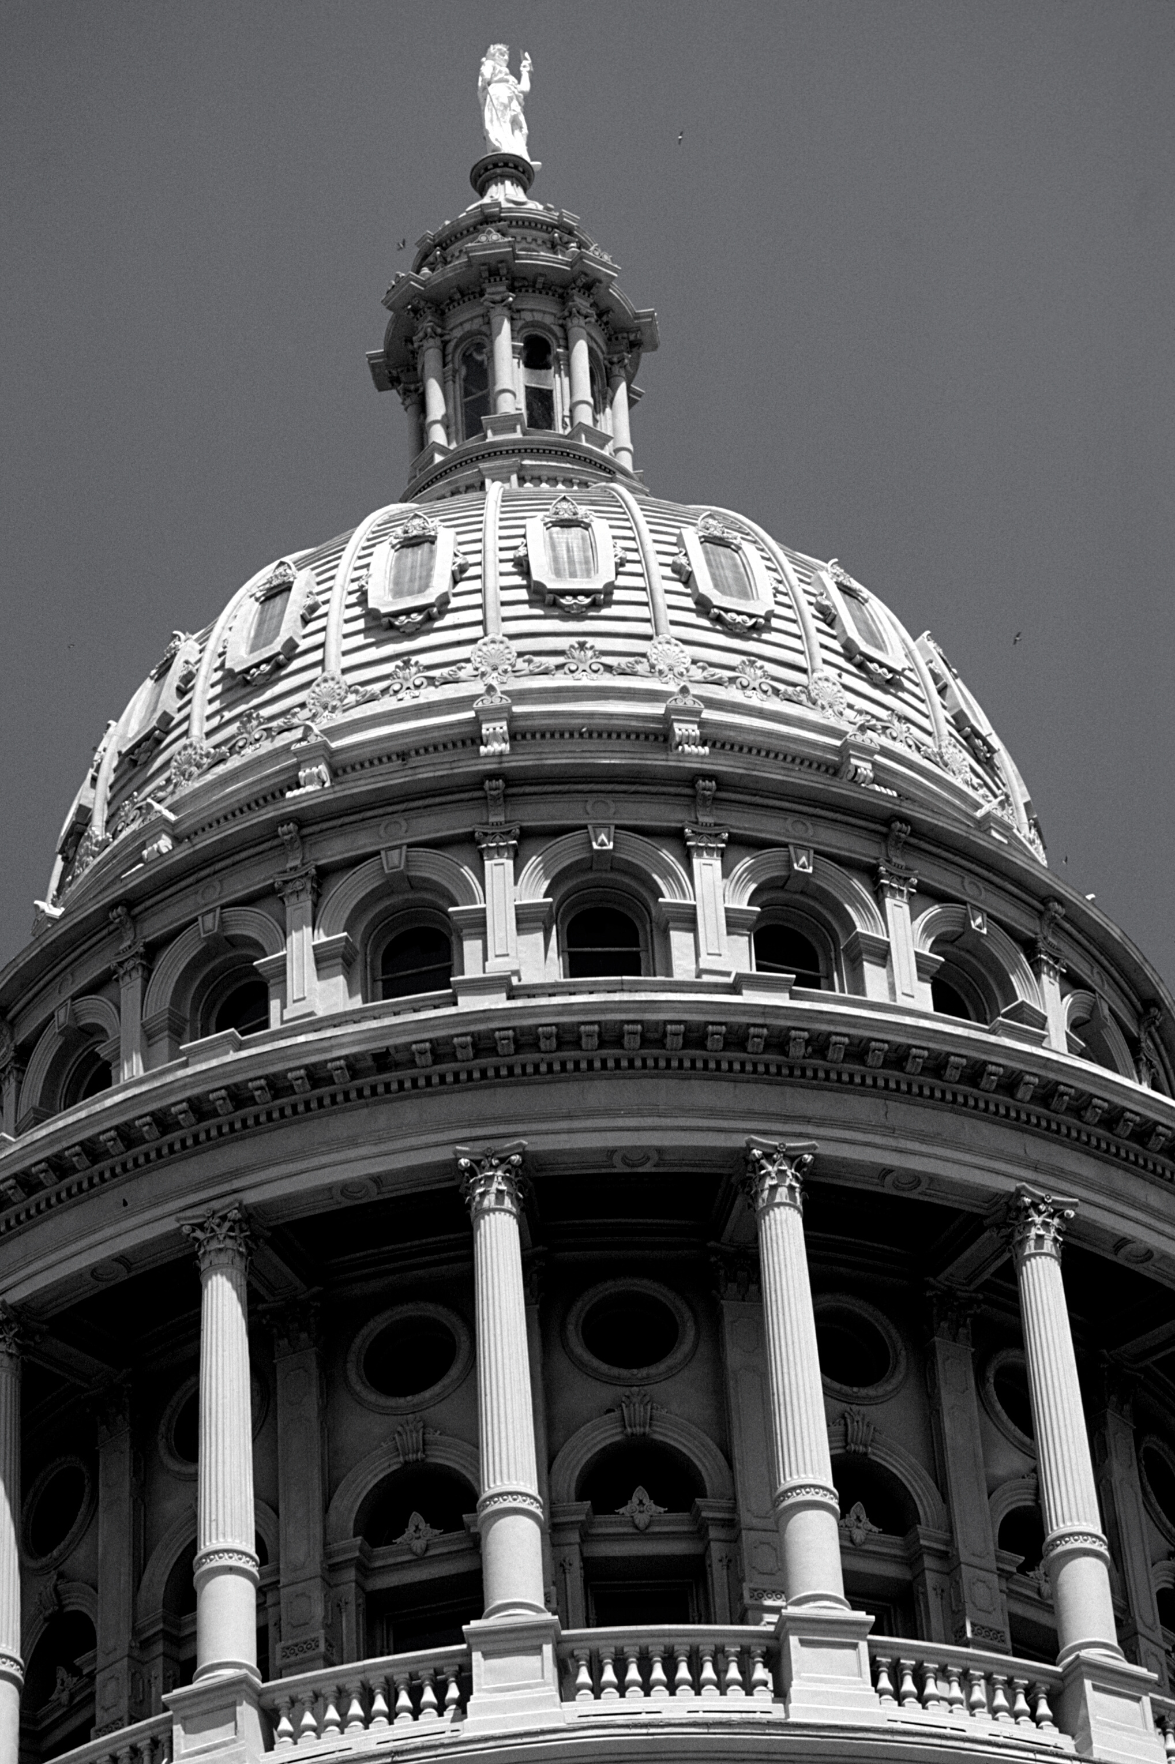
Texas State Board of Pharmacy
TEXAS STATE BOARD OF PHARMACY
Laws and Rules Update
Synthia Hill, PharmD, RPh
Compliance Officer - Austin Region
VAPha
October 16, 2024

Slide 2



Goals
Rules
Identify recent changes in Texas pharmacy rules
Important Updates
TEXAS STATE BOARD OF PHARMACY
Review highlights regarding pharmacy-related news, including CE and legislation
Reminders
Fingerprinting process for the renewal of pharmacist’s license
PMP
Discuss the Prescription Monitoring Program at the Texas State Board of Pharmacy
Notes:
Today I will review recent changes in Texas pharmacy laws and rules and their impact on daily practice.
I will also talk about important updates related to the practice of pharmacy in Texas, and discuss the Texas Prescription Monitoring Program.

Slide 3

Board Members
JULIE SPIER, RPH
BRADLEY A. MILLER, PH.T.R
JENNY DOWNING YOAKUM, RPH
President - Katy
Vice President - Austin
Treasurer - Kilgore
RICK FERNANDEZ, RPH
SUZETTE TIJERINA, RPH
Argyle
Castle Hills
TEXAS STATE BOARD OF PHARMACY
RANDY MARTIN, RPH, PHARMD
IAN SHAW
Fort Worth
Dallas
DONNIE LEWIS, RPH
GARRETT MARQUIS
Athens
Dallas
DONNA MONTEMAYOR
RICK TISCH
San Antonio
Spring
DANIEL R. CARROLL, PHARMD, RPH
Executive Director/Secretary
Notes:
We have eleven Board members appointed by the governor. Seven of our Board members are pharmacists, one of our Board members is a pharmacy technician, and there are three public members. They meet quarterly for our scheduled Board meetings.

Slide 4

Rules Regarding the
Operation of a Pharmacy
Notes:
I’ll first discuss some changes to rules regarding the operation of a pharmacy

Slide 5

Amendments Related to Non-Sterile Compounding
Board Rule §291.131
TEXAS STATE BOARD OF PHARMACY
The amendments update the personnel, environment, labeling, compounding process, quality assurance, and recordkeeping requirements for pharmacies compounding nonsterile preparations.
Adopted: May 2024
Effective: June 2024
Notes:
The other May 2024 adoption amends §291.131.
The amendments update the personnel, environment, labeling, compounding process, quality assurance, and recordkeeping requirements for pharmacies compounding nonsterile preparations.
These amendments were adopted after recommendations were made to the Board from the Compounding Rules Advisory Group in light of the recent USP 795 updates.

Slide 6

Rule Concerning Delivery of Prescription Drugs.
Board Rule §291.12
TEXAS STATE BOARD OF PHARMACY
The rule specifies requirements for the delivery of prescription drugs to a patient or patient’s agent.
Adopted: May 2024
Effective: June 2024
Notes:
Moving back, the first May 2024 adoption is §291.12.
This section applies to the delivery of prescription drugs by a pharmacy licensed by the board as a Class A, Class A-S, Class E, or Class E-S pharmacy.
This rule outlines requirements for delivery standards, packaging, temperature, counseling, notifications, compromised deliveries, records and controlled substances for prescription delivery via common carrier, pharmacy employee, or same-day courier service.

Slide 7
Rule Concerning Delivery of Prescription Drugs.
Board Rule §291.12
TEXAS STATE BOARD OF PHARMACY
The rule specifies requirements for the delivery of prescription drugs to a patient or patient’s agent.
Adopted: May 2024
Effective: June 2024
Notes:
Moving back, the first May 2024 adoption is §291.12.
This section applies to the delivery of prescription drugs by a pharmacy licensed by the board as a Class A, Class A-S, Class E, or Class E-S pharmacy.
This rule outlines requirements for delivery standards, packaging, temperature, counseling, notifications, compromised deliveries, records and controlled substances for prescription delivery via common carrier, pharmacy employee, or same-day courier service.

Slide 8
Temporary Closure of a Pharmacy – No PIC
Board Rule §291.3
Board Rule §291.5
Required Notifications
Closing a Pharmacy
TEXAS STATE BOARD OF PHARMACY
The amendments clarify that a pharmacy must notify the board in writing if the pharmacy temporarily closes for the loss of a pharmacist-in-charge and clarify the notification requirements for amending a pharmacy license.
The amendments provide that a pharmacy may temporarily close -no longer than 30 days - for the loss of a pharmacist-in-charge if the pharmacy timely notifies the board in writing of the temporary closure.
a pharmacy must submit the notification not later than the next business day after the departure of the pharmacist-in-charge.
Adopted: November 2023
Effective: December 4, 2023
Notes:
The next amendments were related to temporary closing of a pharmacy.
The first rule is 291.3, which relates to required notifications. The amendments clarify that a pharmacy must notify the board in writing in the pharmacy temporarily closes for the loss of a PIC.
The second rule affected is 291.5, related to closing a pharmacy. The amendments allow a pharmacy to TEMPORARILY close for the loss of a PIC IF the pharmacy gives timely notification to the Board in writing of the closure.
(2) A pharmacy may temporarily close for lack of a pharmacist-in-charge for no more than 30 days.
If a pharmacy temporarily closes for lack of a pharmacist-in-charge, the pharmacy shall: (A) only allow access to the prescription department if a pharmacist is present; (B) send notification to the board as specified in §291.3(k) of this title (relating to Required Notifications); and (C) either: (i) reopen within 48 hours under the supervision of a new pharmacist-in-charge who has been reported to the board as specified in §291.3(e)(2) of this title; or (ii) comply with the provisions of subsection (a) of this section as far in advance of the closing as allowed by the circumstances.

Slide 9
Temporary Closure of a Pharmacy – No PIC (cont.)
If a pharmacy temporarily closes for lack of a pharmacist-in-charge, the pharmacy must:
  only allow access to the prescription department if a pharmacist is present;
  send a notification to the board; and
  either:
    reopen within 48 hours under the supervision of a new pharmacist-in-charge who has been reported the change to the board; or
    comply with regulation regarding permanently closing a pharmacy
TEXAS STATE BOARD OF PHARMACY

Slide 10


Class C Pharmacy Located in a Freestanding Ambulatory Surgery Center (ASC)
Board Rule §291.76
The amendments clarify that a pharmacist must verify the completeness and reconciliation of the perpetual inventory of controlled substances for an ASC pharmacy.
TEXAS STATE BOARD OF PHARMACY
Adopted: February 2023
Effective: March 7, 2023
Notes:
Now I will look at the February 2023 adoptions.
The first adoption was to Board rule 291.76, related to Class C pharmacies located in a freestanding ambulatory surgical center. Only a small change was made here--the Board voted to adopt language clarifying that a pharmacist must verify the completeness and reconciliation of the perpetual inventory of controlled substances for this type of pharmacy. Previously, the language just said that it must be verified, but not by who; so this clears any ambiguity up by specifying it must be verified by a pharmacist.

Slide 11

Class F Pharmacy - Freestanding Emergency Medical Care Facility
Board Rule §291.151
TEXAS STATE BOARD OF PHARMACY
The amendment clarifies that a pharmacist
must verify the completeness and reconciliation of the perpetual inventory of controlled substances for an FEMCF (freestanding emergency medical care facility, Class F) pharmacy.
Adopted: August 2023
Effective: August 27, 2023
Notes:
And the last August 2023 adoptions I will look at are in 291.151, which are related to freestanding emergency medical care facilities. These are also known as Class F pharmacies.
The amendments clarify that a pharmacist must verify the completeness and reconciliation of the perpetual inventory of controlled substances for this type of pharmacy.
Previously, the rule stated that the inventory "shall be verified", but did not specify by whom. The addition of this language serves to clarify that it must be a pharmacist.

Slide 12


Remote Pharmacy Services
Board Rule §291.121​
The amendments allow remote pharmacies services to be provided using an automated pharmacy system to be provided at healthcare facilities regulated under the Texas Health and Safety Code Chapters 464 –”Facilities Treating Persons with Chemical Dependency” and 577 - “Private Mental Hospitals and other Mental Health Facilities”.
TEXAS STATE BOARD OF PHARMACY
Adopted: May 2023
Effective: May 24, 2023
Notes:
The next amendment adopted in May was related to remote pharmacy services. Amendments to 291.121 essentially expanded the types of facilities in which remote pharmacy services can be provided using an automated pharmacy system, specifically adding those regulated under Chapters 464 and 577 of the Texas Health and Safety Code.
isit
The next amendment adopted in May was related to remote pharmacy services. Amendments to 291.121 essentially expanded the types of facilities in which remote pharmacy services can be provided using an automated Remote pharmacy licenses are granted to pharmacy system, specifically adding those regulated under Chapters 464 and 577 of the Texas Health and Safety Code.
A provider pharmacy may provide remote pharmacy services using an automated pharmacy system to a jail or prison operated by or for the State of Texas, a jail or prison operated by local government or a healthcare facility regulated under Chapter 142 (home and community support services – home health agencies) , 241 (health facility - hospital) , 242 (nursing home / facility), 247 (assisted living facility) , 252 (immediate care facility for adults with intellectual disabilities), 464 (chemical dependency treatment facilities), 534 (community service center), or 577 (private mental hospitals and other mental health facilities), Health and Safety Code, provided drugs are administered by a licensed healthcare professional working in the jail, prison, or healthcare facility.

Slide 13
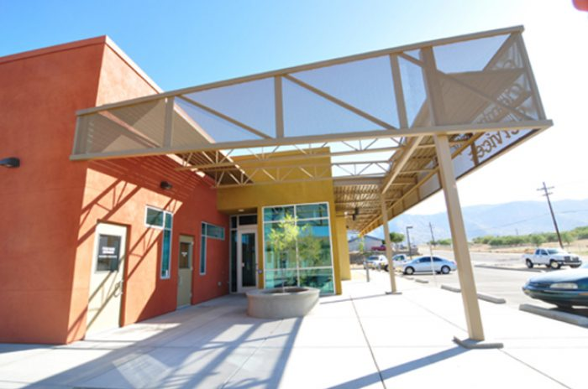
Remote Pharmacy Services
Board Rule §291.121
TEXAS STATE BOARD OF PHARMACY
The amendment allows remote pharmacy services to be provided using an automated pharmacy system at healthcare facilities regulated under Chapter 534 Health and Safety Code - “Services for Persons with Mental Illness or an Intellectual Disability”.
Adopted: August 2023
Effective: August 27, 2023
Notes:
The next adoptions were amendments to rule 291.121. These amendments allow remote pharmacy services to be provided at healthcare facilities regulated under Chapter 534 of the Health and Safety Code.
This amendment was put in place to make sure all healthcare facilities eligible to provide pharmacy services were included, and to not unintentionally exclude facilities.
MENTAL HEALTH AND INTELLECTUAL DISABILITY
SUBTITLE A. SERVICES FOR PERSONS WITH MENTAL ILLNESS OR AN INTELLECTUAL DISABILITY

Slide 14

Prepackaging and Labeling Donated Drugs
Board Rule §291.33
The amendment specifies the prepackaging and labeling requirements for a participating provider to dispense donated prescription drugs under Chapter 442, Health and Safety Code – “Donation of Prescription Drugs”, in accordance with House Bill 4332.
TEXAS STATE BOARD OF PHARMACY
Adopted : November 2023
Effective: December 4, 2023
Notes:
The next adoptions are related to Class A pharmacy operational standards.
These amendments specify prepackaging and labeling requirements for dispensing donated drugs under the Health and Safety Code per House Bill 4332 which
(b) A prepackaged prescription drug a participating provider dispenses to a recipient must contain a label that includes: (1) the drug's brand name or, for a generic version of the drug, the drug's generic name and the manufacturer or distributor of the drug; (2) the amount of the drug in a given dose; (3) the drug's lot number; (4) the earliest expiration date of the drug for that drug lot number; and (5) the quantity of any drug the provider dispenses in more than one dose. (c) A participating provider shall maintain a record of each prepackaged prescription drug dispensed to a recipient. The record must include: (1) the drug's name, the amount of the drug in a given dose, and the dosage size or frequency; (2) the provider's lot number for that drug; (3) the drug's manufacturer or distributor; (4) the manufacturer's lot number for that drug; (5) the expiration dates of the drug from that drug's lot number; (6) the quantity of the drug in each prepackaged unit; (7) the number of prepackaged units that include the drug; (8) the date the drug was prepackaged; (9) the name, initials, or written or electronic signature of the individual who prepackaged the drug; and (10) the written or electronic signature of the pharmacist responsible for the drug's prepackaging.

Slide 15
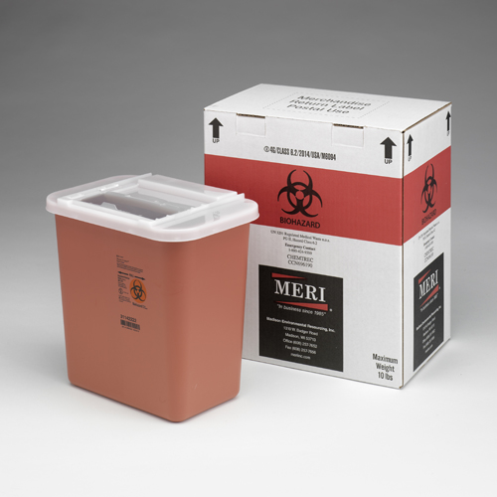
Destruction of Dispensed Drugs
Board Rule §303.1
The amendments remove the inventory requirements for destruction using a waste disposal service of dangerous drugs dispensed in health care facilities or institutions and clarify dangerous drugs may be comingled with controlled substances in a shared container prior to destruction as allowed by federal laws and regulations.
TEXAS STATE BOARD OF PHARMACY
Adopted: February 2023:
Effective: March 7, 2023
Notes:
The next rule adopted we're going to look at is Board rule 303.1, which is related to destruction of dispensed drugs. These adoptions essentially better align the rule with federal regulations. The previous language had some discrepancies with the federal law, so this adoption clears that up. It removes inventory requirements for destruction using a waste disposal service of dangerous drugs in certain settings. It also clarifies that dangerous drugs may be comingled with controlled substances in a shared container prior to destruction, which is allowed by federal laws and regulations.

Slide 16

A brief overview of the
Drug Supply Chain Security Act (DSCSA)
Notes:
Now we're going to switch gears to legislative highlights, and I want to start with the Drug Supply Chain Security Act, also known as the DSCSA.
This is federal legislation that affects pharmacy professionals, so we're going to look at a broad overview of what exactly it is, and what your responsibilities are in terms of being compliant with this legislation.

Slide 17



What is the DSCSA?
Enacted in 2013
The goal of the DSCSA is to further secure the US's drug supply to keep patients safe.
TEXAS STATE BOARD OF PHARMACY
Protects Patients
DSCSA regulations are designed to prevent harmful drugs from entering the supply chain, to detect harmful drugs if they do somehow enter it, and to enable rapid response when harmful drugs are found.
Notes:
So what is the DSCSA?
It was enacted in 2013, so ten years ago, and its goal is to make sure our nation's drug supply is secure so we keep our patients safe.
And how the Act does this is through regulations that are designed to (1) prevent harmful drugs from entering the supply chain, (2) to detect harmful drugs if they somehow DO enter it, and (3) to enable rapid response if or when these harmful drugs are found within the supply chain.

Slide 18

What are a pharmacy's responsibilities under the DSCSA?
Confirm the establishments you do business with are licensed or registered
  Check the registration of manufacturers and repackagers.
  Check the licensing of wholesale distributors and third-party logistics providers.
  Check the licensing of pharmacies through the respective state authority (for example, TSBP).
TEXAS STATE BOARD OF PHARMACY
Receive, store, and provide product tracing documentation
  Only accept drugs that have transaction information, transaction history, and transaction statement.
  Store this tracing documentation for at least six years.
  Provide all this tracing documentation if you sell a prescription drug to a trading partner.
    NOTE: You do not need to provide this information when you dispense the drug to a patient or if you sell it to a pharmacy for dispensing to a specific patient.
Investigate and properly handle suspect and illegitimate drugs
This includes having processes that include the following steps:
    Quarantining and investigating the drugs to determine if they are illegitimate
    If the drugs are found to be illegitimate, work with the manufacturer to ensure patients do not receive these drugs.
    Notify FDA and the trading partners they bought the drug from and sold the drug to.
Notes:
So what are a pharmacy's responsibilities under the DSCSA?
There are three key things you need to do:
The first is to confirm the entities you do business with are licensed or registered appropriately. Does the manufacturer or repackager have the appropriate registration? Is the wholesale distributor properly licensed? Is the pharmacy you're working with properly licensed?
The second thing you need to do is receive, store, and provide product tracing documentation required by the Act. This means only accepting drugs that have transaction INFORMATION, transaction HISTORY, and transaction STATEMENTS. You need to store this documentation for at least six years, and also be able to provide this documentation if you sell the drugs to a trading partner.
You do NOT need to provide this tracing information if you're dispensing the drug to a patient, though. This requirement is within the scope of drugs moving within the supply chain.
And then the final thing you want to be sure to do is to investigate and properly handle suspect and illegitimate drugs. Your pharmacy needs to have processes in place that include the following steps:
(1) Quarantining and investigating suspect drugs to determine if they are illegitimate.
(2) If they ARE illegitimate, you need to work with the manufacturer to ensure patients do not receive these drugs, and then you (3) need to notify the FDA and the trading partners you bought the drug from and sold the drug to.

Slide 19
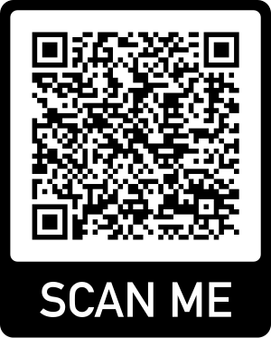
Learn more about the DSCSA and access additional resources from FDA
TEXAS STATE BOARD OF PHARMACY
Trouble with the QR Code above? Visit the FDA at:
https://www.fda.gov/drugs/drug-supply-chain-security-act-dscsa/pharmacists-utilize-dscsa-requirements-protect-your-patients
Notes:
To learn more about the DSCSA, the FDA has a great website that can give you more details and resources on how to be compliant. You can scan the QR code here on the screen and go straight to their information page, and if you need it, the URL is also listed at the bottom of this page.

Slide 20
Rules Regarding Preceptors,
Pharmacist Interns & Extended Interns
Notes:
Now I’m going to switch gears a bit and look at other major rule adoptions within the last few years, this time grouped by subject. Some of these I will look at were the product of the 86th Texas Legislature in 2019. As you’ll see, there was some significant legislation passed during that legislature that impacted the practice of pharmacy, so we want to make sure that those slightly older but still important changes are covered. There are also some more recent adoptions from 2020 that I will review.

Slide 21
Internship Hours
Board Rule §283.4
A pharmacist intern registration expires due to failing the NAPLEX or Texas Pharmacy Jurisprudence Examination only if the intern fails either exam more than once.
The amendments also extends the period that internship hours may be used for licensure from two years to three years from
the date the internship is completed.
TEXAS STATE BOARD OF PHARMACY
Adopted: August 2023
Effective: August 27, 2023
Notes:
Now I will move onto the August 2023 adoptions.
The first adoption was to Board rule 283.4. These amendments extend the period that internship hours may be used for licensure from two years to three years from the date the internship is completed.
So, previously, internship hours would've expired two years after the internship, but now those hours can be used for licensure up to three years instead.

Slide 22
Extended Intern Designation & Pharmacist Intern Registration
Board Rules §283.2 and 283.4
TEXAS STATE BOARD OF PHARMACY
The amendment removed the requirement that a residency program be accredited by the American Society of Health System Pharmacists (ASHP) for a resident to be eligible for designation as an extended-intern.
Adopted: May 2023
Effective: May 24, 2023
Notes:
Two conditions regarding residency programs accredited by ASHP have been removed. The first one is regarding the extended intenshipPreviously in order for a new pharmacy school graduate to be eligible for an extended intern registration, the residency program had to be accredited by ASHP. This requirement has now been removed. A residency program no longer has to be accredited by ASHP in order for an person to be eliglble for an extended intern registration.

Slide 23
Residency Pharmacist Preceptor Requirements
Board Rule §283.6
TEXAS STATE BOARD OF PHARMACY
The amendment removes the condition that a pharmacist preceptor must have six months of residency training if the pharmacist-intern’s residency program is accredited by the American Society of Health System Pharmacists (ASHP).
Adopted: August 2023
Effective: August 27, 2023
Notes:
The next adoption was to Board rule 283.6. It removed the conditions that a preceptor needs to have six months of residency training IF the pharmacist-intern's residency program is accredited by ASHP

Slide 24

Rules Regarding Continuing Education Requirements
Notes:
Now I will look at continuing education requirements.

Slide 25

continuing education
Pharmacists
Notes:
I will look at pharmacists first.
Beginning September 1, 2023, some of the CE requirements for pharmacists have expired, so we will also look at these updates.

Slide 26





Continuing Education | Pharmacists
Subject Requirements
Board Rule §295.8
Current
Expired
Texas Pharmacy Laws or Rules
TEXAS STATE BOARD OF PHARMACY
Pain Management
Human Trafficking Prevention
Mental Health Awareness
Prescribing and Monitoring Controlled Substances*
*(New pharmacists only)
Effective: September 1, 2023
Notes:
So here is a quick overview of the subject requirements you will need to meet for regular renewal and what has expired.
You still need at least 30 hours of CE for regular renewal, but the subject requirements have changed a little, so that's what we're looking at on this page.
You can see that you will still need to meet the Texas pharmacy law CE requirement, the human trafficking prevention requirement, and that new pharmacists will still need to meet the prescribing and monitoring controlled substances CE requirement.
You can also see, though, that requirements have been simplified with the expiration of the pain management and mental health awareness requirements. These are no longer required.

Slide 27
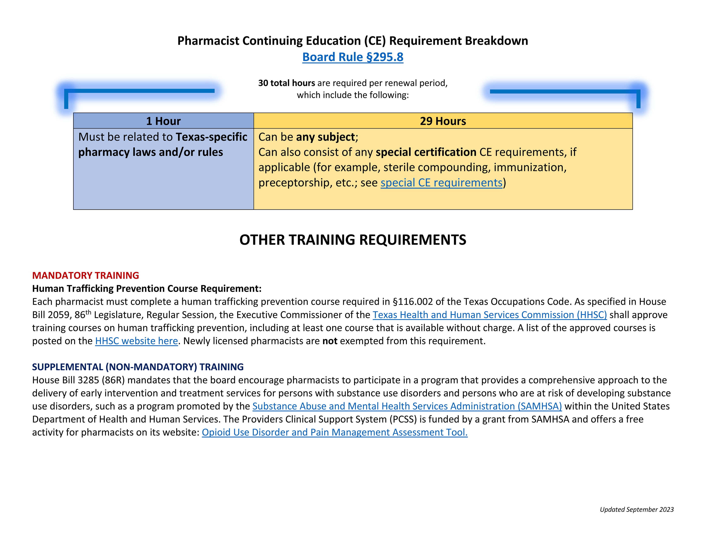
Notes:
Here is the pharmacist summary chart for regular renewal. You can see the breakdown of number of required hours and the subject types that are required. As we discussed earlier, a minimum of 30 hours of CE are still required, but there are fewer specific subject requirements.
At least one hour must be related to Texas pharmacy laws or rules. (This program will meet that requirement.)
Twenty-nine hours can be ANY subject. You can also count any hours completed for specific certifications, such as sterile compounding, immunization, or preceptorship, toward these hours as well.
And then, listed below, is the mandatory human trafficking prevention training course requirement, which you are hopefully familiar with. This is a unique requirement that is technically a training requirement rather than a CE requirement. This was a legislatively mandated requirement from the 86th Texas legislature that affected both pharmacists and pharmacy technicians. It also affected many different healthcare professionals beyond the scope of pharmacy.
It is also a bit unusual in that the approving body of this program is the Texas Health and Human Services Commission (HHSC)--not TSBP.
There are lots of links here on this document and on our website that will bring you to HHSC’s website and their list of approved courses. Anything on that course list will satisfy the requirement and can also be counted as CE if you choose a program that is considered ACPE approved or another approved program type.

Slide 28
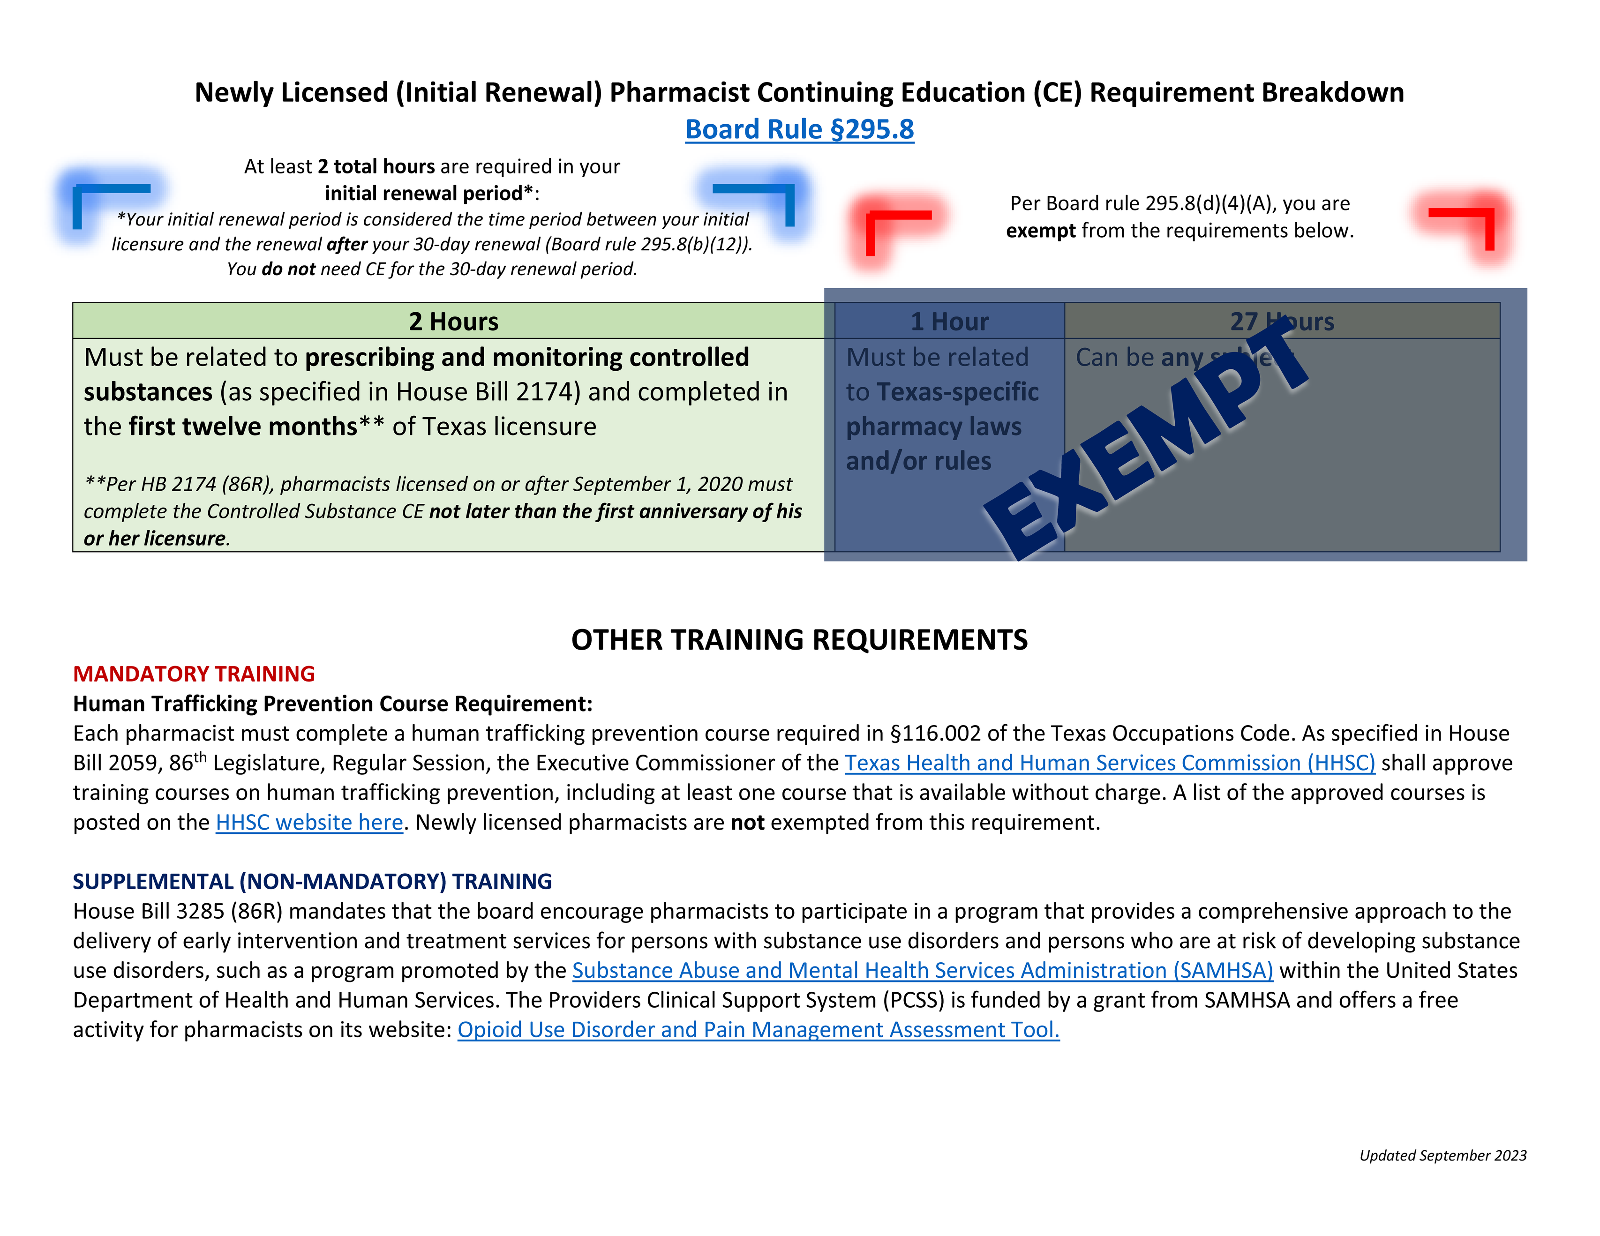
Notes:
And here’s a look at the renewal requirements for pharmacists in their initial renewal period. You’ll see that new pharmacists are except from most CE, but need to meet the legislatively mandated requirements:
(1) the human trafficking prevention training;
(2) and at least two hours of prescribing and monitoring controlled substances. These two hours must be completed within the first year of your Texas licensure.
The human trafficking prevention training requirement will be required each renewal period, but the prescribing and monitoring controlled substances CE is currently a one-time requirement and does not need to be completed for regular renewal. You'll notice it did not appear on the previous summary for regular pharmacist renewal, and this is why.

Slide 29

continuing education
Pharmacy Technicians
Notes:
Now let's look at the subjects pharmacy technicians need for renewal.

Slide 30
Continuing Education | Pharmacy Technicians
Subject Requirements
Board Rule §297.8
Current
TEXAS STATE BOARD OF PHARMACY
Texas Pharmacy Laws or Rules
Human Trafficking Prevention
Effective: September 1, 2023
Notes:
There was actually no change in terms of requirements for technicians. Technicians had fewer subject requirements, so the expiring subjects for pharmacists did not affect technicians. Pharmacy technicians are also still required to complete at least 20 hours of CE for renewal.
For regular renewal, pharmacy technicians still need to meet the Texas pharmacy law CE requirement and the human trafficking prevention training requirement.

Slide 31
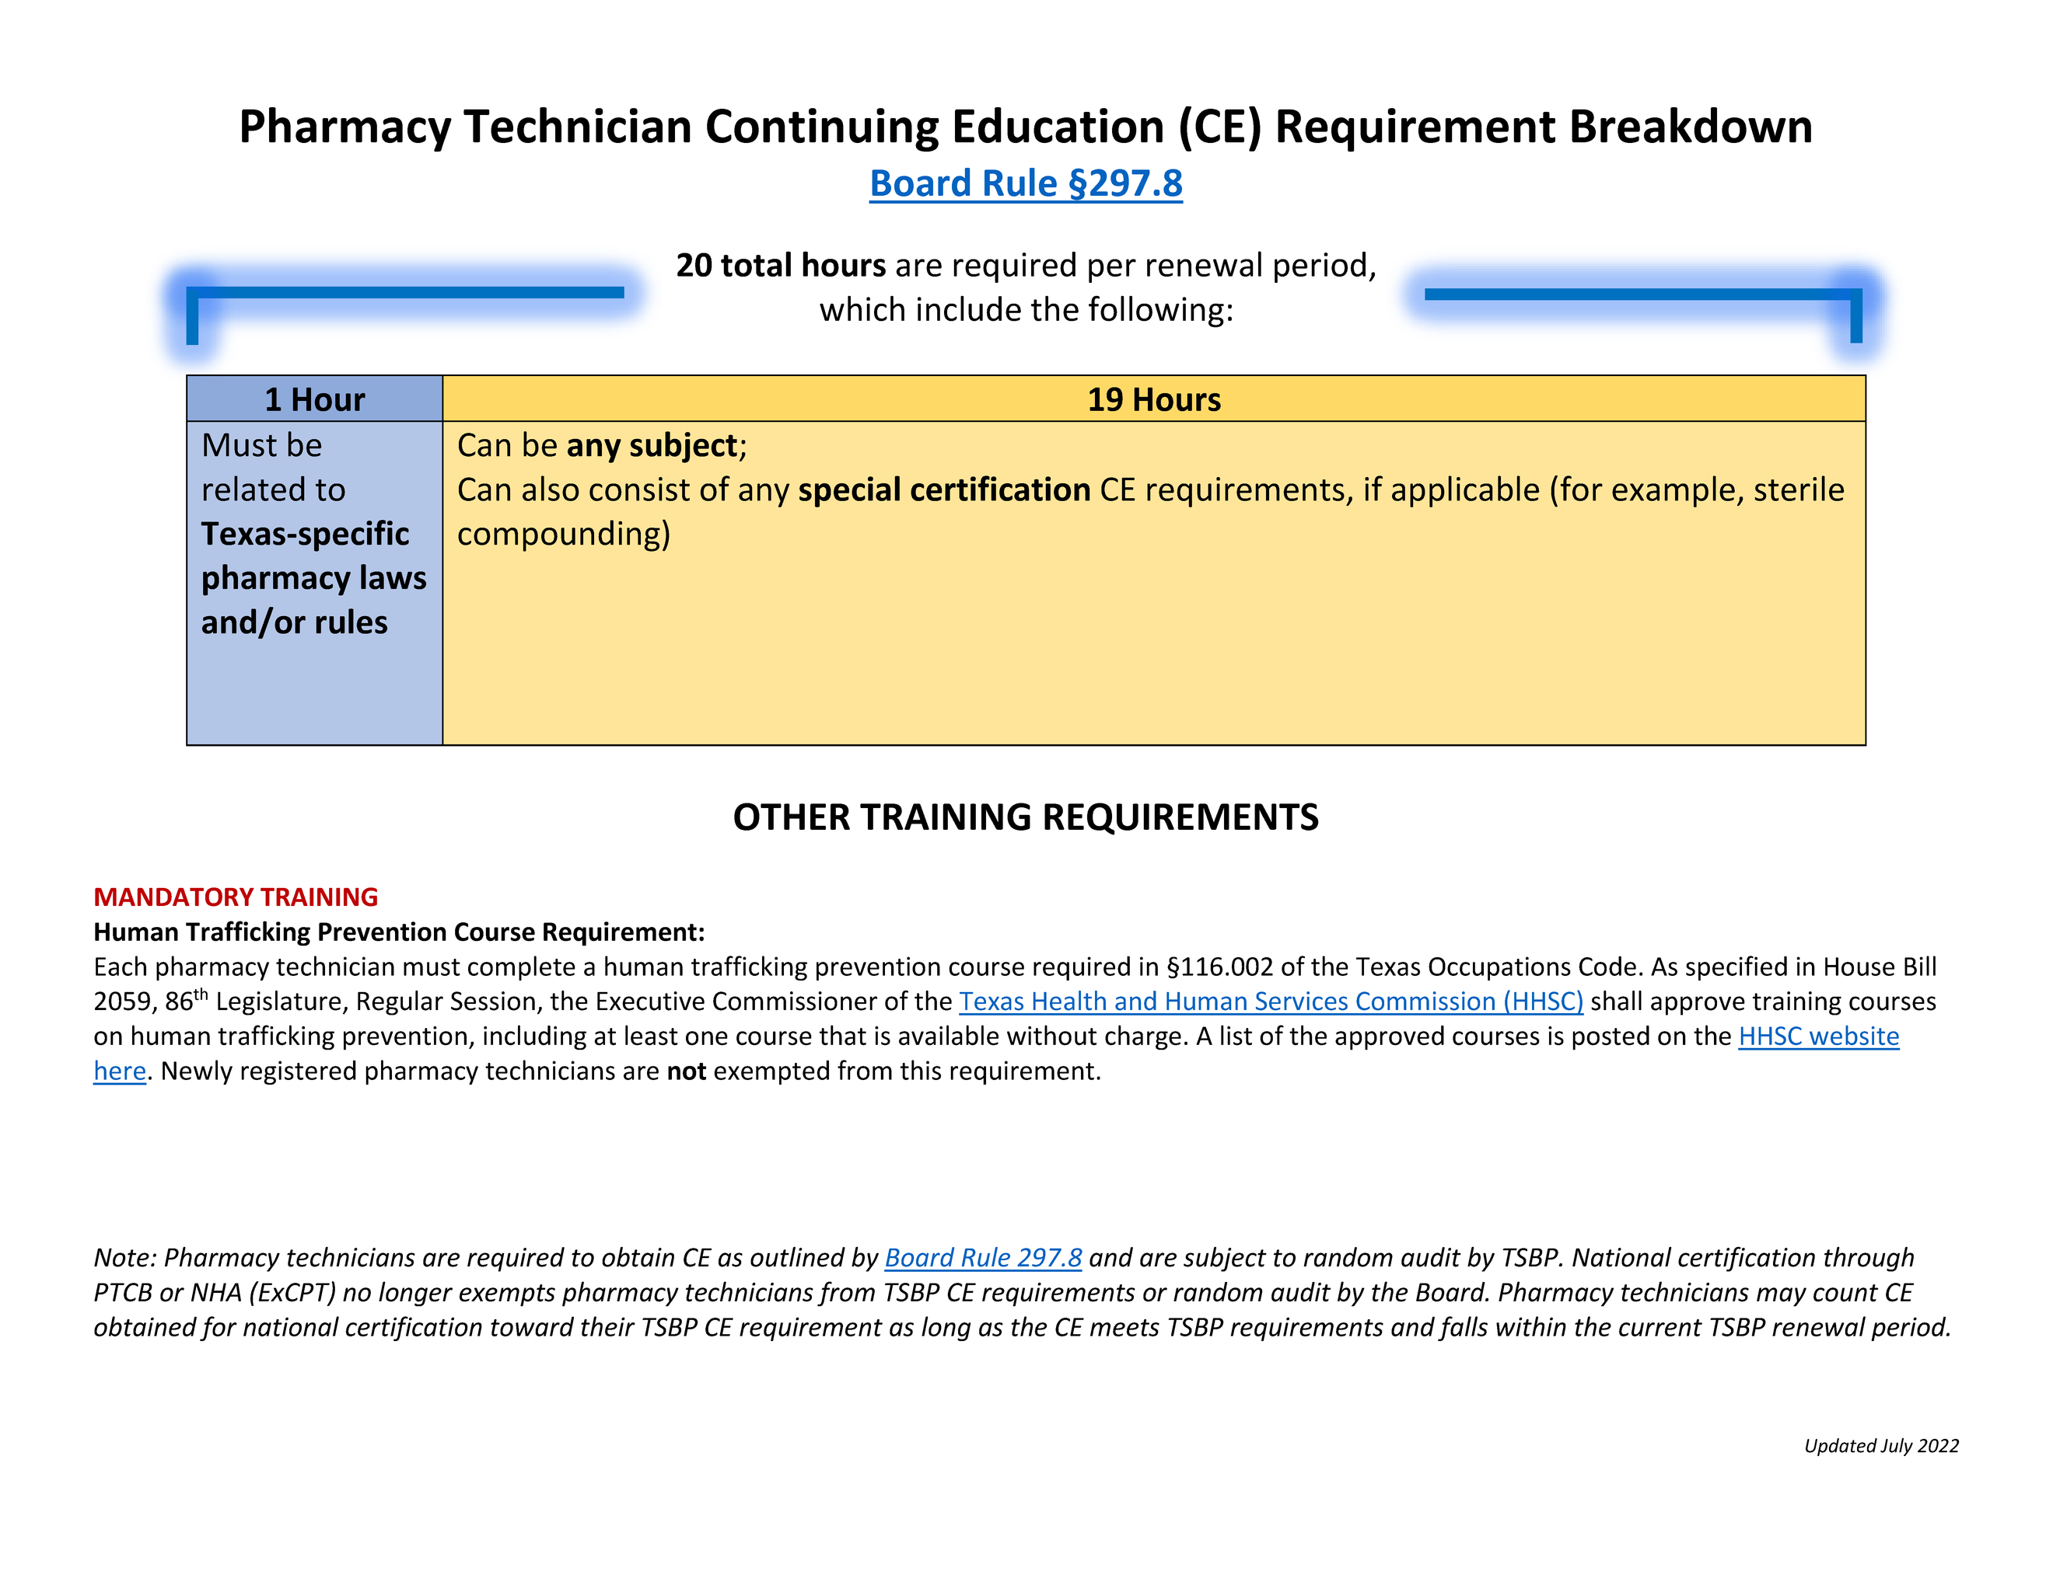
Notes:
And here is a look at the regular pharmacy technician renewal requirements, which, again, have not changed.
Pharmacy technicians must have a total of at least 20 hours of CE, one of which should be specific to Texas pharmacy laws and/or rules. The other nineteen hours may be any subject.
As mentioned previously, pharmacy technicians must also be sure to complete at least one approved human trafficking prevention training course.

Slide 32
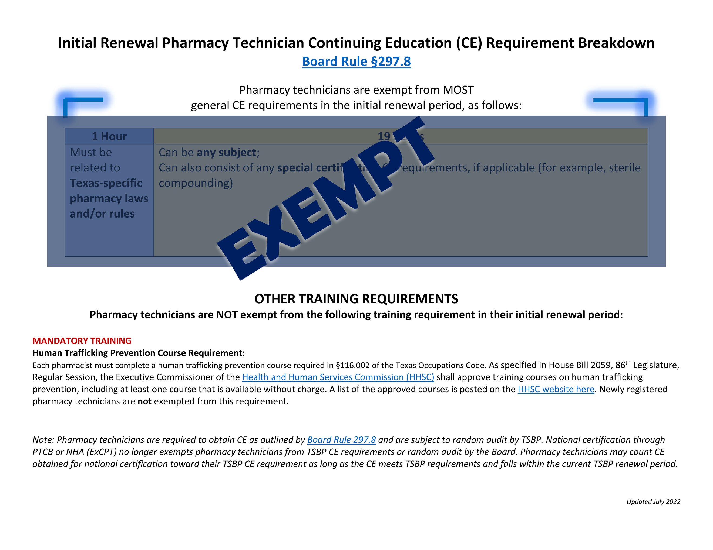
Notes:
And here is a look at the pharmacy technician renewal requirements for new technicians in their initial renewal period. Similarly to pharmacists in their initial renewal period, pharmacy technicians in their initial renewal period are also exempt from most CE requirements, but do need to be sure they're meeting the requirement of completion of at least one approved human trafficking prevention training course.

Slide 33

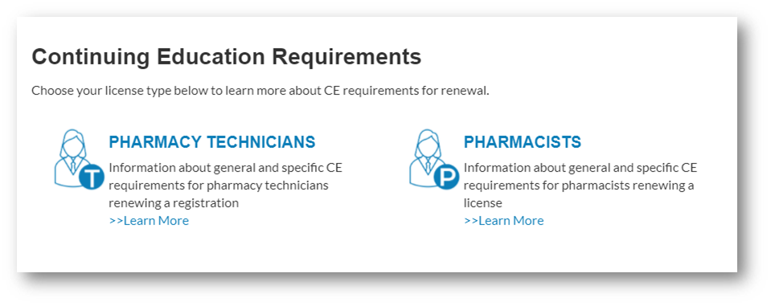
Where can I learn more about the new CE requirements?
www.pharmacy.texas.gov/ce
Select your license or registration type from this page for a comprehensive look at the new requirements and which types of courses may be counted for each.
TEXAS STATE BOARD OF PHARMACY
(You can also find other CE-related FAQs on these pages—we recommend bookmarking them for ease of reference.)
Notes:
As a reminder, you can always find the most up-to-date CE information on our website here--pharmacy (dot) texas (dot) gov (slash) CE.
Just select your license type from this page, and that will bring you to a detailed FAQ page with lots of information.

Slide 34

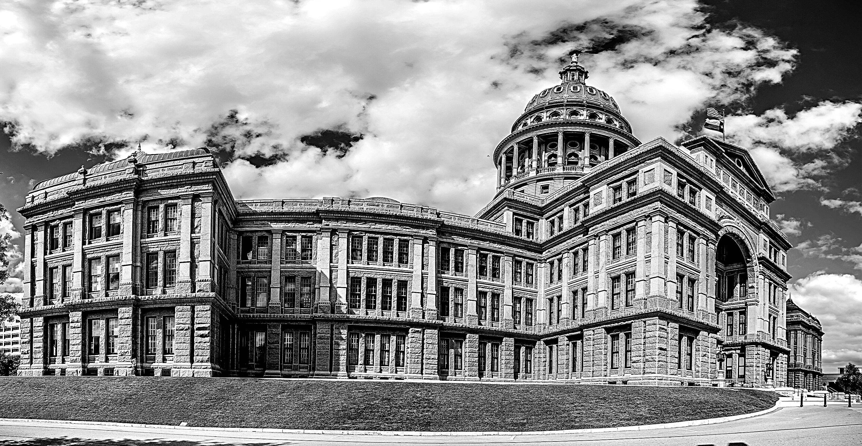
2023 Legislative Session
88th Texas Legislature | Regular Session
Notes:
Now I want to talk briefly about the 2023 legislative session.

Slide 35




88th Texas Legislature
Regular Session Dates
January 10, 2023 - May 29, 2023
TEXAS STATE BOARD OF PHARMACY
Content
Some pharmacy-related and pharmacy-adjacent bills passed
Effective Date(s)
All bills effective September 1, 2023
unless otherwise noted
Notes:
This past legislative session was the 88th Texas Legislature and ran in regular session from January through May of 2023.
Pharmacy-related and pharmacy adjacent bills were passed, and unless otherwise specified by the terms of that bill, they became effective in September 2023.

Slide 36
Bill Overview
HB 25
HB 4166
Relating to wholesale importation of prescription drugs for resale to Texas residents.
Relating to the packaging requirements for certain donated prescription drugs.
HB 617
HB 4331
TEXAS STATE BOARD OF PHARMACY
Relating to a pilot project to provide emergency telemedicine medical services and telehealth services in rural areas.
Relating to the donors of certain unused prescription drugs.
HB 3058
HB 4332
Relating to the provision of certain medical treatment to a pregnant woman by a physician or health care provider.
Relating to the redistribution of donated prepackaged prescription drugs.
Notes:
HB 25 - Relating to wholesale importation of prescription drugs for resale to Texas residents.
HB 617 - Relating to a pilot project to provide emergency telemedicine medical services and telehealth services in rural areas.
HB 3058 - Relating to the provision of certain medical treatment to a pregnant woman by a physician or health care provider.
HB 4166 - Relating to the packaging requirements for certain donated prescription drugs.
HB 4331 - Relating to the donors of certain unused prescription drugs.
HB 4332 - Relating to the redistribution of donated prepackaged prescription drugs.

Slide 37
Bill Overview
SB 14
SB 490
Relating to prohibitions on the provision to certain children of procedures and treatments for gender transitioning, gender reassignment, or gender dysphoria and on the use of public money or public assistance to provide those procedures and treatments.
Relating to itemized billing for health care services and supplied provided by health care providers.
SB 629
TEXAS STATE BOARD OF PHARMACY
Relating to the use of opioid antagonists on public and private school campuses and at or in transit to and from off-campus events.
SB 294
Relating to the use of medication designated for treatment of respiratory distress on public and private school campuses.
SB 2173
Relating to a pilot program for the safe disposal of controlled substance prescription drugs.
SB 422
Relating to the authority of certain military service members to engage in a business or occupation in this state.
Notes:
SB 14 - Relating to prohibitions on the provision to certain children of procedures and treatments for gender transitioning, gender reassignment, or gender dysphoria and on the use of public money or public assistance to provide those procedures and treatments.
SB 294 - Relating to the use of medication designated for treatment of respiratory distress on public and private school campuses.
SB 422 - Relating to the authority of certain military service members to engage in a business or occupation in this state.
SB 490 - Relating to itemized billing for health care services and supplied provided by health care providers.
SB 629 - Relating to the use of opioid antagonists on public and private school campuses and at or in transit to and from off-campus events.
SB 2173 - Relating to a pilot program for the safe disposal of controlled substance prescription drugs.

Slide 38

Rules Regarding
the
Texas PMP
Notes:
Now let’s talk a little bit about the Texas Prescription Monitoring Program, also known as the Texas PMP. It’s an important tool that pharmacy professionals have at their disposal and it’s important to understand some of the key components and functionalities of the PMP.

Slide 39
How to access the PMP
You can navigate to Texas PMP AWARxE from multiple places.
TEXAS STATE BOARD OF PHARMACY
TEXAS STATE BOARD OF PHARMACY
www.pharmacy.texas.gov
www.pharmacy.texas.gov/pmp
TEXAS PRESCRIPTION MONITORING PROGRAM
txpmp.org
Notes:
There are two ways to access the PMP—one is through our website at pharmacy.texas.gov, and the other is through txpmp.org. I will look at both.

Slide 40
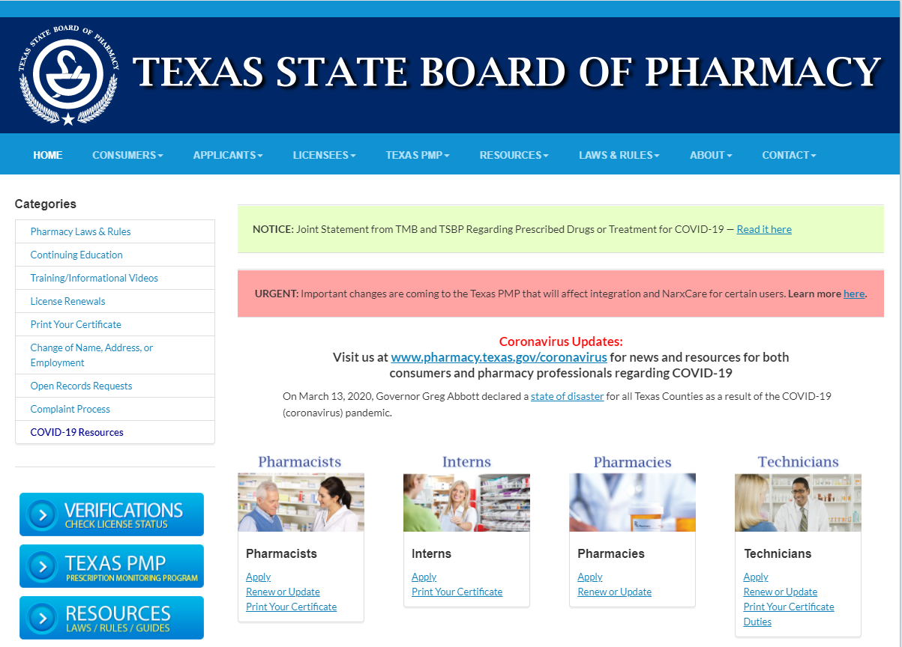

Texas State Board of Pharmacy
Notes:
This picture shows our home page at the Texas State Board of Pharmacy, and as you can see, you can click on that big blue Texas PMP button. You can also click on Texas PMP from the dropdown menu.

Slide 41
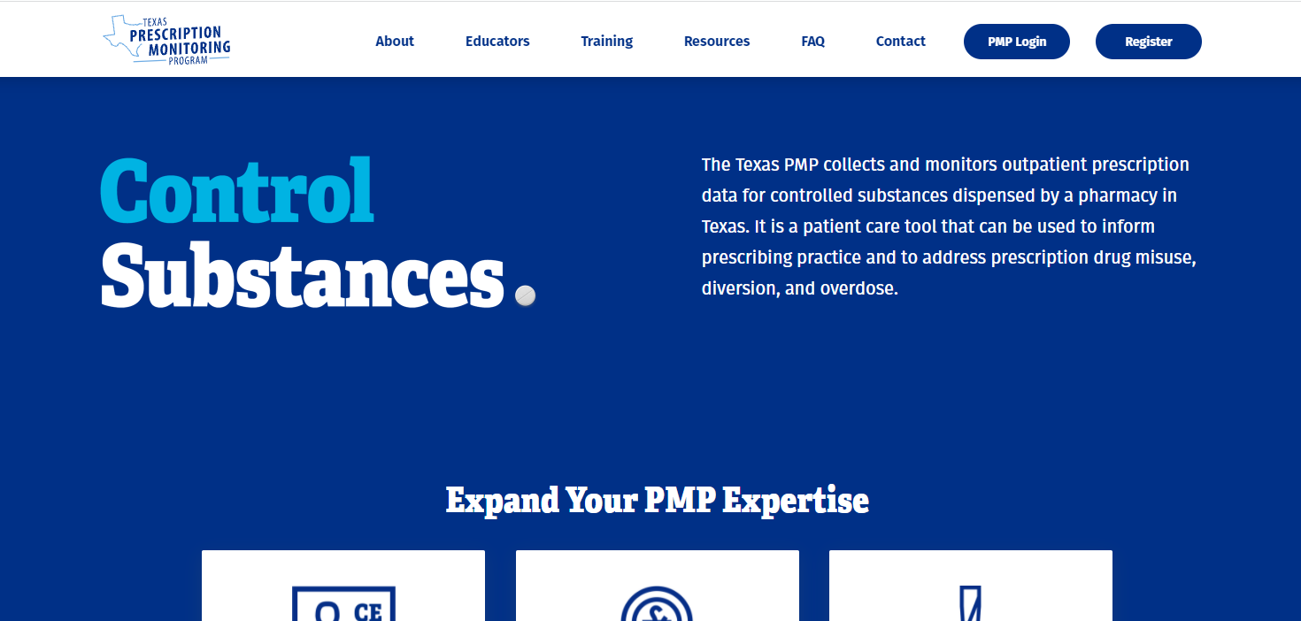
Texas Prescription Monitoring Program
Notes:
Here’s what the home page at txpmp.org looks like. You can see the option to log into the PMP here as well. This site also has lots of great information and statistics regarding the Texas PMP, so I would encourage you to check out information on this site when you have a chance.

Slide 42





Using the PMP
Registration
Patient Search
TEXAS STATE BOARD OF PHARMACY
Prescription Management
Delegate Management
Notes:
There are four main functions you’ll perform in PMP as a pharmacist and/or delegate. There’s registration, which hopefully most of you have already done at this point, and I will look at how to run a patient search, prescription management, and delegate management.

Slide 43
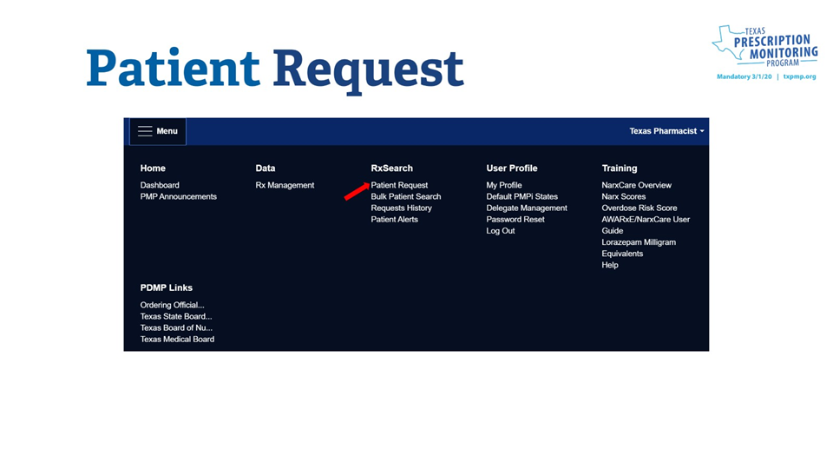
Notes:
Now let’s look at some of those core functions. Again, assuming you’re registered, once you log in, the landing page will look like this.
You can see that you will go under Data for Prescription management. This is where you’ll go if you need to make corrections to prescription data that’s been entered into the PMP. Ss if you’re the person that’s responsible for doing that, this is where you’ll go.
Let’s skip over to User Profile. You’ll see Delegate Management is under that category. That’s where you’ll be able to enter and manage delegates who can look at the PMP for you.
You’ll see that there’s also some training information available to you.
But the majority of your time will be spent under Rx or Prescription Search. So under RxSearch, you’ll click on Patient Request.

Slide 44
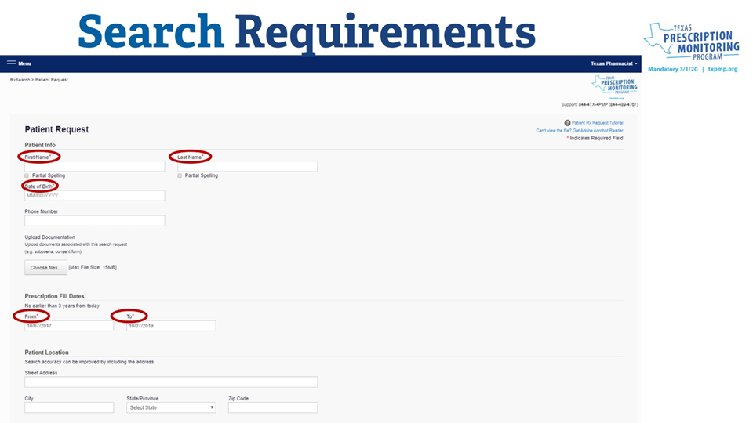
Notes:
When you run a patient search or patient request, the minimum information you need to include is first name, last name, date of birth, and then specify a prescription fill date range. You can also see here that the system allows for partial spellings of first and last name, which is especially helpful if a person was perhaps entered under a shortened name or a variant spelling. You can select Partial Spelling on one or both of those name fields. The minimum characters on partial spellings are either two or three characters.
The prescription fill dates defaults to a one-year time period, but up to three years of data can be searched if you want to expand that date range. Usually, one year is adequate to get you the information that you need.

Slide 45
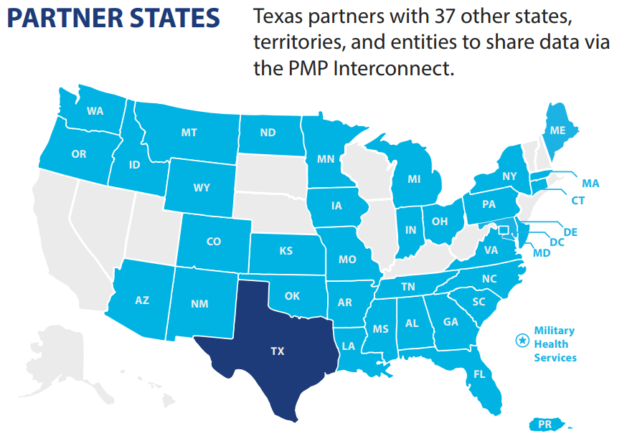
Source: PMP Data FY2023 Quarter One | 9/1/22 - 11/20/22
https://www.pharmacy.texas.gov/files_pdf/pmp/fy2023-q1-pmp-data-sheet.pdf
Notes:
The data we publish also includes current partner states. You can see here that we are currently partnered with many other states and entities to share PMP data via the PMP Interconnect. You can see those indicated here on this map, and it’s important to note that all those states that share a border with Texas are also participating in this interconnect program. So when you go in to do your patient request, especially if you’re in a location near one of these borders, you can select these states in that search query to pull patient data from those states as well.

Slide 46

Changes to the Texas PMP
Overview
The 2023 Texas Legislature approved funding for the Texas State Board of Pharmacy to offer statewide integration of the PMP in pharmacy management systems and NarxCare access at no cost to pharmacies beginning September 1, 2023.
TEXAS STATE BOARD OF PHARMACY
Already use and pay for integration and NarxCare access?
The Texas State Board of Pharmacy will automatically take on payment beginning September 1, 2023.
Don’t have integration and NarxCare access yet?
Navigate to Bamboo Health’s Customer Connect Portal to sign up for integration and NarxCare access, which will be covered beginning September 1, 2023.
connect.bamboohealth.com
Notes:
Now let's go over a few changes to the PMP. The 2023 Texas Legislature approved funding for TSBP to offer statewide integration of the PMP in pharmacy management systems and NarxCare access at no cost to pharmacies beginning September 1, 2023.
If you already pay for these enhancements, TSBP automatically took on payment of those enhancements beginning September 1, 2023.
If you DON'T have access to these yet, you can visit Bamboo Health's Customer Connect Portal to sign up. You can see that URL at the bottom of the page here.

Slide 47

Pharmacy Responsibility – Electronic Reporting
Board Rule §315.6
The amendments specify that a pharmacy must report the data elements indicated as required by the board’s Data Submission Guide for Dispensers.
TEXAS STATE BOARD OF PHARMACY
Adopted: February 2023
Effective: March 7, 2023
Learn More
You can find the Data Submission Guide for Dispensers on our website. Go to this page:
pharmacy.texas.gov/PMP/PMPClearinghouse.asp
Then click on the link titled "Data Submission Guide for Dispensers"
Notes:
The last rule I will talk about amended in February 2023 is related to pharmacy responsibility in terms of electronic reporting.
The adopted amendments specify that a pharmacy must report data as required by the board's Data Submission Guide for Dispensers. Previously, the rule actually spelled out those guidelines, which meant if they changed that the rule would have to change, too. This way, it simplifies the rule language but not the rule meaning, and also directs you to the guide.

Slide 48




PMP Audits
What is it?
An audit of the state law requirement that dispensers look up a patient before dispensing certain drugs
TEXAS STATE BOARD OF PHARMACY
Audit Process
Prescriptions dispensed are randomly selected from all qualifying prescriptions reported each quarter
Audit Focus
TSBP is focused on educating pharmacy professionals about the mandate and encouraging compliance if deficiencies are found
Notes:
Now let's talk briefly about PMP audits.
What exactly is this audit and why is it being implemented?
Well, as you know, pharmacists are required by state law to consult the PMP before dispensing opioids, benzodiazepine, carisoprodol, and barbiturates; so this audit is being conducted by the Board to ensure that pharmacy professionals are complying with this state mandate.
The audit process beings with a random selection of prescriptions dispensed out of the whole system each quarter. Now, this is a vast pool of prescriptions. To give you an idea of the numbers reported to the PMP in a given quarter, for example, in Q2 of 2023, over 4.8 million prescriptions meeting mandate requirements were reported. This is just the state of Texas in a three-month period, so that's a lot of prescriptions.
So of that 4.8 million, again for example if we are looking at Q2 of 2023, a smaller random subset of that number is pulled for audit.
We are still fairly early in the audit process, but want to educate pharmacists and pharmacy technicians that this is happening so you know what to expect and what we're looking for. At this stage, we're really focusing on education and encouraging compliance.

Slide 49
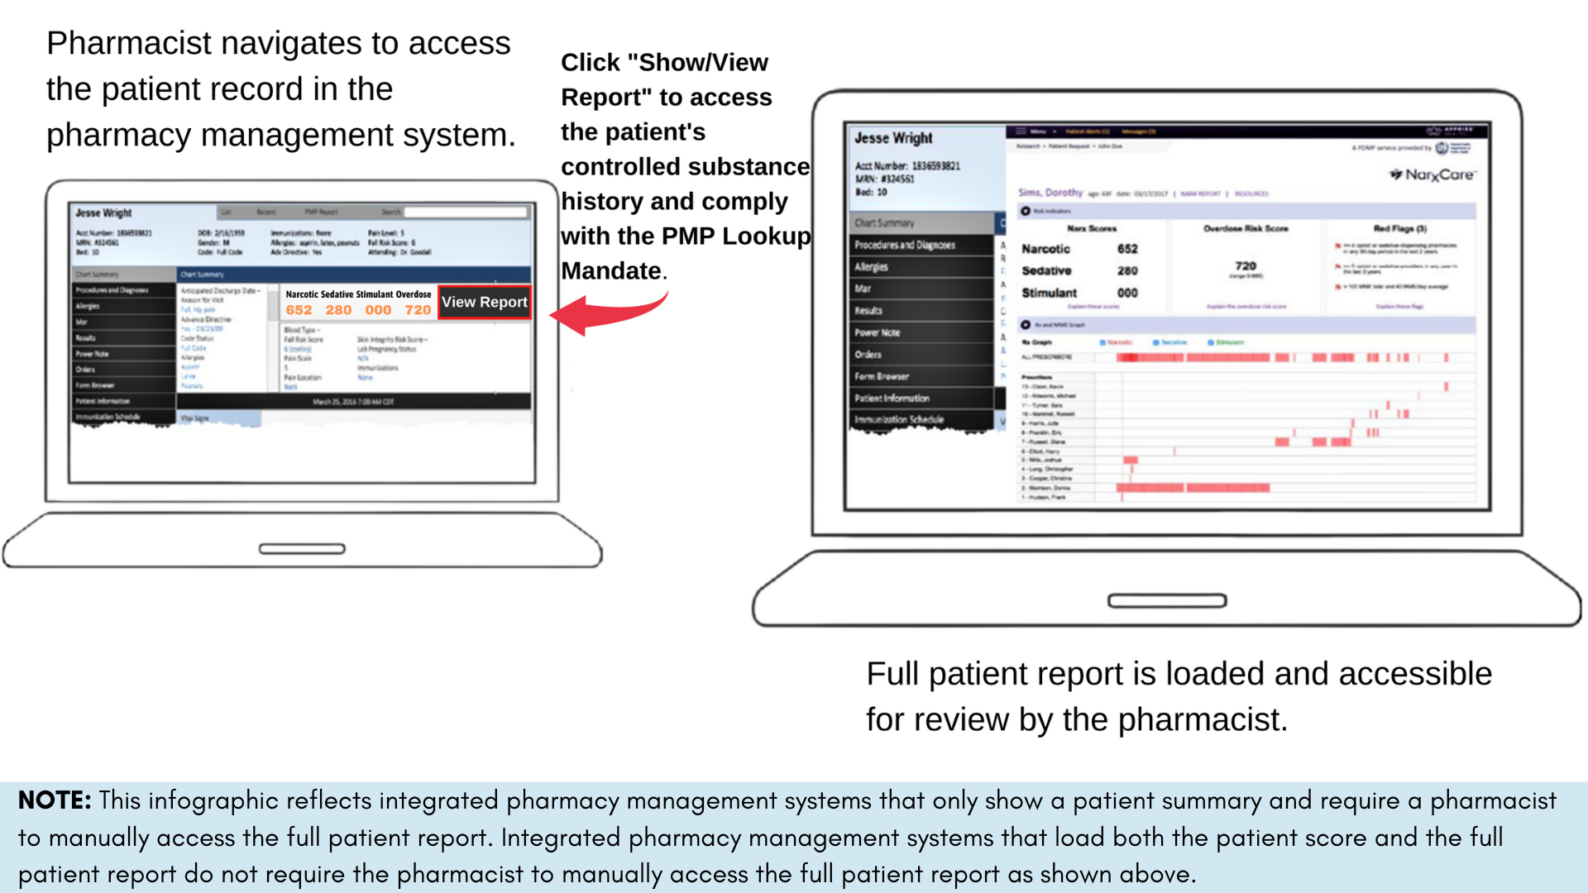
Notes:
In that same vein of mandatory lookup audits, we also want to share an important note about integration, PMP lookup, and compliance. If you have integration in your pharmacy's system, you may run into this issue.
In some integrated pharmacy management systems, a patient score is loaded for viewing when the patient’s record is accessed, RATHER than the full report.
Viewing the patient score ALONE does not comply with the mandated PMP lookup requirement. You must manually initiate a report request by clicking to “View/Show Report” like you see here on the screen to access the full controlled substance history report for the patient and to comply with the mandated PMP lookup requirement.
Other integrated pharmacy management systems will load both the patient score and the full patient report. In this case, you would NOT need to load the report separately to be compliant with the mandate, but this is a common enough issue that we wanted to make you aware of it and how to make sure you are compliant if your system loads the data like this.

Slide 50

PMP Administrative Penalty
Board Rule §281.54
TEXAS STATE BOARD OF PHARMACY
The amendments add an administrative penalty of $500 for the violation of failing to access the Prescription Monitoring Program (PMP) for a patient’s information before dispensing opioids, benzodiazepines, barbiturates, or carisoprodol.
Effective: September 9, 2020
Notes:
As you already know, we’ve implemented rules saying that you need to access the Texas Prescription Monitoring Program (or PMP) for a patient’s information before dispensing opioids, benzodiazepines, barbiturates, or carisoprodol. This mandatory lookup became effective March 1, 2020.
At the August 2020 Board meeting, the Board specifically added an administrative penalty for failing to access a patient’s information before dispensing one of these drugs.
Board rule 281.65 outlines administrative penalties for several scenarios, but this failure to access the PMP wasn’t included until this amendment became effective in September 2020. So now we have an administrative penalty for failure to look up a patient in this case, and that penalty is essentially a fine associated with that failure.

Slide 51

Rules Regarding
Licenses & Registrations
Notes:
Now I will look at recent rule updates related to administrative practices and procedures.

Slide 52
Pharmacy Licensing Fees
Board Rule §291.6
The Texas State Board of Pharmacy adopts amendments to §291.6 concerning Pharmacy License Fees. The amendments increase pharmacy license fees based on expected expenses, specify the application fee for an initial or renewed certificate to provide remote pharmacy services, and remove the fee for issuance of a duplicate renewal certificate.
TEXAS STATE BOARD OF PHARMACY
Initial License
$583 (previously $516)
A Certificate to Provide Remote Pharmacy Services Using:
  automated pharmacy systems: $100
  emergency medication kits (e-kit): $50
  telepharmacy systems: $150
  automated dispensing and delivery systems: $100
Renewal Fee
$580 (previously $513)
Approved: November 2023
Effective: December 4, 2023
(New fees effective January 1, 2024)
Notes:
The next two slides will look at adoptions regarding fee changes.
This is a biennial adoption, so this happens every two years along with the appropriation of funds to TSBP by the Texas legislature.
So the first of these are in Board rule 291.6, pharmacy license fees.
Both initial and renewal fees for pharmacies went up a bit. The initial license fee is now $583, and the renewal fee for a pharmacy is now $580.
Another major change here was that TSBP instituted licensing fees for remote pharmacy services; so if you are adding any remote services to a pharmacy license, there will be a corresponding fee.

Slide 53

New Licensing Fees
Board Rule §295.5
Board Rule §291.121
The amendments increase pharmacist
license fees by $43 based on expected expenses.
The amendments clarify how the board provides a license to pharmacies that provide remote pharmacy services (specified in §﻿291.6).
TEXAS STATE BOARD OF PHARMACY
  Initial License - $381 (previously $338)
  Renewal Fee - $378 (previously $335)
Pharmacy Technician Fees
Pharmacy technician fees have not changed from the previous biennium:
  Initial Registration - $84
  Renewal Fee - $81
  Technician Trainee Fee - $55
Approved: November 2023
Effective: December 4, 2023
(New fees effective January 1, 2024)
Notes:
Now here are the fees for pharmacists. You can see these also increased. Initial licensure is now $381 – increase , and the fee for renewing your pharmacist license is now $378.
Also on this page, you can see that there were amendments to Board rule 291.121 to clarify how TSBP provides a license to engage in remote pharmacy services. We went over the fees for those services on the previous slide.
(e) Remote Pharmacy Services Fee. The application fee for an initial or renewed certificate to provide remote pharmacy services under §291.121 of this title (relating to Remote Pharmacy Services) shall be:
(1) for a certificate to provide remote pharmacy services using automated pharmacy systems under §291.121(a) of this title: $100;
(2) for a certificate to provide remote pharmacy services using emergency medication kits under §291.121(b) of this title: $50;
(3) for a certificate to provide remote pharmacy services using telepharmacy systems under §291.121(c) of this title: $150; and
(4) for a certificate to provide remote pharmacy services using automated dispensing and delivery systems under §291.121(d) of this title: $100.
Note that pharmacy technician fees did not change from the previous biennium.

Slide 54

Amendments Concerning Fee Requirements for Licensure by Examination, Score Transfer, and Reciprocity
Board Rule §283.9
TEXAS STATE BOARD OF PHARMACY
The amendments clarify how the board calculates the fee for failing to timely submit the initial renewal application and license fee for a license to practice pharmacy and correct grammatical errors.
Adopted: February 2024
Effective: March 2024
Notes:
Next, February 2024 adoptions.
The first are to rule 283.9, concerning fee requirements for pharmacist licensure.
These are non-substantive changes, and basically just clarify how the late fee for these licenses are calculated.
expired for 90 days or less, the person may become licensed by making application and paying to the board one initial license fee ($381) and a fee that is one-half of a renewal fee.$570
expired for more than 90 days but less than one year, the person may become licensed by making application and paying to the board one initial license fee($381) and a fee that is equal to a renewal fee ($378). $759
If the initial license has been expired for one year or more, the person shall apply for a new license.

Slide 55

Interim Licenses and Registrations for Military Service Members, Military Veterans, and Military Spouses
Board Rules §283.12 and §297.10
The amendments establish procedures for a military service member who is currently licensed or registered in good standing by a jurisdiction with licensing requirements that are substantially similar to Texas's requirements to obtain an interim pharmacist license (§283.12) or an interim pharmacy technician registration (§297.10) in accordance with Senate Bill 422.
TEXAS STATE BOARD OF PHARMACY
Approved: November 2023
Effective: December 4, 2023
Notes:
I will start with the November 2023 adoptions.
The first are amendments related to military service members. These affected Board rules 283.12 and 297.10. and establish procedures for a military service member to obtain an interim license or registration with TSBP as long as they are currently registered and in good standing with another jurisdiction that has similar licensing requirements.

Slide 56

Other Updates and Reminders
Notes:
Now let's look at a few other updates and reminders before we wrap up.

Slide 57

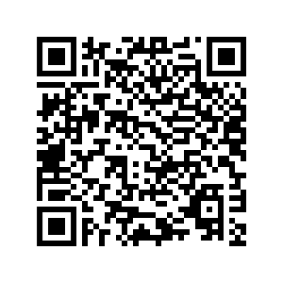
Pharmacist Renewal Fingerprints
Overview
Required per statutory requirement set out in Texas Occupations Code, Sec 602.2101
Learn More
Which pharmacists are affected?
A fingerprint background check will be required prior to the completion of your TSBP license renewal if your initial fingerprints were completed before June 1, 2015
More details
  This is a one-time requirement
  If affected by this requirement, you can complete it at any time before renewal--email us for fingerprint information at fingerprints@pharmacy.texas.gov with:
    Your license number
    Your full name
    Note that you are requesting a link to register for fingerprints.
Notes:
Now let's talk a little bit about pharmacist renewal fingerprints.
A little bit of history and why this is a requirement now:
Fingerprints are required for renewal per a statutory requirement set out in Texas Occupations Code, Sec 602.2101. Essentially, these updated fingerprints are required by law.
Which pharmacists are affected?
A fingerprint background check will be required prior to the completion of your TSBP license renewal if your initial fingerprints were completed before June 1, 2015.
More details:
--This is currently a one-time requirement. You won't have to do this for each renewal period unless legislation changes.
--If you are affected by this requirement, you can wait to complete the fingerprints until you receive your renewal reminder, OR you can complete it at any time before renewal.
Just email us for fingerprint information at fingerprints@pharmacy.texas.gov with:
-Your license number
-Your full name
-Note that you are requesting a link to register for fingerprints.
You can find all of this information and more on our website. Just scan the QR code on your screen here.

Slide 58
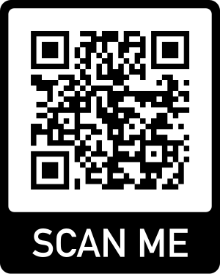
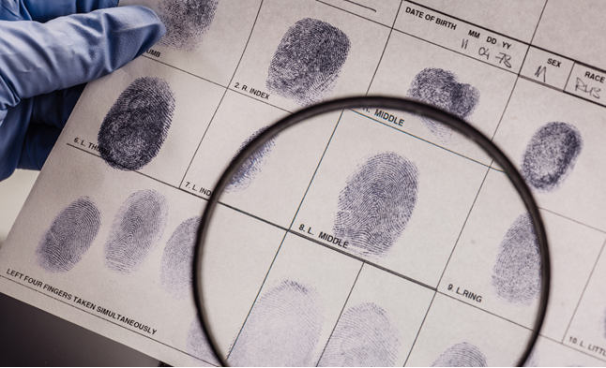
11G3HG
TSBP Fingerprint Service Code

Slide 59

Scams Targeting Pharmacy Professionals
pharmacy.texas.gov/news/scams.asp
Notes:
The first of these is a reminder that you may have already seen on our website. We are continuing to see a large uptick in scams targeting pharmacy professionals and want to spread the word for everyone to be aware this is still a problem, and to take precautions to protect yourself against scammers.
These scams can come in written form, on the phone, fax, via email--basically, any form of contact. They are also becoming more sophisticated. They may spoof TSBP's number or email address so it appears we are contacting you, and they're reported to use a variety of tactics to scare or intimidate targets to extort information or money.
If you suspect a person on the phone or in written correspondence is a scammer, hang up and ALWAYS call TSBP directly to confirm.
We have lots of information on our website about these scams, examples, and how to report scammers, so we encourage you to take a closer look at those when you get the chance.

Slide 60

Questions

Slide 61
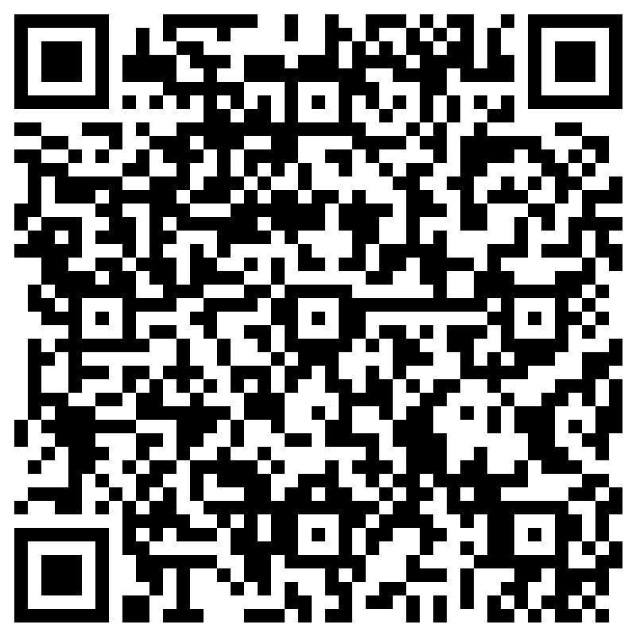
Thank you!
Scan the QR Code with your mobile device to access the CE form. Most phones can scan the QR code through the camera app. Just open your camera app, point it at the code, and open your browser when prompted.
Fill out the form with your name, license number, and email, and verify you were in attendance for the full meeting. Your certificate will be sent via email in 4 - 6 weeks.
TEXAS STATE BOARD OF PHARMACY
Difficulties with the QR code above?
You can also use this URL to access the CE form:
https://forms.office.com/g/spBRLHV3rP

