Slide 1


Econ 637 – Econometrics: Causal Methods
Lecture 2: The Identification Revolution and You
University of San Francisco
Department of Economics
Prof. Jesse Anttila-Hughes
August 21st, 2025

Slide 2
Today we’ll cover:
  The identification revolution
    Angrist and Pischke – 2010 – Taking the Con Out of Econometrics
    Angrist and Pischke – 2017 – Undergraduate Econometrics Instruction
Readings for next class:
  Goldsmith-Pinkham – 2025 – notes for Lecture 1 - Potential Outcomes, Directed Acylic Graphs, and Structural Models
  Goldsmith-Pinkham – 2024 – notes for Lecture 2 - Research Design, Randomization and Design-Based Inference
  Romer - 2016 - The Trouble with Macroeconomics
  Supplemental:
    Card - 2021 - slides from Nobel speech - Model‐Based or Design‐Based?
    Seeing Theory: https://seeing-theory.brown.edu/
    Shapiro - 2022 - Four Steps to an Applied Micro Paper
Note: Centennial Chair’s Address next Thursday, Aug 28th, Xavier auditorium, 3pm
Problem set #1 assigned on Canvas
  Due next Friday August 29th

Slide 3


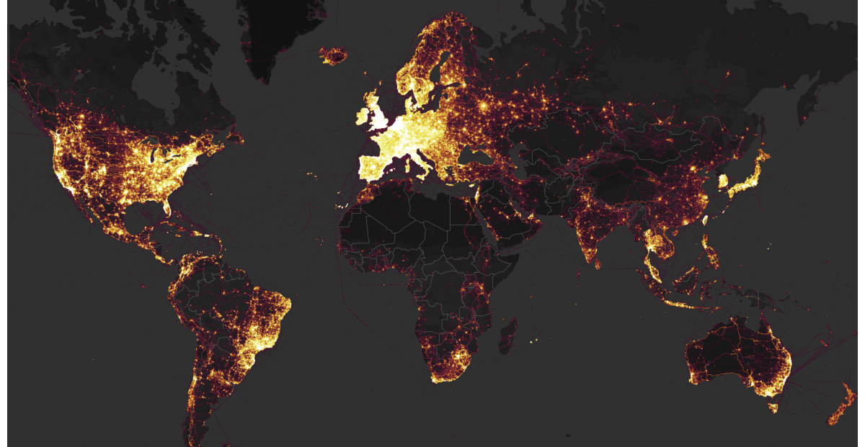
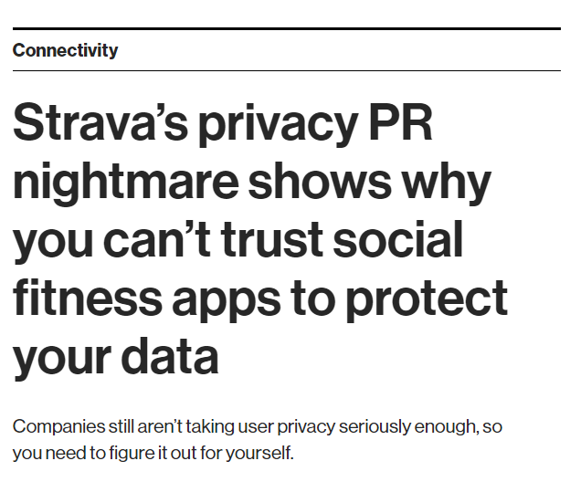
https://www.technologyreview.com/s/610090/stravas-privacy-pr-nightmare-shows-why-you-cant-trust-social-fitness-apps-to-protect-your/

Slide 4
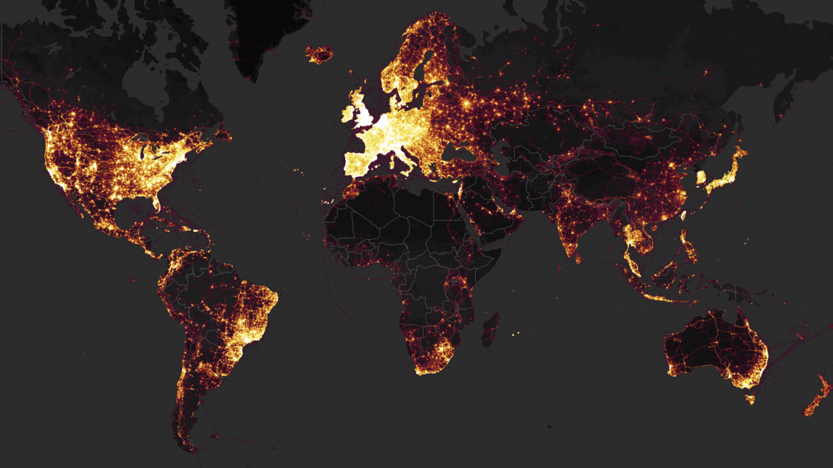
Warm up
In what ways is the Strava map a good estimator for the distribution of population over space?
  What other parameters might be influencing the Strava map?
    What statistical problems could result if we tried to use the Strava map as a proxy for population?

Slide 5
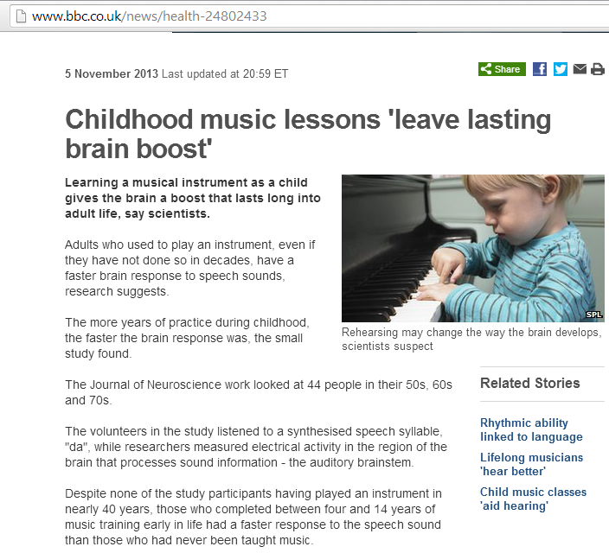
Fundamental Problem of Causal Inference: we can never observe both Y_{i}(0) and Y_{i}(1)
  i.e., counterfactuals are fundamentally unobservable

Slide 6
Introductions
what we should call you
“where you’re from” (whatever version!)
what program you’re in, and what you did over the summer

Slide 7
Econometrics
What is econometrics?
  The statistics used by economists
Why do we learn econometrics?
  Estimating relationships between economic variables
  Testing economic theories and hypotheses
  Forecasting economic variables
  Evaluating or implementing policies
  Understanding others’ research
    Etc.
Econometrics starts with an economic model of reality (e.g., something you’d learn in a theory class) and then generates testable econometric predictions which come from that model
  Sometimes we explicitly define a theoretical mathematical model
    Sometimes we simply articulate it verbally
  Keep in mind, though: all models are wrong, some are useful

Slide 8
What kind of theory models?
Economic model of crime (Becker 1968)
  Derives equation for criminal activity based on utility maximization
  Functional form of relationship not specified
  Equation could have been postulated without economic modeling
Hours spent in
criminal activities
Age
Returns to criminal
activities
Expected
sentence
Wage for legal
employment
Probability of
conviction if
caught
Other
income
Probability of
getting caught

Slide 9
What kind of theory models?
Model of job training and worker productivity
  What is effect of additional training on worker productivity?
  Formal economic theory not really needed to derive equation (but may):
  Other factors may be relevant, but these might be the most important (?)
Hourly wage
Years of formal
education
Weeks spent
in job training
Years of work-
force experience

Slide 10
What kind of econometric models?
Econometric model of criminal activity
  The functional form has to be explicitly specified
  Variables may be approximated by related quantities
  Actual data are used to estimate relevant values
Measure of cri-
minal activity
Wage for legal
employment
Other
income
Frequency of
prior arrests
Unobserved deter-
minants of criminal
activity
e.g. moral character,
wage in criminal activity,
family background,
socioeconomic status,
stress etc etc …
Frequency of
conviction
Average sentence
length after conviction
Age

Slide 11
What kind of econometric models?
Econometric model of job training and worker productivity
Unobserved deter-
minants of the wage
Years of formal
education
e.g. innate ability,
quality of education,
family background …
Hourly wage
Years of work-
force experience
Weeks spent
in job training

Slide 12
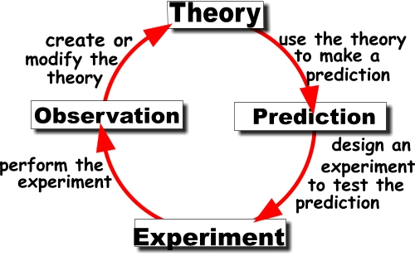
The scientific method
Theory classes
Econometrics

Slide 13
Brief Epistemology Point:
Types of Human Knowledge
Objective
(measurable physical reality)
Subjective
(internal experience)
Intersubjective
(Inter-experientially agreed upon reality)
Econometrics works well with objective knowledge, and can help
with some questions about intersubjective knowledge

Slide 14




Slide 15
http://tuvalu.santafe.edu/~simon/it.pdf

Slide 16
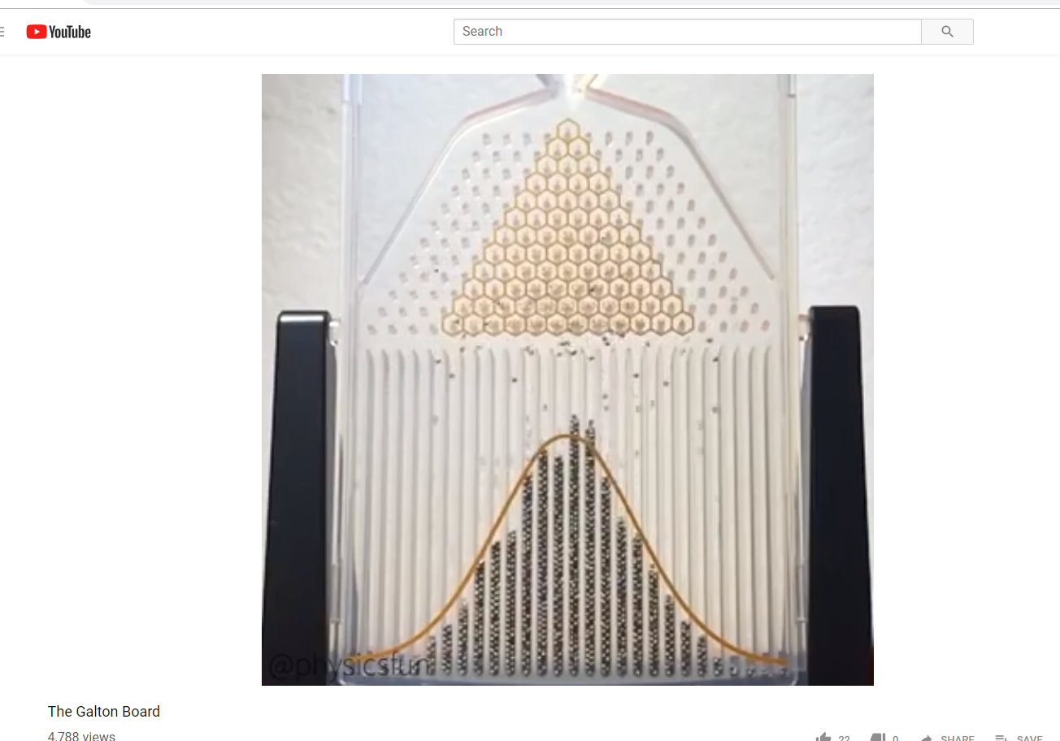
Ex: A Galton Board
https://www.youtube.com/watch?v=Vo9Esp1yaC8

Slide 17
Types of data
Econometric analysis requires data
  Data are repeated measurements or observations which can be grouped or associated in meaningful ways
In general, we distinguish between economic data based on how units of observation are represented relative to time
  Cross-sectional data
    Multiple units of obs., no variation in time
  Time series data
    Single unit of obs., observed across multiple times
  Pooled cross sections
    Multiple unit of obs., multiple times, but different obs. each time
  Panel/Longitudinal data
    Multiple units of obs. with multiple time obs. for each
Econometric methods depend heavily on the type of data used
  Use of inappropriate methods may lead to misleading results
    This will be a big theme in this and later classes (see: panel data)

Slide 18
Types of Data
Cross-sectional data
  individual observations at a single point in time
    E.g., individuals, households, firms, cities, states, countries, diseases, labor markets, types of bird egg etc.
      viewed at / over a single point of time/given period
  In general, any data that have no repeated observations across time are cross-sectional
  Typical applications: really, any basic data work

Slide 19
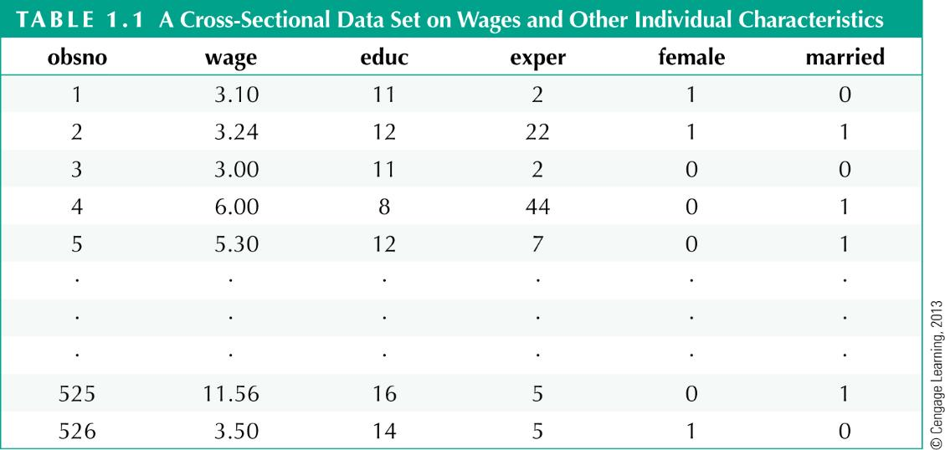
Cross sectional data:
One observation per unit of obs
Cross-sectional data set on wages and other characteristics
Indicator variables
(1=yes, 0=no)
Observation number
Hourly wage

Slide 20
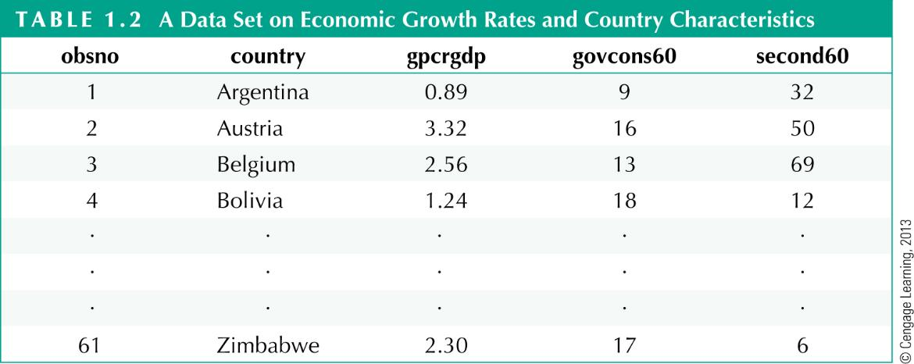
Cross sectional data:
One observation per unit of obs
Cross-sectional data on growth rates and country characteristics
Growth rate of real
per capita GDP
Government consumtion
as percentage of GDP
Adult secondary
education rates

Slide 21
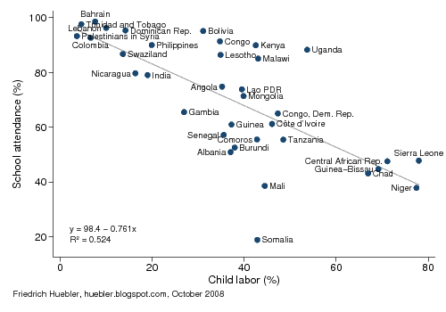

Slide 22
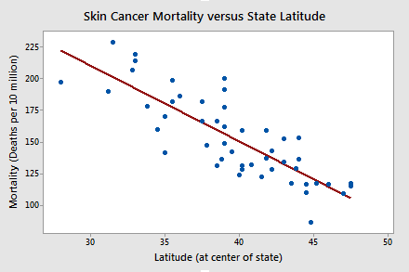

Slide 23
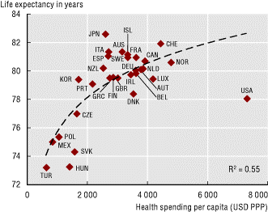

Slide 24
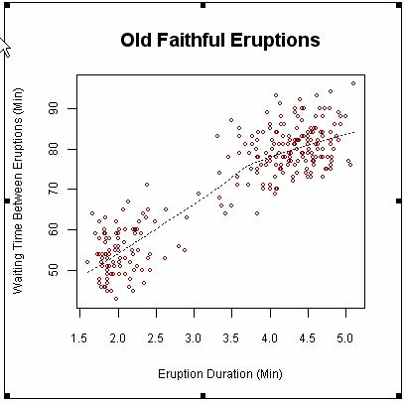

Slide 25
Types of Data
Time series data
  One or more variables describing the state of the world over time
    E.g., stock prices, money supply, consumer price index, gross domestic product, annual homicide rates, automobile sales, atmospheric carbon dioxide concentrations, global fish stocks…
  Ordering of observations conveys important information
  Typical features of time series: trends, seasonality, serial correlation
  Typical applications:
    macroeconomics, finance, forecasting and prediction

Slide 26
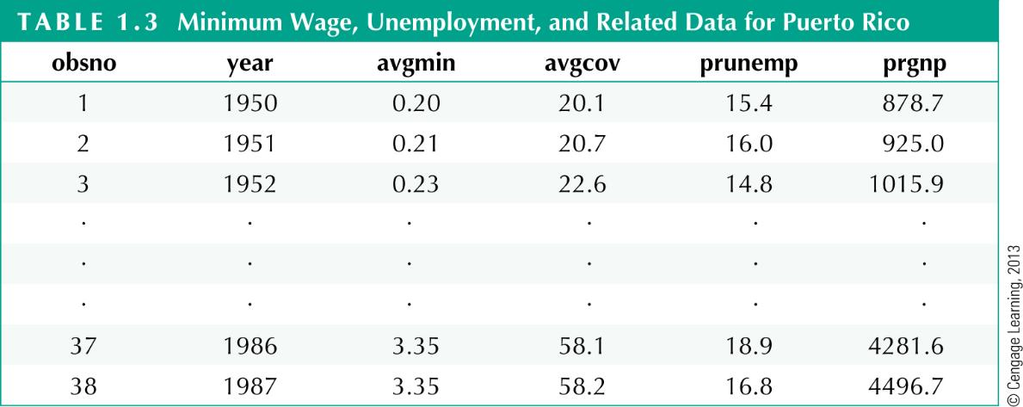
Types of data
Time series data on minimum wages and related variables
Average minimum
wage for given year
Average
coverage rate
Unemployment
rate
Gross national
product

Slide 27
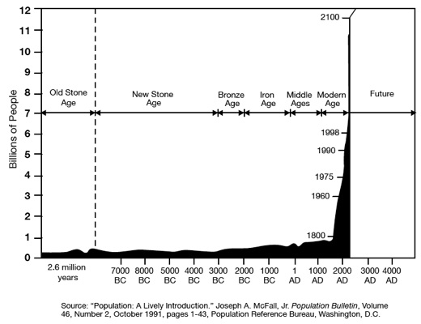

Slide 28
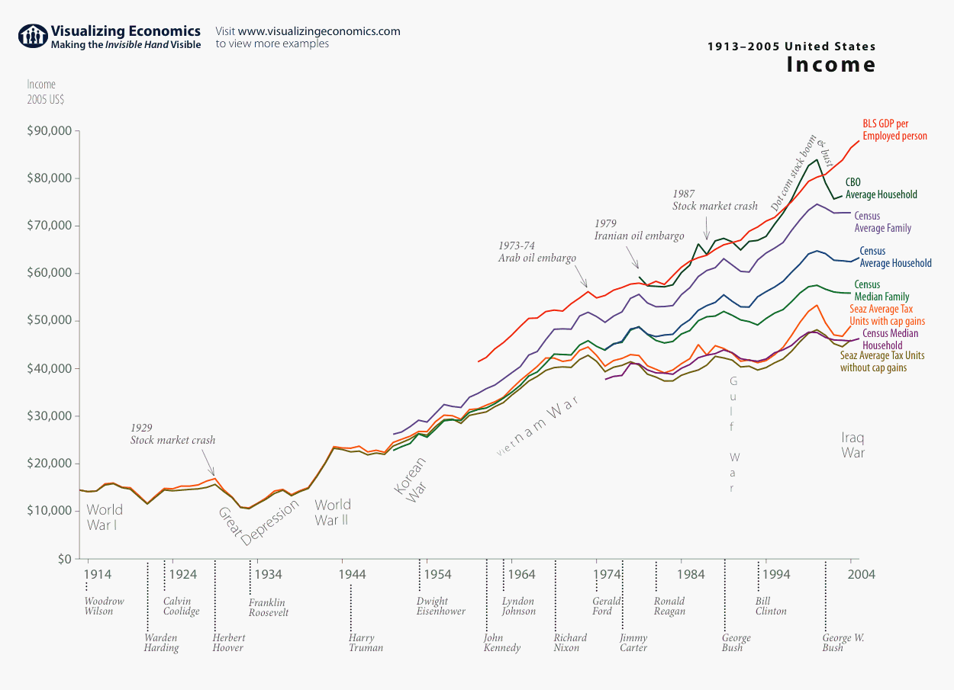

Slide 29
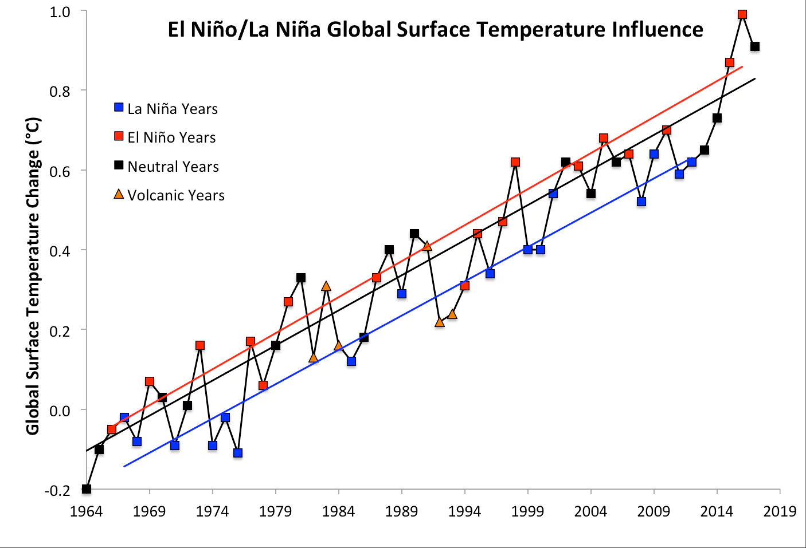
What does this graph tell us about El-Niño years? La Niñas? Volcanoes?

Slide 30
Types of data
Pooled cross sectional data
  Two or more cross sections, each associated with different time periods, combined into one data set
Example:
  Evaluate effect of change in property taxes on house prices
    Random sample of house prices for the year 1993
    A new random sample of house prices for the year 1995
      i.e., you’re not expecting to see the same house more than once
  Compare before/after (1993: before reform, 1995: after reform)
    Perhaps we might use a national sample where multiple different property tax laws changed in different ways to better identify that relationship

Slide 31
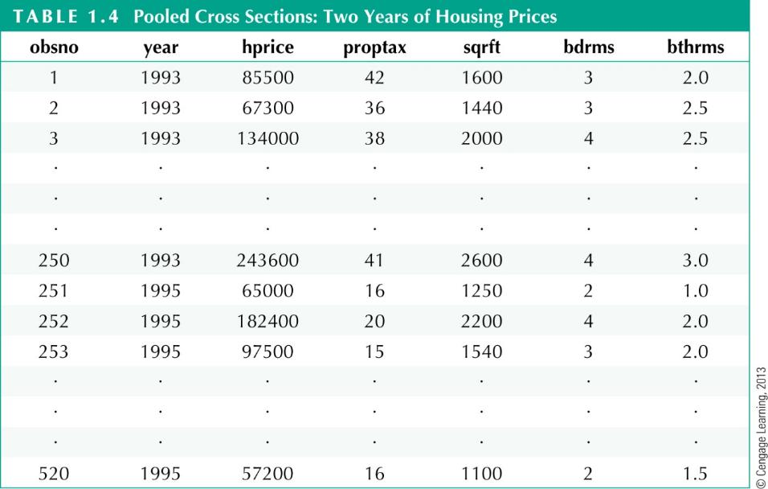
Types of data
Pooled cross sections on housing prices
Property tax
Size of house
in square feet
Number of bathrooms
Before reform
After reform

Slide 32
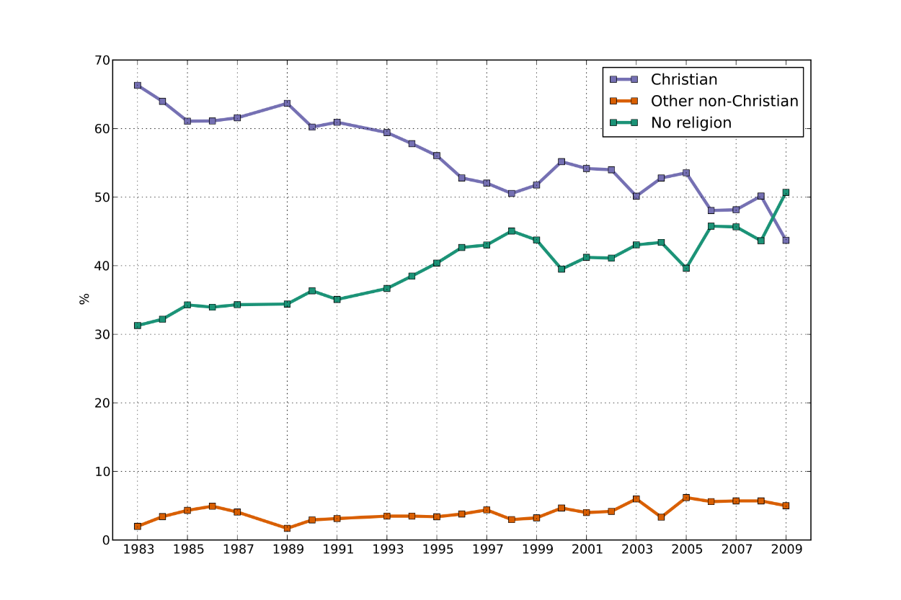
Most survey data are pooled cross sections

Slide 33
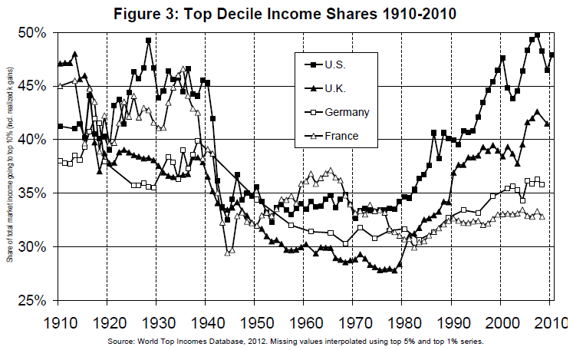
Most survey data are pooled cross sections

Slide 34
Types of data
Panel, or longitudinal, data
  Many observations, each observed multiple times
    Can be used to account for time-invariant unobservables
      E.g., by comparing a something against itself over time and looking at changes
    Can be used to model dynamic responses
Example:
  City crime statistics
    Time-invariant unobserved city characteristics may be modeled
    Effect of policies on crime rates may exhibit time lag
    National vs. regional effects can be explored

Slide 35
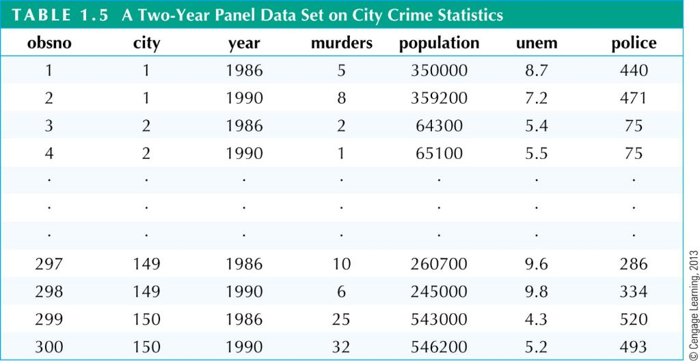
Types of data
Two-year panel data on city crime statistics
Each city has two time
series observations
Number of
police in 1986
Number of
police in 1990

Slide 38
The distinction between pooled cross section / panel / time series data can get blurry

Slide 39
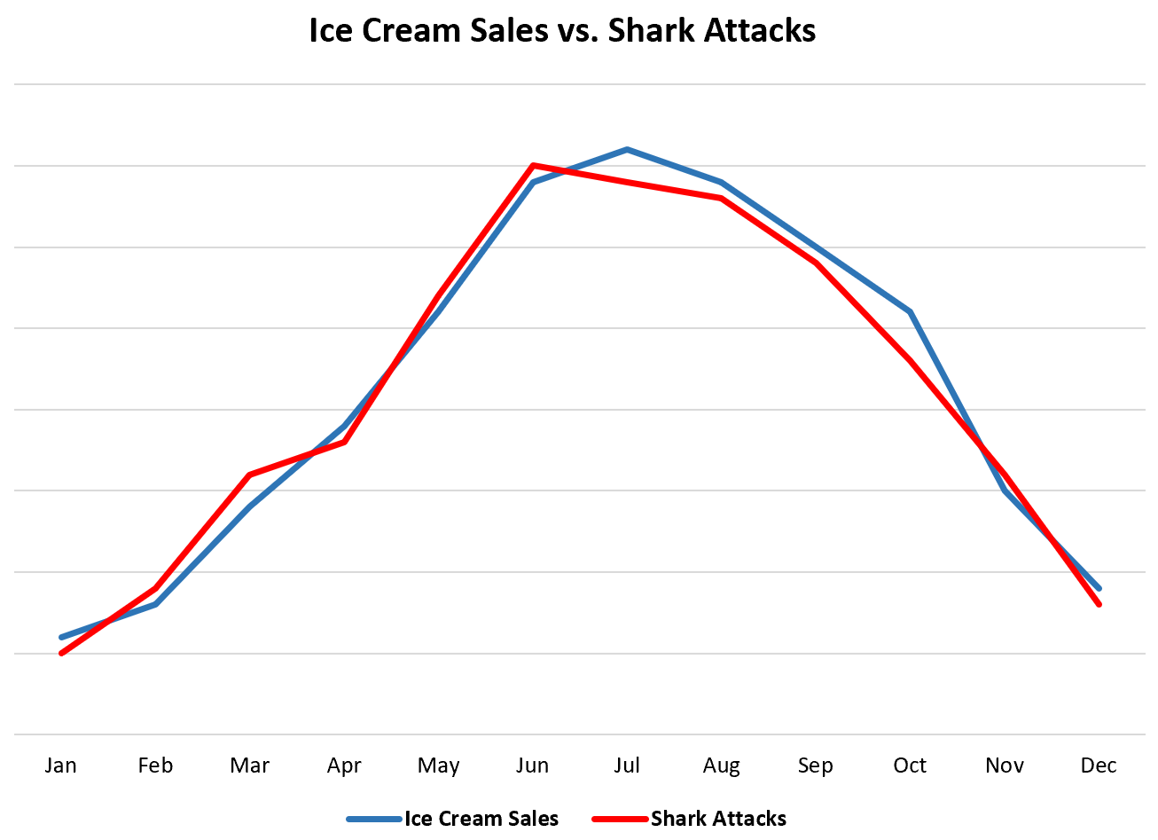
Causal inference methods are especially important in time series and panel data

Slide 40
Causal Inference vs. Association
A major aspect of econometrics that distinguishes it from general statistics is a strong emphasis on causal inference
  Causal inference: evaluating whether a change one variable (x) will lead to a change in another variable (y) assuming nothing else changes (ceteris paribus)
Why do we care about causality?
  A lot of times as econometricians we’re explicitly trying to evaluate a policy to enact
    Thus we want to know what will happen if we change one variable
  More generally, the statistical tools we have can tell us a lot about how two variables covary
    But correlation doesn’t imply causation, and reliably performing causal inference requires designing research appropriately
      This can be very hard if not impossible in practice
  A particular concern is when our two variables x and y are endogenous, or jointly determined
    i.e. x and y co-influence each other
      or there’s a third variable Z that affects both
        or something more insidious…

Slide 41
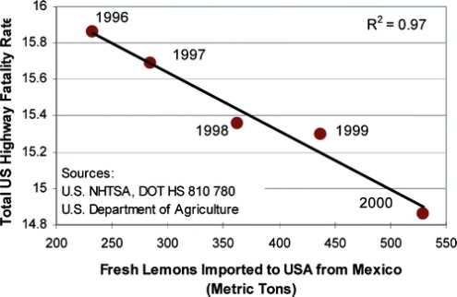
Causal Inference Matters

Slide 42
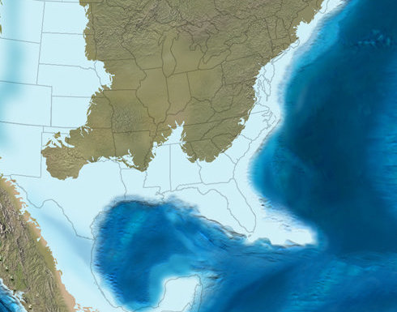
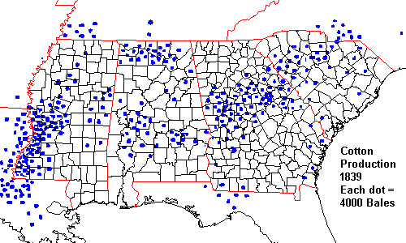
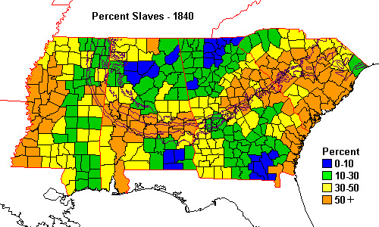
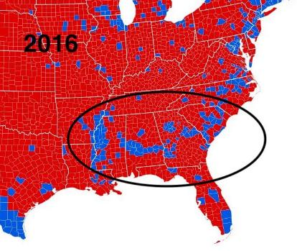
https://twitter.com/latifnasser/status/1323333293467525126

Slide 43
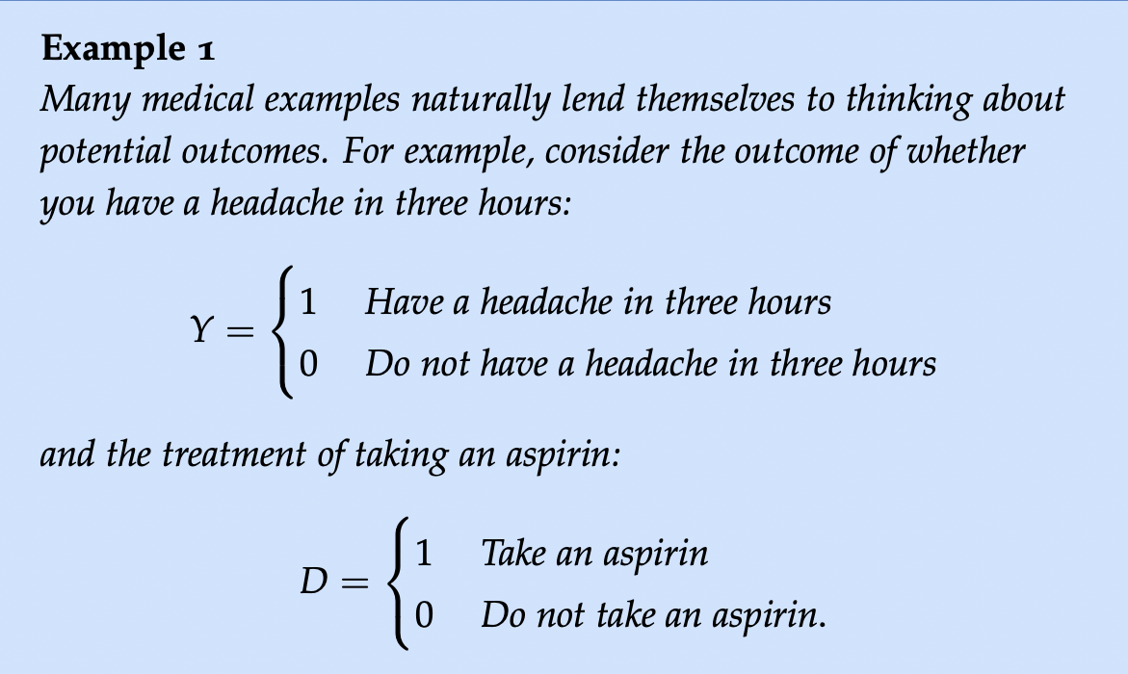
Fundamental Problem of Causal Inference: we can never observe both Y_{i}(D=0) and Y_{i}(D=1) for same i
  i.e., counterfactuals are fundamentally unobservable

Slide 44


Random assignment into
treatment groups
Receives
treatment
Receives
placebo
Lecture notes adapted from Jennifer Hill (2007)

Slide 45
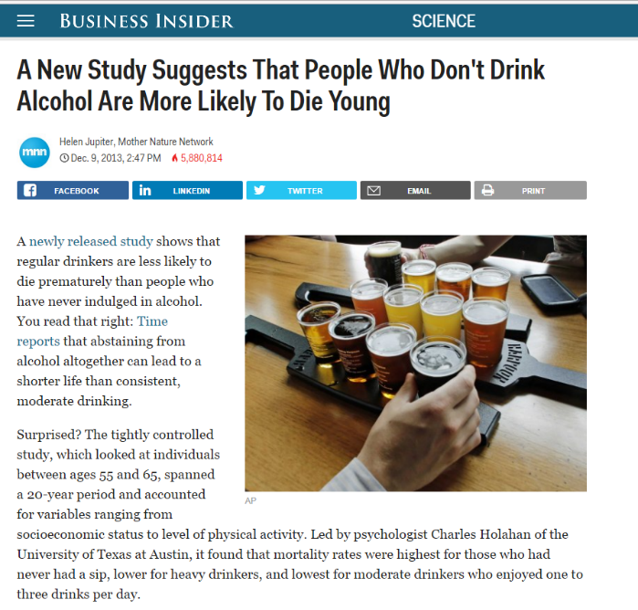
What’s wrong with this?
…What determines consumption choices?

Slide 46

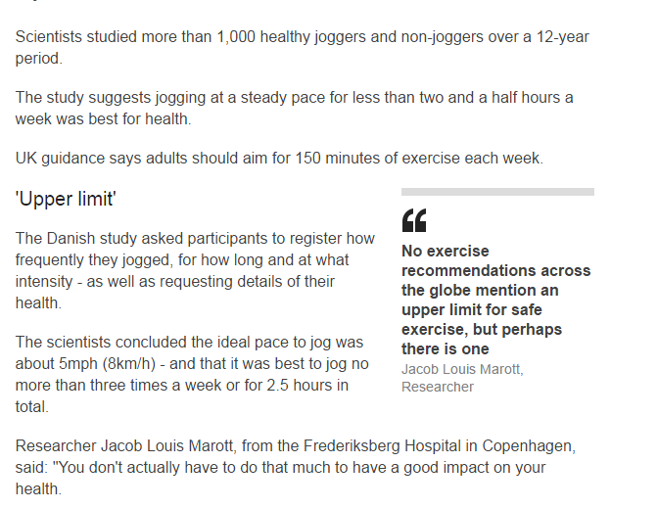
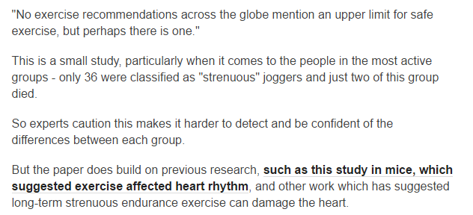

Slide 47


Slide 48
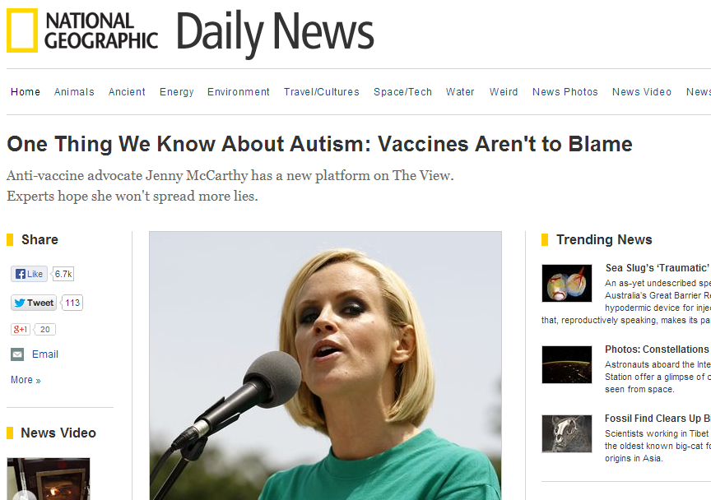

Slide 49


Slide 50
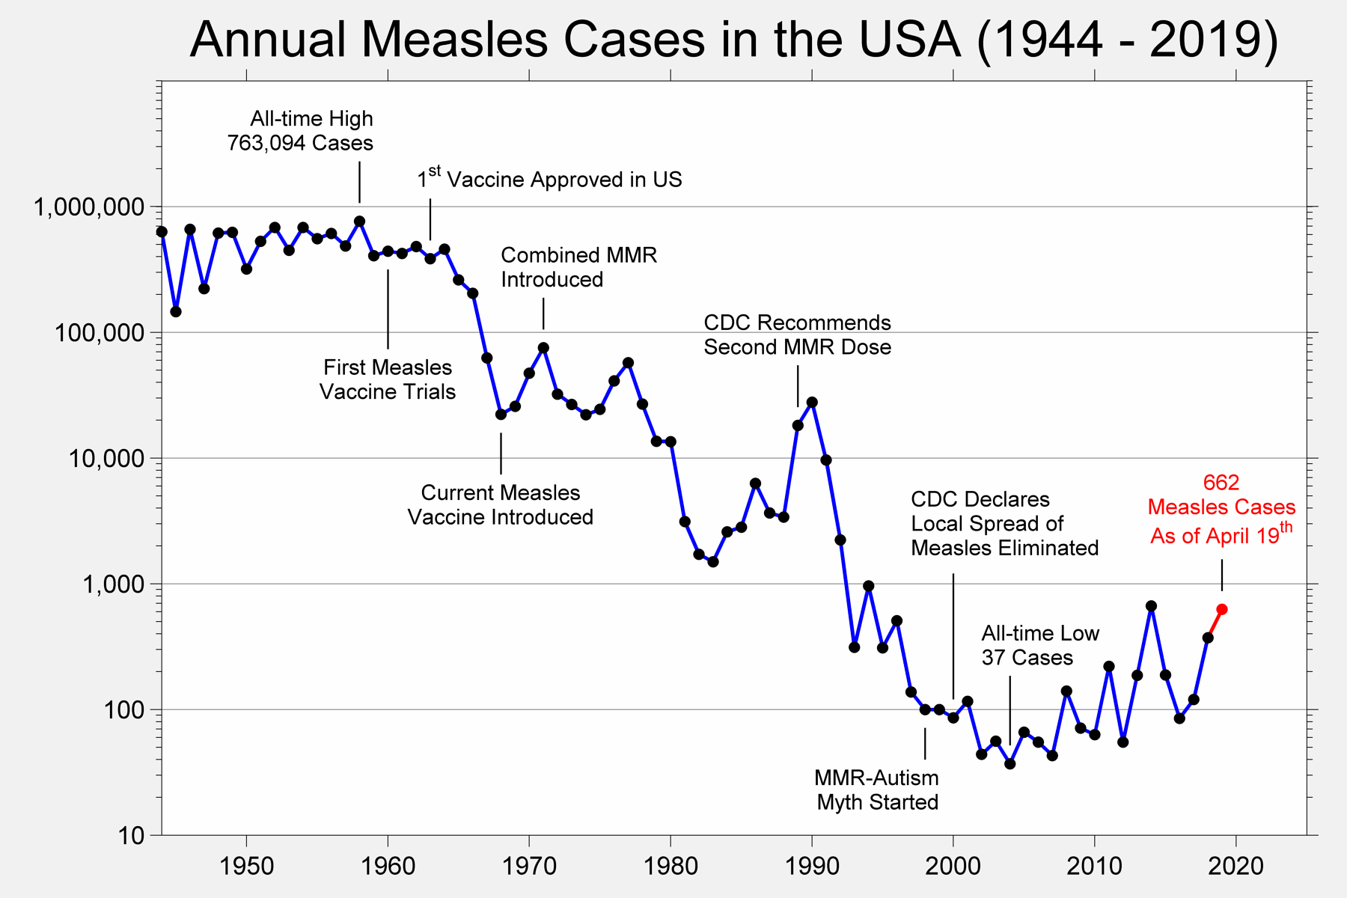

Slide 51


Slide 52

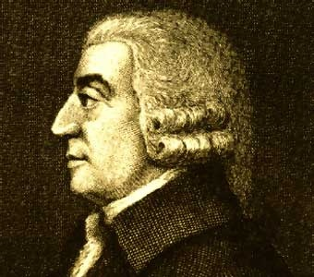
Empirical foundations of economics
Early stages: theory based on observation
This lasted for a while, and is a major contributor to common misunderstandings of what economics does or should do
        (coughcough Austrian economists coughcough)

Slide 53
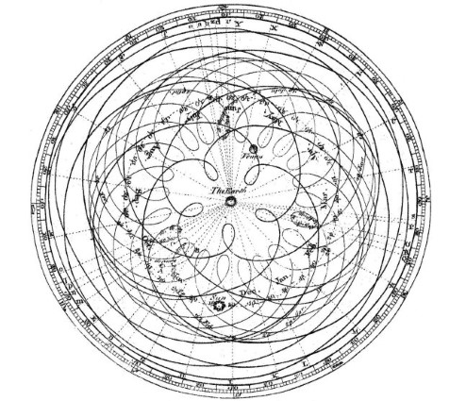
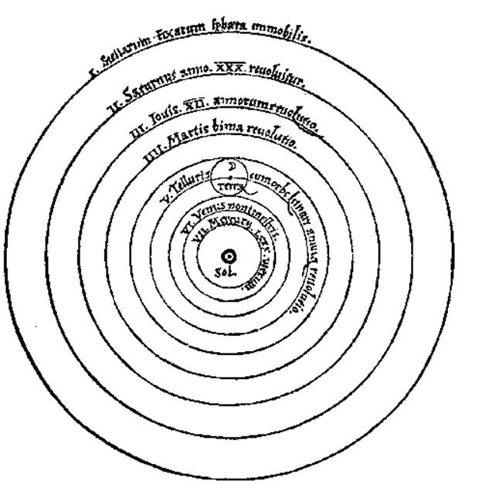
Theories based on observation can be powerful!
Ptolemy’s geocentric model
(Europe pre-1500s)
Galileo’s heliocentric model
(Europe pre-1500s)

Slide 54
The beginnings of more robust empirics and econometrics
In the early-to-mid 1900s computational limitations were enormous but some progress was made
  First instrumental variable (“curve shifter” for determining supply and demand curves for linseed oil) proposed by P.G. Wright in 1928
Endogeneity was conceptually recognized but not necessarily regarded as that confounding
  Theory was still motivating most research, and economists wanted to conceptualize basic aspects of complex systems like “the macroeconomy” or “labor markets”
In this sense they were acting more like the “natural philosopher” precursors to modern scientists

Slide 55
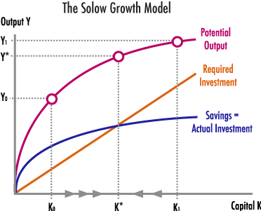

Slide 57
The mid-1900s: empirical economics’ dark ages
Attempts at dealing with endogeneity in economics were limited throughout much of the 1950s, 60s, and 70s
  Some exceptions:
    Sensitivity analysis (what we call robustness checks)
  Structural approaches
    E.g., Heckman’s correction
But, in general when it came to causal inference, mo’ metrics, mo’ problems
  As in, there was a proliferation of techniques which were “fancy” but rested on strong and often absurd assumptions

Slide 58
`

Slide 59
The early 80s crisis:
Leamer on empirics
Edward Leamer (1983):
  “Hardly anyone takes data analysis seriously. Or perhaps more accurately, hardly anyone takes anyone else’s data analysis seriously.”
    “Naïve regressions”
Consequences could be severe
  Isaac Ehrlich on capital punishment in mid 1970s
    “showed” that capital punishment was a major deterrent using one panel of 35 annual country level observations and one year of national cross section
      But those are crime and punishment are endogenously determined…

Slide 60


Slide 61
Hypothesis Testing
Hypothesis testing tells us how likely it was for us to see the difference we observe between an estimate and its test value
  based on the empirical distribution of the estimator given what we know from the Central Limit Theorem
We y decide ex-ante what a threshold “rejection” probability will be when doing hypothesis testing
  This is α, the power of the test
    As a general rule of thumb, we often choose to set α to 5% or 1% before we run a test
In testing, we distinguish between two possible mistakes
  Type 1 Error: accepting a false hypothesis as true
    “False positive”
  Type 2 Error: failing to reject a false hypothesis
    “False negative”
  Generally, we’re more concerned with Type 1, as it represents a mistake in the collective pursuit of knowledge, whereas Type 2 errors are simply continued lack of evidence
More generally: dichotomous hypothesis testing is bad science
Notes:
61

Slide 62
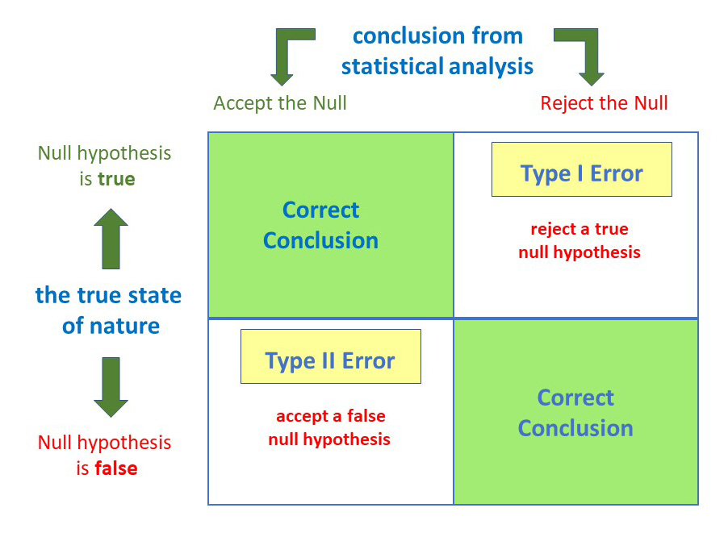

Slide 63
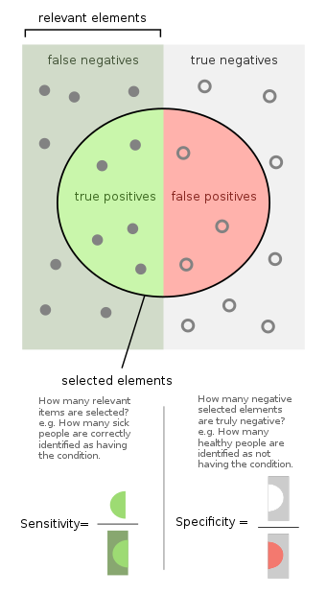
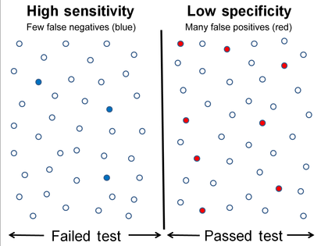

Slide 64
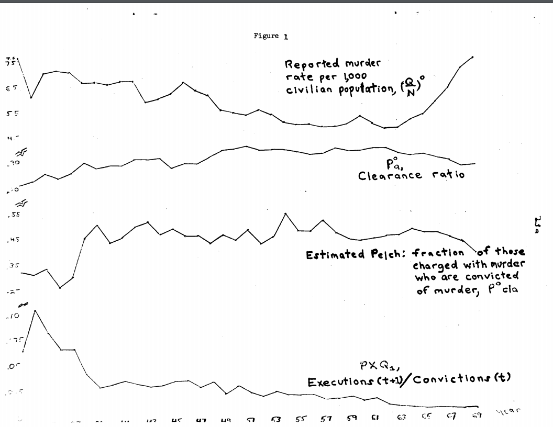
Erhlich (1973)

Slide 65
Causal Frameworks and RCTs
By early 80s there was a sizeable literature bringing ideas from the medical literature surrounding RCTs into the social sciences
  Rubin’s Causal Framework
    “Treatment” vs. “Control” corresponds, at the population level when appropriately randomized, to the difference between two counterfactual states of the world
      This interpretation requires, among other things, independence of other possibly influential factors on assignment of treatment, hence randomization
By the mid 80s this understanding was seeping into economics:
  Zvi Griliches (1986, p. 1466) at the beginning of a chapter on data in The Handbook of Econometrics:
    “If the data were perfect, collected from well-designed randomized experiments, there would hardly be room for a separate field of econometrics.”

Slide 66
RCTs: the gold standard
Randomized experiments are conceptually ideal (“the gold standard”) for answering causal questions because randomization creates different groups that are, on average, virtually identical to each other
  Identical groups receive different treatments (eg treatment or control)
  If the groups have different outcomes, we can safely attribute these differences in outcomes to the different treatments
    rather than any other characteristics of the experimental subjects, because they were on average, the same
      … checking to make sure you randomized right and that’s true is called “checking for balance in treatment”
Randomized experiments can use quite complicated assignment rules, but in general we can think of most randomization as being done either on individuals or in clusters
  If you care only about individual effects we tend to randomize at the individual level
    E.g., does medicine X cure disease Y
  When we care about how groups of individuals interact we do cluster randomization
    E.g., does vaccine X prevent outbreaks of disease Y

Slide 67


Random assignment into
treatment groups
Receives
treatment
Receives
placebo
Notes:
Have people suggest ways.
Coin flips; every other person “A” “B” “A” “B” etc; dividing based on last names
How do we do if we want to ensure we have the same number of people in each group?

Slide 68
A completely randomized experiment
In a completely randomized experiment with n study units and 2 treatment groups
  (i.e., treatment and control, indexed 1 and 0)
We designate being in the treatment group as having treatment indicator variable Z = 1 (control is Z = 0)
  m₀ units are assigned to the control group
  m₁ units are assigned to the treatment group
  each unit has the same probability of receiving the treatment as any other unit
  therefore all possible treatment allocations are equally likely
A common estimate of the effect of treatment in this setting would be
In a simple case this is yielded by the regression
of Y on our treatment indicator variable Z

Slide 69
Average Treatment Effects
In an ideal world, we would be able to observe both counterfactual states for every individual and then compare them
  i.e.,
    we could look at Y_{i}|Z_{i} = 1 and Y_{i}|Z_{i} = 0 for the same individual and calculate the unit treatment effect for that individual
  Buuuut time travel is impossible so we can’t normally observe the same person at the same time both receiving treatment and not!
    Right? Think about it if that’s not clear.
Given the fundamental problem of causal inference we cannot know the unit effects (the individual average difference between counterfactual state)
  Moreover any attempt to ascertain the unit effects would require strong additional assumptions that are probably wrong
However, we can define average effects, e.g., the average treatment effect (ATE):
    E[Y(1) - Y(0)] = E[Y(1)] - E[Y(0)]
The ATE tells us what, on average, our unit treatment effect is
  i.e., the average difference between all the treated (Z=1) and control (Z=0) groups

Slide 70
Randomized experiments: potential outcome notation
For a given treatment, each person can be thought of as having two potential outcomes, Y(0) and Y(1)
  Y(0) is the outcome if the individual doesn’t receive the treatment (i.e. Z=0)
  Y(1) is the outcome if he or she does receive the treatment (i.e. Z=1)
We may think of each of an individuals potential outcomes as being the counterfactual of the other
  As in, if it were not the case that the individual received treatment, they would have been in control

Slide 71
Randomized experiments: potential outcome notation
We use these potential outcomes (Y(0), Y(1)) to define a causal effect for subject i as a comparison of potential outcomes, most often
  τ_{ι} = Y_{i}(1) - Y_{i}(0)
In theory a causal effect can be defined as any function of the potential outcomes such as
  g(Y_{i}(0),Y_{i}(1))=1 if Y_{i}(1)>Y_{i}(0)
Note that a unit can be an individual subject or a group of individuals, e.g., a classroom, a family etc.
Fundamental Problem of Causal Inference: we can never observe both Y_{i}(0) and Y_{i}(1)
  i.e., counterfactuals are fundamentally unobservable

Slide 72
Fundamental Problem of Causal Inference: we can never observe both Y_{i}(0) and Y_{i}(1)
  i.e., counterfactuals are fundamentally unobservable
What’s wrong with this?
…What determines child music education?

Slide 73


Fundamental Problem of Causal Inference: we can never observe both Y_{i}(0) and Y_{i}(1)
  i.e., counterfactuals are fundamentally unobservable

Slide 74
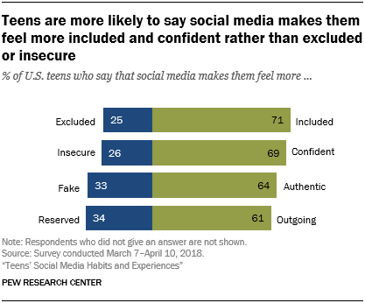
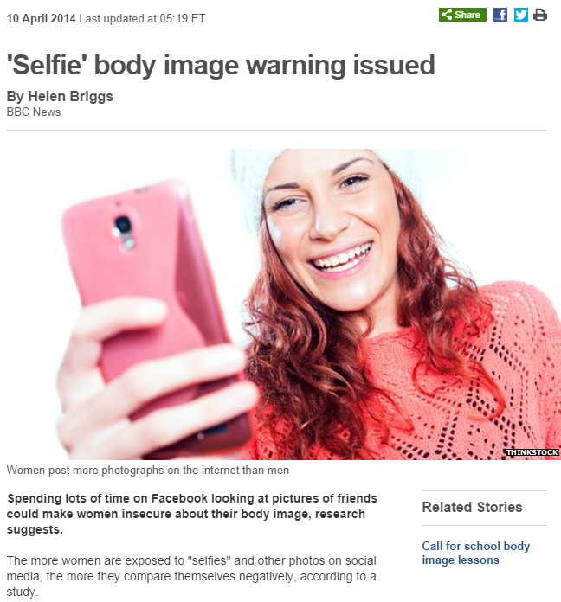
Fundamental Problem of Causal Inference: we can never observe both Y_{i}(0) and Y_{i}(1)
  i.e., counterfactuals are fundamentally unobservable
https://twitter.com/graykimbrough/status/1112792224121741320

Slide 75
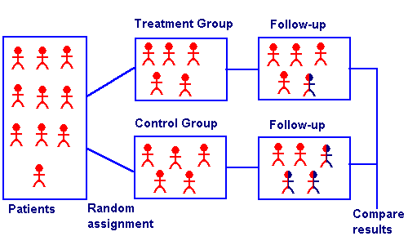
Interpreting coefficients
Estimated efficacy of new cold medicine
number of colds = 0.52 – 0.82 (treated with medicine)
(0.23)
(0.31)
Everything else being equal people who got medicine got .82 fewer colds
The indicator variable here represents 1/0 depending on whether the individual was randomly assigned to the treatment group
What‘s the omitted category on that indicator variable?
1/0 for being in the control group
ATE = E(Y|Z=1) – E(Y|Z=0) = - = -0.82

Slide 76
The identification revolution
By the mid 90s, empirical microeconomics in particular had started to realize that if it wanted to be taken seriously it needed to deal with endogeneity
    Once you understand endogeneity as an issue you can never look at an evaluation of an opt-in job training program again
Specifically, economists recognized the need for “well-identified” econometrics whenever interpreting something causally
  “Well-identified” meaning that one can correctly “identify” what plays a causal role and what does not
This has been heavily driven by the rapid growth in cheap computing
  Running a regular OLS regression with interesting results used to be enough to get published pretty well
    Partly cause it was near the limit of technological feasibility
Most importantly, identification allows for a more objective appraisal of whether a policy or a intervention is likely to work
  This approach is often referred to as quasi-experimental
    As in, the work is sort of like experiments
      Sometimes explicitly, like with RCTs
      Sometimes only somewhat (“quasi-”), as with natural experiments

Slide 77
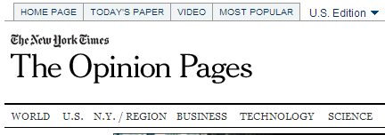
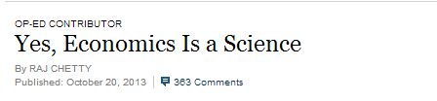
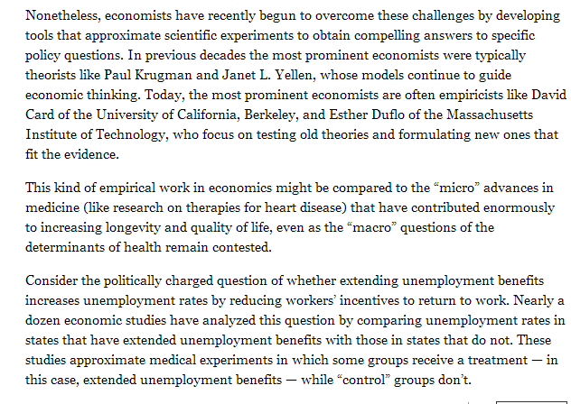

Slide 79
What if we can’t randomize?
Your identification strategy is how you plan to identify your parameter of interest
  The simplest identification strategy is randomization
Unfortunately, randomized experiments are often implausible
  Cost reasons - even small RCTs are expensive
  Moral reasons - e.g., if you want to study conflict you can’t randomly try to provoke violence
  Logistical reasons - Like, we can’t randomly assign good institutions, or favorable geography, or prosocial norms, or…
In such situations we must find some way of inferring (with justification) that our variable of interest can be interpreted as being functionally random
So what can one do?
  Classic: Control for confounding variables that influence treatment or outcomes, using theory as a guide (“structural modeling” approach to research)
    Becomes difficult because of GMA4
      many things we care about are unobservable and complex
        hence we can’t generally assume that the zero conditional mean assumption holds
  New way: Come up with a new identification strategy using a natural source of variation, e.g., a natural experiment
    E.g., difference in differences, instrumental variables, or regression discontinuity
        Sounds great in practice, though you’ve got to find the experiment…
These identification strategies will be covered in greater detail in future courses, but I just want you all to at least know / see and recognize them

Slide 80
Internal vs. External Validity
Concerns about identification within an econometric model are often referred to as concerns over the internal validity of the model
We say that an econometric model is internally valid if we believe that our coefficients of interest are appropriately specified and identified for the specific sample we are using
  e.g.,
    a randomized control trial of a school uniforms grant program in rural Zambia may show that it having a uniform increases attendance by 15%
      And assuming that all your identifying assumptions hold, you can be pretty sure that that was the average effect of granting the uniforms
We say the a model is externally valid if we believe that our identified coefficient of interest can be generalized to outside our sample
  e.g.,
    while we may know that uniforms increase attendance for our sample in rural Zambia, we can’t necessarily infer what will happen in other contexts, such as another country, or children of a different age, or children in urban areas
The tension between doing well identified work and externally valid work is fairly unique to the social sciences, since in most of the natural sciences controlled experiments allow one to skip wracking one’s brain over internal validity and skip straight to external validity

Slide 81
Identification strategies
At the end of the day, all parameter estimation comes back to tensions between and underlying model and random variation
  We can think of this a being the divide between older-style and post-identification revolution econometrics
Model-based
  Controlling for confounders
  Matching / synthetic controls
  Fixed effects
    All model-based identification strategies are only as good as their underlying model!
      See, e.g., Romer (2016)
Randomization-based
  RCTs (randomized control trials)
  Difference in differences
  Instrumental variables
  Regression discontinuity
    All randomization-based identification strategies are only as good as the random variation (and where and how you can find it!)
All real research ultimately needs to rely on both

Slide 82
Controlling for confounders
It is sometimes the case that our treatment variable Z may be interpreted as exogenous conditional on some other variables X₁, X₂, etc.
In this situation we may include our other X variables in our model
  Assuming everything has been well specified this should allow one to interpret the coefficient on Z causally
Generally speaking it is difficult to argue that all relevant confounders have been included in your model, and moreover that the relationship between confounders and treatment is linear, appropriately specified, etc.
  Ex: say you want to know the impact of a marginal year of education
    you can include controls for parents’ education, wealth, etc.
    but you can’t control for things like an individual’s desire to succeed
      or the influence of their friends or families
    Thus those terms are in our error term, and estimates biased
Achieving identification through controls is thus generally difficult or impossible unless you know your model works very well
  Something that the older structural approaches have obscured…

Slide 83
In econ you can basically never know whether you’ve controlled for all
Unobservables correctly (e.g. musical ability, parents, society, etc.)

Slide 84
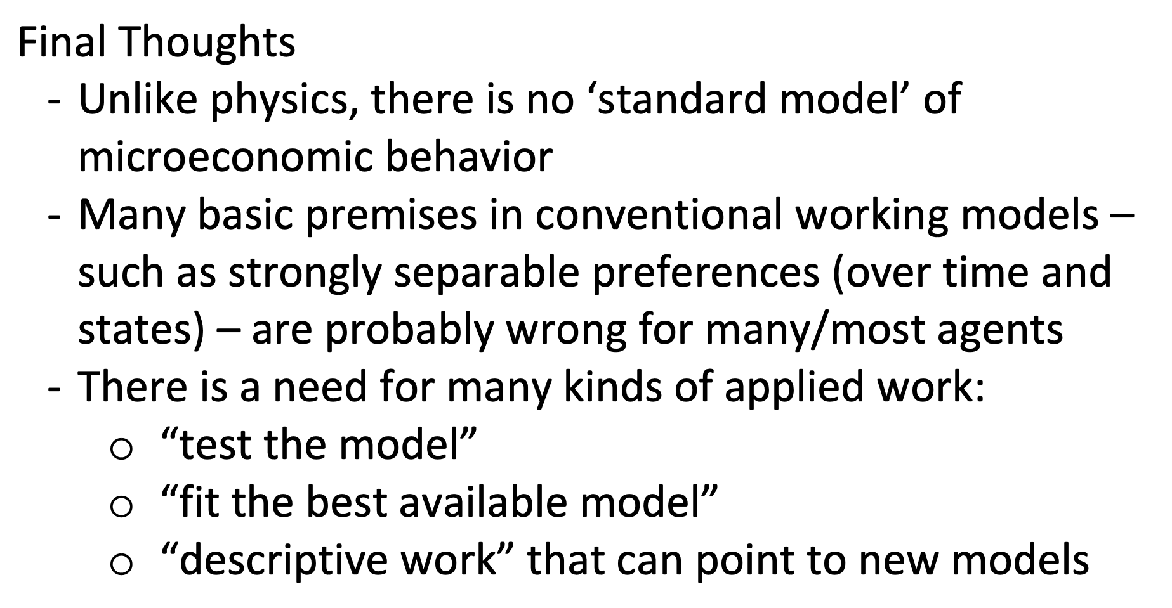
from David Card Nobel Acceptance:

Slide 85
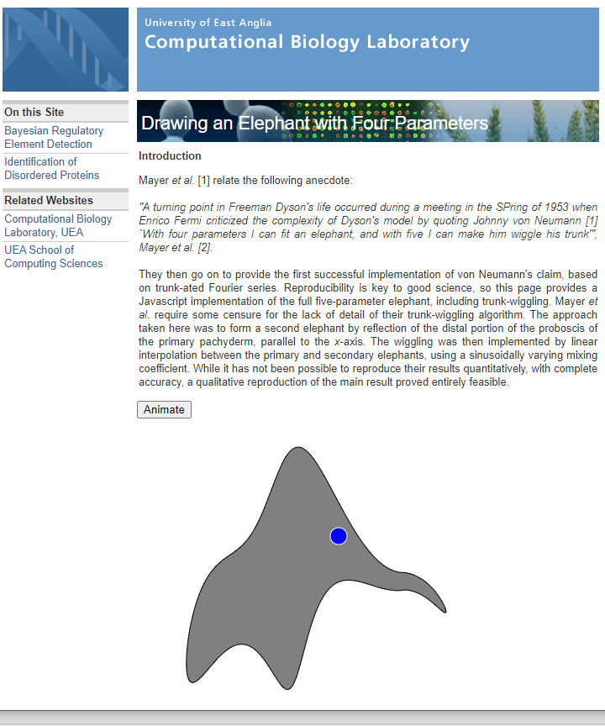
http://theoval.cmp.uea.ac.uk/projects/elephant/
Notes:
http://theoval.cmp.uea.ac.uk/projects/elephant/

Slide 86
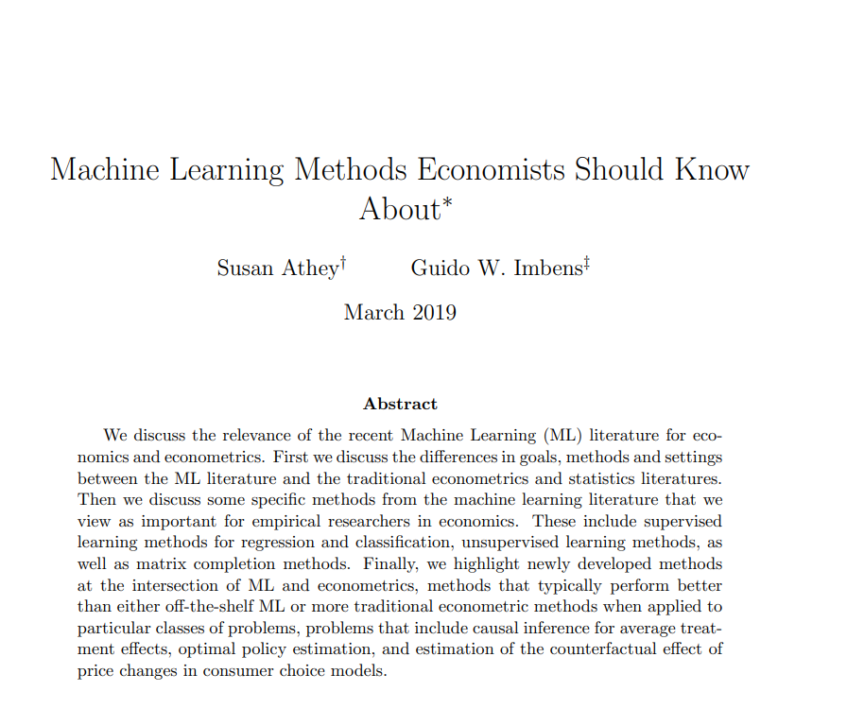

Slide 87
Matching
Matching is the more generalizable case of controlling for confounders
Recall that our fundamental outcome of interest for causal inference is the ATE
  E[Y_{i}(1)] - E[Y_{i}(0)]
    i.e., the average difference between treated and non
  This is difficult to estimate because counterfactual states are never observed
BUT, imagine you were able to match different individuals who differed only on treatment status, then one could plausibly infer counterfactuals
  E.g., compare two 25 year old latino plumbers living in SF both married with associate’s degrees who only seem to differ on whether one received a job training program and one didn’t
There are many different techniques used to generate matching estimators, but they share the same general problem as controlling for covariates
  outside specific circumstances generally won’t get you what you want, though they’re often better than just simple controls
    See, e.g., propensity score matching

Slide 88

E.g., one could match otherwise very similar workers, some who
received job training and some who didn’t, and look a differences in outcomes
What’s potentially wrong with that?
Matching is basically “using a lot of controls” and the GMA4 concerns still hold!

Slide 89


Slide 90
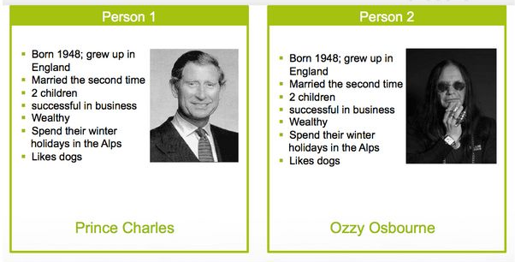
Matching

Slide 91
Fixed Effects
If our observations are observed repeatedly (usually over time, though sometimes over space or some other underlying variable) then we may be able to achieve identification by controlling for invariant confounders
  In other words, we can take advantage of the fact that the same units of observation should behave similarly over time
One simple way of doing this is by using a fixed effects estimator for our observations
  We identify some fundamental subgrouping in our data (usually though not always the unit of observation) and include indicator variables for each observation
  These indicator variables then control for the average relationship between being in the subgroup and our Y outcome
    E.g., the average high school graduation rate in your county, or the average price of your good, or…
If we believe or may argue that timing of treatment is exogenous this will often help us achieve identification
  Often FE alone aren’t enough, but combined with a good identification strategy they can often be relied upon to yield conditionally exogenous treatment
    See, for example, Angrist and Pischke (2017) on running fully saturated models
      indicators capturing for average outcomes relevant groups demographic subgroups combine pretty well with a plausibly exogenous treatment
        This is the sort of thing you’ll talk about more in metrics II and III
    This is why, e.g., effects of climate variability, which is random, are easily identifiable
FE isn’t usually your entire id strategy, but you’ll often throw them in to control for the average impact of nonvarying unobservables in a given region / time period / demographic cohort / etc.

Slide 94
Country FE
Year FE

Slide 95
Difference in differences
One of the classic simple ways of trying to get identification is to look at changes before and after, e.g., a certain policy is passed in different states
  If the timing is plausibly exogenous, then on average we should see the impact of the policy
With a diff-in-diff estimator, we do not estimate
  E[Y_{i}(1)] - E[Y_{i}(0)]
But rather
  E[ΔY_{i}(1)] - E[Δ Y_{i}(0)]
    i.e., we only look at the change in Y for treated vs. control groups
The advantage of diff-in-diff is that there are many situations where treatment is sharply defined in time, and hence for sufficiently large numbers of observations (and assuming timing of treatment isn’t endogenous) effects can be easily estimated
  Classic diff-in-diff type papers: national policy is enacted which only impacts certain states, look a the state-by-state level changes

Slide 96
Ray Fisman – 2001 – Estimating the Value of Political Connections
What is the value of corrupt political connection?
Looks at Indonesian firms connected to Suharto (on a scale from 0 to 4), and uses Suharto illness announcements to estimate that the most connected firms lose one quarter of their
value if Suharto suddenly died.
(increasing dependency)

Slide 97
Instrumental variables
Sometimes we would like to infer the impact of a X on Y when the two variables are clearly endogenous
  Classic example: the influence of changes in supply or demand on market prices
If there exists some third variable Z which influences X but does not influence Y aside from through its influence on X then we may use the exogenous variation in Z to instrument for X
  This assumption is known as the exclusion restriction
In essence, this means we
  Regress X on Z
  Take our predicted X values (which are linear combinations of Z)
  Regress Y on our predicted Xs
If we know Z only influences Y through X, then we have identified variation in X that is NOT jointly determined (i.e., endogenous with) Y
  Thus we may interpret our coefficient on X as causal
Good instruments are hard to find, and exclusion restrictions can generally only be argued for, not proven
  But when done nicely a good instrument can be great

Slide 98


Slide 99
Regression Discontinuity
Sometimes treatment is assigned due to a specific rule
  E.g., to get into my high school you had to get a certain score on a standardized test
We often believe that such rules are quasi-random from the point of view of individuals right near the threshold of assignment
  E.g., there shouldn’t be a huge difference between the kids getting 1200s on their SATs and 1190s, and whether the cutoff is 1200 0r 1190 is a function of the larger dynamics of the selection process, number of units being selected, etc.
If this rule and the running variable that determines treatment are both known, then one may use a regression discontinuity estimator
  Functionally, we look at units just above and just below the treatment cutoff, check to make sure that they don’t differ systematically, and then compare differences
    In essence, for a small number of individuals around the cutoff treatment can be viewed as exogenous
RD can often give us nice identification when we can find it
  Though it’s often particularly difficult to get external validity there

Slide 100
Endogeneity by example: Classroom size and educational achievement
This again?
Solutions:
Randomization
Natural Experiment

Slide 101


Randomization

Slide 102
Natural Experiment

Slide 103

RD: compare groups just above and below cutoff
if rule strictly enforced should be quasi-random

