Slide 1
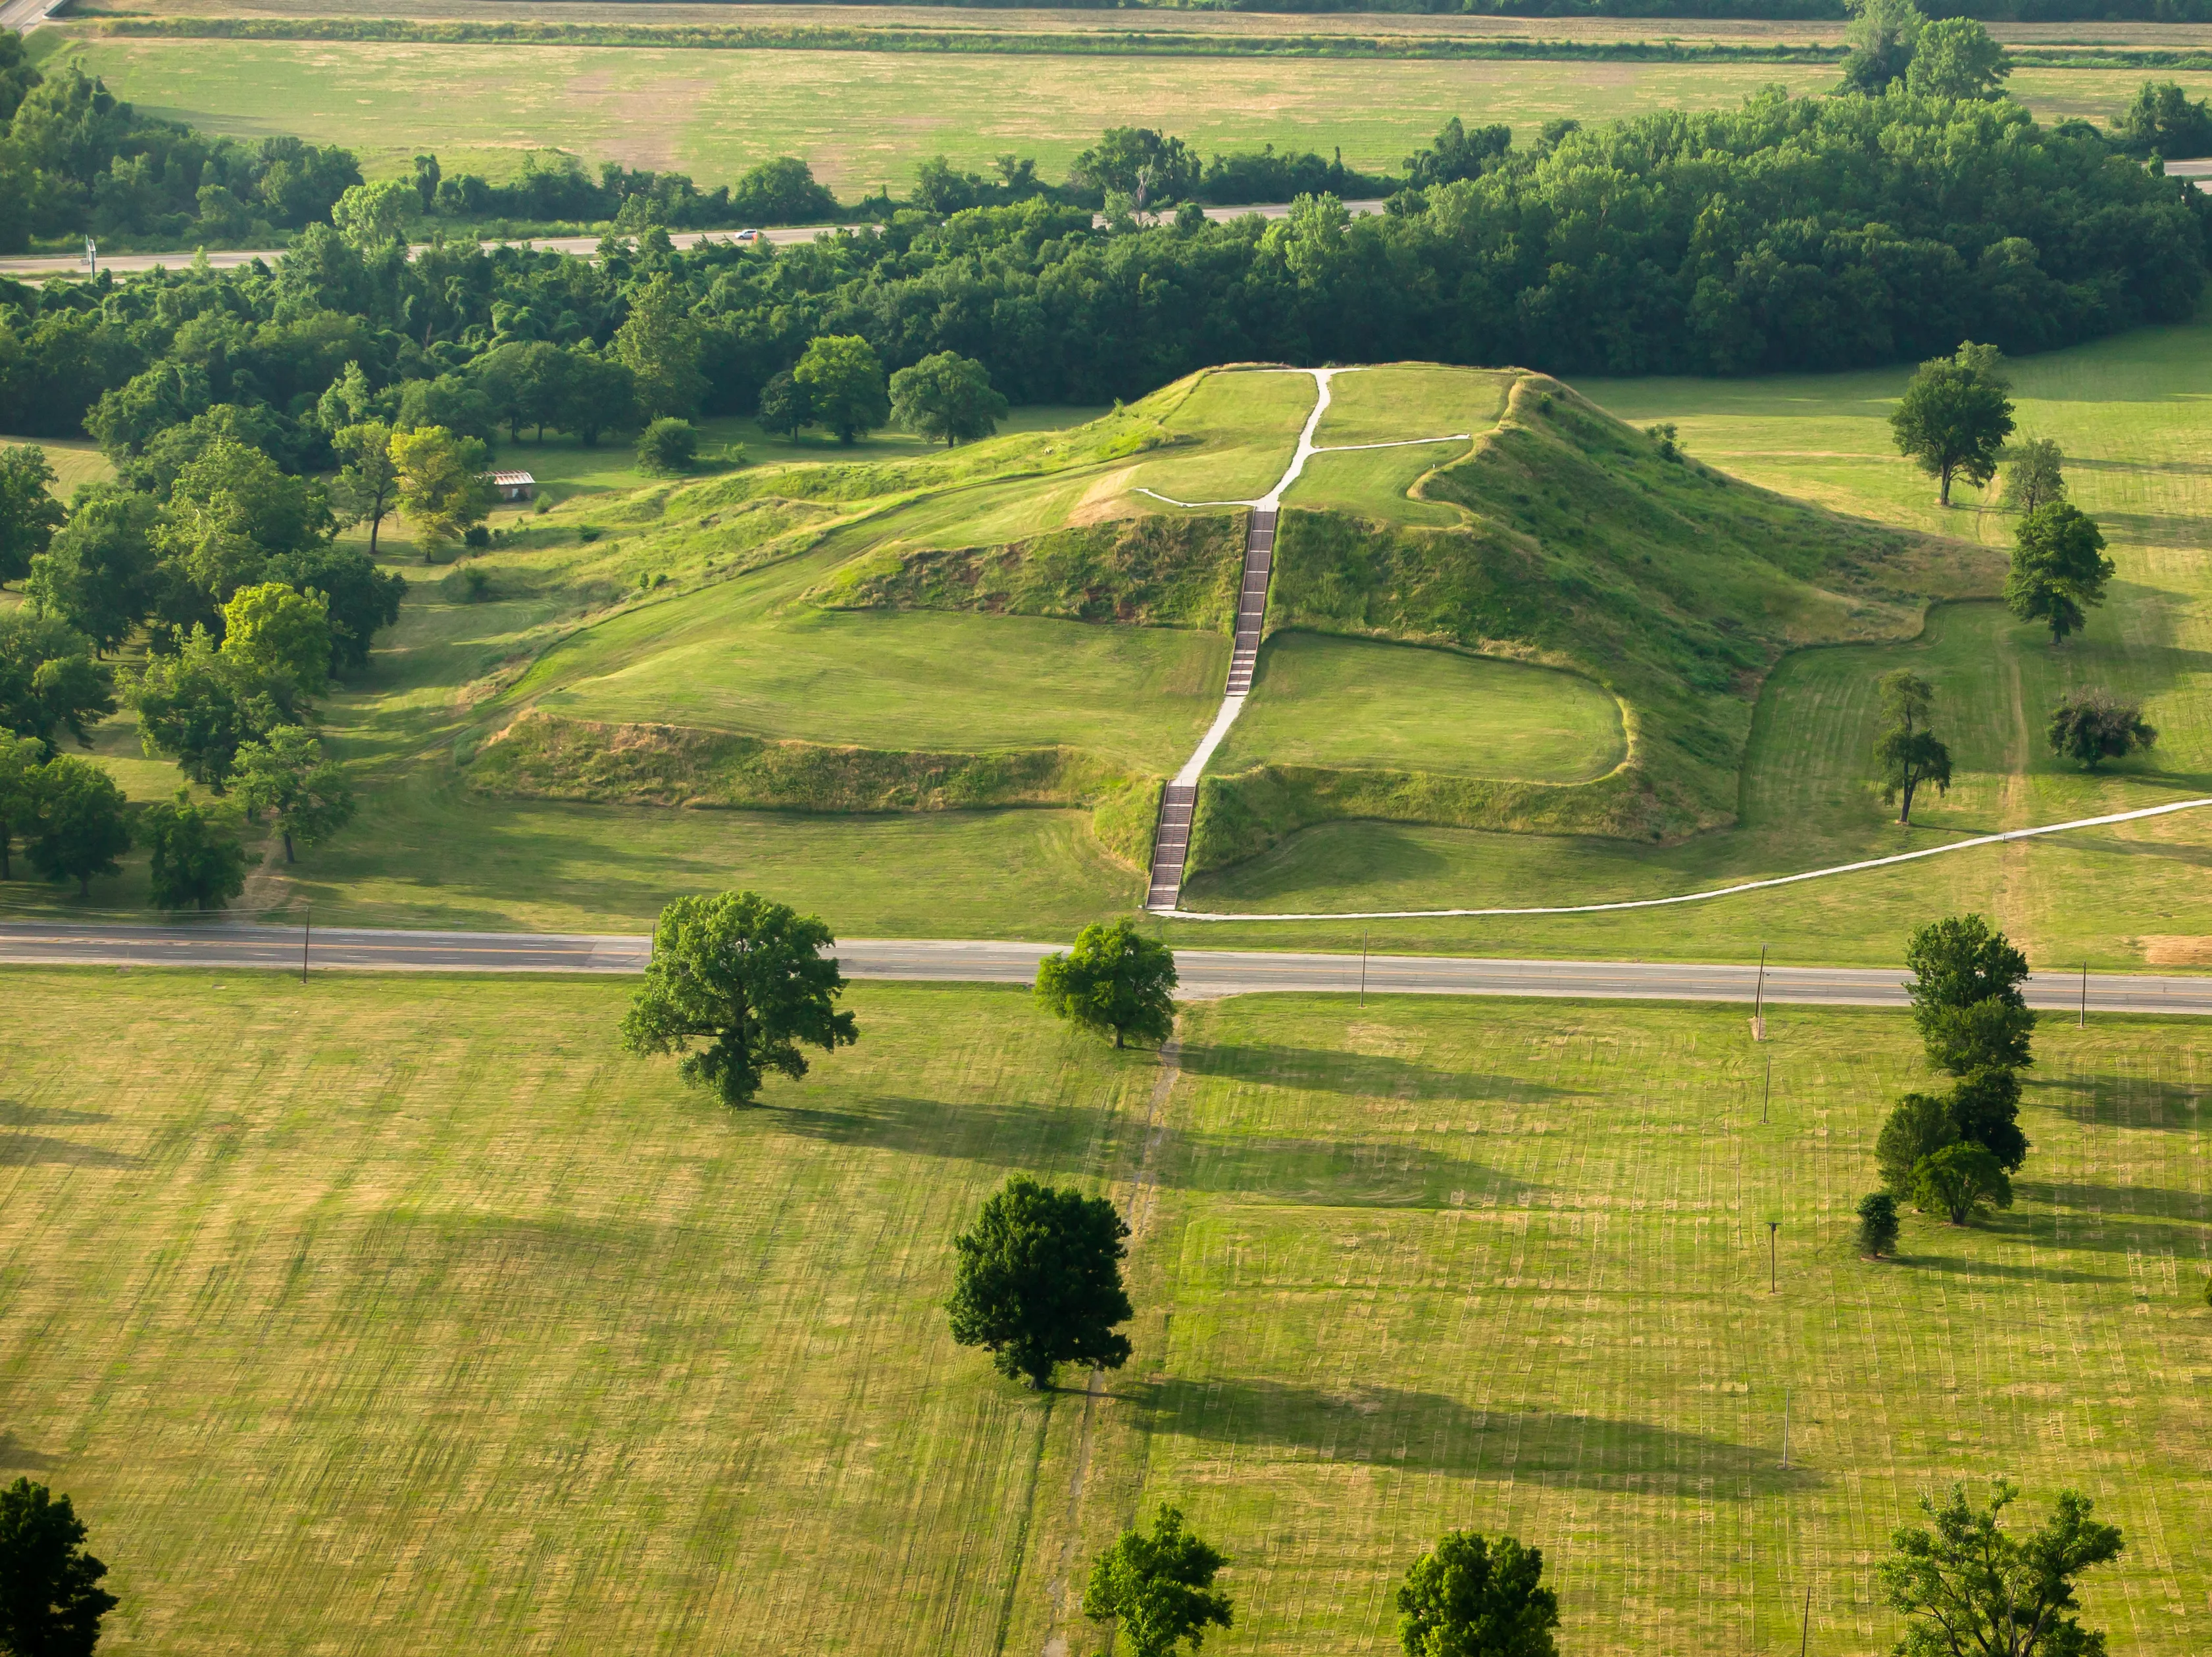
Econ 280 / BAIS 103
Lecture 3: The World in 1491
University of San Francisco
Department of Economics
Prof. Jesse Anttila-Hughes
January 30th, 2025
Notes:
https://en.wikipedia.org/wiki/Cahokia

Slide 2
Welcome to Econ 280 / BAIS 103!
Today we’ll cover:
  The world in 1491
    What did the global economy look like over human history?
      Mann - “1491” in The Atlantic, Harari - Sapiens – Ch. 1, Diamond - Guns Germs and Steel – Prologue
    Malthus and the premodern civilizations
Readings for next time:
  Steinsson - 2021 - Malthus and Pre-Industrial Stagnation
  Clark - 2005 - The Capability Approach: Its Development, Critiques and Recent Advances
  Supplemental reading:
    Matranga - 2024 - The Ant and the Grasshopper
My office hours: Tues 3-5pm and Wed 2-4pm by appointment
  Teaching assistant will also hold office hours, TBA shortly
Question set 1 actually assigned today, due next Monday 2/10

Slide 3
Warm up!
What was the most surprising thing you learned from the 1491 and Sapiens readings?
  What did it change in terms of your understanding of the economics of the premodern world?
    How does that influence your understanding of the world today?

Slide 4
Review from last class
Today’s global economy is quintessentially capitalist, which is to say it combines three key institutions
    private property, markets, and firms
  The modern global capitalist system brought a lot of good
    expansion in fundamental capabilities due to technology
    improvements in health, communication, transport, food…
        aka. “economic development”
    Peace, prosperity, and many freedoms (?)
  It has also brought a lot of bad
    exploitation, subjugation, oppression, and eradication
    ecocide, extinction, and existential environmental collapse
    potentially very negative cultural changes
Regardless of our opinion of the capitalist global economy, we can model it, or any economy, as a set of relationships between consumers and producers
  The circular model of the economy divides the world into households that consume, and firms the produce, linking the two via product and factor markets

Slide 5
The global economy in 1491

Slide 6
Our First Model:
The Circular-Flow Diagram
The Circular-Flow Diagram: a visual model of the economy, shows how money and work flow through and links markets between households and firms
Two types of agents
  households
  firms
Two markets:
  the market for goods and services
  the market for factors of production
A market is an institution that allows individuals to collectively exchange goods and services
Notes:
6
Originally from Mankiw Principles text

Slide 7
FIGURE 1: The Circular-Flow Diagram
Households:
Own the factors of production,
sell/rent them to firms for income
Buy and consume goods & services
Firms
Households
Firms:
Buy/hire factors of production,
use them to produce goods and services
Sell goods & services
Notes:
7
Originally from Mankiw Principles text

Slide 8
Model 1: The Economy as Circular Flow of Goods and Services
Revenue
Spending
Markets for Goods & Services
G & S sold
G & S bought
Firms
Households
Factors of production
Labor, land, capital
Markets for Factors of Production
Wages, rent, profit
Income
Notes:
8
Originally from Mankiw Principles text

Slide 9
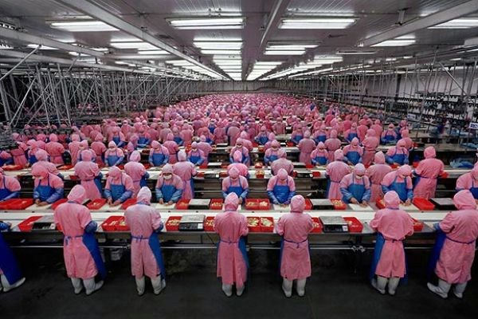
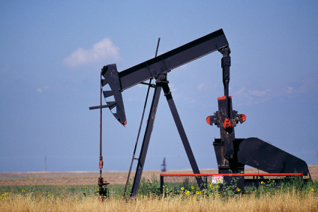
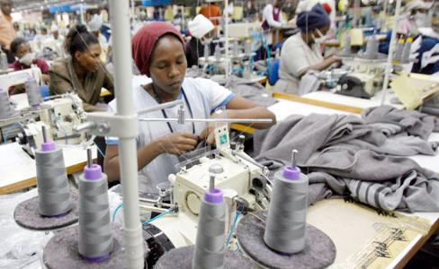
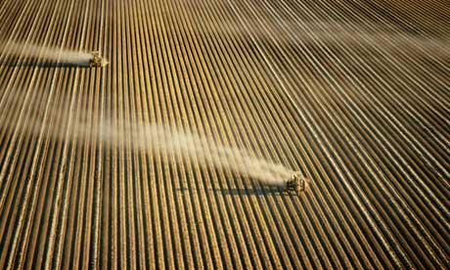

Slide 10
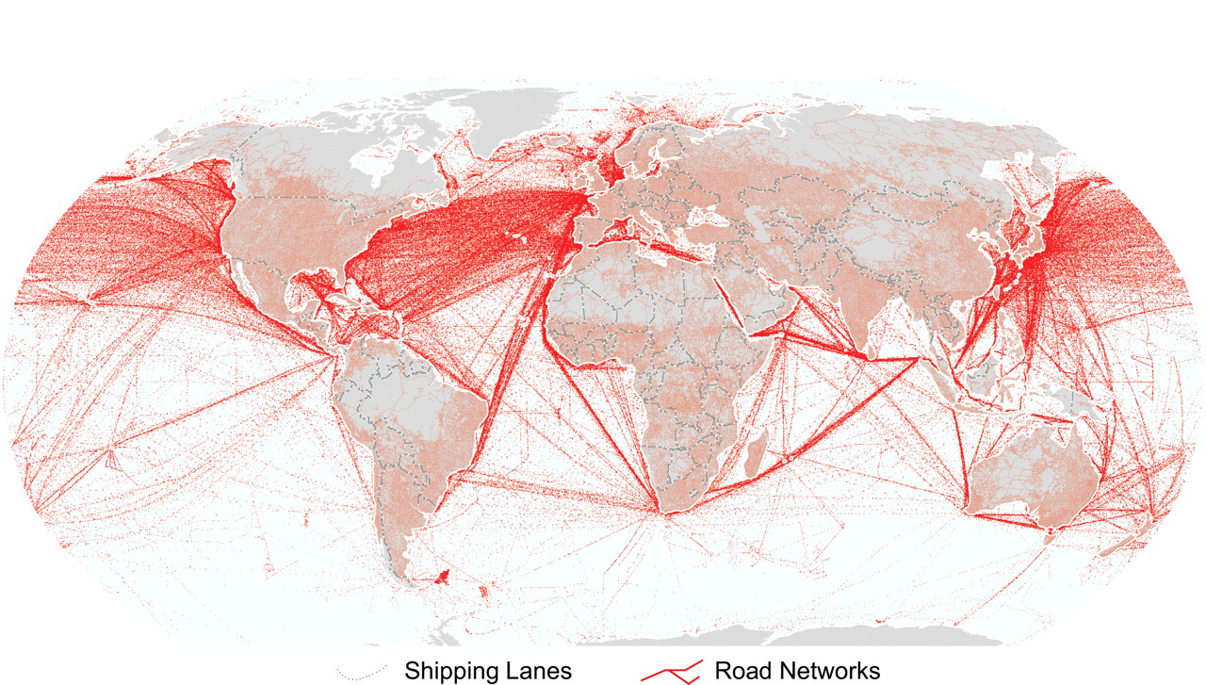

Slide 11
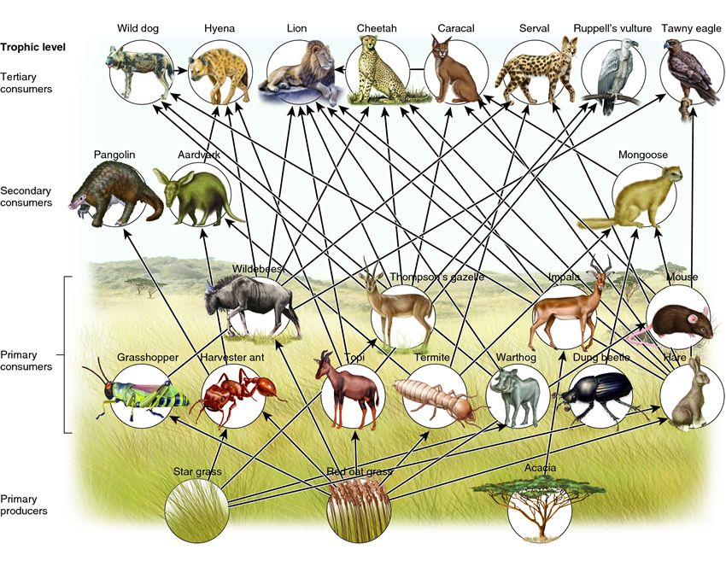

Slide 12
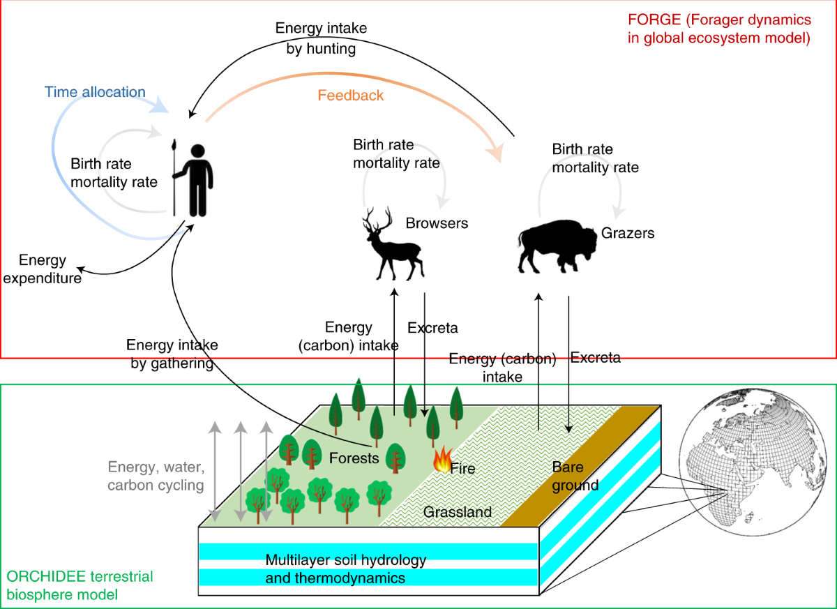

Slide 13
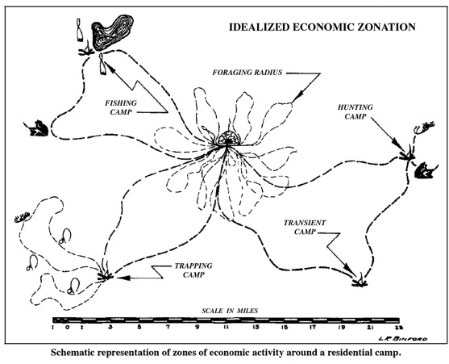
Notes:
https://www.sciencedirect.com/science/article/abs/pii/S1040618216306796

Slide 14
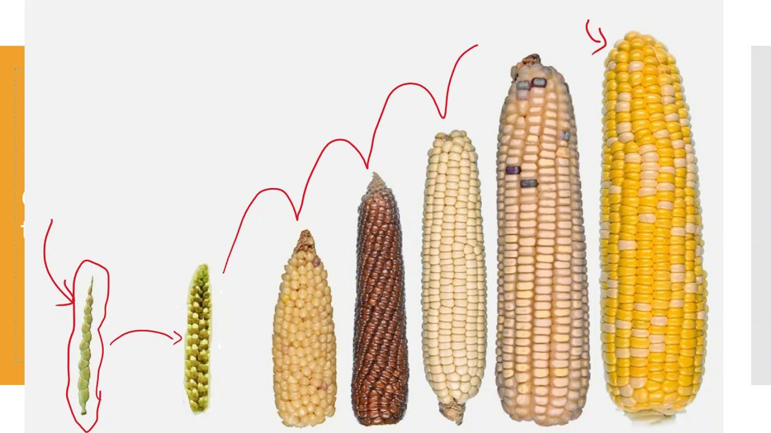
What’s the difference between an economy and an ecosystem?

Slide 15
Some background

Slide 16
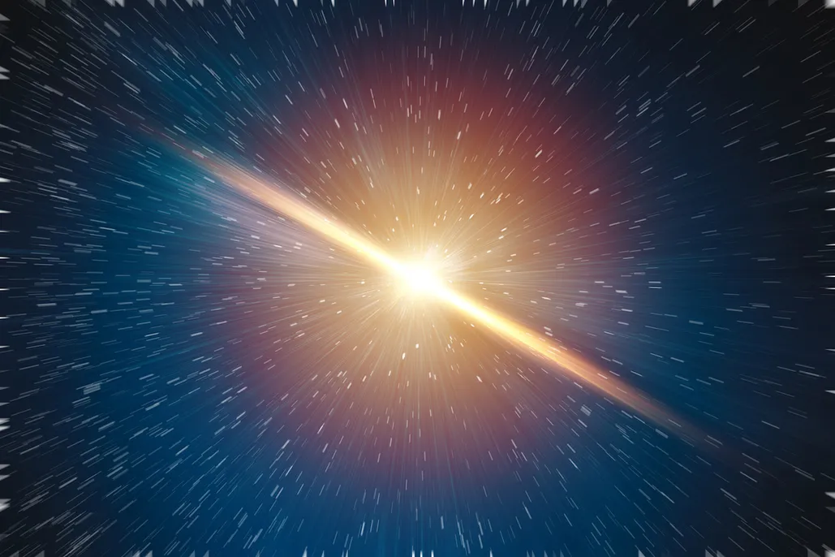

Slide 17
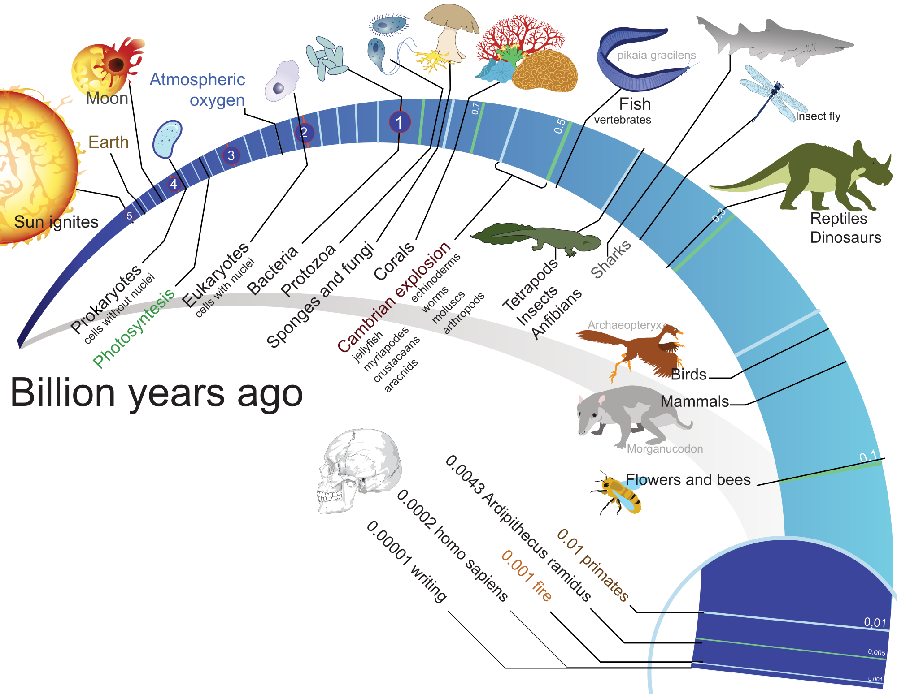

Slide 18
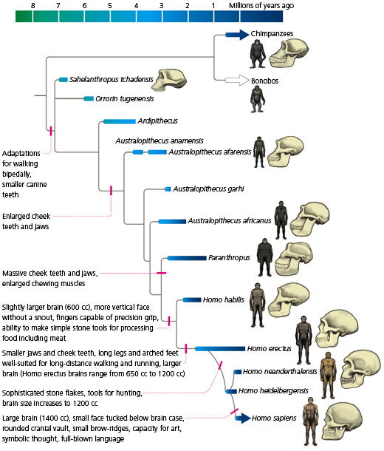

Slide 19
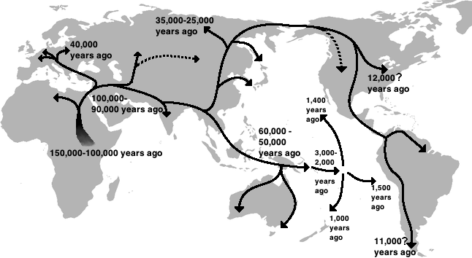

Slide 20
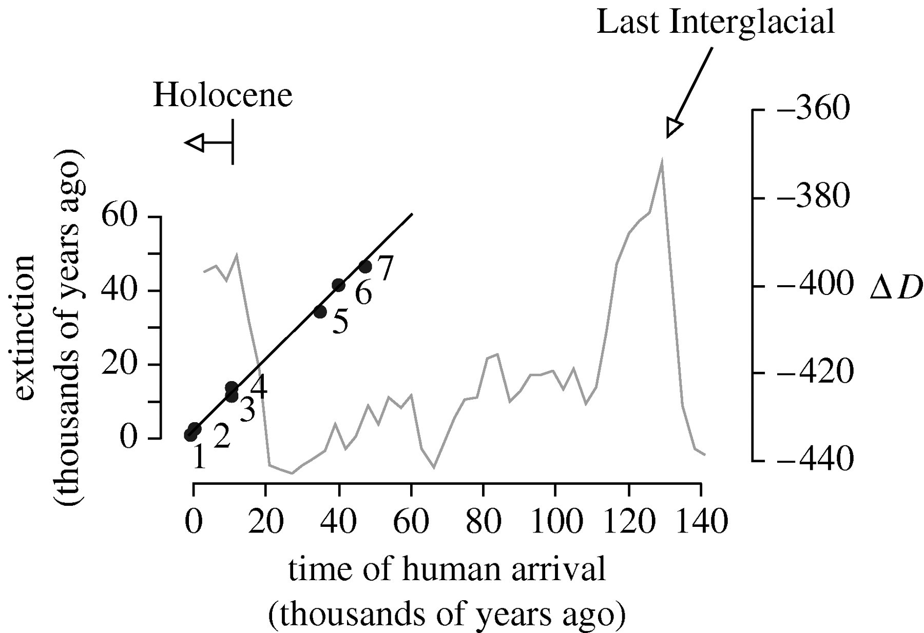
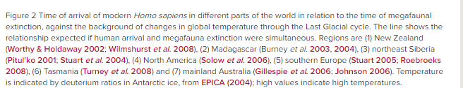

Slide 21
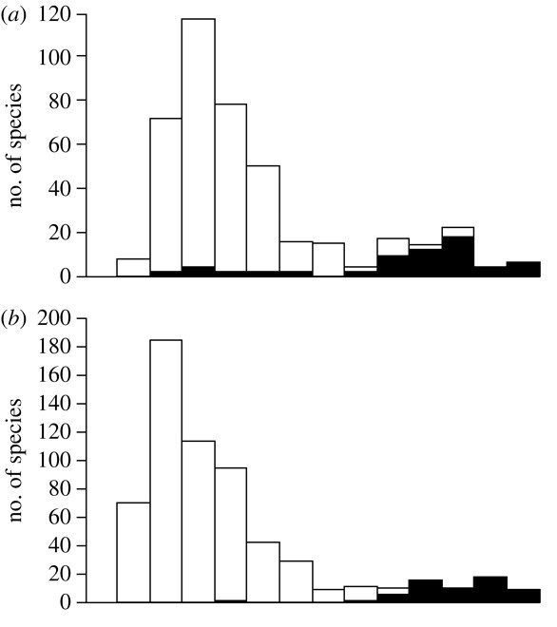
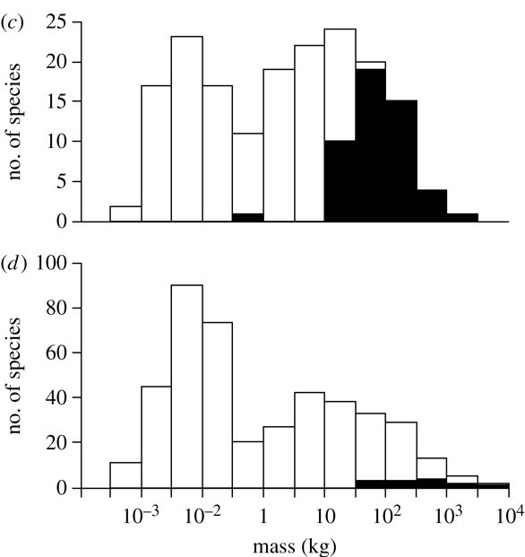
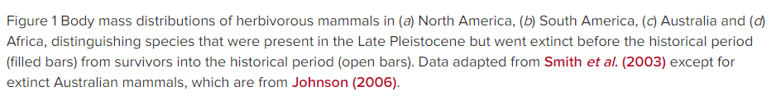

Slide 22
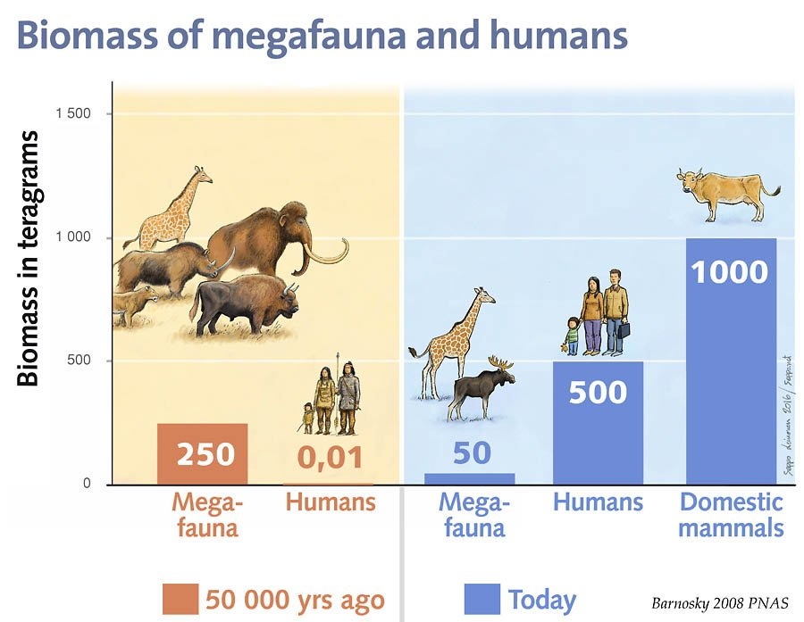

Slide 23
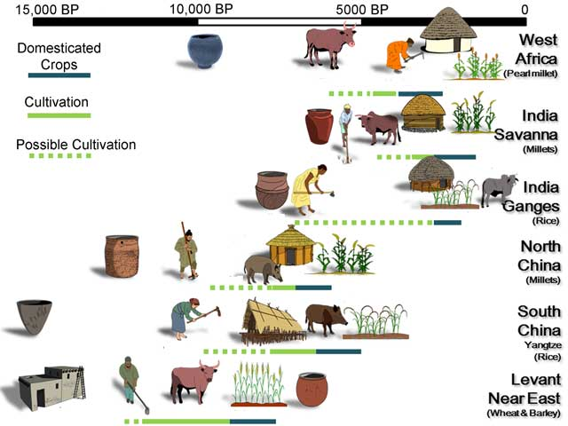

Slide 24
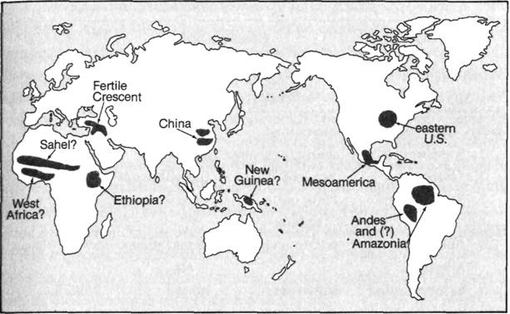
The Neolithic Revolution

Slide 25
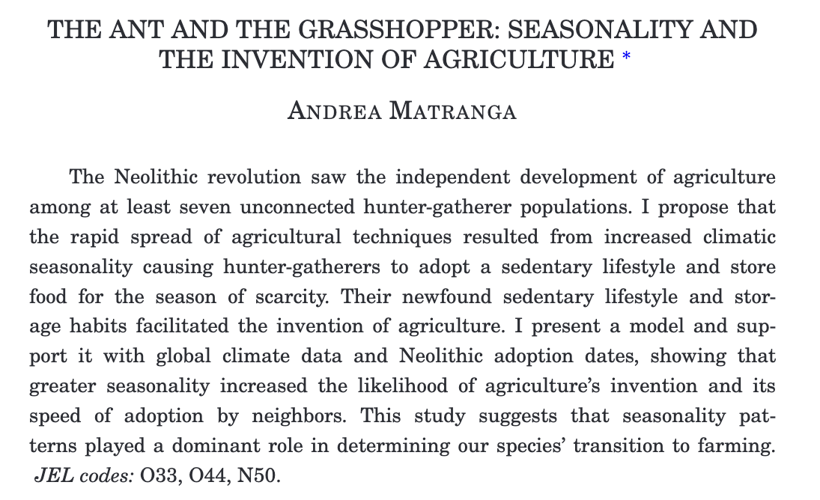

Slide 26
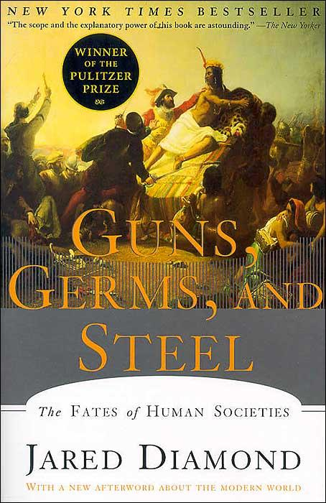

1990s: Diamond and others begin to unpack environmental correlates of development in empirically defensible ways

Slide 27
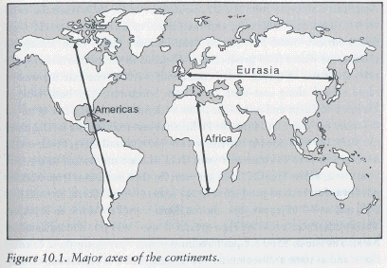
Guns Germs & Steel
Major thesis:
  current distribution of development outcomes was largely influenced by countries’ agricultural capacity and geography as determined eons ago
    “biogeography”
We can think of these as environmentally-provided public goods
Examples:
  Grain and produce varieties
    Domesticable animals
  Ease of travel / long coasts
    Influences trade, spread of ideas, but also resilience to disease due to exposure
  Distribution of other natural resources, e.g., coal or oil
Not very well-identified work in general, but very thought provoking and great history
  Also gets a LOT of hate in some quarters of academia

Slide 28
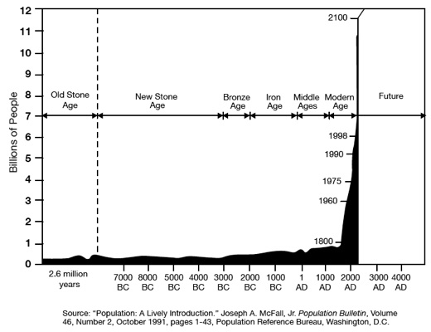
Relative to the speed of the natural world
(climate, evolution, etc.) modernity has lasted very briefly

Slide 29
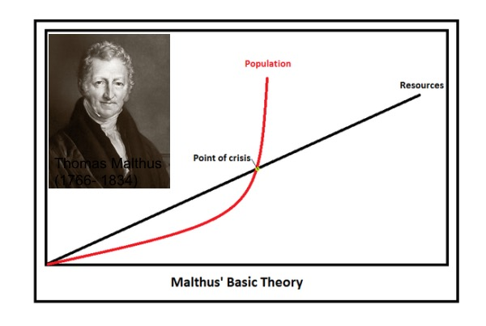

Slide 30
Malthus -
An Essay on the Principle of Population
Written in 1798 counter to the prevailing wisdom of the time that population growth was welfare enhancing
  Adam Smith – Wealth of Nations – 1776
    "The most decisive mark of the prosperity of any country is the increase in the number of its inhabitants”
  More generally a major utopian movement in social theory at the time
    … sad face ☹
Remarkably good description of population dynamics in subsistence societies:
  Steady state: zero average population or output per capita growth
    Very consistent with data and model of “humans as a species”
  Increases in living standards due to increased wealth / new technology do not persist in time, rather simply grow population
    Better living standards -> more survival -> larger population with same resource base
      Also consistent with data
  Shocks to population size and standard of living are inversely correlated
    Consistent with data and testable
      e.g., Black Plague, but also a variety of other tests

Slide 31
What happens when there is a shock to productivity?
What happens when there is a shock to population?

Slide 33
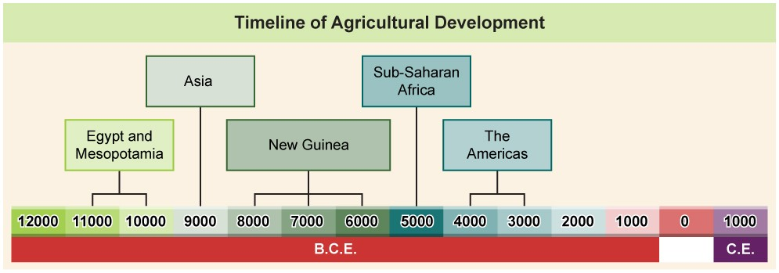
The Neolithic Revolution

Slide 38
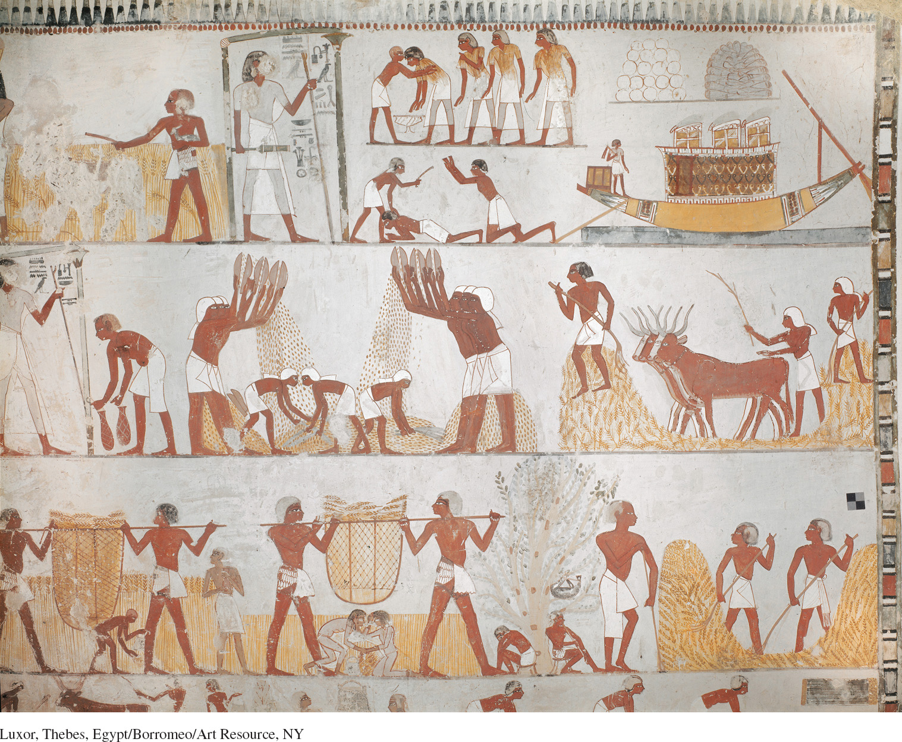
Tomb of Menna, Thebes, Egypt 14th century BCE

Slide 39
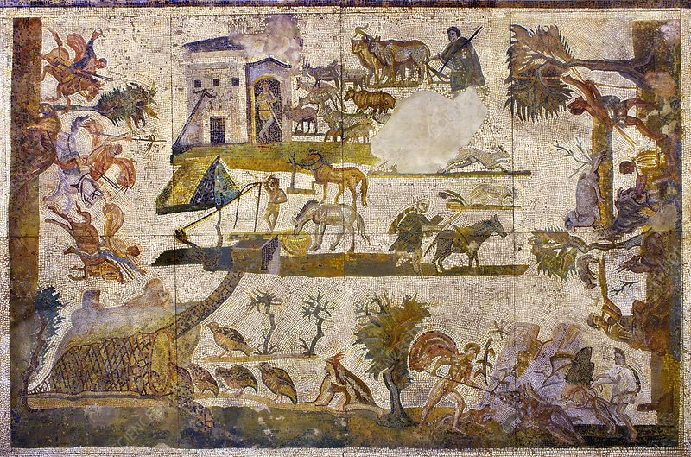
2nd century AD mosaic from the House of the Laberii at Uthina, a Roman colony in the valley of the Miliana, Tunisia. It shows the various activities of a 'mixed economy' estate, including oxen ploughing the wheatfield (the main source of its income), a shepherd with a flock of sheep, a herdsman with goats, partridges being driven into a keep, a pole-and-bucket well with a horse drinking nearby, olive trees, dogs, horses and a mule. Hunting is also shown, including a figure spearing a wild boar. Although this part of north-west Africa was the major producer and exporter of wheat to Rome and the Roman Empire, by the end of the 1st century AD, soil exhaustion and erosion plus the increased demand from Rome for olive oil and wine, meant the producers were encouraged by the State to bring into cultivation the more marginal land on which they planted olive groves and vines.
Notes:
https://www.alamy.com/2nd-century-ad-mosaic-from-the-house-of-the-laberii-at-uthina-a-roman-colony-in-the-valley-of-the-miliana-tunisia-it-shows-the-various-activities-o-image334879602.html

Slide 40
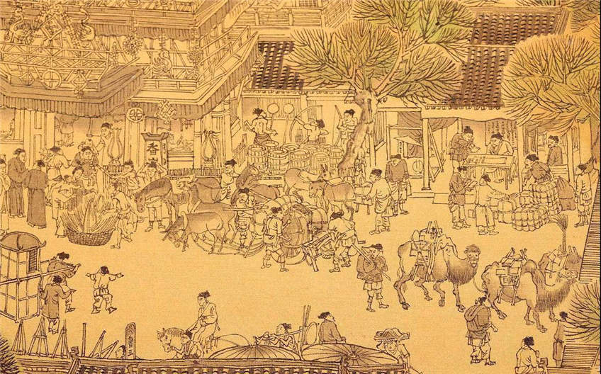
Along the River During the Qingming Festival 清明上河圖
Song dynasty (1085–1145CE)
Notes:
https://en.wikipedia.org/wiki/Along_the_River_During_the_Qingming_Festival

Slide 41
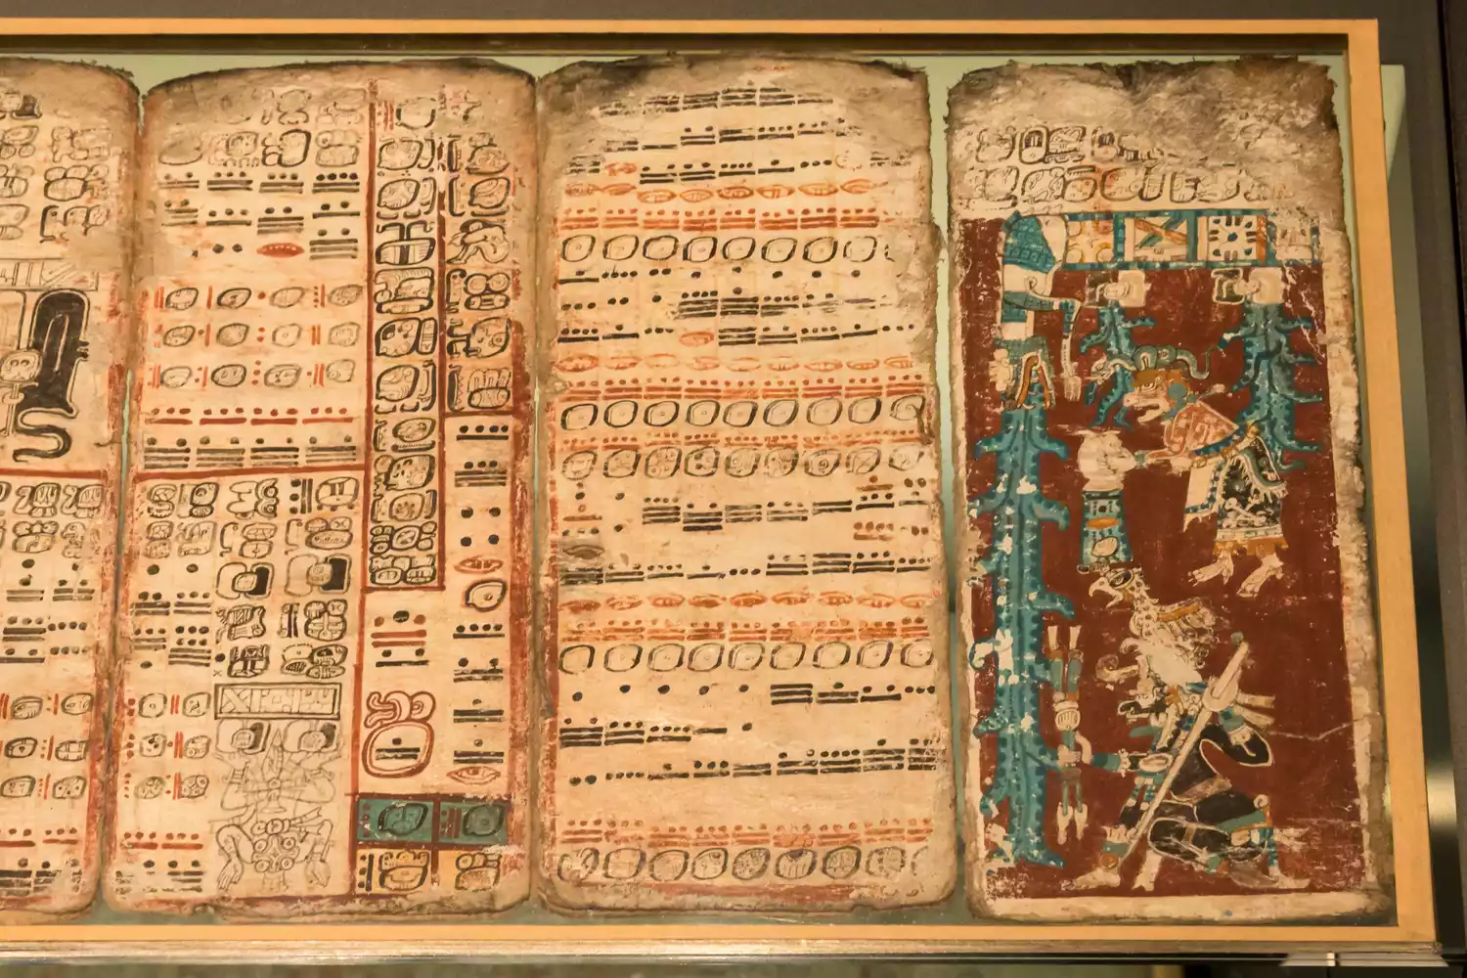
https://en.wikipedia.org/wiki/Dresden_Codex
Dresden Codex
Mayan Empire (11th or 12th century)
Notes:
https://en.wikipedia.org/wiki/Dresden_Codex

Slide 42
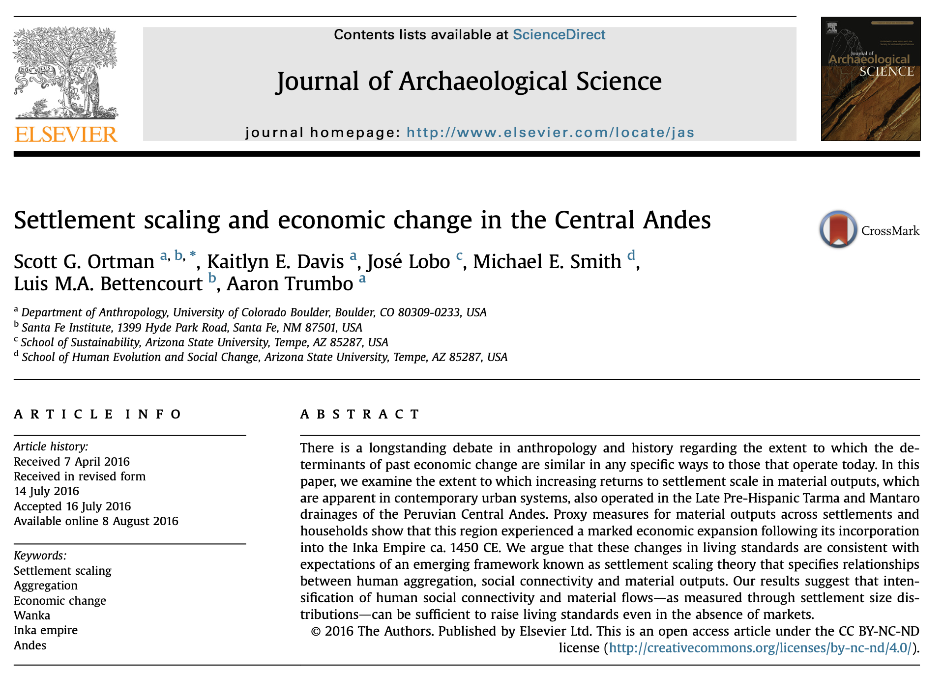

Slide 43
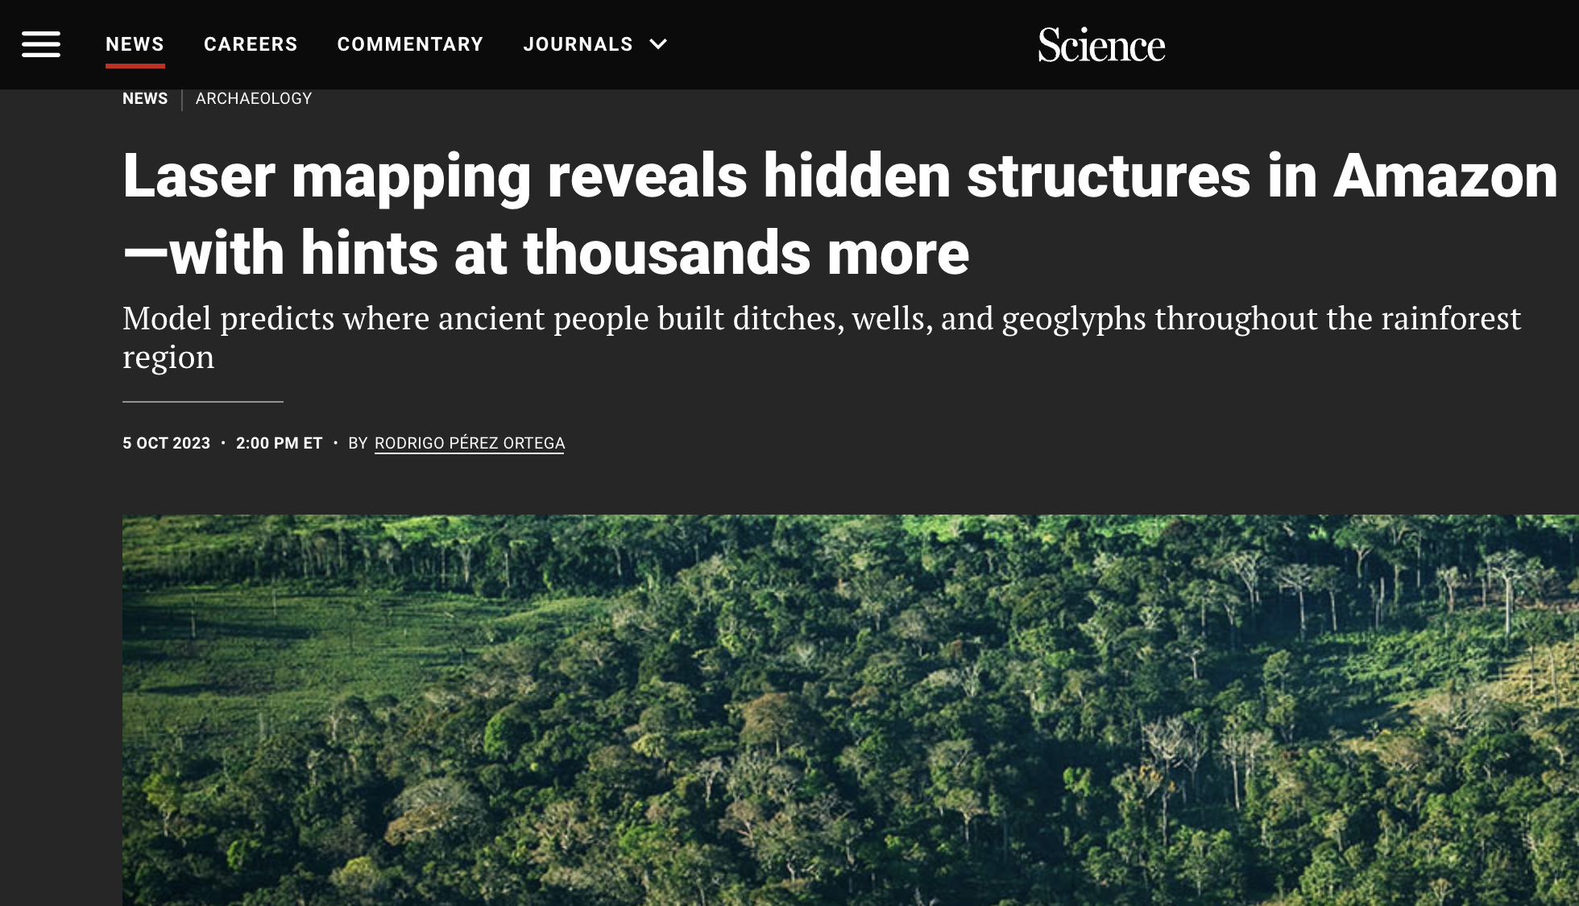
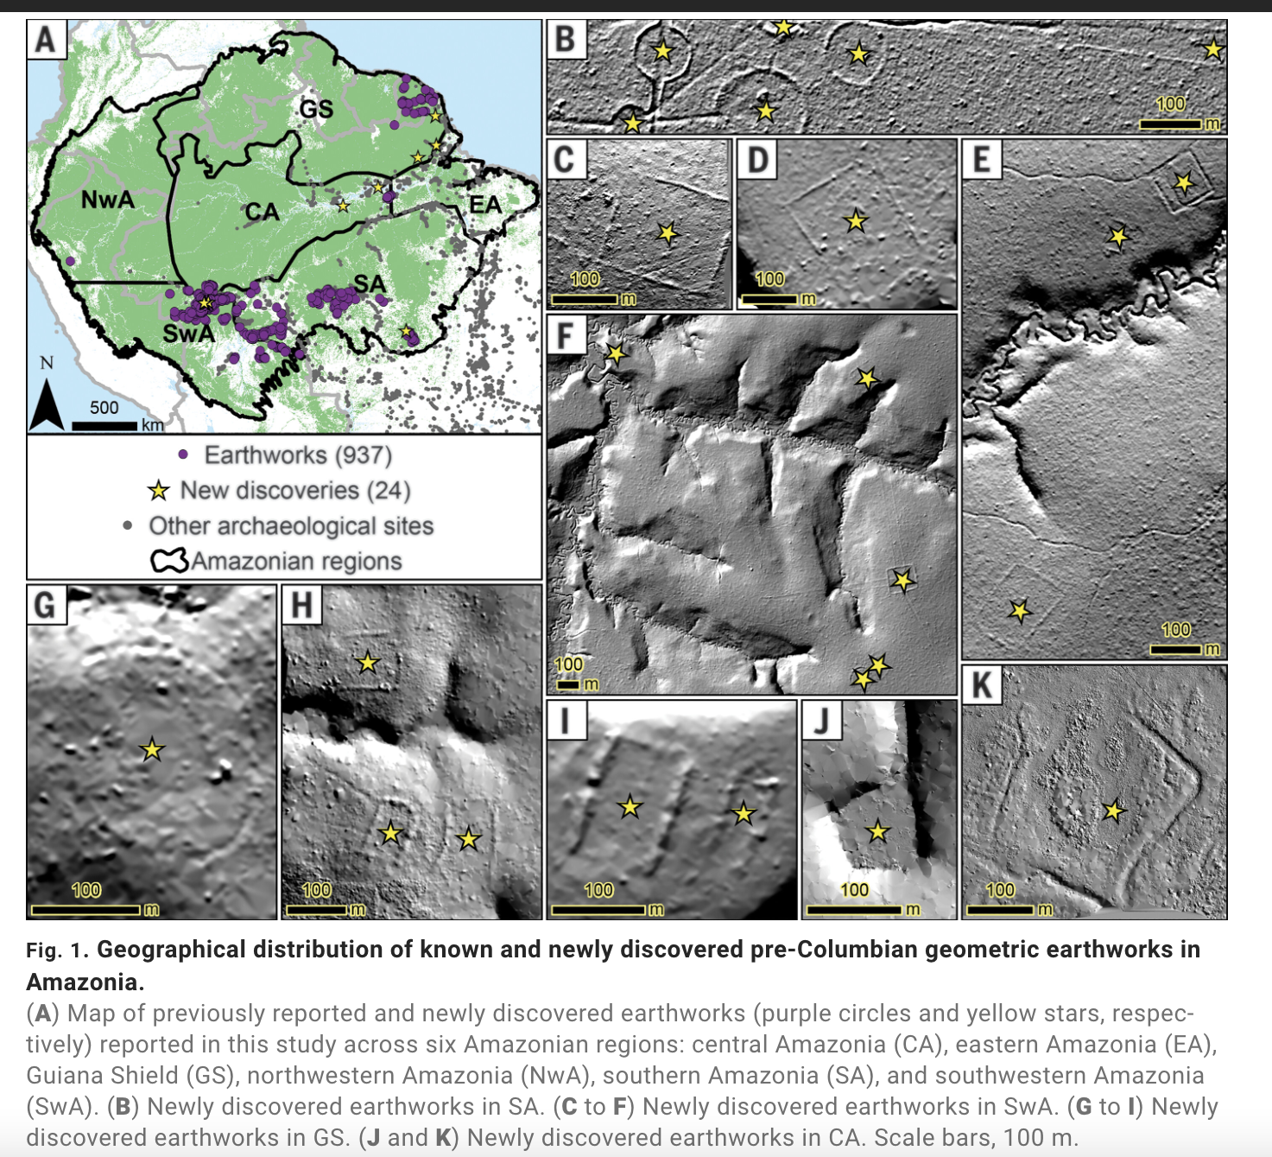
Notes:
https://www.science.org/content/article/laser-mapping-reveals-hidden-structures-in-amazon-hints-thousands-more

Slide 45
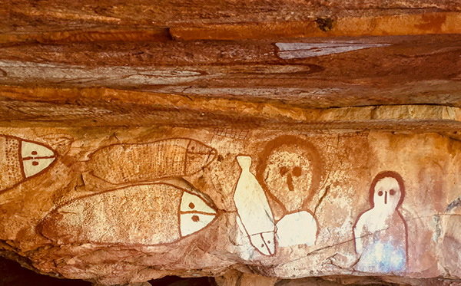
Wandjina Rock Art
NW Australia (~2-4000BCE)
Notes:
https://en.wikipedia.org/wiki/Wandjina

Slide 46
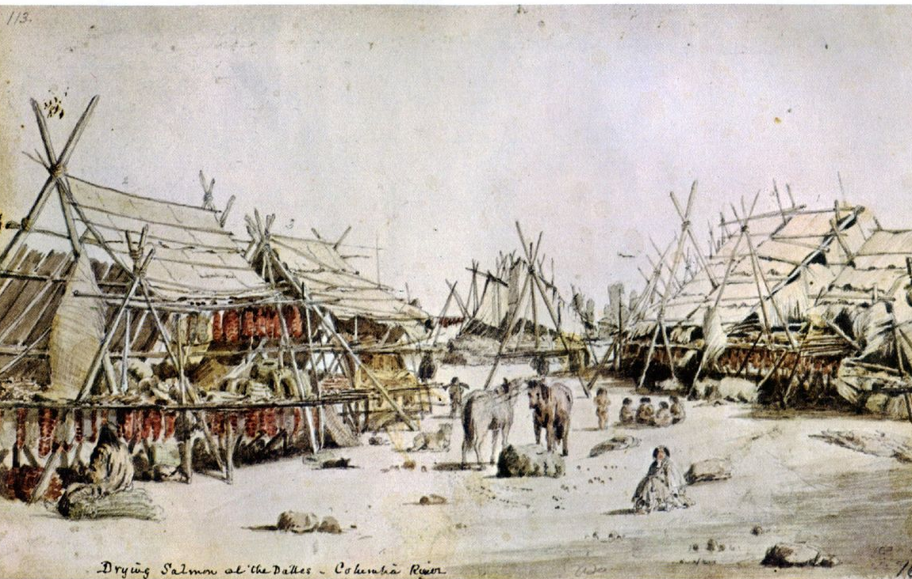
Draying salmon at the Dalles – Columbia River
US Pacific NW (1840s)

Slide 47
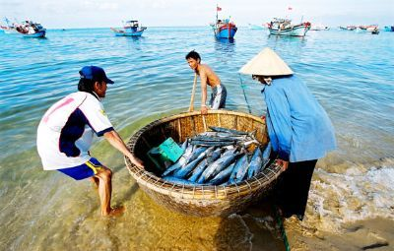
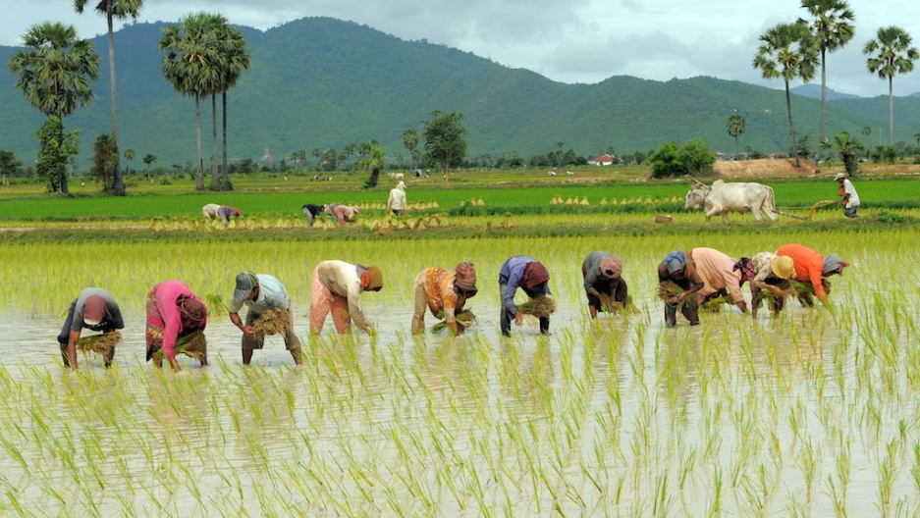
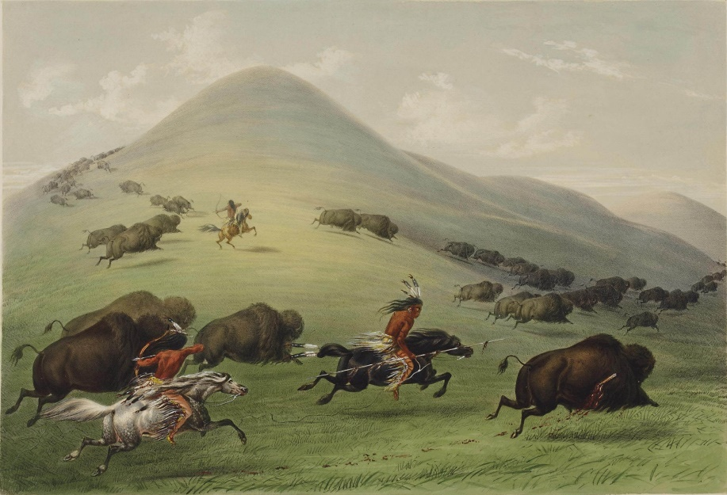
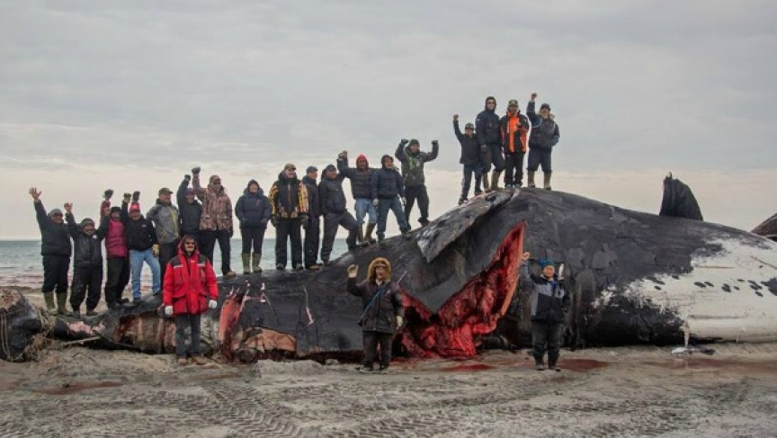

Slide 48
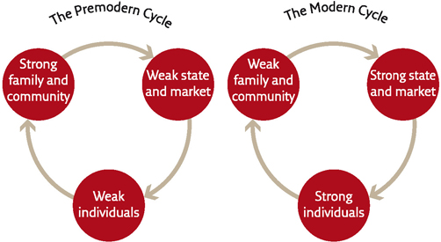
…Harari, Sapiens

