Slide 1
SUMMARY
State election laws are generally mandatory for state-wide uniformity,
including registration procedures which, in part, are delegated directly to county auditors.
These powers bypass county boards.
However, the use of electronic roster systems
is not mandated by the state and not required to be uniformly used state-wide.
Furthermore, the decision to use them
is not delegated or assigned directly to the county auditor.
Local governing bodies (county, municipal, school district) may decide use.
Subsequently, they may delegate duties to their head election officials.
If counties desire to use rosters, they must obtain municipal approval.
Municipalities govern precincts and have autonomy.

Slide 2
By Minnesota Statutes, Municipalities have Autonomy
201.225 ELECTRONIC ROSTER AUTHORIZATION.
Subdivision 1. Authority.
A county, municipality, or school district may use electronic rosters for any election. In a county, municipality, or school district that uses electronic rosters, the head elections official may designate that some or all of the precincts use electronic rosters. An electronic roster must comply with all of the requirements of this section. An electronic roster must include information required in section 201.221, subdivision 3, and any rules adopted pursuant to that section.
The governing bodies make the use decision, not head election officials
201.221
Subd. 4.County rules.
The county auditor of each county may adopt rules that delegate to the secretary of state or municipal officials in that county the duties assigned to county auditors by this chapter. Delegation of duties to the secretary of state requires the approval of the secretary of state. Delegation to a municipal official requires the approval of the governing body of the municipality. Delegation by the county auditor of the duty to accept registrations does not relieve the county auditor of the duty to accept registrations. Each delegation agreement must include a plan to allocate the costs of the duties to be delegated.
If the county says yes to use, then they must obtain municipal consent

Slide 3
ELECTRONIC ROSTER SYSTEM AUTHORITY FLOW CHART BY STATUTES
Law Making
By Public Vote
Minnesota Statutes
201.221 & 201.225
By statutes, the decision to fund and use electronic rosters is policy-making by enabled governing bodies which negotiate agreements or JPAs.
No Mandates.
That’s the Law.
Enabling Authority
Policy Making
By Public Vote
Governing Bodies
County Municipality School District
Board City Council/Town Board Board
Delegated
Authority
Use
Agreement
or JPA
Delegated
Authority
Delegated
Authority
Public
Administration
Subject to
Public
Data
Requests
County Head Election Official
Municipal Head Election Official
School District Head Election Official
Delegation Plan
and
Implementation

Slide 4
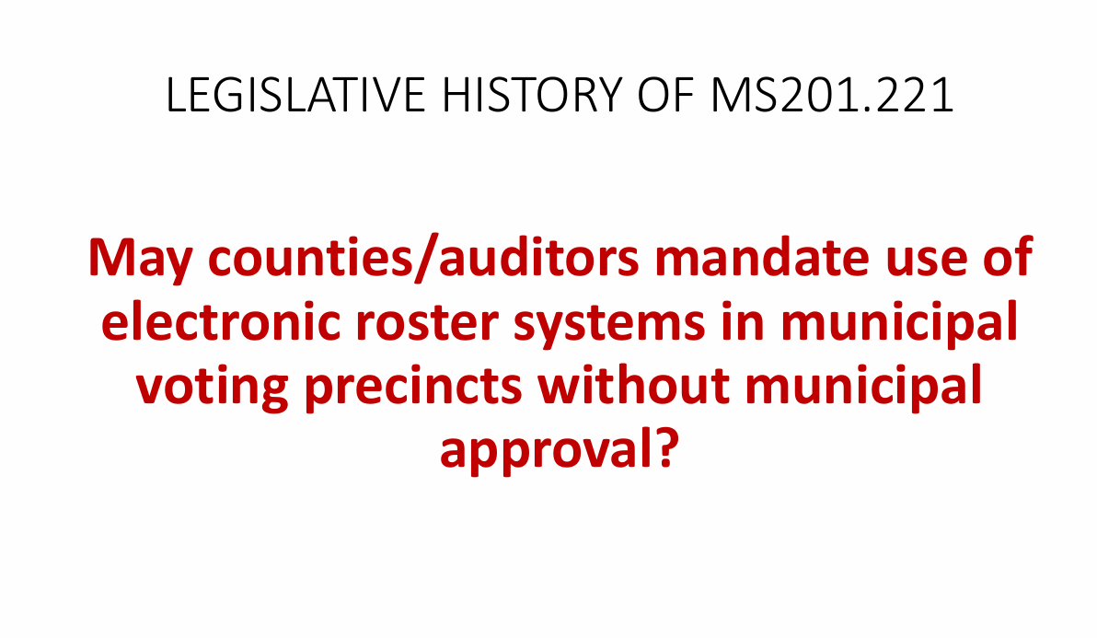

Slide 5
