Slide 1

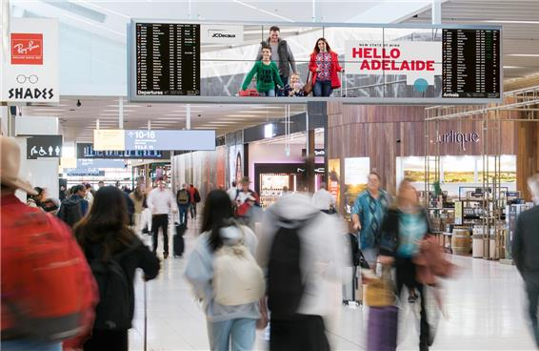

Adelaide Airport
Australia

Slide 2

Lightboxes
Location Details
2 lightboxes at business lounges

Slide 3
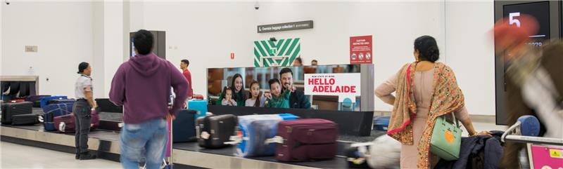
International Arrivals
Location Details
International Arrivals- Baggage Carousel 1

Slide 4
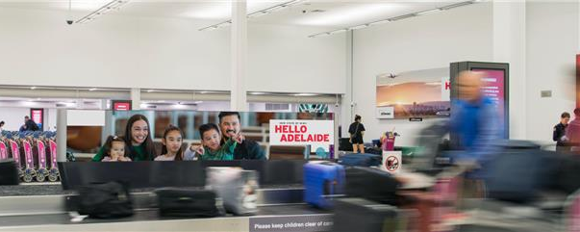
International Arrivals
Location Details
International Arrivals- Baggage Carousel 2

Slide 5
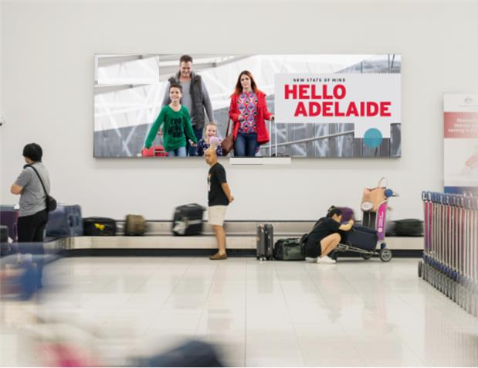
International Arrivals
Location Details
Wall mount carousel 1, International Arrivals

Slide 6
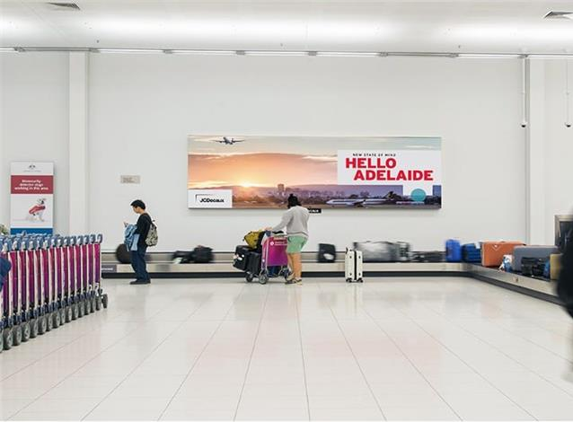
International Arrivals
Location Details
Wall mount carousel 2, International Arrivals

Slide 7
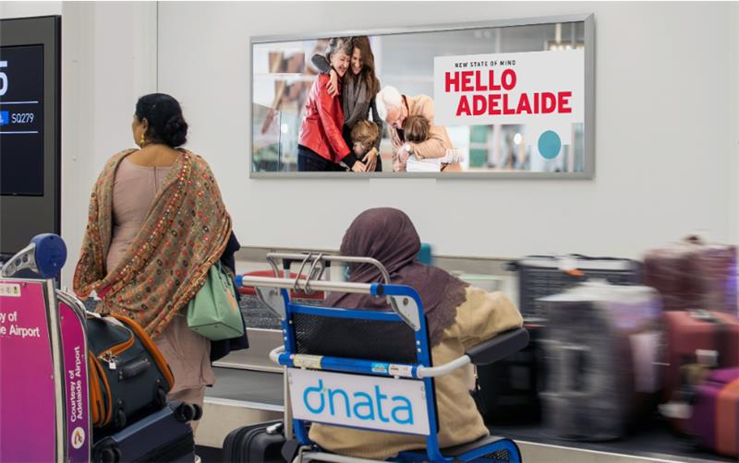
International Arrivals
Location Details
Wall mount carousel 3, International Arrivals

Slide 8
Thank You

