Slide 1
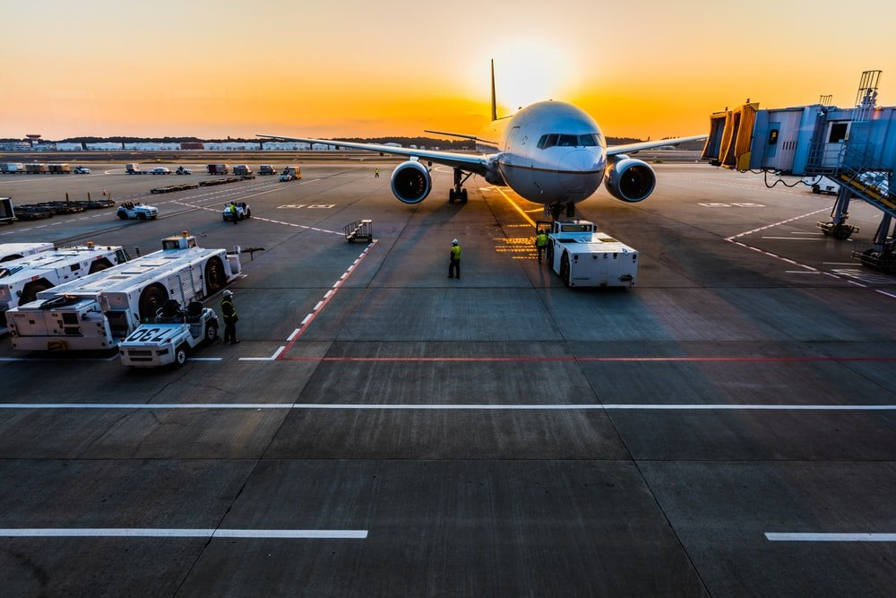


Perth Airport
Australia

Slide 2

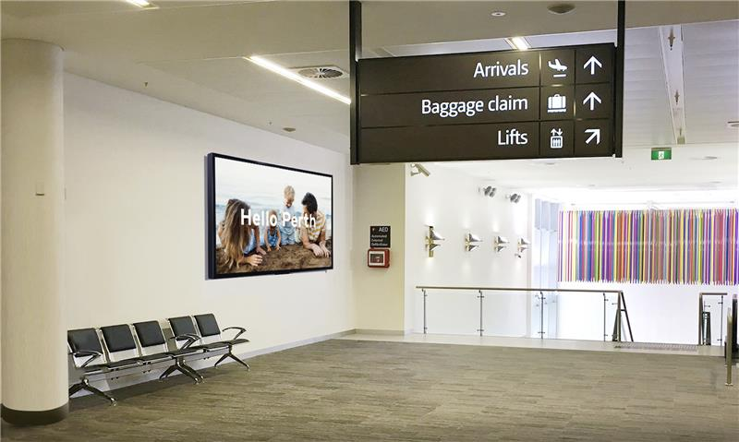
International
Arrivals
Location Details
T1 International Arrivals- After Security

Slide 3
International Baggage Claim
Location Details
T3 International Arrivals Baggage Carousel

Slide 4
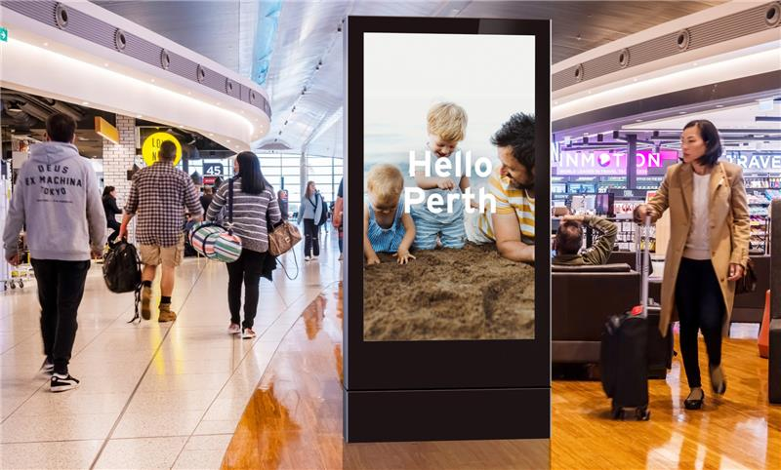
Domestic Departures
Location Details
T1 Domestic Departures- Small Format

Slide 5
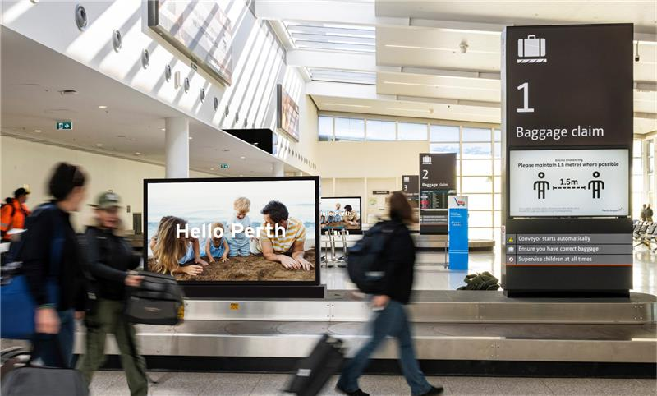
Domestic Baggage Claim
Location Details
T2 Domestic Arrivals Baggage Carousel

Slide 6
Thank You

