Slide 1

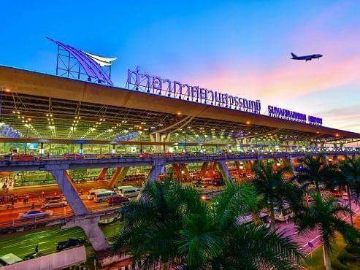

Suvarnabhumi Airport Bangkok, Thailand

Slide 2


Slide 3


Slide 4

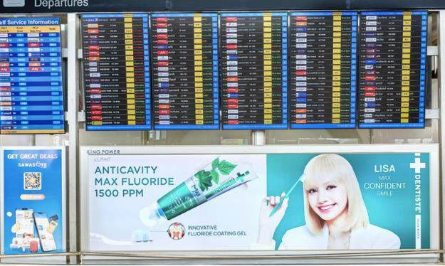
Check-In Fid Network
Location details
International &Domestic Departures
Spec
Media: 9 Lightboxes
Dimensions: 3.75 m (W) x 1.20 m (H) Indicative rate: 206250 USD

Slide 5

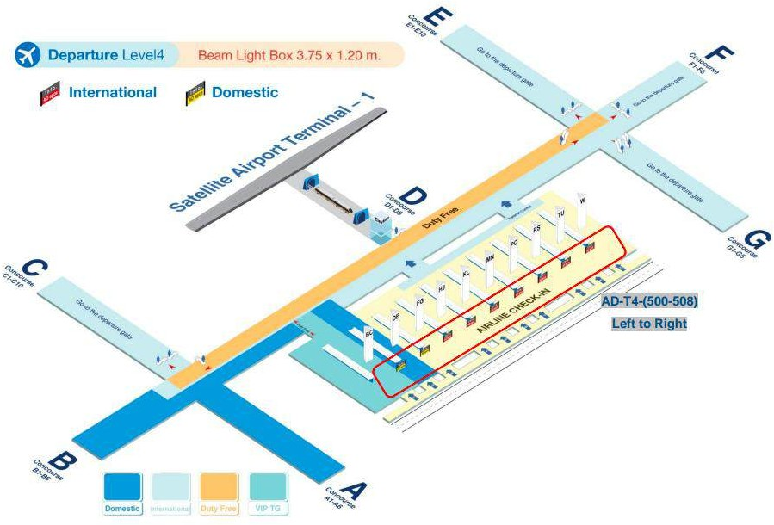
Map View

Slide 6

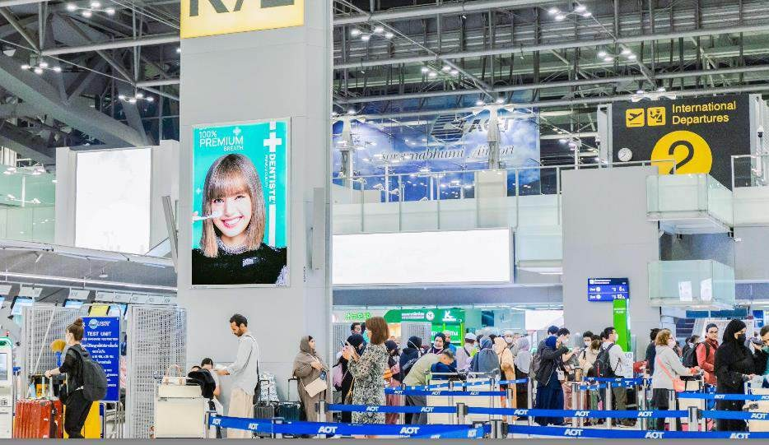
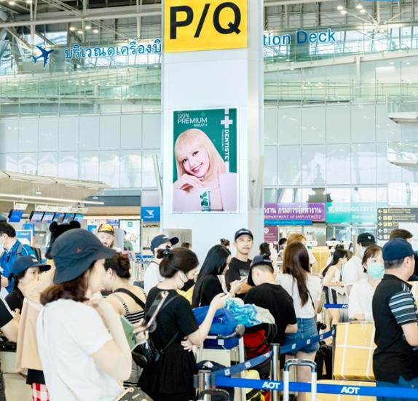
Check-In Domination Lightbox Network
Location details
International & Domestic Departure
Spec
Media: Network A 15 Lightboxes (5 Media) Indicative rate : 214350 USD
Network B 12 Lightboxes (4 Media) Indicative rate : 164000 USD Dimensions 1.70 m (W) x 2.50 m (H)

Slide 7
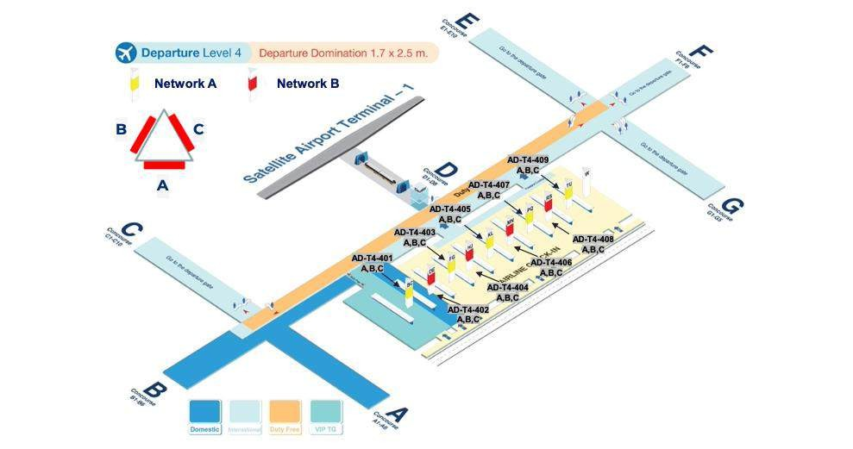
Map View

Slide 8


Security Check Lightbox - Before Security Check
Location details
International Security Checking Area
Spec
Media: Lightbox
Dimensions: 5.00 M (W) X 2.00 M (H) Indicative rate: 60150 USD

Slide 9

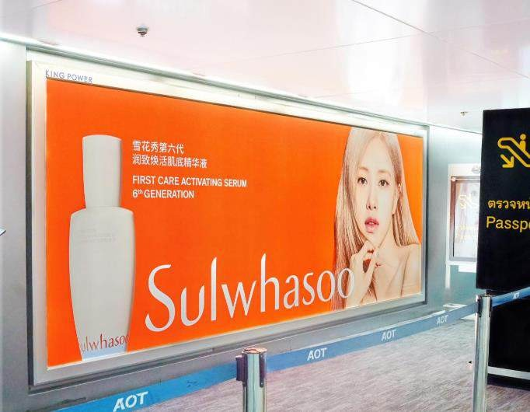
Security Check Lightbox - After Security Check
Location details
International Departures
Spec
Media: Side Wall Lightbox
Dimensions: 5.00m W x 2.00 m H Indicative rate: 77900 USD

Slide 10
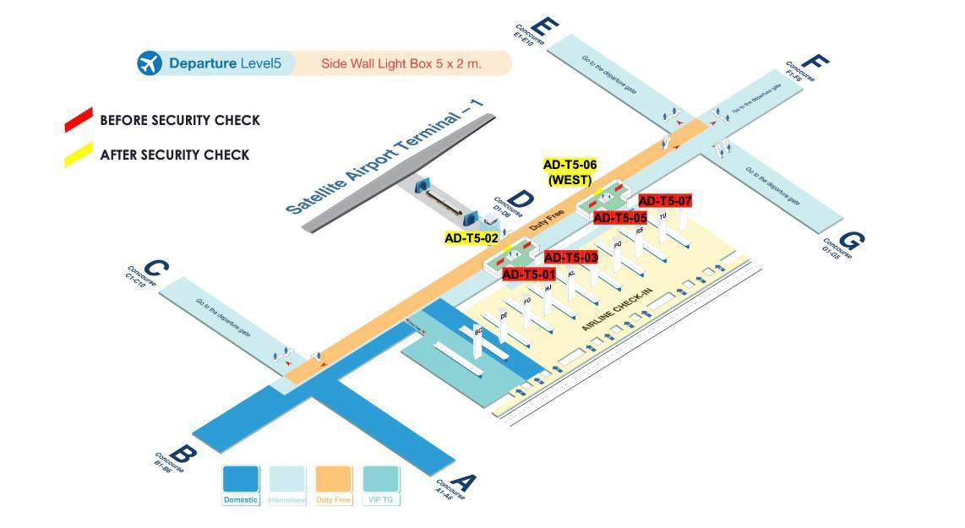
Map View for Network A and B

Slide 11

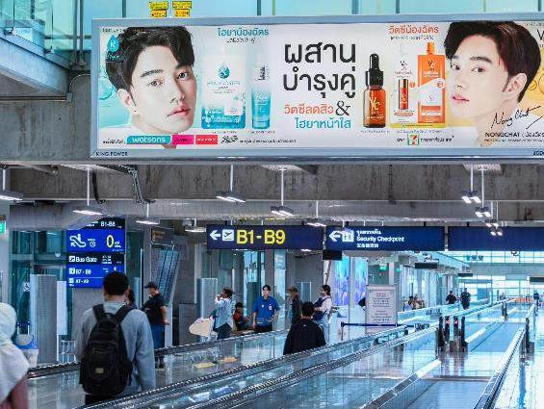
Arrival Concourse Lightbox – Head-On
Location details
International / Arrival corridors
Spec
Media: 1 Beam Lightbox
Dimensions: 5.00 m (W) x 1.50 m (H) Indicative rate: 87850 USD

Slide 12
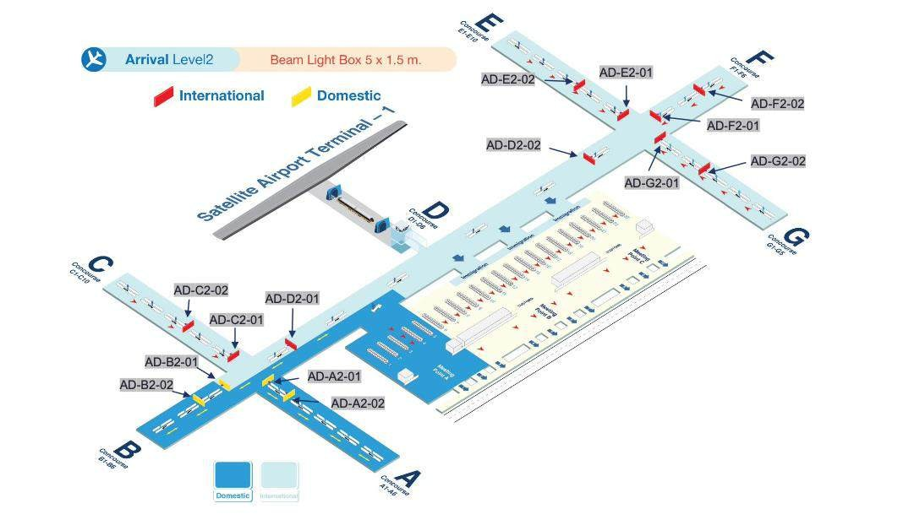
Map View

Slide 13
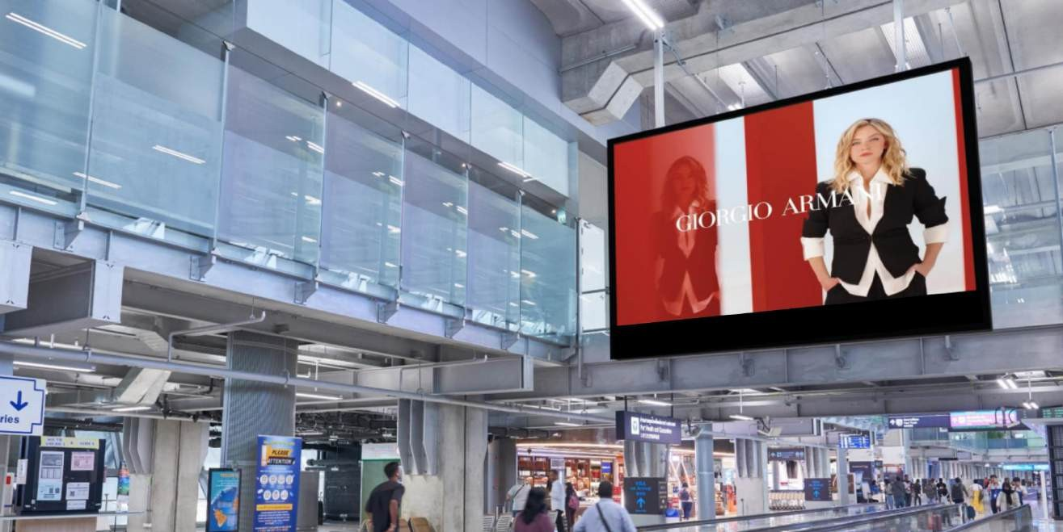
Arrival Concourse Dual Digital
Location details
International Arrival corridor
Spec
Media: 2 LED Media
Dimensions: 5.00 m (W) x 3.00 m (H) Indicative rate: 162950 USD

Slide 14
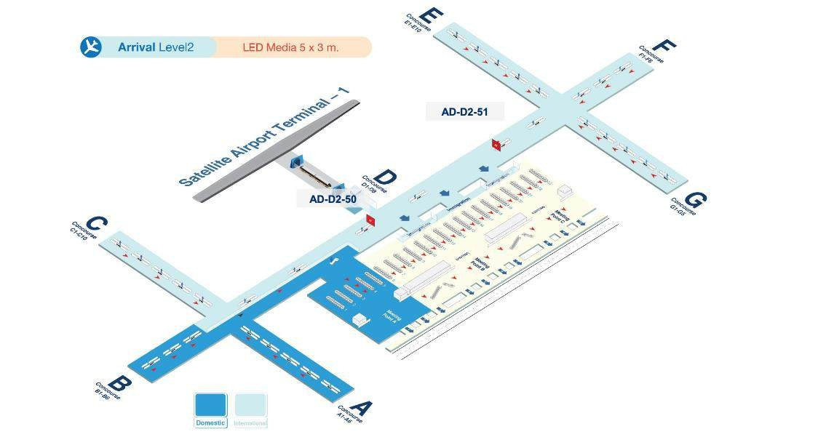
Map View

Slide 15

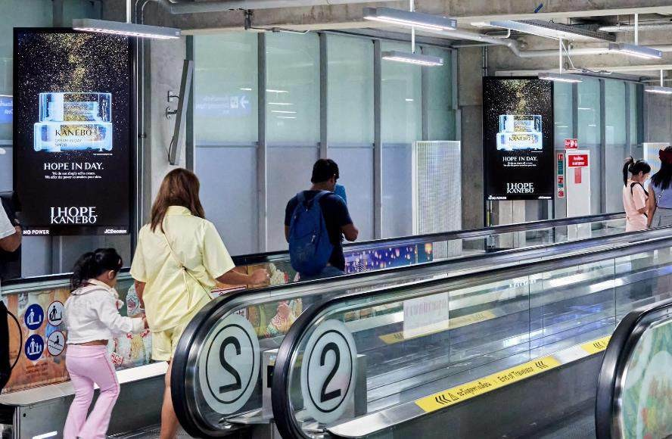
Arrival Concourse Digital Network
Location details
International Arrivals
Spec
Media: 10 LCD Screens
Dimensions: 85” ( 1.08 m W x 1.90 m H )
Indicative rate: 1062500 USD

Slide 16
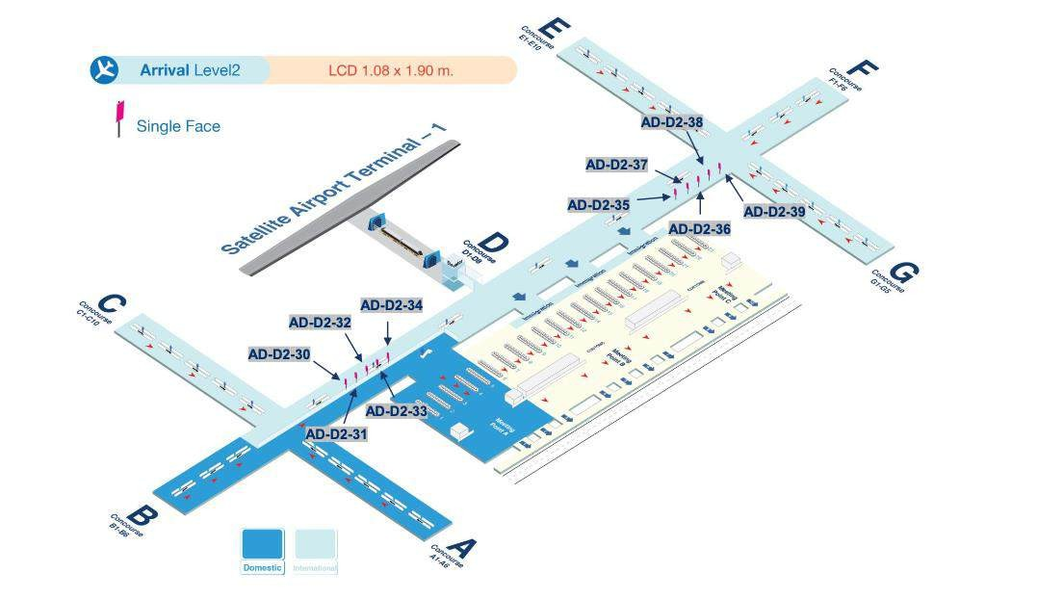
Map View

Slide 17
Thank You

