Slide 1
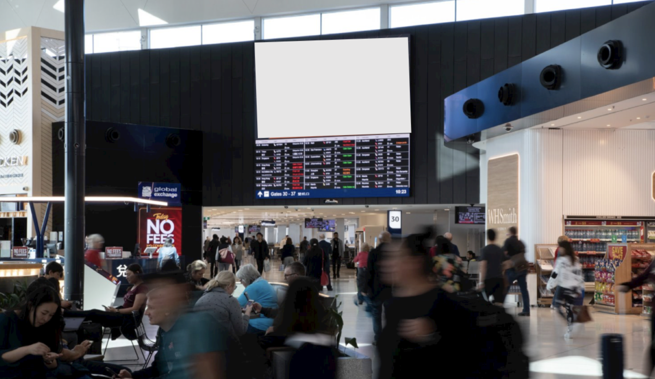


Sydney International
Airport
Australia

Slide 2
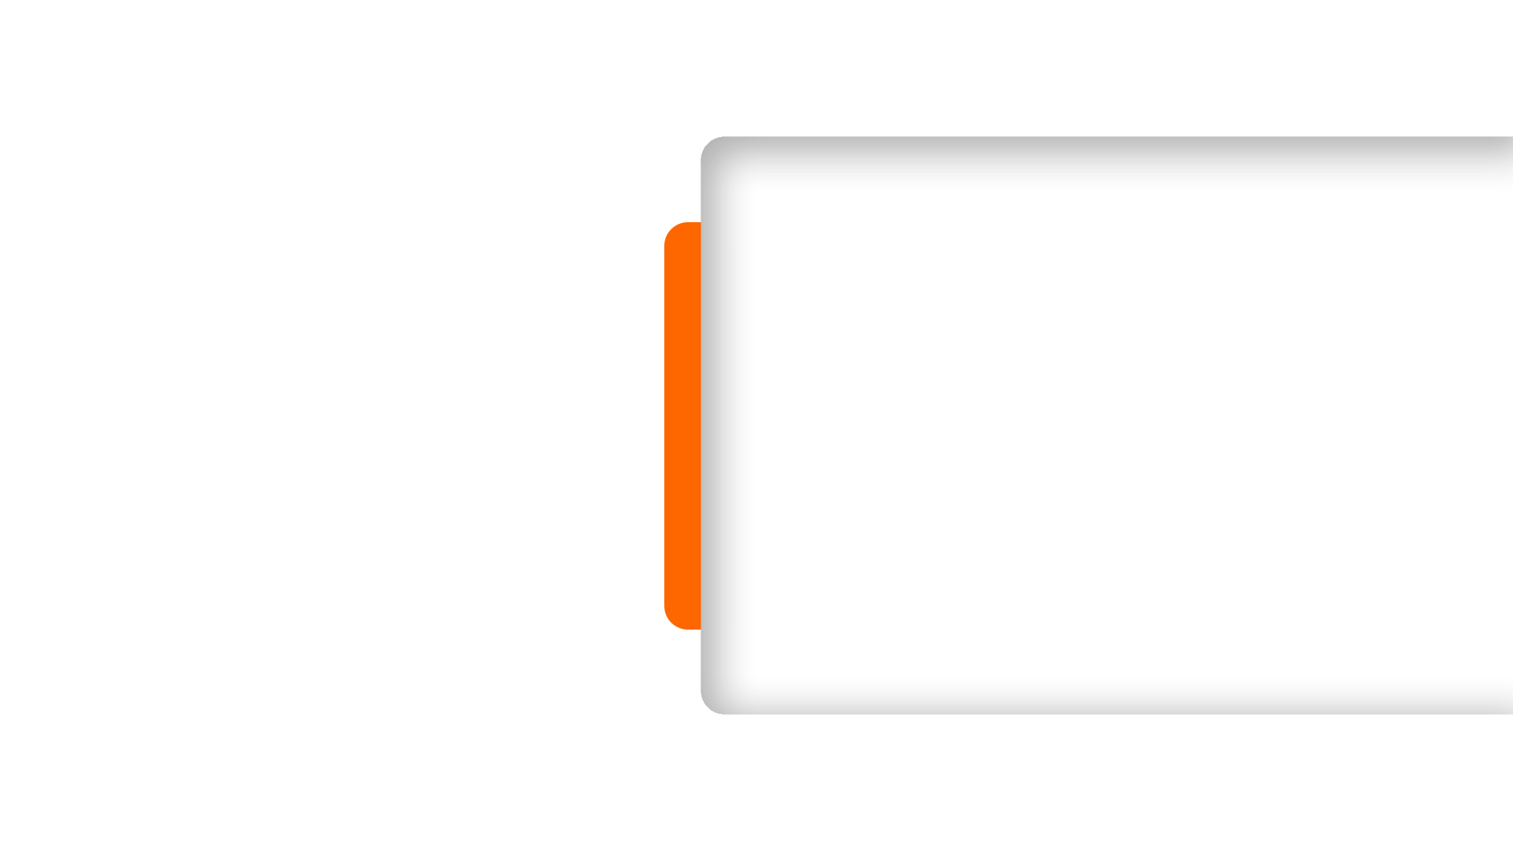
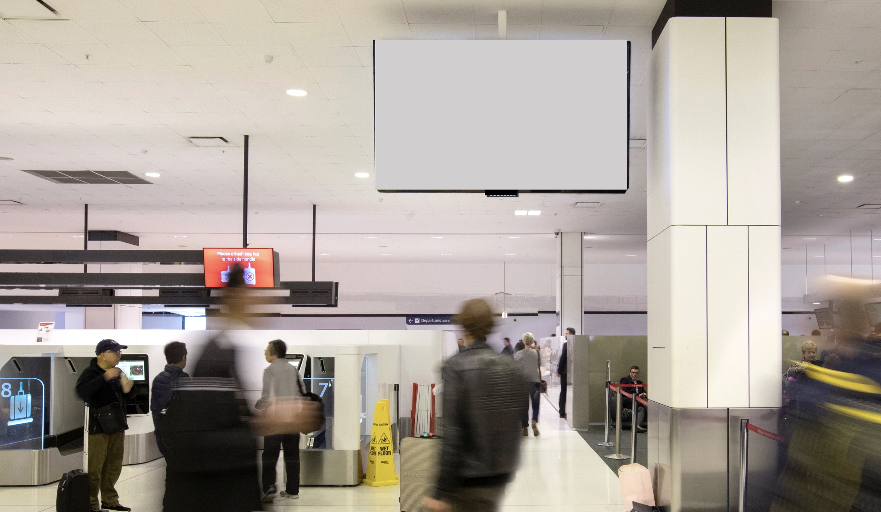
T1 International
Check-in Pack
Location Details
12 x full motion, LFD screens
11 screens located between Check In counters and a special LED wall.

Slide 3
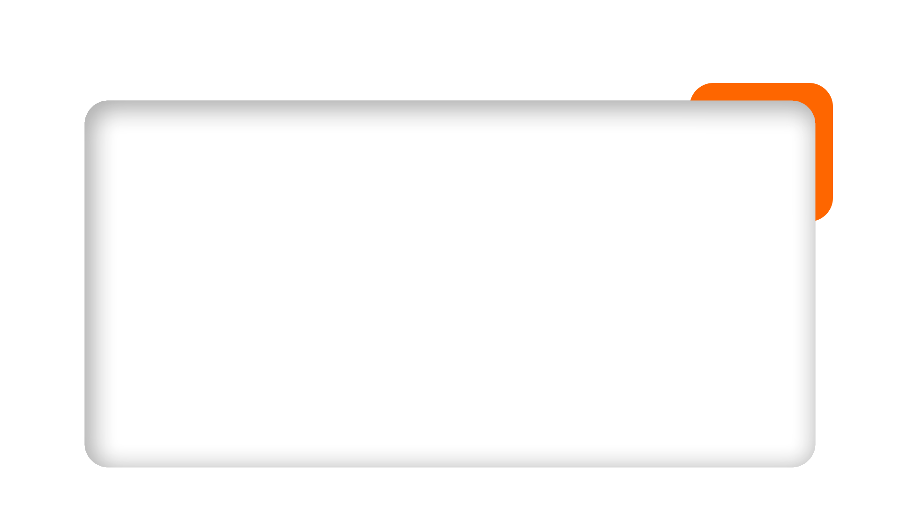
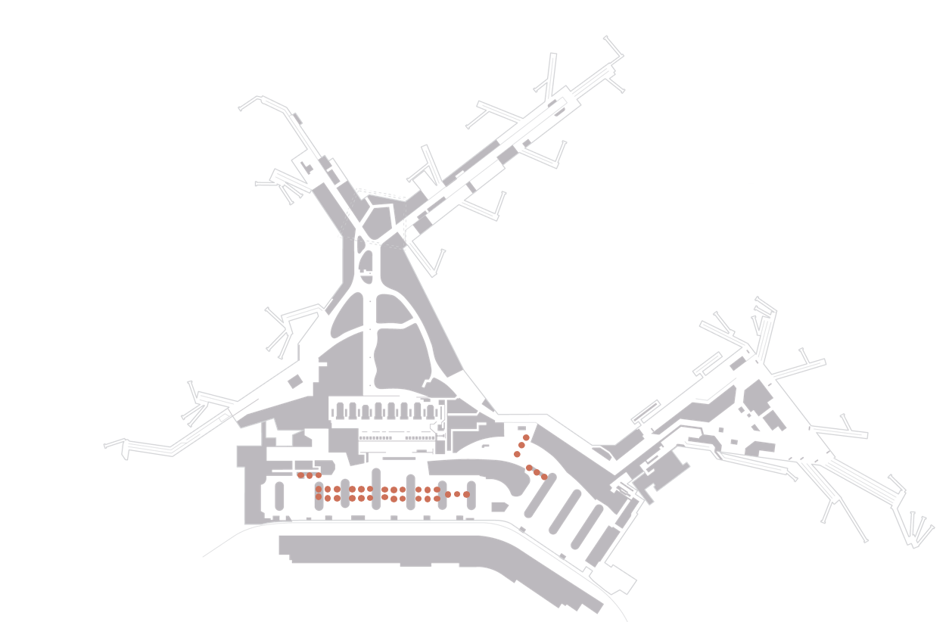
Map View

Slide 4
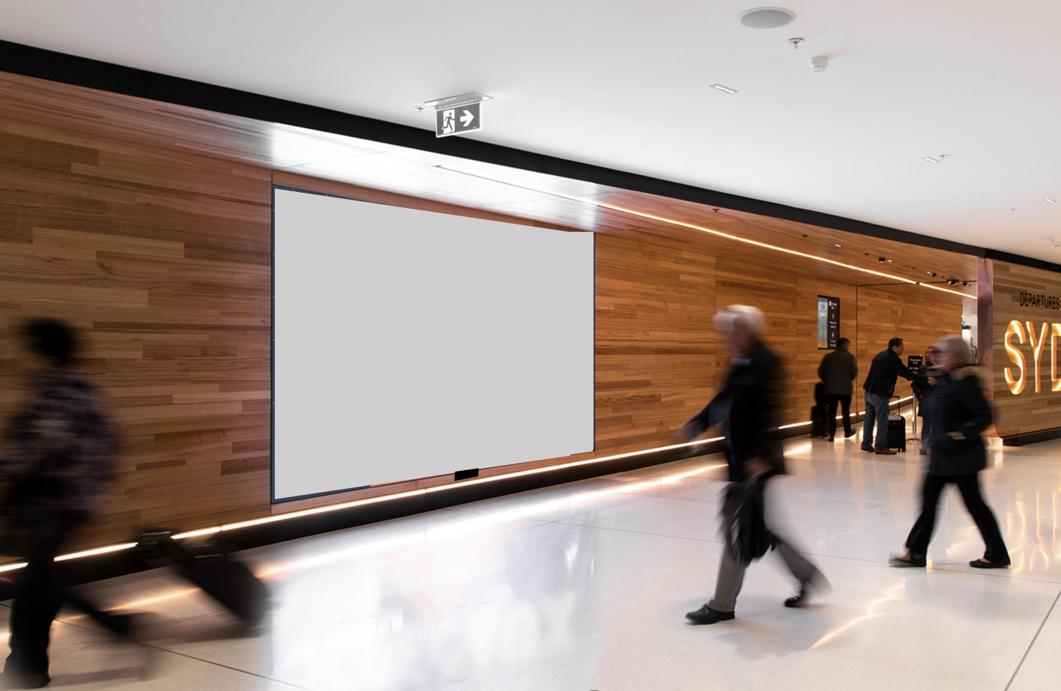
T1 International Gateway Pack
Location Details
The newly unveiled Departures Wall
2 LED screens, situated at the farewell point

Slide 5
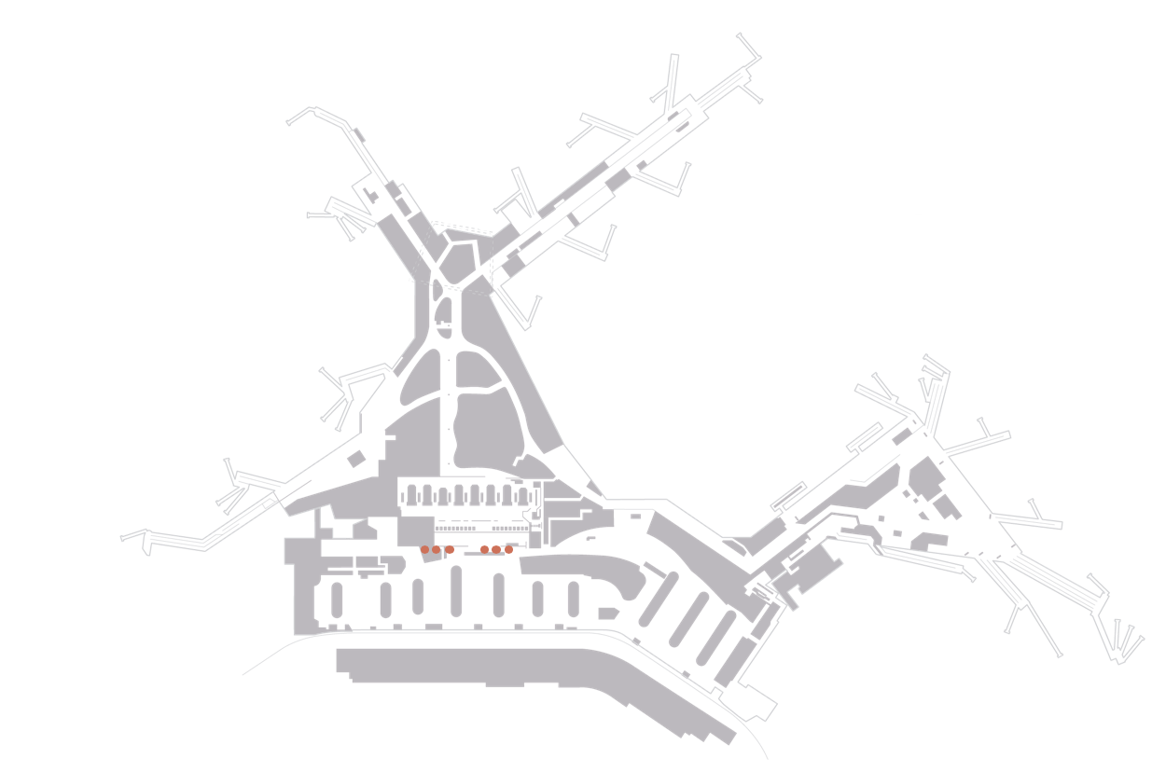
Map View

Slide 6
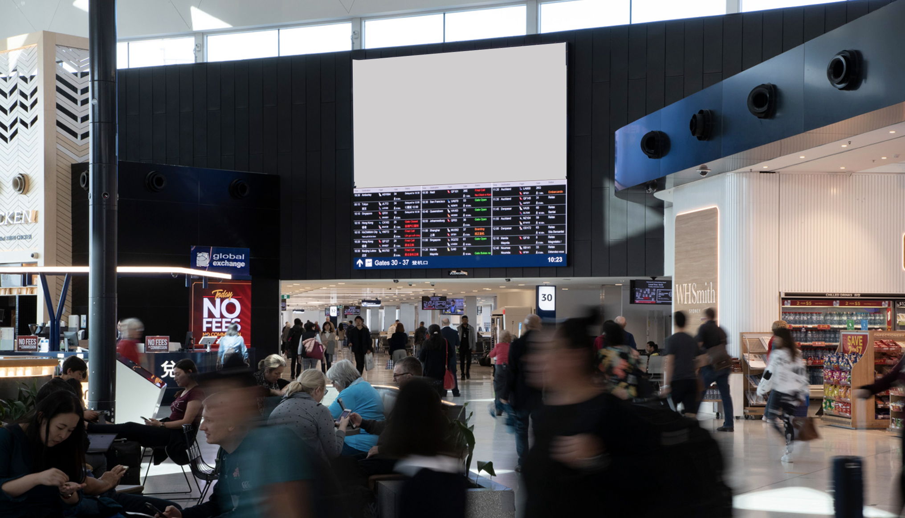
T1 International
Concourse Pack
Location Details
4 x full motion, 16:9 LFD screens hanging across the Duty Free shopping space in the main atrium as well as
4 screens above the main seating areas in Pier B and Pier C

Slide 7
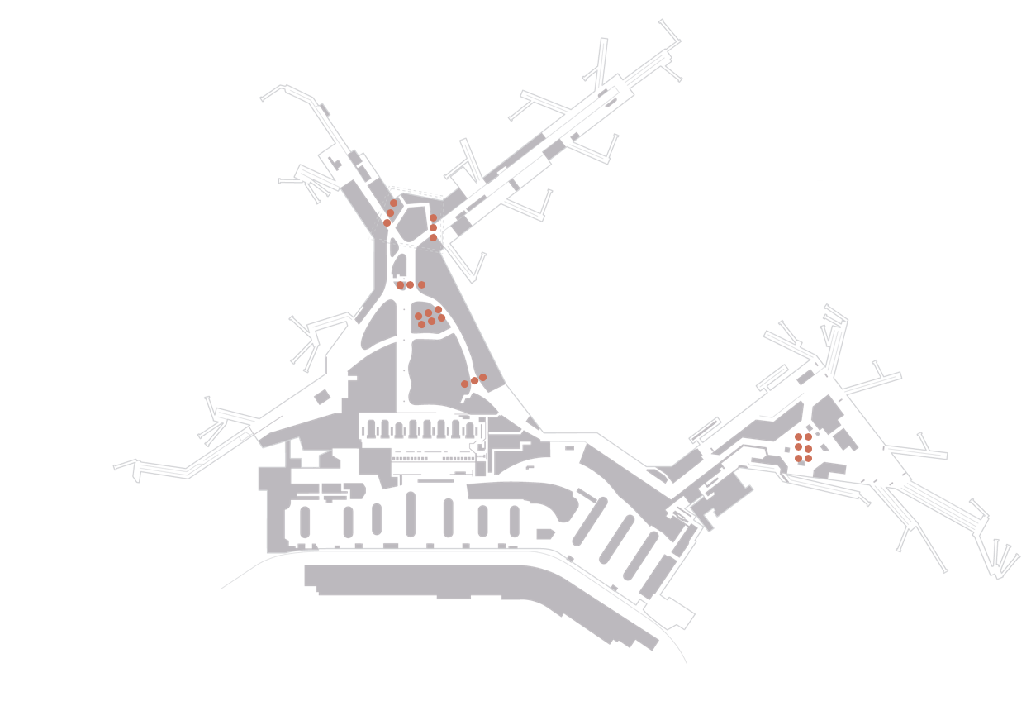
Map View

Slide 8
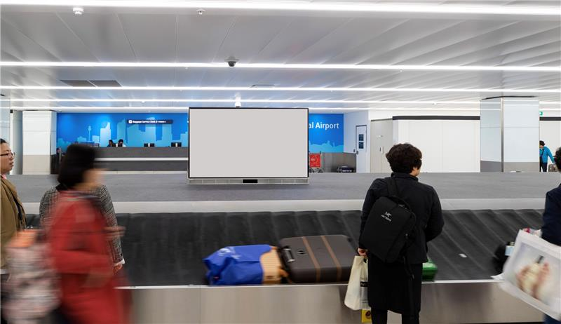
T1 International Baggage Pack
Location Details
26 x full motion,16:9 ratio, digital screens covering the T1 Arrivals Baggage carousels.

Slide 9
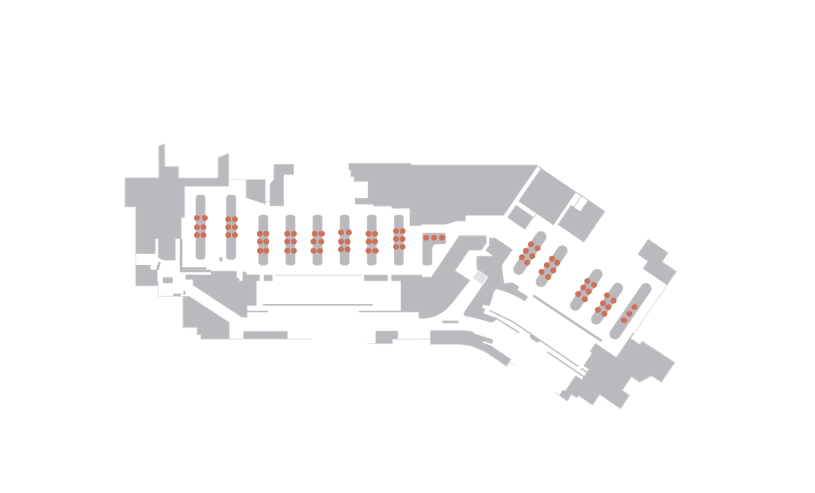
Map View

Slide 10
Thank You

