Slide 1


Publications Recommendation

Slide 2
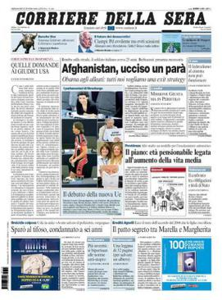
Corriere della Sera
Italy
Tier One
Reaches affluent Italian readers who value luxury and culture, positioning The Red Sea as a premium and exclusive destination.
Estimated reach
400000

Slide 3
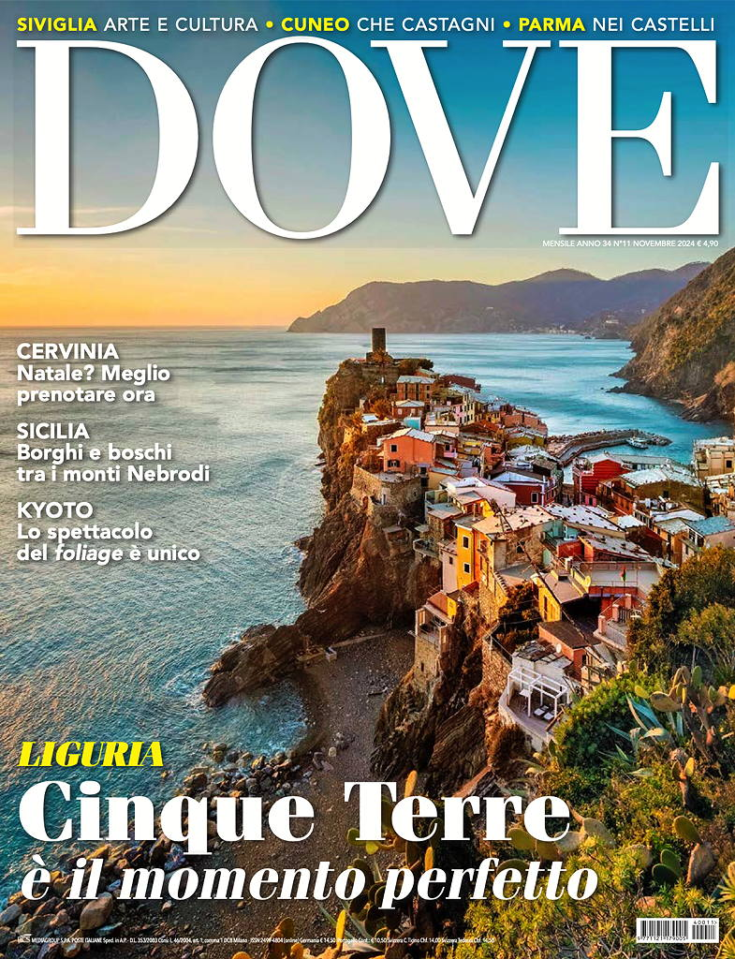
Dove Viaggi
Italy
Tier One Appeals to Italian luxury travelers with The Red Sea's eco-friendly and luxurious experiences.
Estimated reach
400000

Slide 4
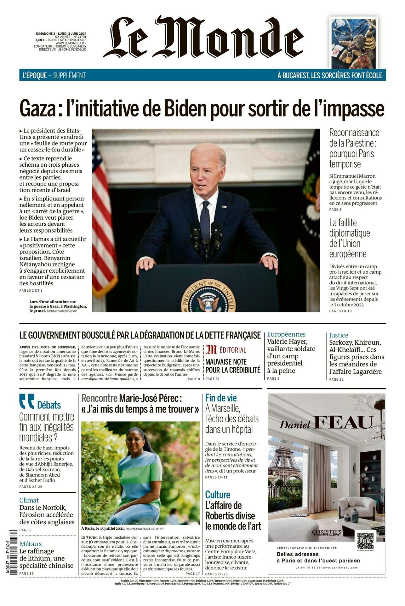
Le Monde
France
Tier One Highly trusted French newspaper with eco-conscious readership, aligning with The Red Sea's commitment to renewable energy.
Estimated reach
600000

Slide 5
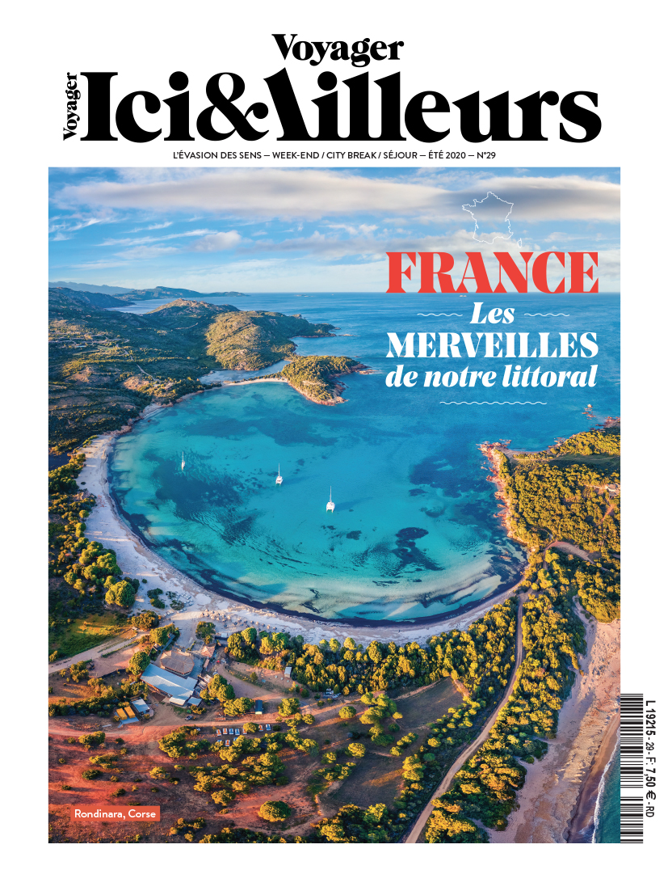
Voyager Ici et Ailleurs
France
Tier One Popular for showcasing unique eco-tourism destinations like The Red Sea, ideal for French audiences.
Estimated reach
350000

Slide 6
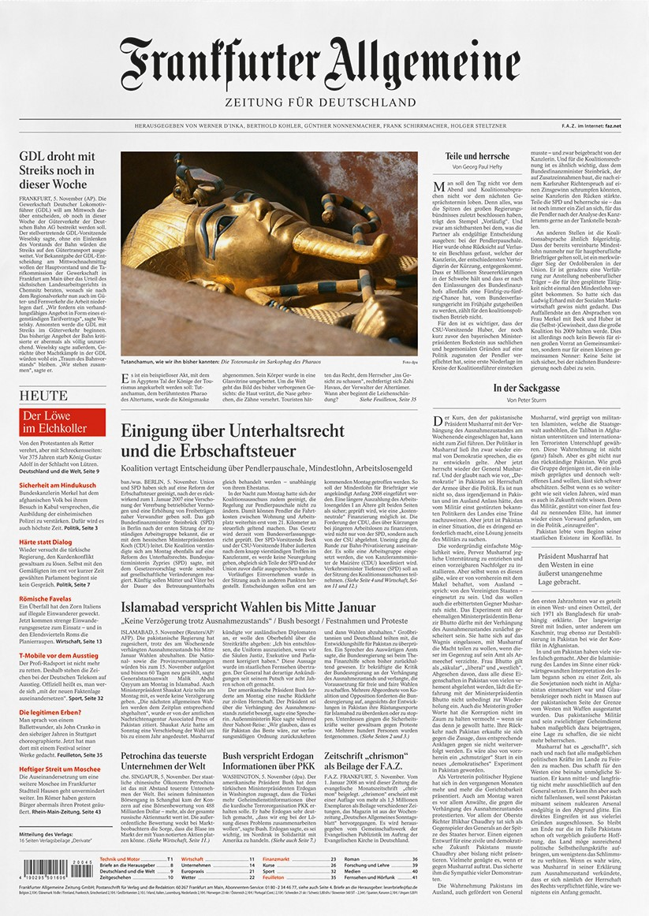
FAZ
Germany
Tier One Renowned in Germany for its comprehensive national reach, essential for promoting The Red Sea.
Estimated reach
780000

Slide 7
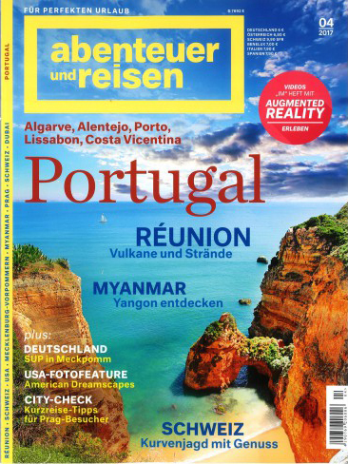
Abenteuer und Reisen
Germany
Tier One Highly regarded by German adventure enthusiasts, ideal for promoting The Red Sea's marine and eco-tourism.
Estimated reach
350000

Slide 8
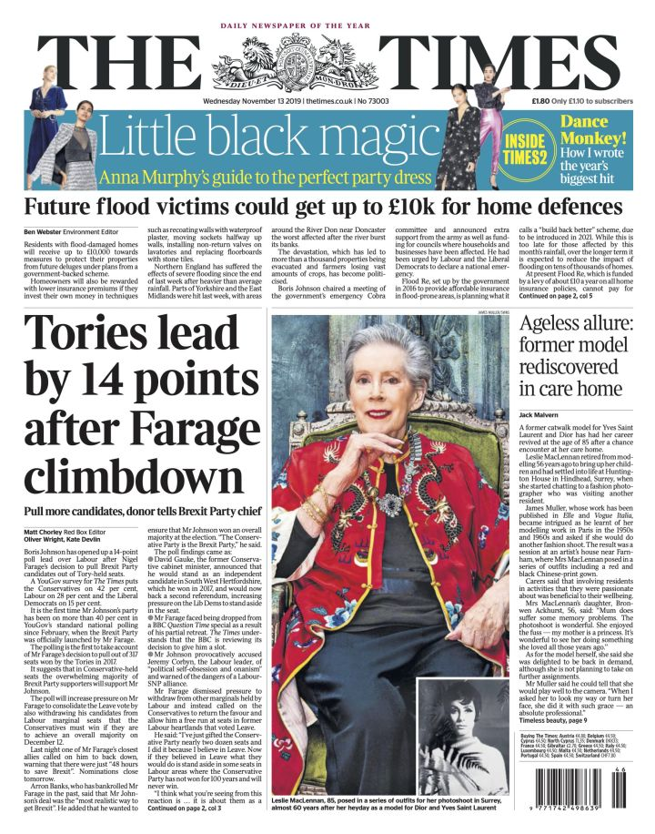
The Times
UK
Tier One UK’s leading newspaper, offering extensive credibility for promoting The Red Sea as a global luxury destination.
Estimated reach
780000

Slide 9
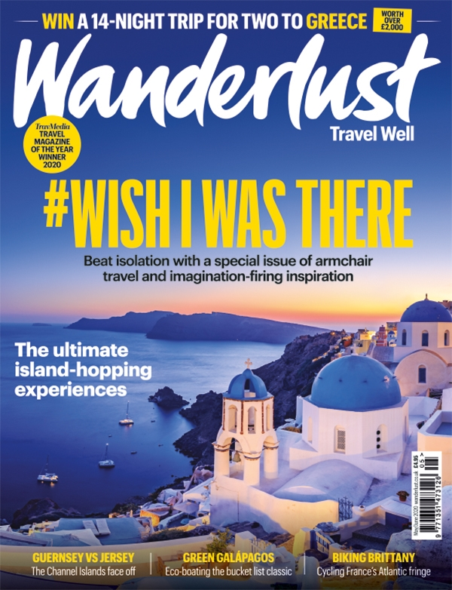
Wanderlust
UK
Tier One Widely read by UK audiences seeking bespoke travel experiences, matching The Red Sea's offerings.
Estimated reach
450000

Slide 10
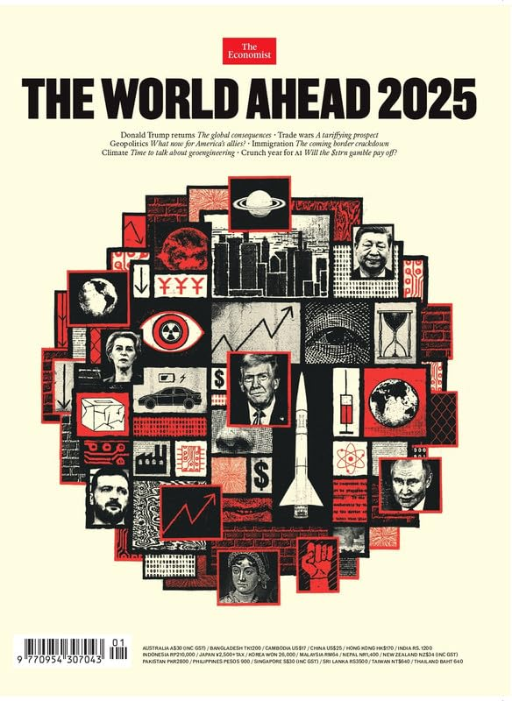
The Economist
UK
Business Highly regarded for showcasing global luxury and sustainable destinations like The Red Sea.
Estimated reach
400000

Slide 11
Thank You

