Slide 1

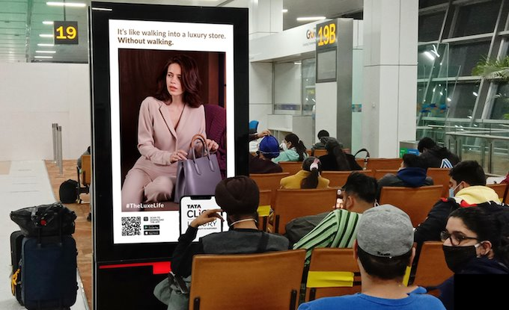

Top Airports
Recommendations
in India

Slide 2
India

Slide 3
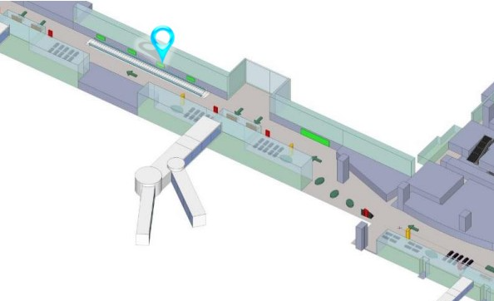
Bangalore International Airport, Karnataka, India Light Box at International Boarding Lounge, Bangalore Airport

Slide 4
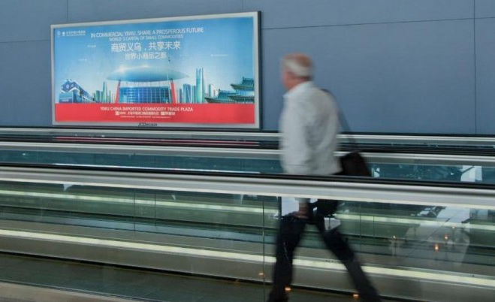

Slide 5
Bangalore International Airport, Karnataka, India Light Box at International Boarding Lounge, Bangalore Airport
Rates and details
Number of Screens: 1
Lighting type: Back-Lit
Size: 1.3m (H) x 3m (W)
Number of production: 1
Total number of months required: 1

Slide 6
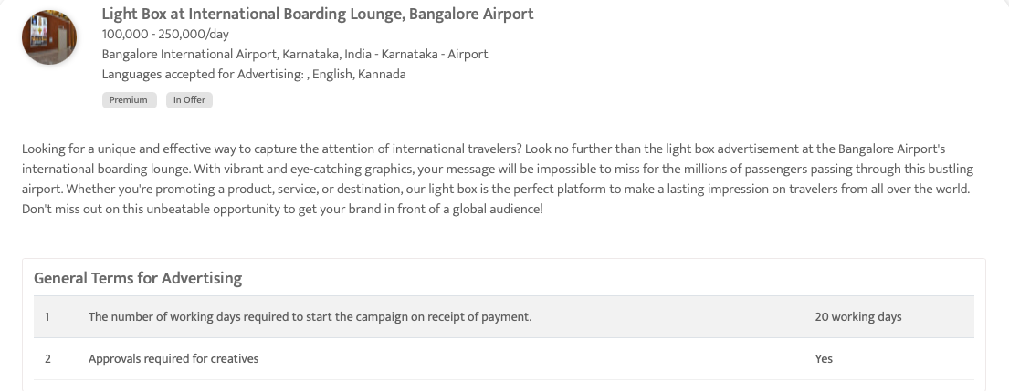

Slide 7
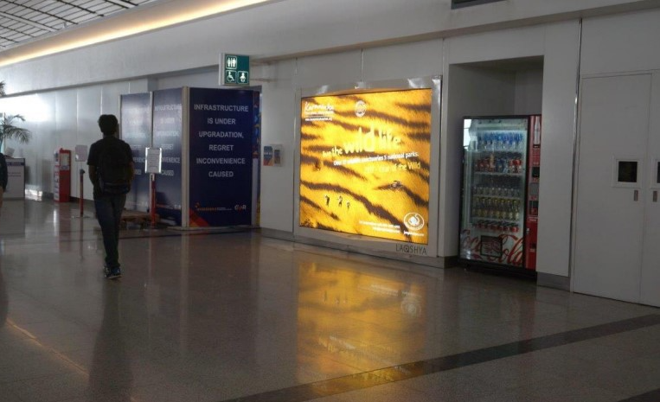
Rajiv Gandhi International Airport, Hyderabad – Telangana
Lightbox Ad at International SHA, Rajiv Gandhi International Airport

Slide 8
Rajiv Gandhi International Airport, Hyderabad – Telangana
Lightbox Ad at International SHA, Rajiv Gandhi International Airport
Rates and details
Number of Screens: 1
Lighting type: Back-Lit
Size: 10 feet X 7 feet
Number of production: 1
Total number of months required: 1

Slide 9
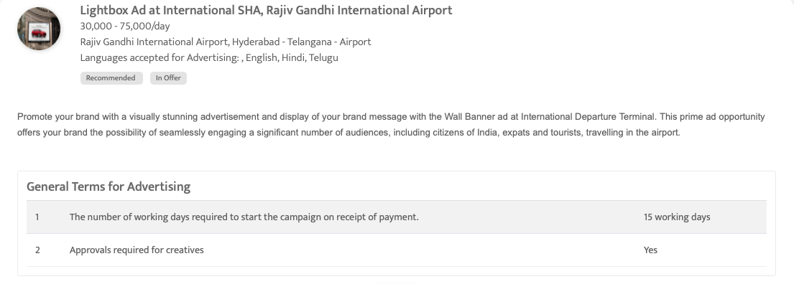

Slide 10
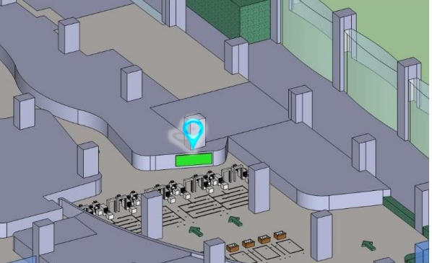
Bangalore International Airport, Karnataka, India
Light Box at International Security Hold Area, Bangalore International Airport, India

Slide 11
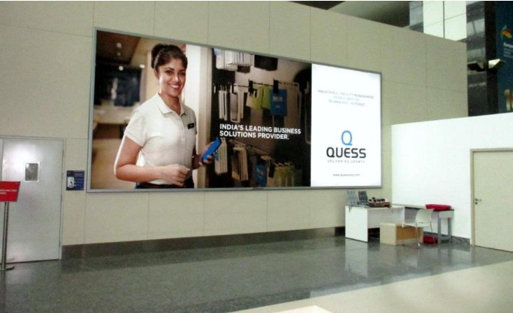

Slide 12
Bangalore International Airport, Karnataka, India
Light Box at International Security Hold Area, Bangalore International Airport, India
Rates and details
Number of Screens: 1
Lighting type: Back-Lit
Size: 3m (H) x 7.2m (W)
Number of production: 1
Total number of months required: 1

Slide 13
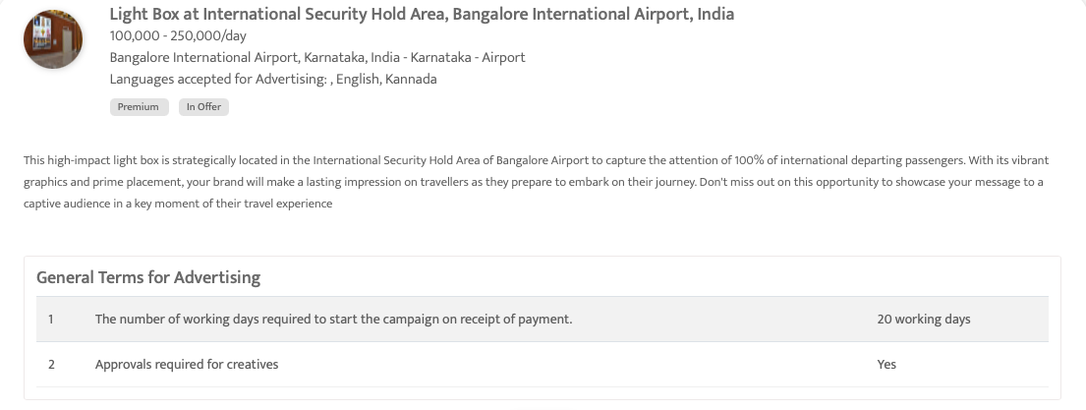

Slide 14
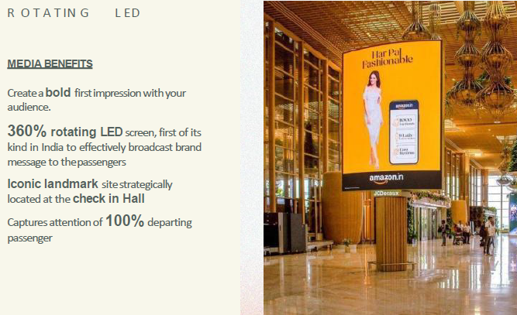
Bangalore International Airport, Karnataka, India
Rotating LED Display, Check In Hall, Bangalore International Airport, India

Slide 15
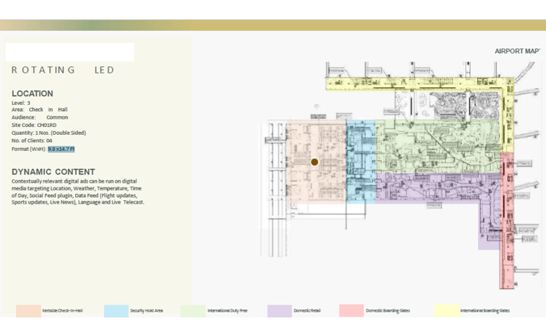

Slide 16
Bangalore International Airport, Karnataka, India
Rotating LED Display, Check In Hall, Bangalore International Airport, India
Rates and details
Number of Screens: 2
Lighting type: Lit
Size: 9.8 x14.7Ft
Single Rotation Time in Seconds:
Duration of creative in seconds: 15
Number of production: 1
Total number of months required: 1

Slide 17
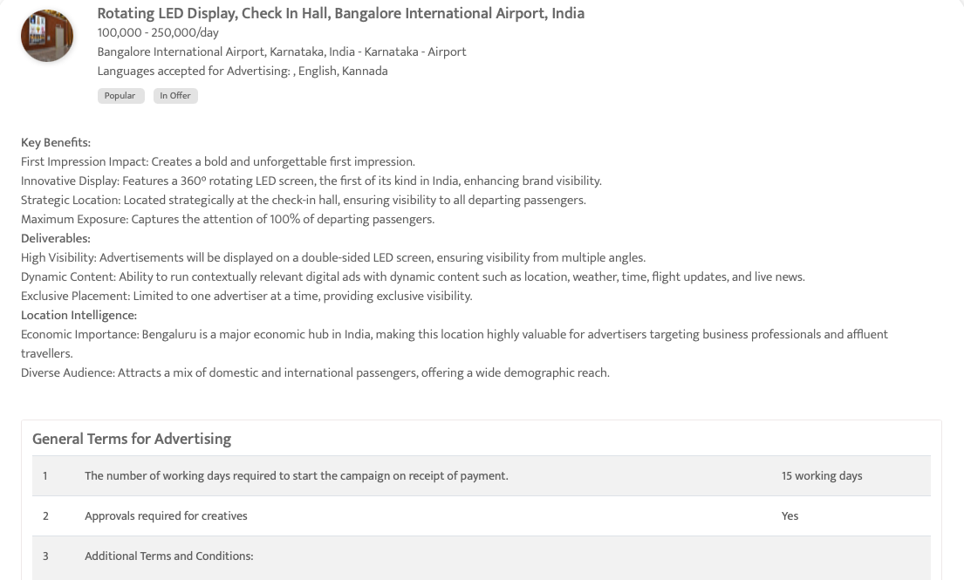

Slide 18
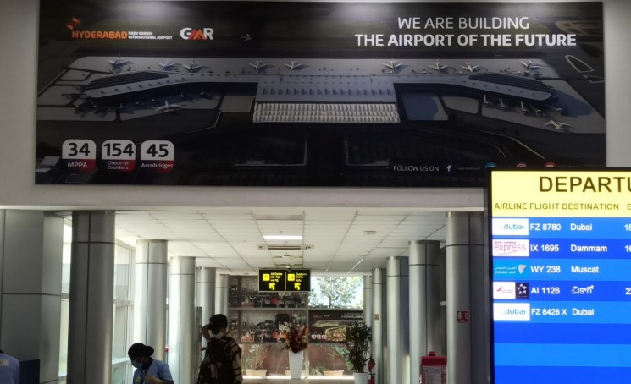
Rajiv Gandhi International Airport, Hyderabad – Telangana
Wall Banner Ad at International Departure Terminal, Rajiv Gandhi International Airport

Slide 19
Rajiv Gandhi International Airport, Hyderabad – Telangana
Wall Banner Ad at International Departure Terminal, Rajiv Gandhi International Airport
Rates and details
Number of Screens: 1
Lighting type: Non-Lit
Size: 19.5 feet x 6.5 feet
Number of production: 1
Total number of months required: 1

Slide 20
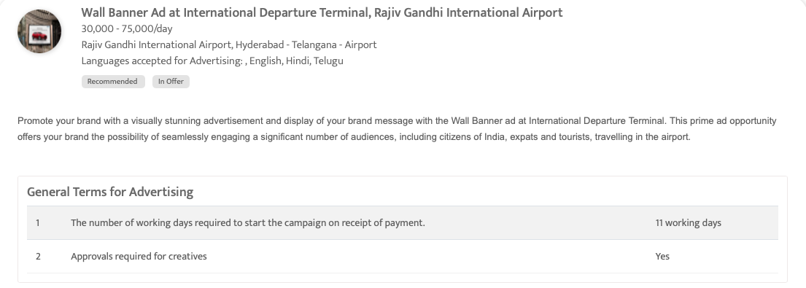

Slide 21
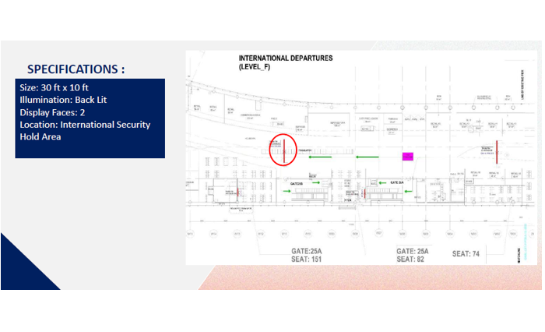
Rajiv Gandhi International Airport, Hyderabad – Telangana
Huge backlit display at International Security Hold Area, Rajiv Gandhi International Airport

Slide 22
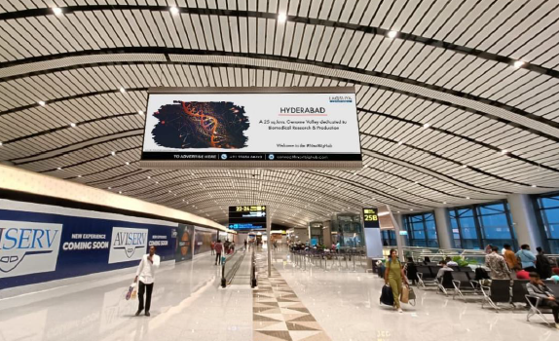

Slide 23
Rajiv Gandhi International Airport, Hyderabad – Telangana
Huge backlit display at International Security Hold Area, Rajiv Gandhi International Airport
Rates and details
Number of Screens: 2
Lighting type: Back-Lit
Size: 30 ft x 10 ft
Number of production: 1
Total number of months required: 1

Slide 24
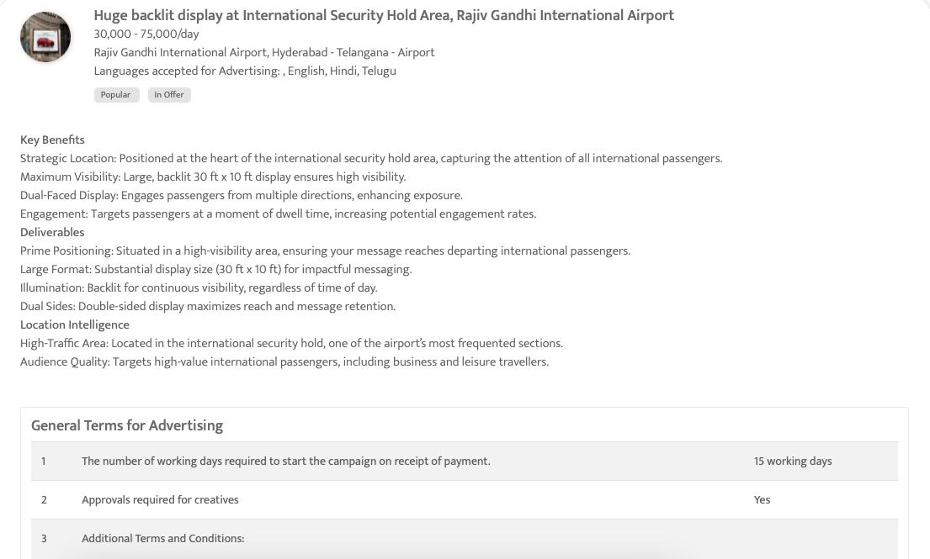

Slide 25
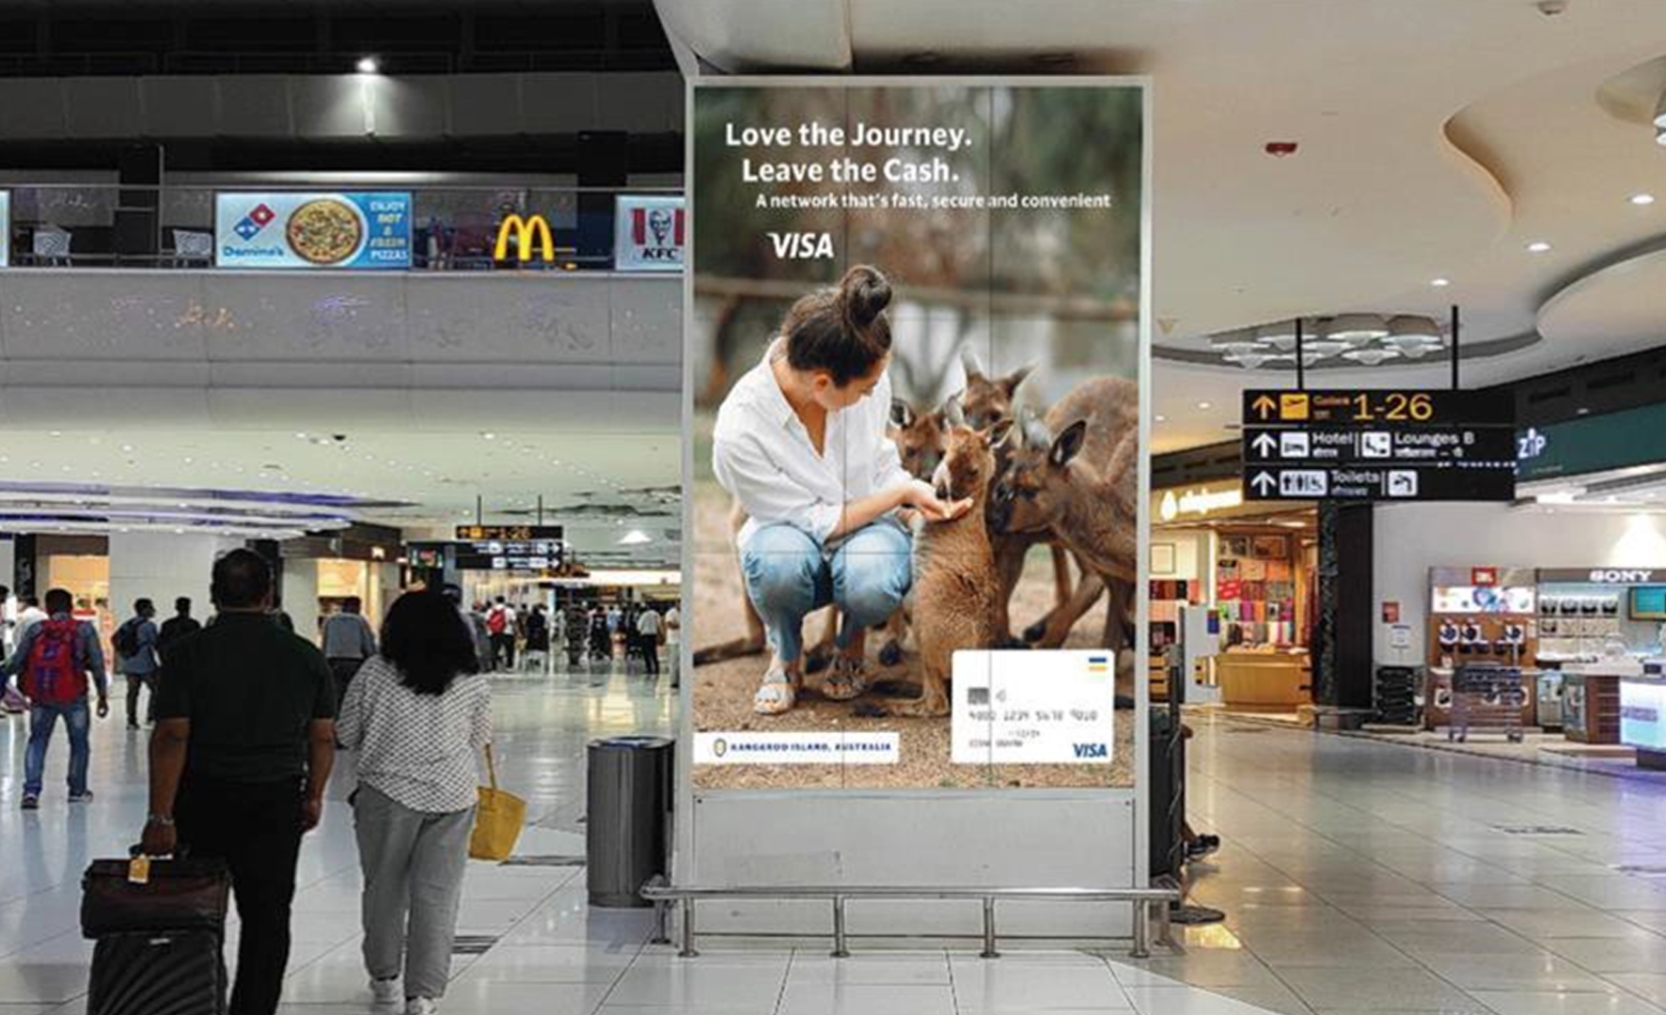
Indira Gandhi International Airport, Delhi, India
Exclusive Videowall at Retail Area, Indira Gandhi International Airport, Delhi, India

Slide 26
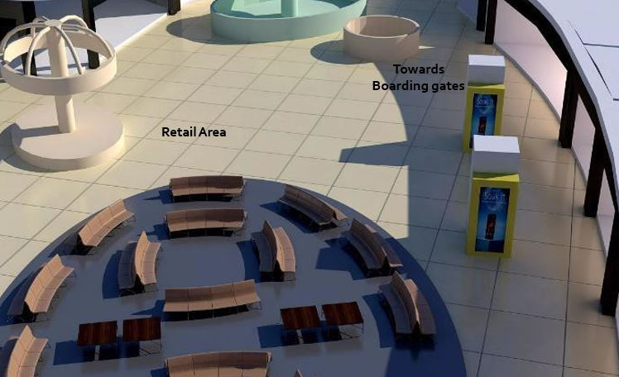

Slide 27
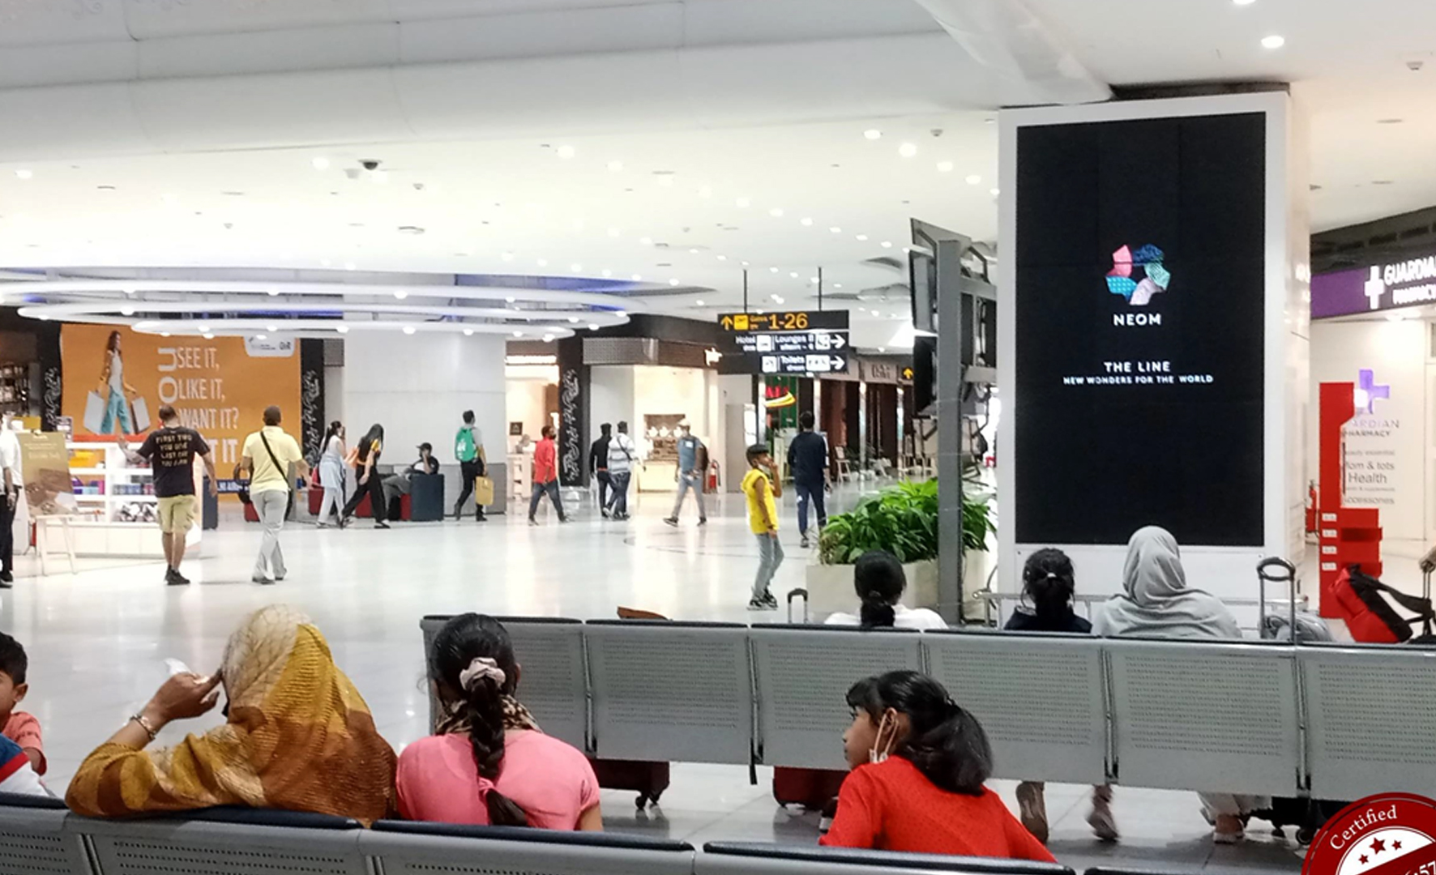

Slide 28
Indira Gandhi International Airport, Delhi, India
Exclusive Videowall at Retail Area, Indira Gandhi International Airport, Delhi, India
Rates and details
Number of Screens: 1
Lighting type: Lit
Size: 5.8’ X 10.1’
Number of production: 1
Total number of months required: 1

Slide 29
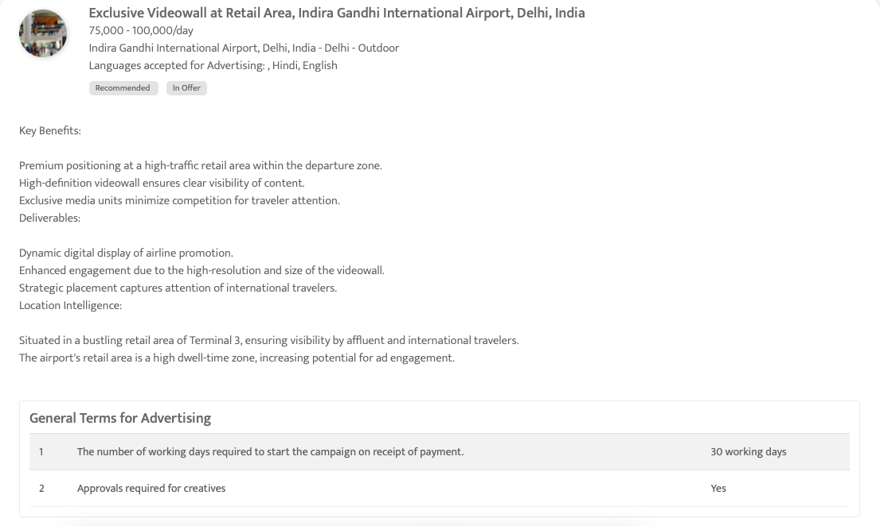

Slide 30
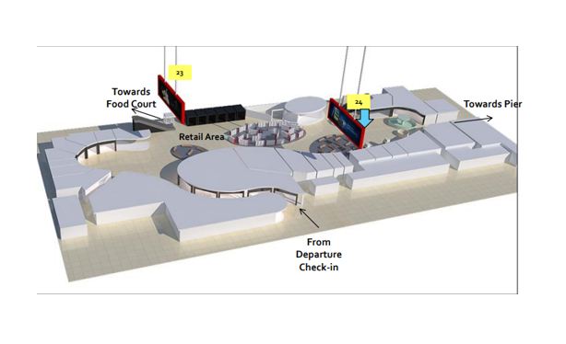
Indira Gandhi International Airport, Delhi, India
Backlit Display at Retail Area, T3 International Departures- Indira Gandhi International Airport, India

Slide 31
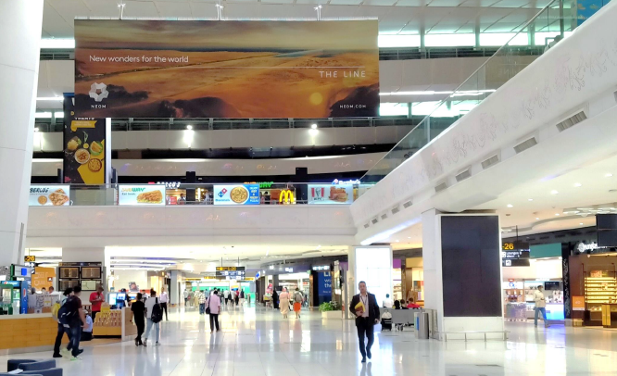

Slide 32
Indira Gandhi International Airport, Delhi, India
Backlit Display at Retail Area, T3 International Departures- Indira Gandhi International Airport, India
Rates and details
Number of Screens: 2 (Double-sided)
Lighting type: Back-Lit
Size: 33’ x 10’
Number of production: 1
Total number of months required: 1

Slide 33
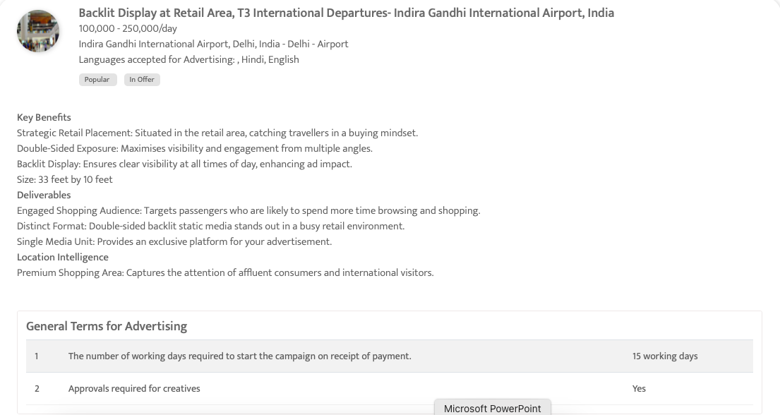

Slide 34
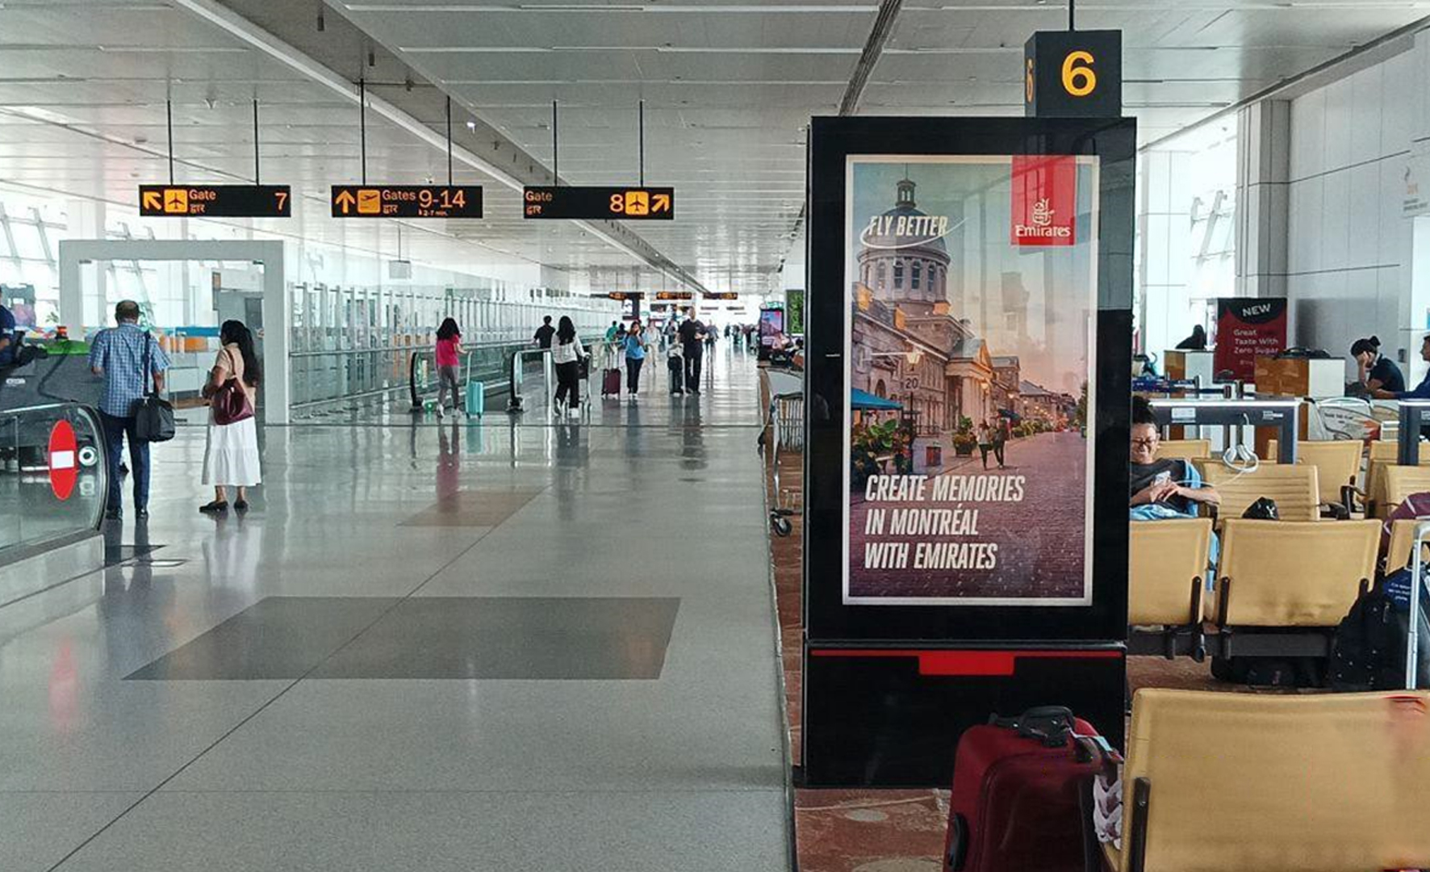
Indira Gandhi International Airport, Delhi, India
Digital Network at Indira Gandhi International Airport, Delhi, India

Slide 35
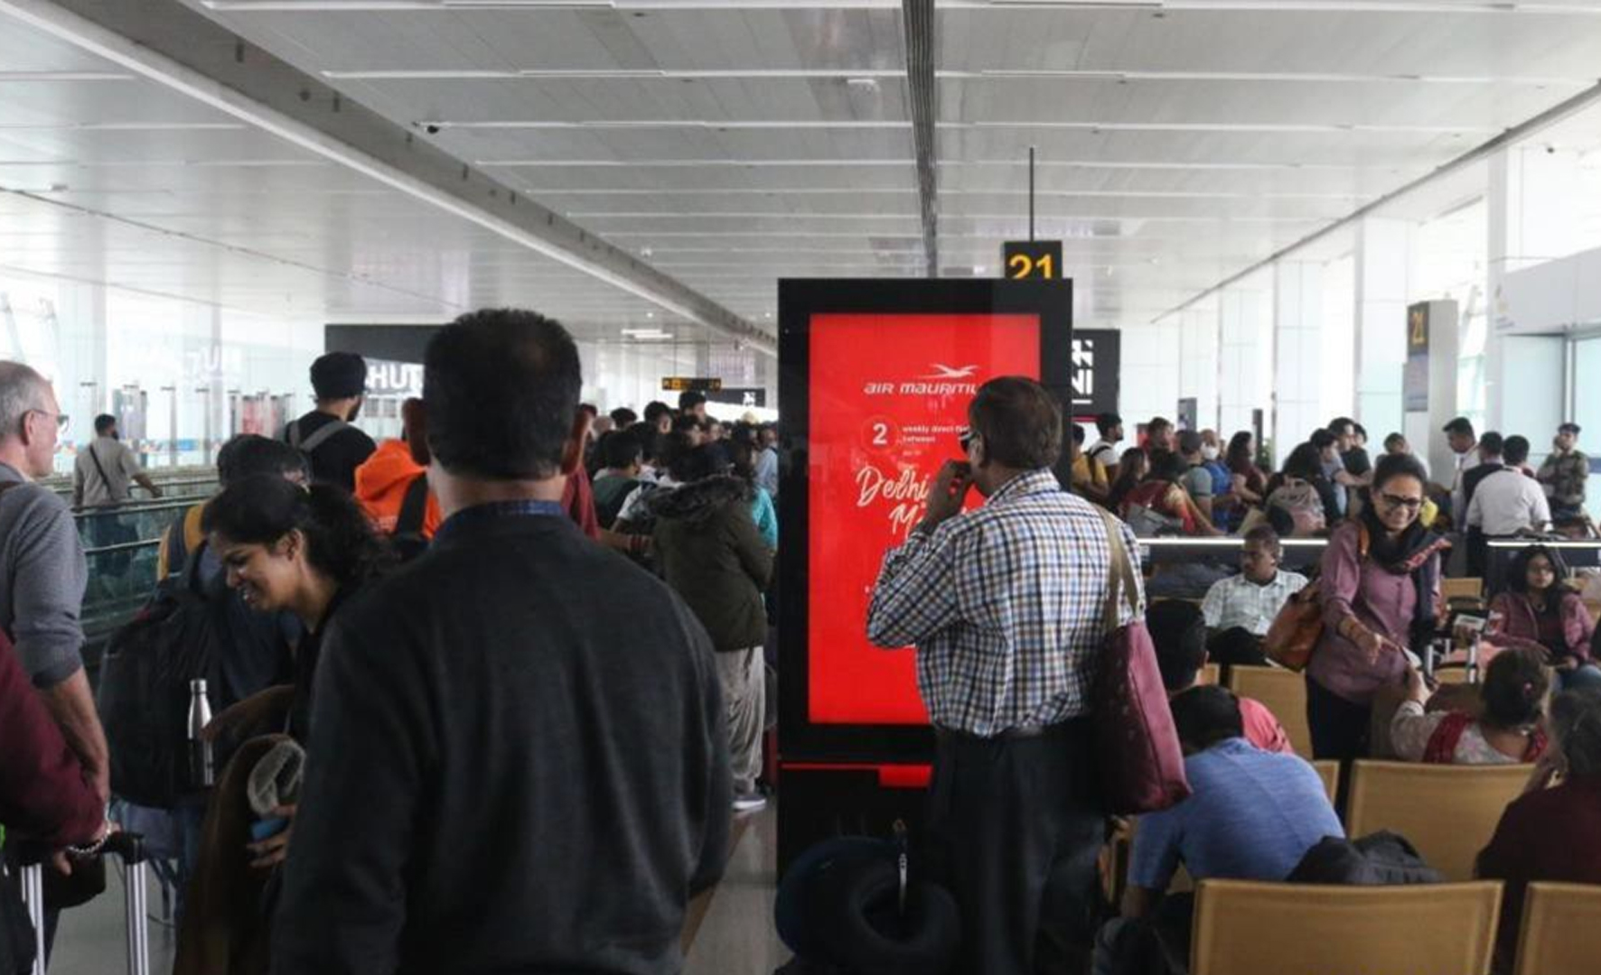

Slide 36
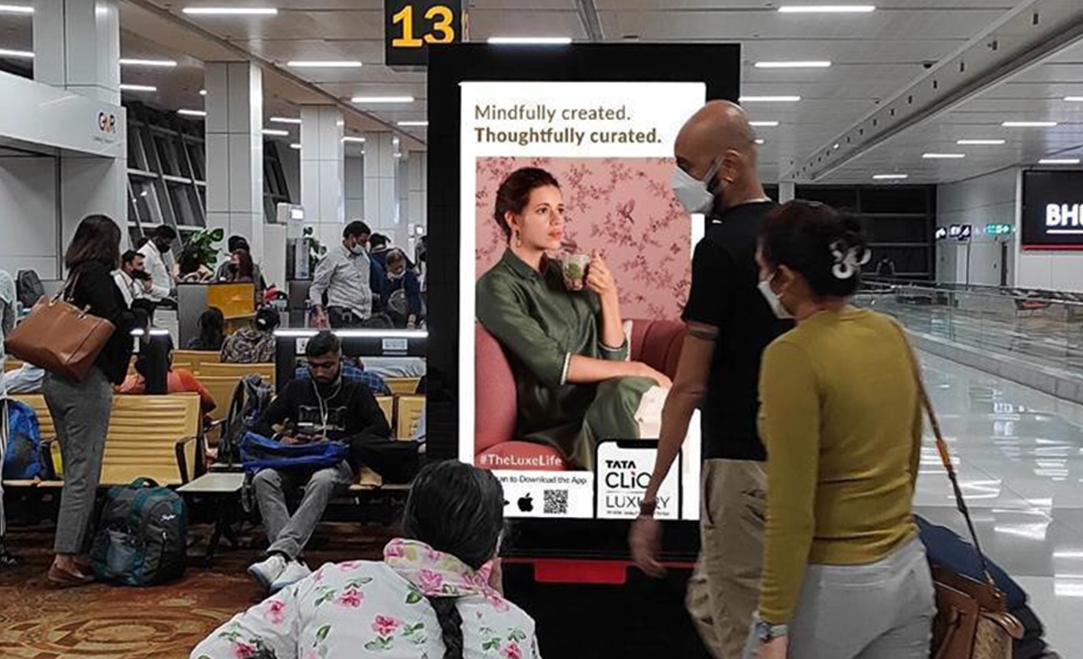

Slide 37
Indira Gandhi International Airport, Delhi, India
Digital Network at Indira Gandhi International Airport, Delhi, India
Rates and details
Number of Screens: 62
Lighting type: Lit
Size: 65” each screen
Number of production: 1
Total number of months required: 1

Slide 38
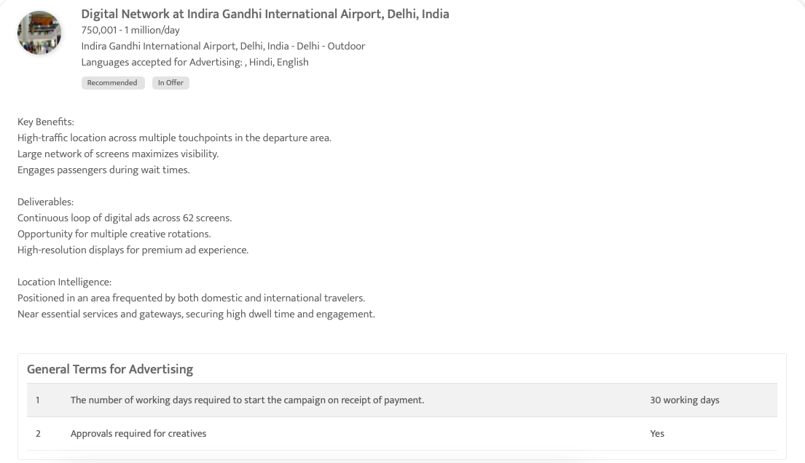

Slide 39
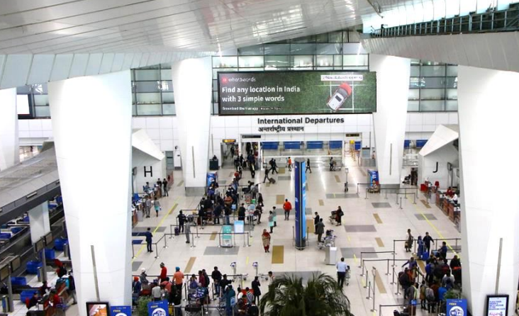
Indira Gandhi International Airport, Delhi, India
Ambient Lit display at Check-in area of T3, International Departures-Indira Gandhi International Airport, Delhi, India

Slide 40
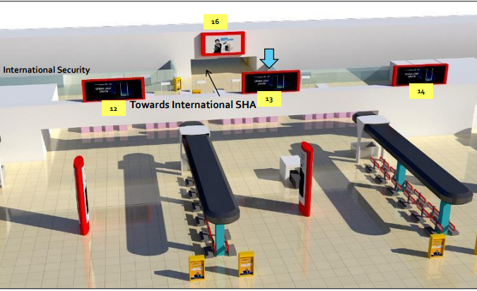

Slide 41
Indira Gandhi International Airport, Delhi, India
Ambient Lit display at Check-in area of T3, International Departures-Indira Gandhi International Airport, Delhi, India
Rates and details
Number of Screens: 1
Lighting type: Lit
Size: 60' x 15'
Number of production: 1
Total number of months required: 1

Slide 42
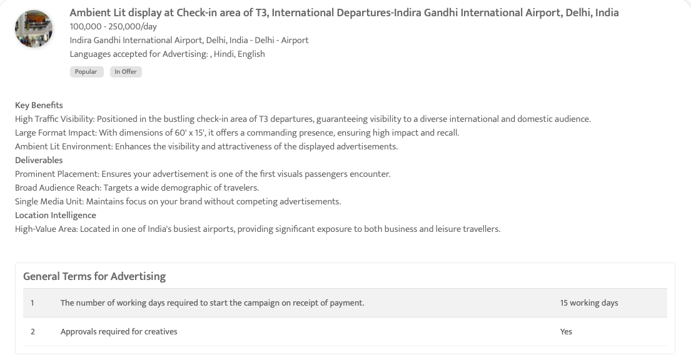

Slide 43
India

Slide 44
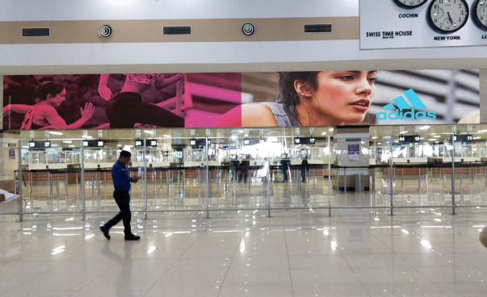
Cochin International Airport, Kochi
Non-lit Billboards, above the immigration and security check, International Departure, Cochin International Airport

Slide 45
Cochin International Airport, Kochi
Non-lit Billboards, above the immigration and security check, International Departure, Cochin International Airport
Rates and details
Number of Screens: 2
Lighting type: Non-Lit
Size: 35’ x 7’ (245 sq. ft.) each
Number of production: 1
Total number of months required: 1

Slide 46
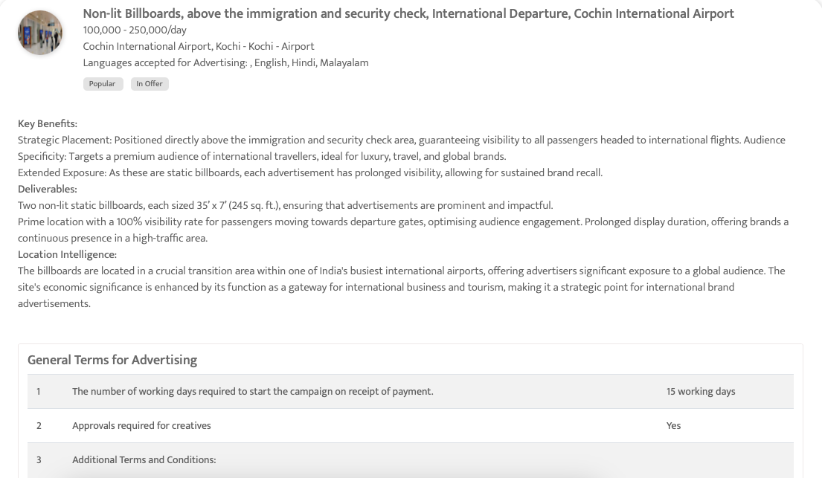

Slide 47
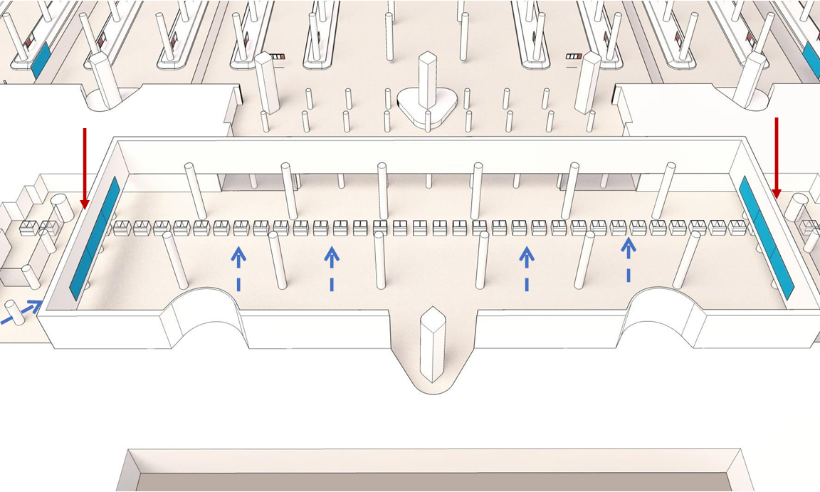
Mumbai International Airport, Maharashtra, India
Backlit screen at the Immigration Hall, International Arrival, Mumbai Airport, India

Slide 48
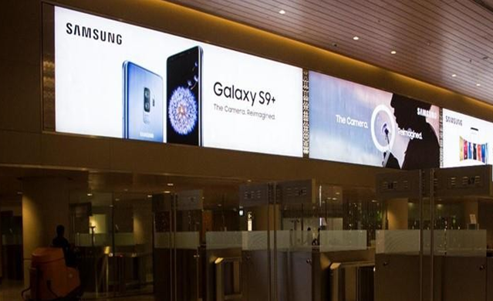

Slide 49
Mumbai International Airport, Maharashtra, India
Backlit screen at the Immigration Hall, International Arrival, Mumbai Airport, India
Rates and details
Number of Screens: 1
Lighting type: Back-Lit
Size: 80 ft (w) * 10 ft (h) (Is divided into 3 parts, each 26.4’ x 7.87’)
Number of production: 1
Total number of months required: 1

Slide 50
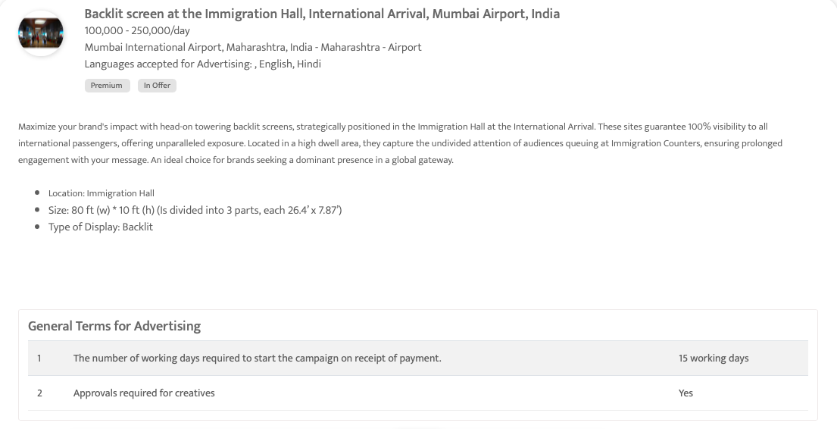

Slide 51
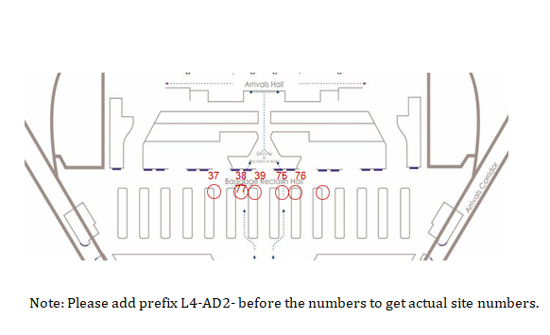
Mumbai International Airport, Maharashtra, India
Light Boxes After Baggage Claim, International Arrival, Mumbai International Airport, India

Slide 52
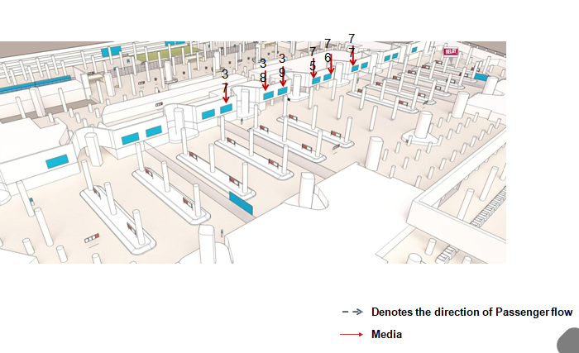

Slide 53
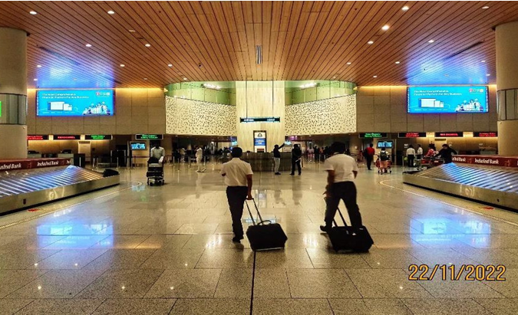

Slide 54
Mumbai International Airport, Maharashtra, India
Light Boxes After Baggage Claim, International Arrival, Mumbai International Airport, India
Rates and details
Number of Screens: 2
Lighting type: Back-Lit
Size: 16 ft 2 in (w) * 6 ft 10 in (h)
Number of production: 1
Total number of months required: 1

Slide 55
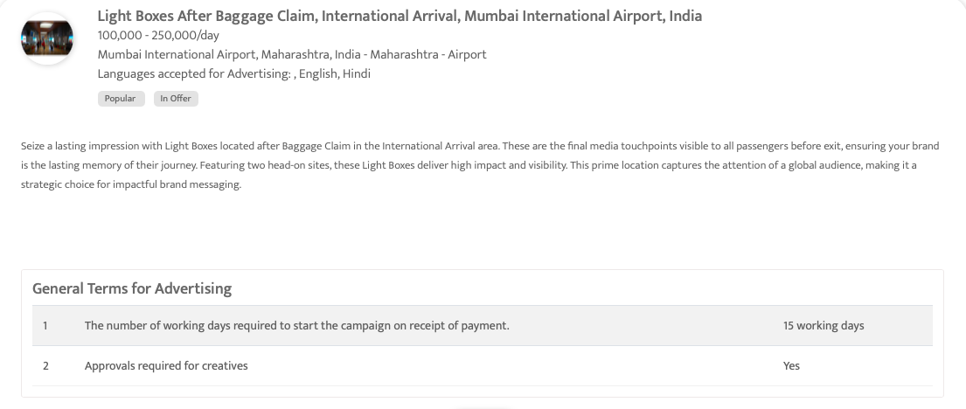

Slide 56
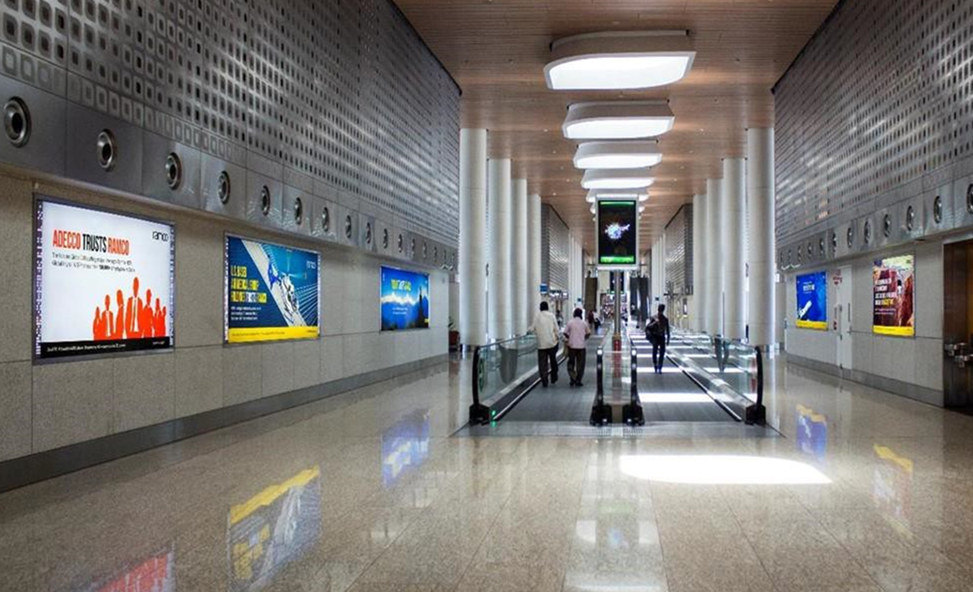
Mumbai International Airport, Maharashtra, India
Light boxes at the entrance to Departure pier, Mumbai International Airport, India

Slide 57
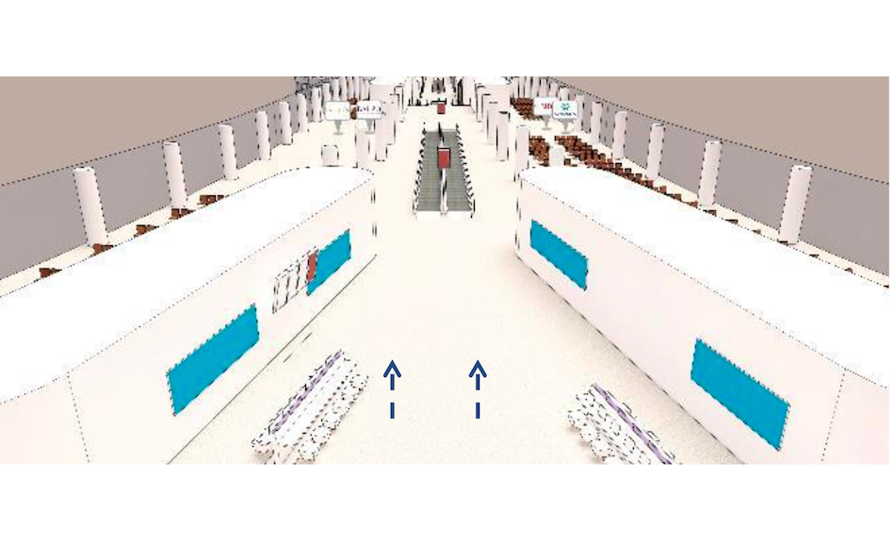

Slide 58
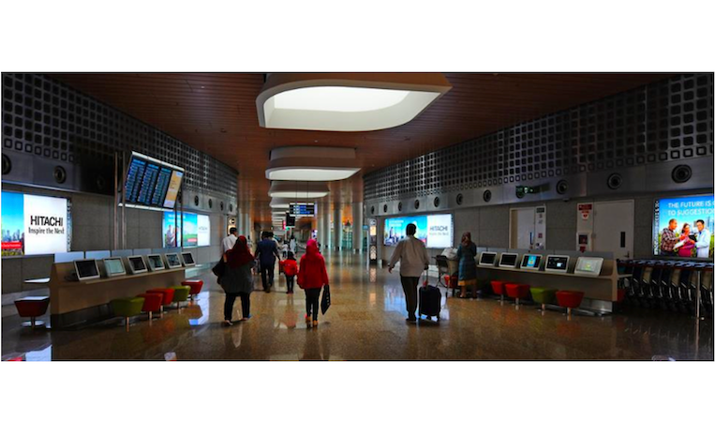

Slide 59
Mumbai International Airport, Maharashtra, India
Light boxes at the entrance to Departure pier, Mumbai International Airport, India
Rates and details
Number of Screens: 7
Lighting type: Back-Lit
Size: Custom
Number of production: 1
Total number of months required: 1

Slide 60
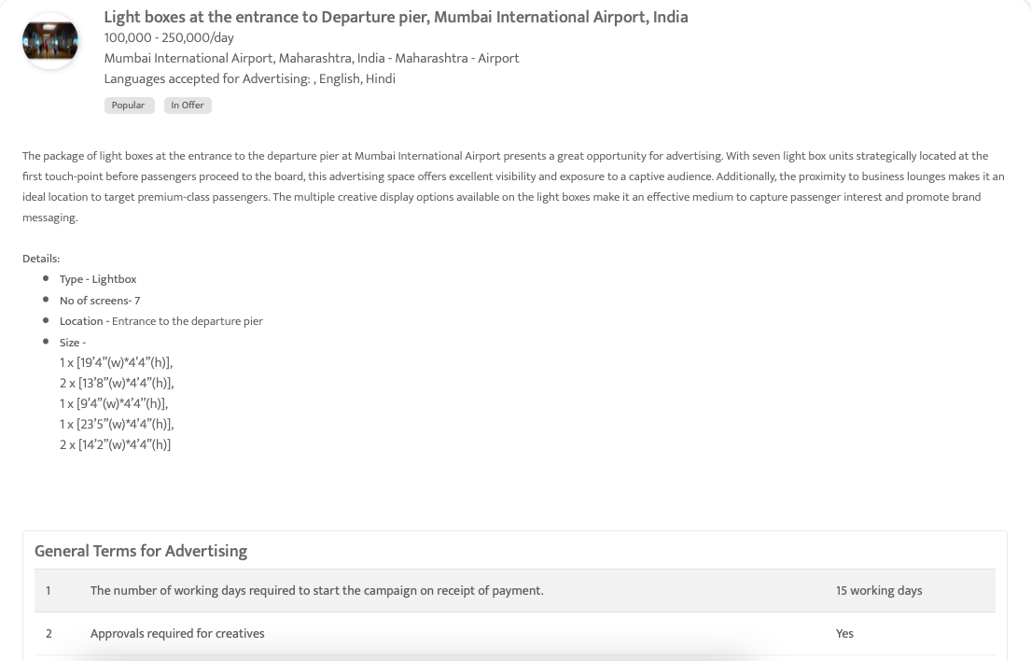

Slide 61
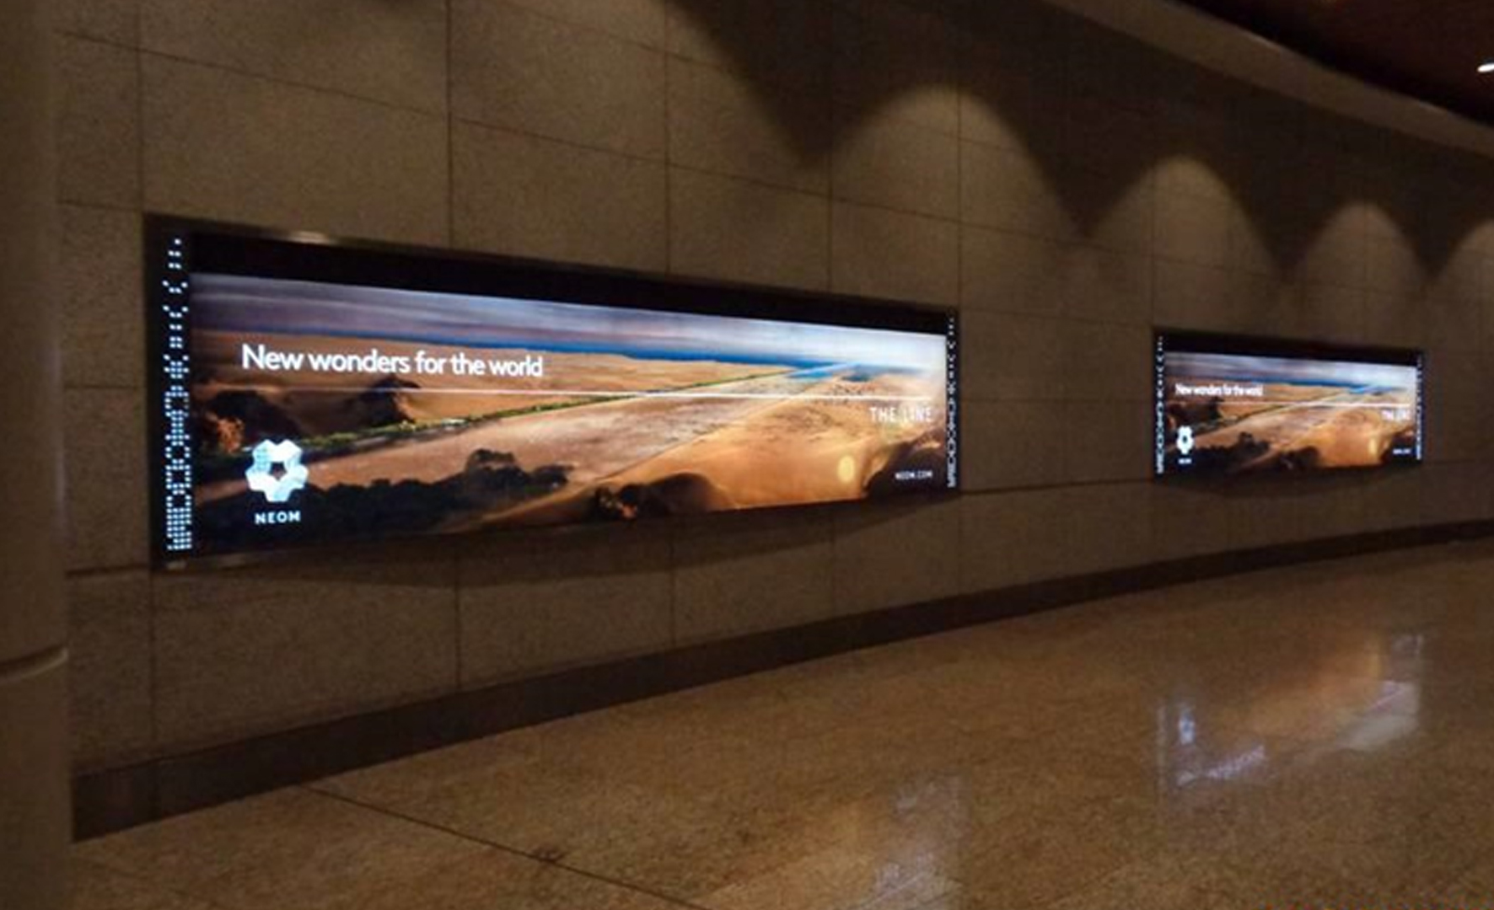
Mumbai International Airport, Maharashtra, India
Light Boxes at Entry of the North West Pier, Mumbai International Airport, India

Slide 62
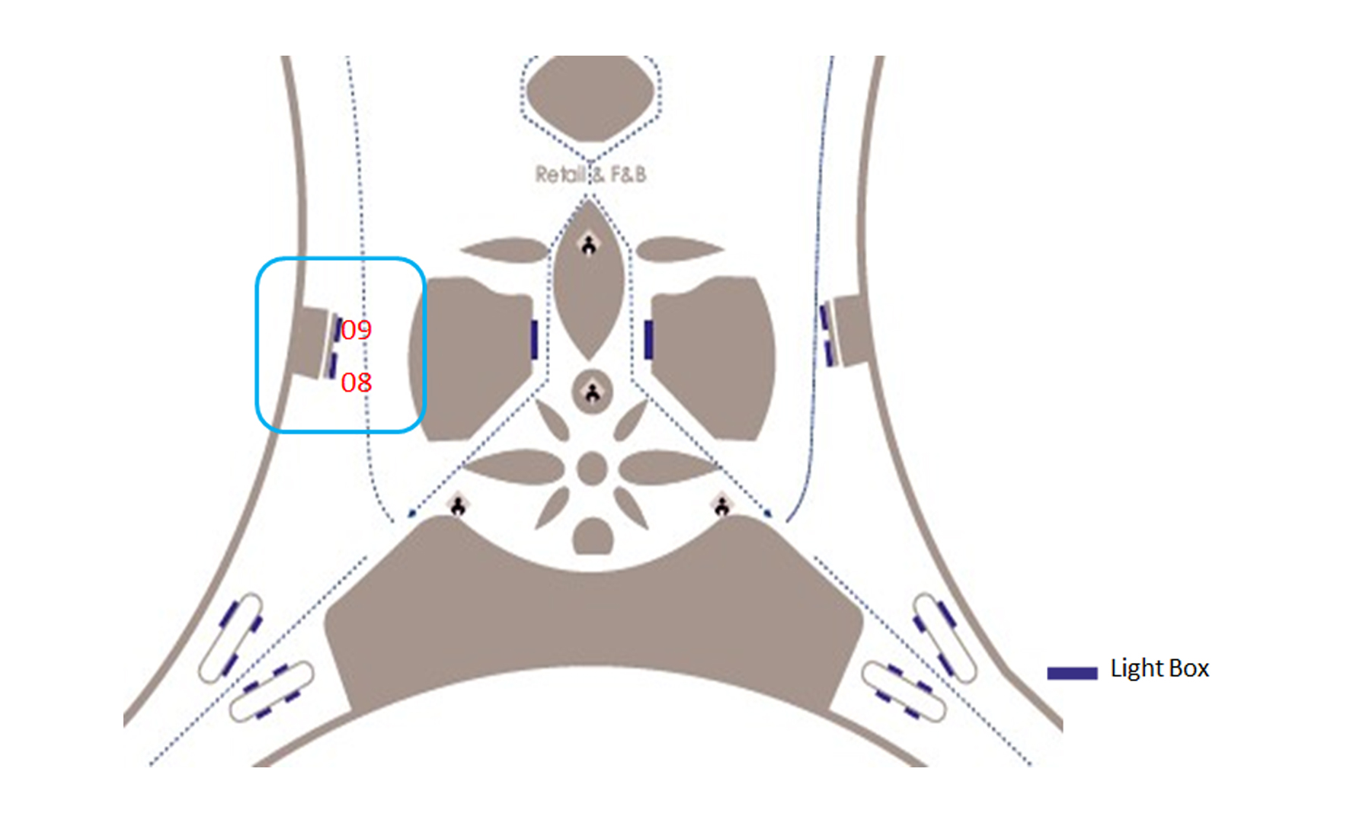

Slide 63
Mumbai International Airport, Maharashtra, India
Light Boxes at Entry of the North West Pier, Mumbai International Airport, India
Rates and details
Number of Screens: 2
Lighting type: Back-Lit
Size: 18 ft 6 in(w) * 3 ft 10 in (h)
Number of production: 1
Total number of months required: 1

Slide 64
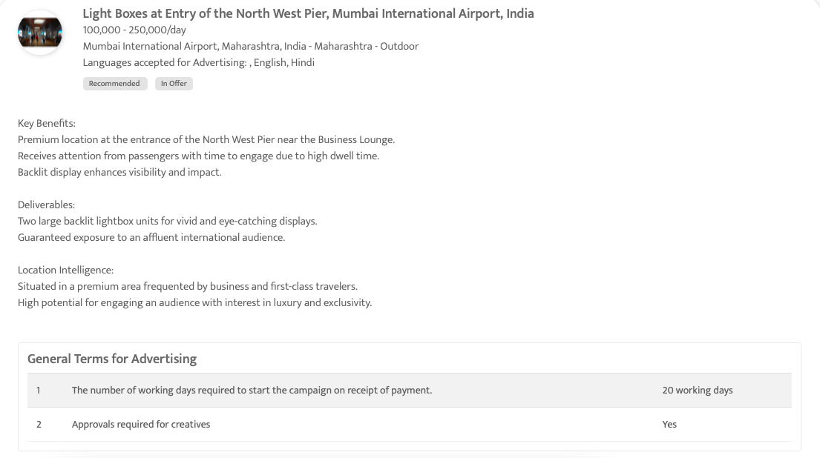

Slide 65
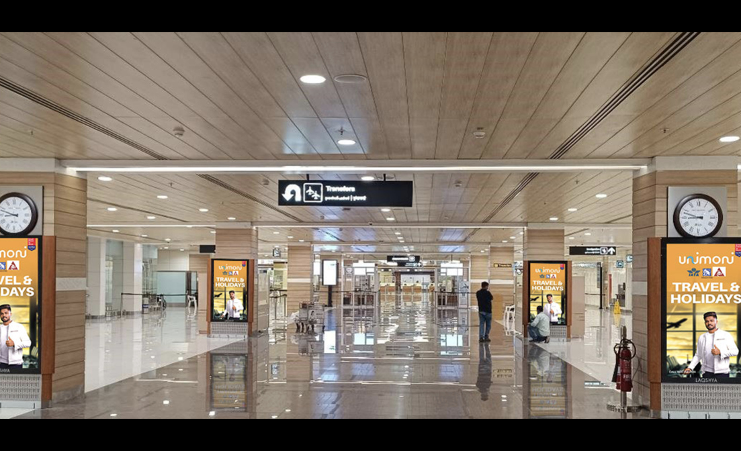
Cochin International Airport, Kochi
Digital Display Screens at Cochin Airport - Captivating Arrivals Engagement

Slide 66
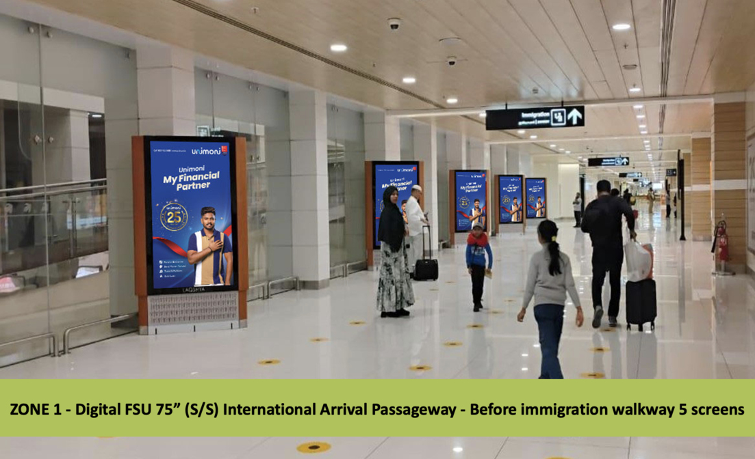

Slide 67
Cochin International Airport, Kochi
Digital Display Screens at Cochin Airport - Captivating Arrivals Engagement
Rates and details
Number of Screens: 27
Number of production: 1

Slide 68
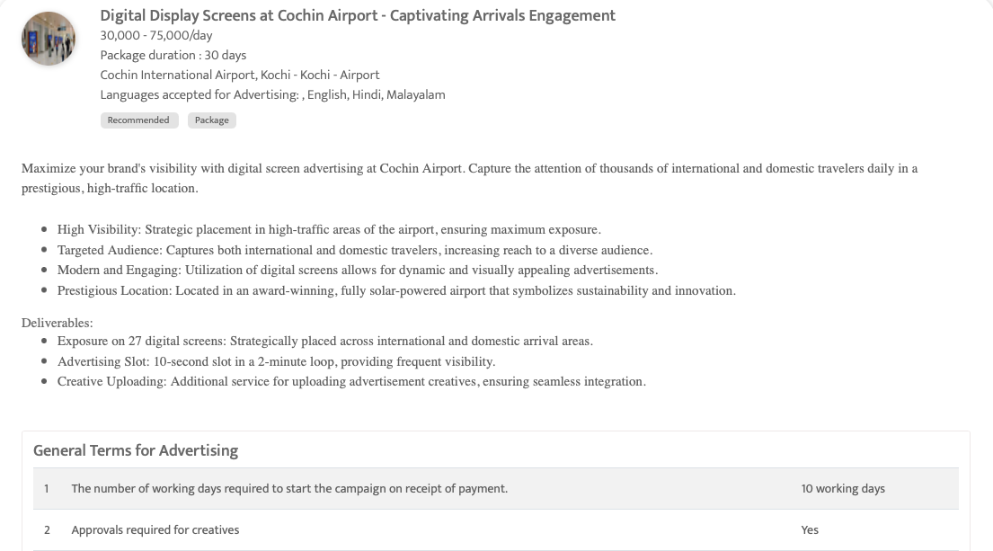


Slide 69

Mumbai International Airport, Maharashtra, India
Light Boxes at International Departures, entry of the North East Pier at L4, Mumbai International Airport, India

Slide 70
Mumbai International Airport, Maharashtra, India
Light Boxes at International Departures, entry of the North East Pier at L4, Mumbai International Airport, India
Rates and details
Number of Screens: 2
Lighting type: Back-Lit
Size: 18 ft 3 in (width) x 4 ft 4 in (height) and 13 ft 4 in (width) x 4 ft 4 in (height)
Number of production: 1
Total number of months required: 1

Slide 71


Slide 72

Mumbai International Airport, Maharashtra, India
4 Quad towers,8 Lightboxes & 2 Double-sided Totems- int'l departure, Mumbai Airport, India

Slide 73


Slide 74


Slide 75


Slide 76


Slide 77


Slide 78
Mumbai International Airport, Maharashtra, India
4 Quad towers,8 Lightboxes & 2 Double-sided Totems- int'l departure, Mumbai Airport, India
Rates and details
Number of Screens: 16
Lighting type: Back-Lit
Size: Quad tower: 4' x 5'5" (Width x Height) Lightbox: 8' x 13'7" (Width x Height) and 2' x 5'5" (Width x Height) Totem: 3'8" (Width) x 9' (Height)
Number of production: 1
Total number of months required: 1

Slide 79


Slide 80
Thank You
media@masscomglobal.com | www.masscomglobal.com
Masscom Global FZE, Office No: 220, One UAQ Building, UAQ Free Trade Zone, Umm Al Quwain, United Arab Emirates.

