Slide 1
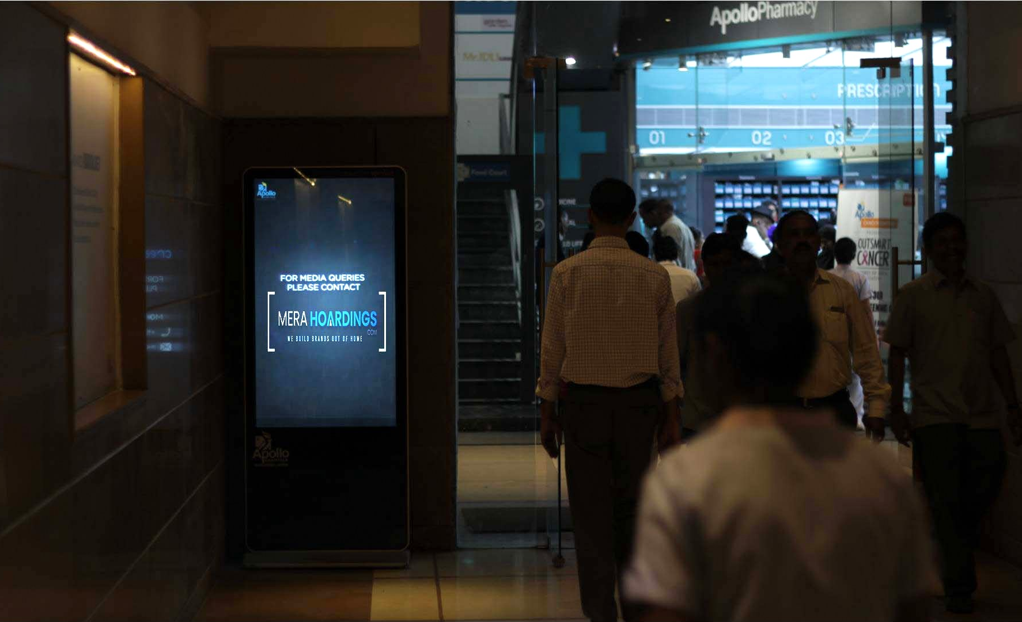


Top Media
Recommendations
in Indian

Slide 2
Indian Prime Out Of Home

Slide 3
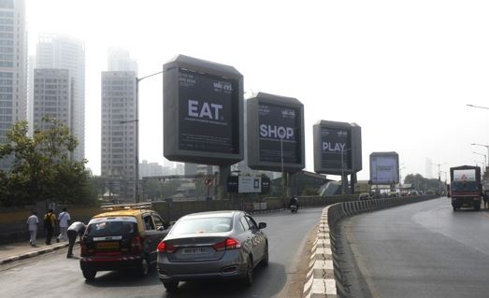
Mahalaxmi Junction Billboard Package – Exclusive Access to Affluent Audiences, Mumbai
7 billboards at Mahalaxmi Junction, Mumbai

Slide 4
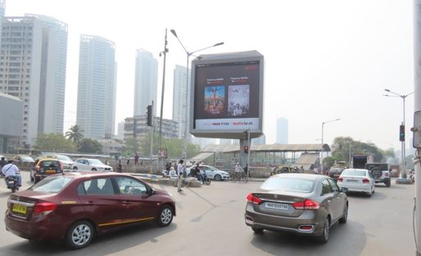

Slide 5
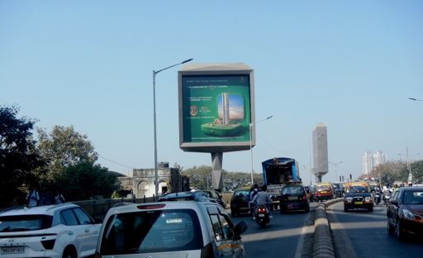

Slide 6
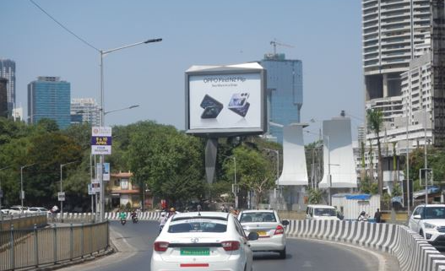

Slide 7
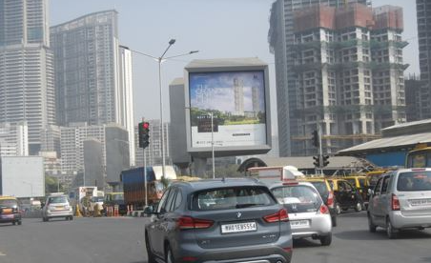

Slide 8
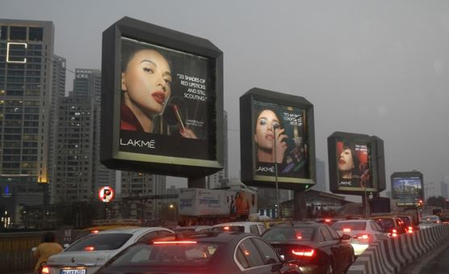

Slide 9
Mahalaxmi Junction Billboard Package – Exclusive Access to Affluent Audiences, Mumbai
7 billboards at Mahalaxmi Junction, Mumbai
Rates and details
Number of Screens: 7
Number of production: 1

Slide 10
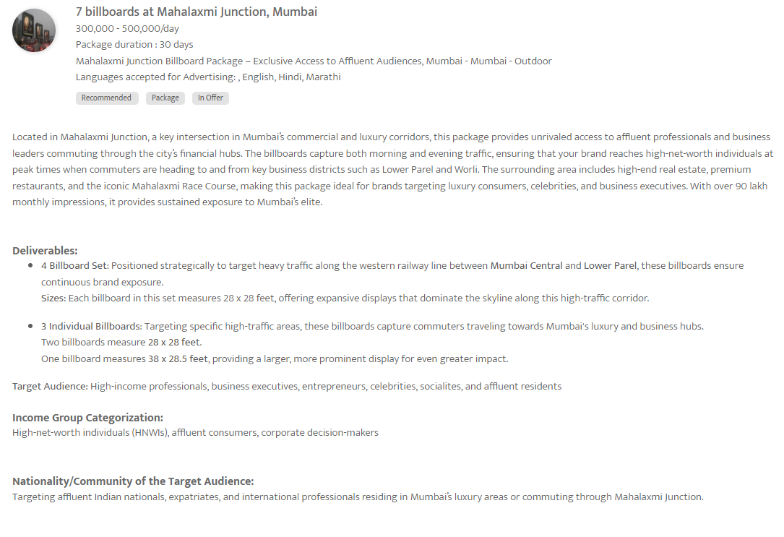

Slide 11
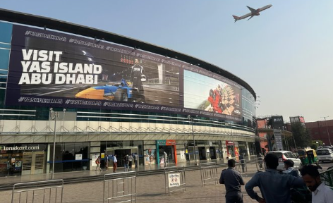
Dwarka Sec 21 Pacific Mall, Coming From Vivanta To Gurgaon- Delhi, India
Facade ad on Dwarka Sec 21 Pacific Mall

Slide 12
Dwarka Sec 21 Pacific Mall, Coming From Vivanta To Gurgaon- Delhi, India
Facade ad on Dwarka Sec 21 Pacific Mall
Rates and details
Number of Screens: 1
Lighting type: Non-Lit
Size: 170 x 30
Number of production: 1
Total number of months required: 1

Slide 13
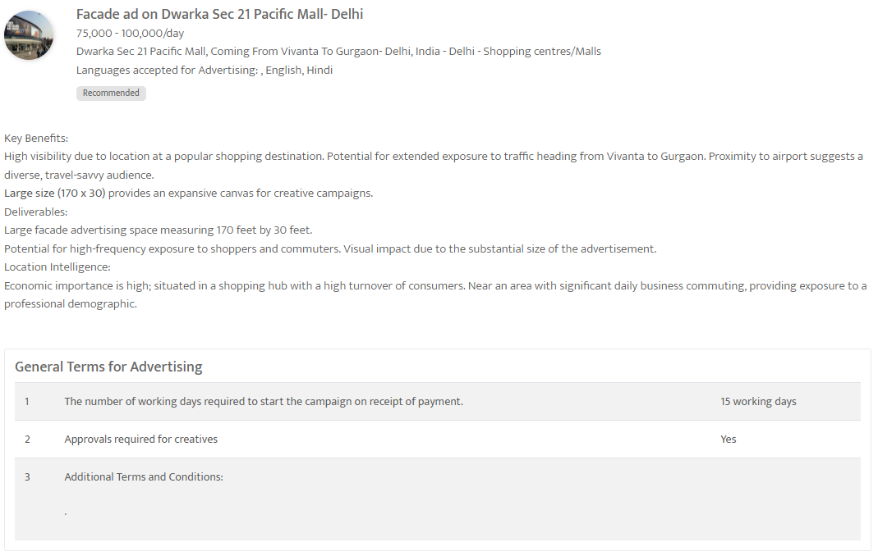

Slide 14
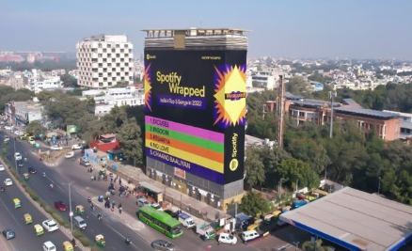
Green Park Metro Station - Delhi - Facade ad at Green Park Metro Station- Delhi

Slide 15
Green Park Metro Station
Facade ad at Green Park Metro Station- Delhi
Rates and details
Number of Screens: 1
Lighting type: Non-Lit
Size: TBC
Number of production: 1
Total number of months required: 1

Slide 16
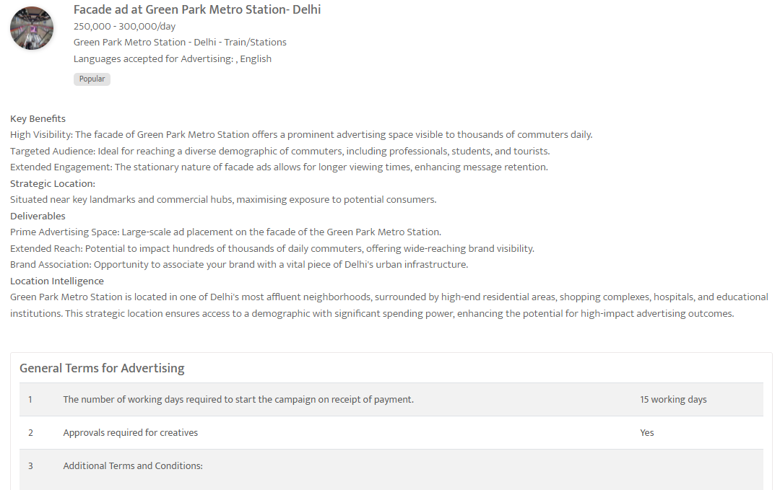

Slide 17
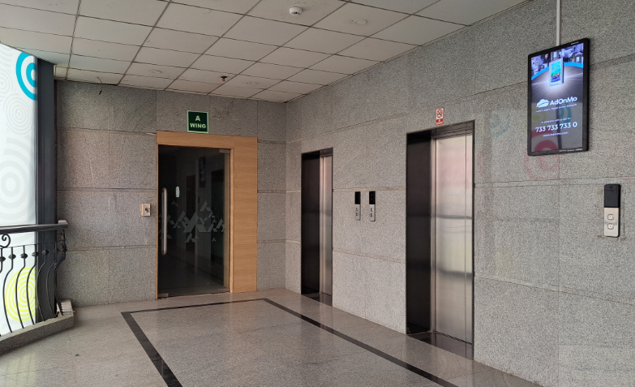
Prime Out of Home Sites Chennai, India
Prime Out of Home Sites Chennai - 284 Screen Package

Slide 18
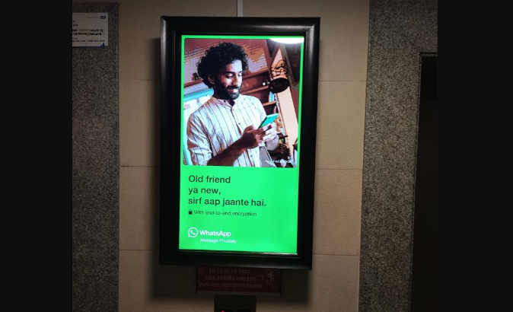

Slide 19
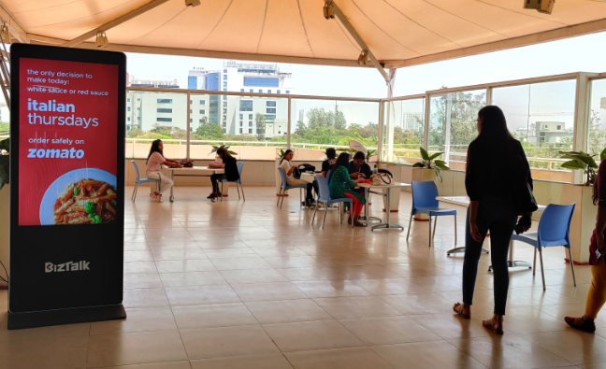

Slide 20
Prime Out of Home Sites Chennai, India
Prime Out of Home Sites Chennai - 284 Screen Package
Rates and details
Number of Screens: 284
Number of production: 1

Slide 21
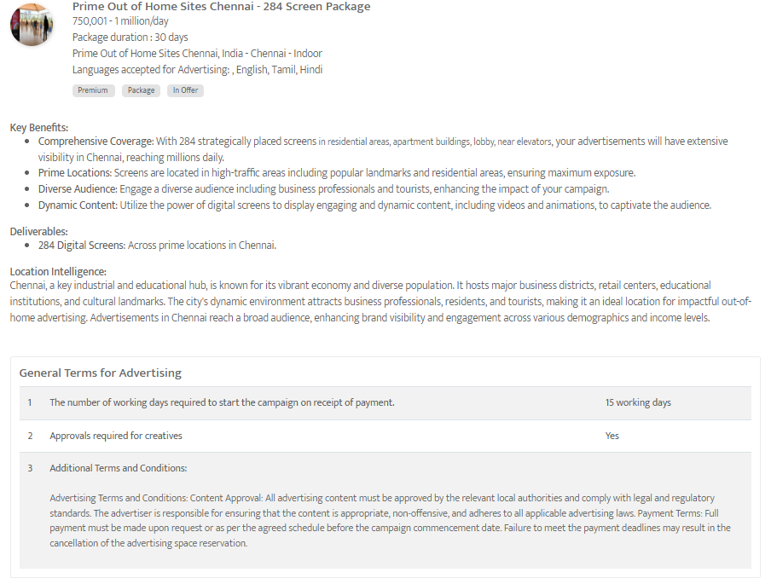

Slide 22
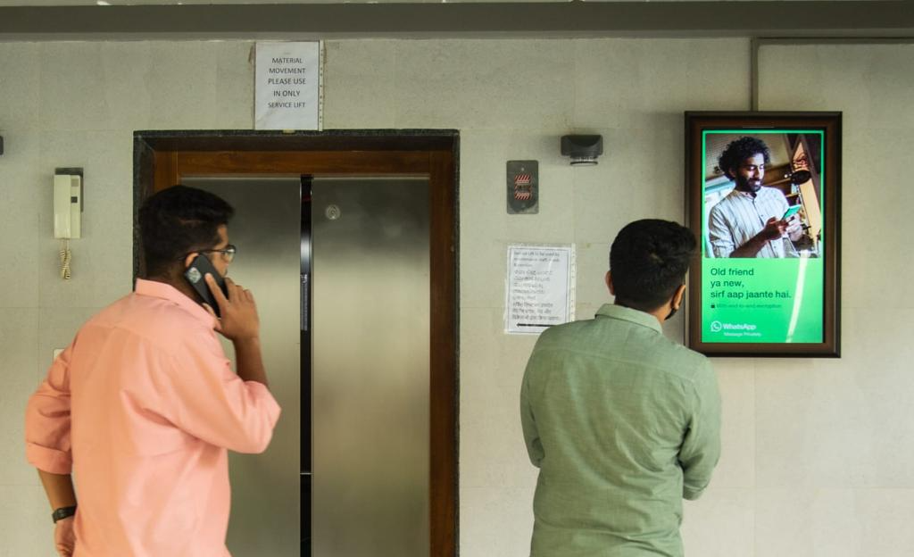
Key metro cities in India
Bahubali Out of Home India Advertising Package

Slide 23
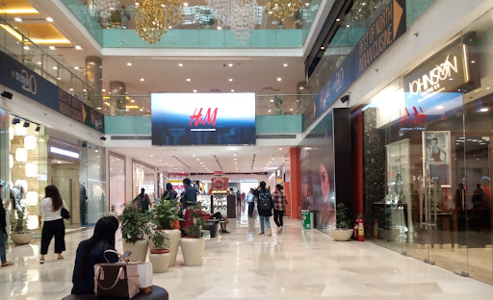

Slide 24
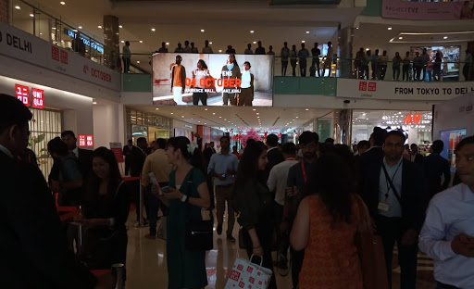

Slide 25
Key metro cities in India
Bahubali Out of Home India Advertising Package
Rates and details
Number of Screens: 2511
Number of production: 1

Slide 26
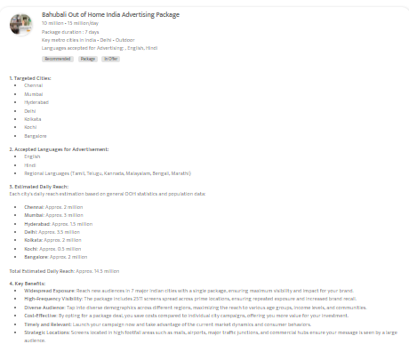

Slide 27
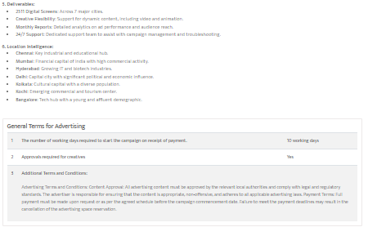

Slide 28
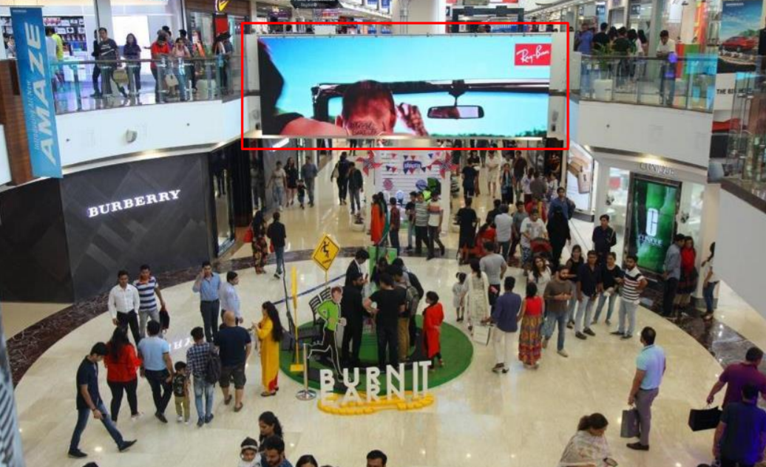
Select City Walk Mall
LED Screen Network at Select City Walk Mall, Mac Atrium

Slide 29
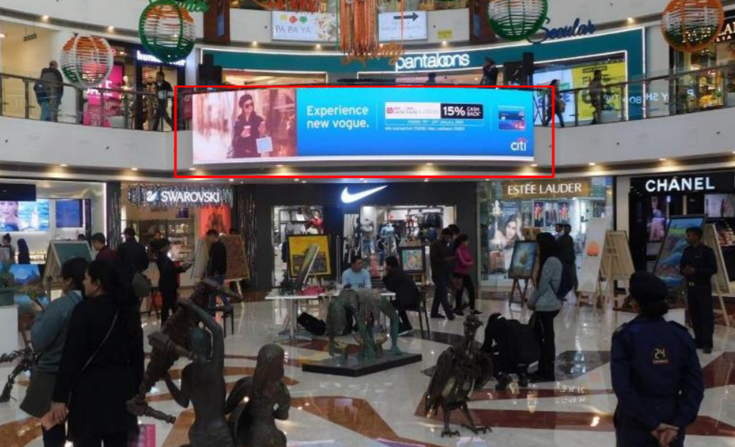

Slide 30
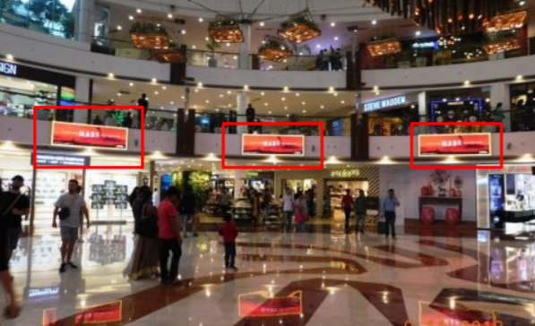

Slide 31
Select City Walk Mall - Delhi - LED Screen Network at Select City Walk Mall, Mac Atrium
Rates and details
Number of Screens: 8
Lighting type: Lit
Size: Various
Duration of creative in seconds: 30
Number of production: 1
Total number of months required: 1

Slide 32
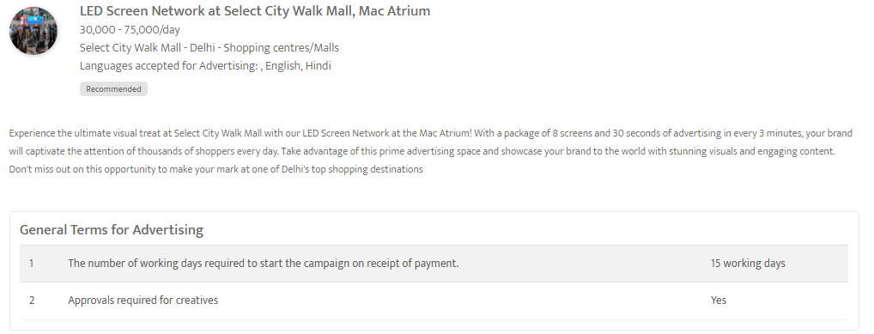

Slide 33
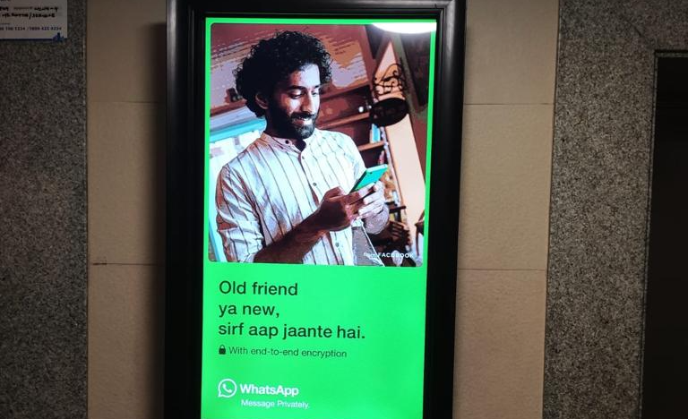
Prime out of home sites in Delhi, India
Prime Out of Home Sites Delhi Advertising Package

Slide 34
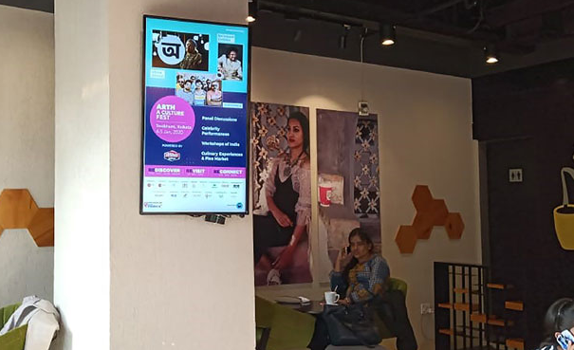

Slide 35
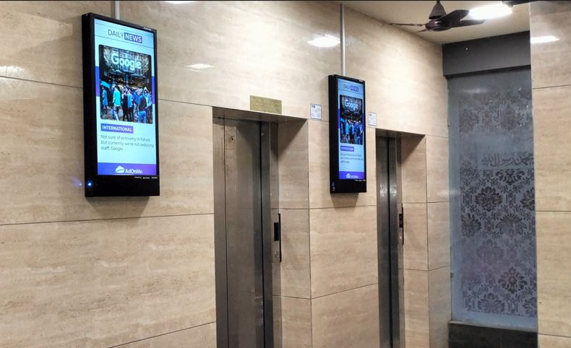

Slide 36
Prime out of home sites in Delhi, India
Prime Out of Home Sites Delhi Advertising Package
Rates and details
Number of Screens: 399
Number of production: 1

Slide 37
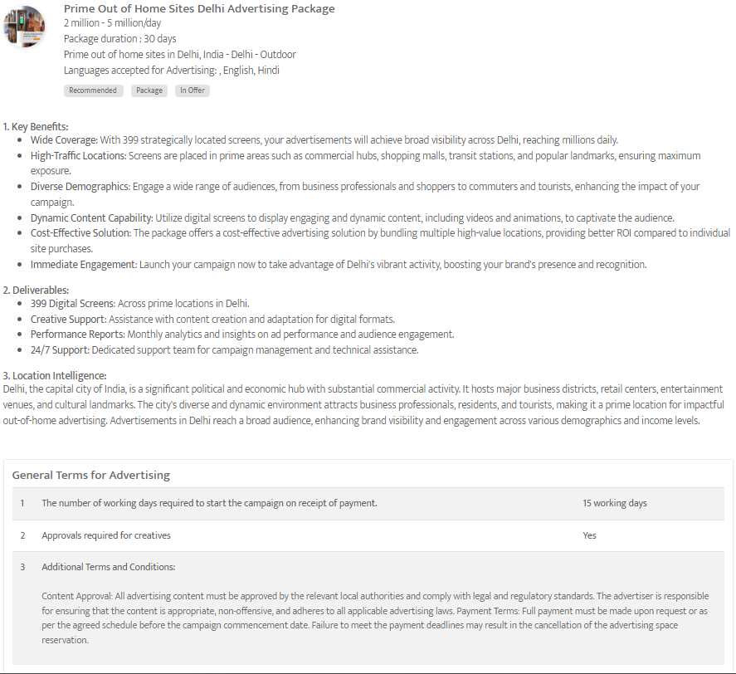

Slide 38
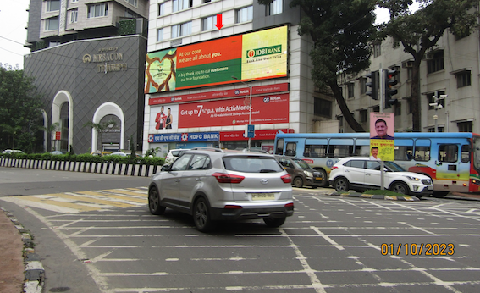
Babulnath Junction ET, Mumbai
LED Screen at Babulnath Junction ET, Mumbai

Slide 39
Babulnath Junction ET, Mumbai - Mumbai - LED Screen at Babulnath Junction ET, Mumbai
Rates and details
Number of Screens: 1
Lighting type: Lit
Size: 60 x 16 feet
Single Rotation Time in Seconds: 60
Duration of creative in seconds: 10
Number of production: 1
Total number of months required: 1

Slide 40
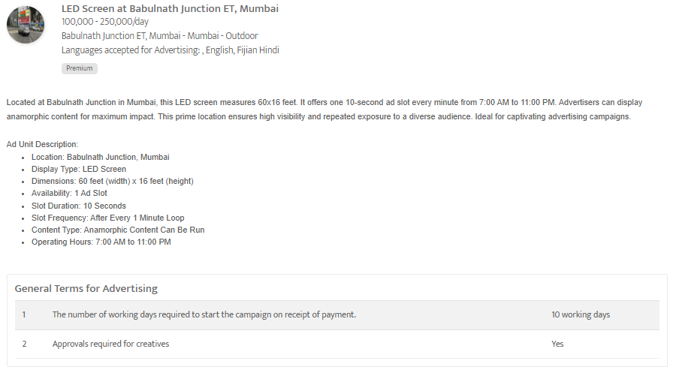

Slide 41
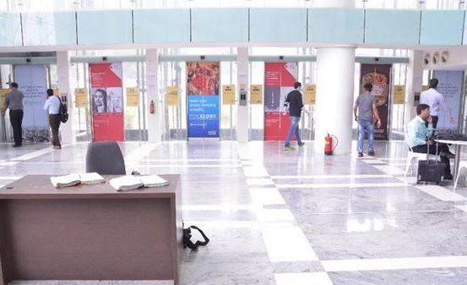
Across Main Croporate Parks Of Mumbai - Mumbai - Digital Screen Across Main Croporate Parks Of Mumbai

Slide 42
Across Main Croporate Parks Of Mumbai
Digital Screen Across Main Croporate Parks Of Mumbai
Rates and details
Number of Screens: 33
Lighting type: Lit
Size: 4(W) X 8(H)
Number of production: 1
Total number of months required: 1

Slide 43
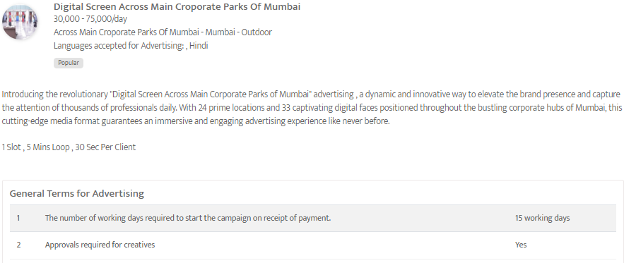

Slide 44
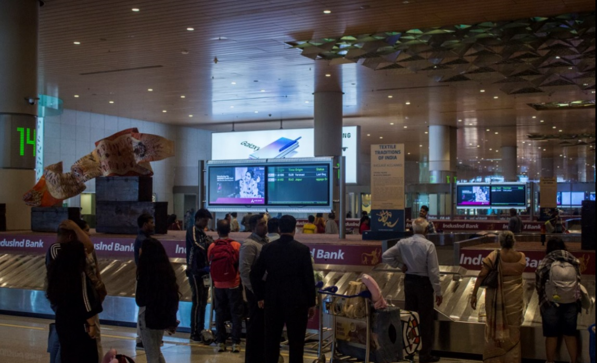
Prime out of home sites in Mumbai, India
Prime Out of Home Sites Mumbai Advertising Package

Slide 46
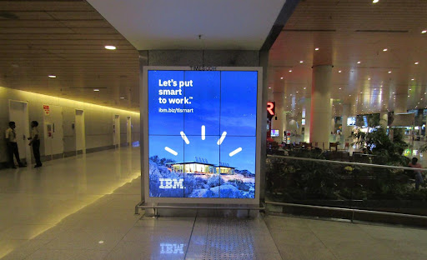

Slide 48
Prime out of home sites in Mumbai, India
Prime Out of Home Sites Mumbai Advertising Package
Rates and details
Number of Screens: 578
Number of production: 1

Slide 49
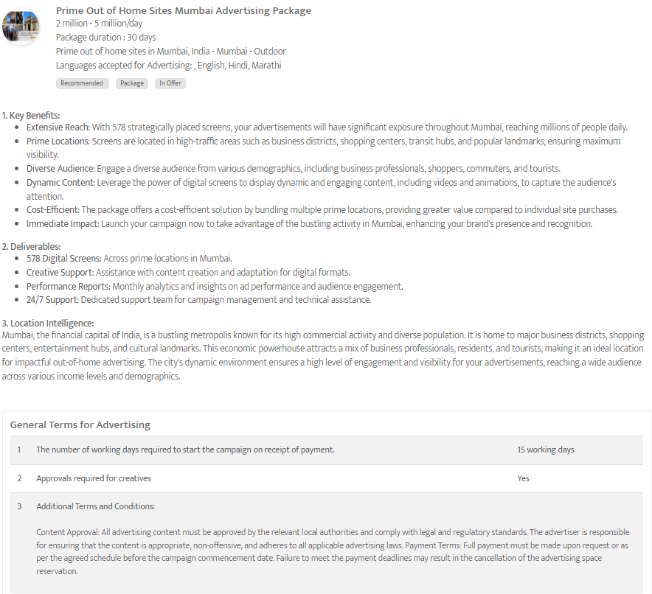

Slide 50
Thank You
media@masscomglobal.com | www.masscomglobal.com
Masscom Global FZE, Office No: 220, One UAQ Building, UAQ Free Trade Zone, Umm Al Quwain, United Arab Emirates.

