Slide 1



Top Newspapers
Recommendations
in India

Slide 2
India

Slide 3

Business Standard, India - Half page ad on inside pages of Business Standard, India
India
Newspaper

Slide 4
Business Standard, India - Half page ad on inside pages of Business Standard, India
India
Newspaper
Rates and details
Frequency: Daily
Size: 25cm (H) x 33cm (W) ​
Standard Positions: Half Page
Number of production: 1
Number of insertions required: 1

Slide 5


Slide 6

The Hindu Business Line - Full page ad on inside page
India
Newspaper

Slide 7
The Hindu Business Line - Full page ad on inside page
India
Newspaper
Rates and details
Frequency: Weekly
Size: TBC
Standard Positions: Full page
Number of production: 1
Number of insertions required: 1

Slide 8


Slide 9
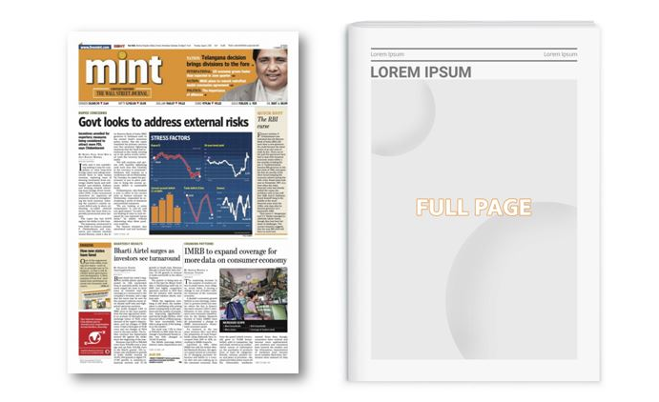
Mint - Full page ad on inside pages
India
Newspaper

Slide 10
Mint - Full page ad on inside pages
India
Newspaper
Rates and details
Frequency: Daily
Size: TBC
Standard Positions: Full page
Number of production: 1
Number of insertions required: 1

Slide 11
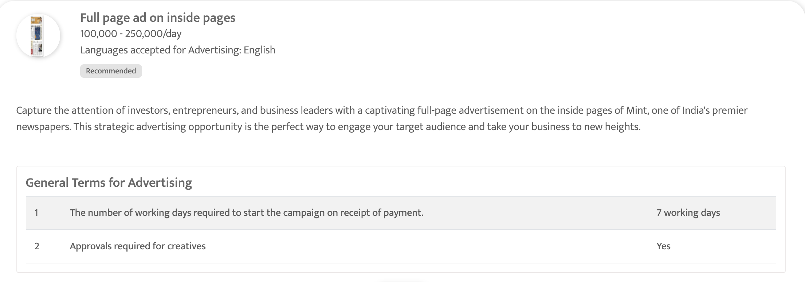

Slide 12

The Economic Times, India - Full page ad on Inside page of The Economic Times, India
India
Newspaper

Slide 13
The Economic Times, India - Full page ad on Inside page of The Economic Times, India
India
Newspaper
Rates and details
Frequency: Daily
Size: TBC
Standard Positions: Full page
Number of production: 1
Number of insertions required: 1

Slide 14


Slide 15
Thank You
media@masscomglobal.com | www.masscomglobal.com
Masscom Global FZE, Office No: 220, One UAQ Building, UAQ Free Trade Zone, Umm Al Quwain, United Arab Emirates.

