Slide 1

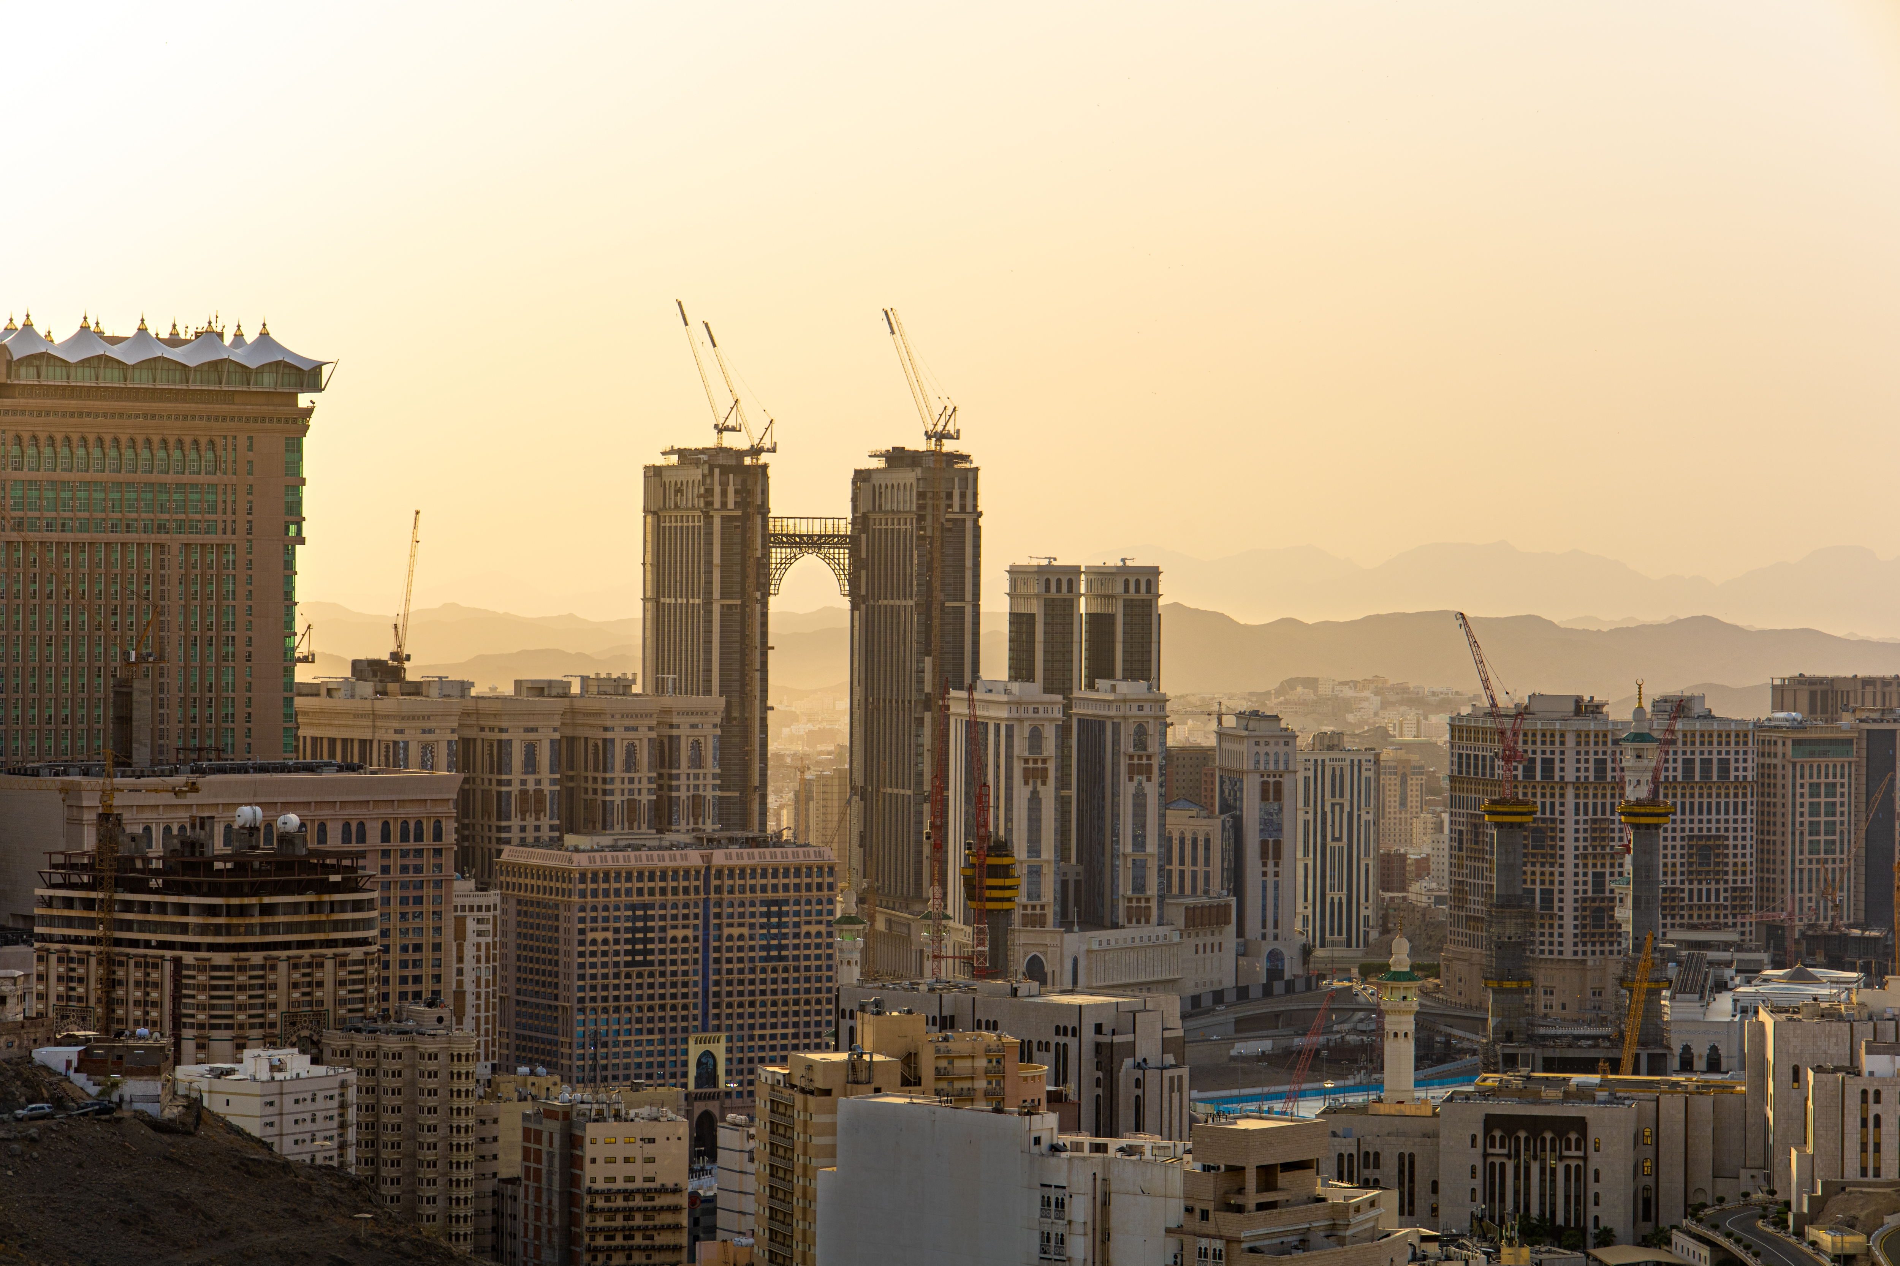

Top Media
Recommendations
in Saudi Arabia

Slide 2
Airports

Slide 3
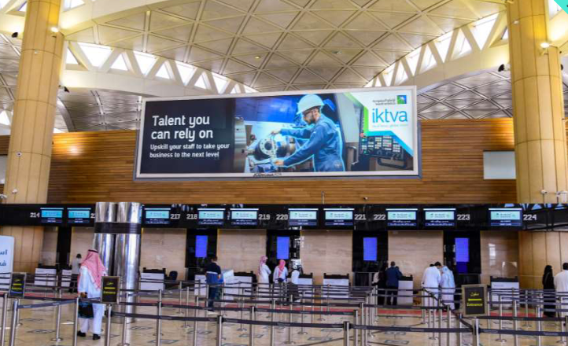
Riyadh International Airport, Saudi Arabia – Riyadh Light Box at Riyadh International Airport T2 – Check-in

Slide 4
Riyadh International Airport, Saudi Arabia – Riyadh Light Box at Riyadh International Airport T2 – Check-in
Details
Number of Screens: 2
Lighting type: Back-Lit
Size: 14m x 4m (56m2)
Number of production: 1
Total number of months required: 1

Slide 5
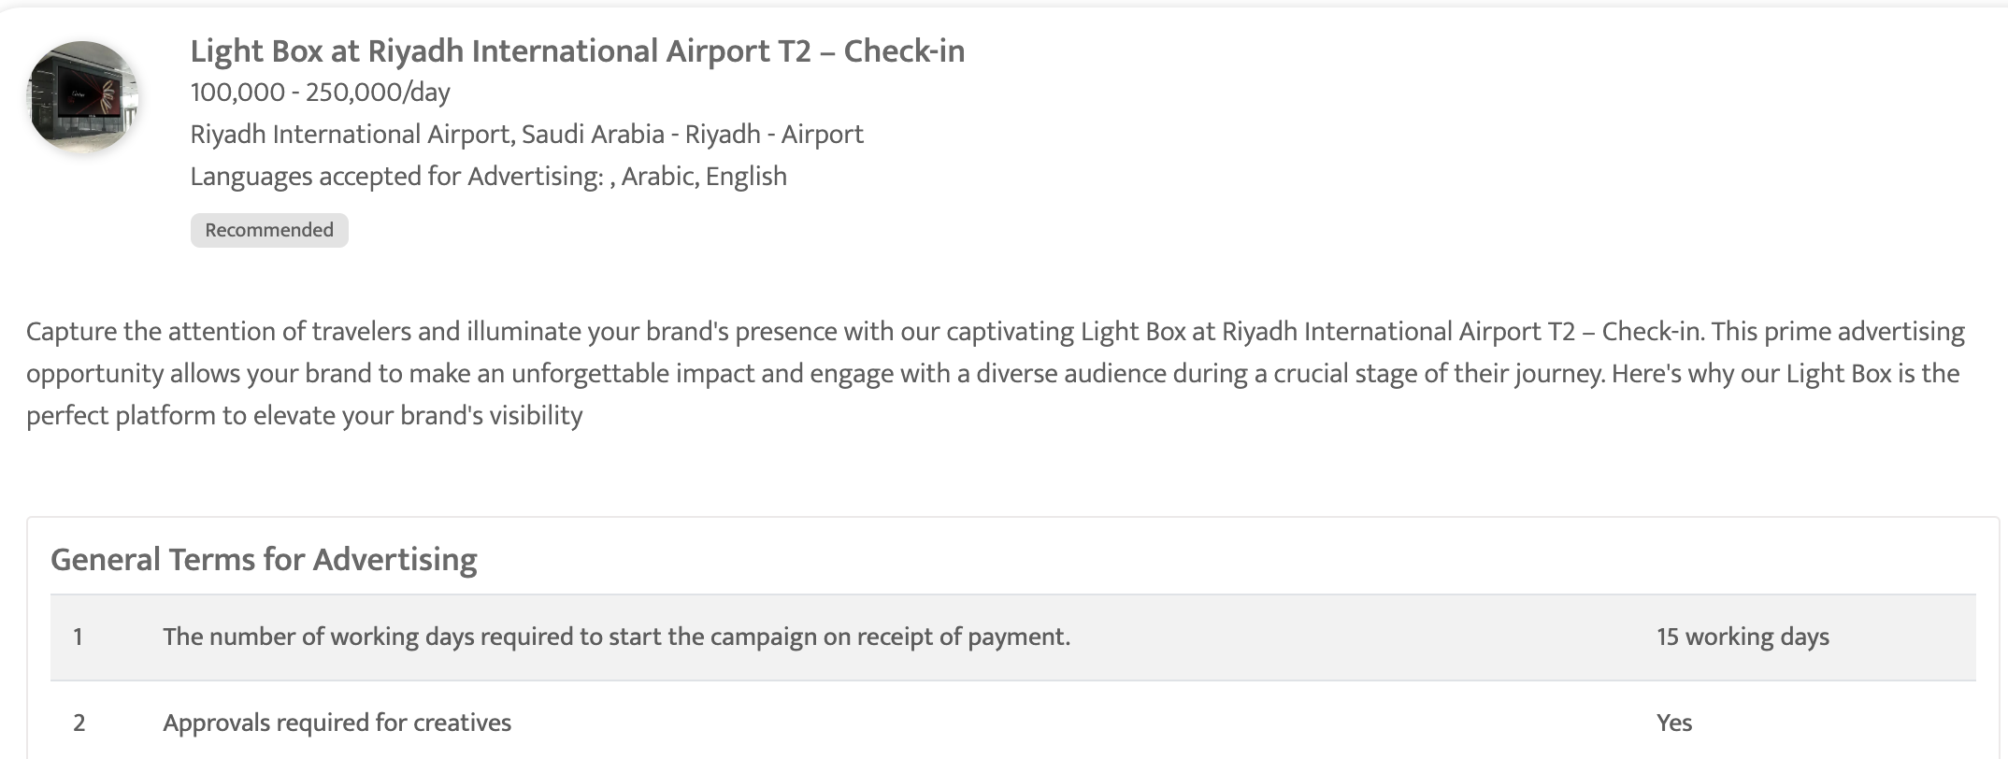

Slide 6
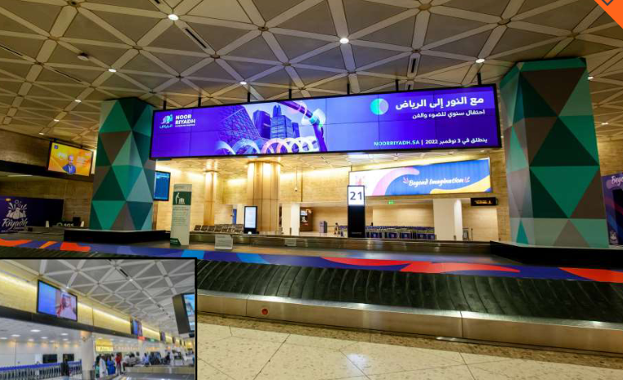
Riyadh International Airport, Saudi Arabia – Riyadh Digital Screen at Riyadh International Airport, T2 – Baggage Claim

Slide 7
Riyadh International Airport, Saudi Arabia Digital Screen at Riyadh International Airport, T2 – Baggage Claim
Details
Number of Screens: 8
Lighting type: Back-Lit
Size: 103” Plasma Screens (12) Hanging LED screens (2)
Number of production: 1
Total number of months required: 1

Slide 8
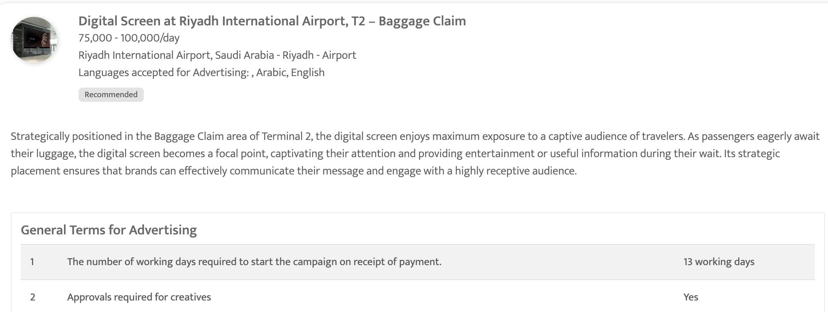

Slide 9
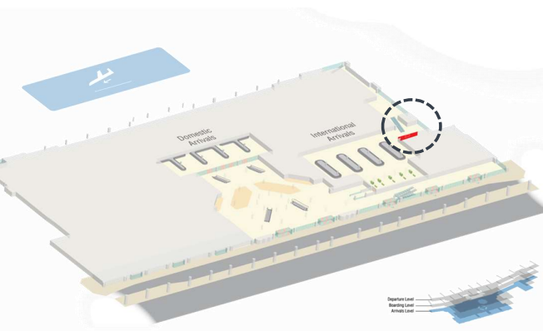
Dammam International Airport- Dammam, Saudi Arabia Lightbox and sticker coverage at International Arrivals Level, Baggage Claim area in Dammam International Airport

Slide 10
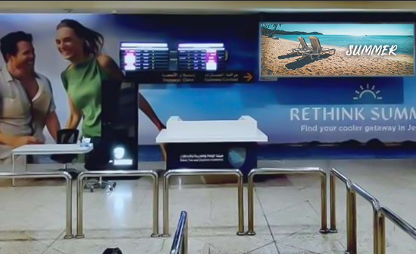

Slide 11
Dammam International Airport- Dammam, Saudi Arabia Lightbox and sticker coverage at International Arrivals Level, Baggage Claim area in Dammam International Airport
Details
Lighting type: Lit
Size: Lightbox: 4m x 1.3m (5.2m²) Sticker: 73m²
Number of production: 1
Total number of months required: 1

Slide 12
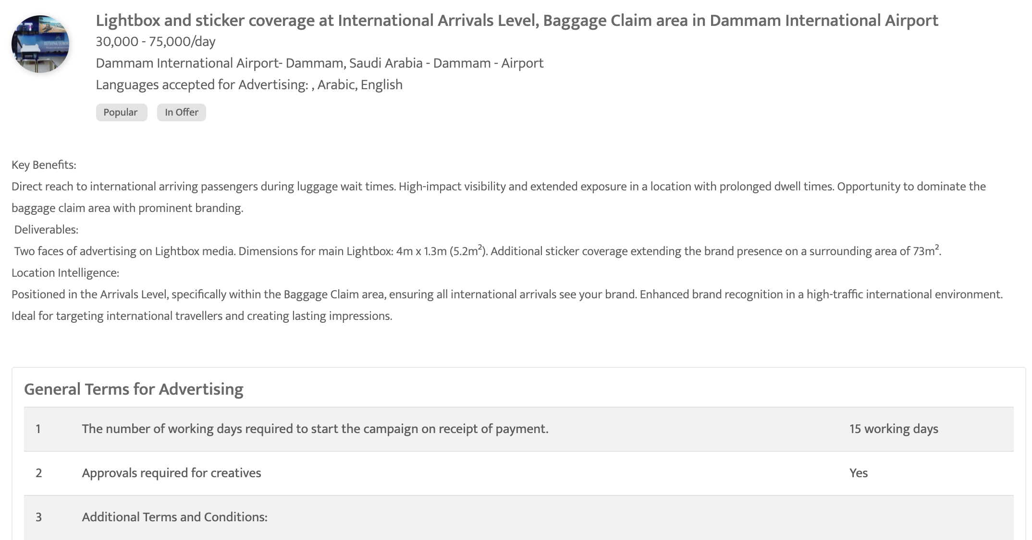

Slide 13
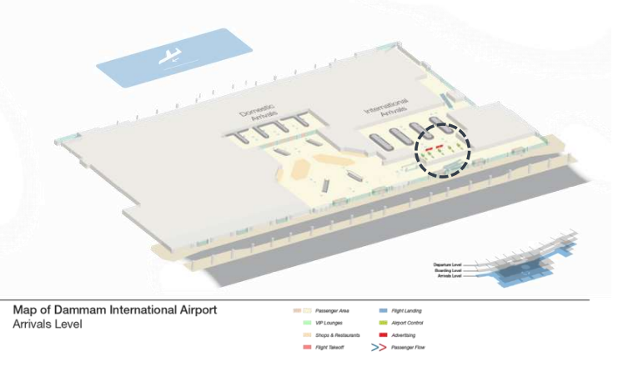
Dammam International Airport- Dammam, Saudi Arabia Digital Screens at Baggage claim, Arrivals & Boarding Levels-Dammam International Airport

Slide 14
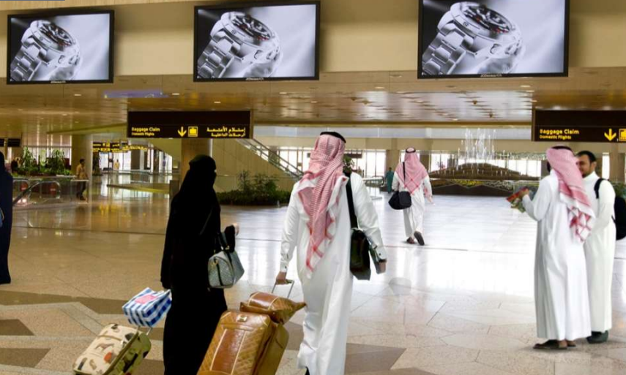

Slide 15
Dammam International Airport- Dammam, Saudi Arabia Digital Screens at Baggage claim, Arrivals & Boarding Levels-Dammam International Airport
Details
Number of Screens: 7
Lighting type: Lit
Size: 103" Plasma
Single Rotation Time in Seconds: 70
Duration of creative in seconds: 10
Number of production: 1
Total number of months required: 1

Slide 16
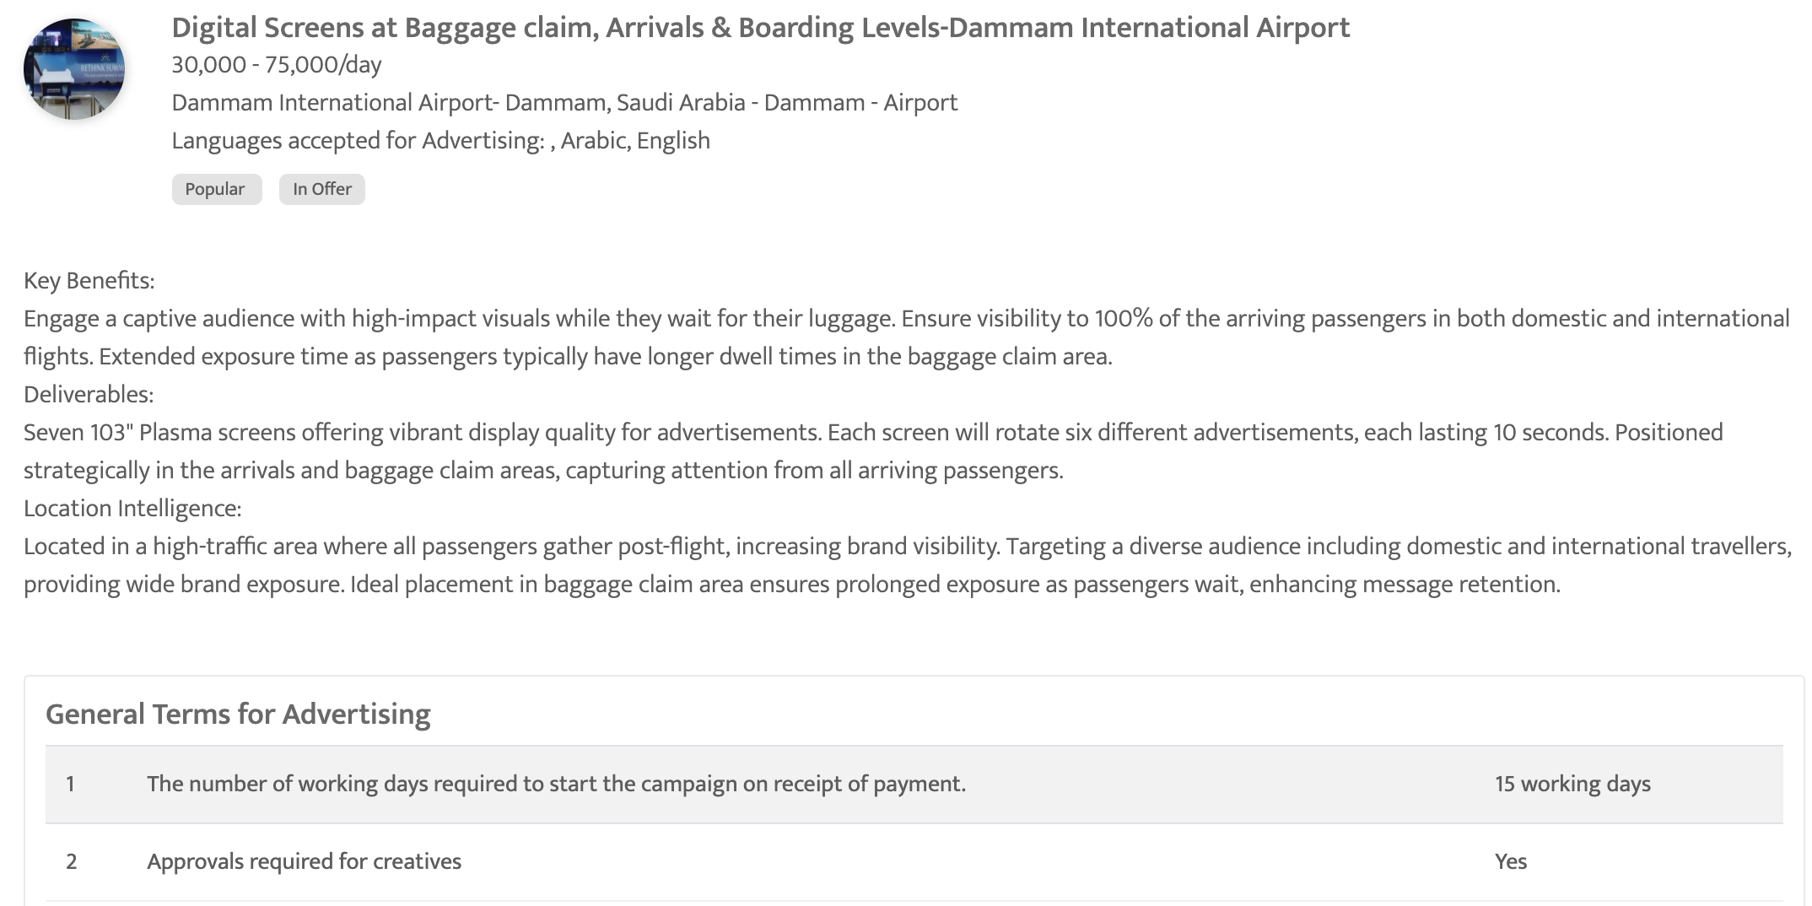

Slide 17
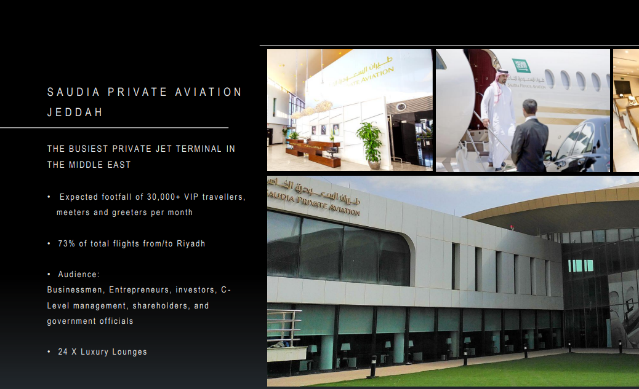
Saudi Private Aviation, Jeddah, Saudi Arabia Digital Screens at Main halls and lounges, Saudi Private Aviation

Slide 18
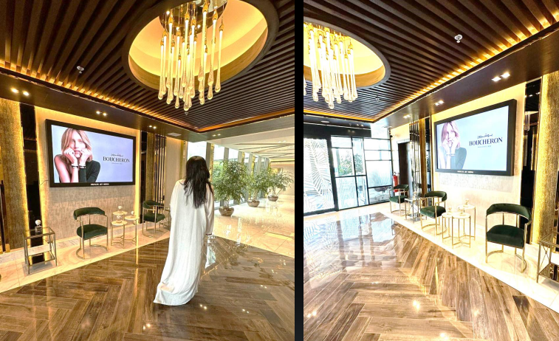

Slide 19
Saudi Private Aviation, Jeddah, Saudi Arabia Digital Screens at Main halls and lounges, Saudi Private Aviation
Details
Number of Screens: 5
Lighting type: Lit
Size: 85 and 75 Inch
Single Rotation Time in Seconds: None
Duration of creative in seconds: 30
Number of production: 1
Total number of months required: 1

Slide 20
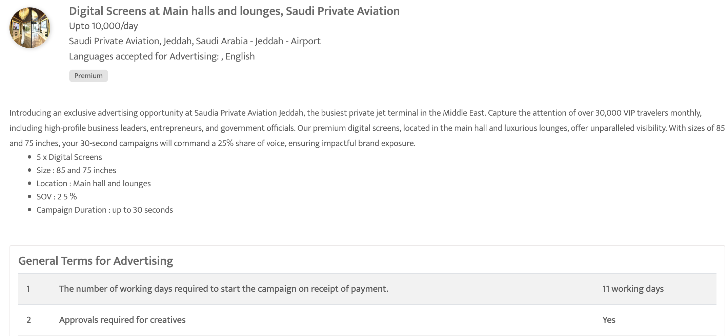

Slide 21
Out of home

Slide 22
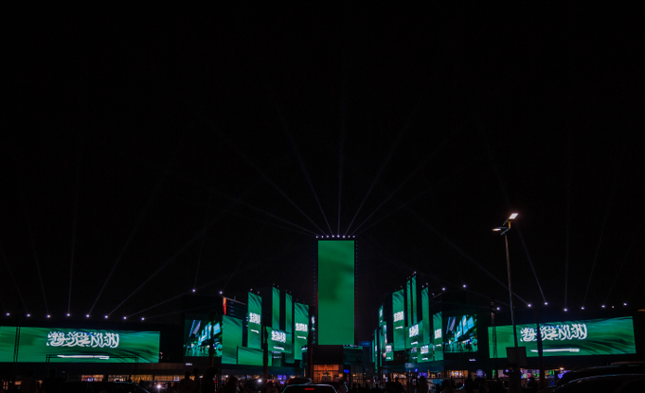
Riyadh Times Square, Saudi Arabia – Riyadh Digital Screen Domination at Riyadh Times Square

Slide 23
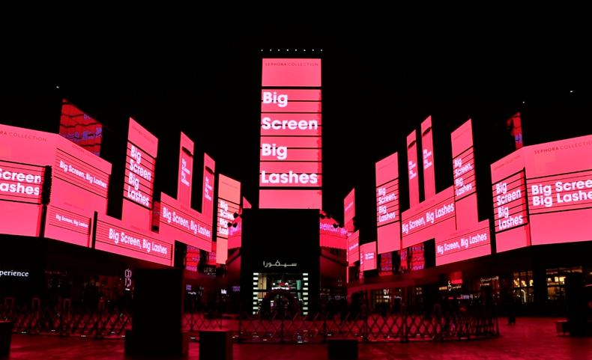

Slide 24
Riyadh Times Square, Saudi Arabia Digital Screen Domination at Riyadh Times Square
Details
Number of Screens: 78
Number of production: 1

Slide 25
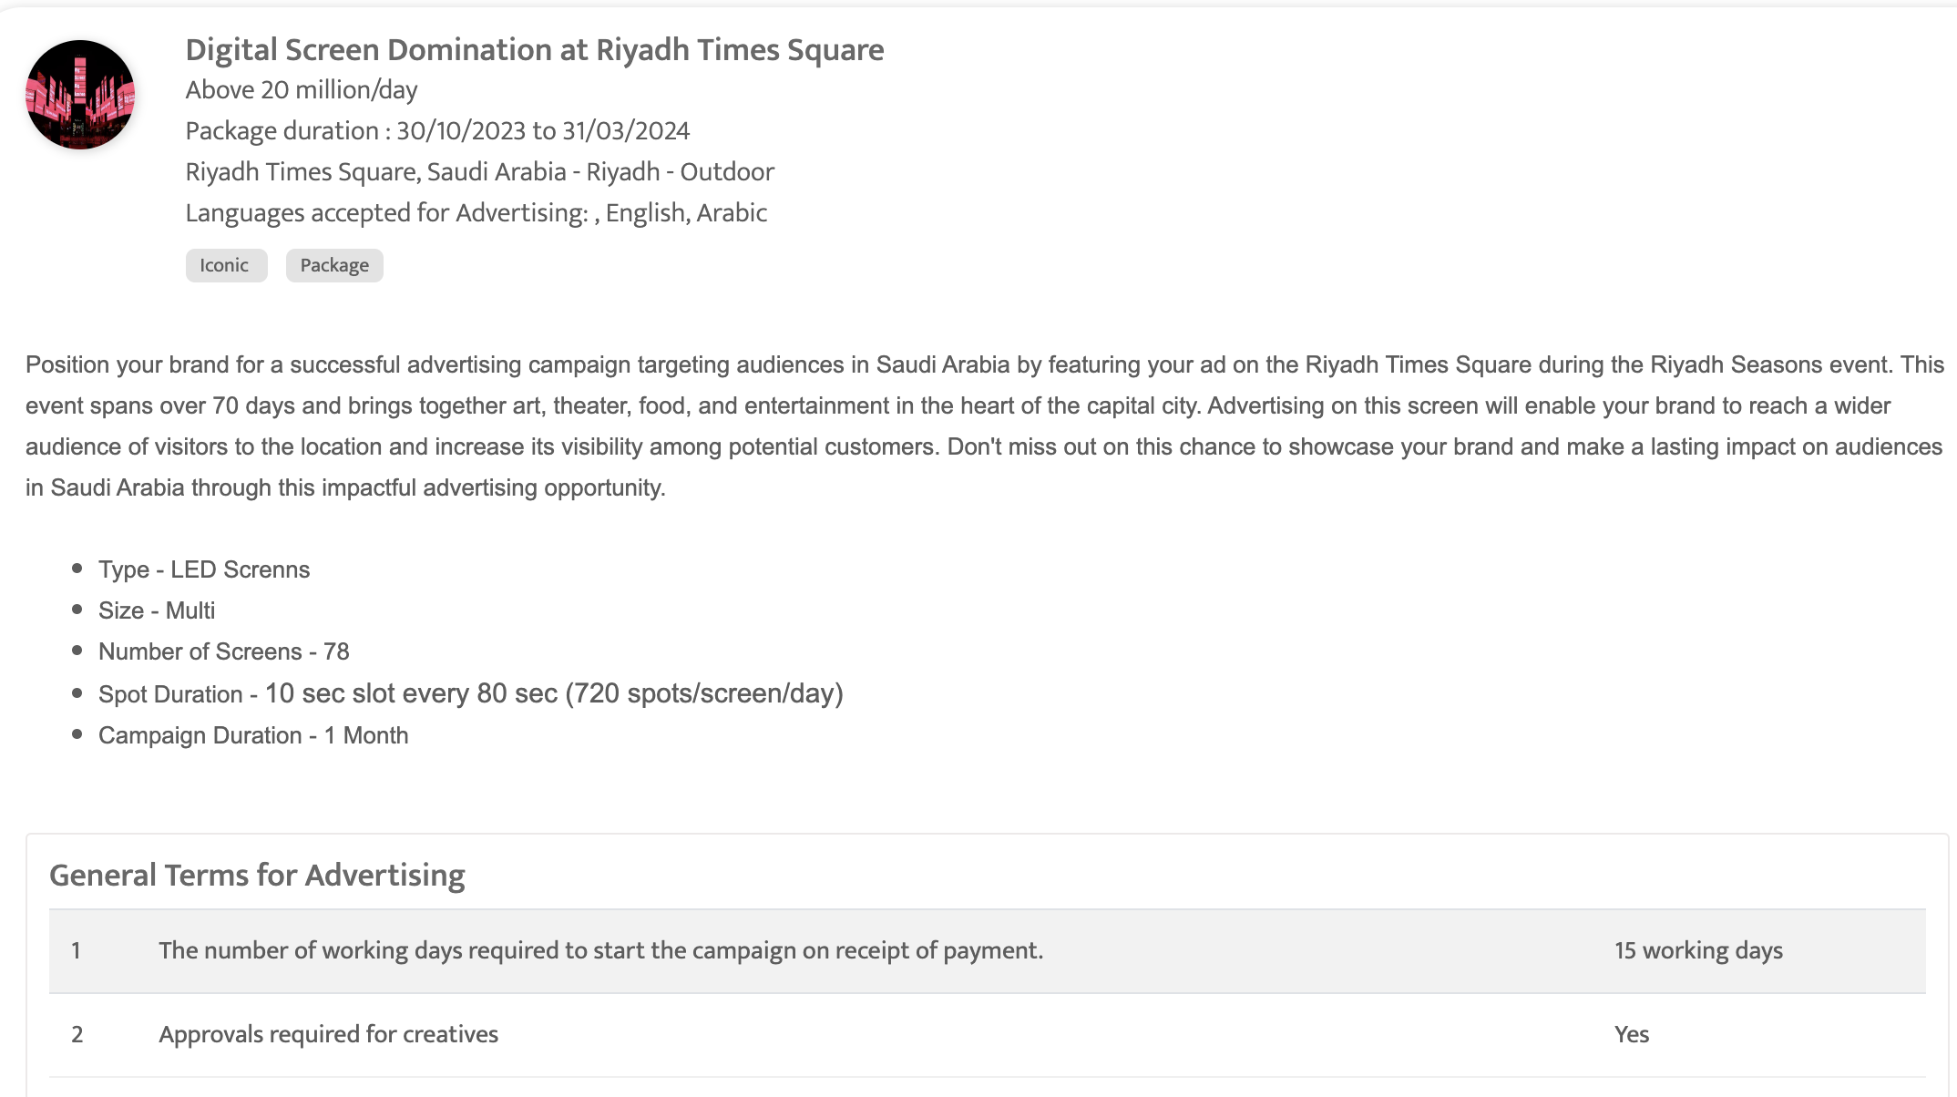

Slide 26
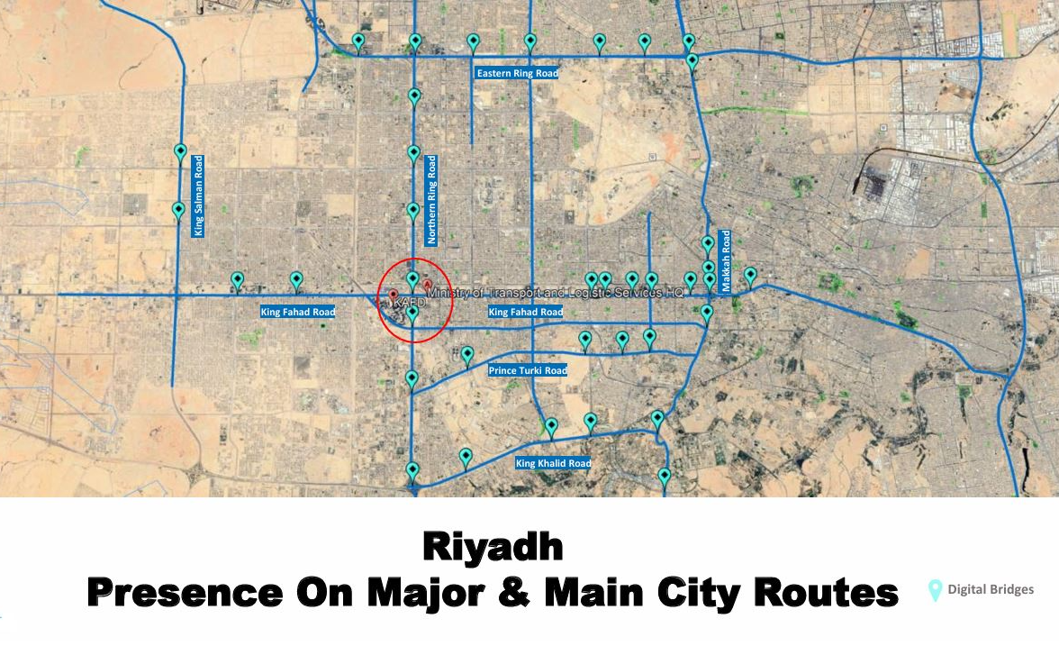
Riyadh, Saudi Arabia – Riyadh Two weeks, high impact blitz campaign

Slide 27
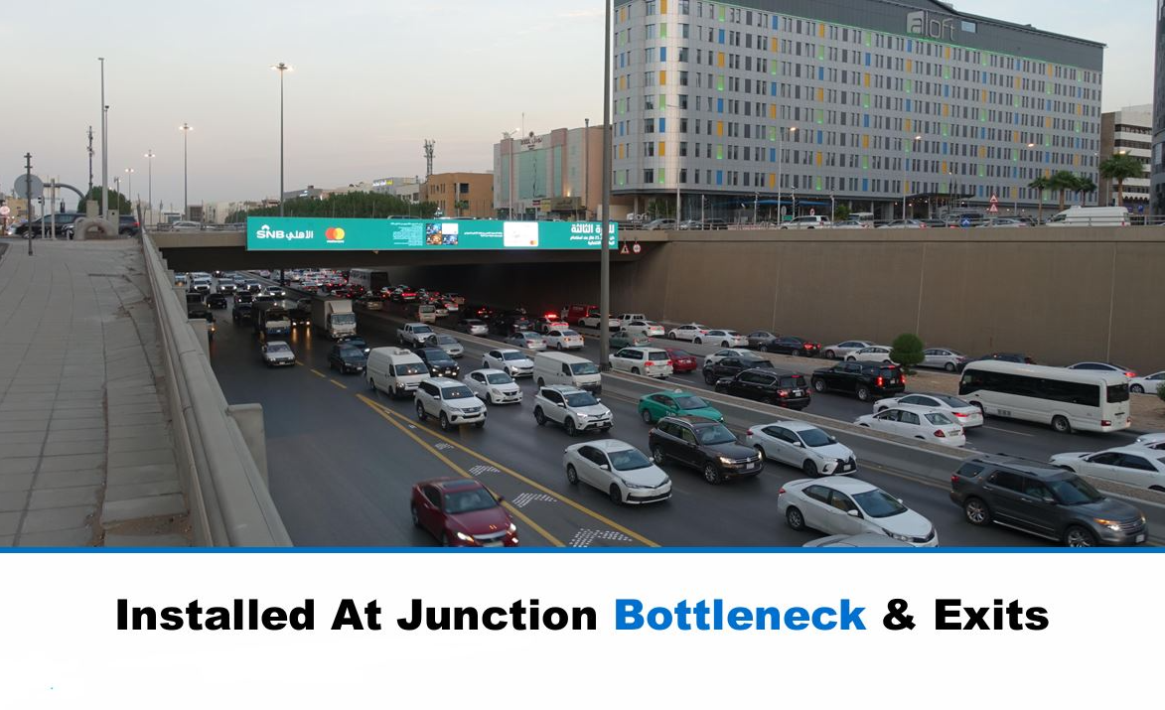

Slide 28
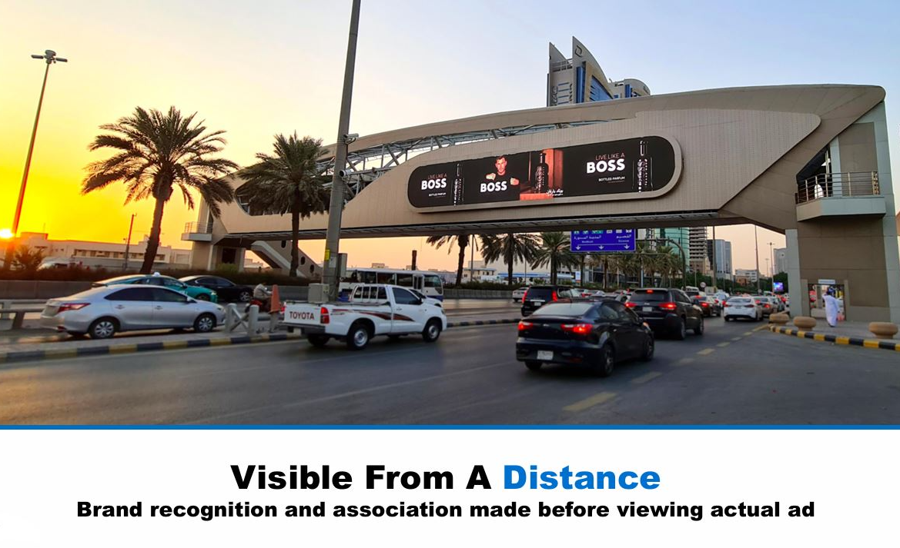

Slide 29
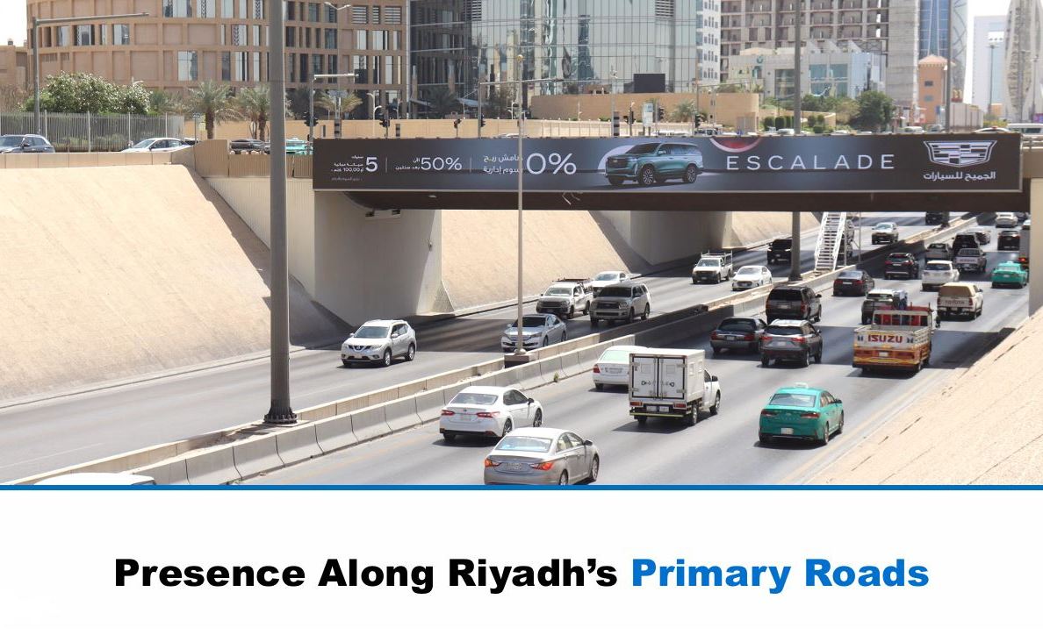

Slide 30
Riyadh, Saudi Arabia - Riyadh – Riyadh Two weeks, high impact blitz campaign
Details
Number of Screens: 15
Number of production: 1

Slide 31
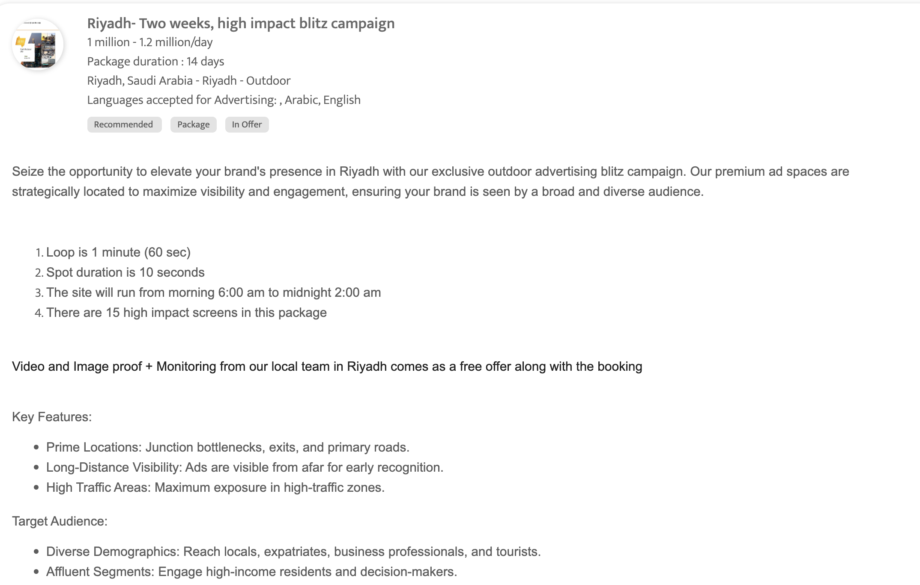
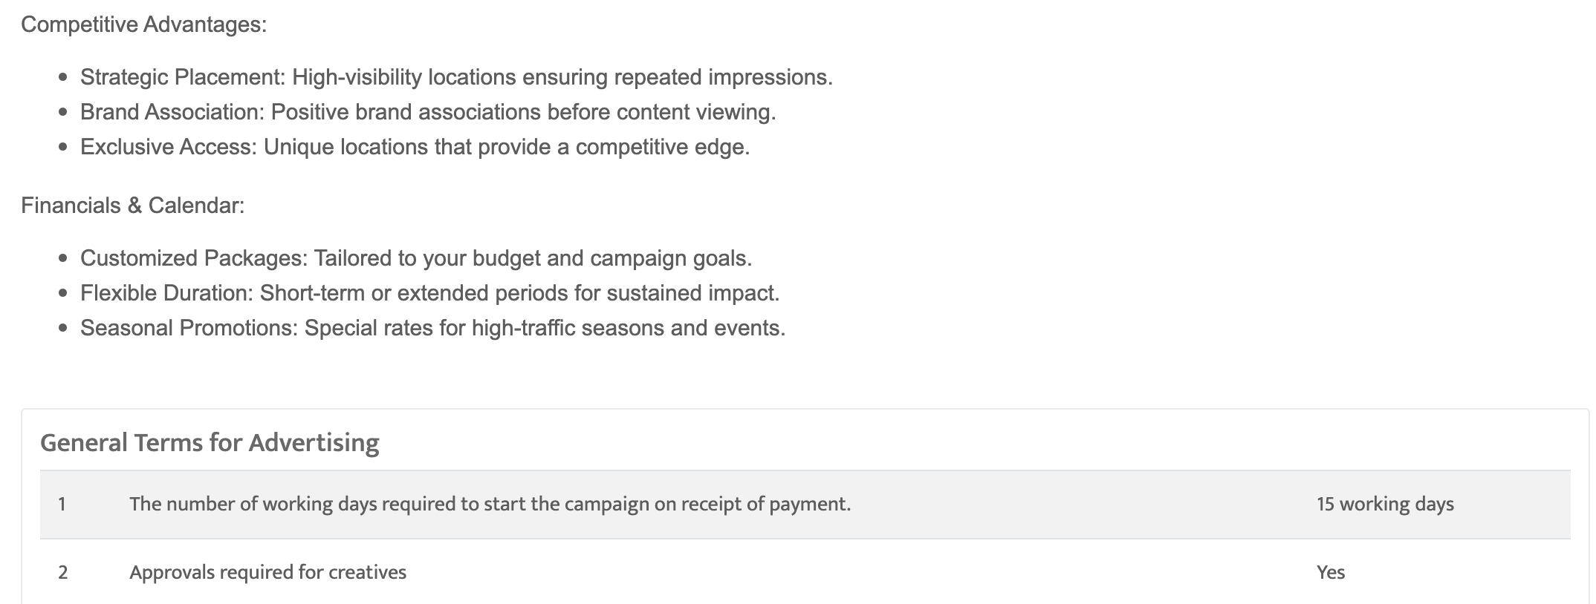

Slide 32
King Abdulaziz Road, Jeddah, Saudi Arabia Prime Digital Screens and Static Billboards near King Abdulaziz Road, Jeddah
Details
Number of Screens: TBC
Lighting type: Lit
Size: TBC
Number of production: 1
Total number of months required: 1

Slide 33
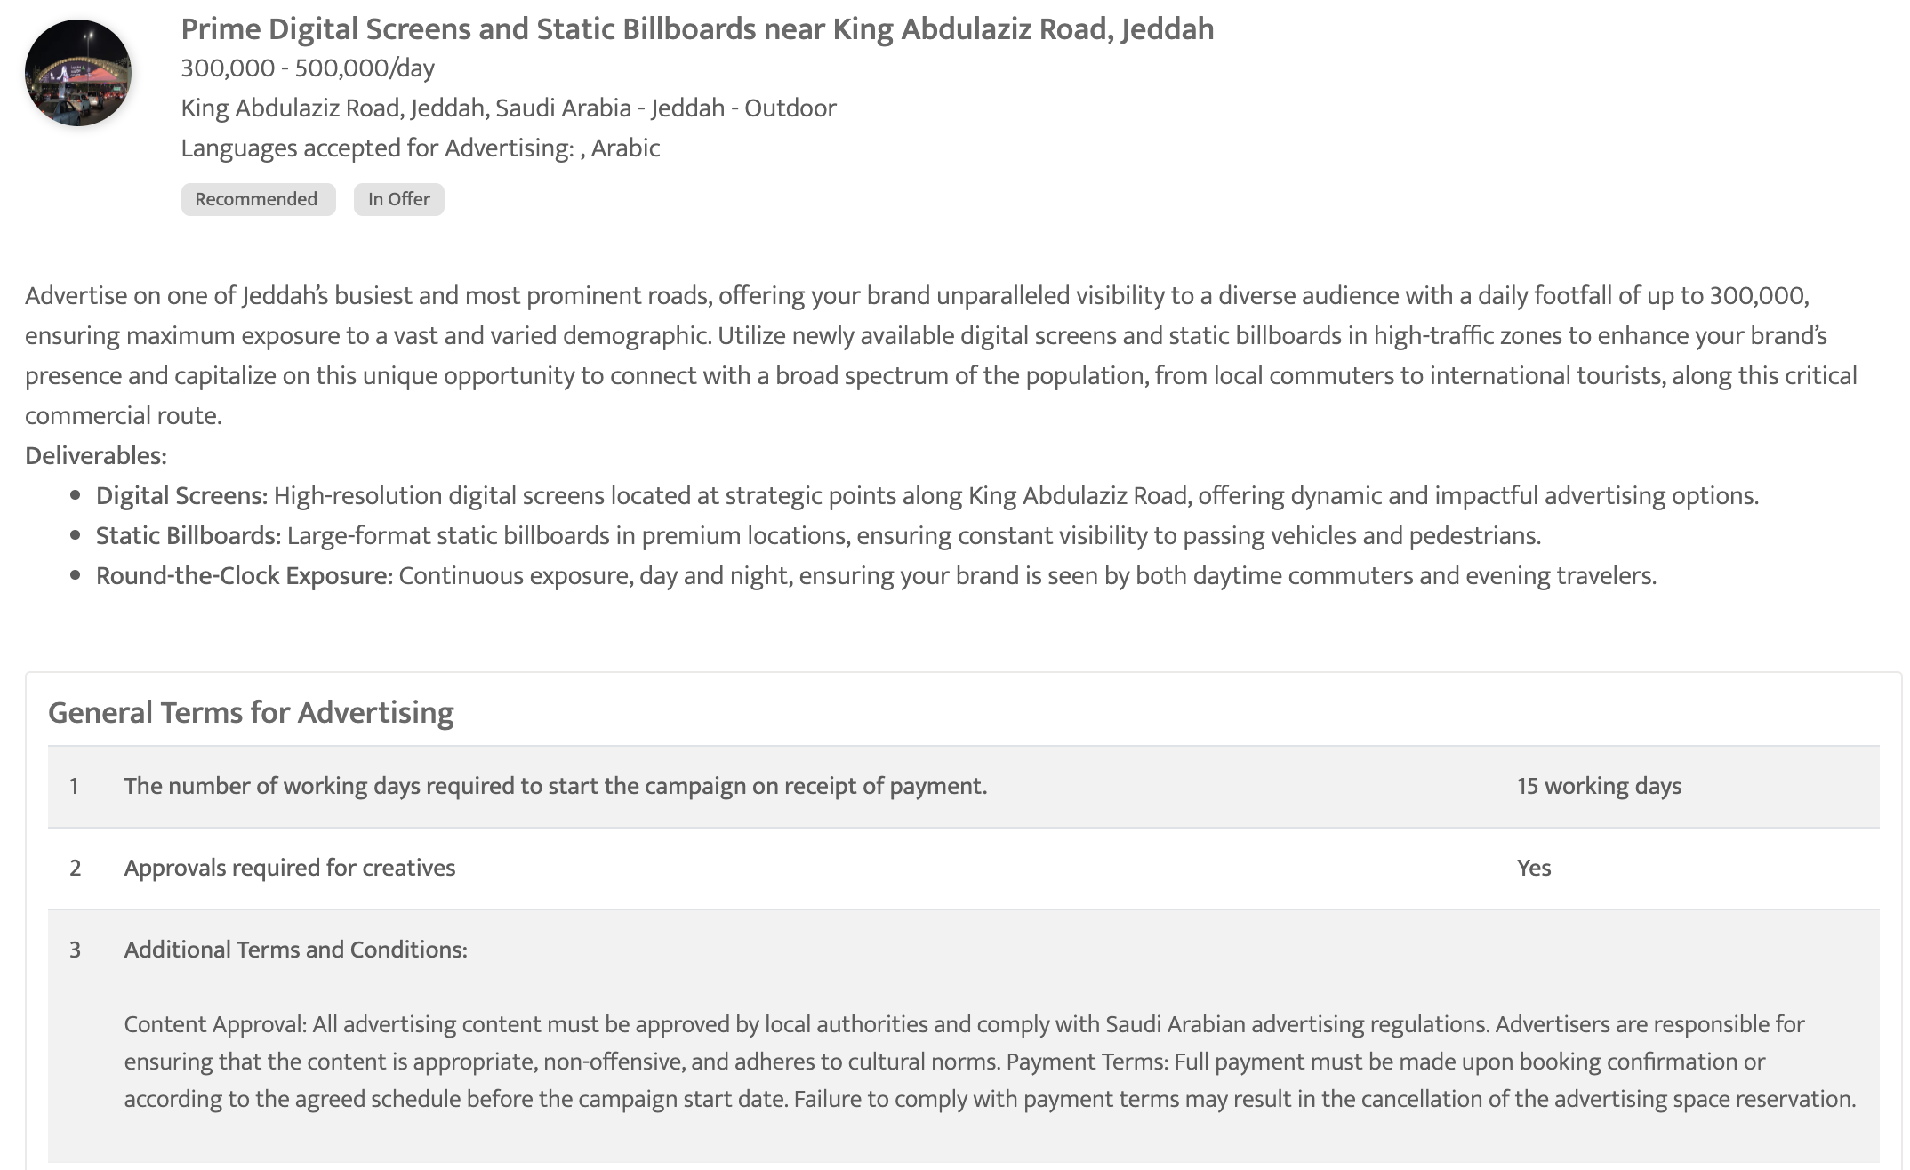

Slide 34
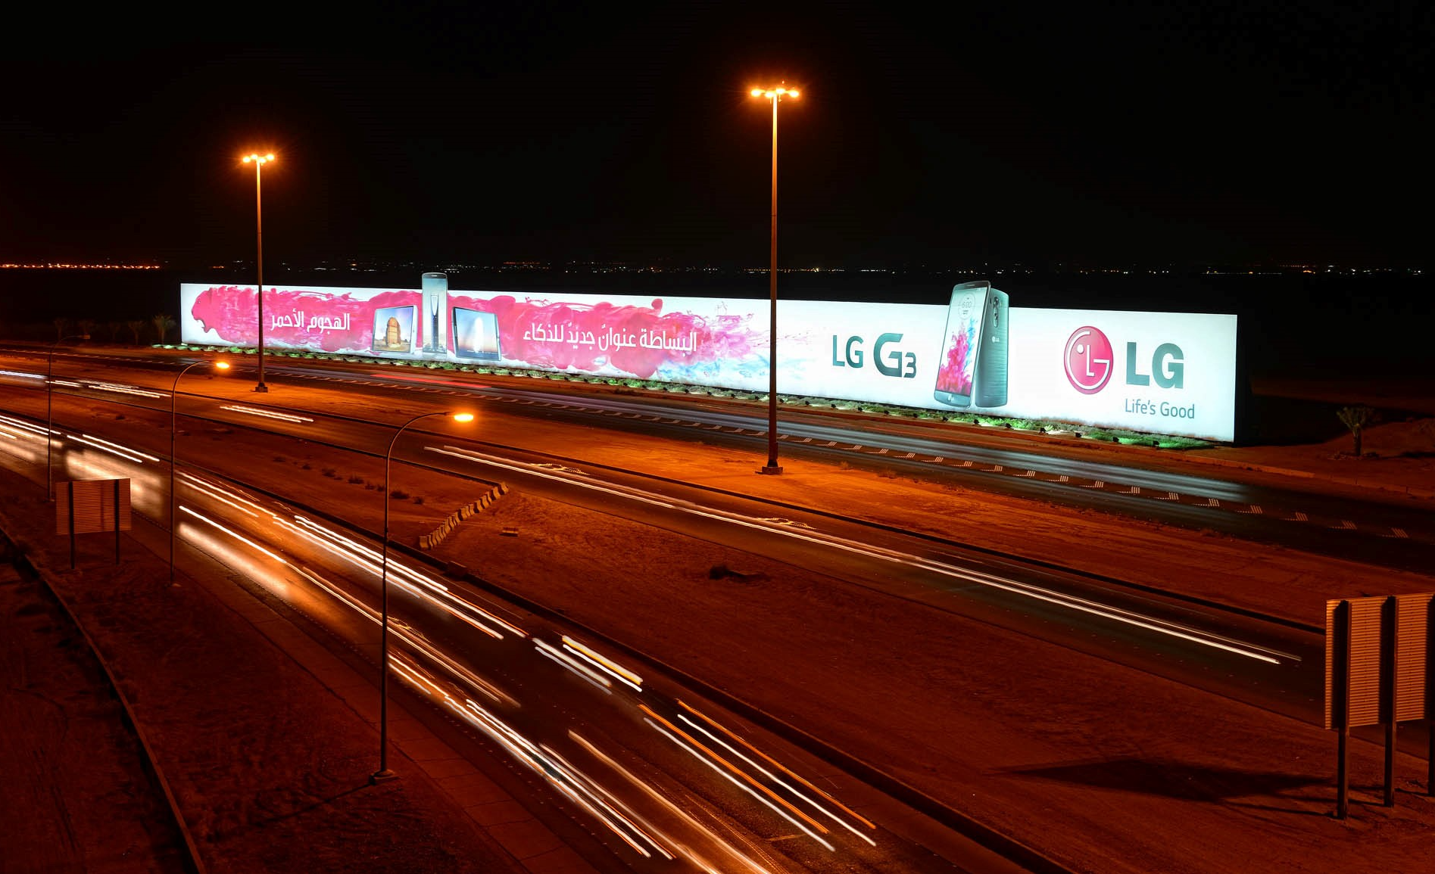
Top B2B Locations in Saudi Arabia for High-Impact Business Audience Premium Digital Screens and Static Billboards in B2B locations, Saudi Arabia

Slide 35
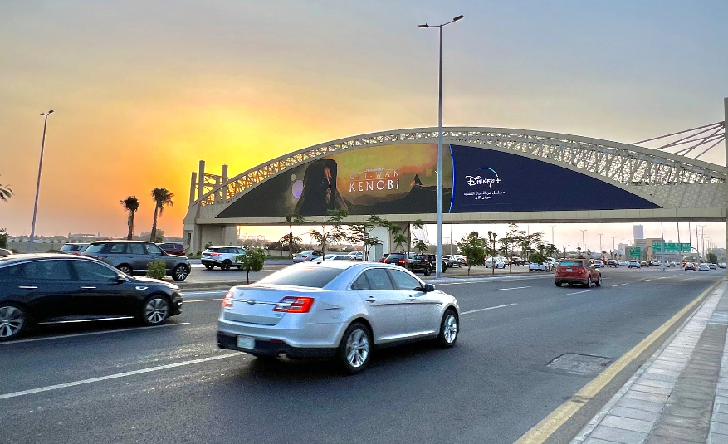

Slide 36
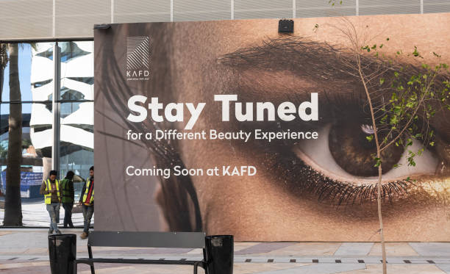

Slide 37
Top B2B Locations in Saudi Arabia for High-Impact Business Audience Premium Digital Screens and Static Billboards in B2B locations, Saudi Arabia
Details
Number of Screens: TBC
Number of production: 1

Slide 38
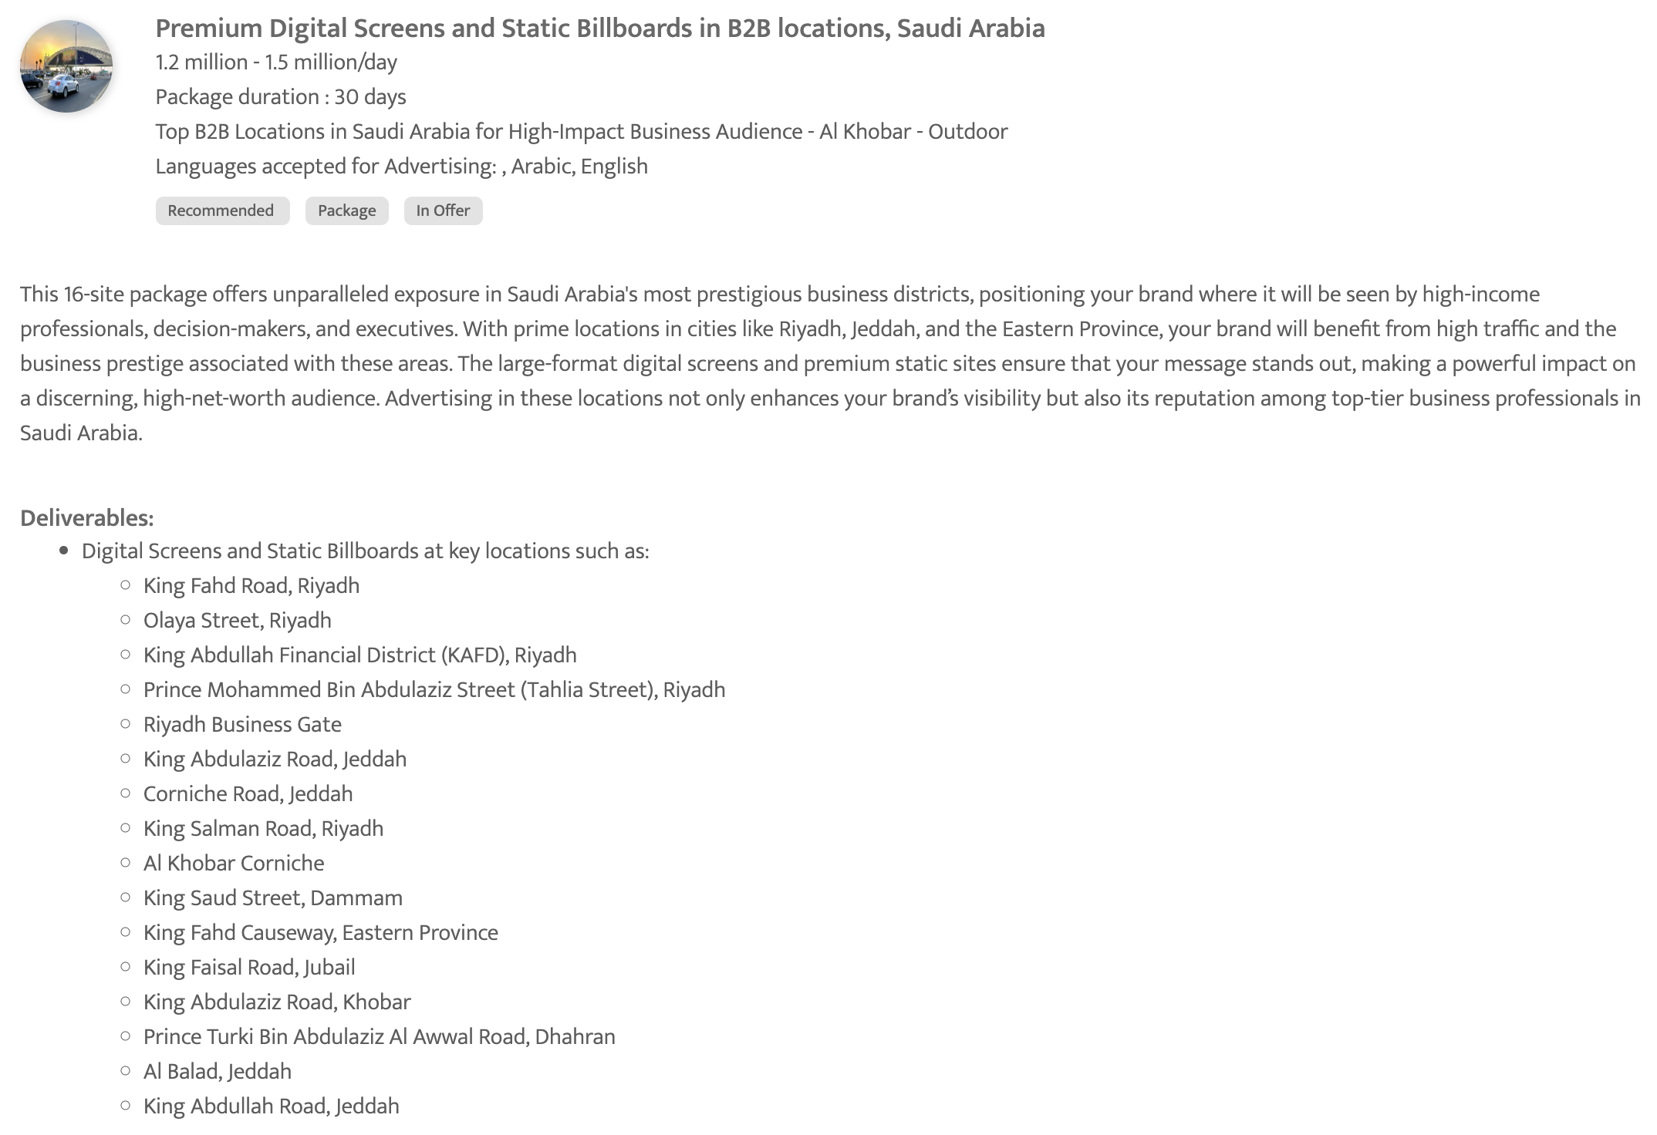
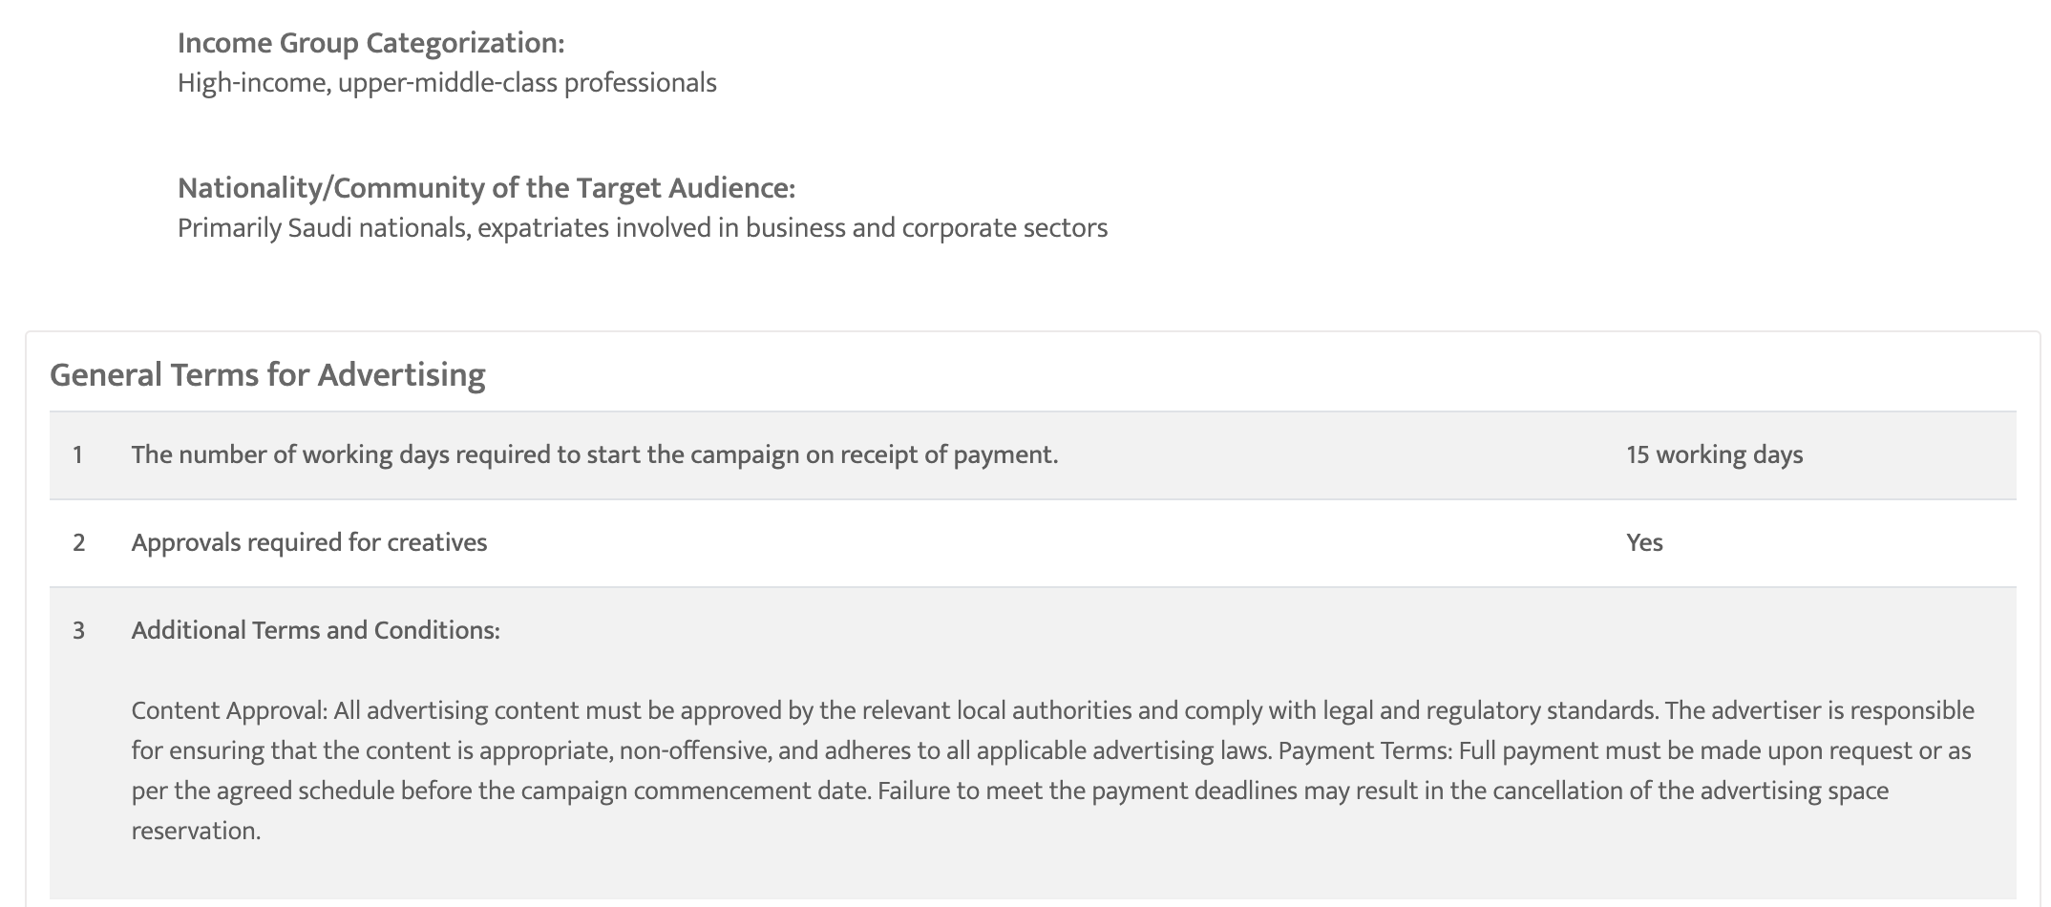

Slide 39
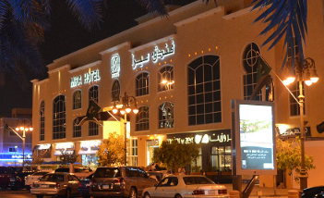
Prince Mohammed Bin Abdulaziz Street (Tahlia Street), Riyadh, Saudi Arabia Premium Billboards & Digital Displays near Prince Mohammed Bin Abdulaziz Street (Tahlia Street)

Slide 40
Prince Mohammed Bin Abdulaziz Street (Tahlia Street), Riyadh, Saudi Arabia Premium Billboards & Digital Displays near Prince Mohammed Bin Abdulaziz Street (Tahlia Street)
Details
Number of Screens: TBC
Lighting type: Lit
Size: TBC
Number of production: 1
Total number of months required: 1

Slide 41
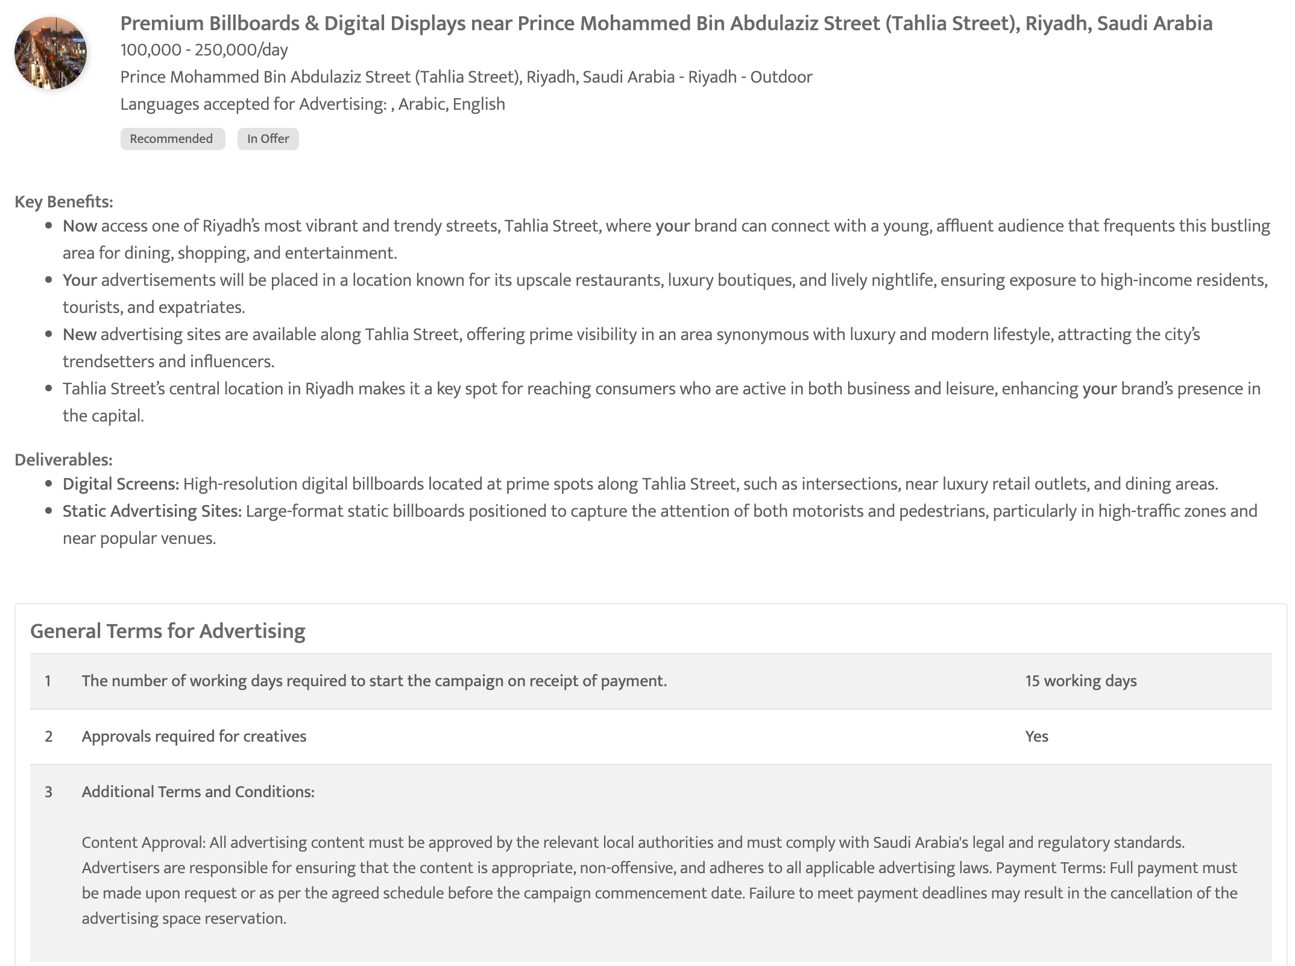

Slide 42
Newspapers

Slide 43
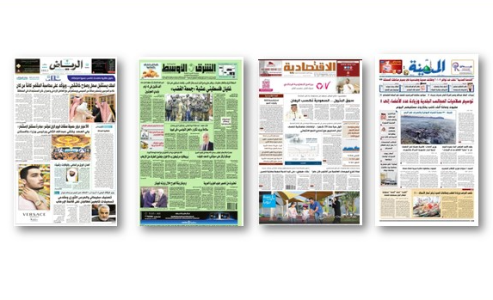
Highlight your brand with Top Arabic Newspaper Takeover Full Page Arabic Package

Slide 44
Highlight your brand with Top Arabic Newspaper Takeover Full Page Arabic Package
Details
Frequency: Daily
Number of production: 1

Slide 45
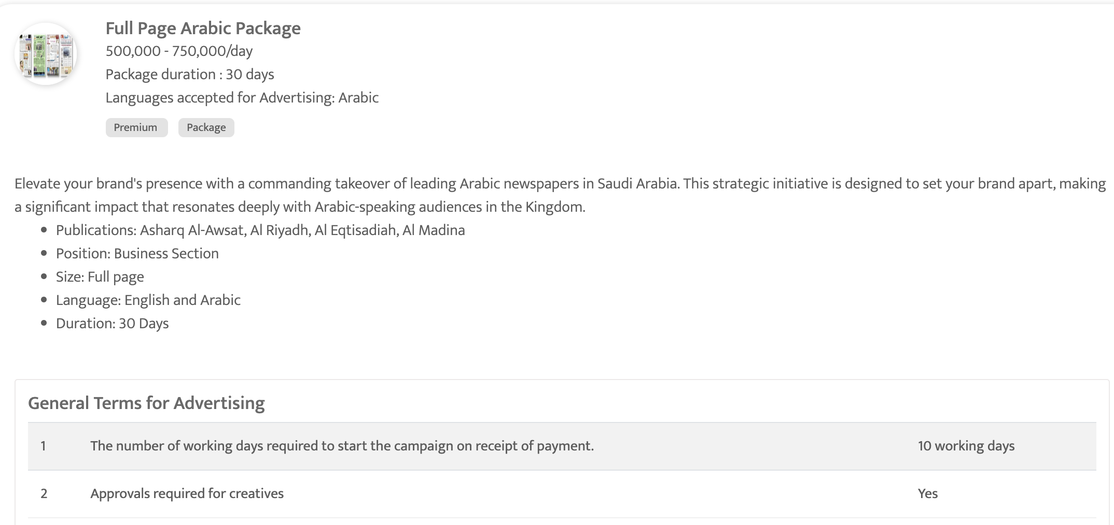

Slide 46
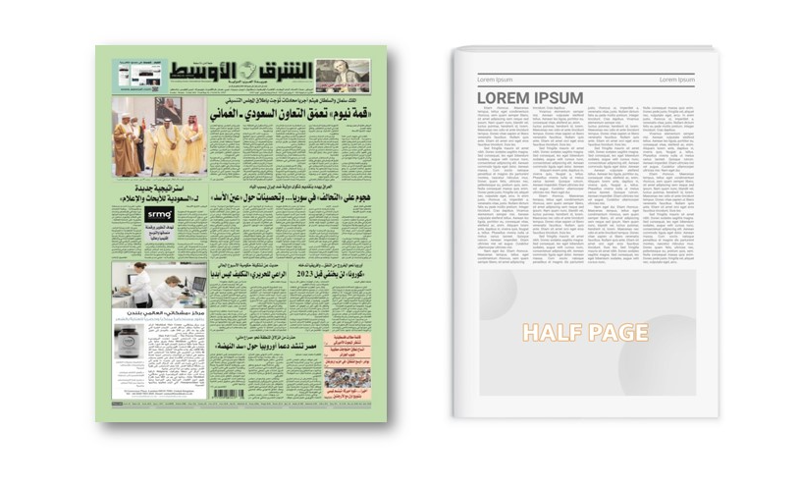
Asharq al-Awsat
Half Page ad on Business Page

Slide 47
Asharq al-Awsat Half Page ad on Business Page
Details
Frequency: Daily
Size: 50cm (H) x 30.5cm (W)
Premium Positions: Half Page
Number of production: 1
Number of insertions required: 1

Slide 48
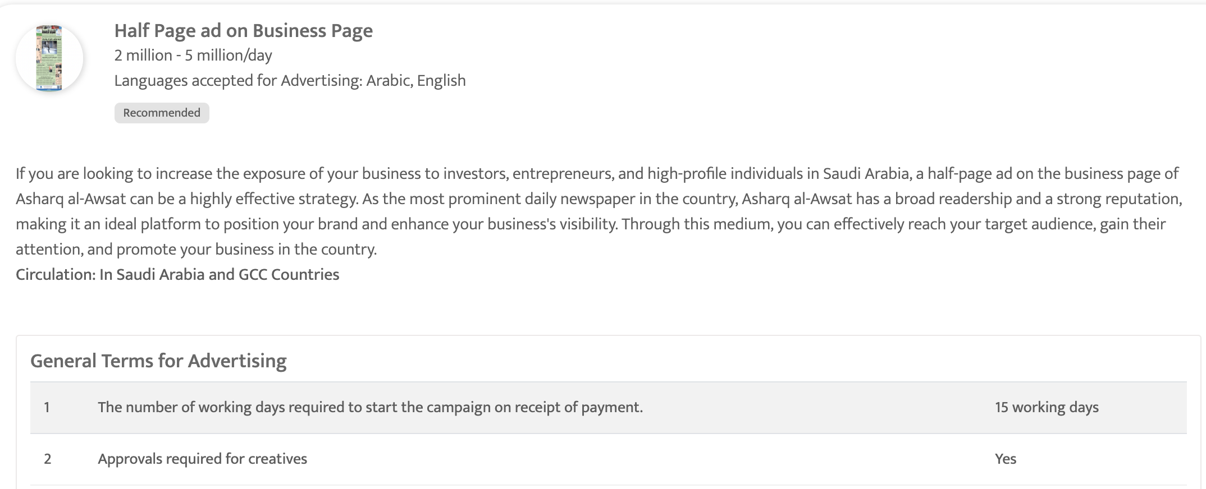

Slide 49
Television

Slide 50

MBC 1 - 30 Sec ad spot during Night Prime Time show

Slide 51
MBC 1 - 30 Sec ad spot during Night Prime Time show
Details
Time band: Night
Spot Duration (seconds): 30 sec
Time: 19:00 - 22:00
Number of production: 1
Number of spots required: 20

Slide 52
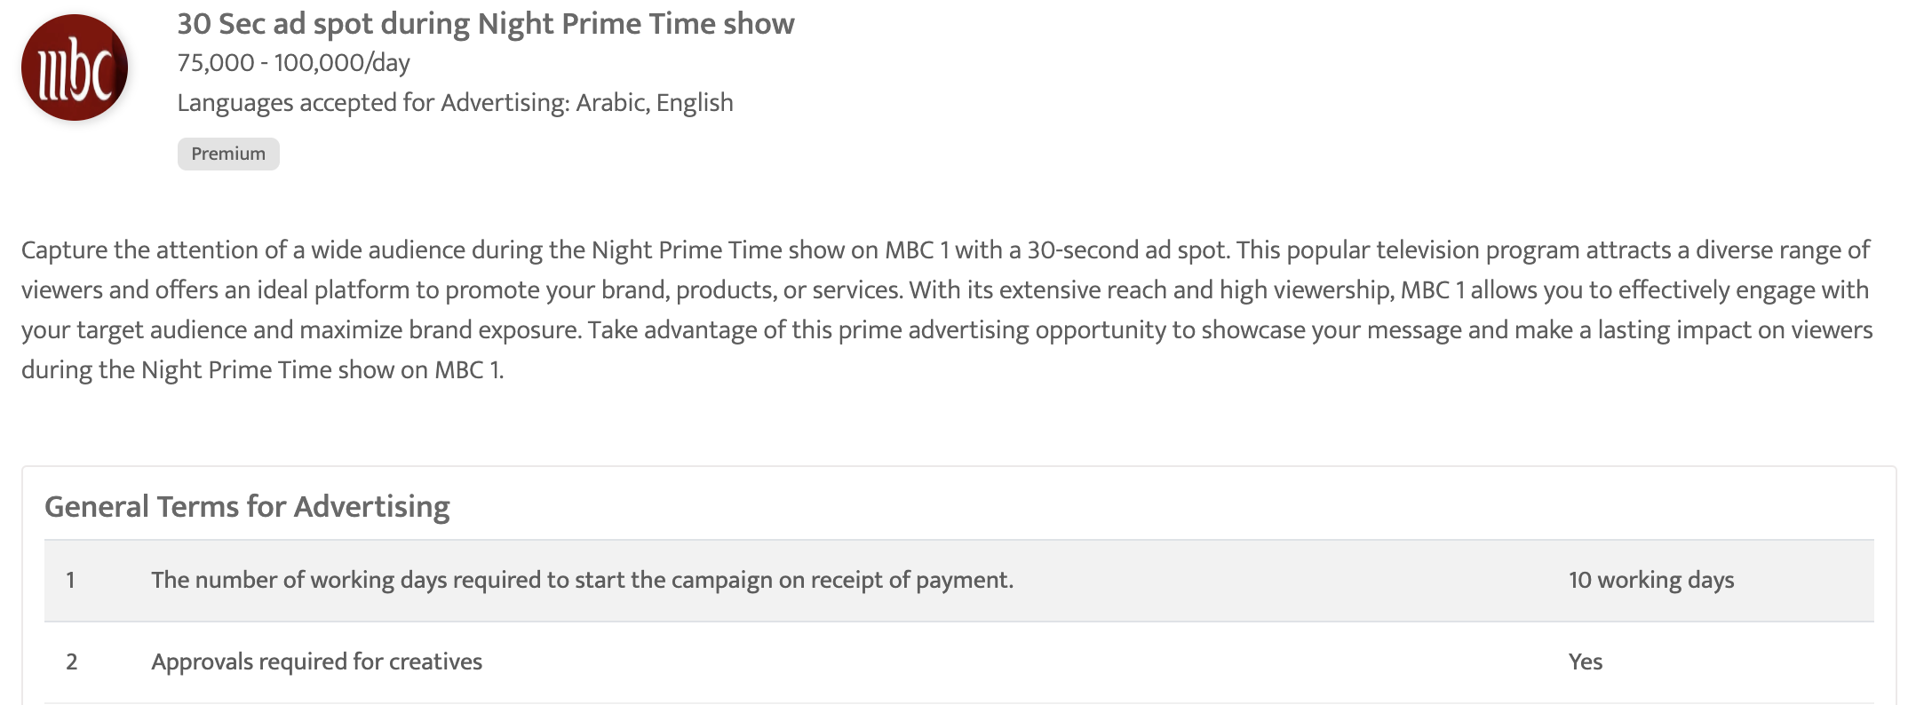

Slide 53
Thank You
media@masscomglobal.com | www.masscomglobal.com
Masscom Global FZE, Office No: 220, One UAQ Building, UAQ Free Trade Zone, Umm Al Quwain, United Arab Emirates.

