Slide 1

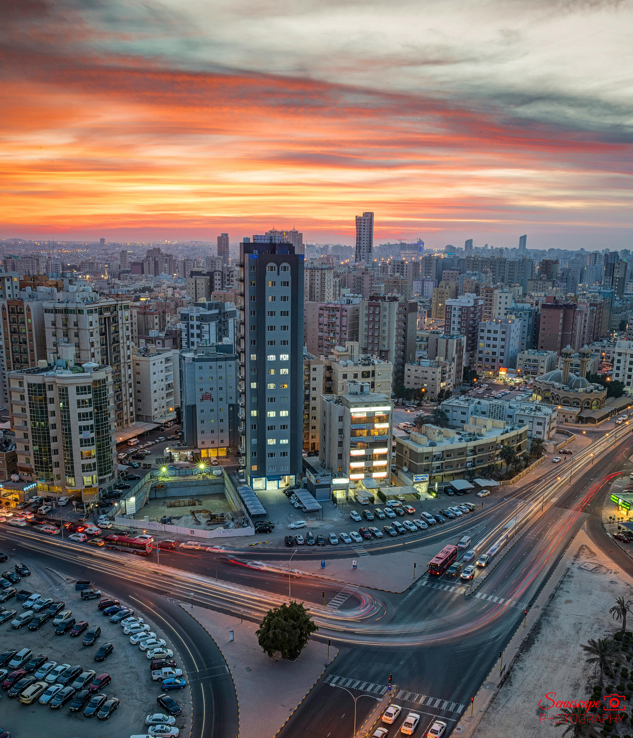

Top Media
Recommendations
in Kuwait

Slide 2
Newspaper

Slide 3
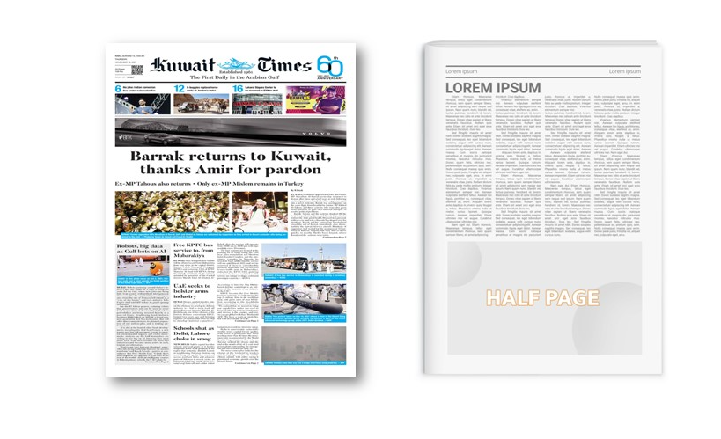
Kuwait Times, Kuwait Times, Kuwait
Half Page ad on First Business Page, Kuwait Times, Kuwait
Newspaper

Slide 4
Kuwait Times, Kuwait Times, Kuwait
Half Page ad on First Business Page, Kuwait Times
Newspaper
Details
Frequency: Daily
Size: TBC
Premium Positions: Half Page
Number of production: 1
Number of insertions required: 1

Slide 5
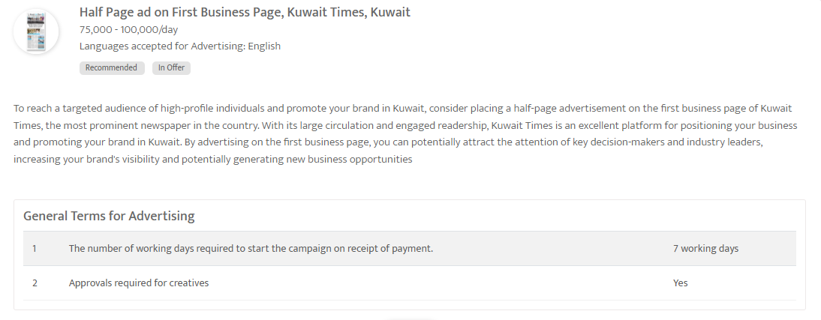

Slide 6
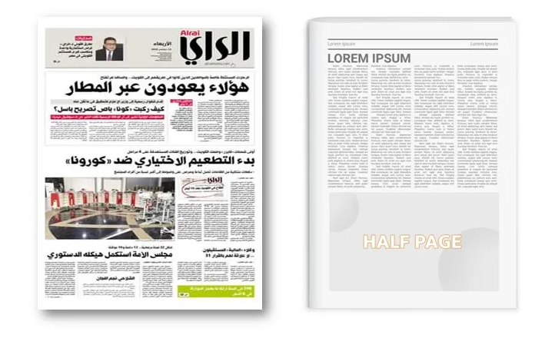
Al Rai - Half Page Editorial ad on page 3
Newspaper

Slide 7
Al Rai - Half Page Editorial ad on page 3
Newspaper
Details
Frequency: Daily
Size: TBC
Premium Positions: Half Page
Number of production: 1
Number of insertions required: 1

Slide 8
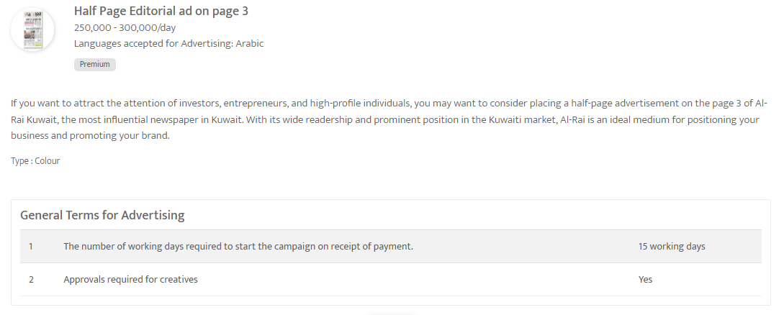

Slide 9
Airports

Slide 10
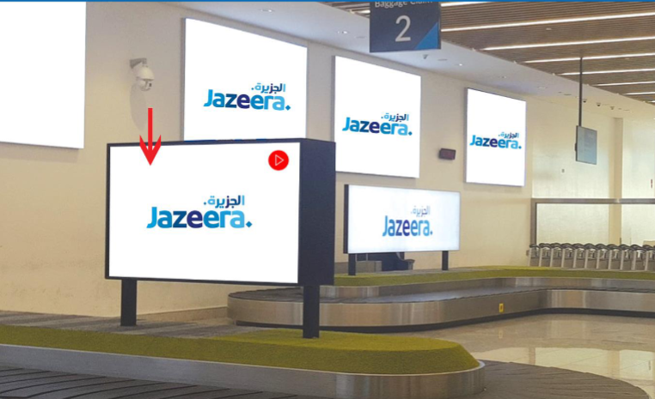
Kuwait International Airport, Kuwait - Al Farwaniyah
Digital Screen package at T5- Jazeera Airways, Kuwait International Airport
Out of Home

Slide 11
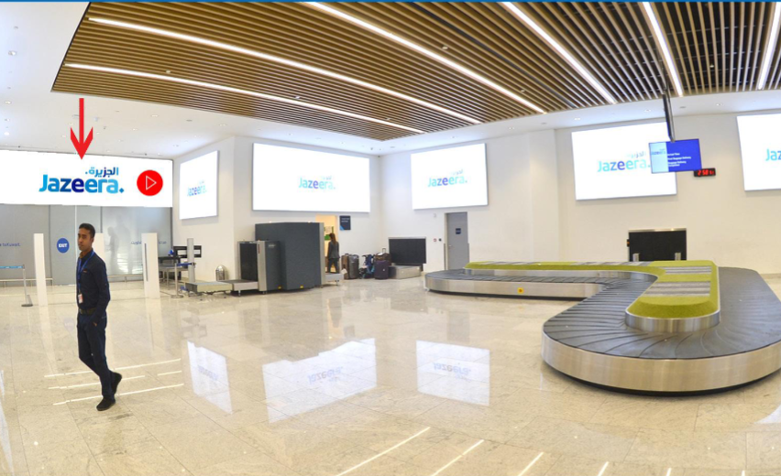

Slide 12
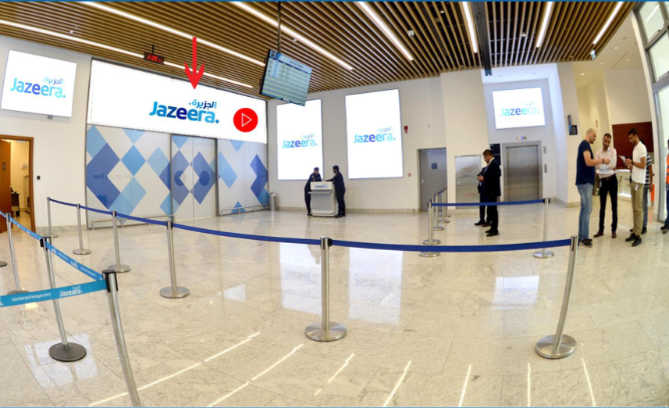

Slide 13
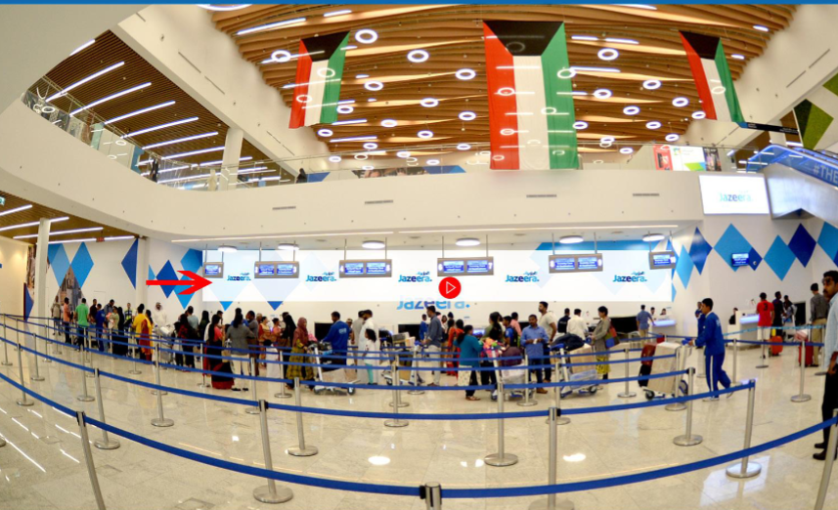

Slide 14
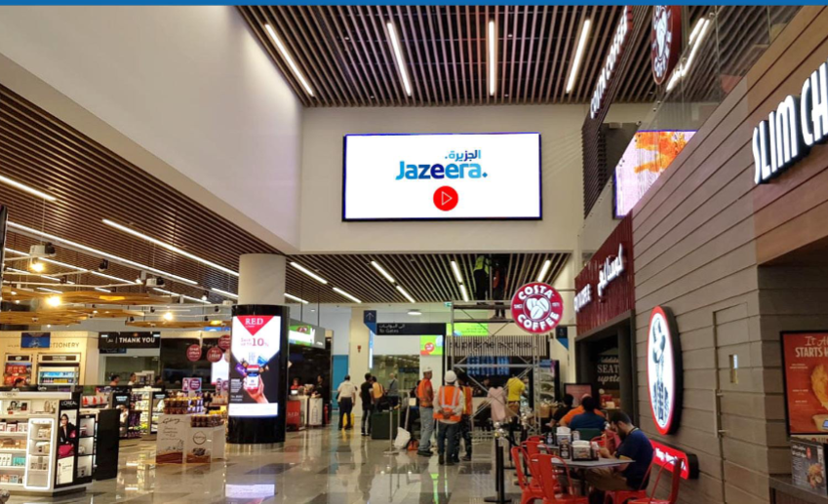

Slide 15
Kuwait International Airport, Kuwait - Al Farwaniyah
Digital Screen package at T5- Jazeera Airways, Kuwait International Airport, Kuwait
Out of Home
Details
Number of Screens: 8
Lighting type: Lit
Size: 8
Single Rotation Time in Seconds:
Duration of creative in seconds: 10
Number of production: 1
Total number of months required: 1

Slide 16
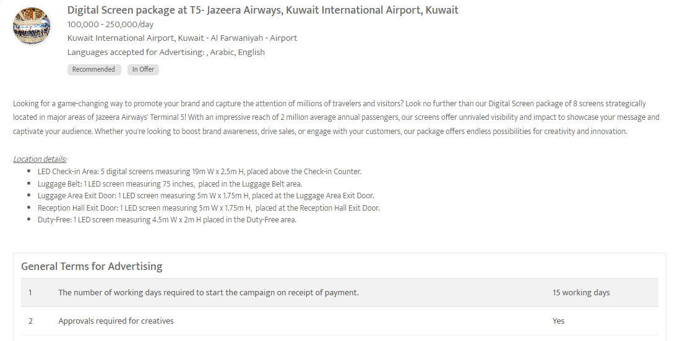

Slide 17
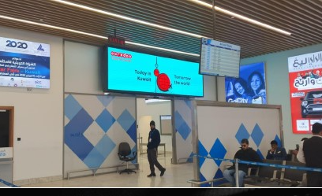
Reception Hall, Exit Door, Kuwait Airport T5, (Jazeera Airways) , Kuwait city, Kuwait
Digital Screen at Jazeera Airways Reception Hall
Out of Home

Slide 18
Reception Hall, Exit Door, Kuwait Airport T5, (Jazeera Airways) , Kuwait city , Kuwait
Digital Screen at Jazeera Airways Reception Hall
Out of Home
Details
Number of Screens: 1
Lighting type: Back-Lit
Size: 5m (W) X 1.75m (H)
Single Rotation Time in Seconds: 10
Duration of creative in seconds: 10
Number of production: 1
Total number of months required: 1

Slide 19
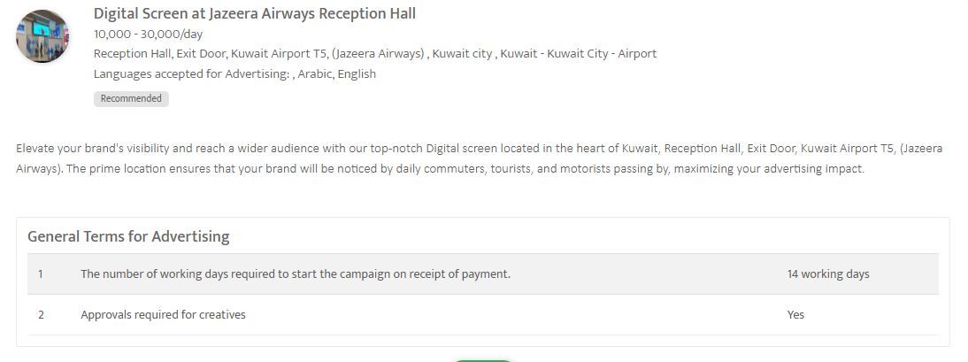

Slide 20
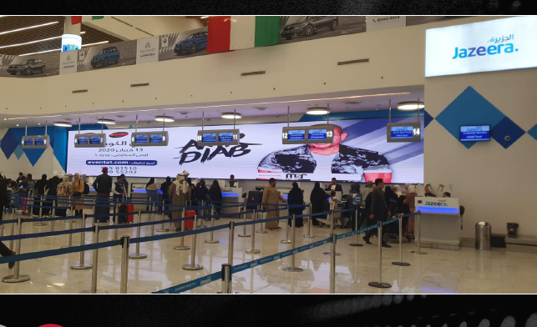
Kuwait International Airport, Kuwait - Kuwait City
LED Screen at Kuwait Airport
Out of Home

Slide 21
Kuwait International Airport, Kuwait - Kuwait City
LED Screen at Kuwait Airport
Out of Home
Details
Number of Screens: 6
Number of production: 1

Slide 22
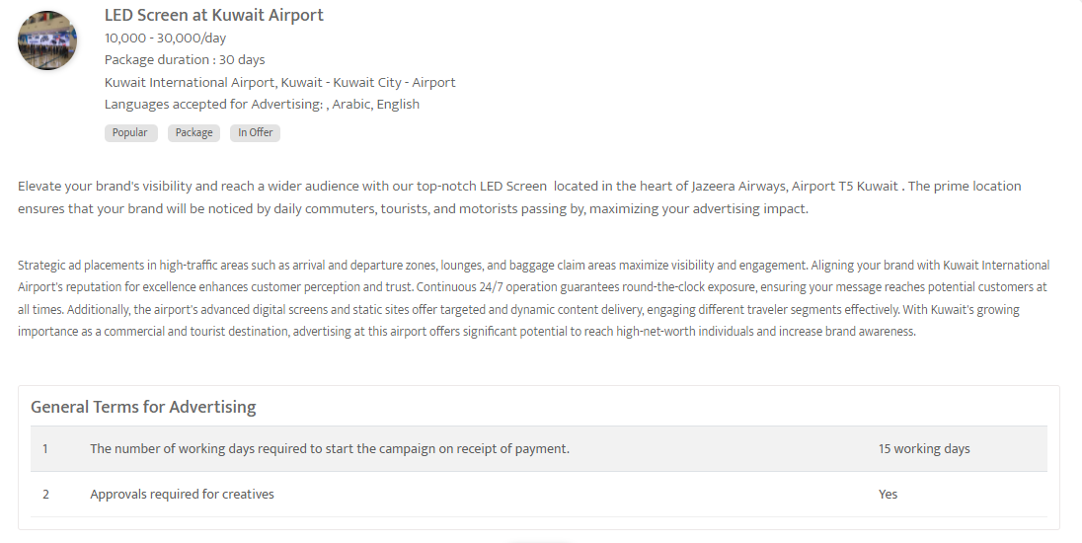

Slide 23
Out of home

Slide 24
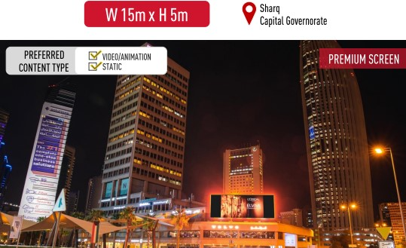
Strategic Outdoor Recommendation to Target Capital and Hawally Governorate , Kuwait - Salmiya
DOOH Package in Prime Locations
Out of Home

Slide 25
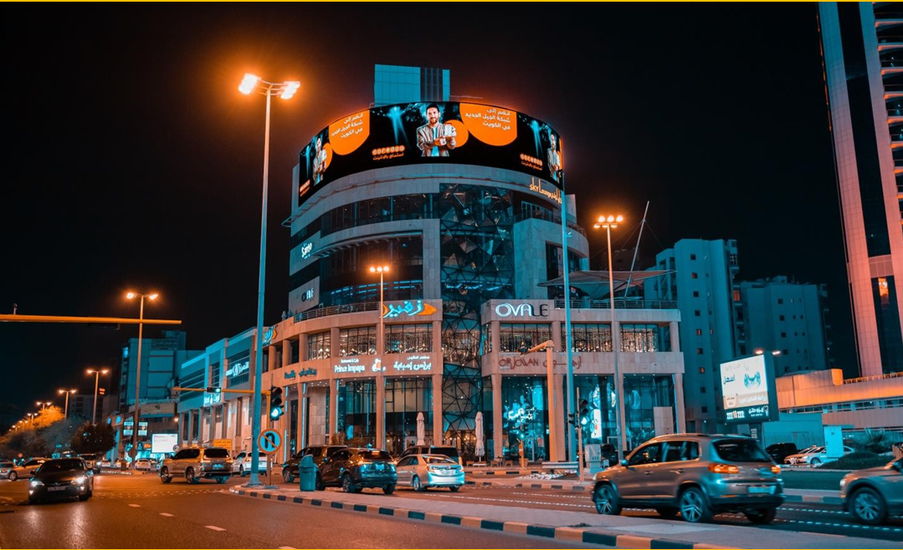

Slide 26
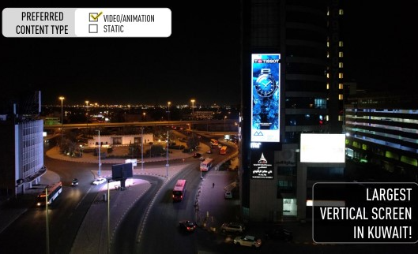

Slide 27
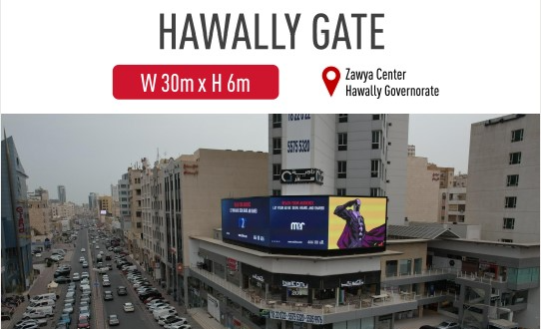

Slide 28
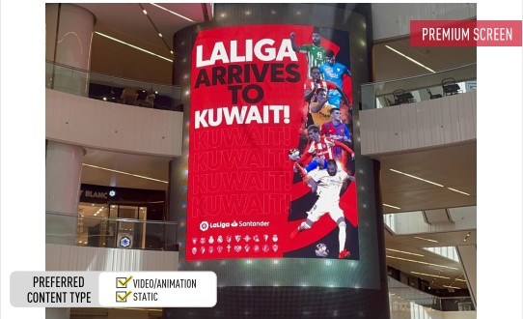

Slide 29
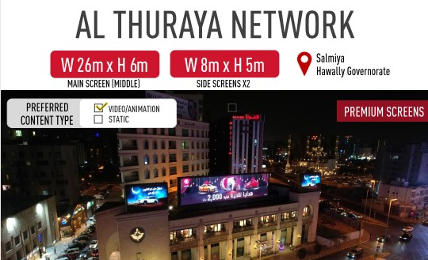

Slide 30
Strategic Outdoor Recommendation To Target Capital and Hawally Governorate , Kuwait - Salmiya –
DOOH Package in Prime Locations
Out of Home
Details
Number of Screens: 15
Number of production: 1

Slide 31
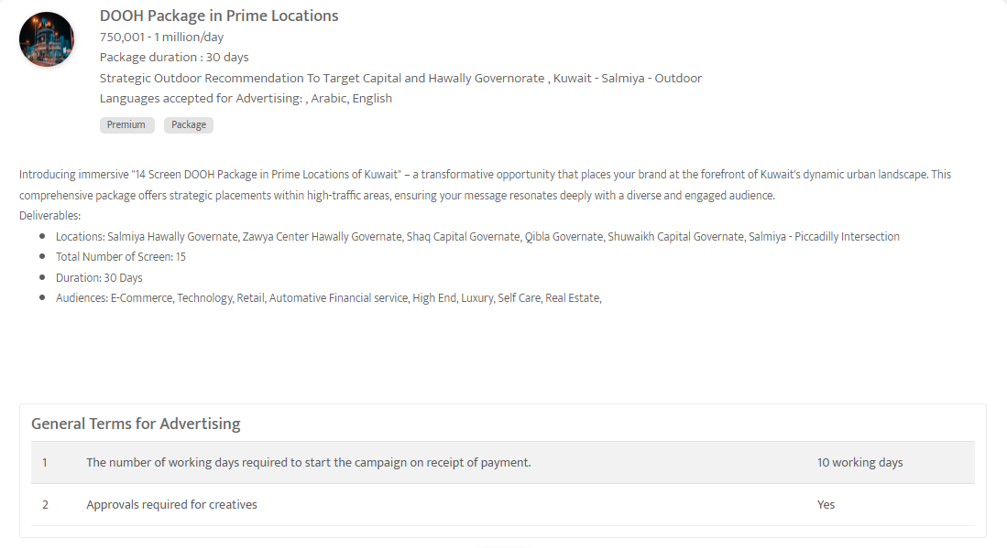

Slide 32
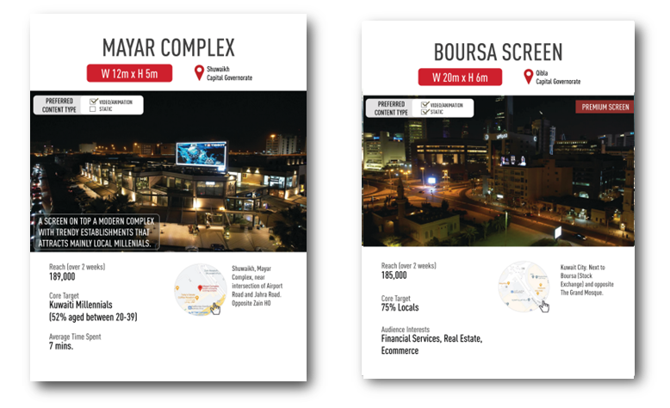
Premium DOOH Site package in Kuwait , Kuwait City
DOOH Screens Network in Kuwait
Out of Home

Slide 33
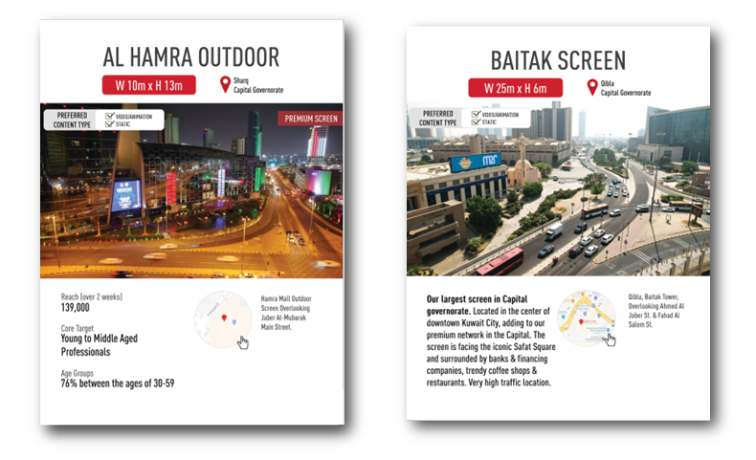

Slide 34
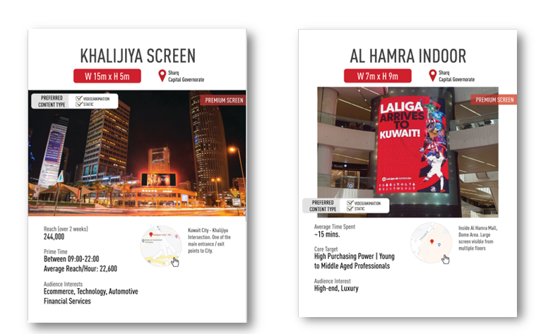

Slide 35
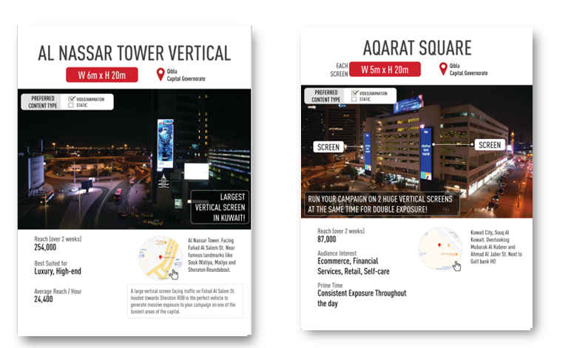

Slide 36
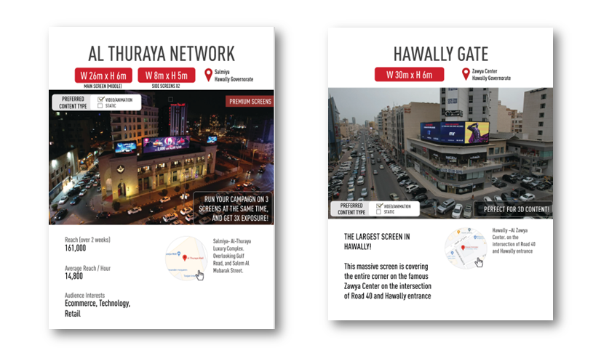

Slide 37
Premium DOOH Site package in Kuwait , Kuwait City
DOOH Screens Network in Kuwait
Out of Home
Rates and details
Number of Screens: 10
Number of production: 1

Slide 38
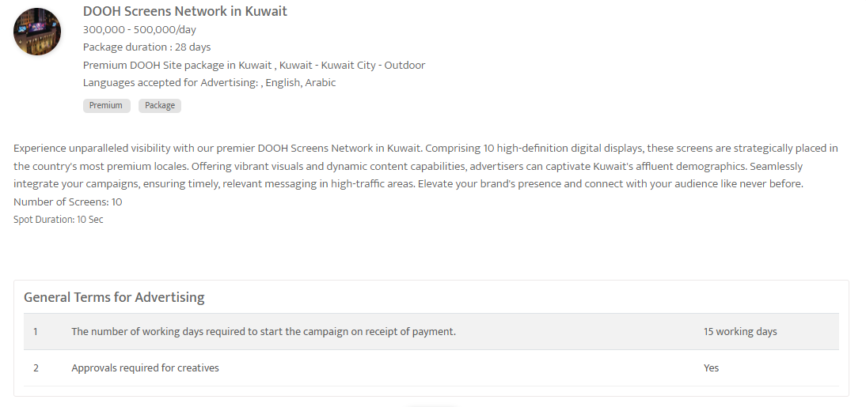

Slide 39
Thank You
media@masscomglobal.com | www.masscomglobal.com
Masscom Global FZE, Office No: 220, One UAQ Building, UAQ Free Trade Zone, Umm Al Quwain, United Arab Emirates.

