Slide 1

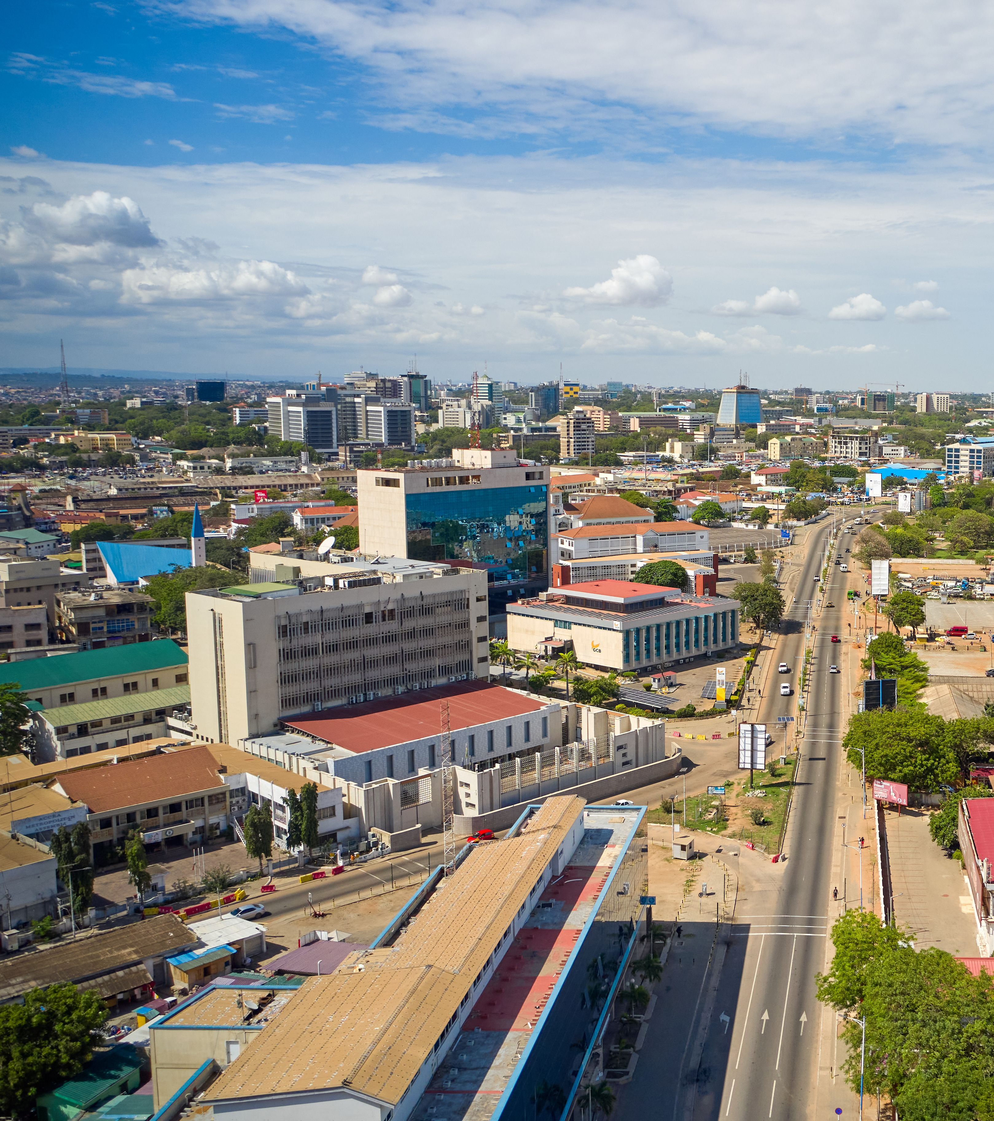


Top Media
Recommendations
in Senegal

Slide 2
Prime airports

Slide 3
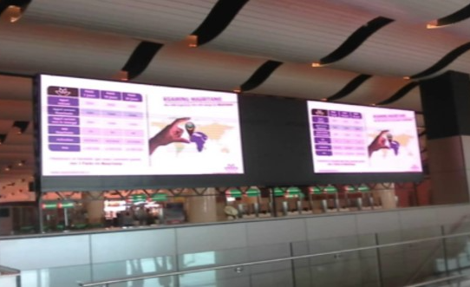
Dakar International Airport, Senegal Digital Screen Ad at Departure Area Near Cafeteria

Slide 4
Dakar International Airport, Senegal Digital Screen Ad at Departure Area Near Cafeteria
Details
Number of Screens: 1
Lighting type: Lit
Size: 2.5 x 5m
Single Rotation Time in Seconds:
Duration of creative in seconds:
Number of production: 1
Total number of months required: 1

Slide 5
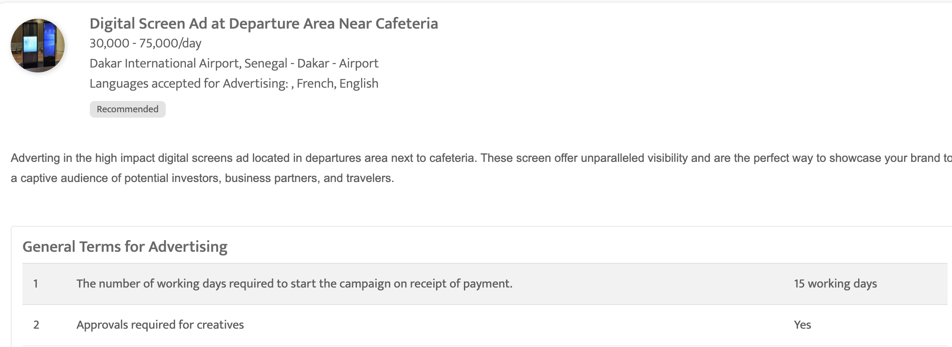

Slide 6
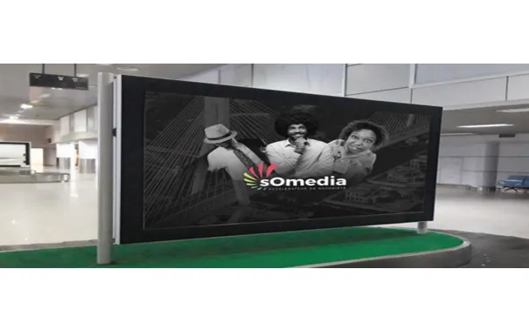
Blaise Diagne International Airport LED Screen at Departure zone public hall in front of Cafeteria

Slide 7
Blaise Diagne International Airport LED Screen at Departure zone public hall in front of Cafeteria
Details
Number of Screens: 1
Lighting type: Lit
Size: 30m2
Single Rotation Time in Seconds:
Duration of creative in seconds:
Number of production: 1
Total number of months required: 1

Slide 8
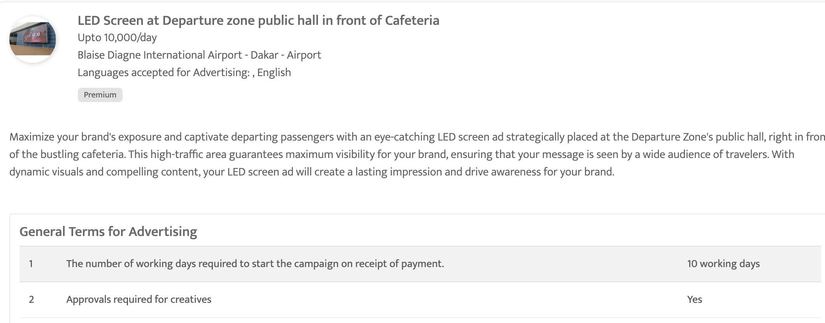

Slide 9
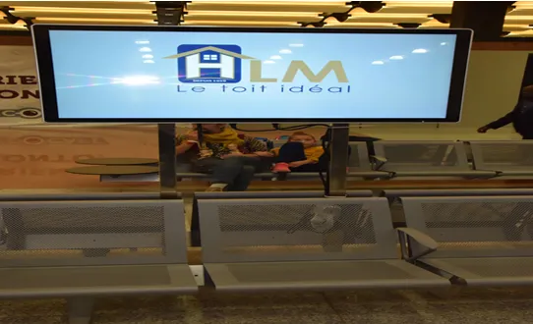
Blaise Diagne International Airport – Dakar LED Screen at Boarding Zone, Blaise Diagne International Airport

Slide 10
Blaise Diagne International Airport – Dakar LED Screen at Boarding Zone, Blaise Diagne International Airport
Details
Number of Screens: 1
Lighting type: Lit
Size: 60 inch
Single Rotation Time in Seconds:
Duration of creative in seconds: 15
Number of production: 1
Total number of months required: 1

Slide 11
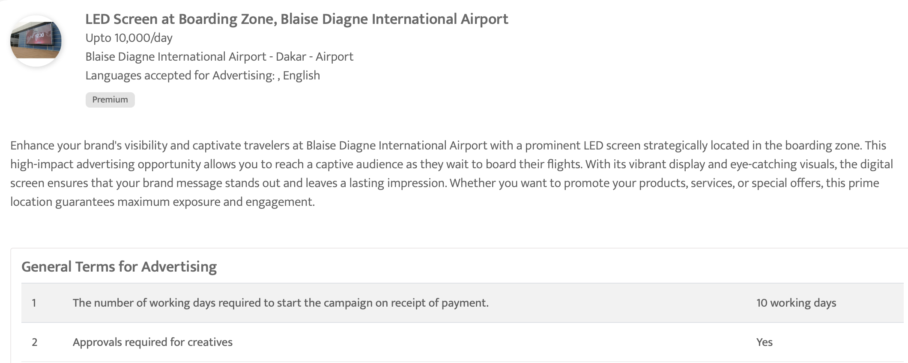

Slide 12
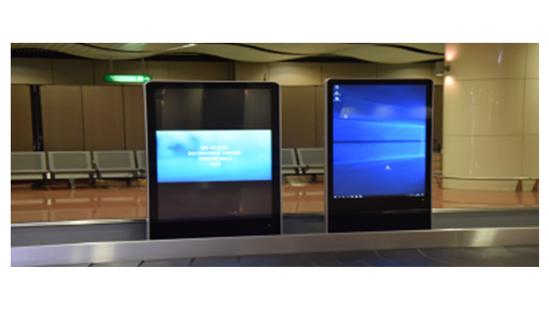
Blaise Diagne International Airport – Dakar Digital Screen at arrival area luggage, Blaise Diagne International Airport

Slide 13
Blaise Diagne International Airport – Dakar Digital Screen at arrival area luggage, Blaise Diagne International Airport
Details
Number of Screens: 1
Lighting type: Lit
Size: TBC
Single Rotation Time in Seconds:
Duration of creative in seconds: 15
Number of production: 1
Total number of months required: 1

Slide 14
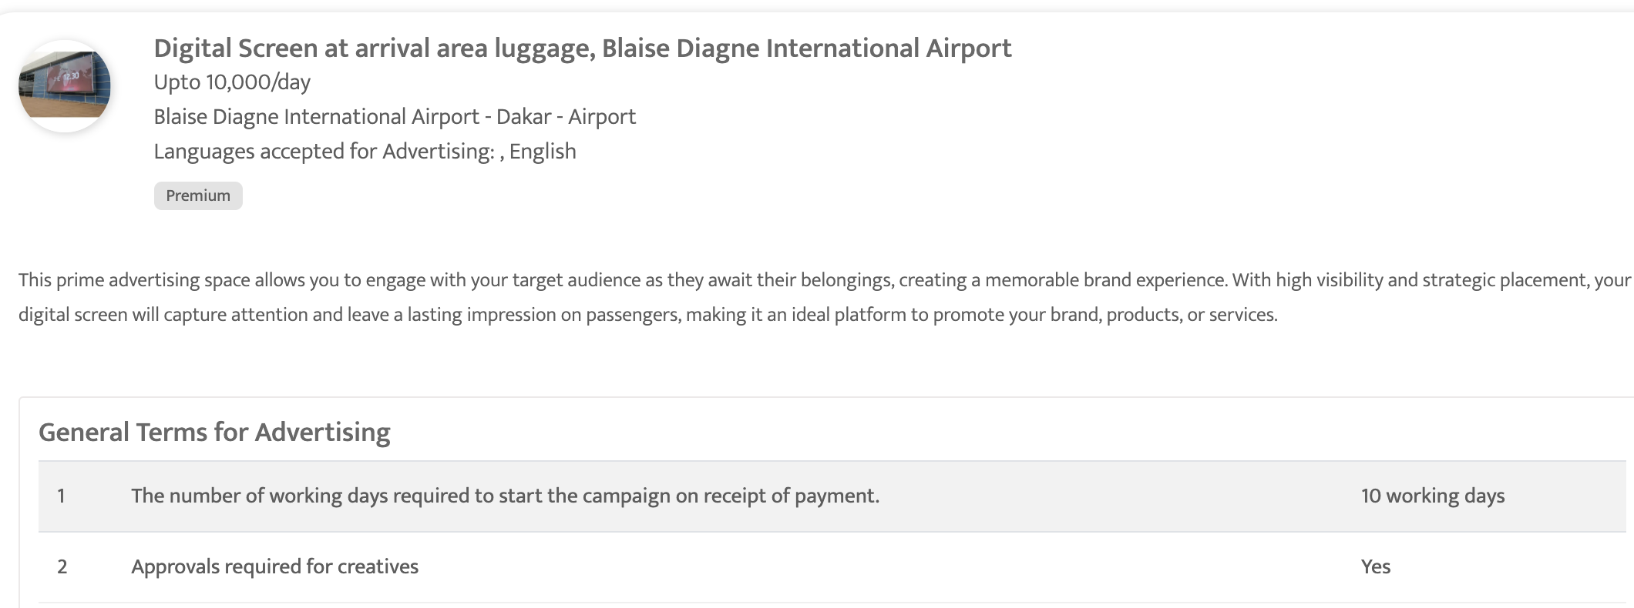

Slide 15
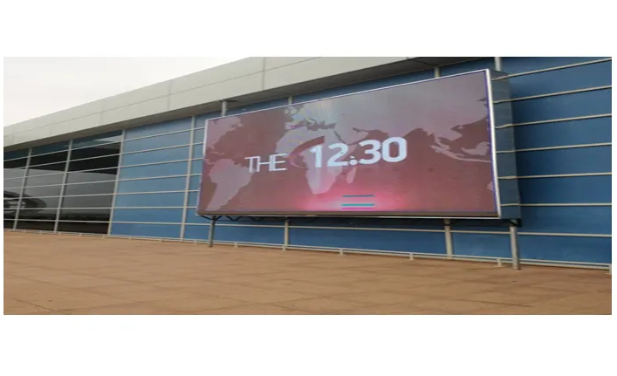
Blaise Diagne International Airport – Dakar LED Screen at Departure Zone, Dakar International Airport

Slide 16
Blaise Diagne International Airport – Dakar LED Screen at Departure Zone, Dakar International Airport
Details
Number of Screens: 1
Lighting type: Lit
Size: 30m2
Single Rotation Time in Seconds:
Duration of creative in seconds:
Number of production: 1
Total number of months required: 1

Slide 17
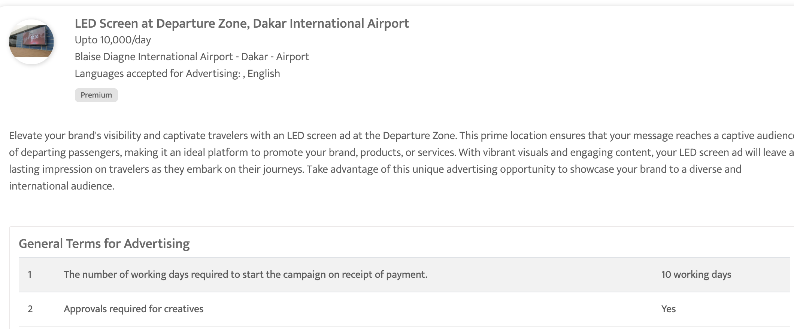

Slide 18
Top out of home sites

Slide 19
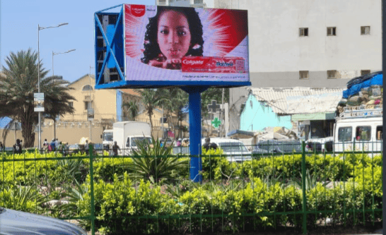
Grand theatre in Dakar, Senegal Hoarding at Grand theatre, Dakar Plateau

Slide 20
Grand theatre in Dakar, Senegal Hoarding at Grand theatre, Dakar Plateau
Details
Number of Screens: 1
Lighting type: Non-Lit
Size: 20 Sqm
Single Rotation Time in Seconds:
Duration of creative in seconds:
Number of production: 1
Total number of months required: 1

Slide 21
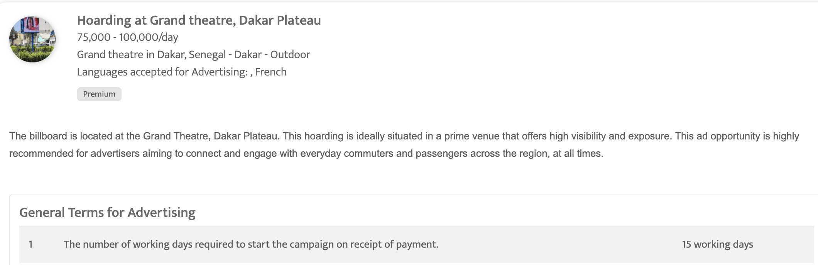

Slide 22
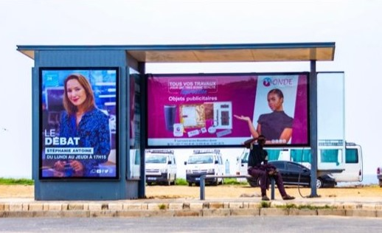
Dakar City – Dakar Bus Shelter Branding Dakar City

Slide 23
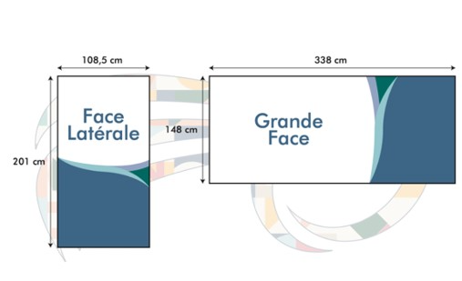

Slide 24
Dakar City – Dakar Bus Shelter Branding Dakar City
Details
Number of Screens: 10
Number of production: 1

Slide 25
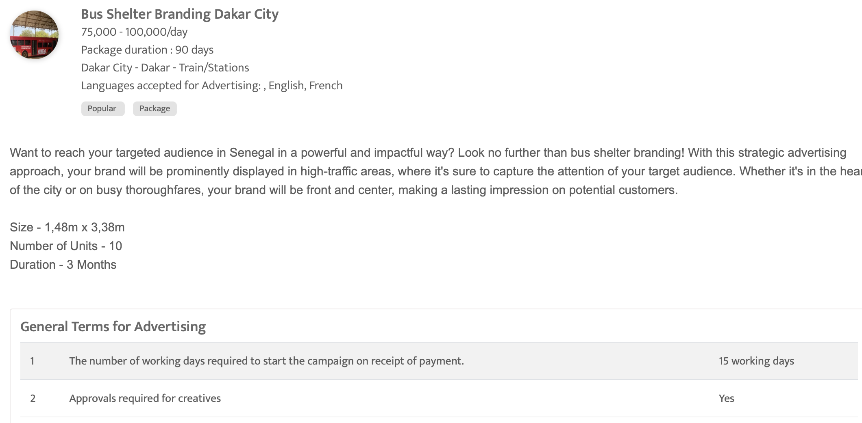

Slide 26
Business Newspapers

Slide 27
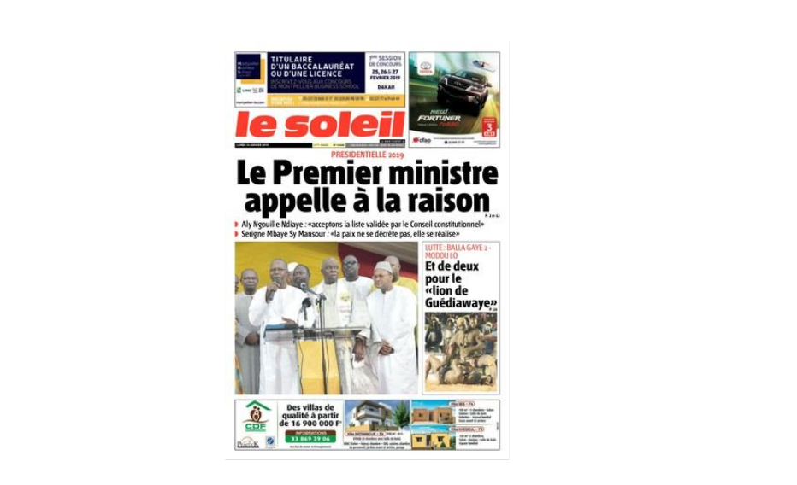
Le Soleil, Senegal Full page ad on inside pages

Slide 28
Le Soleil, Senegal Full page ad on inside pages
Details
Frequency: Daily
Size: TBC
Standard Positions: Full page
Number of production: 1
Number of insertions required: 1

Slide 29
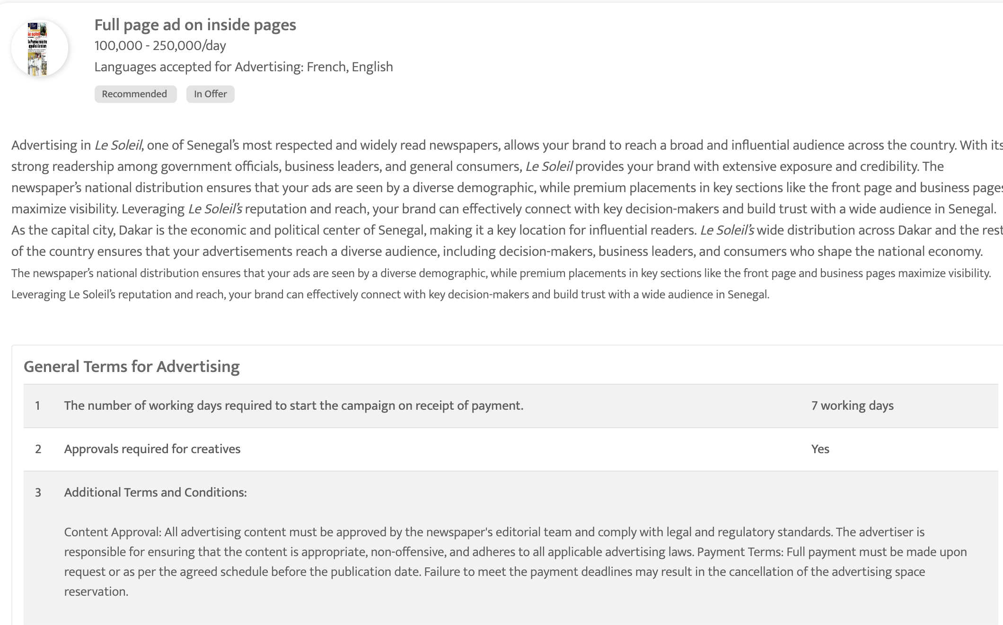

Slide 30

Sud Quotidien, Senegal Prime Placements on Business Page or Early Inside Pages

Slide 31
Sud Quotidien, Senegal Prime Placements on Business Page or Early Inside Pages
Details
Frequency: Daily
Size: TBC
Standard Positions: Full page
Number of production: 1
Number of insertions required: 1

Slide 32
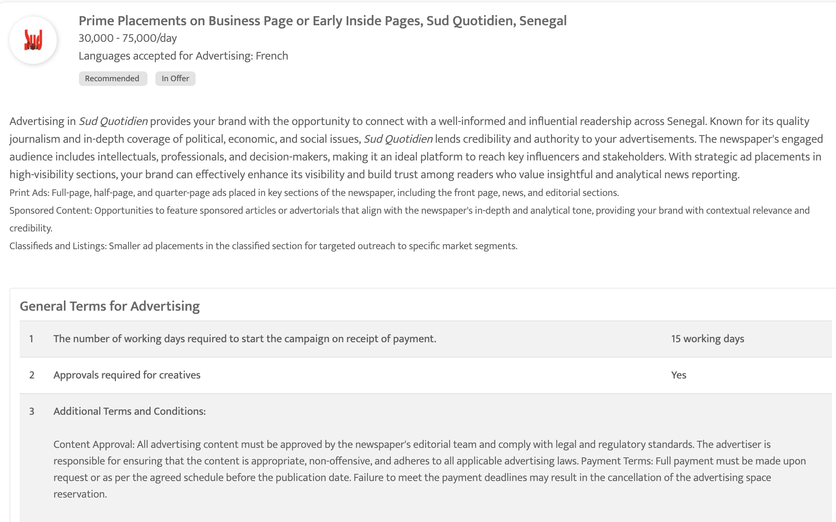

Slide 33
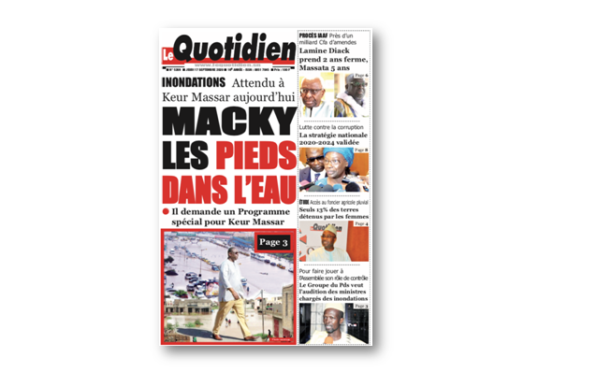
Le Quotidien Full page ad on inside pages

Slide 34
Le Quotidien Full page ad on inside pages
Details
Frequency: Daily
Size: TBC
Standard Positions: Full page
Number of production: 1
Number of insertions required: 1

Slide 35
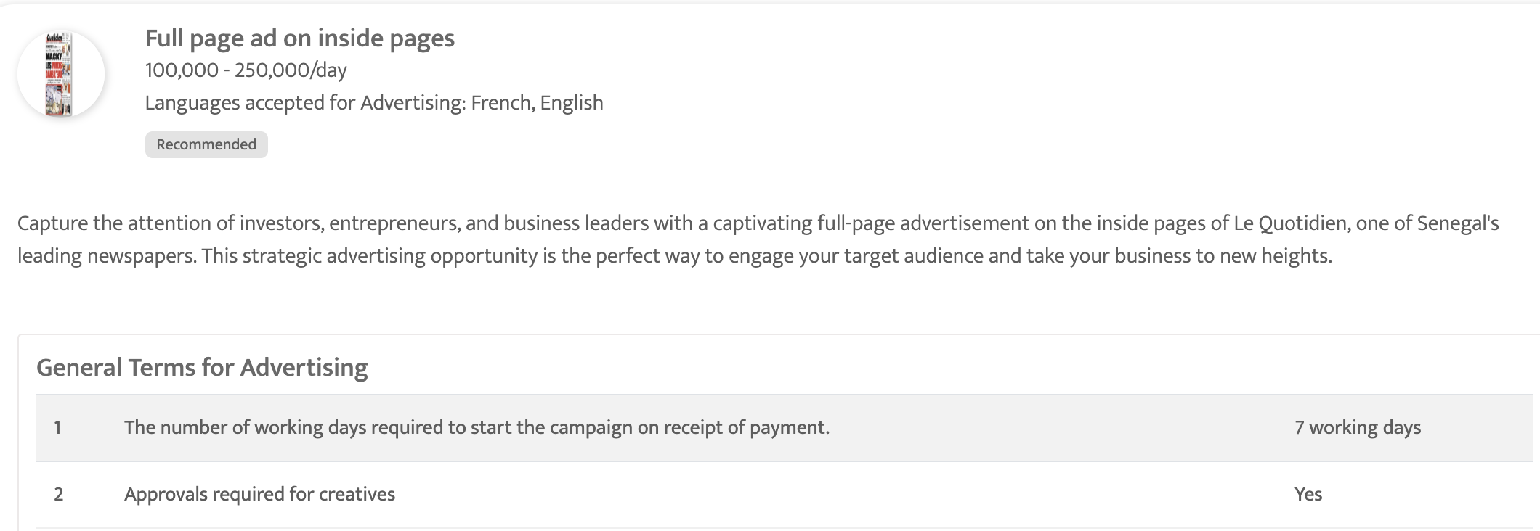

Slide 36
Thank You
media@masscomglobal.com | www.masscomglobal.com
Masscom Global FZE, Office No: 220, One UAQ Building, UAQ Free Trade Zone, Umm Al Quwain, United Arab Emirates.

