Slide 1

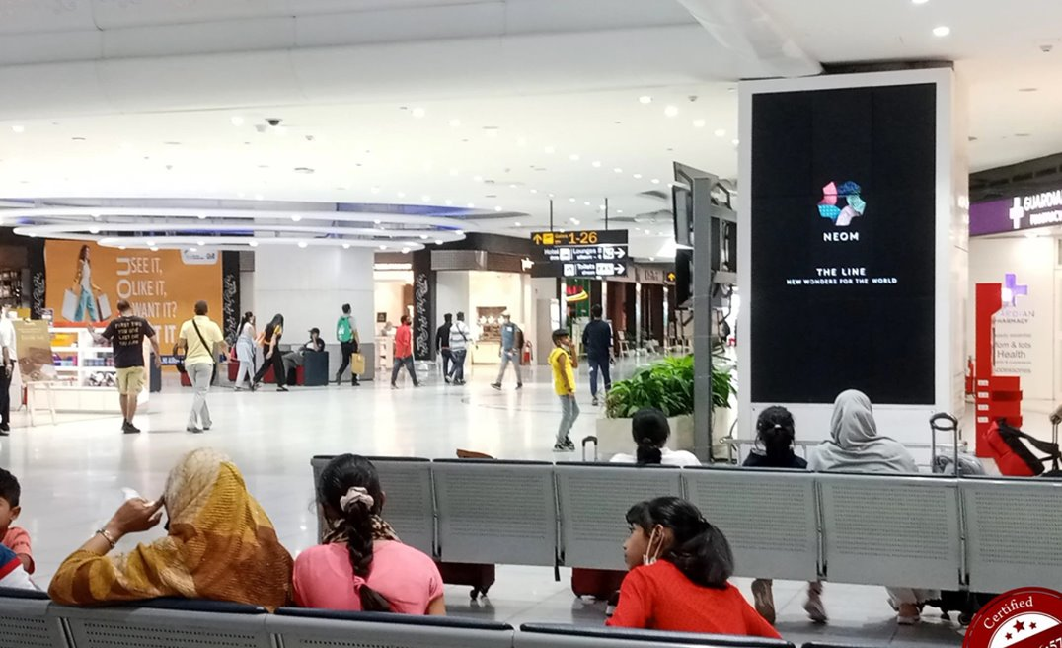

Top Media
Recommendations
in India

Slide 2
India

Slide 3
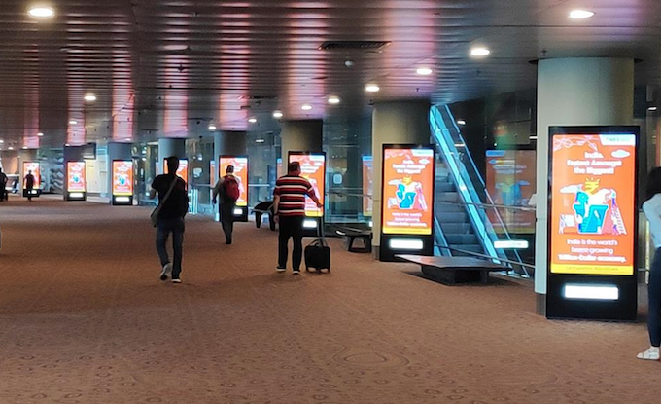
Gateway to India's Elite: Programmatic DOOH in Major Indian Airports
Programmatic DOOH Major Airport Destinations Across India

Slide 4
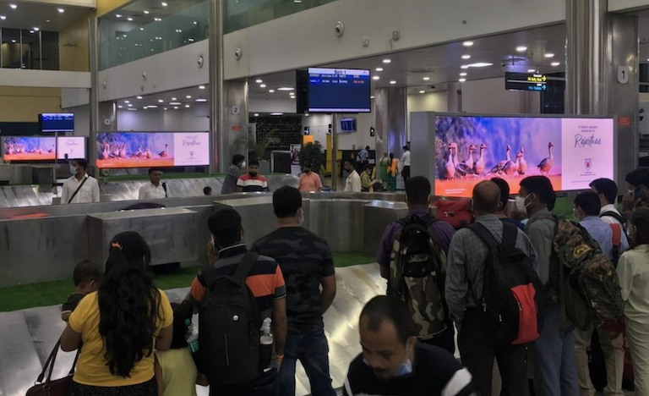

Slide 5
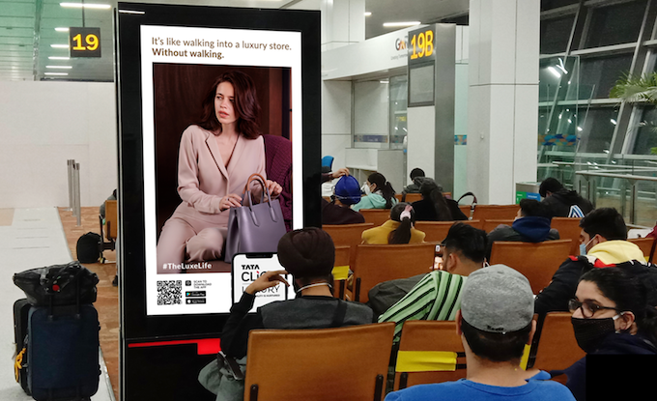

Slide 6
Gateway to India's Elite: Programmatic DOOH in Major Indian Airports
Programmatic DOOH Major Airport Destinations Across India
Rates and details
Category: Digital Out of Home
Airports: Video Ads
Size: Video Ads
Number of production: 1
Number of impressions required: 100000

Slide 7
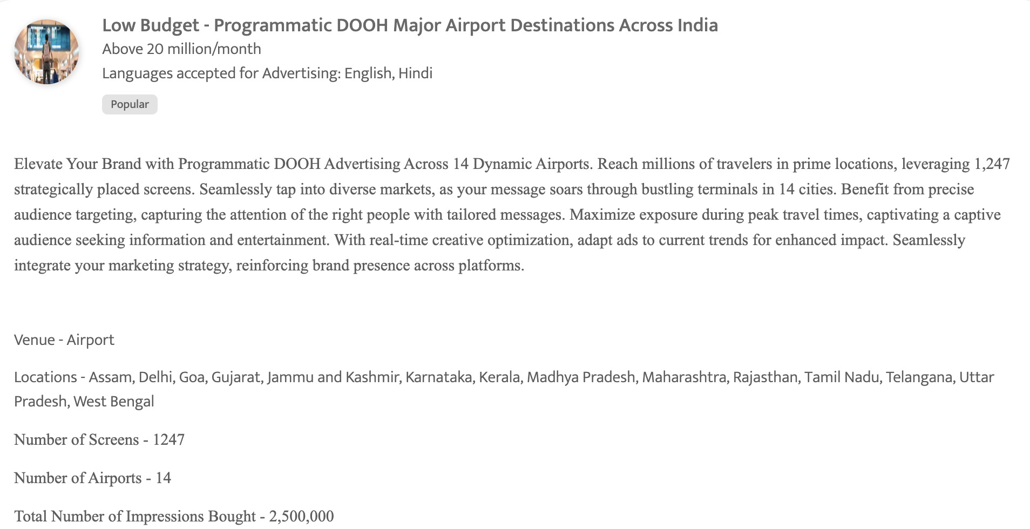
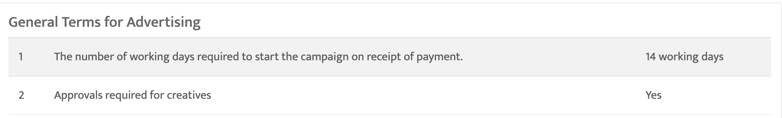

Slide 8
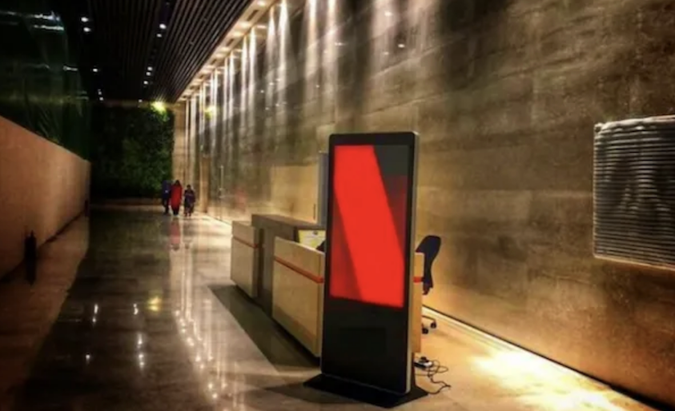
Zoom into the Tech Hubs: Your Brand on Programmatic DOOH in Key Tech Enclaves
Progrommatic DOOH Across India's Tech Parks

Slide 9
Zoom into the Tech Hubs: Your Brand on Programmatic DOOH in Key Tech Enclaves
Progrommatic DOOH Across India's Tech Parks
Rates and details
Category: Digital Out of Home
Number of production: 1

Slide 10
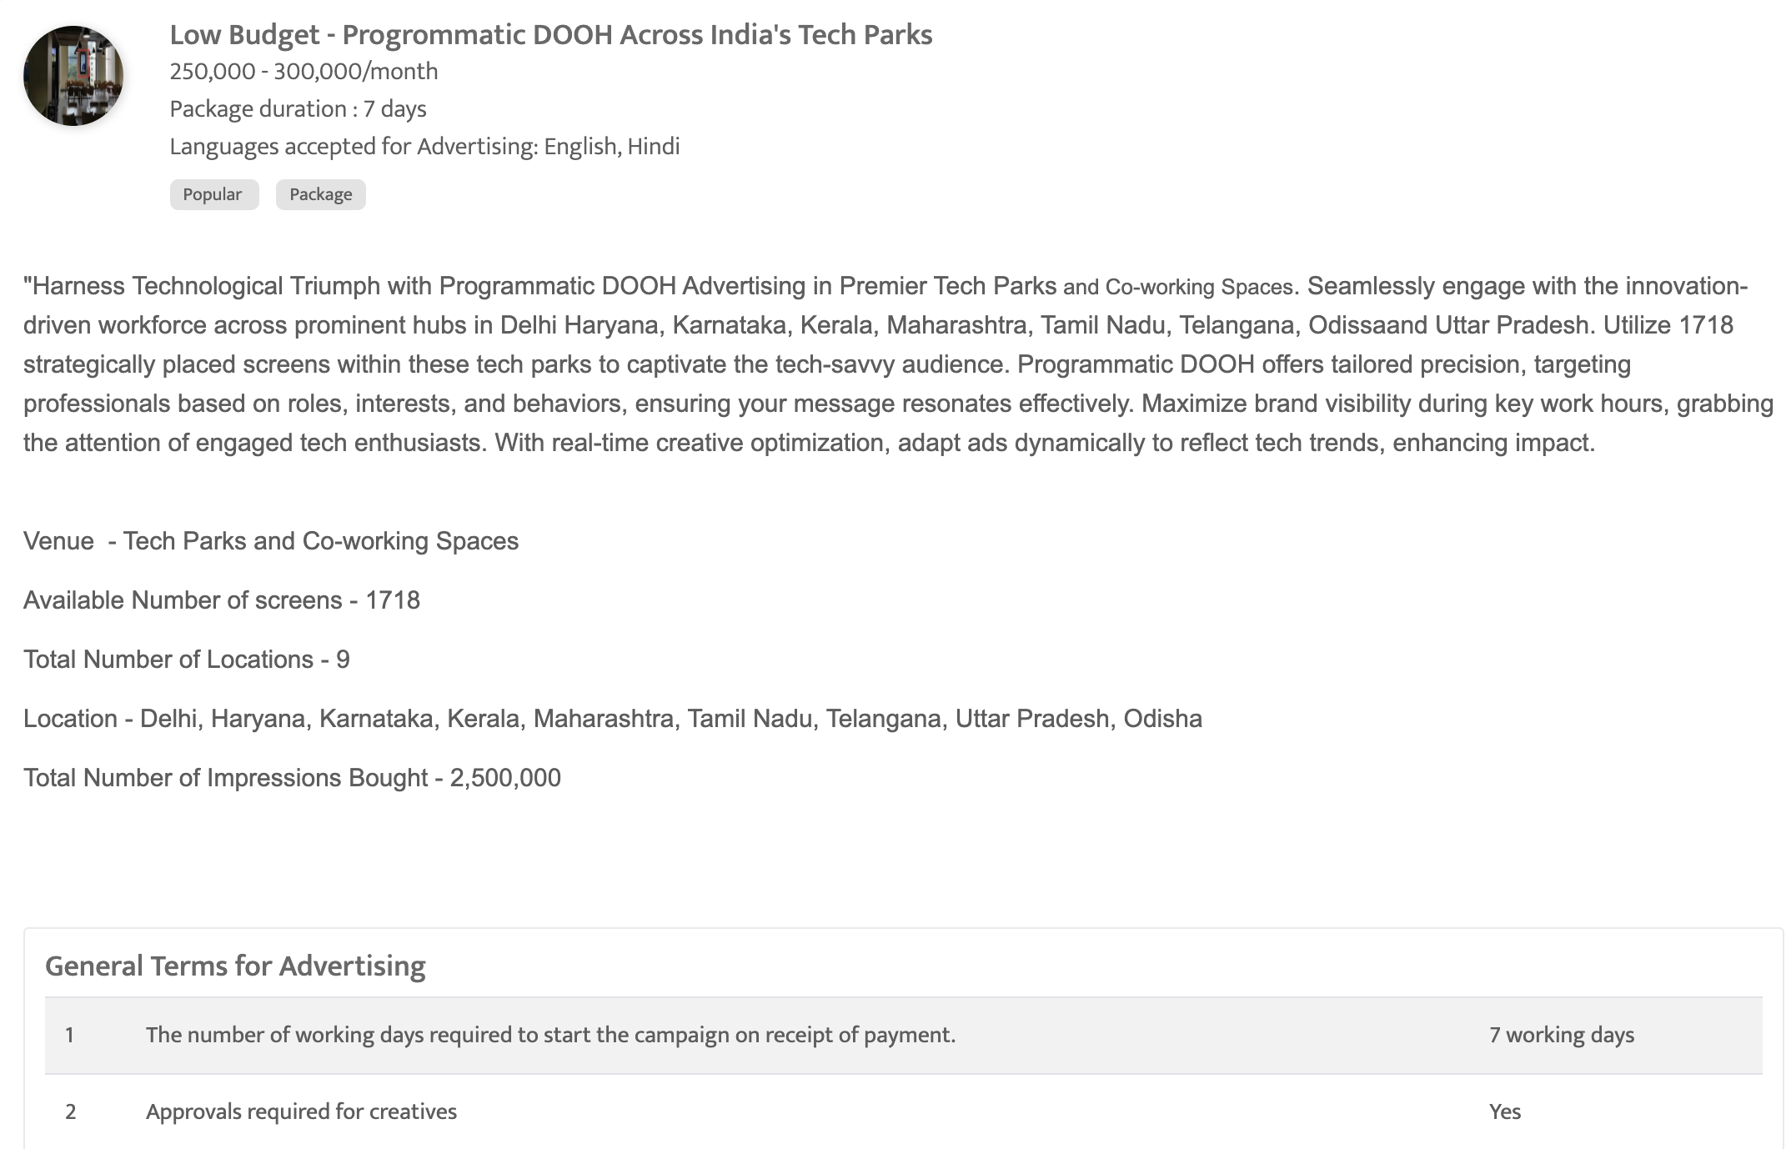

Slide 11
Thank You
media@masscomglobal.com | www.masscomglobal.com
Masscom Global FZE, Office No: 220, One UAQ Building, UAQ Free Trade Zone, Umm Al Quwain, United Arab Emirates.

