Slide 1
Premium Television Options

Slide 2
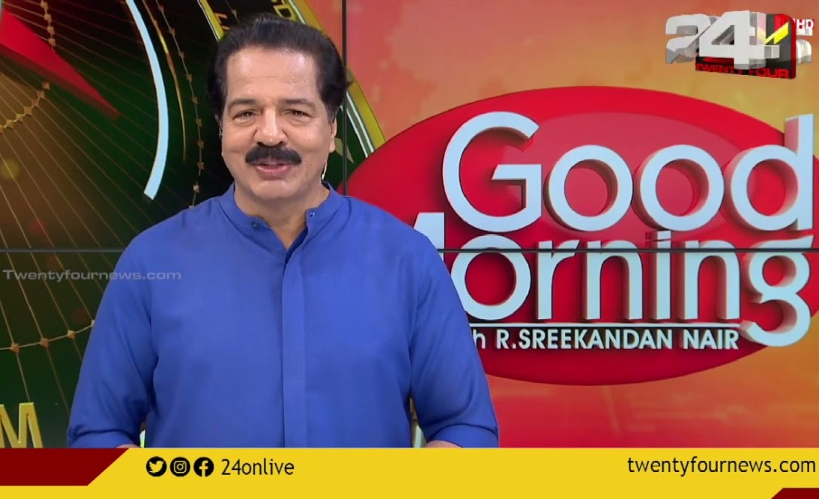
24 News - 10-Second ad Spot during 'Good Morning with Sreekandan Nair'

Slide 3
24 News - 10-Second ad Spot during 'Good Morning with Sreekandan Nair'
Rates and details
Time band: Morning
Spot Duration (seconds): 10 sec
Time: 07:00 - 10:00
Number of production: 1
One time production cost: USD 0.00
Rate/spot: Final Rates To Be Confirmed
Discounted rate: Final Rates To Be Confirmed
Number of spots required: 20
Sub Total: Final Rates To Be Confirmed

Slide 4
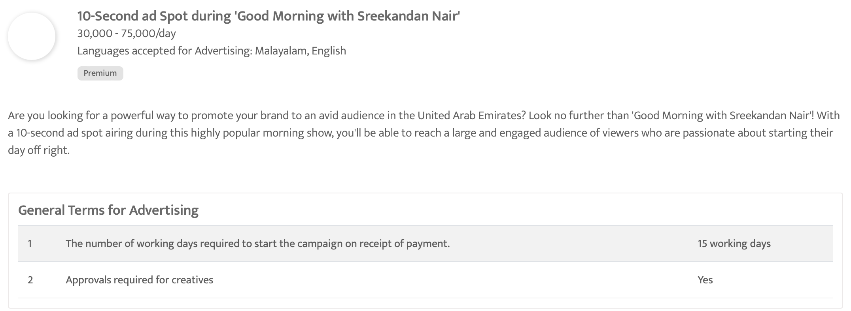

Slide 5
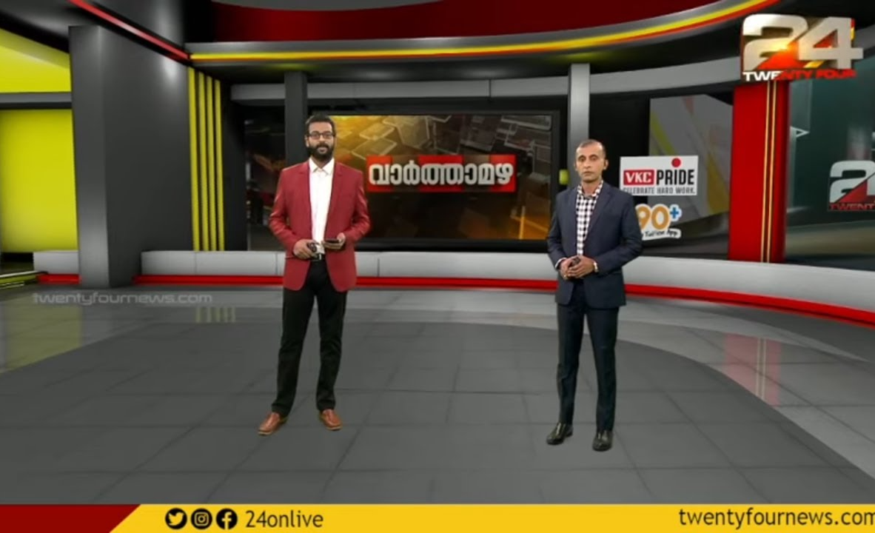
24 News - 10-Second ad Spot during Prime Time News Bulletin 'Varthamazha'

Slide 6
24 News - 10-Second ad Spot during Prime Time News Bulletin 'Varthamazha'
Rates and details
Time band: Night
Spot Duration (seconds): 10 sec
Time: 21:30 - 22:00
Number of production: 1
One time production cost: USD 0.00
Rate/spot: USD 40.84
Discounted rate: USD 36.75
Number of spots required: 20
Sub Total: USD 735.00

Slide 7
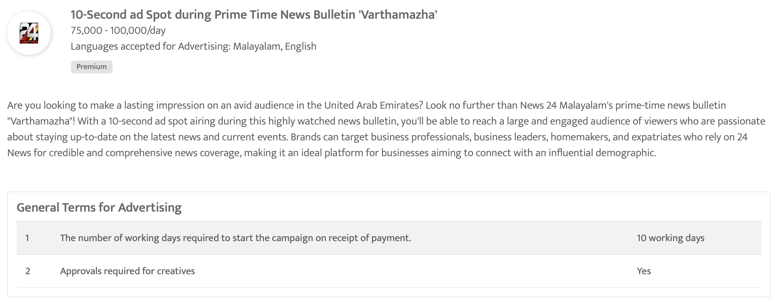

Slide 8

Sky News Arabia - 30 sec spot Ad during the evening show Radar Al Akhbar (LIVE)

Slide 9
Sky News Arabia - 30 sec spot Ad during the evening show Radar Al Akhbar (LIVE)
Rates and details
Time band: Evening
Spot Duration (seconds): 30 sec
Time: 18:00 - 18:45
Number of production: 1
One time production cost: USD 0.00
Rate/spot: USD 3000.00
Discounted rate: USD 2700.00
Number of spots required: 20
Sub Total: USD 54000.00

Slide 10
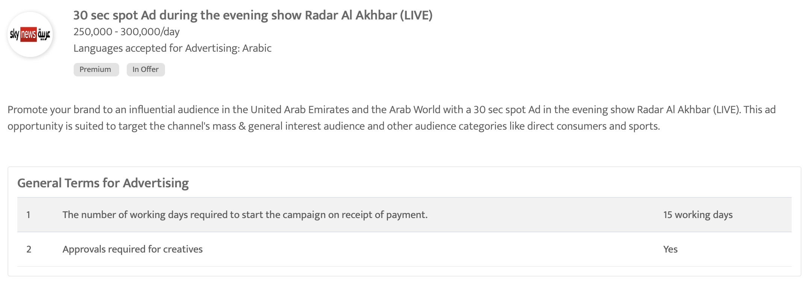

Slide 11

Sky News Arabia - 30 sec spot Ad in the night sports bulletin

Slide 12
Sky News Arabia - 30 sec spot Ad in the night sports bulletin
Rates and details
Time band: Night
Spot Duration (seconds): 30 sec
Time: 21:45 - 22:00
Number of production: 1
One time production cost: USD 0.00
Rate/spot: USD 3000.00
Discounted rate: USD 2700.00
Number of spots required: 20
Sub Total: USD 54000.00

Slide 13
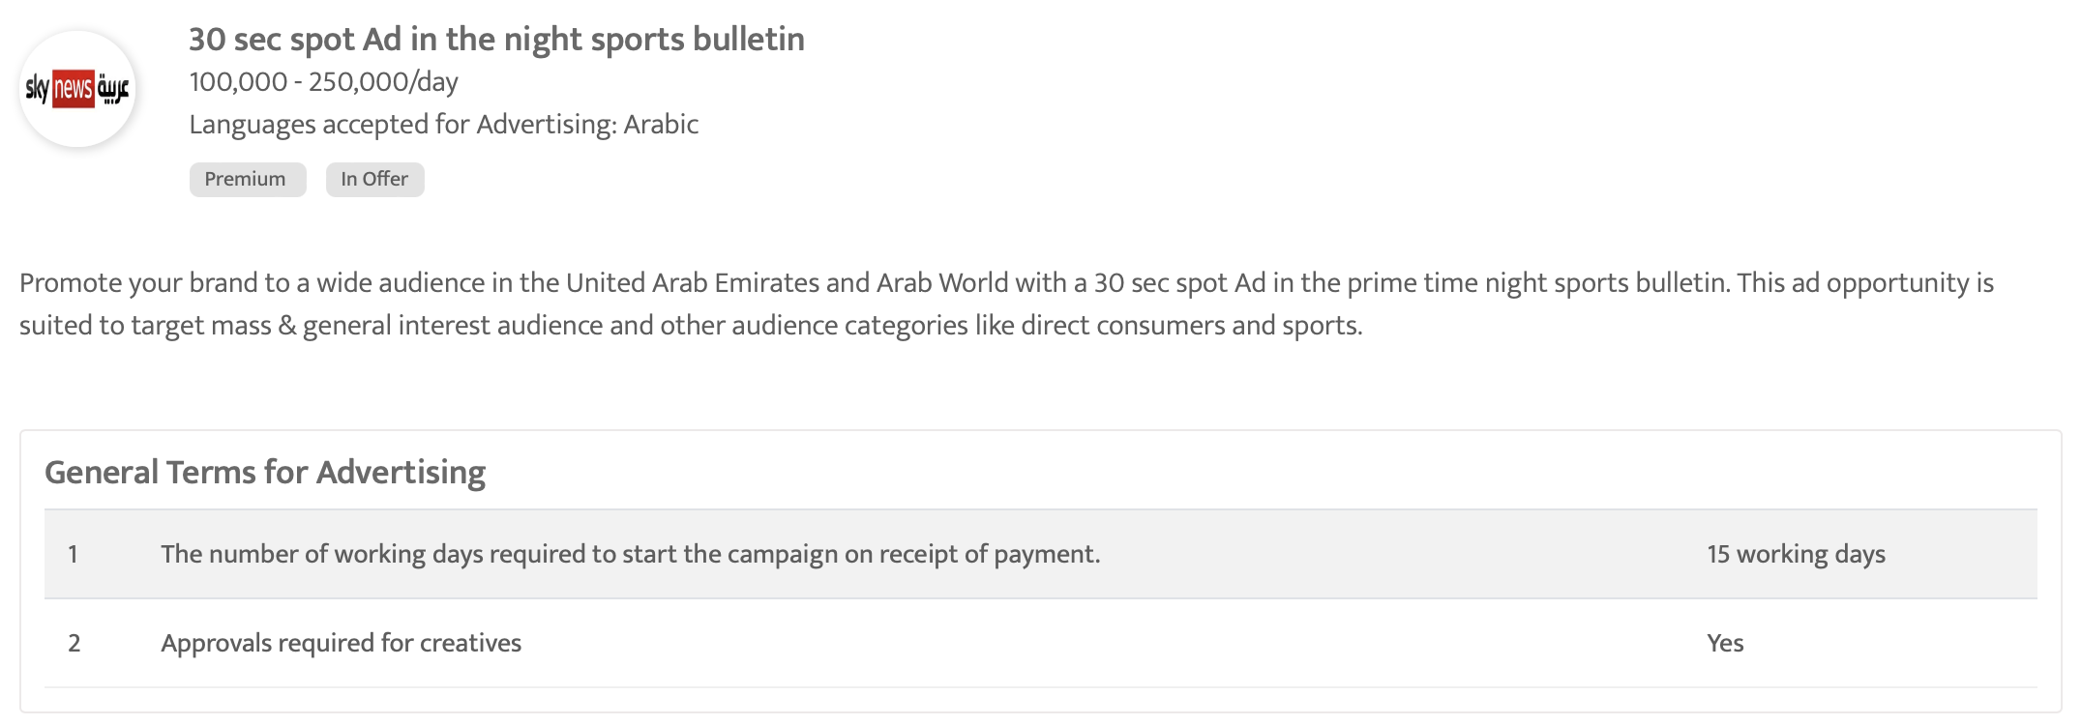

Slide 14
ZEE AFLAM - 30-Sec Ad Spot During Night Prime Time Bollywood Movies
Rates and details
Time band: Night
Spot Duration (seconds): 30 sec
Time: 19:00 - 21:30
Number of production: 1
One time production cost: USD 0.00
Rate/spot: USD 2041.94
Discounted rate: USD 1837.75
Number of spots required: 20
Sub Total: USD 36755.00

Slide 15
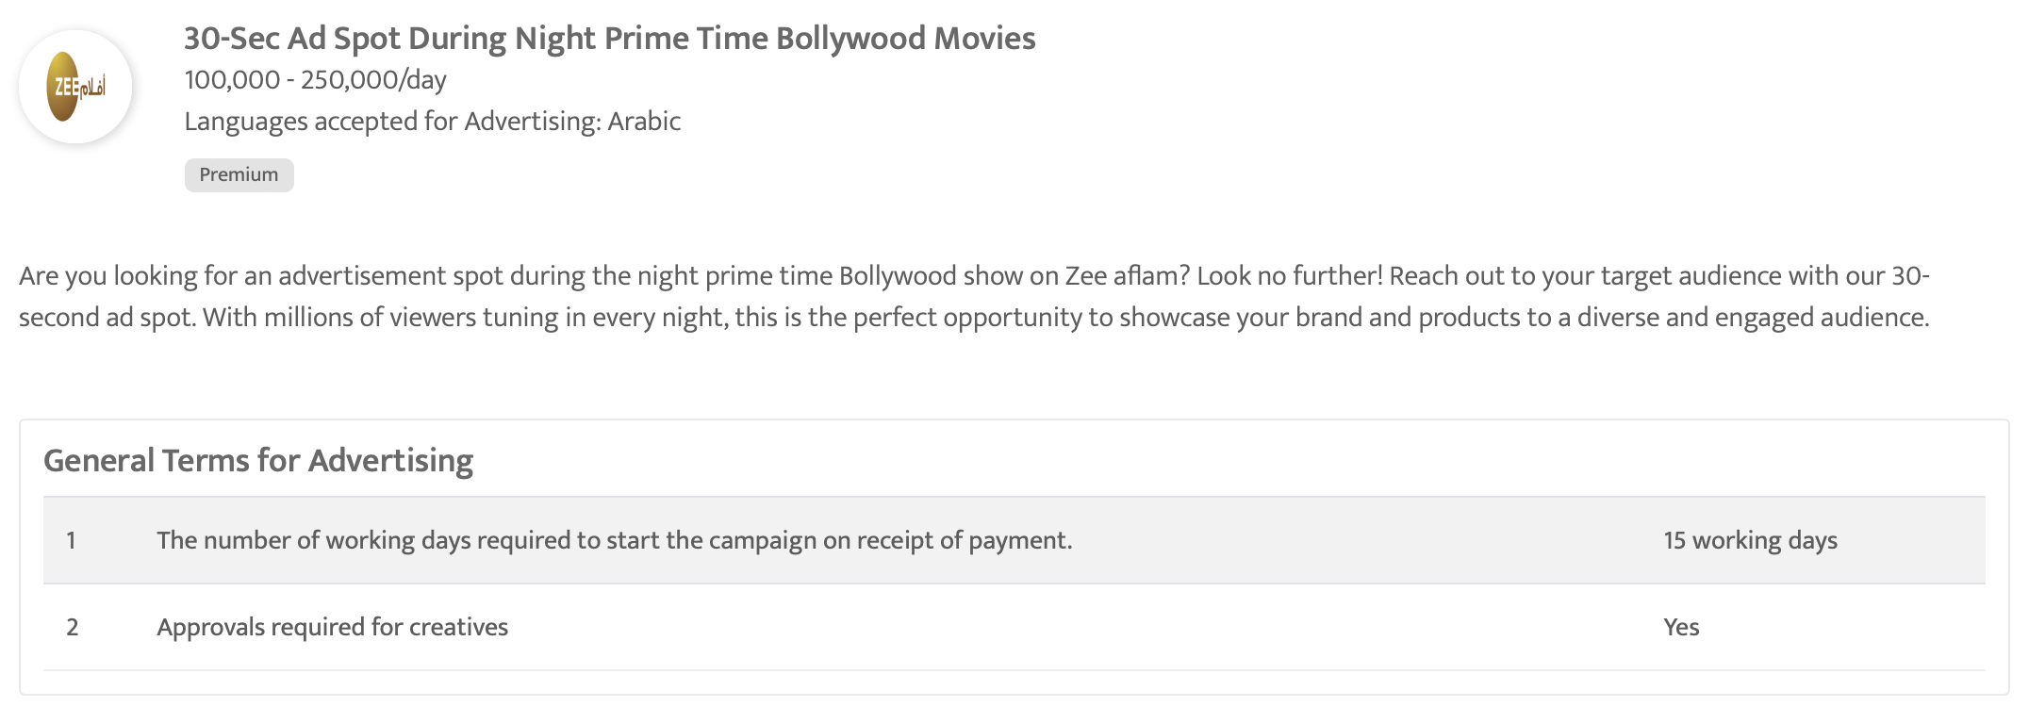

Slide 16
Colors ME - 30 sec Ad Spot During Prime Time Show
Rates and details
Time band: Night
Spot Duration (seconds): 30 sec
Time: 22:00 - 22:30
Number of production: 1
One time production cost: USD 0.00
Rate/spot: USD 600.00
Discounted rate: USD 540.00
Number of spots required: 20
Sub Total: USD 10800.00

Slide 17
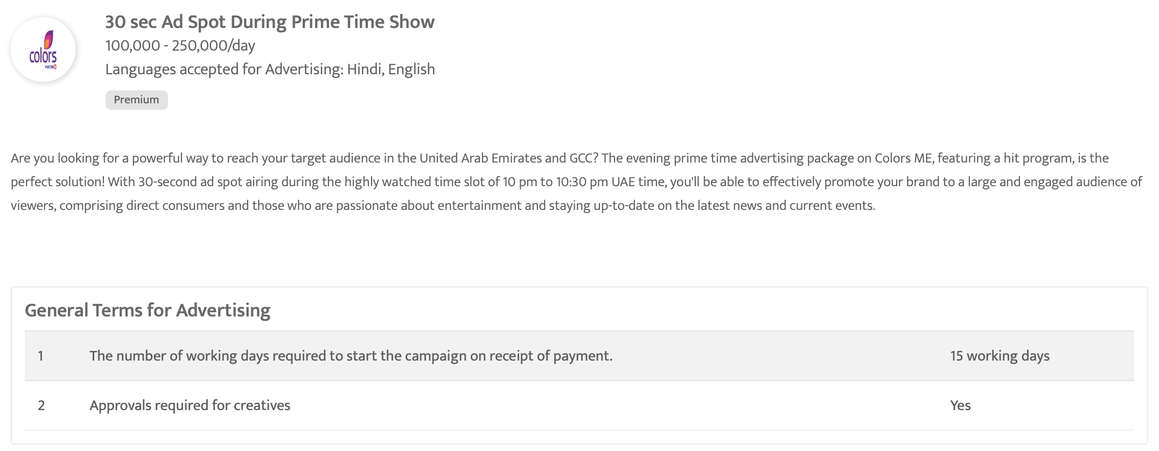

Slide 18

Mathrubhumi News - 30 Sec ad Spot during the evening prime time - Gulf Time

Slide 19
Mathrubhumi News - 30 Sec ad Spot during the evening prime time - Gulf Time
Rates and details
Time band: Evening
Spot Duration (seconds): 30 sec
Time: 21:30 - 23:59
Number of production: 1
One time production cost: USD 0.00
Rate/spot: USD 122.52
Discounted rate: USD 110.26
Number of spots required: 20
Sub Total: USD 2205.20

Slide 20
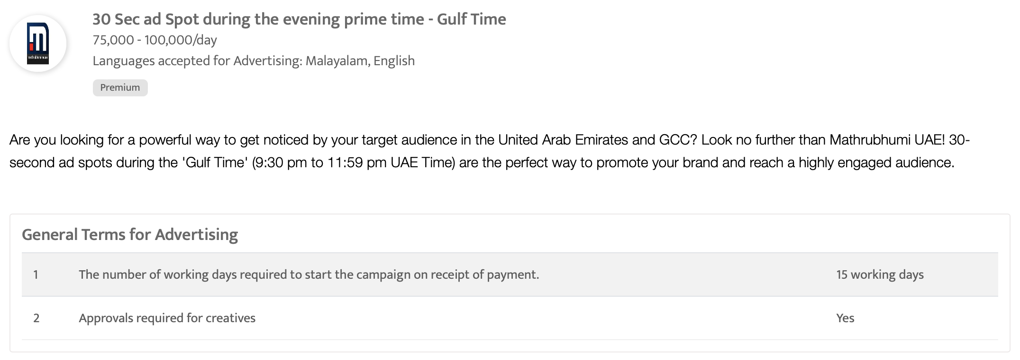

Slide 21

ZEE TV - 30 sec ad spot during the prime time show 'Pyar Ka Pehla Naam'

Slide 22
ZEE TV - 30 sec ad spot during the prime time show 'Pyar Ka Pehla Naam'
Rates and details
Time band: Night
Spot Duration (seconds): 30 sec
Time: 21:00 - 21:30
Number of production: 1
One time production cost: USD 0.00
Rate/spot: USD 1361.29
Discounted rate: USD 1225.16
Number of spots required: 20
Sub Total: USD 24503.20

Slide 23
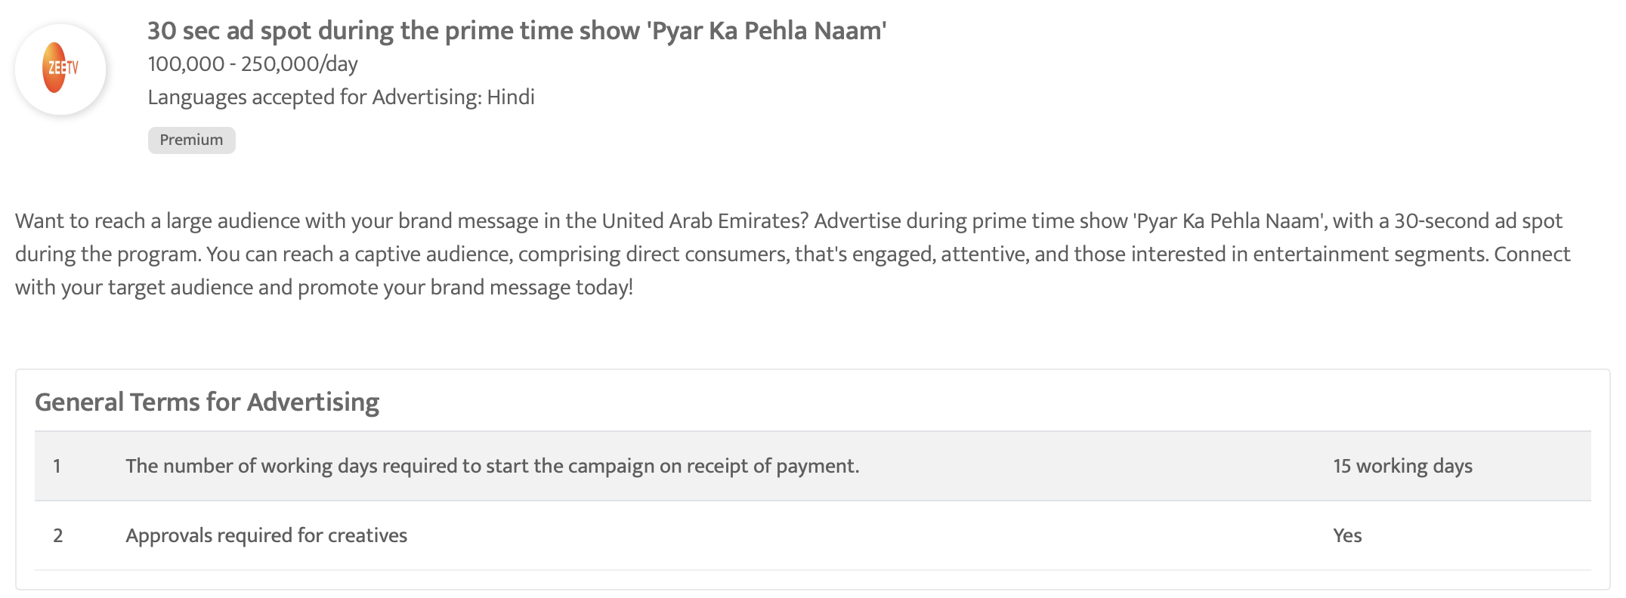

Slide 24

NDTV 24x7 English - 10 sec ad spot during evening prime time programs

Slide 25
NDTV 24x7 English - 10 sec ad spot during evening prime time programs
Rates and details
Time band: Evening
Spot Duration (seconds): 10 sec
Time: 19:00 - 23:00
Number of production: 1
One time production cost: USD 0.00
Rate/spot: USD 45.00
Discounted rate: USD 40.50
Number of spots required: 20
Sub Total: USD 810.00

Slide 26
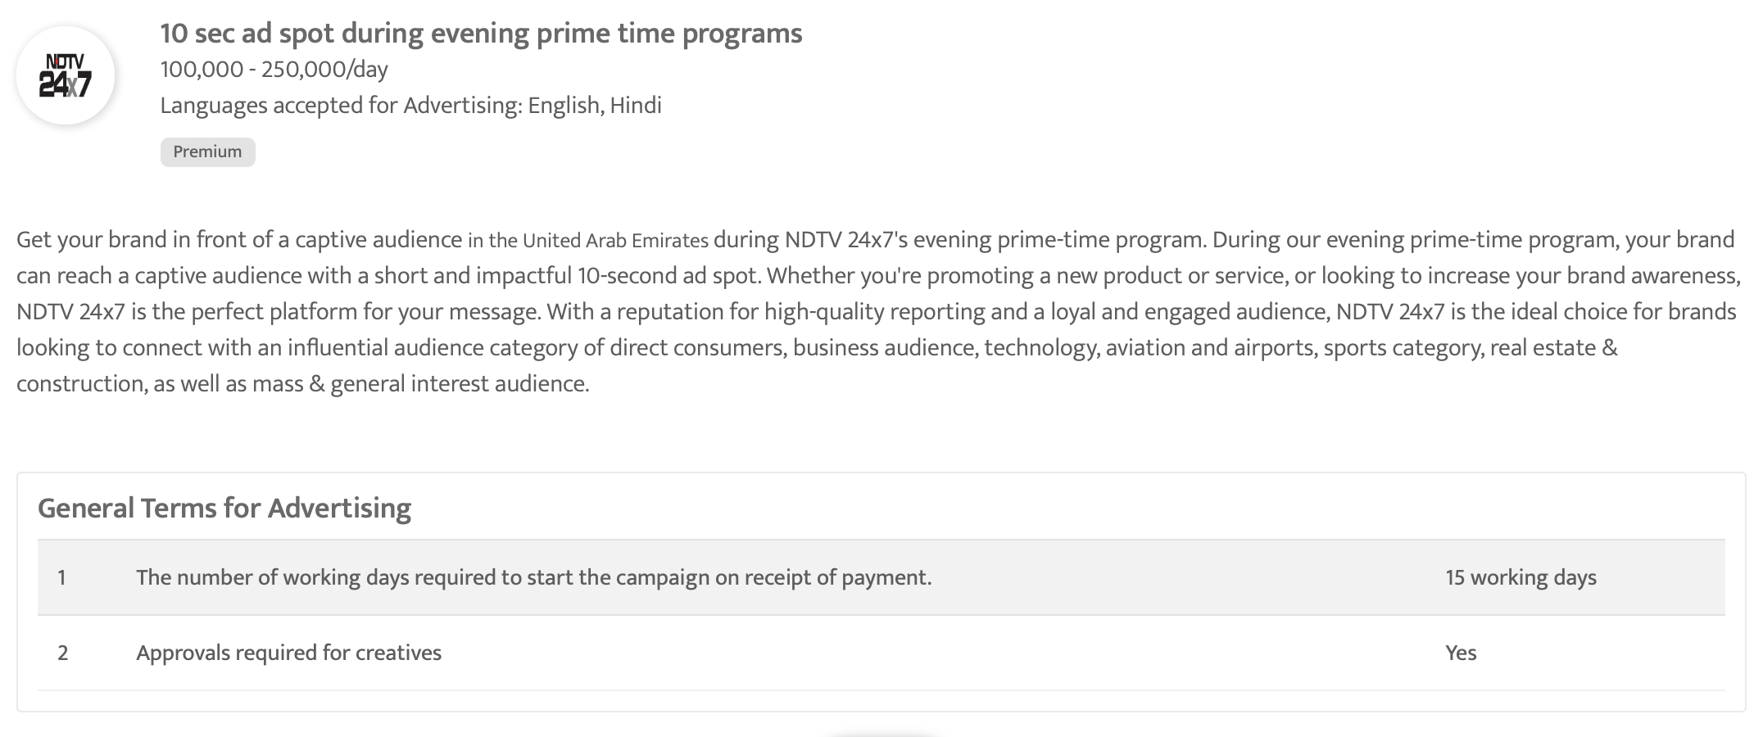

Slide 27
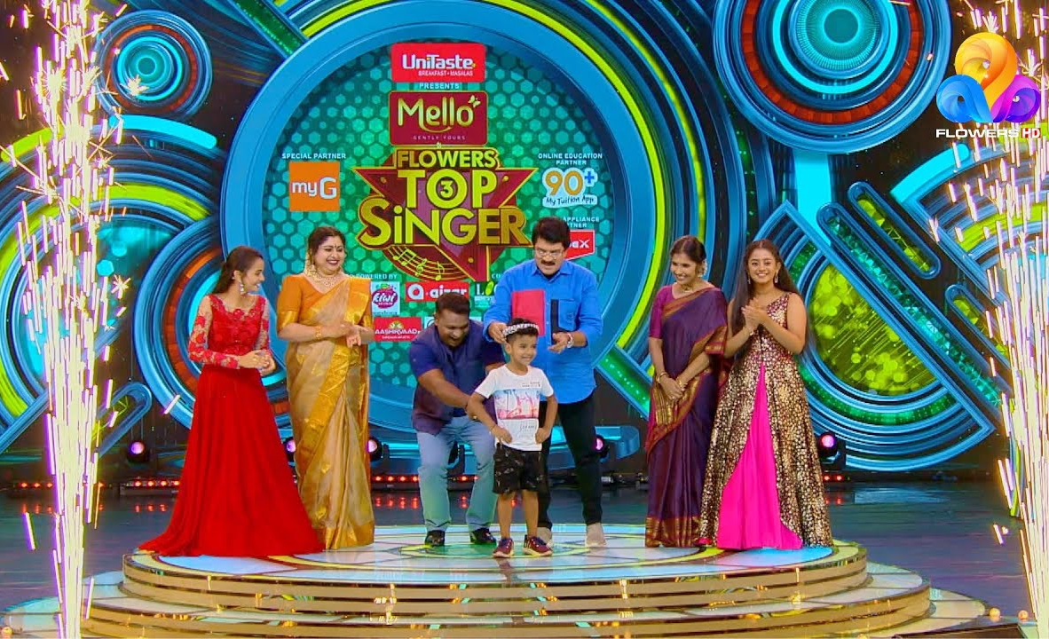
Flowers International Hd TV - 10-sec ad in the prime-time show 'Top singer'

Slide 28
Flowers International Hd TV - 10-sec ad in the prime-time show 'Top singer'
Rates and details
Time band: Night
Spot Duration (seconds): 10 sec
Time: 19:30 - 21:00
Number of production: 1
One time production cost: USD 0.00
Rate/spot: USD 118.98
Discounted rate: USD 107.08
Number of spots required: 20
Sub Total: USD 2141.60

Slide 29
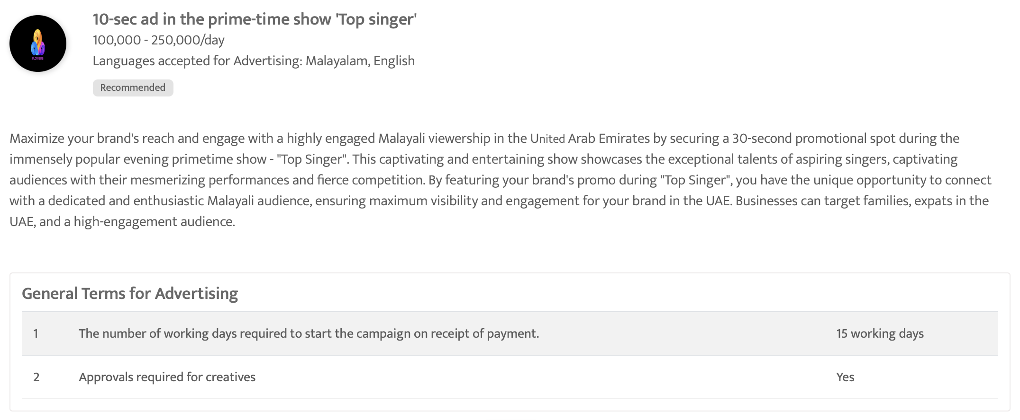

Slide 30

CNBC Arabia - 30 sec spot Ad during the morning business show 'Compass'

Slide 31
CNBC Arabia - 30 sec spot Ad during the morning business show 'Compass'
Rates and details
Time band: Morning
Spot Duration (seconds): 30 sec
Time: 09:30 - 14:30
Number of production: 1
One time production cost: USD 0.00
Rate/spot: USD 3500.00
Discounted rate: USD 3150.00
Number of spots required: 20
Sub Total: USD 63000.00

Slide 32
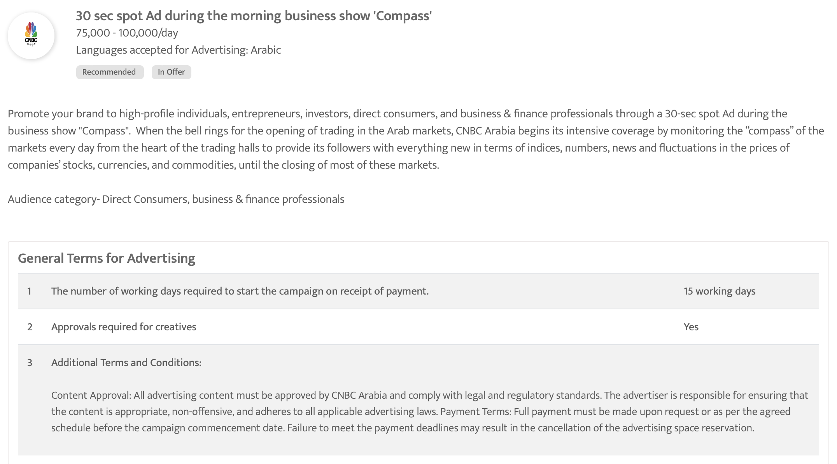

Slide 33

CNBC Arabia - 30 sec spot Ad during the show 'World Stock Exchanges'

Slide 34
CNBC Arabia - 30 sec spot Ad during the show 'World Stock Exchanges'
Rates and details
Time band: Afternoon
Spot Duration (seconds): 30 sec
Time: 17:30 - 18:00
Number of production: 1
One time production cost: USD 0.00
Rate/spot: USD 2000.00
Discounted rate: USD 1800.00
Number of spots required: 20
Sub Total: USD 36000.00

Slide 35
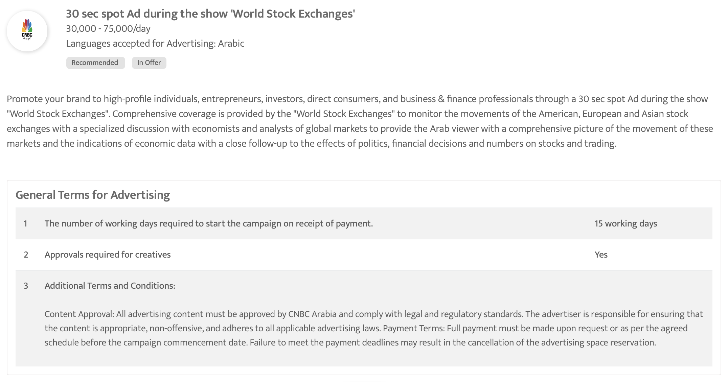

Slide 36

CNBC Arabia - 30 sec spot ad during the business show 'The Market Path'

Slide 37
CNBC Arabia - 30 sec spot ad during the business show 'The Market Path'
Rates and details
Time band: Afternoon
Spot Duration (seconds): 30 sec
Time: 14:30 - 15:00
Number of production: 1
One time production cost: USD 0.00
Rate/spot: USD 3500.00
Discounted rate: USD 3150.00
Number of spots required: 20
Sub Total: USD 63000.00

Slide 38
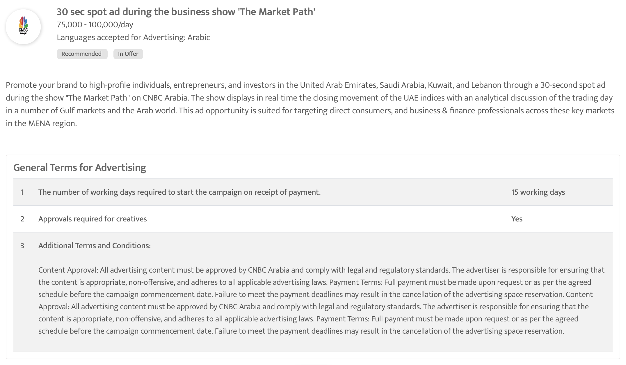

Slide 39

Sky News Arabia - 30 Sec Ad spot during the show 'News Room Debate'

Slide 40
Sky News Arabia - 30 Sec Ad spot during the show 'News Room Debate'
Rates and details
Time band: Night
Spot Duration (seconds): 30 sec
Time: 22:00 - 23:45
Number of production: 1
One time production cost: USD 0.00
Rate/spot: USD 3000.00
Discounted rate: USD 2700.00
Number of spots required: 20
Sub Total: USD 54000.00

Slide 41
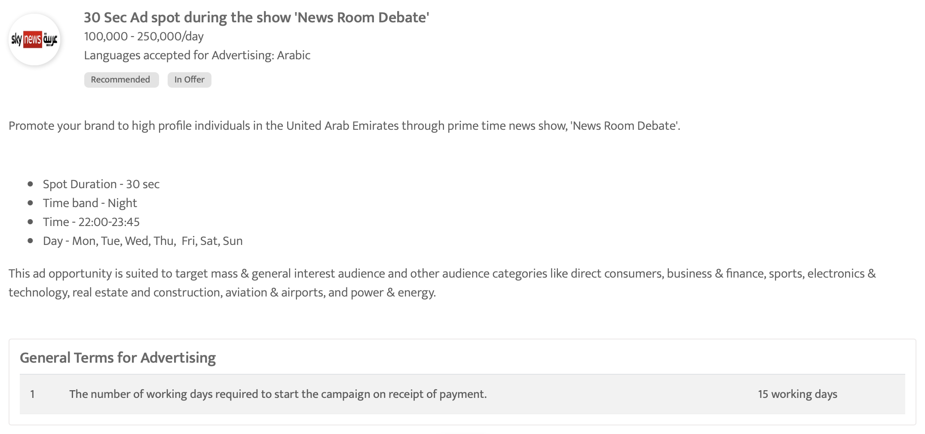

Slide 42
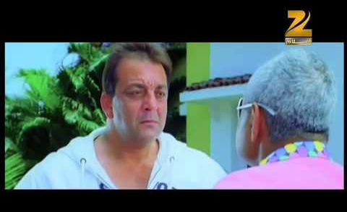
ZEE AFLAM - 30-Sec Ad Spot During Weekday Evening Prime Time Movie Shows

Slide 43
ZEE AFLAM - 30-Sec Ad Spot During Weekday Evening Prime Time Movie Shows
Rates and details
Time band: Evening
Spot Duration (seconds): 30 sec
Time: 16:00 - 18:30
Number of production: 1
One time production cost: USD 0.00
Rate/spot: USD 2041.93
Discounted rate: USD 1837.74
Number of spots required: 20
Sub Total: USD 36754.80

Slide 44
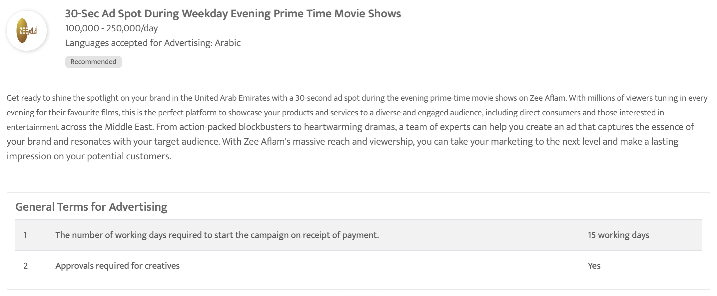

Slide 45

Asharq news bloomberg, United Arab Emirates - Evening Prime Time Programmes in Asharq news bloomberg, United Arab Emirates

Slide 46
Asharq news bloomberg, United Arab Emirates - Evening Prime Time Programmes in Asharq news bloomberg, United Arab Emirates
Rates and details
Time band: Evening
Spot Duration (seconds): 30 sec
Time: 06:00 - 10:00
Number of production: 1
One time production cost: USD 0.00
Rate/spot: Final Rates To Be Confirmed
Discounted rate: Final Rates To Be Confirmed
Number of spots required: 20
Sub Total: Final Rates To Be Confirmed

Slide 47
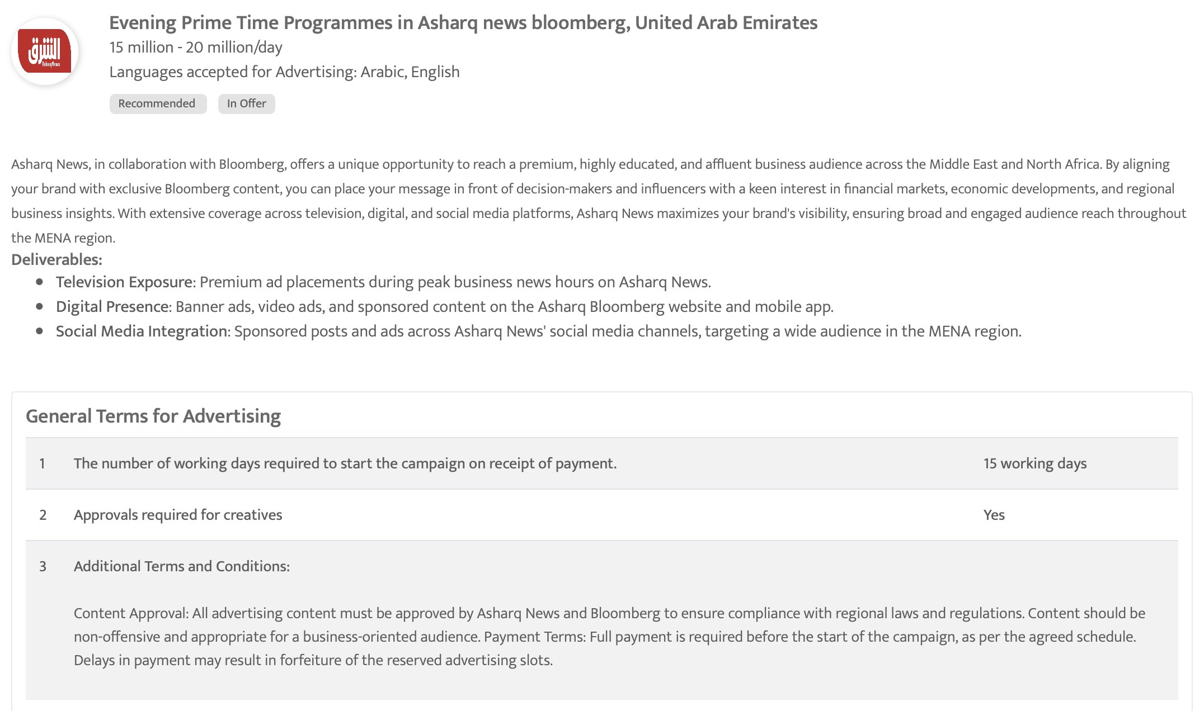

Slide 48

Dubai One, United Arab Emirates - Evening Prime Time Programmes, Dubai One, United Arab Emirates

Slide 49
Dubai One, United Arab Emirates - Evening Prime Time Programmes, Dubai One, United Arab Emirates
Rates and details
Time band: Evening
Spot Duration (seconds): 30 sec
Time: 21:00 - 22:00
Number of production: 1
One time production cost: USD 0.00
Rate/spot: Final Rates To Be Confirmed
Discounted rate: Final Rates To Be Confirmed
Number of spots required: 20
Sub Total: Final Rates To Be Confirmed

Slide 50
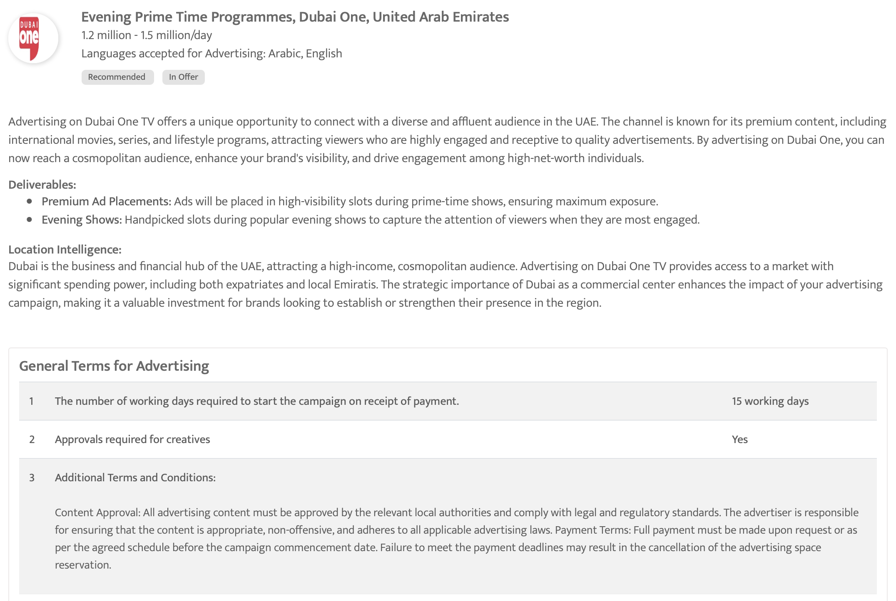

Slide 51
NDTV 24x7 English - 30 sec ad spot during night prime time programs

Slide 52
NDTV 24x7 English - 30 sec ad spot during night prime time programs
Rates and details
Time band: Night
Spot Duration (seconds): 30 sec
Time: 19:00 - 23:00
Number of production: 1
One time production cost: USD 0.00
Rate/spot: USD 151.00
Discounted rate: USD 135.90
Number of spots required: 20
Sub Total: USD 2718.00

Slide 53
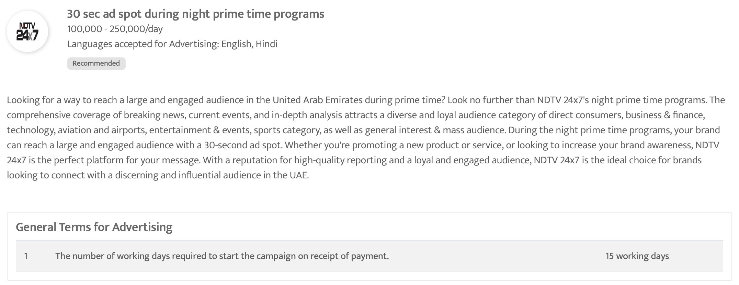

Slide 54

Media One - 10-sec ad spot during evening prime time program

Slide 55
Media One - 10-sec ad spot during evening prime time program
Rates and details
Time band: Night
Spot Duration (seconds): 10 sec
Time: 19:00 - 23:59
Number of production: 1
One time production cost: USD 0.00
Rate/spot: USD 68.06
Discounted rate: USD 61.26
Number of spots required: 20
Sub Total: USD 1225.20

Slide 56
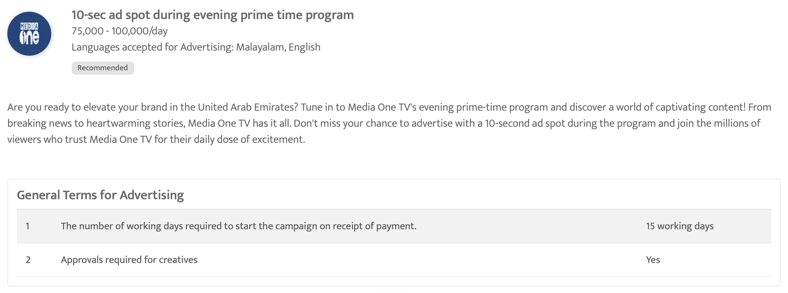

Slide 57

Bloomberg Middle East, United Arab Emirates - Evening Prime Time Programmes in Bloomberg Middle East, United Arab Emirates

Slide 58
Bloomberg Middle East, United Arab Emirates - Evening Prime Time Programmes in Bloomberg Middle East, United Arab Emirates
Rates and details
Time band: Evening
Spot Duration (seconds): 30 sec
Time: 18:00 - 22:00
Number of production: 1
One time production cost: USD 0.00
Rate/spot: Final Rates To Be Confirmed
Discounted rate: Final Rates To Be Confirmed
Number of spots required: 20
Sub Total: Final Rates To Be Confirmed

Slide 59
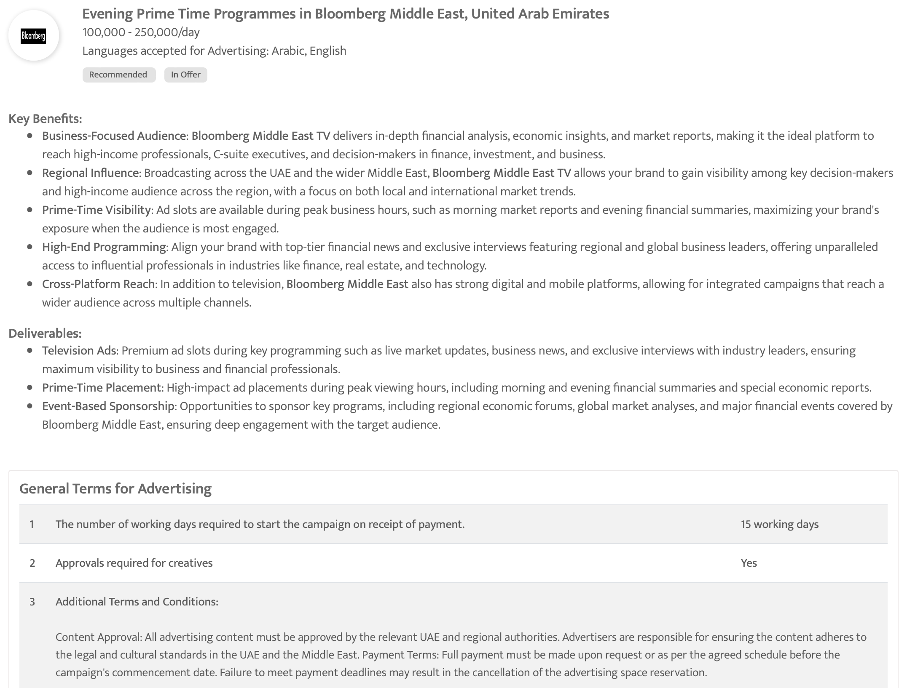

Slide 60

Wion TV - 30-sec ad spot during the award winning show 'Gravitas'

Slide 61
Wion TV - 30-sec ad spot during the award winning show 'Gravitas'
Rates and details
Time band: Night
Spot Duration (seconds): 30 sec
Time: 21:00 - 22:00
Number of production: 1
One time production cost: USD 0.00
Rate/spot: USD 500.00
Discounted rate: USD 450.00
Number of spots required: 20
Sub Total: USD 9000.00

Slide 62
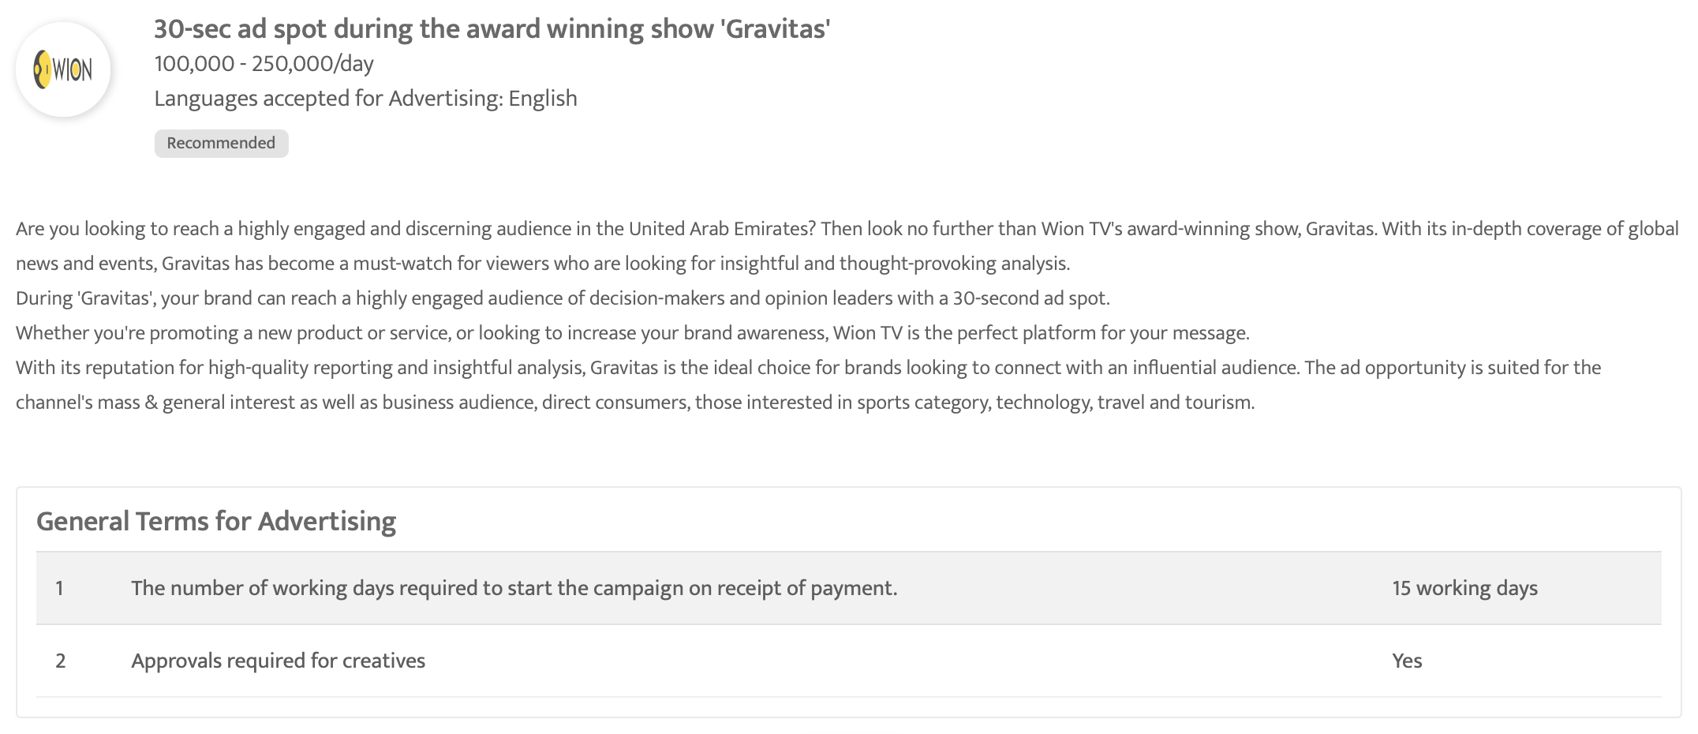

Slide 63

Al Arabiya, United Arab Emirates - Evening Prime Time Programmes in Al Arabiya, United Arab Emirates

Slide 64
Al Arabiya, United Arab Emirates - Evening Prime Time Programmes in Al Arabiya, United Arab Emirates
Rates and details
Time band: Evening
Spot Duration (seconds): 30 sec
Time: 21:00 - 22:00
Number of production: 1
One time production cost: USD 0.00
Rate/spot: Final Rates To Be Confirmed
Discounted rate: Final Rates To Be Confirmed
Number of spots required: 20
Sub Total: Final Rates To Be Confirmed

Slide 65
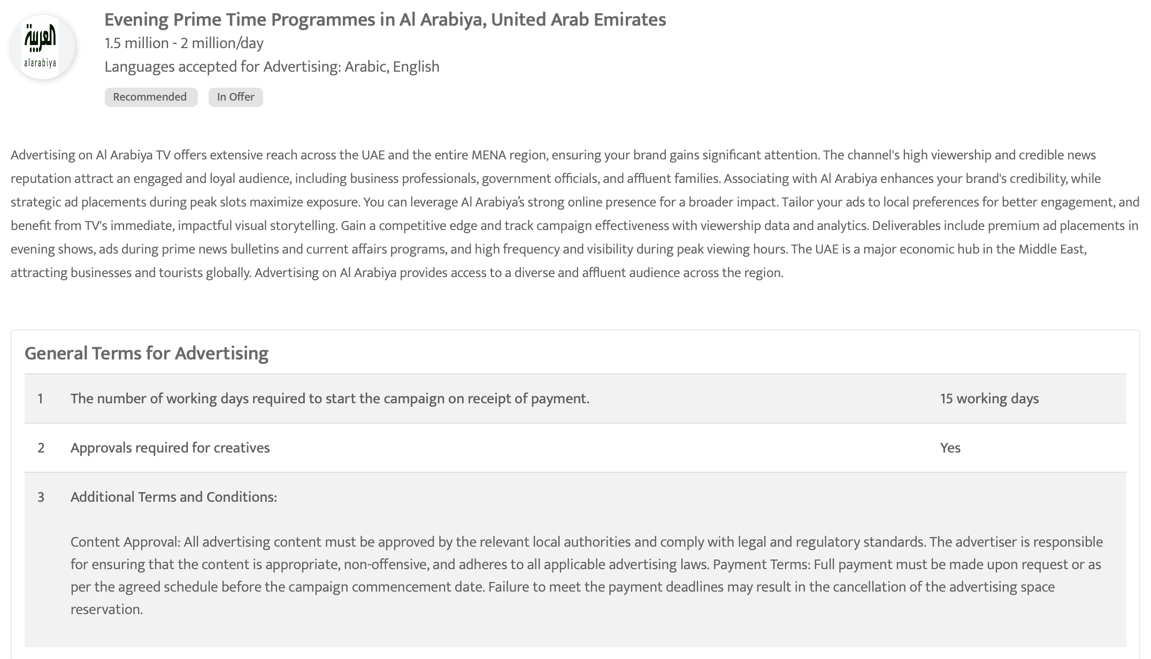

Slide 66

Zee Alwan - 30-Sec ad spot during night prime time program 'Qafas Dahabi'

Slide 67
Zee Alwan - 30-Sec ad spot during night prime time program 'Qafas Dahabi'
Rates and details
Time band: Night
Spot Duration (seconds): 30 sec
Time: 21:00 - 21:30
Number of production: 1
One time production cost: USD 0.00
Rate/spot: USD 1633.55
Discounted rate: USD 1470.19
Number of spots required: 20
Sub Total: USD 29403.80

Slide 68
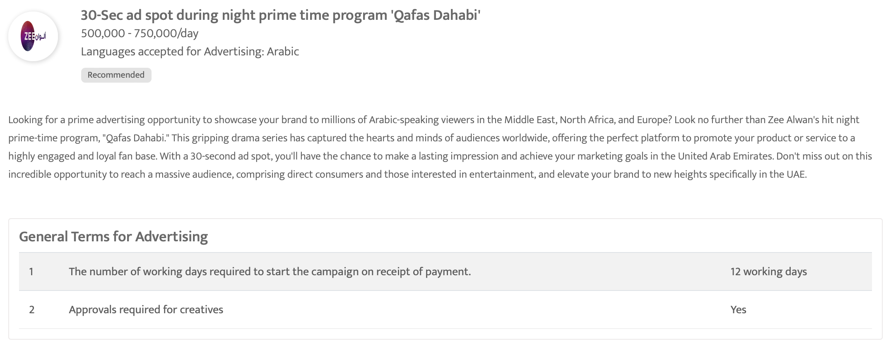

Slide 69

PTC Chak De - 30 sec spot Ad during the show 'Chak De Hits'

Slide 70
PTC Chak De - 30 sec spot Ad during the show 'Chak De Hits'
Rates and details
Time band: Evening
Spot Duration (seconds): 30 sec
Time: 17:00 - 23:00
Number of production: 1
One time production cost: USD 0.00
Rate/spot: USD 80.00
Discounted rate: USD 72.00
Number of spots required: 20
Sub Total: USD 1440.00

Slide 71
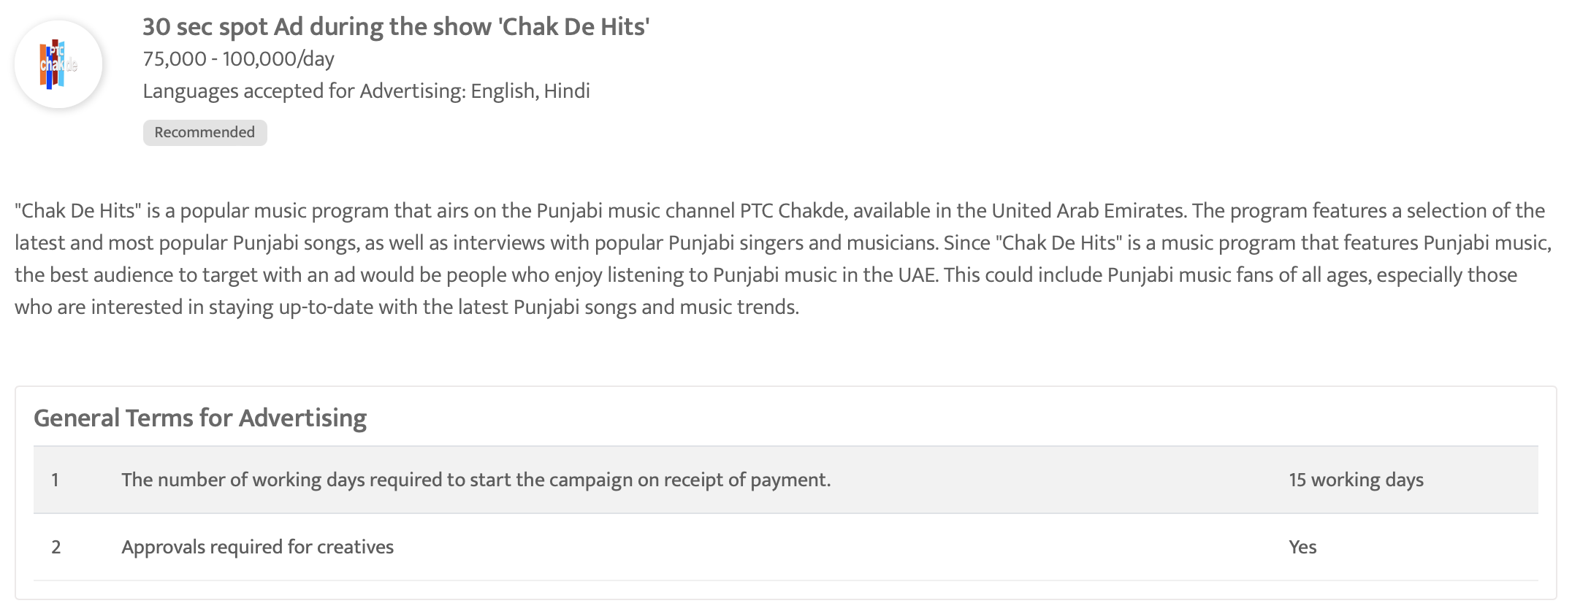

Slide 72
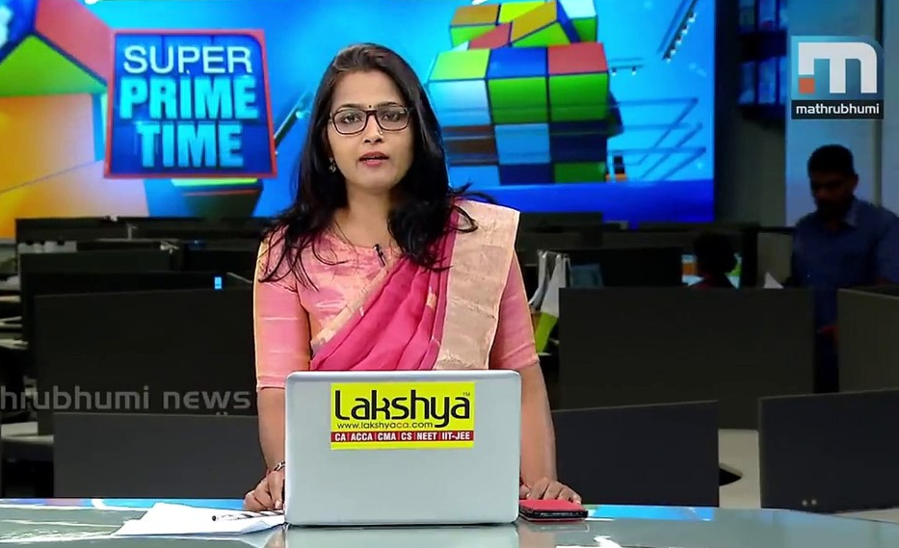
Mathrubhumi News - 30 Sec spot Ad during the Super Prime Time

Slide 73
Mathrubhumi News - 30 Sec spot Ad during the Super Prime Time
Rates and details
Time band: Night
Spot Duration (seconds): 30 sec
Time: 18:30 - 19:30
Number of production: 1
One time production cost: USD 0.00
Rate/spot: USD 408.39
Discounted rate: USD 367.55
Number of spots required: 20
Sub Total: USD 7351.00

Slide 74
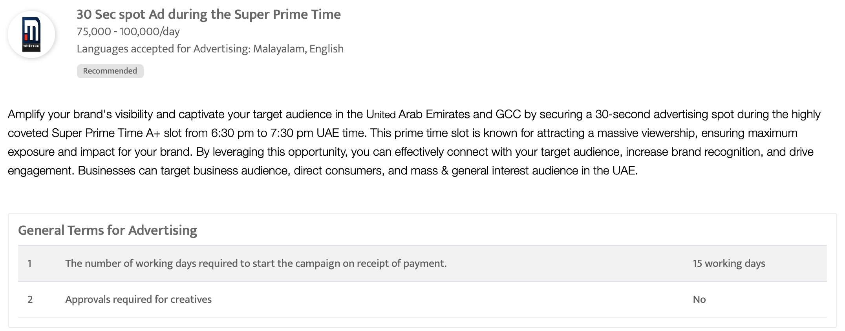

Slide 75

Zee Alwan - 30-sec ad spot during night prime time program 'Khafaya Alqoloub'

Slide 76
Zee Alwan - 30-sec ad spot during night prime time program 'Khafaya Alqoloub'
Rates and details
Time band: Night
Spot Duration (seconds): 30 sec
Time: 22:10 - 22:30
Number of production: 1
One time production cost: USD 0.00
Rate/spot: USD 2722.58
Discounted rate: USD 2450.32
Number of spots required: 20
Sub Total: USD 49006.40

Slide 77
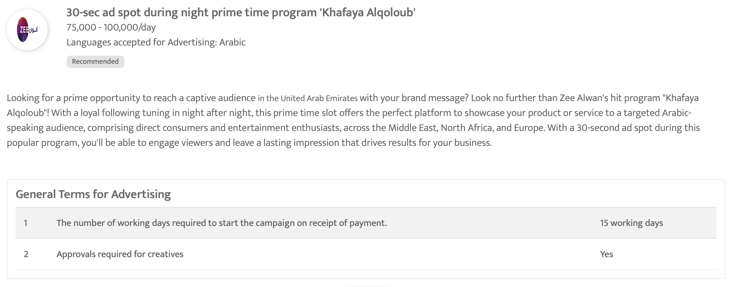

Slide 78
ZEE KERALAM - 30Sec ad spot during night prime time show "Mrs. Hitler"
Rates and details
Time band: Evening
Spot Duration (seconds): 30 sec
Time: 20:30 - 21:00
Number of production: 1
One time production cost: USD 0.00
Rate/spot: Final Rates To Be Confirmed
Discounted rate: Final Rates To Be Confirmed
Number of spots required: 20
Sub Total: Final Rates To Be Confirmed

Slide 79
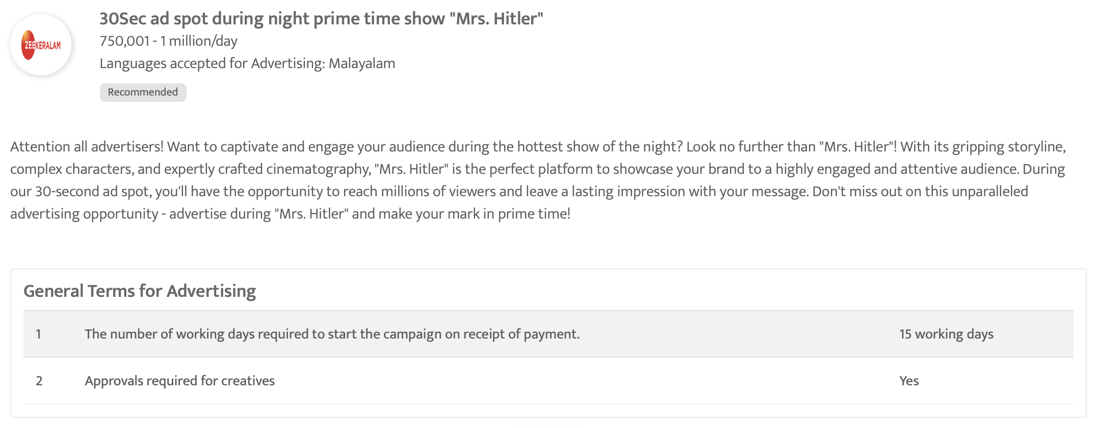

Slide 80
Recommended Television OOH

Slide 81
Flowers International Hd TV - 10-sec ad in the prime-time show 'Top singer'
Rates and details
Time band: Night
Spot Duration (seconds): 10 sec
Time: 19:30 - 21:00
Number of production: 1
One time production cost: USD 0.00
Rate/spot: USD 118.98
Discounted rate: USD 107.08
Number of spots required: 20
Sub Total: USD 2141.60

Slide 83
CNBC Arabia - 30 sec spot Ad during the morning business show 'Compass'

Slide 84
CNBC Arabia - 30 sec spot Ad during the morning business show 'Compass'
Rates and details
Time band: Morning
Spot Duration (seconds): 30 sec
Time: 09:30 - 14:30
Number of production: 1
One time production cost: USD 0.00
Rate/spot: USD 3500.00
Discounted rate: USD 3150.00
Number of spots required: 20
Sub Total: USD 63000.00

Slide 86
CNBC Arabia - 30 sec spot Ad during the show 'World Stock Exchanges'
Rates and details
Time band: Afternoon
Spot Duration (seconds): 30 sec
Time: 17:30 - 18:00
Number of production: 1
One time production cost: USD 0.00
Rate/spot: USD 2000.00
Discounted rate: USD 1800.00
Number of spots required: 20
Sub Total: USD 36000.00

Slide 88
CNBC Arabia - 30 sec spot ad during the business show 'The Market Path'
Rates and details
Time band: Afternoon
Spot Duration (seconds): 30 sec
Time: 14:30 - 15:00
Number of production: 1
One time production cost: USD 0.00
Rate/spot: USD 3500.00
Discounted rate: USD 3150.00
Number of spots required: 20
Sub Total: USD 63000.00

Slide 90
Sky News Arabia - 30 Sec Ad spot during the show 'News Room Debate'
Rates and details
Time band: Night
Spot Duration (seconds): 30 sec
Time: 22:00 - 23:45
Number of production: 1
One time production cost: USD 0.00
Rate/spot: USD 3000.00
Discounted rate: USD 2700.00
Number of spots required: 20
Sub Total: USD 54000.00

Slide 92
ZEE AFLAM - 30-Sec Ad Spot During Weekday Evening Prime Time Movie Shows
Rates and details
Time band: Evening
Spot Duration (seconds): 30 sec
Time: 16:00 - 18:30
Number of production: 1
One time production cost: USD 0.00
Rate/spot: USD 2041.93
Discounted rate: USD 1837.74
Number of spots required: 20
Sub Total: USD 36754.80

Slide 94
Asharq news bloomberg, United Arab Emirates - Evening Prime Time Programmes in Asharq news bloomberg, United Arab Emirates

Slide 95
Asharq news bloomberg, United Arab Emirates - Evening Prime Time Programmes in Asharq news bloomberg, United Arab Emirates
Rates and details
Time band: Evening
Spot Duration (seconds): 30 sec
Time: 06:00 - 10:00
Number of production: 1
One time production cost: USD 0.00
Rate/spot: Final Rates To Be Confirmed
Discounted rate: Final Rates To Be Confirmed
Number of spots required: 20
Sub Total: Final Rates To Be Confirmed

Slide 97
Dubai One, United Arab Emirates - Evening Prime Time Programmes, Dubai One, United Arab Emirates

Slide 98
Dubai One, United Arab Emirates - Evening Prime Time Programmes, Dubai One, United Arab Emirates
Rates and details
Time band: Evening
Spot Duration (seconds): 30 sec
Time: 21:00 - 22:00
Number of production: 1
One time production cost: USD 0.00
Rate/spot: Final Rates To Be Confirmed
Discounted rate: Final Rates To Be Confirmed
Number of spots required: 20
Sub Total: Final Rates To Be Confirmed

Slide 100
NDTV 24x7 English - 30 sec ad spot during night prime time programs

Slide 101
NDTV 24x7 English - 30 sec ad spot during night prime time programs
Rates and details
Time band: Night
Spot Duration (seconds): 30 sec
Time: 19:00 - 23:00
Number of production: 1
One time production cost: USD 0.00
Rate/spot: USD 151.00
Discounted rate: USD 135.90
Number of spots required: 20
Sub Total: USD 2718.00

Slide 103
Media One - 10-sec ad spot during evening prime time program

Slide 104
Media One - 10-sec ad spot during evening prime time program
Rates and details
Time band: Night
Spot Duration (seconds): 10 sec
Time: 19:00 - 23:59
Number of production: 1
One time production cost: USD 0.00
Rate/spot: USD 68.06
Discounted rate: USD 61.26
Number of spots required: 20
Sub Total: USD 1225.20

Slide 106
Bloomberg Middle East, United Arab Emirates - Evening Prime Time Programmes in Bloomberg Middle East, United Arab Emirates

Slide 107
Bloomberg Middle East, United Arab Emirates - Evening Prime Time Programmes in Bloomberg Middle East, United Arab Emirates
Rates and details
Time band: Evening
Spot Duration (seconds): 30 sec
Time: 18:00 - 22:00
Number of production: 1
One time production cost: USD 0.00
Rate/spot: Final Rates To Be Confirmed
Discounted rate: Final Rates To Be Confirmed
Number of spots required: 20
Sub Total: Final Rates To Be Confirmed

Slide 109
Wion TV - 30-sec ad spot during the award winning show 'Gravitas'

Slide 110
Wion TV - 30-sec ad spot during the award winning show 'Gravitas'
Rates and details
Time band: Night
Spot Duration (seconds): 30 sec
Time: 21:00 - 22:00
Number of production: 1
One time production cost: USD 0.00
Rate/spot: USD 500.00
Discounted rate: USD 450.00
Number of spots required: 20
Sub Total: USD 9000.00

Slide 112
Al Arabiya, United Arab Emirates - Evening Prime Time Programmes in Al Arabiya, United Arab Emirates

Slide 113
Al Arabiya, United Arab Emirates - Evening Prime Time Programmes in Al Arabiya, United Arab Emirates
Rates and details
Time band: Evening
Spot Duration (seconds): 30 sec
Time: 21:00 - 22:00
Number of production: 1
One time production cost: USD 0.00
Rate/spot: Final Rates To Be Confirmed
Discounted rate: Final Rates To Be Confirmed
Number of spots required: 20
Sub Total: Final Rates To Be Confirmed

Slide 115
Zee Alwan - 30-Sec ad spot during night prime time program 'Qafas Dahabi'

Slide 116
Zee Alwan - 30-Sec ad spot during night prime time program 'Qafas Dahabi'
Rates and details
Time band: Night
Spot Duration (seconds): 30 sec
Time: 21:00 - 21:30
Number of production: 1
One time production cost: USD 0.00
Rate/spot: USD 1633.55
Discounted rate: USD 1470.19
Number of spots required: 20
Sub Total: USD 29403.80

Slide 118
PTC Chak De - 30 sec spot Ad during the show 'Chak De Hits'

Slide 119
PTC Chak De - 30 sec spot Ad during the show 'Chak De Hits'
Rates and details
Time band: Evening
Spot Duration (seconds): 30 sec
Time: 17:00 - 23:00
Number of production: 1
One time production cost: USD 0.00
Rate/spot: USD 80.00
Discounted rate: USD 72.00
Number of spots required: 20
Sub Total: USD 1440.00

Slide 121
Mathrubhumi News - 30 Sec spot Ad during the Super Prime Time

Slide 122
Mathrubhumi News - 30 Sec spot Ad during the Super Prime Time
Rates and details
Time band: Night
Spot Duration (seconds): 30 sec
Time: 18:30 - 19:30
Number of production: 1
One time production cost: USD 0.00
Rate/spot: USD 408.39
Discounted rate: USD 367.55
Number of spots required: 20
Sub Total: USD 7351.00

Slide 124
Zee Alwan - 30-sec ad spot during night prime time program 'Khafaya Alqoloub'
Rates and details
Time band: Night
Spot Duration (seconds): 30 sec
Time: 22:10 - 22:30
Number of production: 1
One time production cost: USD 0.00
Rate/spot: USD 2722.58
Discounted rate: USD 2450.32
Number of spots required: 20
Sub Total: USD 49006.40

Slide 126
ZEE KERALAM - 30Sec ad spot during night prime time show "Mrs. Hitler"
Rates and details
Time band: Evening
Spot Duration (seconds): 30 sec
Time: 20:30 - 21:00
Number of production: 1
One time production cost: USD 0.00
Rate/spot: Final Rates To Be Confirmed
Discounted rate: Final Rates To Be Confirmed
Number of spots required: 20
Sub Total: Final Rates To Be Confirmed

Slide 128
Thank You

