Slide 1

Powering Brands in the UAE : High-Impact Print Solution and Home Page Takeover

Slide 2
Premium Print Solution

Slide 3
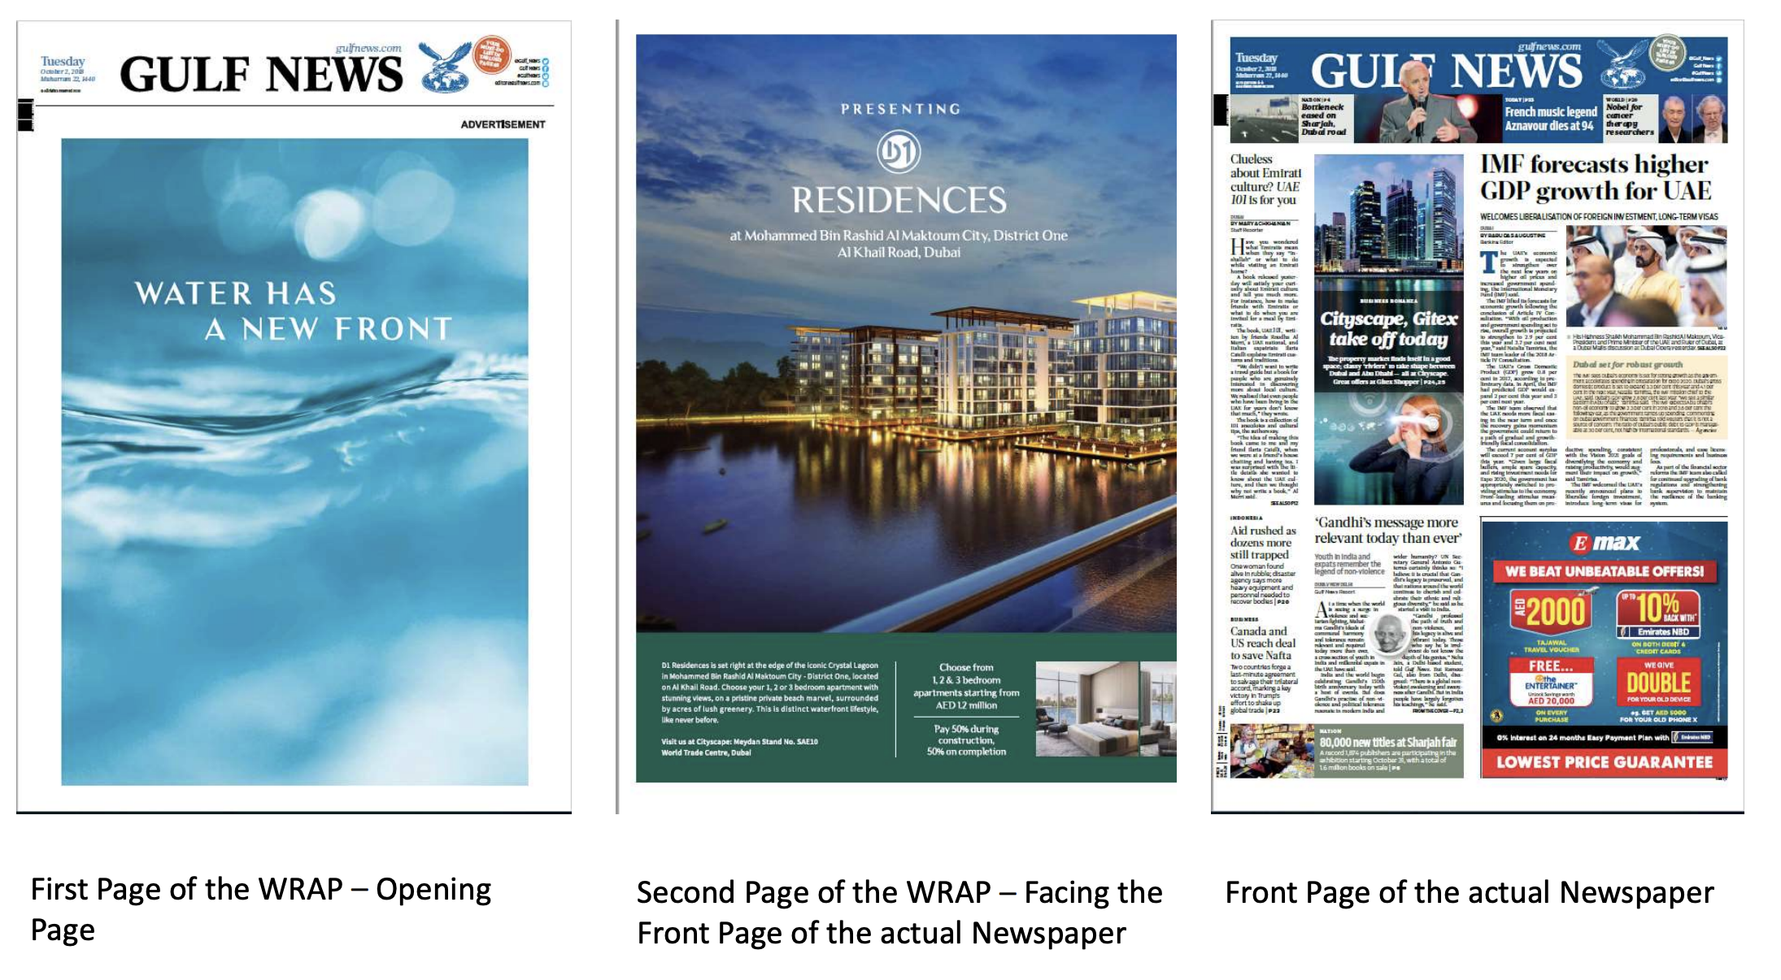
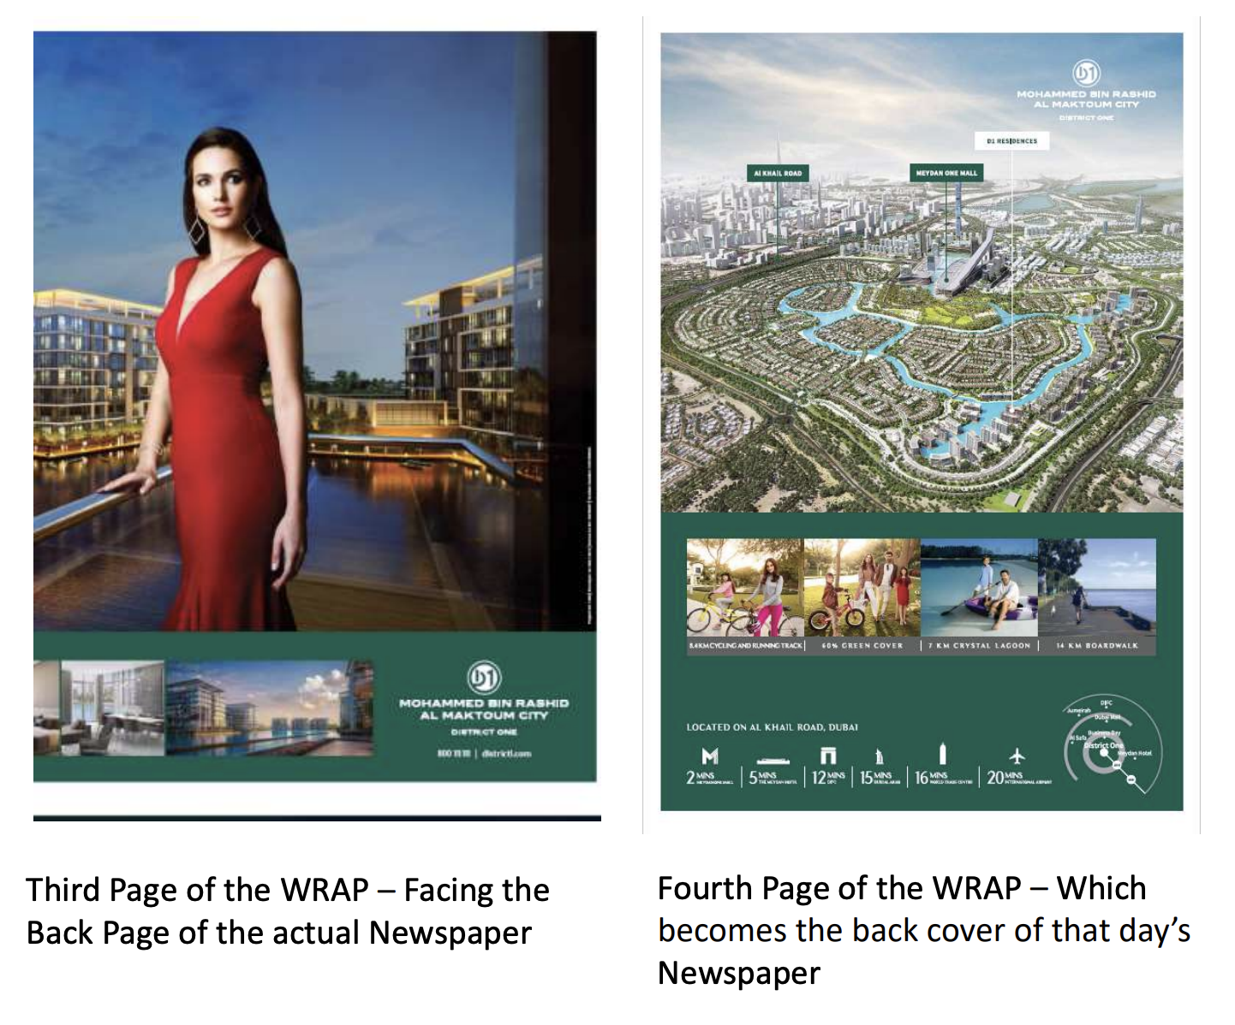
Gulf News – Advertising Overview
Language: English
Position available: Front page 4 page jacket- image on right side for reference in this slide
Other ad sizes available : Full page, half page, quarter page, full page 3/5

Slide 4
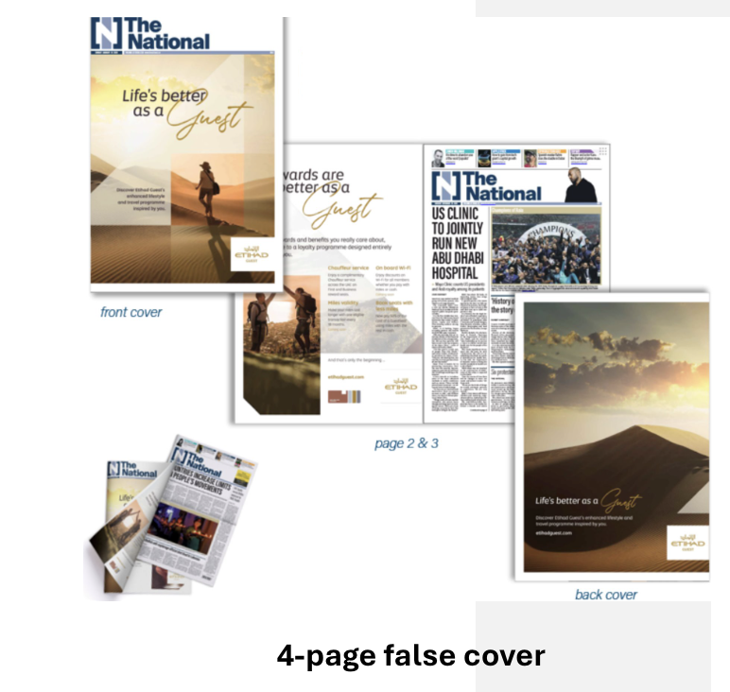
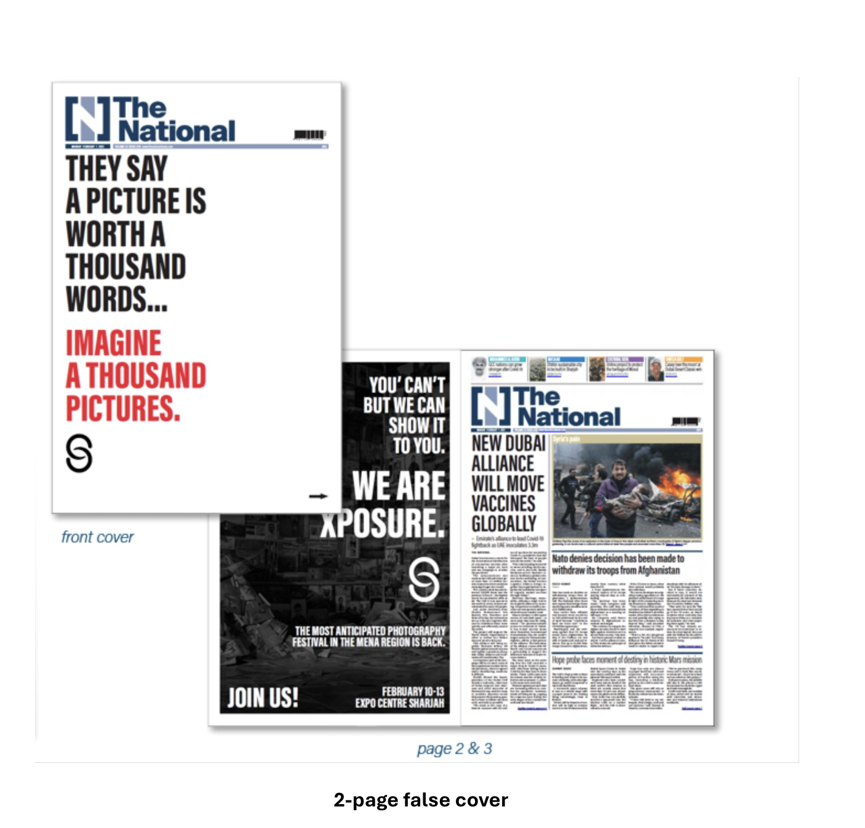
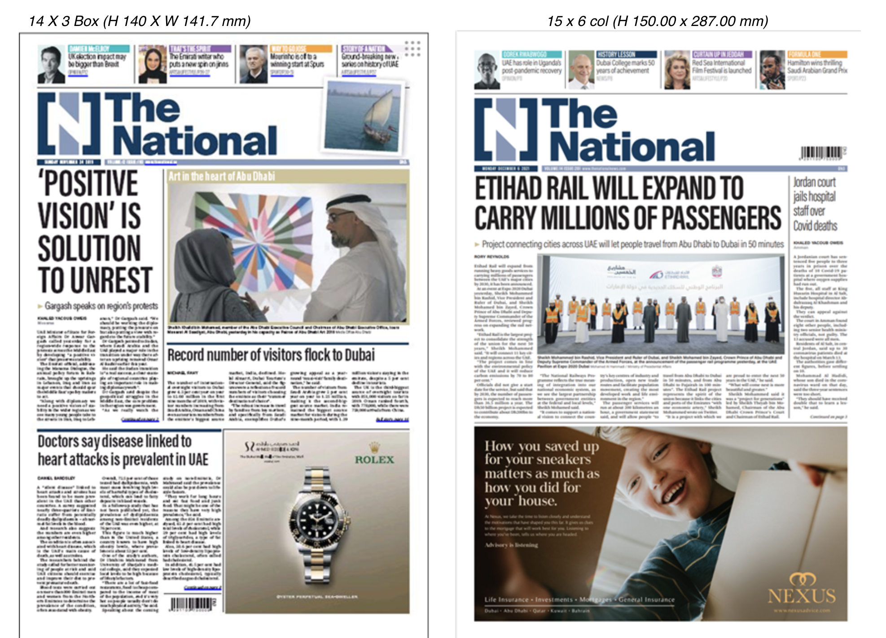
The National – Advertising Options
Available Formats:
Jacket Ad in The National
  2-pager (front + back flap)
  4-pager (front cover + inner flaps + back cover)
  Language: English
Ad sizes available: Front page- H 14 x W14.17 cm, H15 X W 28.7 cm, Full page 5
Premium Positioning: Complete wraparound visibility—your brand is the first and last impression.

Slide 5
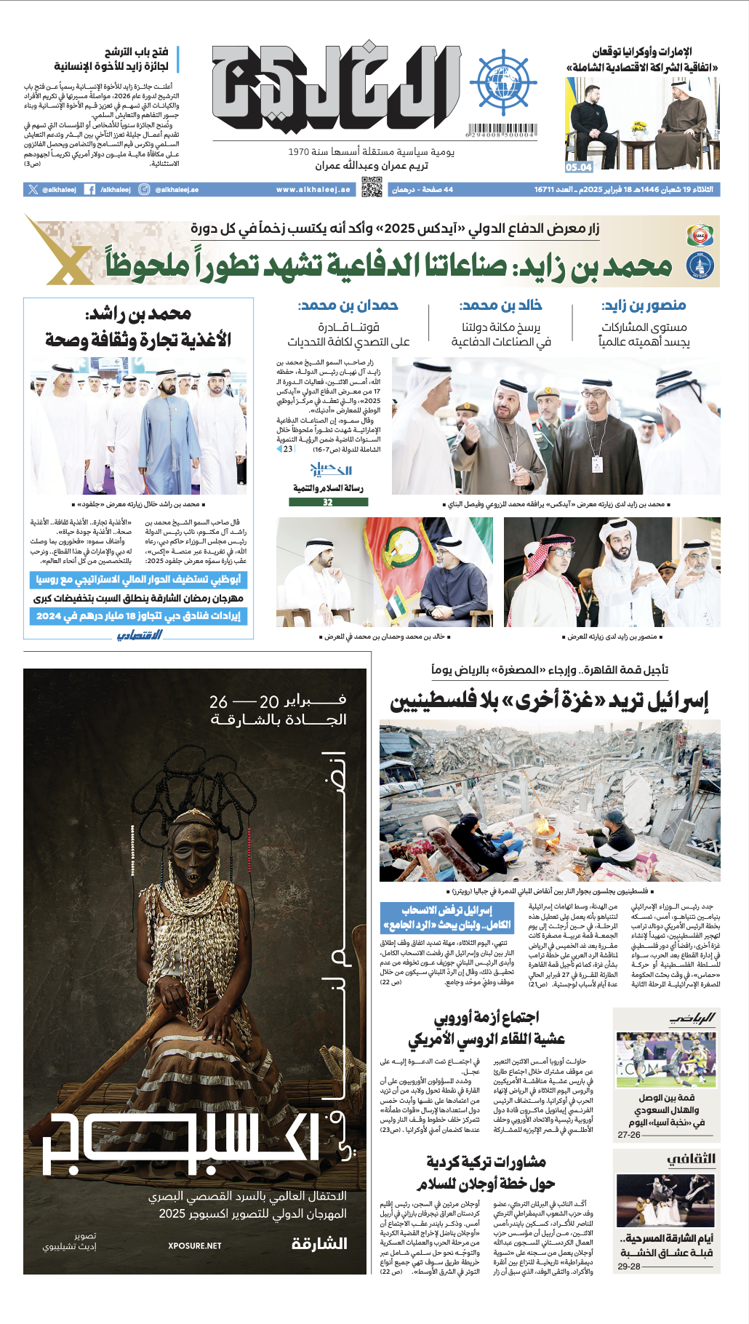
Al Khaleej
Al Khaleej – Advertising Overview
Language: English
Position available: Front page
Ad size availability- Full page, quarter page
Jacket ad
Half jacket available
Offers partial cover exposure for impactful visibility at a more economical scale

Slide 6
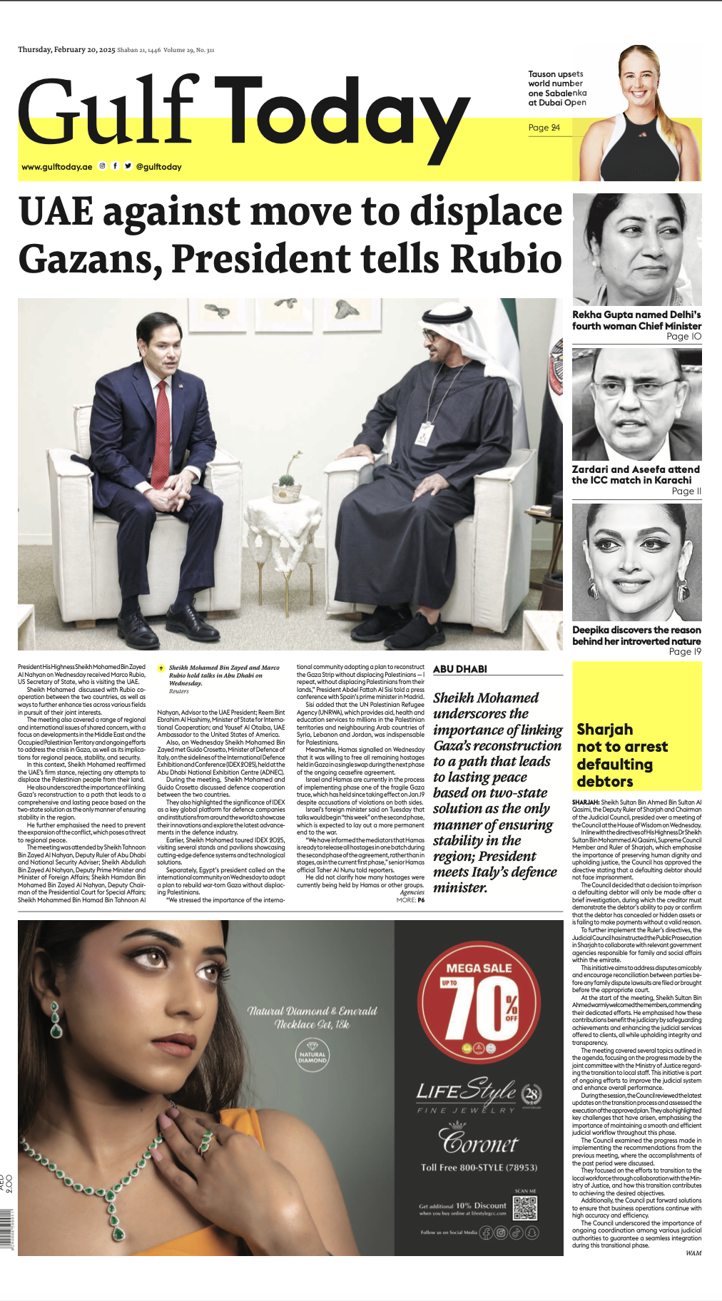
The Gulf Today
Language: English
Position Available: Front page
Ad Size Availability - Full page, quarter page
Jacket Ad
Half Jacket available
Offers partial cover exposure for impactful visibility at a more economical scale
Gulf Today – Advertising Overview

Slide 7
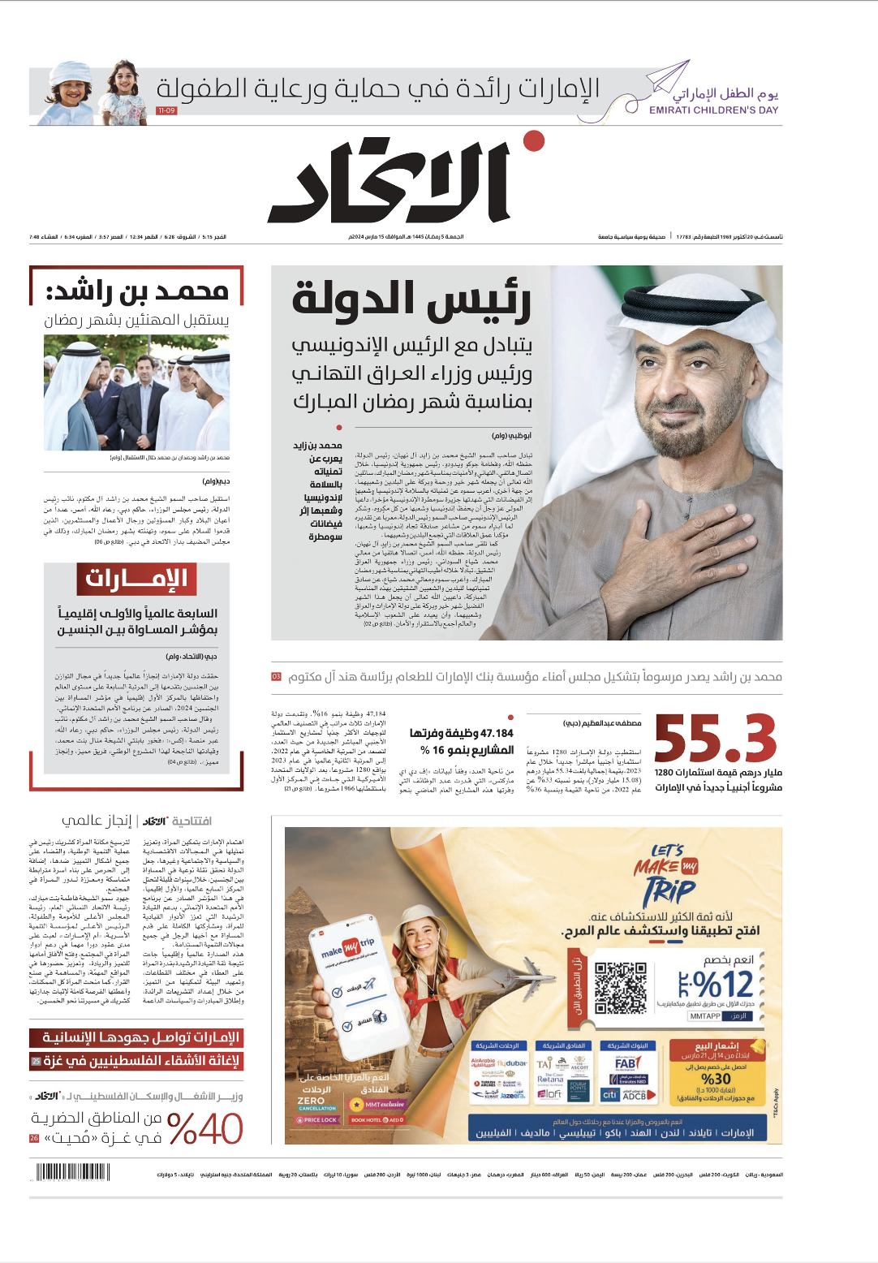
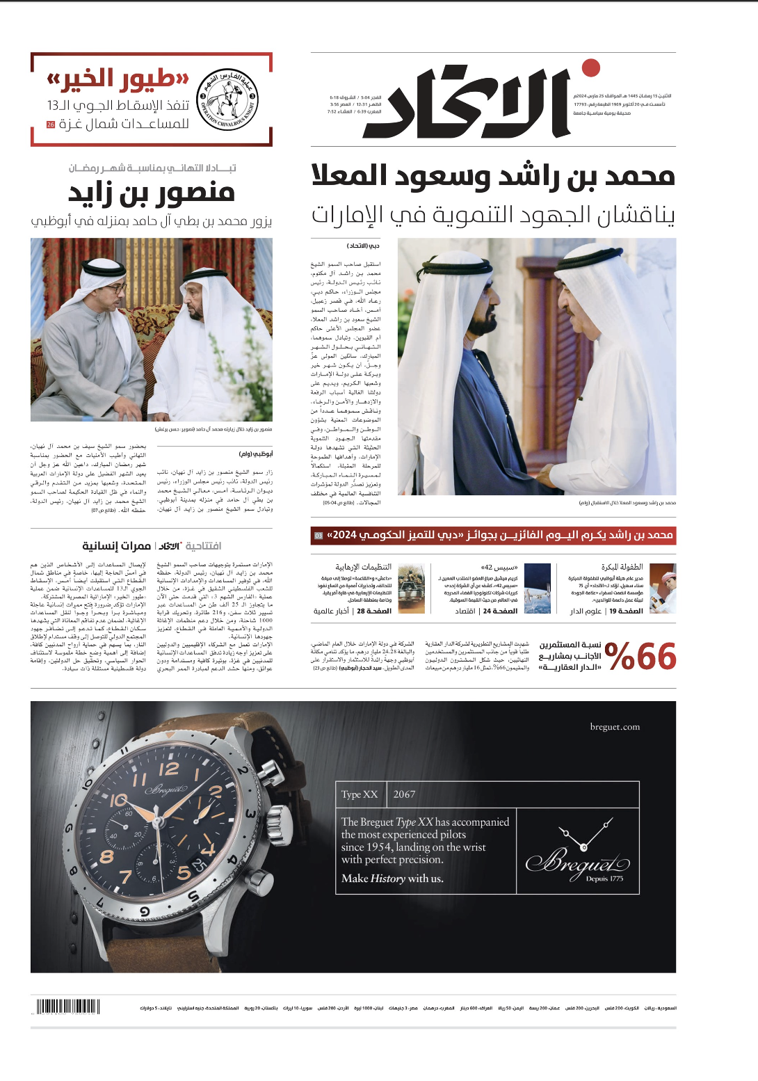
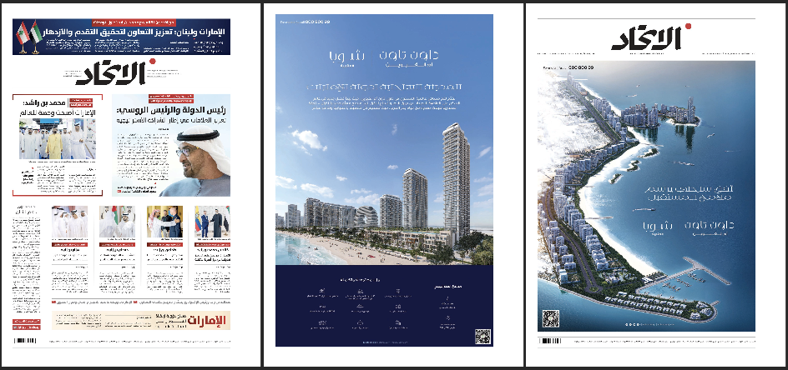
Al Ittihad - Advertising Overview
Language: Arabic
Position: Front page
Available ad types & sizes:
Full front half page ad
Front quarter page ad
Front page jacket ad
Full page
12 X 4
12 X 6

Slide 8
Home Page Takeover (HPTO)- Recommendation

Slide 9
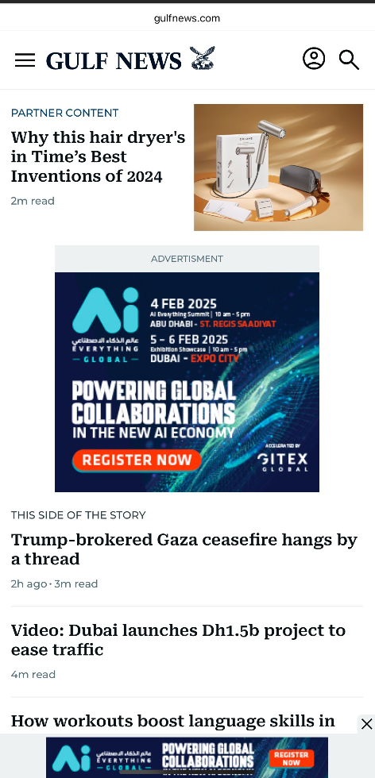
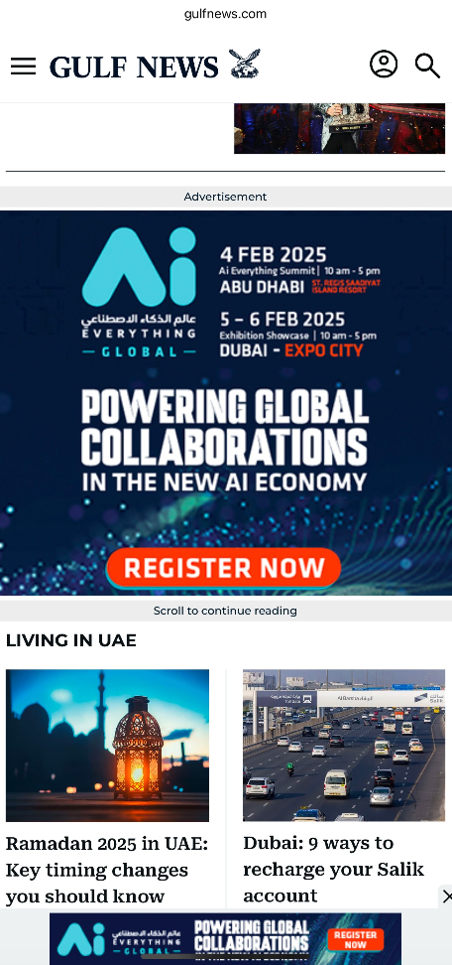
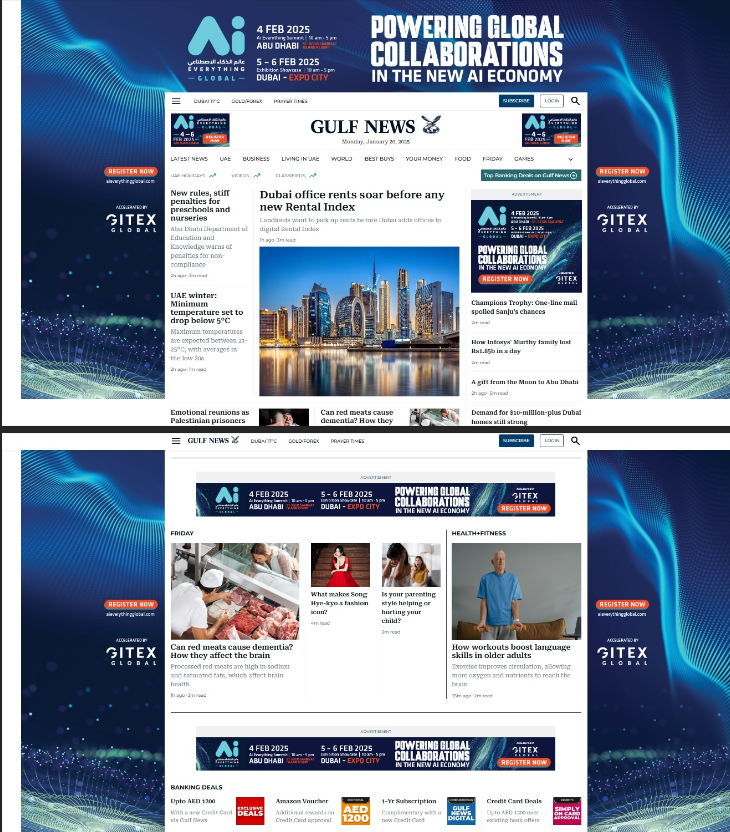
Gulf News - HPTO Ad Specifications
Platform coverage: Desktop, Mobile & App
Duration: 2 days
Ad formats included: Wallpapers, ear panels, overlays with fixed units
Estimated impressions: Approximately 1 million to 2 million+

Slide 10
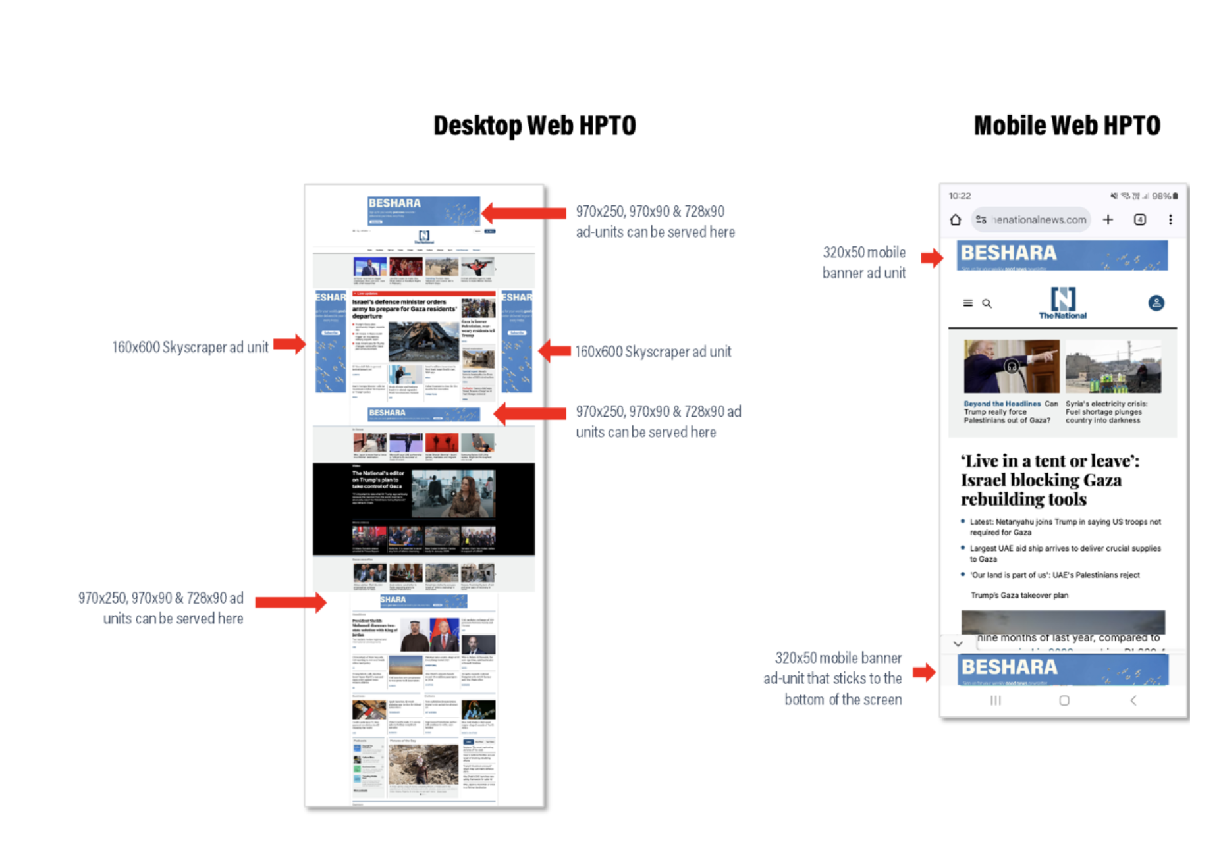
The National- HPTO Ad Specifications
Desktop Web HPTO
Desktop Top Banner
Desktop Left Skyscraper
Desktop Right Skyscraper
Mobile Web HPTO
Mobile Top Banner
Mobile Sticky Bottom Banner
MPU
Estimated impressions for skinning format - 200k
Estimated impressions for roadblock- 80k

Slide 11
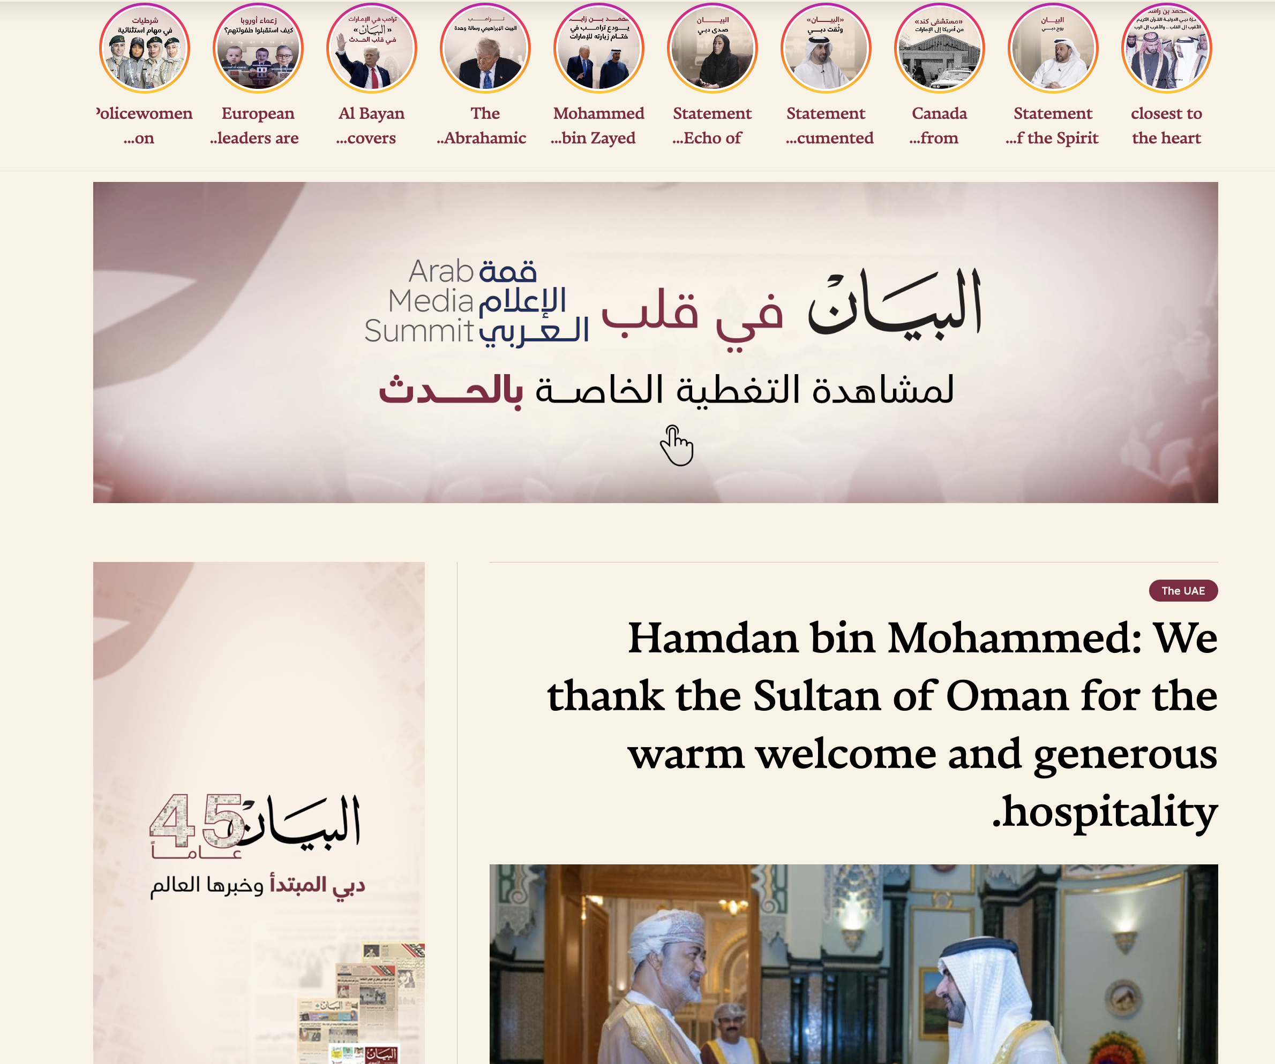
AL Bayan- 1 Day HPTO Banner Specs
Banner Type: 1 Day HPTO (Homepage Takeover)
Location: Homepage
Target Market: UAE
Banner Sizes Supported
Estimated Impressions: 10,000 to 12,000 impressions in one day

Slide 12
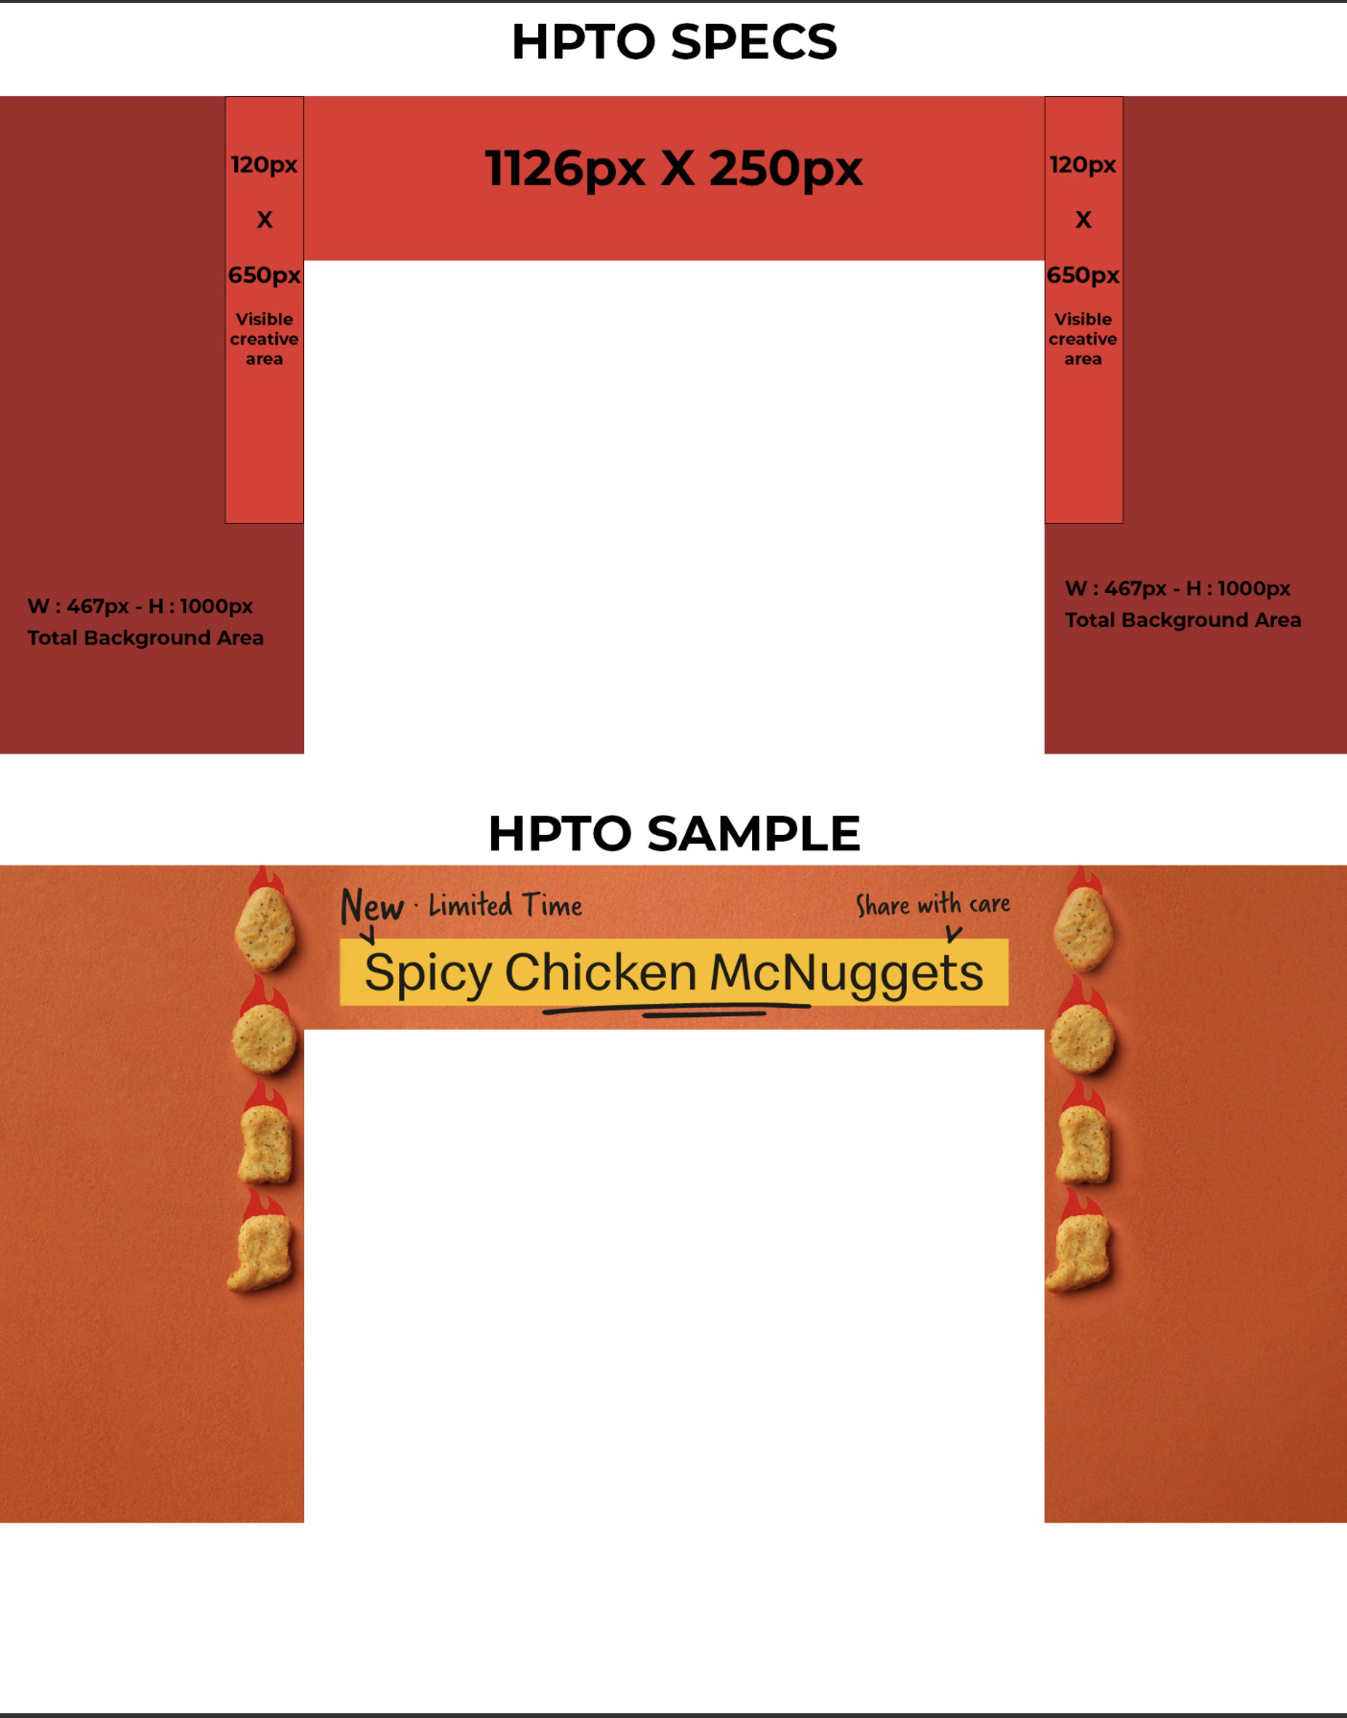
Khaleej Times - HPTO Ad Specifications
Branded Skin
Headerboard
Left & Right Skin Visible Creative Area
Interstitials (Mobile)
Interstitials (Desktop)

Slide 13
Thank You

