Slide 1
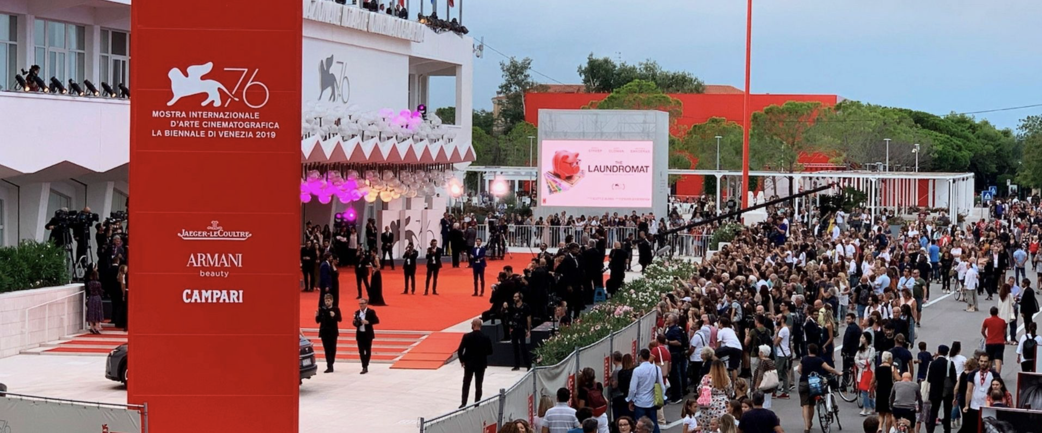

VENICE FILM FESTIVAL
🌐 World-Class Ad Spaces- 2025

Slide 2
Capture the Spotlight at the 82nd Venice International Film Festival
Transform your brand into a star at the world's oldest film festival. Our premium advertising package puts you in the spotlight alongside cinema's biggest names.

Slide 3
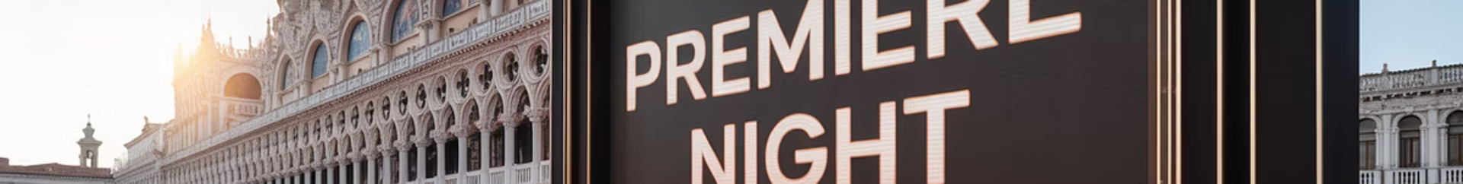




Prime Advertising Location
Premium Position
Giant 24 sqm LED screen facing the red carpet
Maximum Visibility
Positioned directly beside celebrity photo opportunities
Iconic Setting
In front of the historic Palazzo del Cinema
Captive Audience
Over 300,000 attendees during the 11-day festival

Slide 4
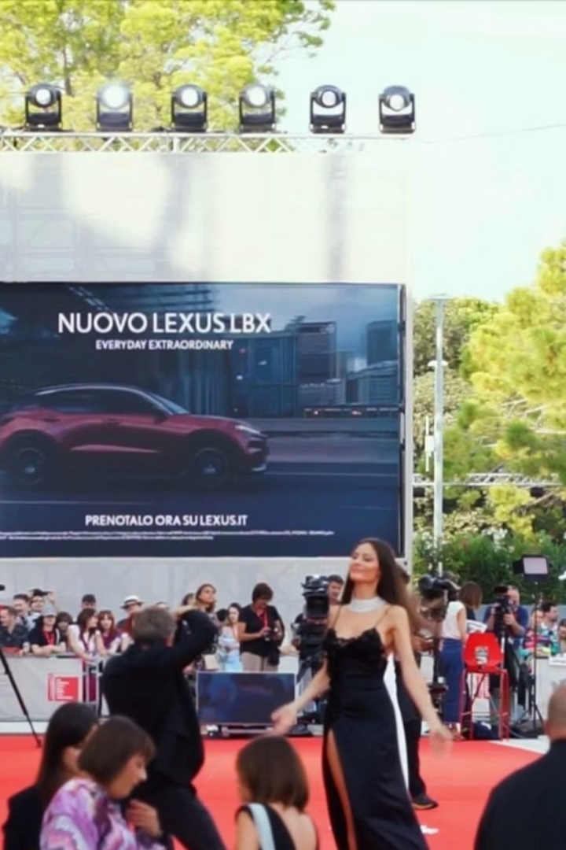
Extended Screen Time
1
Morning
10:00 AM - Screen activates as festival opens to attendees
2
Afternoon
Peak foot traffic as screenings and events begin
3
Evening
Prime red carpet premieres with maximum visibility
4
Late Night
Post-premiere crowds until 1:00 AM
15 hours of daily operation means your brand stays visible from morning till night.

Slide 5








Content That Captivates
Red Carpet
Festival Highlights
Live footage of arriving celebrities
Curated content from throughout the event
Movie Trailers
Your Brand
Your ad appears alongside exclusive film previews
Premium advertising slots in high-rotation

Slide 6
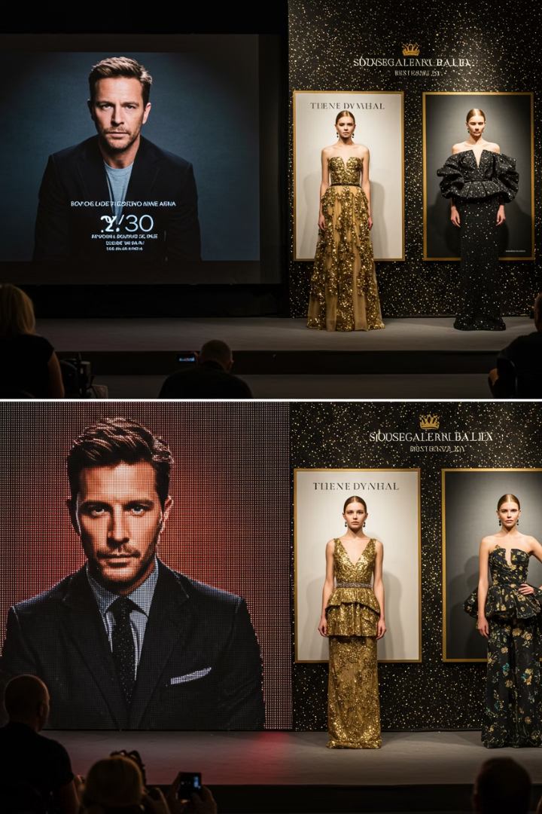
Advertising Packages
30-Second Premium Package
15-Second Quick Impact Package
990 spots over 11 days
1,980 spots over 11 days
6 insertions per hour
12 insertions per hour
Maximum impact for complex messages
Ideal for brand recognition
Special Pricing
€20,400 base package
€150 insertion fee per video
Exceptional value for premium placement

Slide 7
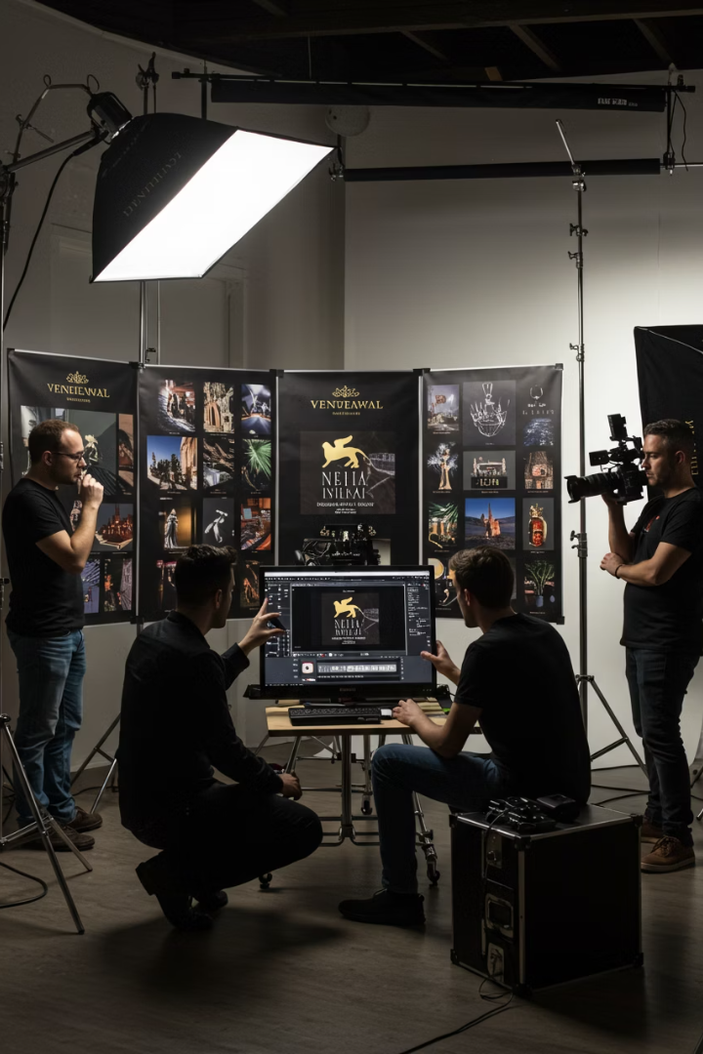
Complimentary Production Services
Provide Your Materials
Send us your images, videos, and brand guidelines
Custom Production
Our in-house team creates your 15-second spot as Free Value add
Review & Approval
We'll send you a draft for feedback and revisions
Prime Time Display
Your approved spot joins the festival rotation

Slide 8
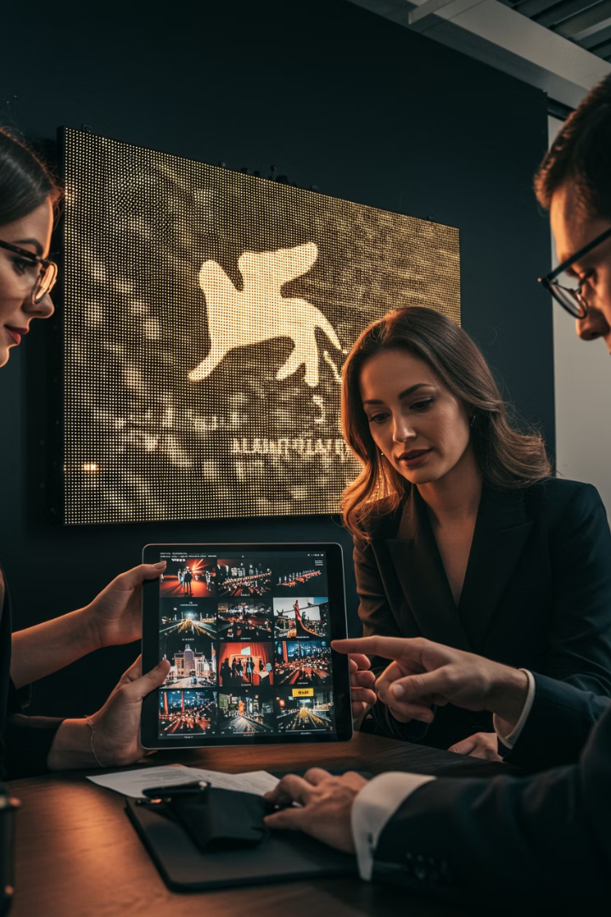




Documentation & Support
Photographic Evidence
Receive images of your spot on screen from day one
Video Documentation
Ongoing footage throughout the festival period
On-Site Team
Dedicated staff available to assist with any requests
Performance Reporting
Documentation of your campaign's visibility and impact

Slide 9
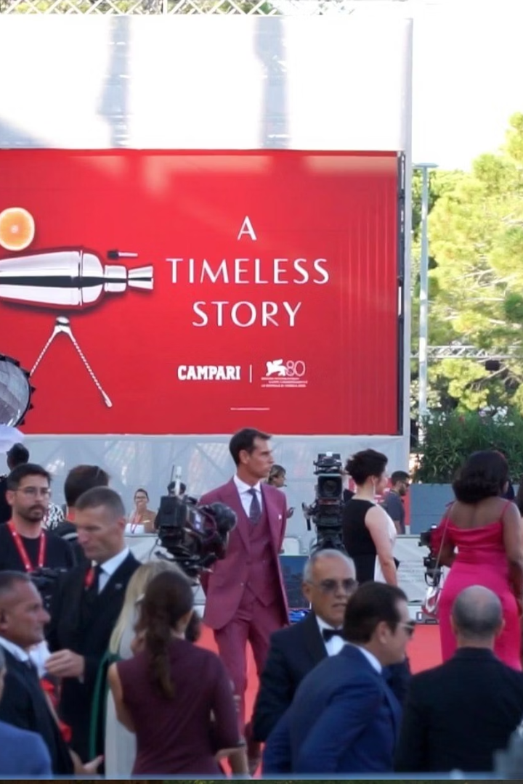
Book Your Spot Today
11
Festival Days
August 27 - September 6, 2025
15
Hours Daily
Maximum exposure from 10 AM to 1 AM
300K+
Attendees
Affluent film industry professionals and enthusiasts
10 days@ USD 38,000
Premium positioning at exceptional value
Limited advertising slots available. Contact our team now to secure your brand's place at cinema's most prestigious celebration.

