Slide 1
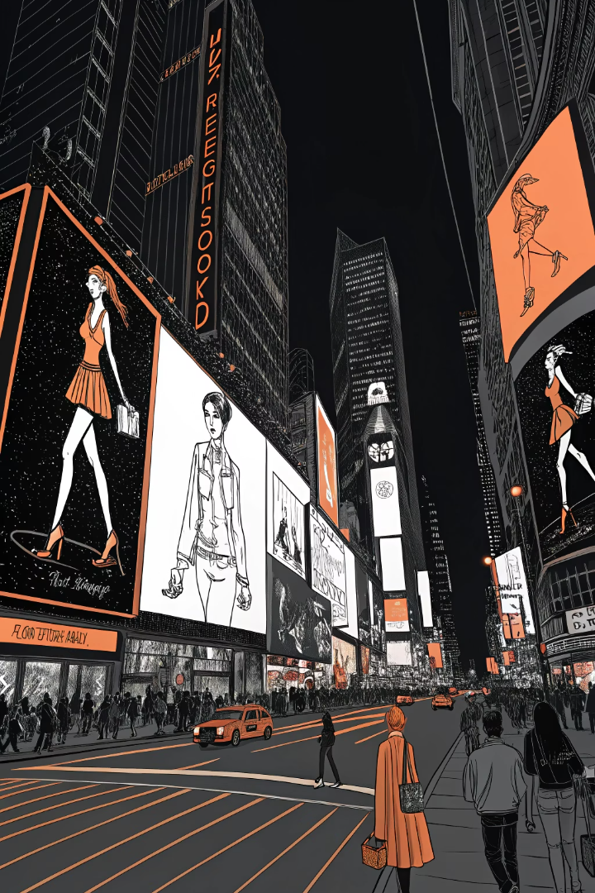

Fashion Show Promos@ Times Square Billboards
From 2022 to 2025, major fashion brands transformed Times Square's iconic digital billboards into spectacular runway alternatives. These innovative campaigns merged fashion, technology, and public space.

Slide 2



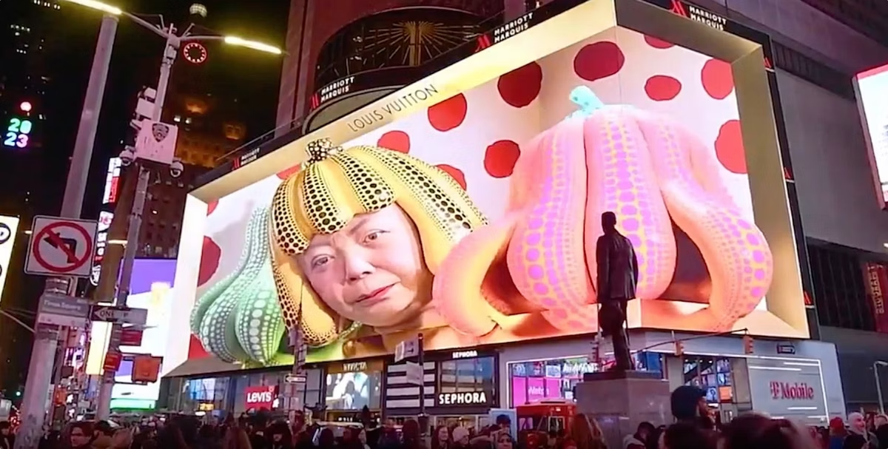

Louis Vuitton × Yayoi Kusama
3D Digital Billboard
January 2023 Launch
Marriott Marquis megascreen displayed Kusama's signature polka-dot pumpkins emerging from an LV trunk.
The anamorphic display created buzz for the collection's release.
Global Campaign
Part of a worldwide rollout bringing art and fashion to one of the busiest advertising venues.

Slide 3
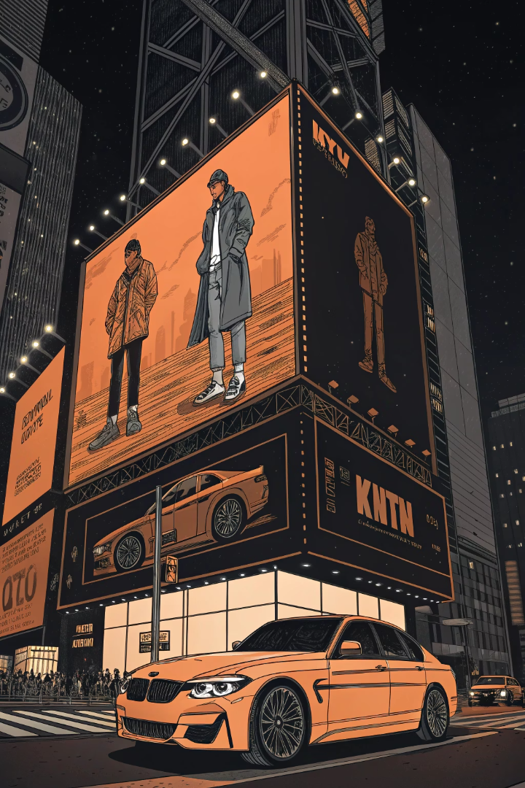
BMW × Kith Collaboration
1
October 3, 2022
Massive 3D anamorphic video played across a 14,000-square-foot billboard above 47th Street.
2
First Reveal
BMW's new XM hybrid SUV debuted on the giant screen.
3
Second Reveal
Custom Kith-themed BMW i4 M50 electric car showcased.
4
Paris Connection
Coincided with Paris Fashion Week where the car officially debuted.

Slide 4
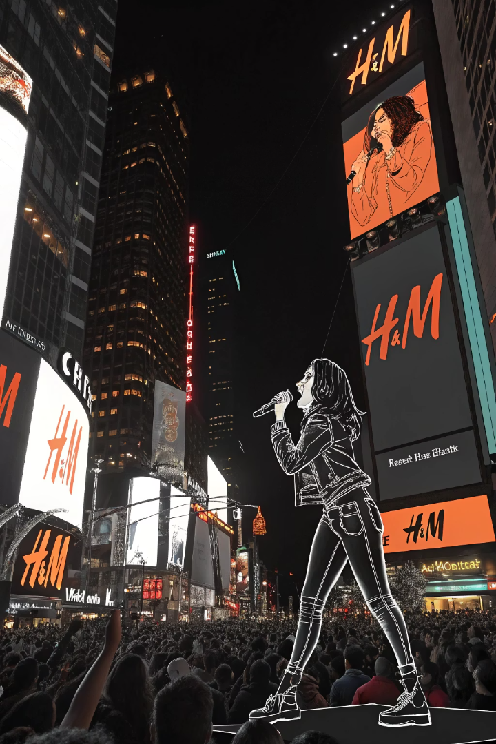
H&M – Charli XCX Takeover
Surprise Announcement
With only 30 minutes' notice, thousands gathered in Times Square.
Countdown Spectacle
Every screen in the square displayed a synchronized countdown.
Live Performance
Screens live-streamed Charli XCX's 15-minute set celebrating H&M's new holiday collection.
Continued Campaign
LED displays flashed campaign visuals and shout-outs to collaborators after the performance.

Slide 5
Times Square Fashion Week
Independent Event
September 2023 Highlights
Aligned with NYFW but open to the public. Established in 2020 during the pandemic.
Live runway shows at Father Duffy Square in its 4th year.
Uses Times Square itself as a runway venue with digital billboards for fashion showcases.
"Digital fashion shows" played on enormous LED screens above the plaza.
Drew over 10,000 attendees to see emerging designers' collections.

Slide 6








Conscious Fashion Campaign
Female Founders
NYFW Timing
Spotlighted ten emerging women entrepreneurs in fashion.
Ran from September 9-14, 2022 during Fashion Week.
High Visibility
UN Collaboration
Featured across high-traffic Times Square screens.
Initiative by Fashion Impact Fund with the UN.

Slide 7
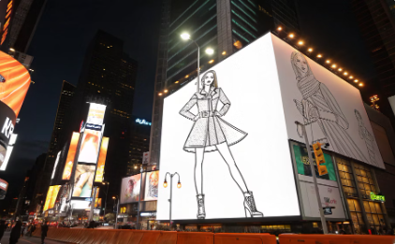
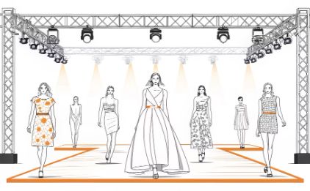
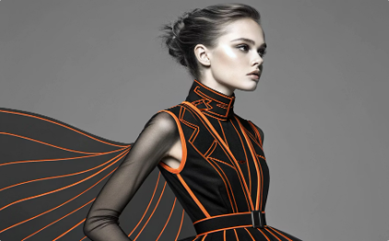
Mitch Desunia's NYFW Moment
Rising Star
Philippine-born designer Mitch Desunia celebrated his NYFW debut with Times Square exposure.
Runway Success
Presented his Spring/Summer 2023 collection during New York Fashion Week.
Young Talent
13-year-old model Giselle Niemand called seeing herself in Times Square "the most amazing moment."

Slide 8






Key advantages
Global Visibility
Instant worldwide exposure through social media sharing
Technological Innovation
3D anamorphic displays creating immersive experiences
Democratized Fashion
Public access to traditionally exclusive fashion events
From luxury houses to indie labels, Times Square billboards have become essential for amplifying fashion shows, collection launches, and creative collaborations.

Slide 9
