Slide 1




Slide 2







2025 MEDIA KIT
Africa is the world’s youngest, fastest-urbanising, and most digitally connected continent.
Digitally connected.
Ready to lead
600m+
internet users
76%
mobile penetration
4 3 %
projected urban population
by 2030
$25t
consumer spending forecast
by 2030
(Sources: McKinsey, GSMA, World Bank)

Slide 3

2025 MEDIA KIT
Our mission
To deliver trusted, context-rich stories across digital, broadcast, and print platforms, allowing brands to engage
Africa’s high-value business travellers before,
during and after their journey.

Slide 4
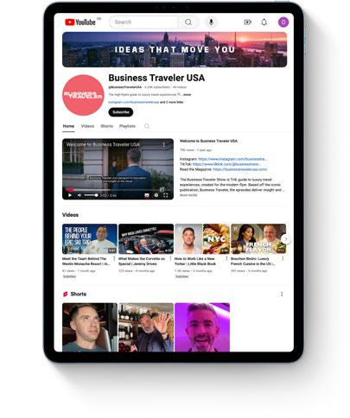
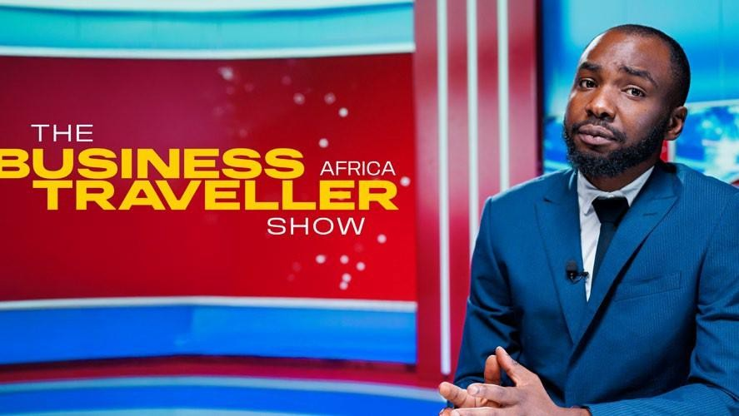
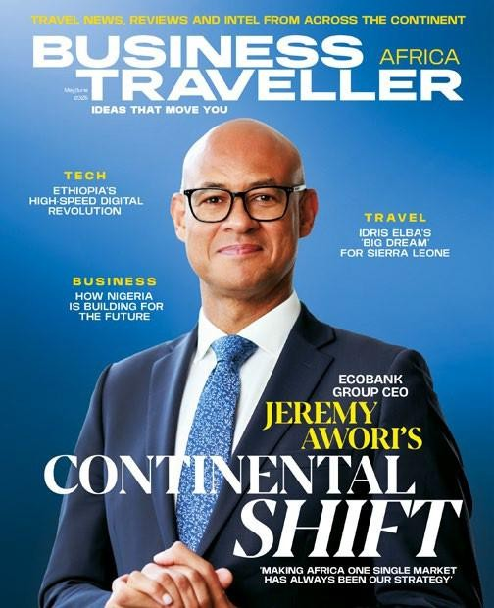

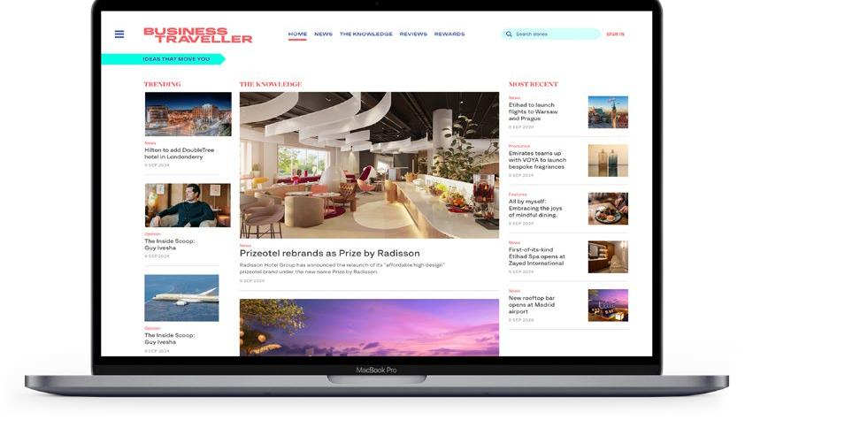
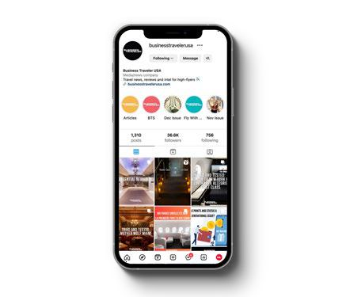
Engagement Opportunities
2025 MEDIA KIT
Collaborate across channels to create powerful, insight-driven brand campaigns.
Build thought leadership through branded storytelling
Activate campaigns across every Business Traveller Africa platform
Extend your message via the global Business Traveller network

Slide 5

Movers, makers and c-suite influencers
2025 MEDIA KIT
30+
business trips
per year
$433k
average household
income
Our readers are globally mobile, digitally connected and always in the market for bold ideas.
Senior leaders: government, VC,
C-suite, and innovators
High spending power, high travel frequency and high connectivity
Mirrors Business Traveller’s
global audience.
45
hotel nights
annually

Slide 6
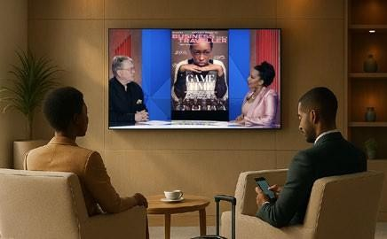
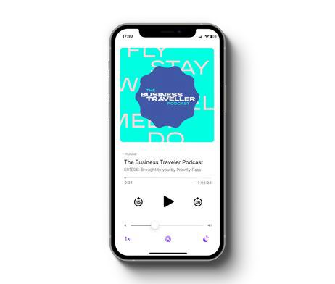
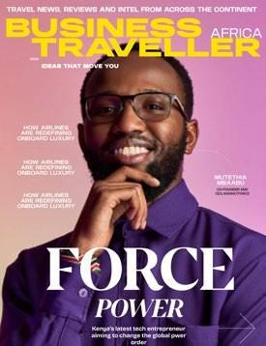
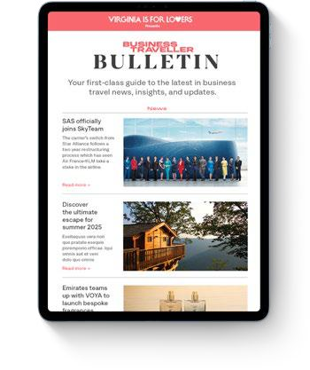
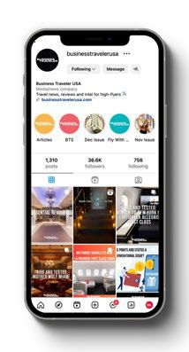
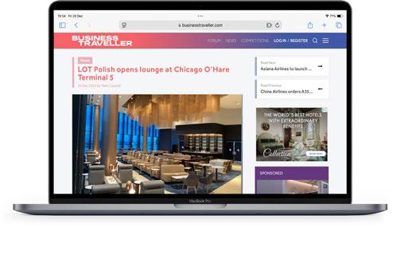
2025 MEDIA KIT
Airport TV &
Lounge Screens
Platform ecosystem
Be present wherever Africa’s business
leaders consume, connect and travel.
Podcast
Print
Newsletters
Social
Web

Slide 7

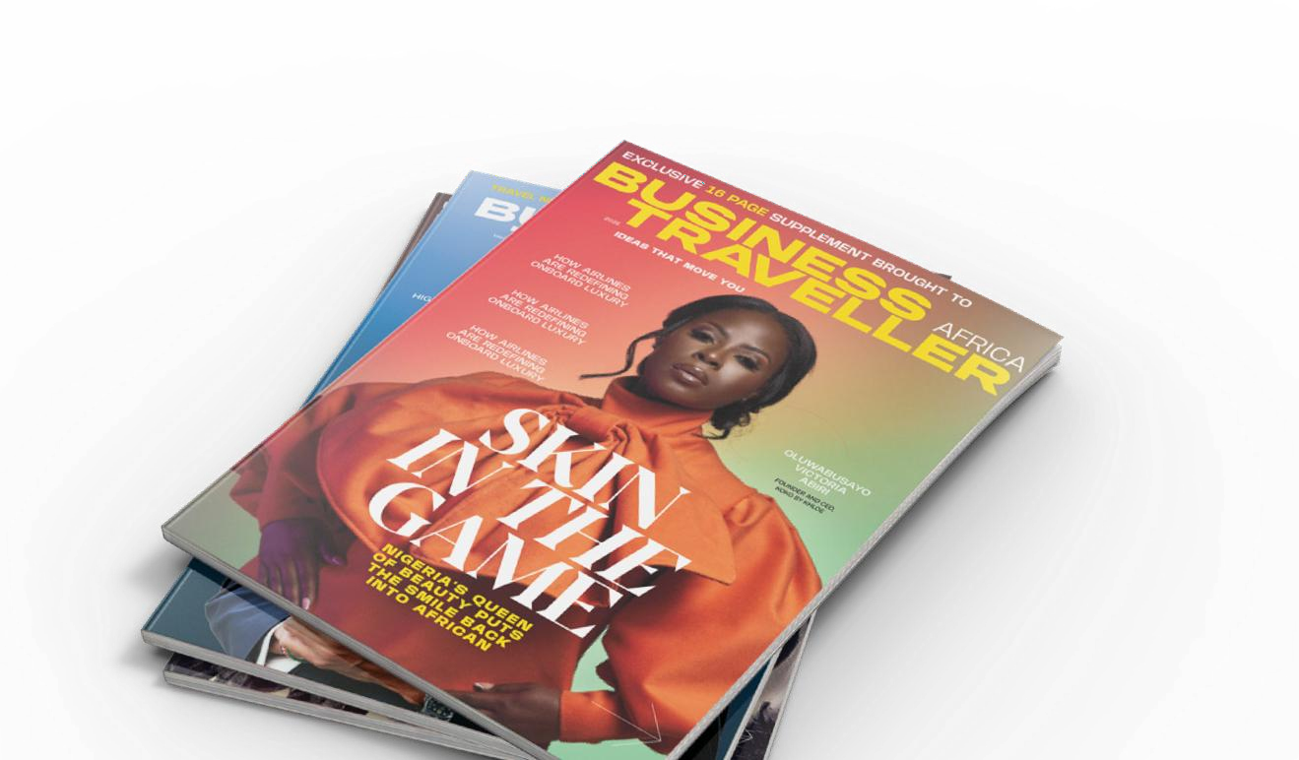
Print Magazine
2025 MEDIA PROPOSAL
Multiple editorial and advertising opportunities sit along- side award-winning travel, business and entertainment journalism. Connect with an excited, engaged and captive audience in a way like no other.
Display Ads
Advertorial
Q & A Features
Multi-page Exclusives
Reach per edition
1.8million travelling passengers
Bi-Monthly Magazine
Print Run
30 - 50,000 for two months
Distribution Partners:
Airport Lounges
5 Star Hotels
African Union
South Africa
(2026) - Kenya Airways | Brussels Airlines
Reach Per Year
1.8m
Print Run - Per Edition
30-50K

Slide 8
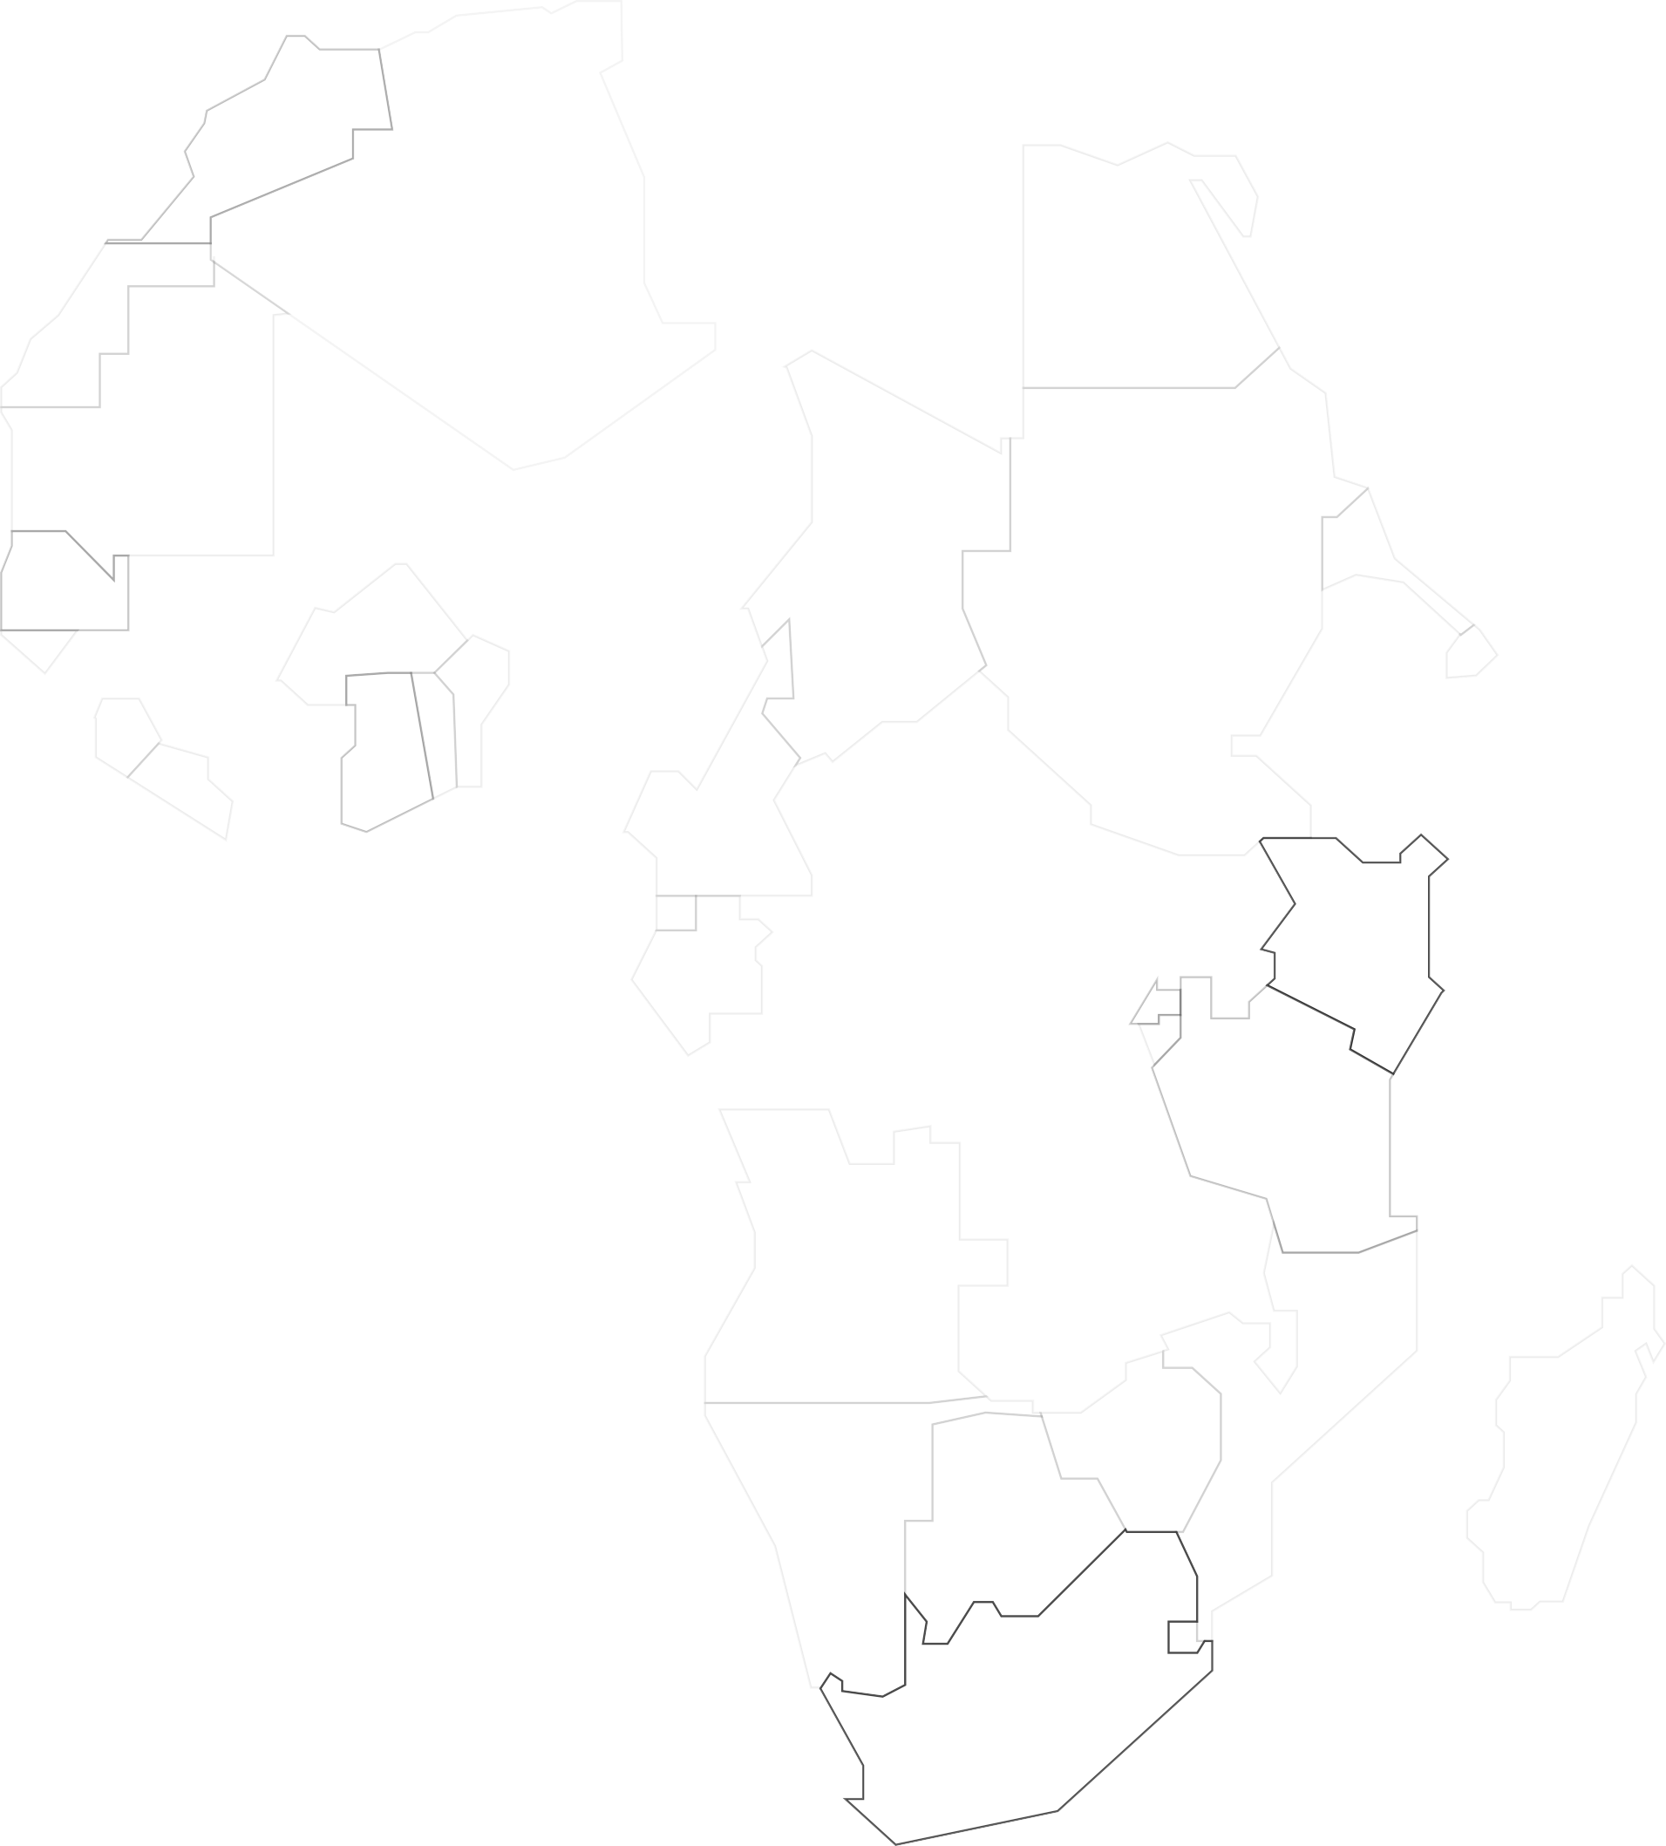



2025 MEDIA KIT
ETHIOPIA
Addis is racing to transit-hub
dominance; our AirportTV screens sit in the very concourse where this growth lands.
MOROCCO
EGYPT
11.8 million
passengers via Addis Ababa
Bole (+13.6 % YoY)
17million
passengers flew Ethiopian
Airlines in FY 2023/24
KENYA
Nairobi has become East Africa’s deal hub; brands gain first-mover share-of- voice among investors and conference traffic.
2.4 million
international arrivals
8.8 million
passengers via JKIA Nairobi
The youngest, fastest-growing market on earth
Capture attention in Africa’s four most active business aviation markets in 2025, 2026 and beyond
SENEGAL
GHANA
IVORY COAST
NIGERIA
Sheer volume keeps Lagos & Abuja lounges packed with C-suite flyers; premium
visibility in our print copies =
high-frequency impressions.
UGANDA
CONGO
RWANDA
TANZANIA
SOUTH AFRICA
Still the continent’s #1 premium-fare market; advertisers tap a concentrated, big-spend audience in lounges and hotel drop-points.
18.4 million
passengers through OR Tambo
JNB (+34 % YoY
10.4 million
at Cape Town, lifting national
total past 30 million
15.7 million
total air passengers

Slide 9
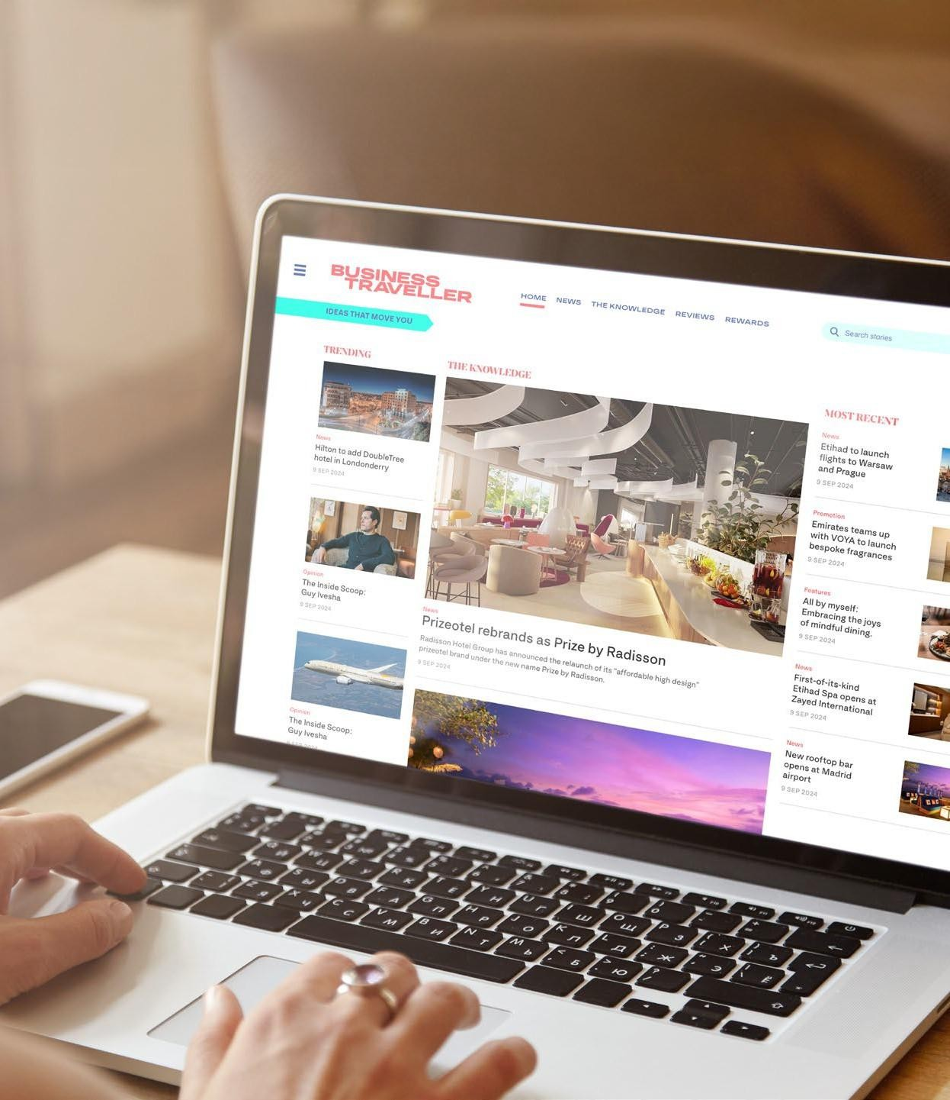
Web Category
2025 MEDIA KIT
Digital storytelling approach with online sponsored articles to drive awareness and inspire action.
Additional Search Engine Optimisation benefits and
increase visibility through search.
Own an entire page on the Business Traveller Website with your branded embedded content, articles, videos and banners - all about your brand.
510,565
Page view per Month
120,000
Average Users per month
1,200,000
Peak Season (May – August)
www.businesstraveller.com/africa

Slide 10
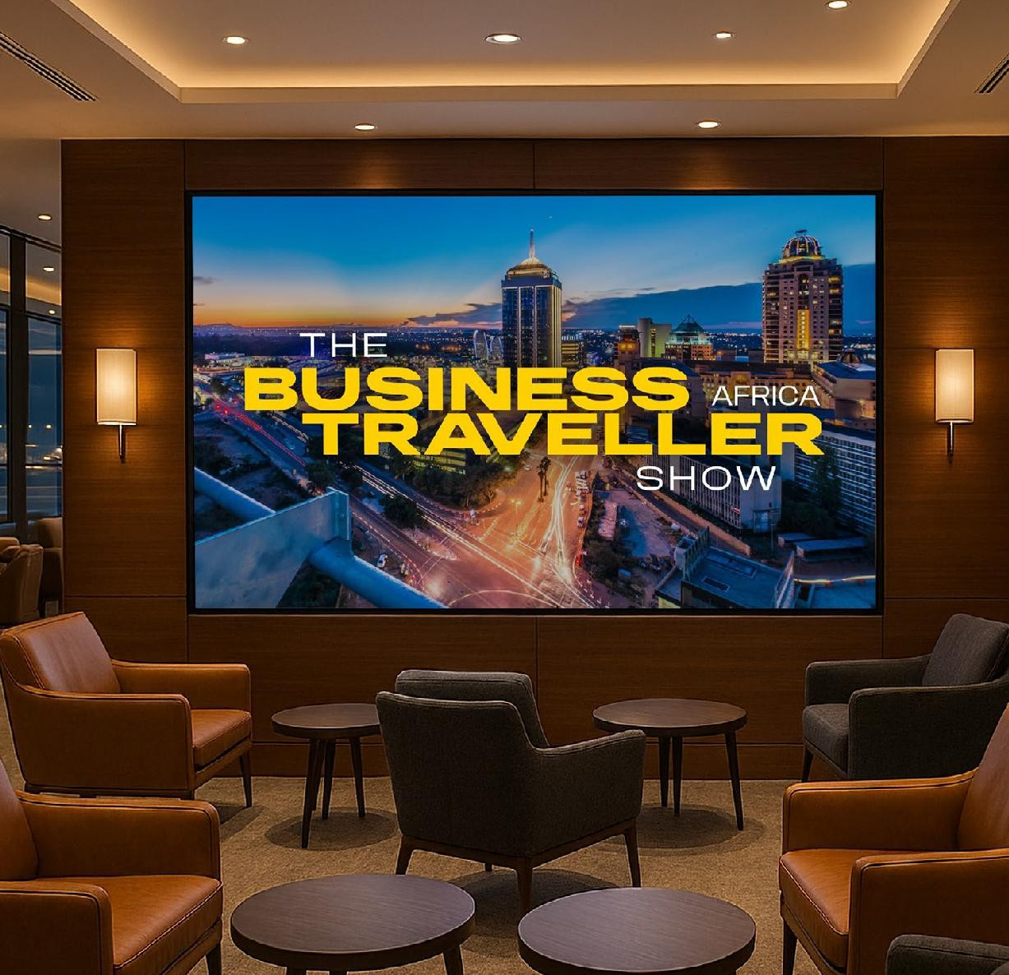
Airport TV & lounge screens
Create awareness at one of the busiest airports in Africa. Implement targeted campaigns in airport lounges through ReachTV at Addis Ababa Bole International Airport, Ethiopia.
2025 MEDIA KIT
20 Airport Screens at Bole International Airport
Full year impression
10.8 million
Number of spots
4x Spots / hr (every day)
Provide pre-roll slot + Mini content
30 – 60 Sec | 1min – 2min
WATCH
Business Traveller Africa TV Show Episode with Vinay Mahtani, CEO Churchgate, Developers of the iconic World Trade Centre, Abuja.

Slide 11
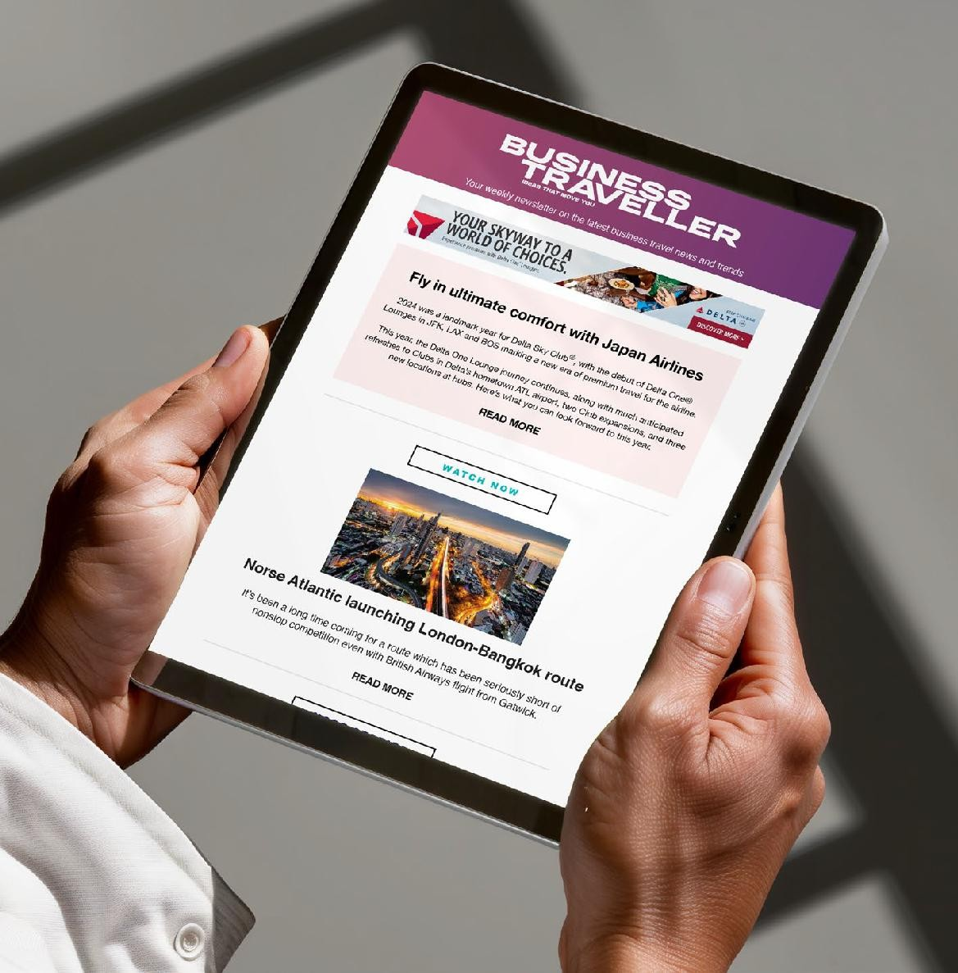



Newsletters
Gain direct access to an influential readership through Business Traveller Africa’s bi-weekly newsletter delivered to a curated list of globally mobile executives, investors, and discerning professionals.
2025 MEDIA KIT
Launch Timeline
January 2026
Distribution Channels
Sponsored Article | Newsletter Banner
Frequency
2 Newsletter realises per month
Projected Subscribers: 5000

Slide 12

Social
2025 MEDIA KIT
A view worth
Our digital presence provides an always on edition to your marketing
delivery.
Strategically crafted social content delivers your message with precision, enhancing both reach and resonance, cutting through the noise to connect with an audience that values insight and influence that converts to experience.
LINKEDIN (Global): 19K Followers YouTube (Global): 14K Followers Facebook (Africa): 19K Followers
the journey

Slide 13
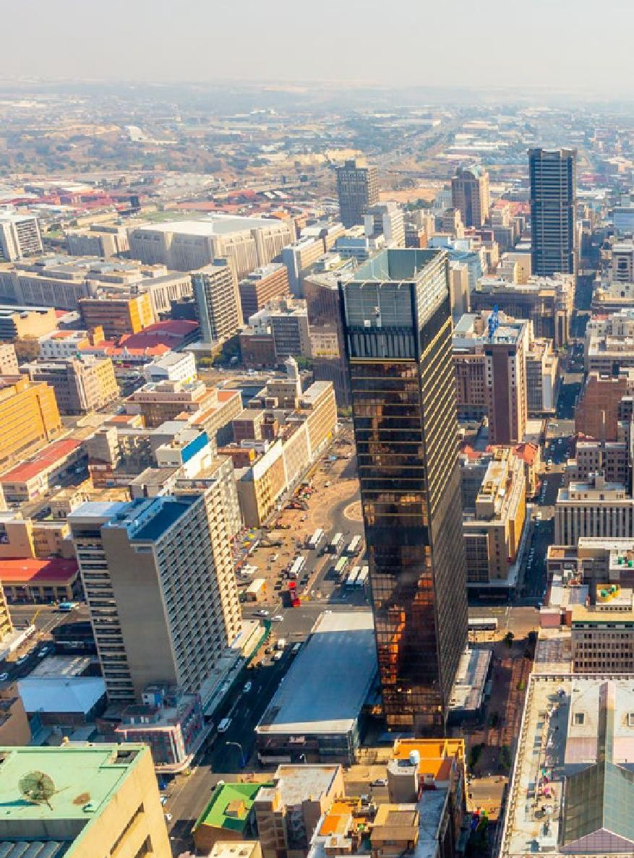



Content ambition
2025 MEDIA KIT
Content creation that champions the people, policies and possibilities
shaping modern Africa.
Signature content franchises featuring Africa’s most influential
C-suite leaders, founders, investors,
and creatives.
Core areas of editorial focus:
Energy & Sustainability
Technology
Trade & Investment
Mobile Banking
Innovation & Culture
Finance
Hospitality

Slide 14
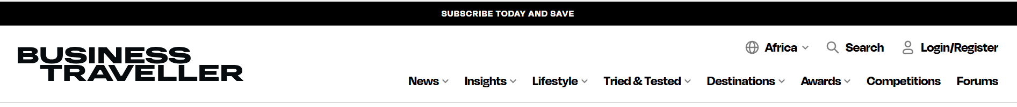

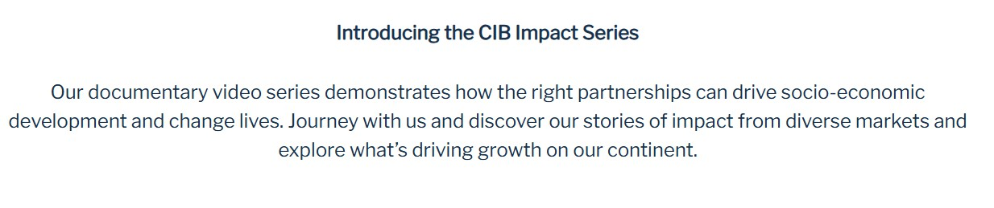
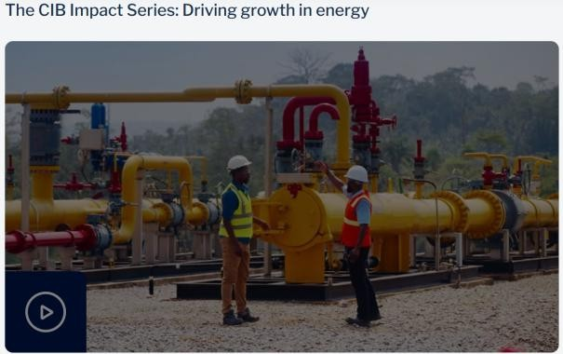
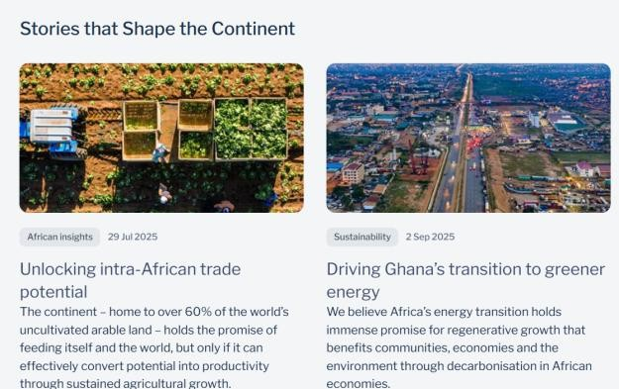
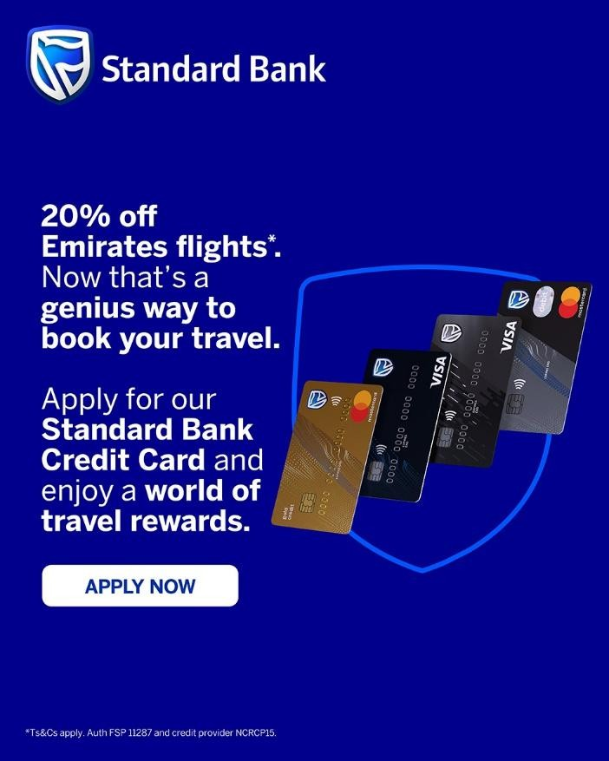

Brand Hub
2025 MEDIA KIT
Branded Content Page with Label
Content by Standard Bank
Dedicated Branded Hub inside Business Traveller Global → Africa section accompanied by multi-channel distribution.
Client Banner Ad – clickable to client specified landing page
It’s a branded hub that lives on inside a trusted global platform, reaching decision-makers in Africa and beyond—on the page, on screen, and in the lounge.
Ownable URL (e.g. businesstraveller.com/africa/partnerhub/[brand])
Editable intro text
CTA button
Brand label (“Content by [Brand]”) + logo + CTA
blocks
Visit Stanbic Bank
Mix of articles, embedded videos, and native stories.
Your investment keeps working long after the campaign flight ends.
Editorial articles about the brand by our editors
Embedded video campaigns
Native Advertising with CTA link to product / brand offer
Always-on PR and Distribution platform
MOCKUP ONLY
Final layout might differ

Slide 15

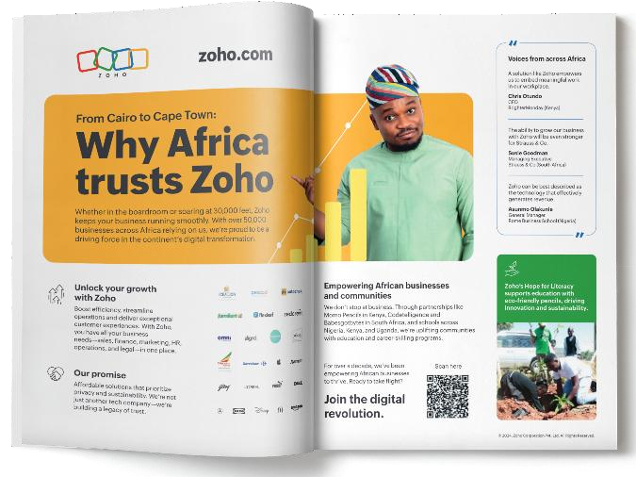
Brand Hub Investment
20 Million Impressions + Reach 70 Million Business Travellers In Africa
2025 MEDIA PROPOSAL
Print Magazine
CEO Features, Ccultural leadership, Energy
Website Article
Sponsorship content plus
Newsletter
Tech, talent and transformation; where innovation leads
Airport TV Show
Special sponsor for TV show
An investment for the world’s best travel media package

Slide 16
6-month Media Investment
20 Million Impressions + Reach 70 Million Business Travellers In Africa
2025 MEDIA PROPOSAL
Print Magazine
CEO Features, Ccultural leadership, Energy
Website Article
Sponsorship content plus
Newsletter
Tech, talent and transformation; where innovation leads
Airport TV Show
Special sponsor for TV show
An investment for the world’s best travel media package

Slide 17

BT Africa - Media Roll Out Plan
2025 MEDIA PROPOSAL
 | Nov-25 | Dec-25 | Jan-26 | Feb-26 | Mar-26 | Apr-26 | MY-26 | Jun-26 | Sep-26 | Oct-26 | Nov-26 | Dec-26
Print Magazine | Double Page Spread |  | Double Page Spread |  | Double Page Spread |  | Double Page Spread |  | Double Page Spread |  | Double Page Spread
Website Articles | Article |  |  | Article |  |  | Article |  |  | Article
AirportTV Screens | AirportTV Screens |  | AirportTV Screens |  | AirportTV Screens |  | AirportTV Screens |  | AirportTV Screens |  | AirportTV Screens
Newsletter |  |  | 1 Newsletter (2 Weeks) |  |  |  | 1 Newsletter (2 Weeks) |  |  |  |  | 1 Newsletter (2 Weeks)

Slide 18

Thank you
2025 MEDIA PROPOSAL

