Slide 1

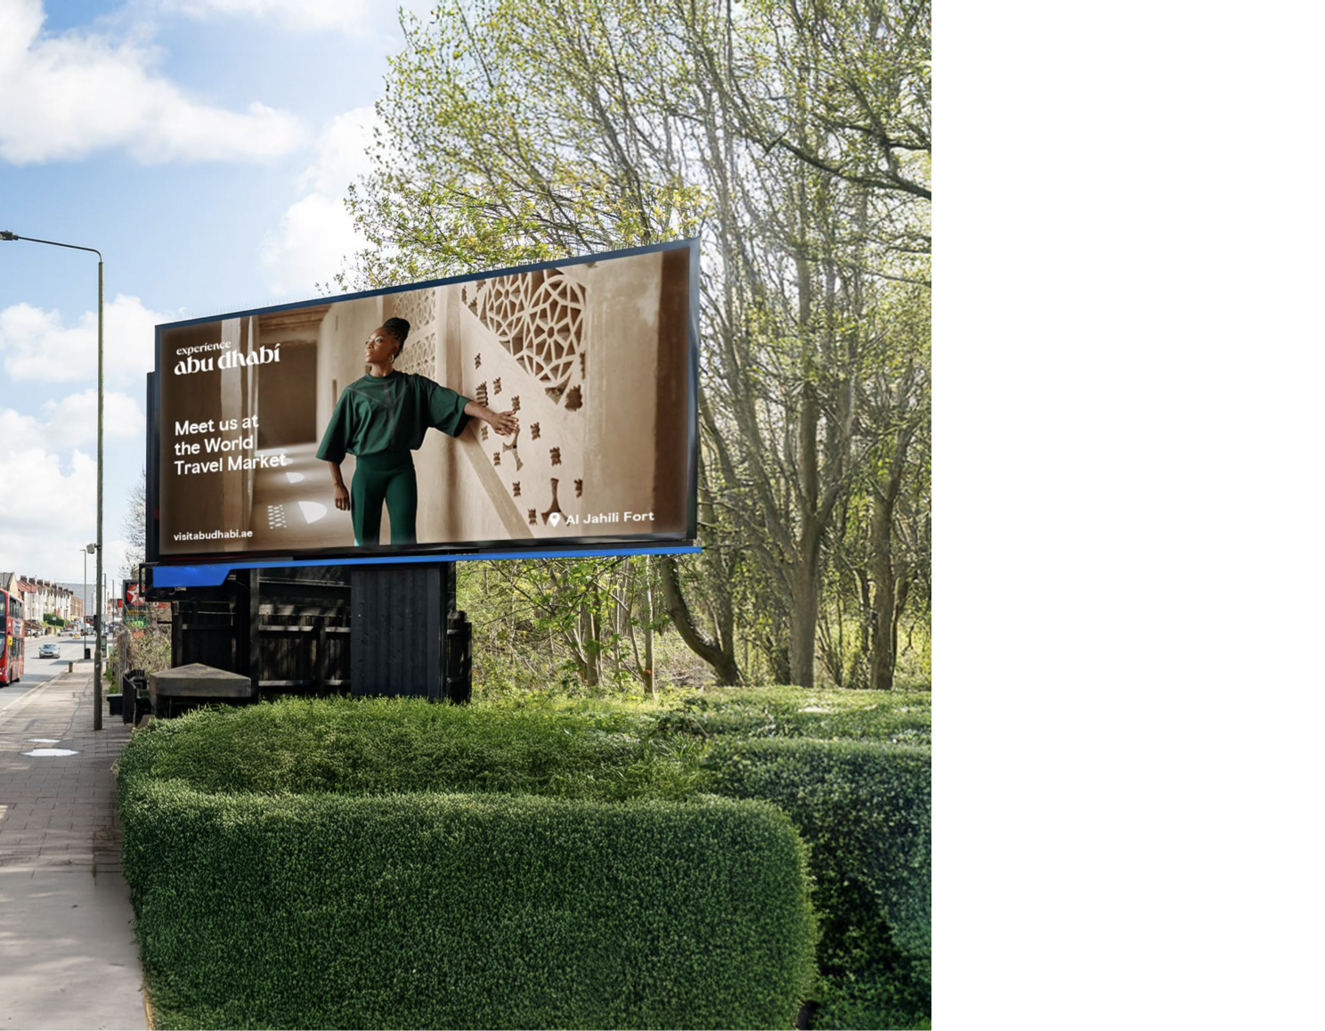

Experience Abu Dhabi

Slide 2
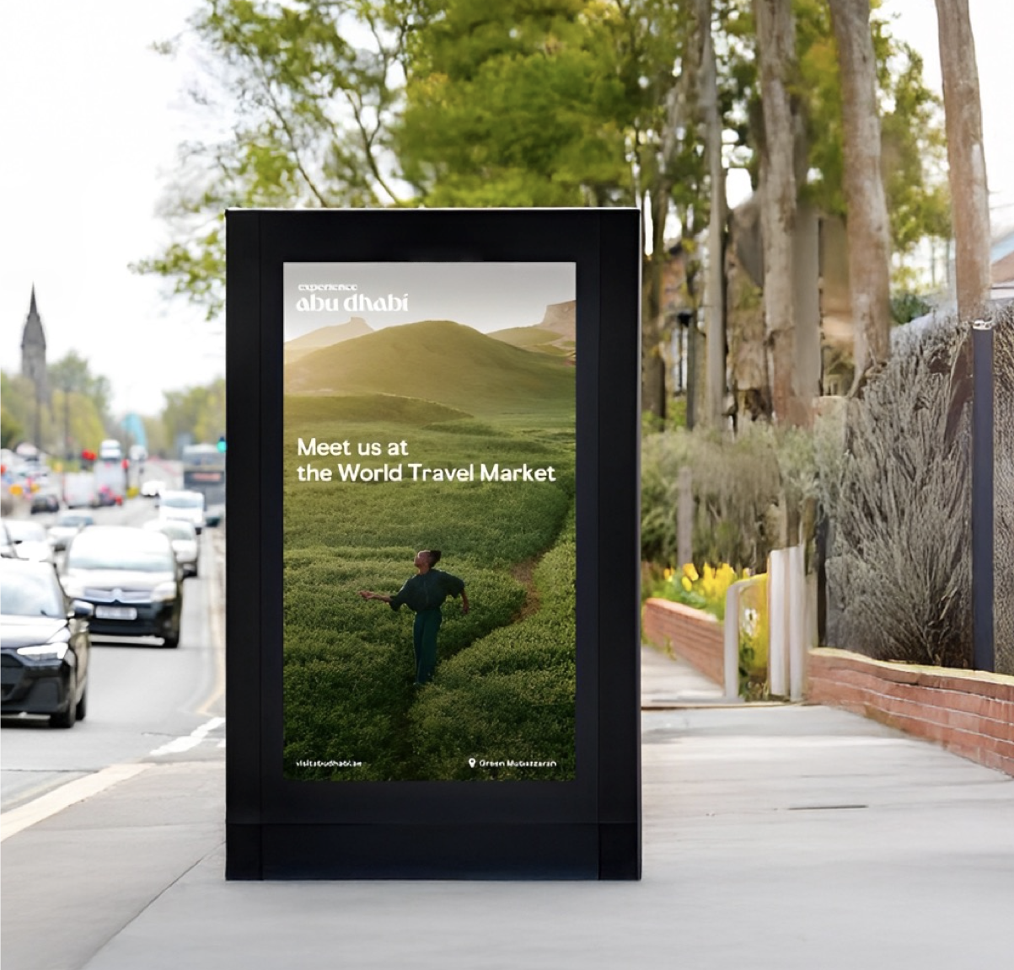
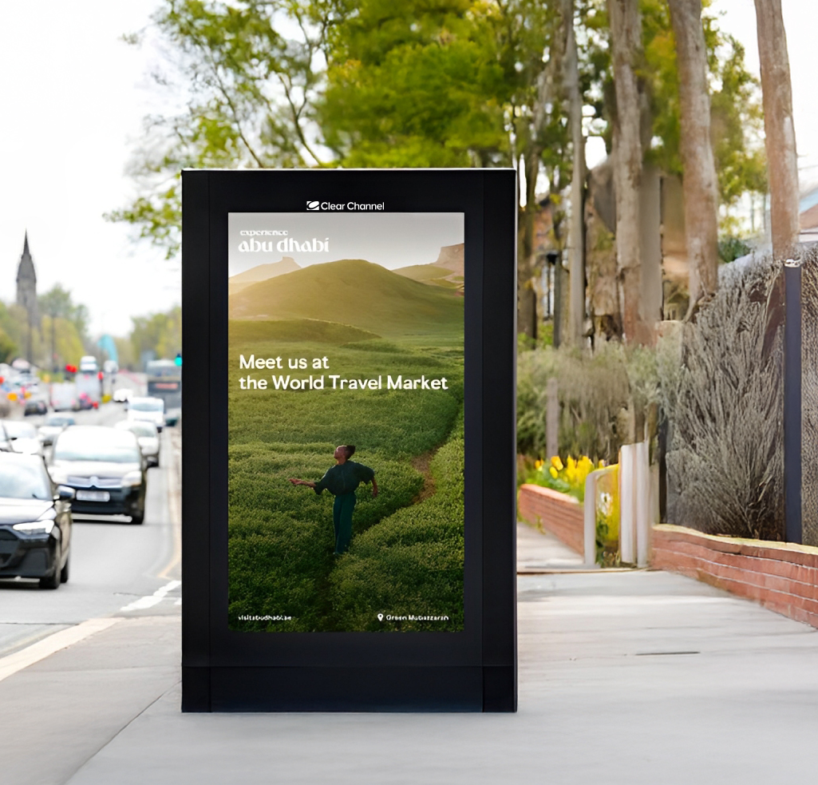

Overview
Abu Dhabi Tourism sought to amplify its presence at WTM London 2024, one of the world’s premier travel trade events. With a targeted Programmatic Out-of-Home (pDOOH) campaign strategically placed around ExCeL London, the goal was to captivate industry professionals, decision-makers, and travel influencers.
Pag. 02

Slide 3
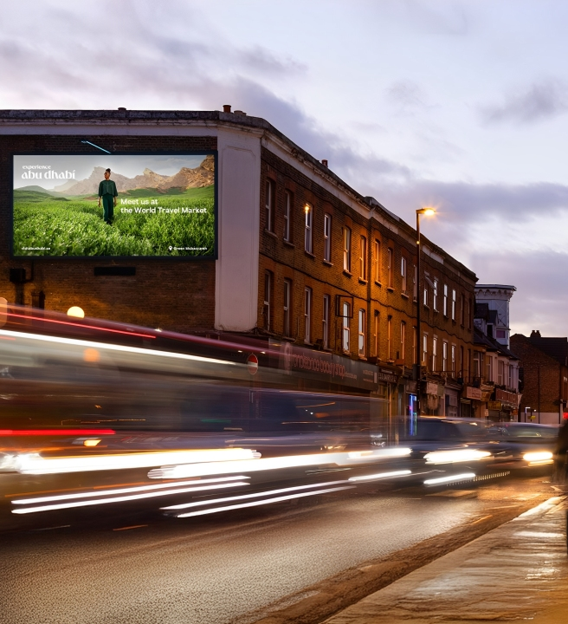
Objectives
Increase awareness of Abu Dhabi
As a premier travel destination.
Capture the attention of WTM
attendees, including travel executives
& media professionals.
Reinforce Abu Dhabi’s brand
Positioning through dynamic &
high-impact pDOOH placements.
Pag. 03

Slide 4
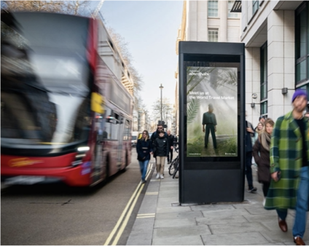
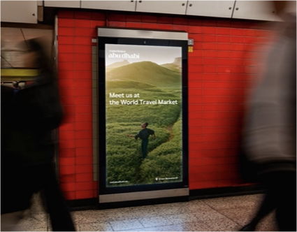
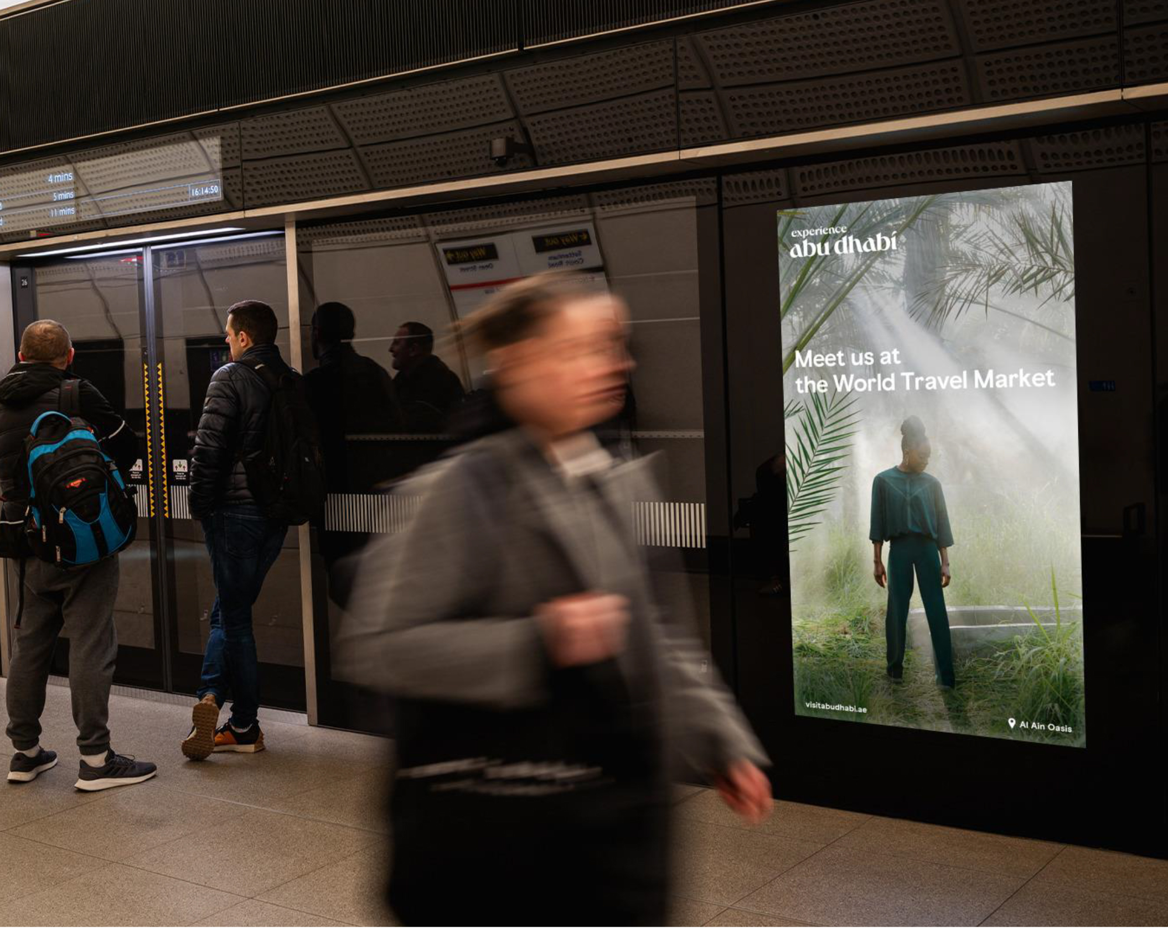
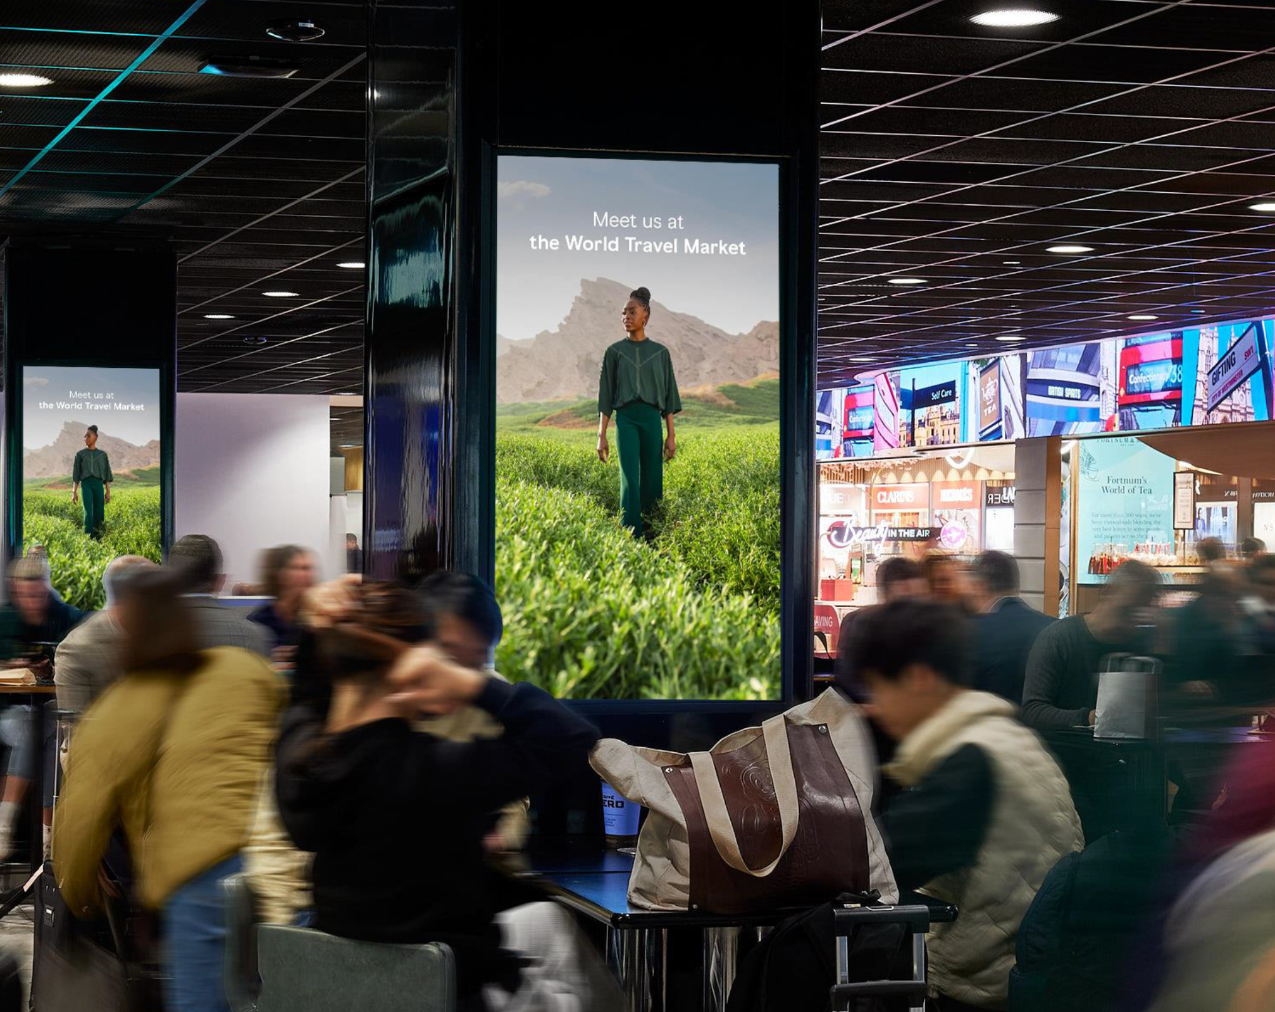
The Neuron leveraged a strategic DOOH
Approach to ensure maximum visibility:
Prime Locations
Dynamic Creative Execution
Time-Sensitive Delivery
Budget Optimization
Digital screens positioned in high-traffic areas around ExCeL London, including key entrances, corridors, and nearby transit routes.
Engaging, high-resolution visuals showcasing Abu Dhabi’s culture, attractions, and hospitality.
Ads ran during peak footfall hours, ensuring optimal reach among event attendees.
Smart allocation of the $10,000 budget to maximize exposure and impact.
Pag. 04

Slide 5
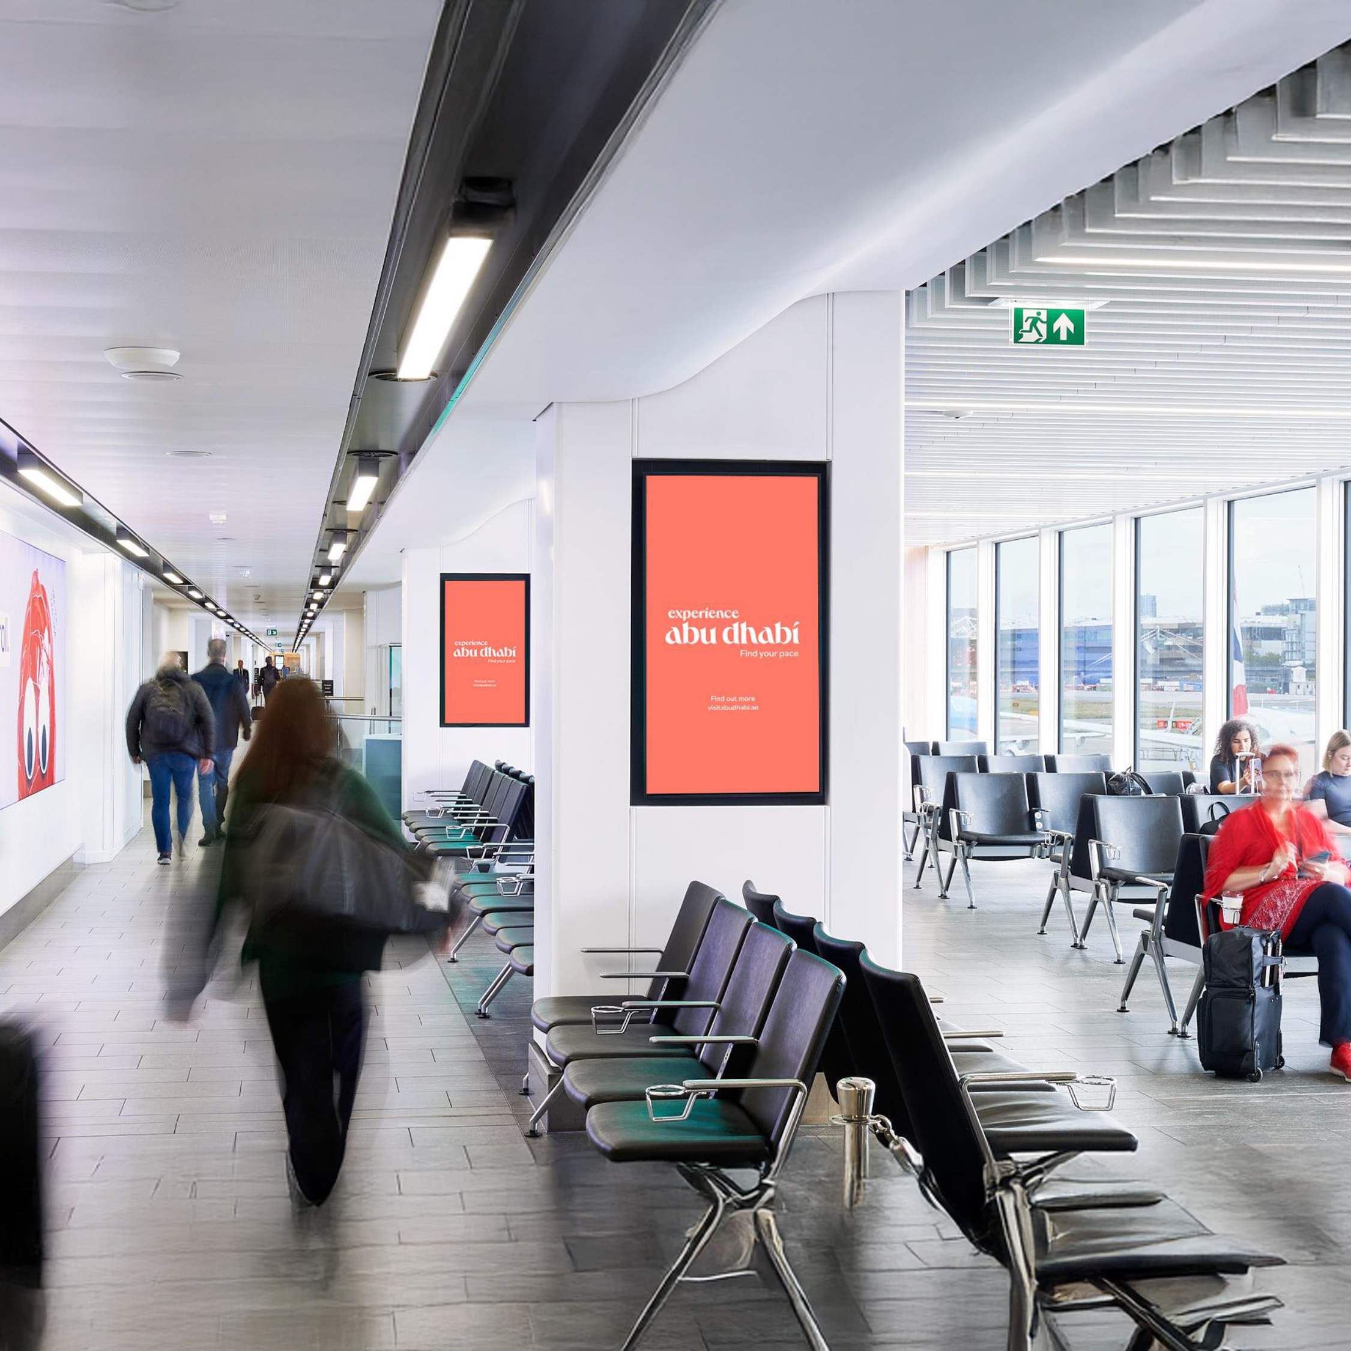
Results
High-Impact Engagement:
Thousands of travel professionals
exposed to Abu Dhabi’s messaging.
Strategic Brand Awareness:
Increased visibility within a highly relevant audience.
Effective Budget Utilization
Maximized exposure with well-placed digital assets.
Pag. 05

Slide 6



Key Takeaways
By strategically deploying pDOOH advertising at ExCeL London, Abu Dhabi Tourism successfully engaged a targeted audience at WTM 2024, reinforcing its position as a must-visit global destination.
Looking Ahead
With this campaign’s success, Abu Dhabi Tourism continues to explore innovative ways to leverage pDOOH for future global events.
423,205
Impressions
38,382
Playouts
Pag. 06

Slide 7
Thank you

