Slide 1
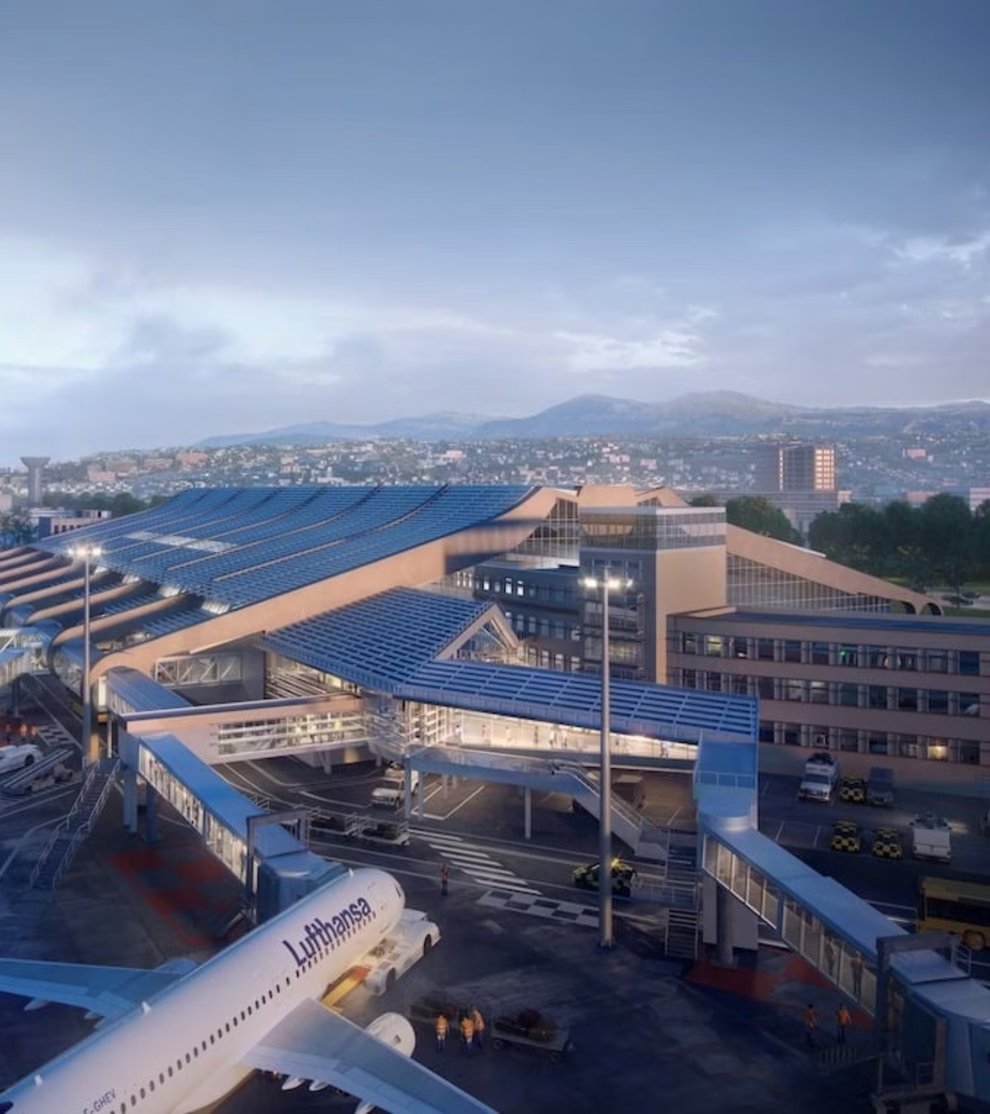
MIPIM 2026
PDOOH CAMPAIGN
Nice Côte d'Azur Airport
PDOOH Recommendations
A premium programmatic digital out-of-home activation strategy designed to captivate high-value travelers arriving at the gateway to the French Riviera — perfectly timed for MIPIM 2026.

Slide 2
Campaign at a Glance
This activation delivers massive reach across Nice Côte d'Azur Airport's digital network, placing your brand directly in the path of MIPIM attendees, UHNWIs, and global investors during one of the world's most prestigious real estate event.
1.92M
85
1
$50K
Forecasted Impressions
Estimated Screens
Venue Type
Total Budget
High-frequency exposure across the terminal network
Comprehensive airport-wide digital coverage
Airport — premium captive audience environment
Efficient CPM across a high-impact venue

Slide 3

CAMPAIGN OVERVIEW
Campaign Overview
The activation runs from March 9 to March 13, 2026 — strategically aligned with the MIPIM 2026 period to maximize exposure among elite international travelers, industry delegates, and VIP attendees transiting through Nice Côte d'Azur Airport.
Line Item
Start Date
End Date
Screens
Budget
Daily Budget
Impressions
Airport
3/9/2026
3/13/2026
85
$50,000
10,000 USD
1,929,998
With a daily budget of $10,000 USD, the campaign ensures consistent, high-frequency delivery throughout the activation window — generating over 1,929,998 forecasted impressions across the airport's premium digital signage network.

Slide 4

GEO TARGETING
Geo Targets
The campaign targets screens exclusively within Nice, France, ensuring your brand reaches travelers at the primary airport serving MIPIM 2026 and the broader French Riviera. Two geo-targeting configurations provide comprehensive coverage across the terminal network.
Country
State / Region
City
Number of Screens
France
—
Nice
76
France
Provence-Alpes-Côte d'Azur
Nice
9
Together, these 85 screens form a powerful network spanning arrivals, departures, and high-dwell zones — capturing the attention of an international audience at the gateway for MIPIM 2026 attendees.

Slide 5


CREATIVE SPECIFICATIONS
Creative Sizes
Multiple creative formats are supported across the airport's diverse screen inventory. The dominant format is 1920×1080 (landscape), covering the vast majority of screens. Plan your hero creative in this format first, then adapt for secondary sizes to ensure full network coverage.
Ad Content Size (W×H)
Screens
Duration
Formats
1920 × 1080
78
10 sec
Image, Video
1920 × 1080
10
—
Upon Request
960 × 960
2
10 sec
Image, Video
1080 × 1920
2
—
Upon Request
1152 × 960
1
10 sec
Image, Video
576 × 576
1
10 sec
Image, Video
576 × 960
1
10 sec
Image, Video
768 × 960
1
10 sec
Image, Video
1056 × 576
1
10 sec
Image, Video
The standard spot duration is 10 seconds. Both static image and video formats are accepted on most screens. Certain placements require custom specifications.

Slide 6
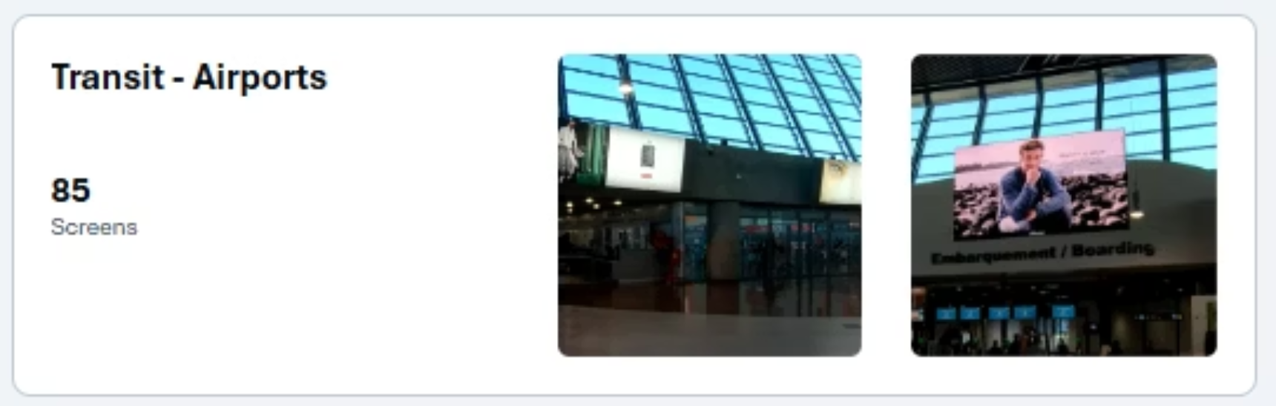

VENUE TYPES
Venue Types
This campaign activates exclusively within the airport venue category — one of the most powerful environments for luxury and event-driven advertising. Airport audiences are captive, affluent, and in a heightened state of attention, making them ideal recipients of premium brand messaging during the MIPIM 2026 window.
High Dwell Time
Affluent Audience
Captive Environment
Travelers spend an average of 2+ hours in the terminal — extended exposure to your message
Airport travelers skew high-income, making them the ideal audience for luxury brand activations
Limited distractions and clear sightlines ensure strong viewability and recall

Slide 7
VENUE DEEP DIVE
Nice Côte d'Azur Airport
France's third-busiest airport and the premier gateway to the French Riviera. During the MIPIM 2026 period, the airport welcomes a surge of international VIPs, real estate professionals, luxury travelers and media from around the globe — presenting an unparalleled opportunity to connect with the world's most influential audiences at scale.

Slide 8
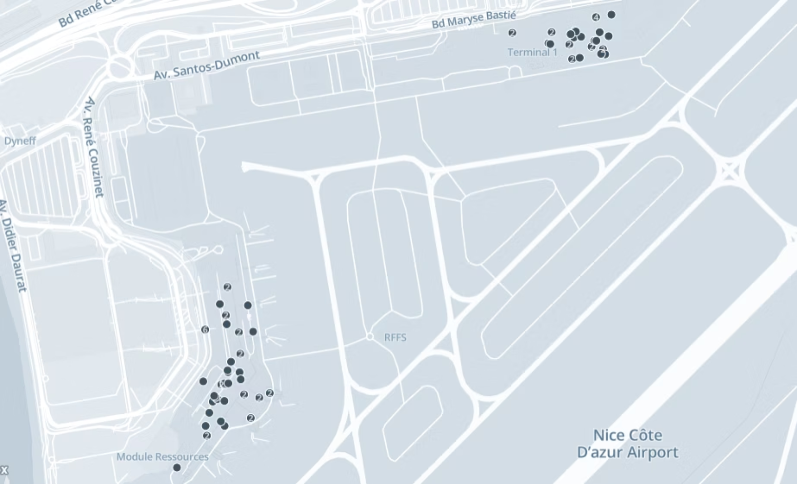

SCREEN MAP
Screen Map View
The network of 85 digital screens is strategically distributed across the airport's terminals, covering key passenger touchpoints including check-in areas, security queues, departure gates, baggage claim, and arrival corridors. This comprehensive placement ensures multiple impressions per traveler throughout their airport journey.
85 Total Screens
Multiple Touchpoints
High-Traffic Zones
Full airport coverage across departures and arrivals
From check-in to boarding, repeated brand exposure
Screens positioned in peak dwell-time locations

Slide 9

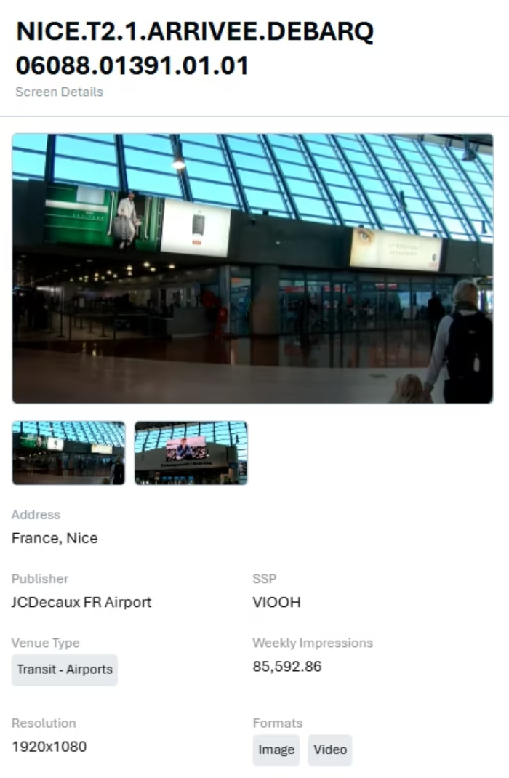
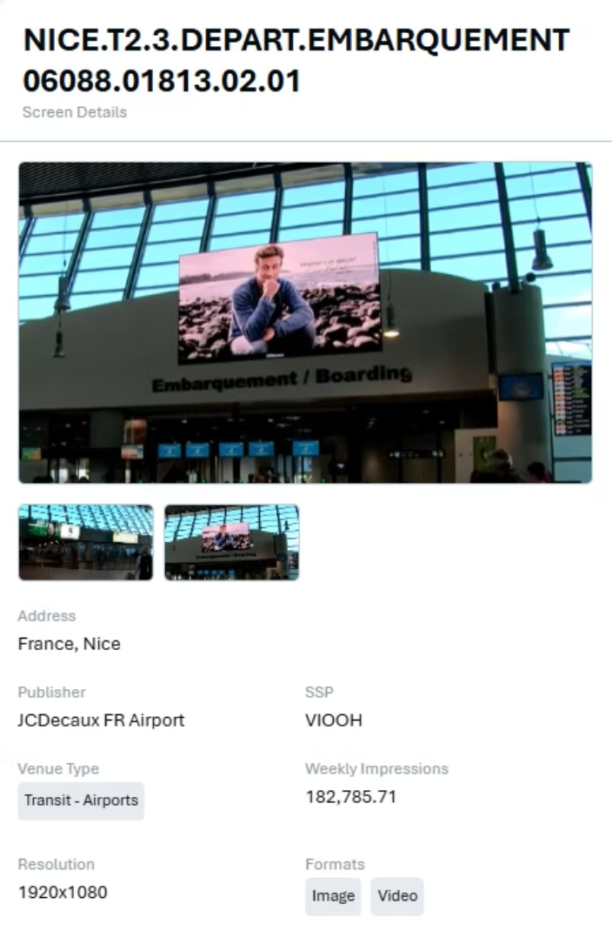

SCREEN EXAMPLES — SET 1
Screen Placements
Below are representative of digital screen placements within Nice Côte d'Azur Airport, showcasing the prominent positioning and high-visibility formats available for your campaign creative.
Caution: Programmatic Digital Out-of-Home (pDOOH) campaigns do not provide full activation screen-level proof. While impression delivery and play logs are available, platform-level reporting for MIPIM 2026 does not guarantee visibility on every individual screen at every moment for all MIPIM attendees.

Slide 10
Thank You
We look forward to bringing your brand to life at Nice Côte d'Azur Airport during MIPIM 2026.
85 Screens
1.92M+ Impressions
$50,000 Budget
Full airport coverage
Massive reach during MIPIM 2026
Premium yet efficient

