Slide 1
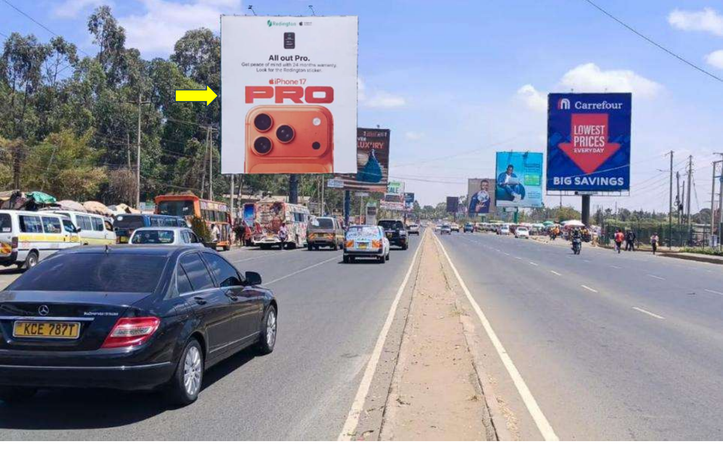
Karen – The Hub Mall Junction

Slide 2
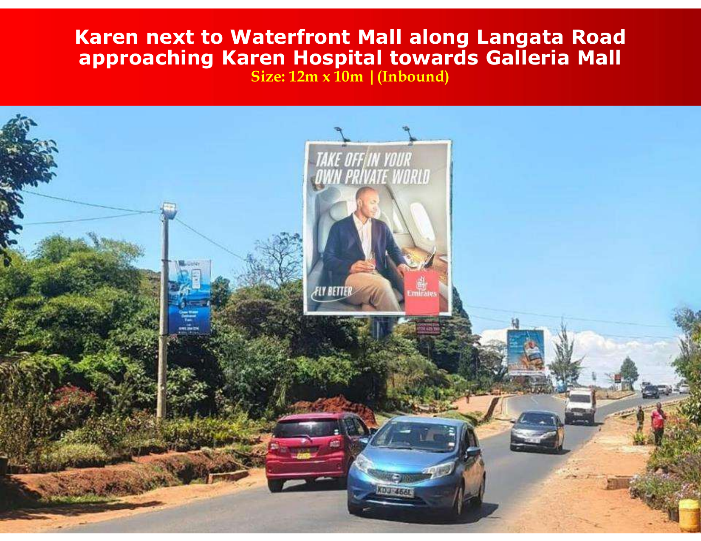
Karen – Waterfront / Langata Road

Slide 3
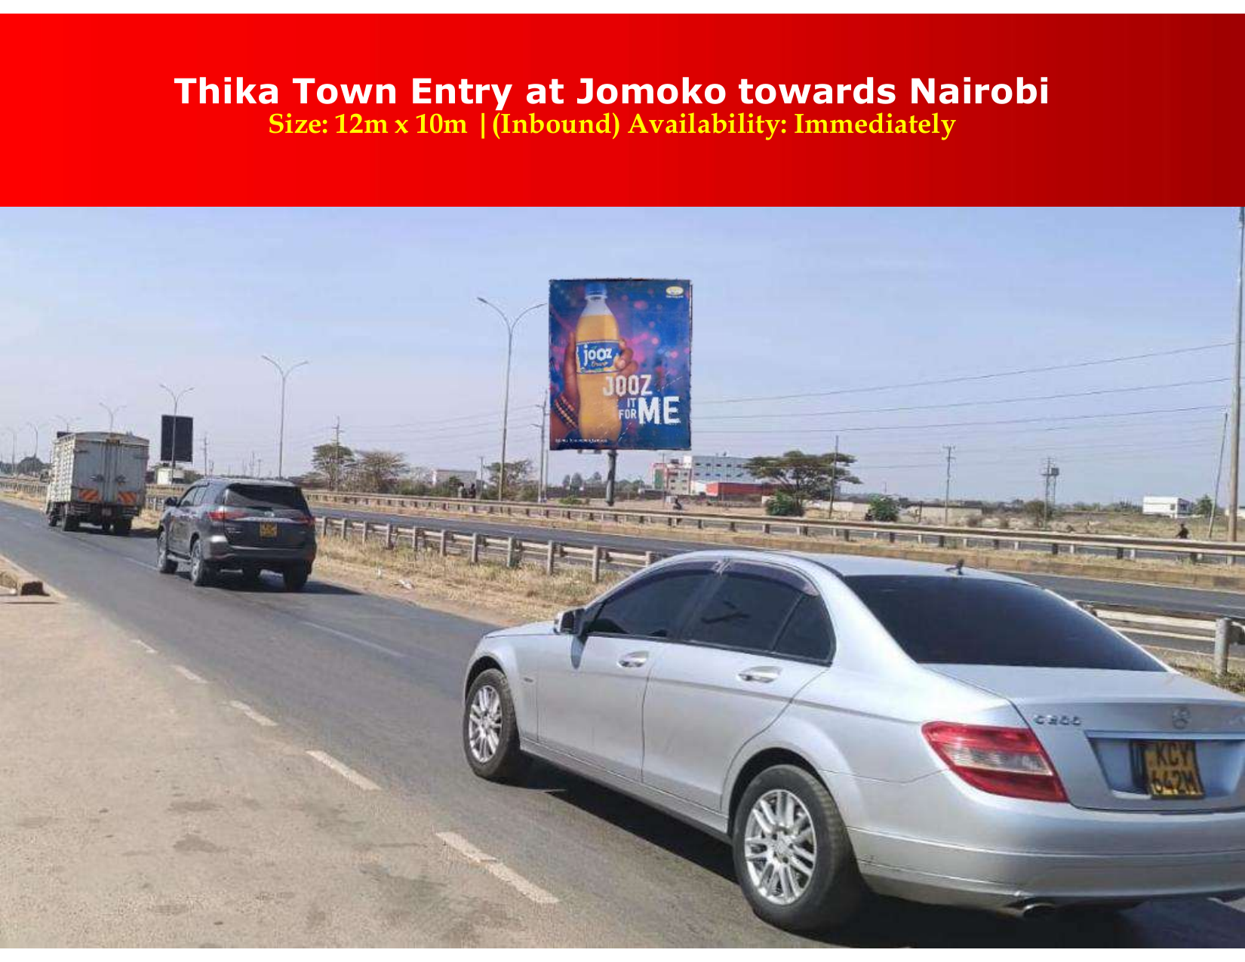
Thika Town Entry – Jomoko

Slide 4
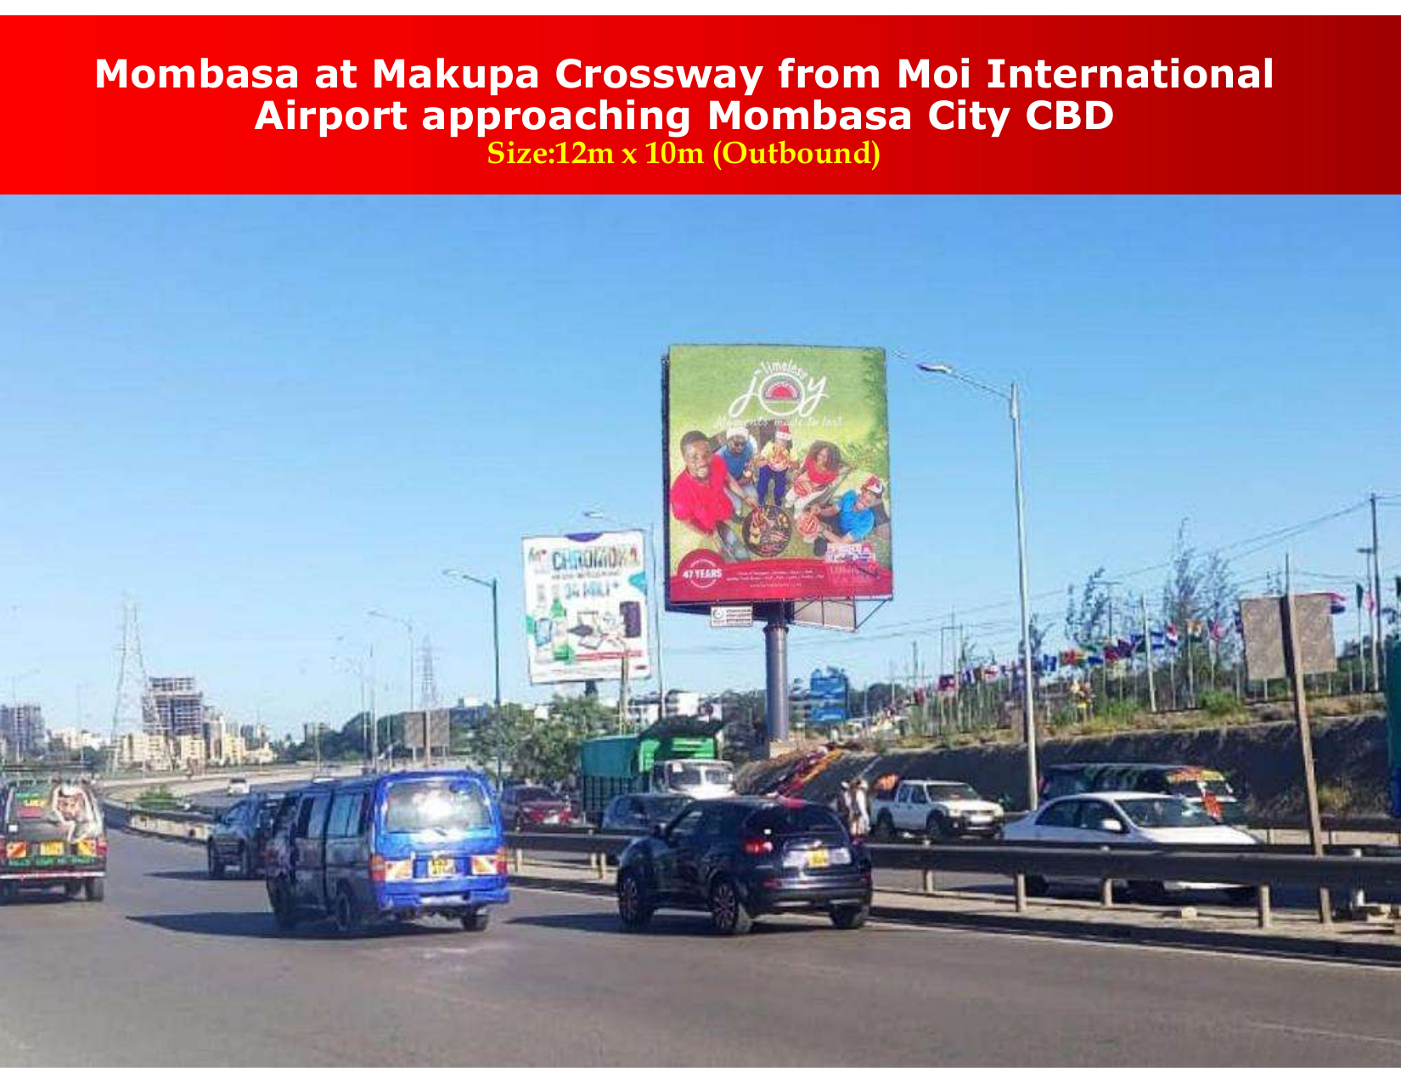
Makupa Crossway – Airport to CBD

Slide 5
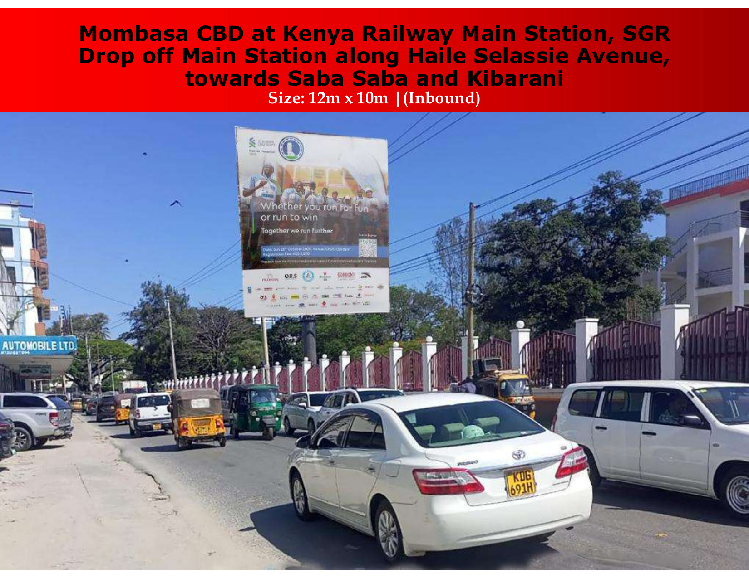
Mombasa CBD – SGR Drop-Off

Slide 6
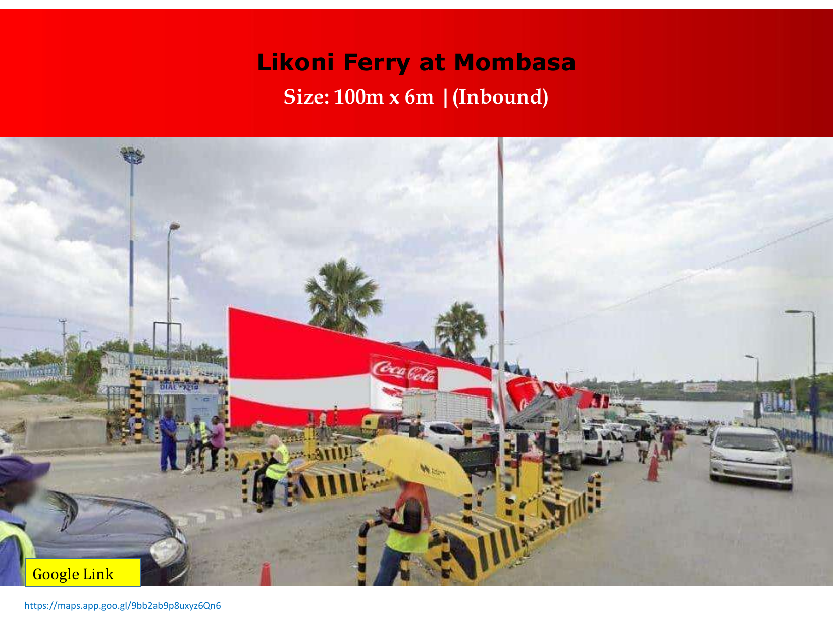
Likoni Ferry – Landmark 100m Format

Slide 7
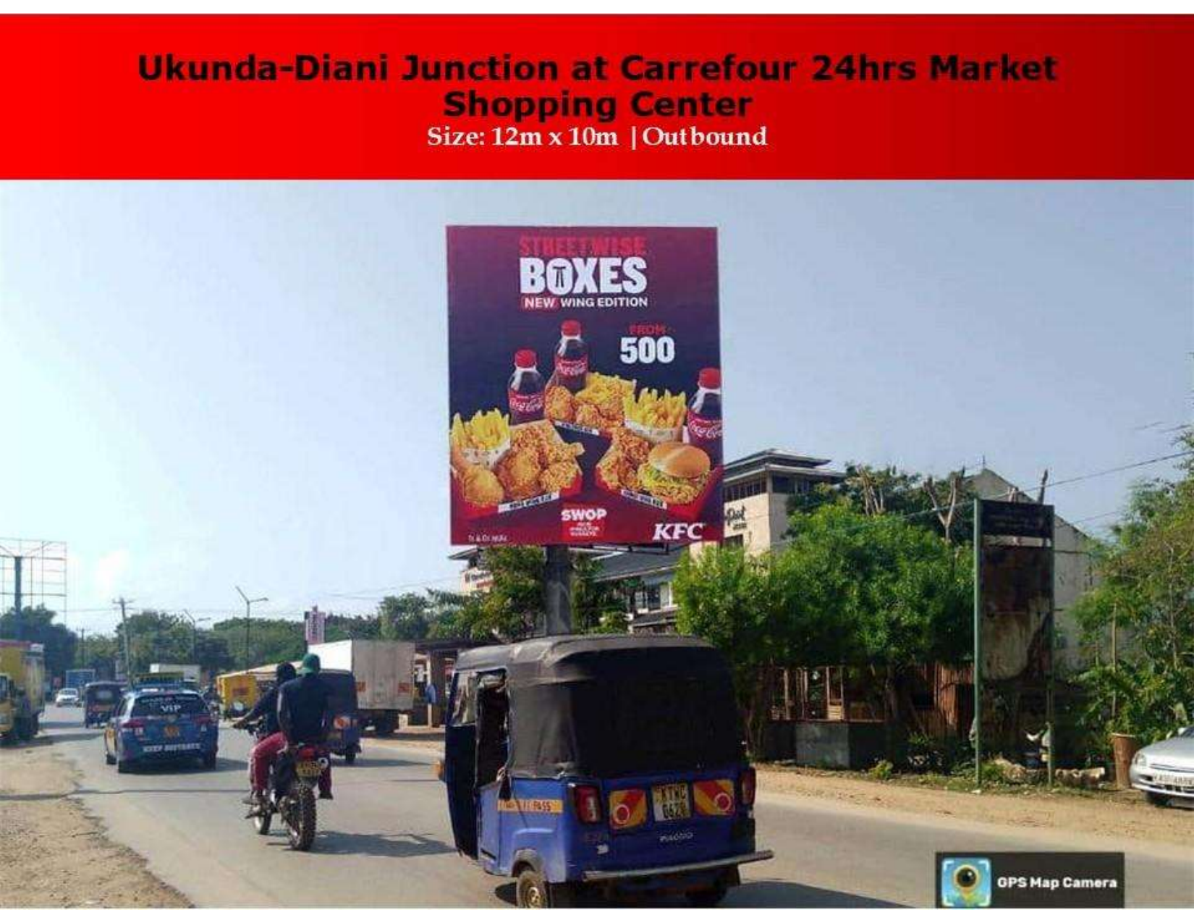
Ukunda – Diani Junction

Slide 8
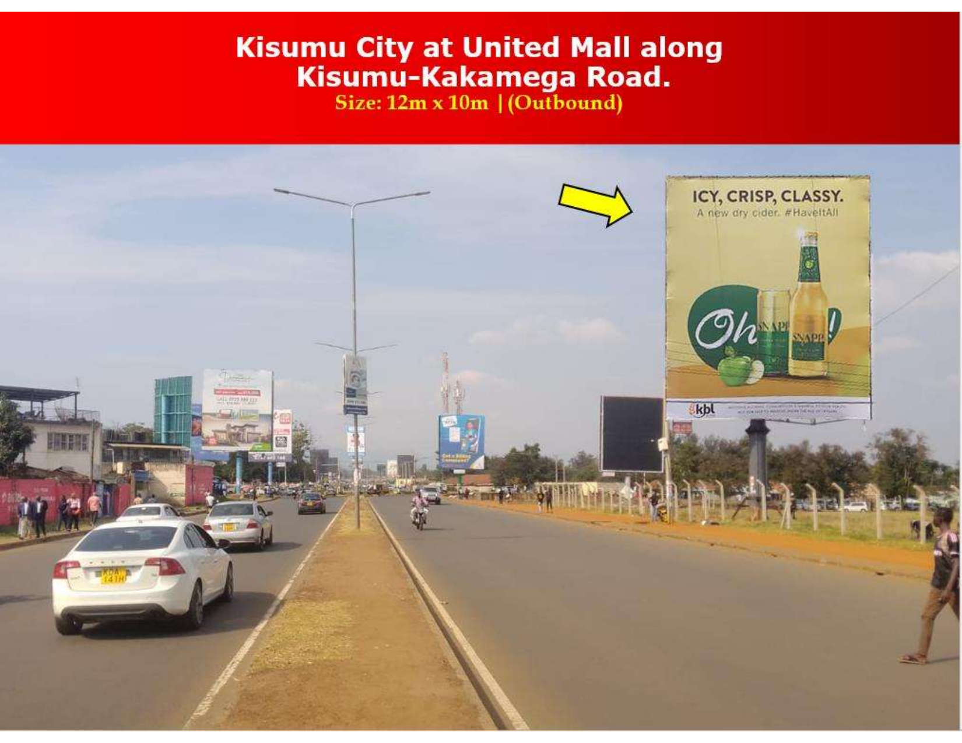
Kisumu – United Mall Corridor

Slide 9
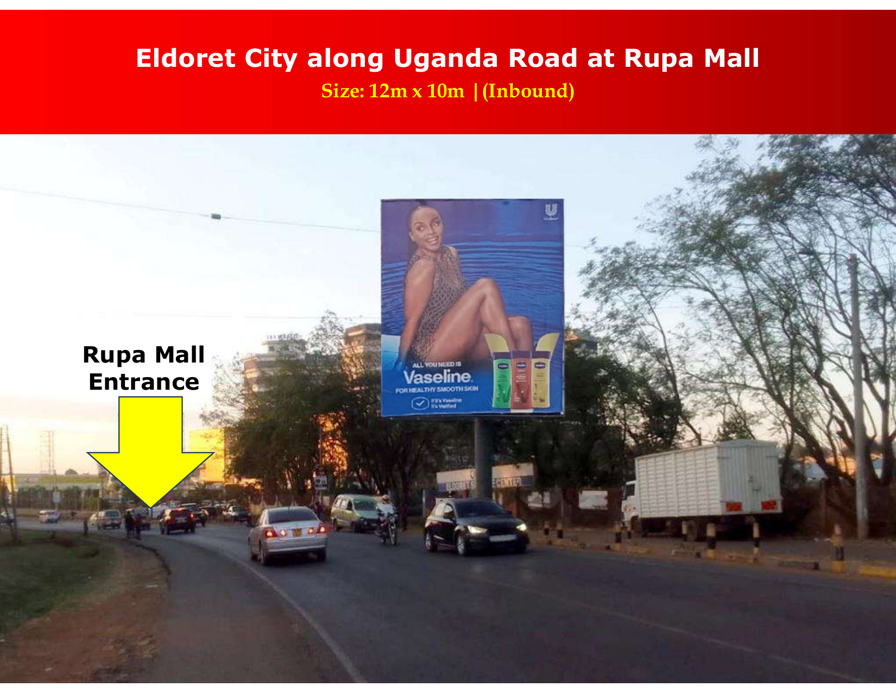
Eldoret – Rupa Mall Corridor

Slide 10
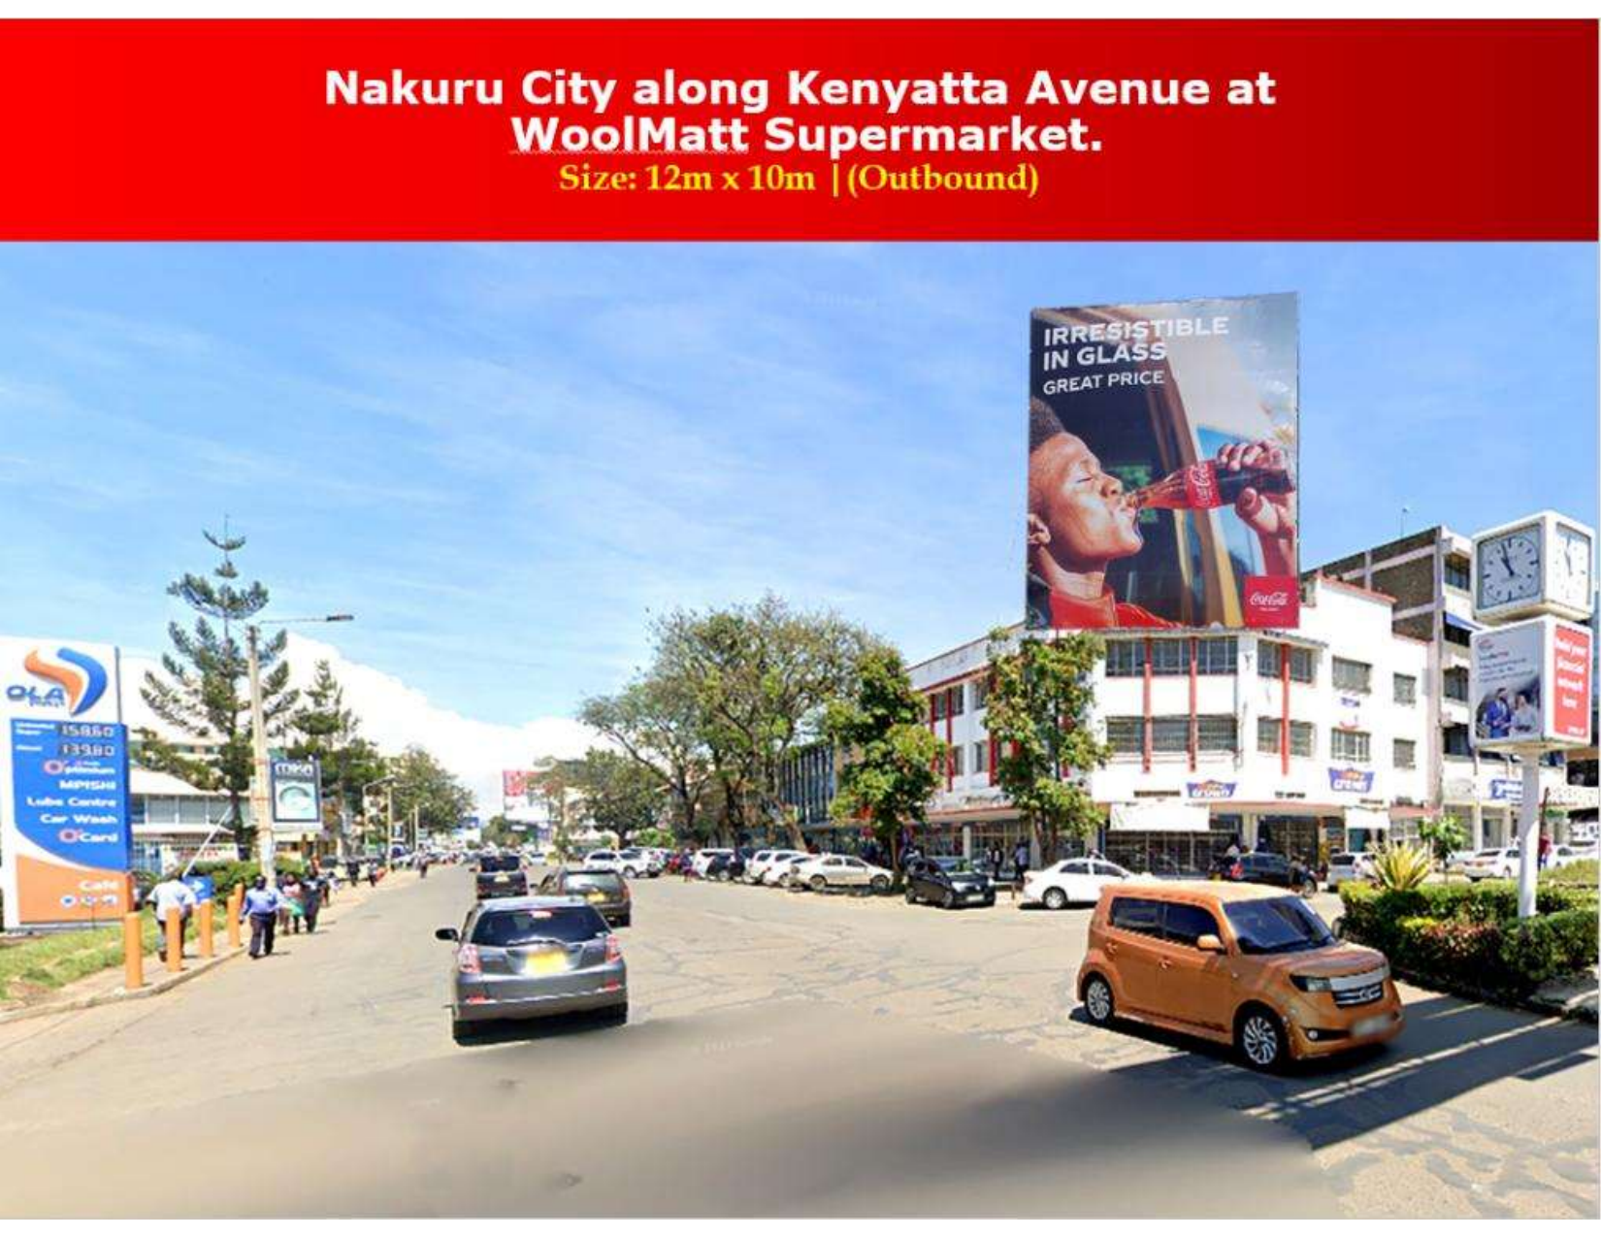
Nakuru – Kenyatta Avenue

Slide 11
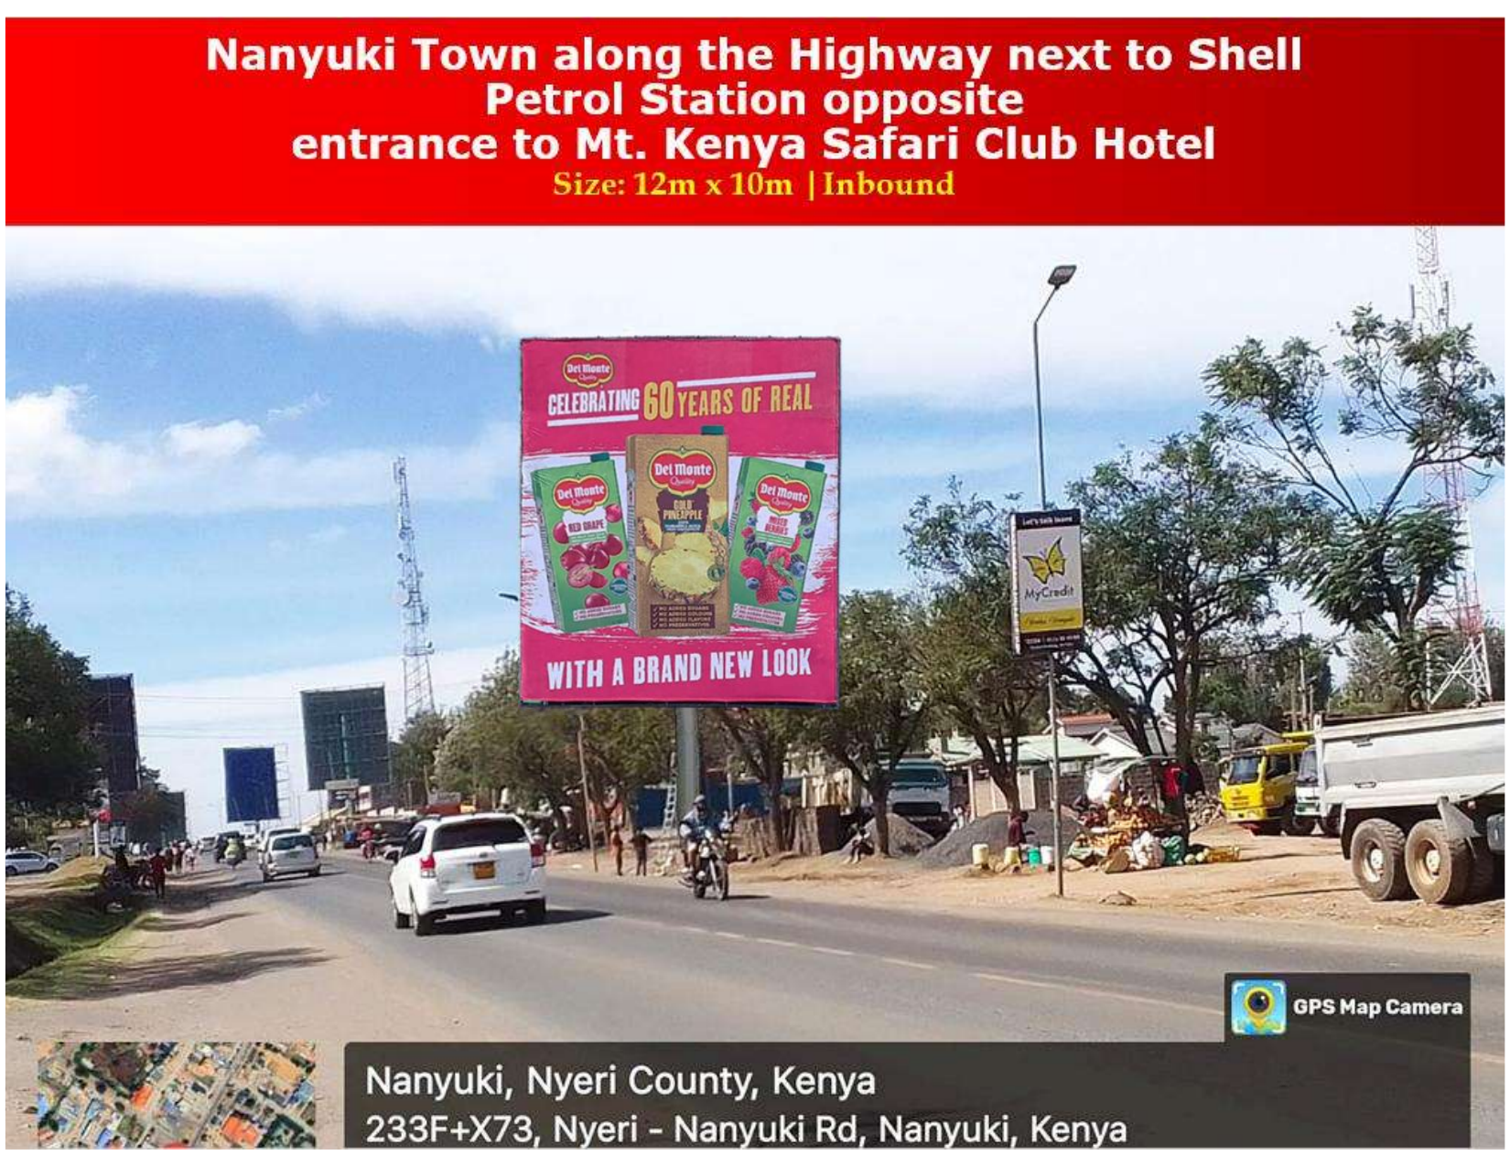
Nanyuki – Mt Kenya Corridor

Slide 12
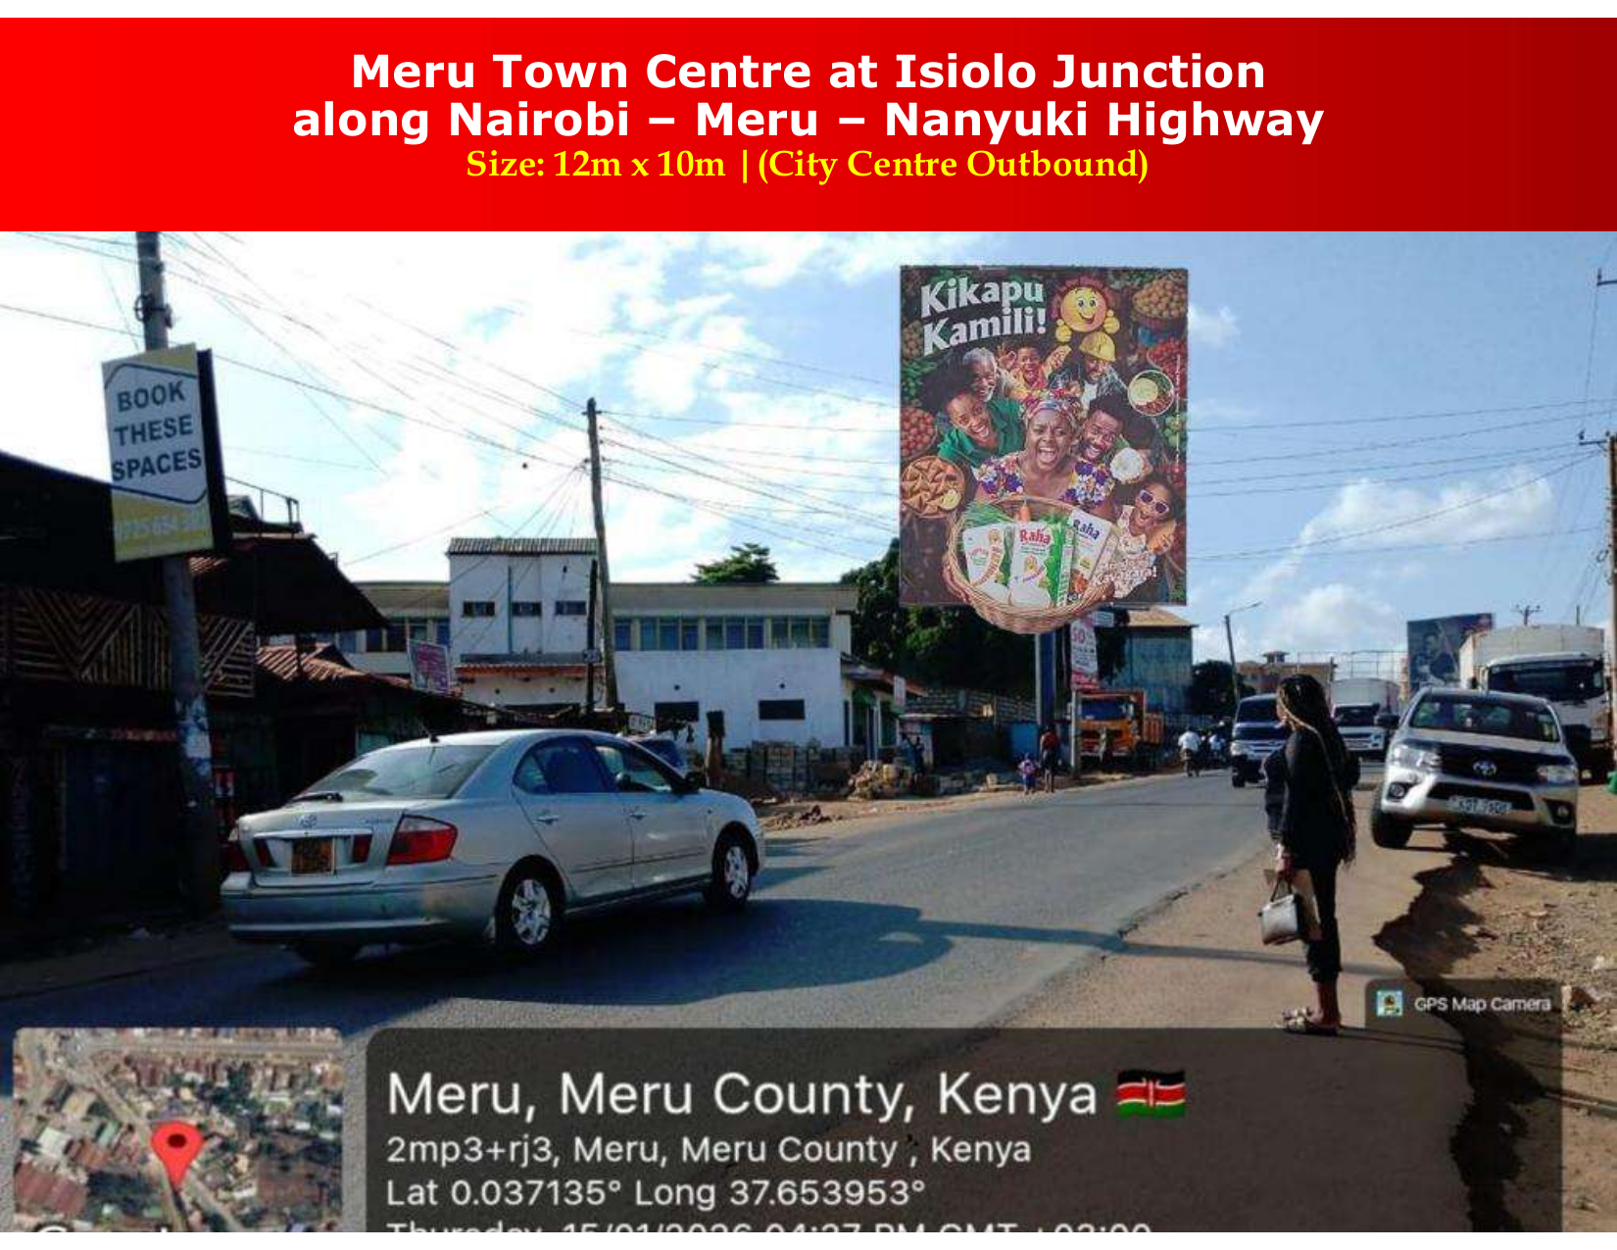
Meru – Isiolo Junction

Slide 13
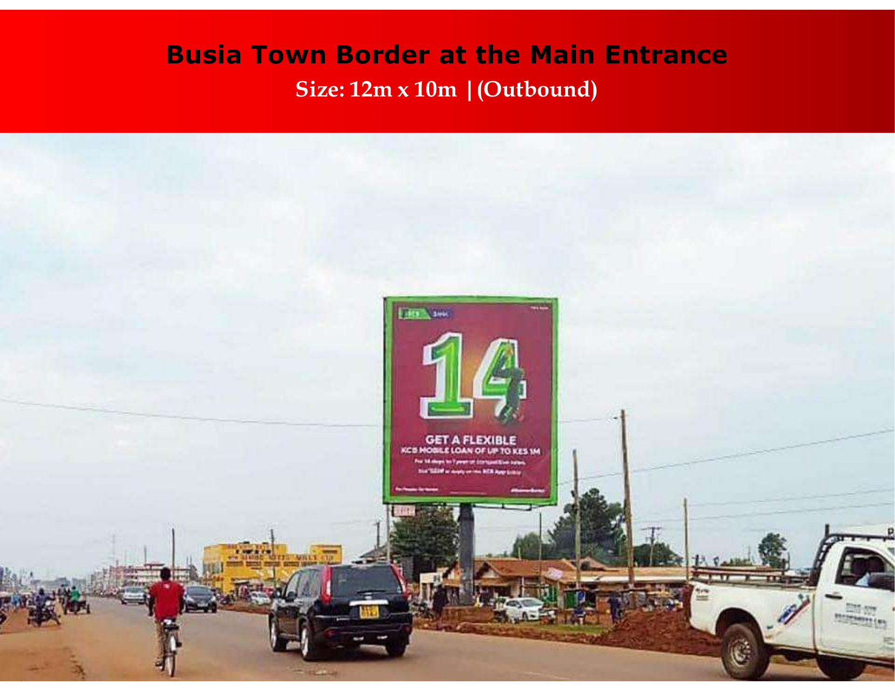
Busia Border – Main Entrance

