Slide 1
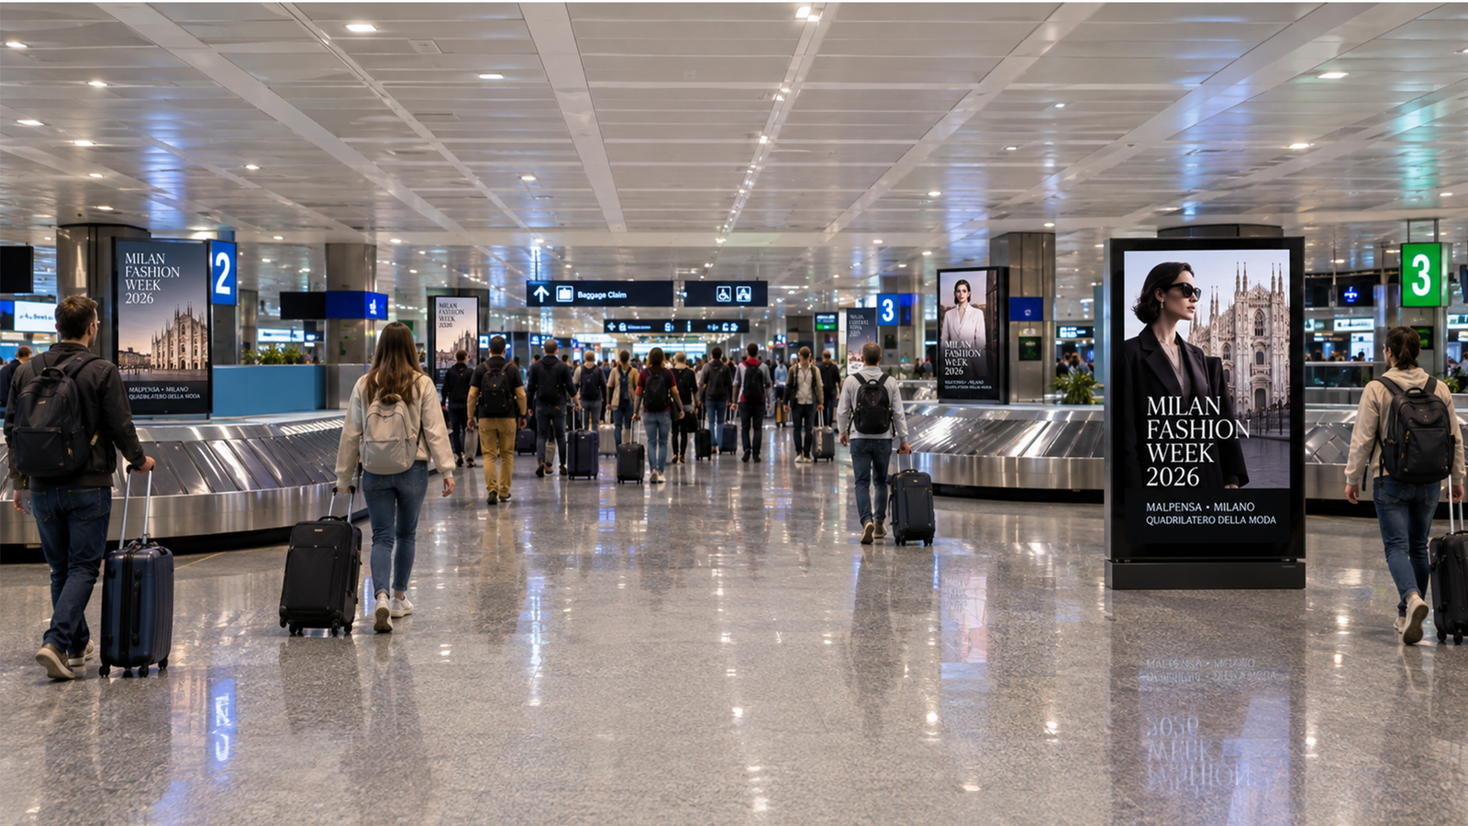
PROGRAMMATIC DOOH PROPOSAL
Milan Fashion Week 2026
Milano Moda Donna — Reaching Buyers, Press & Private Clients Across Milan
Milan-Malpensa Airport + Metropolitan City DOOH · 22–28 September 2026
THE EXPLORE PACKAGE — $250/hr · $20,000/wk min.
Prepared by Masscom Global — Wealth in motion intelligence.

Slide 2
THE OPPORTUNITY
Milano Moda Donna: Seven Days Where Fashion
Capital Meets Global Buying Power
22–28 SEP
2.76M+
150+
5–15M
2026, Milan
Quadrilatero della Moda
Monthly passengers across
the Milan airport system
Digital screens across
airport & city network
Estimated monthly
impressions available
Milano Moda Donna, organized by Camera Nazionale della Moda Italiana, draws international buyers, press and private clients into a compact, walkable circuit — arriving through Malpensa and moving through the Quadrilatero della Moda for a single, dense week.
HOW THE SEVEN DAYS SHAPE A FLIGHT
Tue–Wed (22–23 Sep): Arrival weight — buyers & press land first
Thu–Fri (24–25 Sep): Private-client & talent arrivals cluster mid-week
Sat–Sun (26–27 Sep): Departure weight, as the audience moves on to Paris
MASSCOM GLOBAL | Milan Fashion Week 2026 PDOOH Proposal
02

Slide 3
MEDIA INTELLIGENCE
The Reachable Audience
Derived from Masscom Global's September 2026 Milan media-planning window
2.76 million+
passengers a month across the Milan airport system
150+
$1,500
3–5 days
5–15M
Digital screens in
multiple formats
Per day, entry
package pricing
From brief to
live screens
Estimated monthly
impressions
Daily-rate pricing and a three-to-five-day activation window mean Malpensa placements can be weighted precisely — to the early arrivals wave, the mid-week private-client cluster, or the departure side as the audience moves on to Paris.
MASSCOM GLOBAL | Milan Fashion Week 2026 PDOOH Proposal
03

Slide 4
MEDIA INTELLIGENCE
How the Seven Days Actually Shape a Flight
Daily-rate flexibility lets the plan follow the audience through the week
Tue
22 Sep
Wed
23 Sep
Thu
24 Sep
Fri
25 Sep
Sat
26 Sep
Sun
27 Sep
Mon
28 Sep
Arrival weight · buyers & press
Private-client & talent arrivals
Departure weight · onward to Paris
Daily rates and a three-to-five-day activation mean Malpensa can be weighted to arrivals early, to the private-client cluster mid-week, and to the departure side as the audience moves on to Paris.
MASSCOM GLOBAL | Milan Fashion Week 2026 PDOOH Proposal
04

Slide 5
MEDIA INTELLIGENCE
Milan vs. the World's Fashion Capitals
Screen density and passenger volume at comparable European hubs
Milan Malpensa (MXP) ★ This Campaign
150+
2.76M / mo
digital screens
London Heathrow
567
6.6M / mo
digital screens
Frankfurt
359
5.0M / mo
digital screens
Paris Charles de Gaulle
274
5.6M / mo
digital screens
Zurich
219
1.3M / mo
digital screens
Milan carries fewer screens than the largest European hubs — meaning less clutter and a lower cost of entry, while still reaching a 2.76M+ monthly passenger base concentrated around a single, dense fashion-week window.
Source: Masscom Global network data. Comparison hub figures are drawn from the same network dataset; pricing, activation timeline and impression ranges are current rate-card estimates, not guarantees.
MASSCOM GLOBAL | Milan Fashion Week 2026 PDOOH Proposal
05

Slide 6
CAMPAIGN INVESTMENT
Campaign Summary
The Explore Package — Milan-Malpensa Airport + Metropolitan City, balanced weekly investment
264
9
$20,000
35.1M
Targetable Screens
Venue Types
Total Weekly Budget
Weekly Impressions
Line Item | Start | End | # Screens | Weekly Budget | Daily Budget
Milan-Malpensa Airport (MXP) | 9/22/2026 | 9/28/2026 | 105 | $10,000 | $1,428.57
Milan Metropolitan City | 9/22/2026 | 9/28/2026 | 159 | $10,000 | $1,428.57
Campaign window spans the confirmed 22–28 September 2026 Milano Moda Donna dates, split evenly across the airport and city line items — a total investment of $20,000 per week. Weekly impressions: ~23.2M across MXP and ~11.8M across the city network — 35.1M total per week, per Masscom Global's Milan inventory file.
Caution: Programmatic Digital Out-of-Home (pDOOH) campaigns do not provide full activation screen-level proof. While delivery and play logs are available, platform-level reporting does not guarantee visibility on every individual screen at every moment.
MASSCOM GLOBAL | Milan Fashion Week 2026 PDOOH Proposal
06

Slide 7
CAMPAIGN PLAN
Venue Type Mix
264 screens across airport transit and premium city outdoor formats
MALPENSA AIRPORT (MXP) — 105 SCREENS
MILAN METROPOLITAN CITY — 159 SCREENS
Venue Type | Screens
Departures Hall | 43
Shopping Area | 21
Arrival Hall | 20
Baggage Claim | 11
Transit – Airports (general) | 7
Food Court | 3
Venue Type | Screens
Outdoor – Billboards | 95
Outdoor – Billboards – Roadside | 52
Outdoor – Billboards – Spectacular | 12
Airport inventory is weighted to Departures Hall (41%) and Shopping Area — the two zones where international buyers and press dwell longest before connecting onward. City inventory leans on high-visibility roadside and spectacular billboard formats across the Quadrilatero della Moda and arterial routes.
Caution: Programmatic Digital Out-of-Home (pDOOH) campaigns do not provide full activation screen-level proof. While delivery and play logs are available, platform-level reporting does not guarantee visibility on every individual screen at every moment.
MASSCOM GLOBAL | Milan Fashion Week 2026 PDOOH Proposal
07

Slide 8
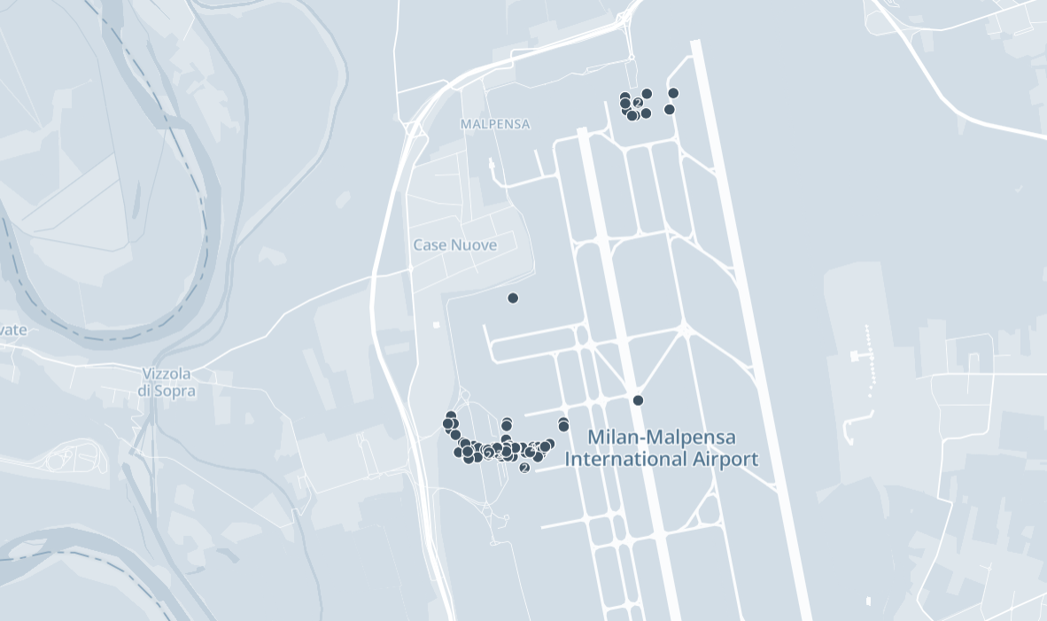
AIRPORT COVERAGE
Milan-Malpensa International Airport (MXP)
105 available screens across arrivals, departures & shopping zones
105
Available screens
6
Venue types across the terminals
23.2M
Weekly impressions (MXP)
Milan-Malpensa is Italy's principal gateway for international fashion traffic — part of a Milan airport system carrying 2.76M+ passengers monthly. Screens span both terminals, weighted to the arrivals-to-baggage journey where buyers and press first land.
Caution: Programmatic Digital Out-of-Home (pDOOH) campaigns do not provide full activation screen-level proof. While delivery and play logs are available, platform-level reporting does not guarantee visibility on every individual screen at every moment.
MASSCOM GLOBAL | Milan Fashion Week 2026 PDOOH Proposal
08

Slide 9
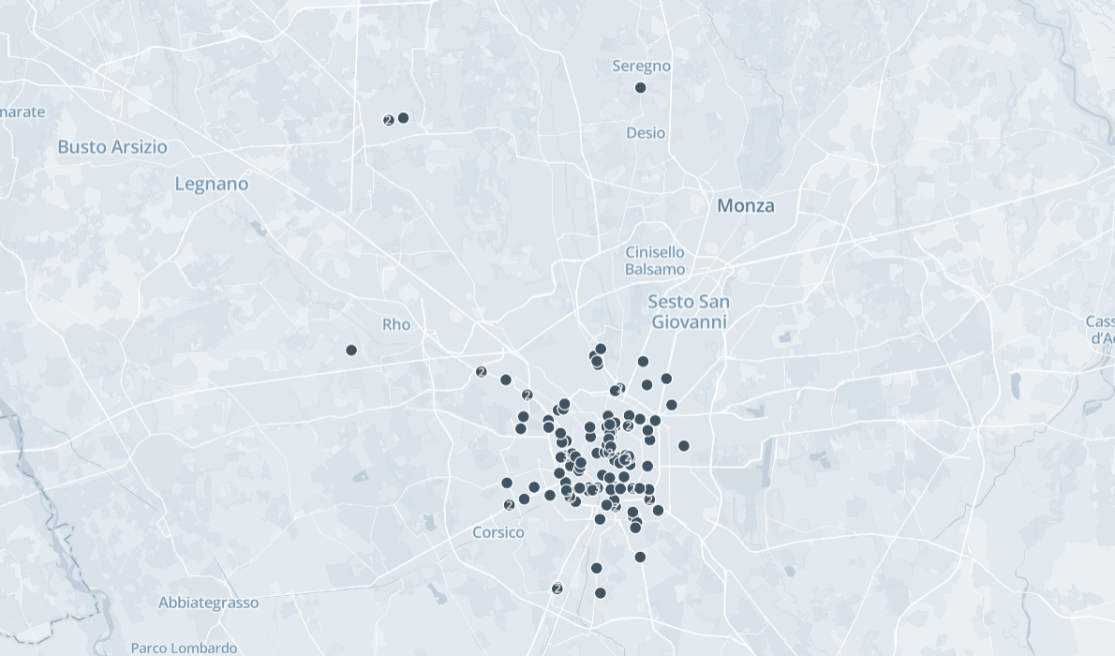
CITY COVERAGE
Milan Metropolitan City
159 available screens across the Quadrilatero della Moda and arterial routes
159
Available city screens
3
Outdoor billboard formats —
roadside, standard & spectacular
11.8M
Weekly impressions (city)
Coverage concentrates around central Milan — the Quadrilatero della Moda, Duomo, and the arterial roads feeding the fashion district — with additional reach into Monza, Rho and Corsico for commuter and event-day traffic during the show week.
Caution: Programmatic Digital Out-of-Home (pDOOH) campaigns do not provide full activation screen-level proof. While delivery and play logs are available, platform-level reporting does not guarantee visibility on every individual screen at every moment.
MASSCOM GLOBAL | Milan Fashion Week 2026 PDOOH Proposal
09

Slide 10
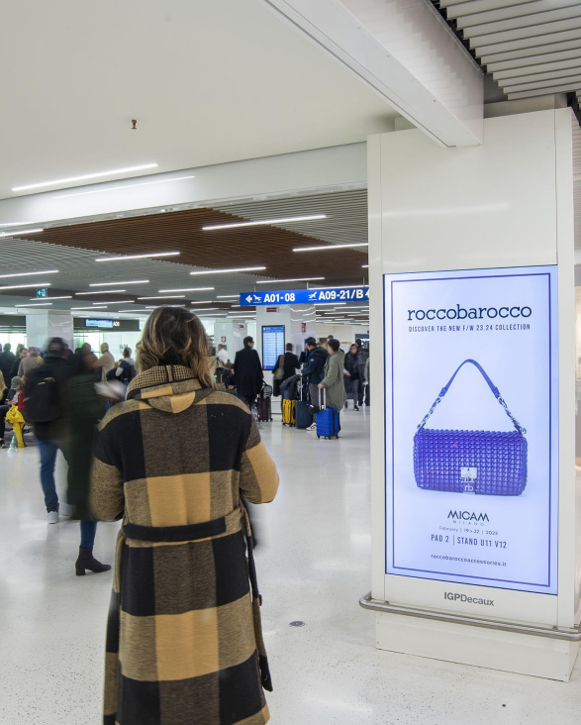
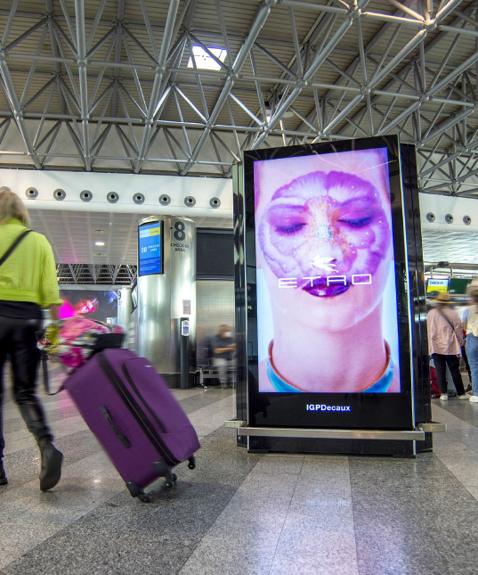
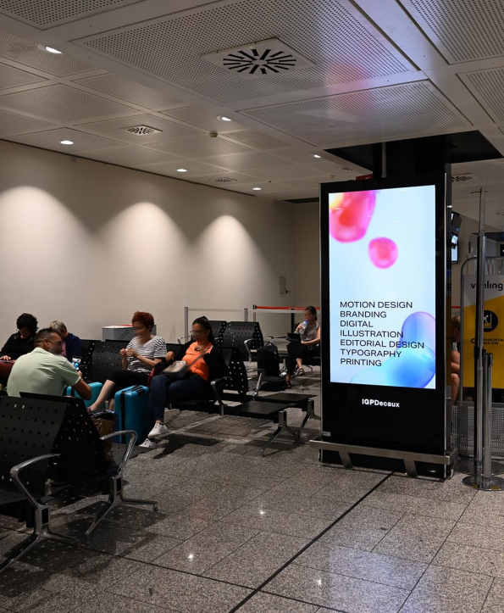
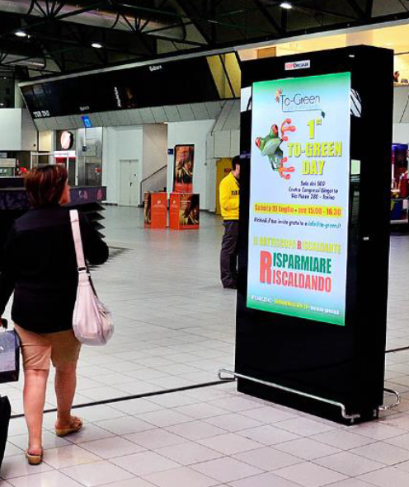
CREATIVE ENVIRONMENTS
Inventory in Context — Malpensa Airport (MXP)
A sample of premium DOOH placements across the terminal network
Roccobarocco — terminal pillar screen
Etro — terminal digital wall
Terminal concourse — freestanding kiosk
Departures lounge — digital wall
Caution: Programmatic Digital Out-of-Home (pDOOH) campaigns do not provide full activation screen-level proof. While delivery and play logs are available, platform-level reporting does not guarantee visibility on every individual screen at every moment.
MASSCOM GLOBAL | Milan Fashion Week 2026 PDOOH Proposal
10

Slide 11
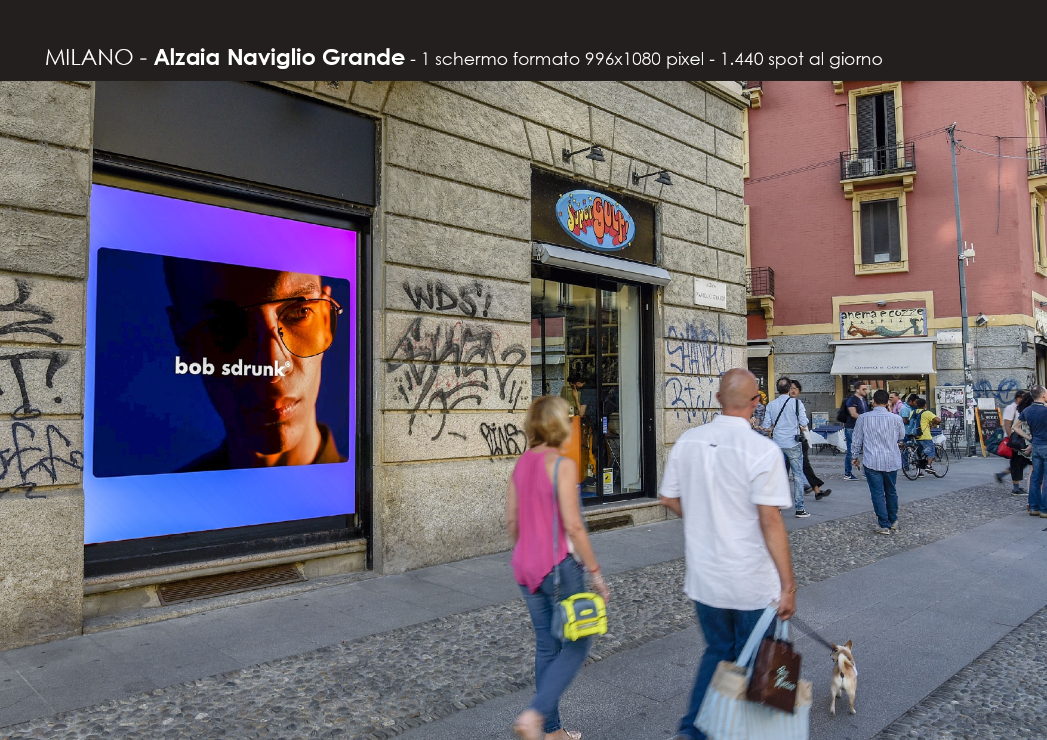
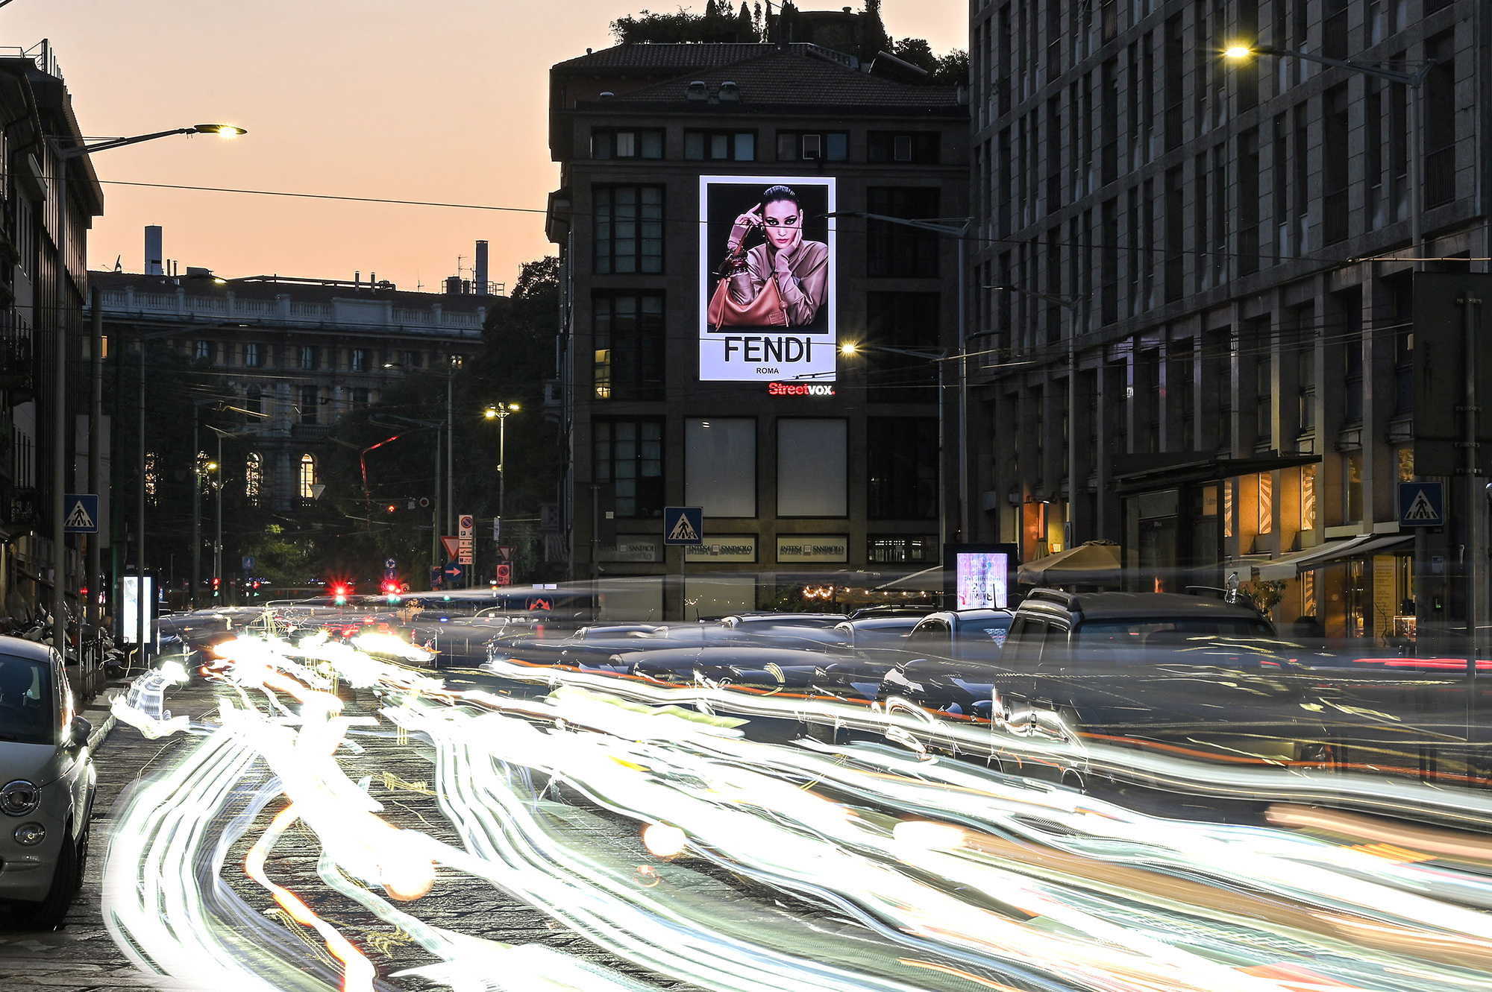
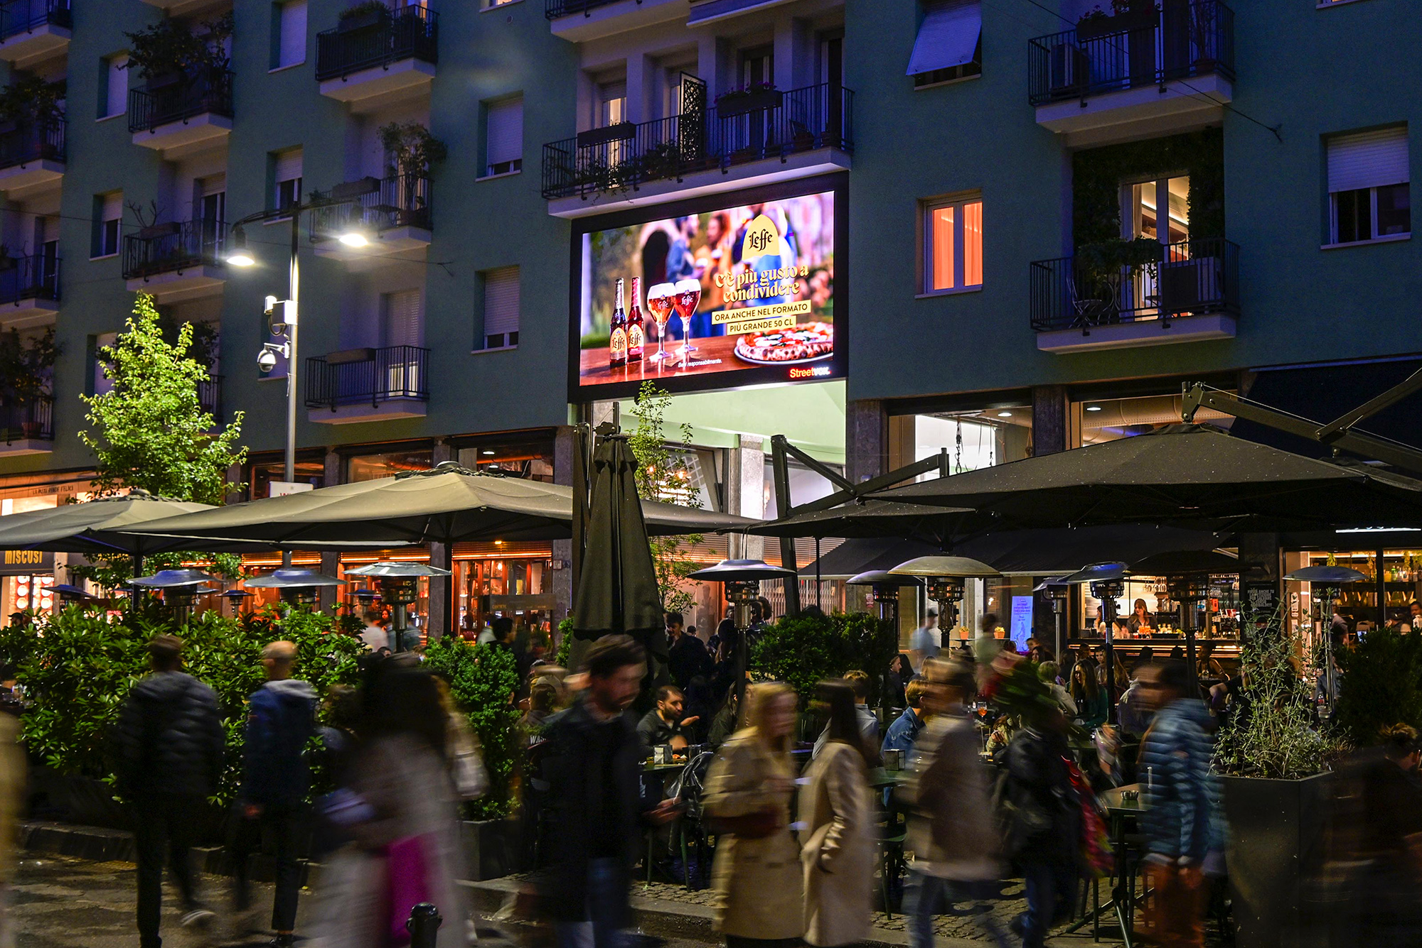
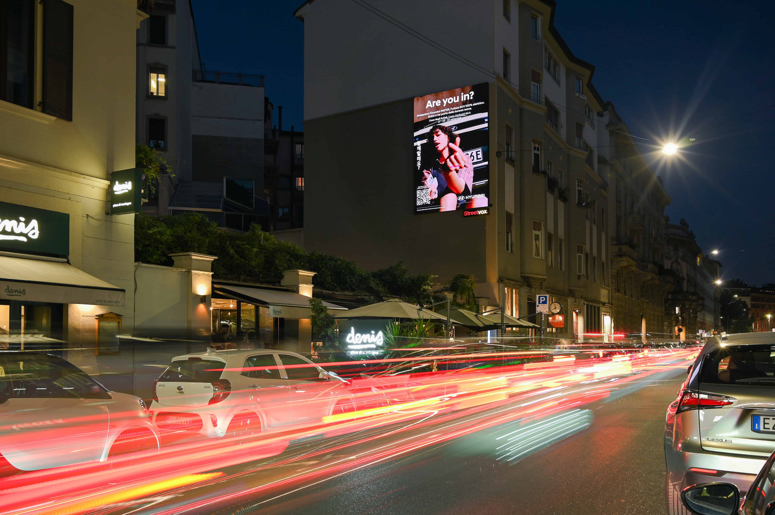
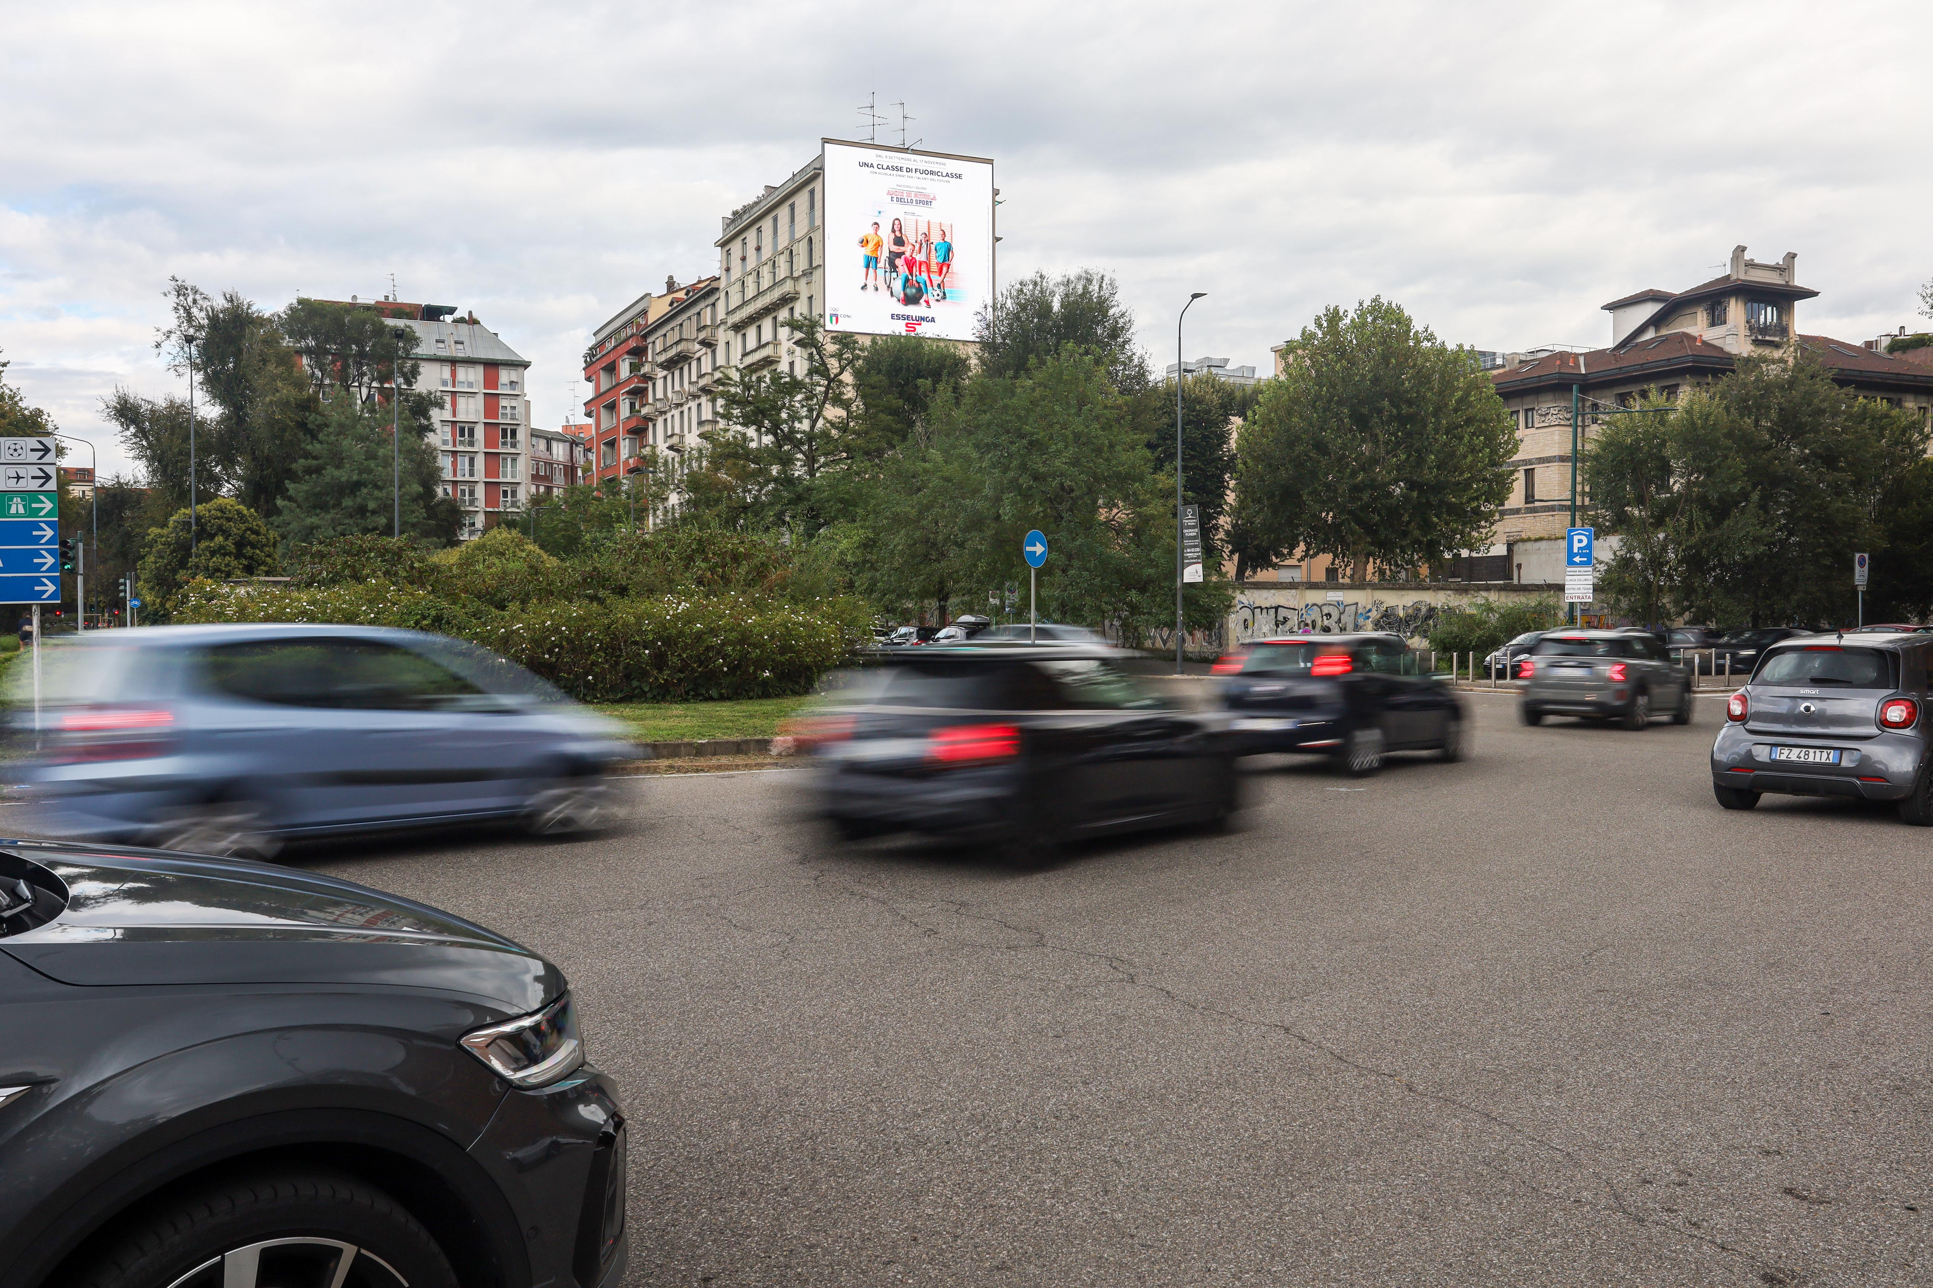
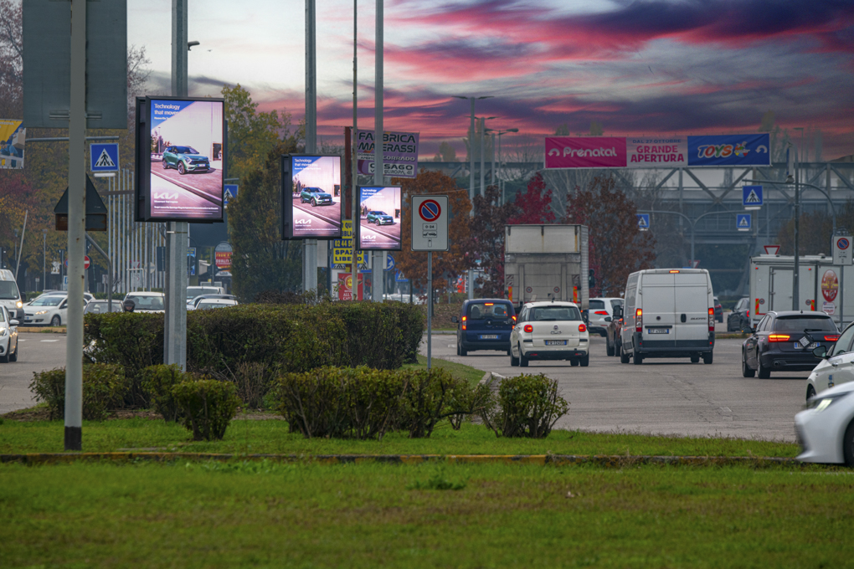
CREATIVE ENVIRONMENTS
Inventory in Context — Milan Metropolitan City
A sample of premium DOOH placements across the Quadrilatero della Moda and arterial routes
Alzaia Naviglio Grande — storefront screen
Fendi — Streetvox building-scale screen
Leffe — Streetvox neighborhood screen
Hyundai — Streetvox building-scale screen
Esselunga / CONI — roadside spectacular
Urban roundabout — digital panel cluster
Caution: Programmatic Digital Out-of-Home (pDOOH) campaigns do not provide full activation screen-level proof. While delivery and play logs are available, platform-level reporting does not guarantee visibility on every individual screen at every moment.
MASSCOM GLOBAL | Milan Fashion Week 2026 PDOOH Proposal
11

Slide 12
WHY MASSCOM GLOBAL
The Masscom Global Standard
1
Verified inventory & audience data
2
Transparent delivery reporting
Every terminal, screen count and passenger figure is checked against current operator data, not published estimates.
Proof of play, placement documentation and post-campaign reporting so you see exactly where and when creative ran.
3
Benchmarked recommendations
4
We absorb the complexity
Terminal mix and city weighting set against comparable campaigns across our 1,000+ airport network.
Negotiation, trafficking, creative specs and delivery are on us; you approve the plan and see the results.
MASSCOM GLOBAL | Milan Fashion Week 2026 PDOOH Proposal
12

Slide 13
Milano Moda Donna Runs Once a Season.
Malpensa and the Quadrilatero della Moda see their heaviest fashion-week traffic in a fixed seven-day window — a campaign confirmed after 22 September misses the arrival wave entirely.
01
02
03
Confirm budget & dates
Finalize creative specs
Approve & traffic
Lock the 9/22–9/28/2026 window across MXP and city inventory — $20,000/week total.
We supply full spec sheets per venue type and screen size.
Masscom Global handles negotiation, trafficking and delivery reporting.
Book Expert Consultation — calendly.com/masscomgx/15min
Masscom Global — Wealth in motion intelligence. | 1,000+ airports, 180+ countries
Also planning October? Ask about London Fashion Week, Paris Fashion Week, Oktoberfest, Monaco Yacht Show & SF Dreamforce — the full Masscom Global Combo Menu.

