Slide 1
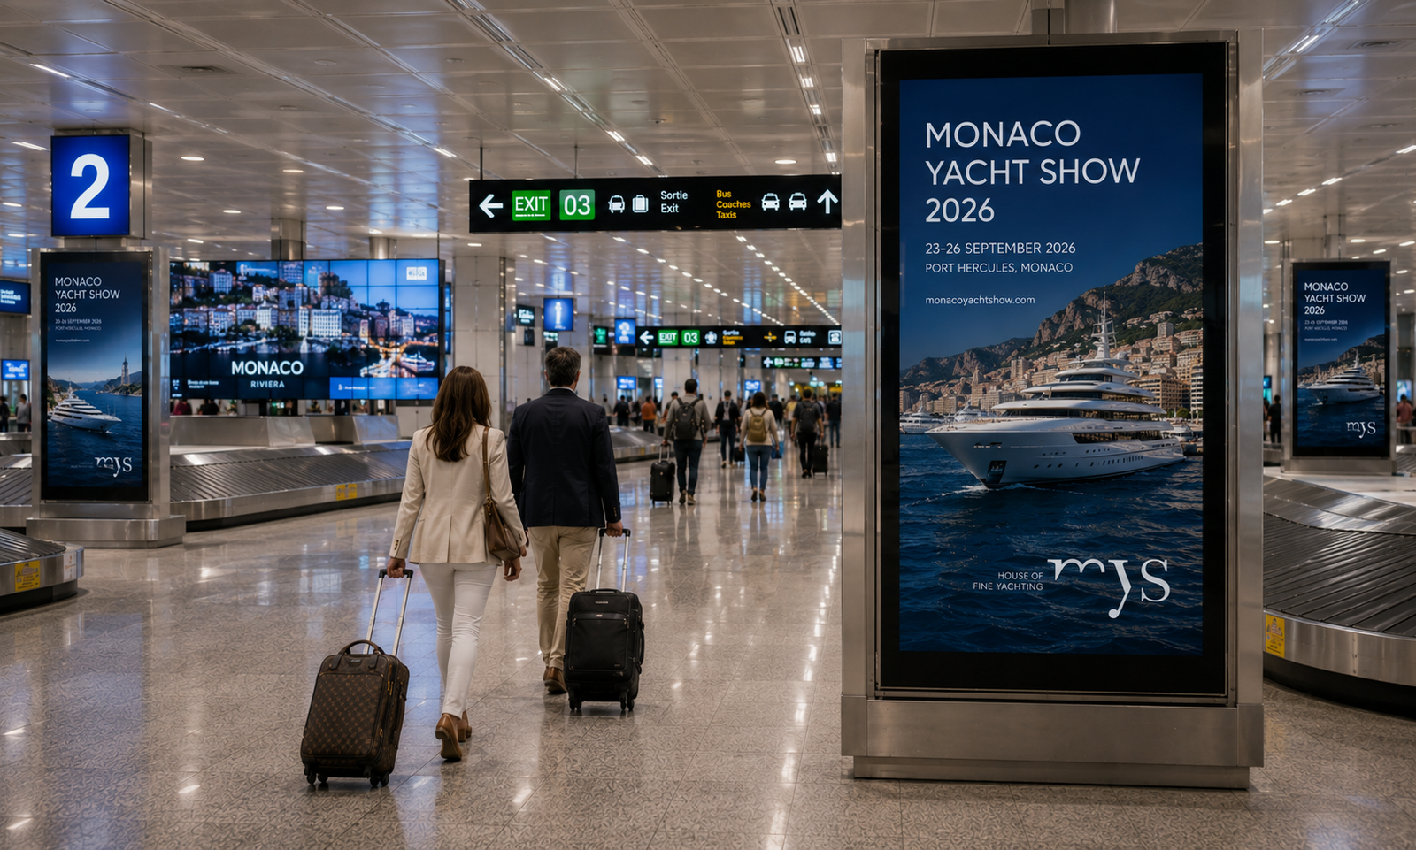
PROGRAMMATIC DOOH PROPOSAL
Monaco Yacht Show 2026
Reaching Superyacht Buyers, Brokers & Owners Across the Riviera
Nice Côte d'Azur Airport + Monaco City DOOH · 23–26 September 2026
THE EXPLORE PACKAGE — $250/hr · $20,000/wk min.
Prepared by Masscom Global — Wealth in motion intelligence.

Slide 2
THE OPPORTUNITY
Four Days Where the Superyacht World
Converges on Monte Carlo
The Monaco Yacht Show, the world's leading in-water superyacht event, draws owners, brokers, press and private buyers into a compact, walkable footprint around Port Hercule — arriving via Nice Côte d'Azur and Monaco Heliport, then moving on foot through Monte Carlo for four dense show days.
23–26 SEP
2026
1.27M+
157
2 km²
Monte Carlo,
Port Hercule
Monthly passengers
through Nice Côte d'Azur
Targetable screens across
airport & city network
Walkable circuit —
airport to port to city
HOW THE FOUR DAYS SHAPE AN ARRIVAL
Wed 23 Sep: Arrival weight — owners, brokers & press land first via NCE and the Monaco Heliport
Thu–Fri (24–25 Sep): Peak show-floor traffic clusters around Port Hercule and the Casino Square
Sat 26 Sep: Departure weight, as the buying audience moves on to the next circuit stop
MASSCOM GLOBAL | Monaco Yacht Show 2026 PDOOH Proposal
2

Slide 3
MEDIA INTELLIGENCE
The Reachable Audience
Derived from Masscom Global's September 2026 Monaco/Nice media-planning window
1.27M+
157
$1,500
3–5 days
Monthly passengers
through Nice Côte d'Azur
Targetable screens across
airport & city network
Per day, entry
package pricing
From brief to
live screens
Daily-rate pricing and a three-to-five-day activation window mean the NCE and Monaco City placements can be weighted precisely — to the arrivals wave, the show-floor peak, or the departure side as the circuit moves on.
MASSCOM GLOBAL | Monaco Yacht Show 2026 PDOOH Proposal
3

Slide 4
MEDIA INTELLIGENCE
How the Four Days Actually Shape an Arrival
Daily-rate flexibility lets the plan follow the audience through the show
Tue
22 Sep
Wed
23 Sep
Thu
24 Sep
Fri
25 Sep
Sat
26 Sep
Sun
27 Sep
Arrival weight · owners & press
Peak show-floor traffic
Departure weight · onward
Daily rates and a three-to-five-day activation mean NCE and Monaco City coverage can be weighted to arrivals early, to the show-floor peak mid-week, and to the departure side as the audience moves on to the next circuit stop.
MASSCOM GLOBAL | Monaco Yacht Show 2026 PDOOH Proposal
4

Slide 5
MEDIA INTELLIGENCE
Nice vs. the World's Gateway Airports
Screen density and passenger volume at comparable European hubs
Nice Côte d'Azur (NCE)
London Heathrow
Frankfurt
Paris Charles de Gaulle
Zurich
★ This Campaign
150+
digital screens
567
digital screens
359
digital screens
274
digital screens
219
digital screens
1.27M / mo
6.6M / mo
5.0M / mo
5.6M / mo
1.3M / mo
Nice carries far fewer screens than the largest European hubs — meaning less clutter and a lower cost of entry, while still reaching a 1.27M+ monthly passenger base concentrated around a single, dense show week and its direct Monaco heliport link.
Source: Masscom Global network data. Comparison hub figures are drawn from the same network dataset; pricing, activation timeline and impression ranges are current rate-card estimates, not guarantees.
MASSCOM GLOBAL | Monaco Yacht Show 2026 PDOOH Proposal
5

Slide 6
CAMPAIGN INVESTMENT
Campaign Summary
The Explore Package — Nice Côte d'Azur Airport + Monaco City, balanced weekly investment
157
2
$20,000
52.3M
Targetable Screens
Venue Types
Total Weekly Budget
Weekly Impressions
Line Item | Start | End | # Screens | Weekly Budget | Daily Budget
Nice Côte d'Azur Airport (NCE) | 9/23/2026 | 9/26/2026 | 90 | $10,000 | $1,428.57
Monaco City | 9/23/2026 | 9/26/2026 | 67 | $10,000 | $1,428.57
Campaign window spans the confirmed 23–26 September 2026 Monaco Yacht Show dates, split evenly across the airport and city line items — a total investment of $20,000 per week. Weekly impressions: ~47.0M across NCE and ~5.3M across Monaco City — 52.3M total per week, per Masscom Global's Monaco inventory file.
Caution: Programmatic Digital Out-of-Home (pDOOH) campaigns do not provide full activation screen-level proof. While delivery and play logs are available, platform-level reporting does not guarantee visibility on every individual screen at every moment.
MASSCOM GLOBAL | Monaco Yacht Show 2026 PDOOH Proposal
6

Slide 7
CAMPAIGN PLAN
Venue Type Mix
157 screens across airport transit and premium city outdoor formats
NICE CÔTE D'AZUR AIRPORT (NCE) — 90 SCREENS
MONACO CITY — 67 SCREENS
Venue Type | Screens
Transit – Airports | 90
Venue Type | Screens
Outdoor – Urban Panels | 67
Airport inventory runs entirely through Transit – Airports formats along the arrivals-to-boarding journey at NCE, the gateway used by the vast majority of international owners, brokers and press. Monaco City inventory concentrates on Outdoor – Urban Panels across La Condamine, the Casino Square approach and the streets feeding Port Hercule.
Caution: Programmatic Digital Out-of-Home (pDOOH) campaigns do not provide full activation screen-level proof. While delivery and play logs are available, platform-level reporting does not guarantee visibility on every individual screen at every moment.
MASSCOM GLOBAL | Monaco Yacht Show 2026 PDOOH Proposal
7

Slide 8
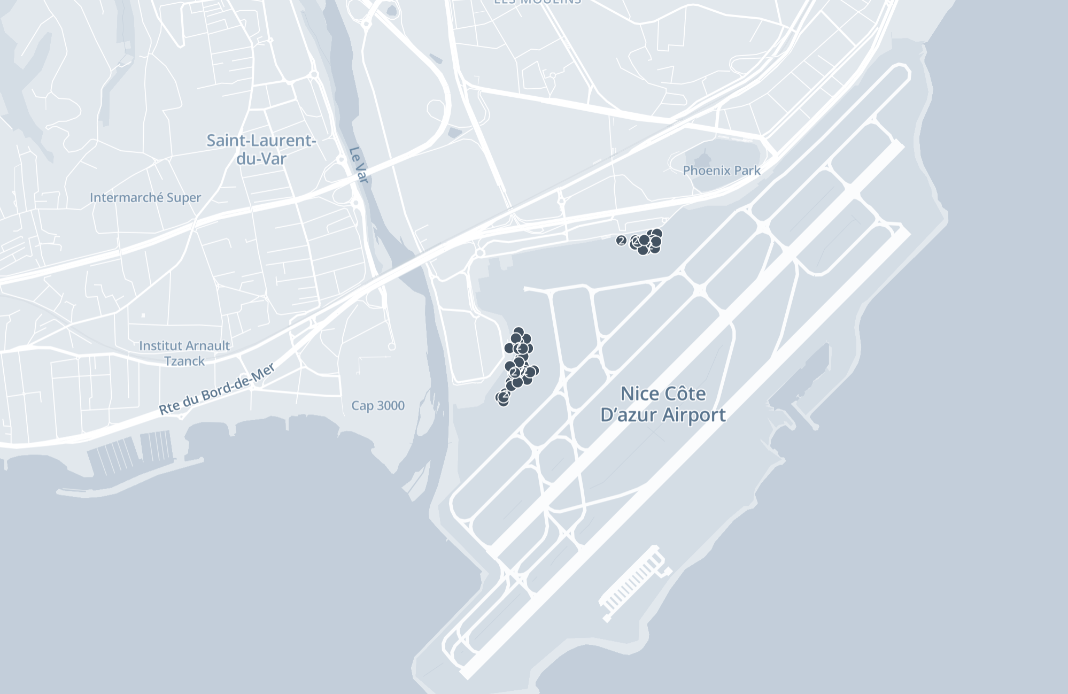
AIRPORT COVERAGE
Nice Côte d'Azur International Airport (NCE)
90 available screens along the arrivals-to-boarding journey
90
Available screens
1
Venue type across the terminal
47.0M
Weekly impressions (NCE)
Nice Côte d'Azur is the principal international gateway to the French Riviera and the working airport for Monaco, linked to Port Hercule by a direct heliport shuttle. Screens are concentrated along the boarding and arrivals corridors where owners, brokers and press pass on their way to and from the show.
Caution: Programmatic Digital Out-of-Home (pDOOH) campaigns do not provide full activation screen-level proof. While delivery and play logs are available, platform-level reporting does not guarantee visibility on every individual screen at every moment.
MASSCOM GLOBAL | Monaco Yacht Show 2026 PDOOH Proposal
8

Slide 9
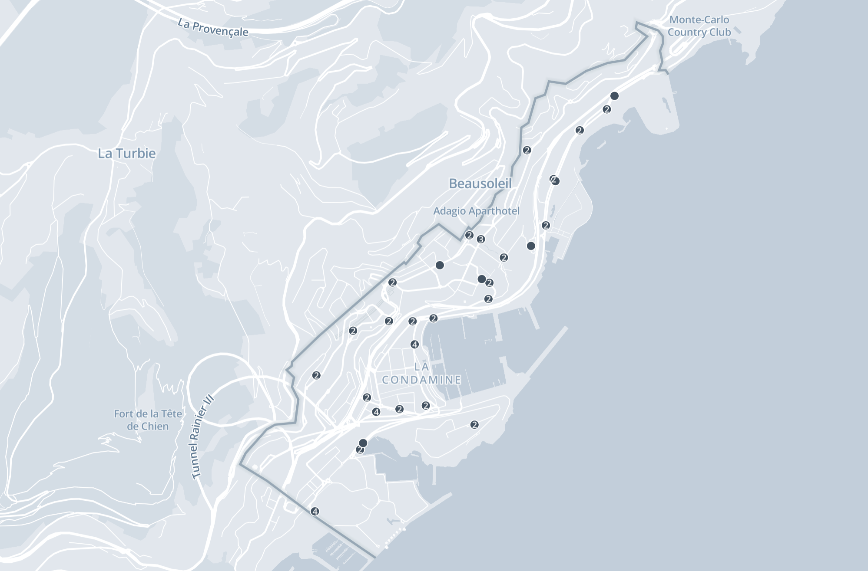
CITY COVERAGE
Monaco City
67 available screens across La Condamine and the approach to Port Hercule
67
Available city screens
1
Outdoor urban panel format
5.3M
Weekly impressions (city)
Coverage concentrates along the route between Beausoleil, La Condamine and the Casino Square — the walking corridor connecting hotels, the tunnel approach from Nice, and Port Hercule itself, reaching the show's audience throughout the day.
Caution: Programmatic Digital Out-of-Home (pDOOH) campaigns do not provide full activation screen-level proof. While delivery and play logs are available, platform-level reporting does not guarantee visibility on every individual screen at every moment.
MASSCOM GLOBAL | Monaco Yacht Show 2026 PDOOH Proposal
9

Slide 10
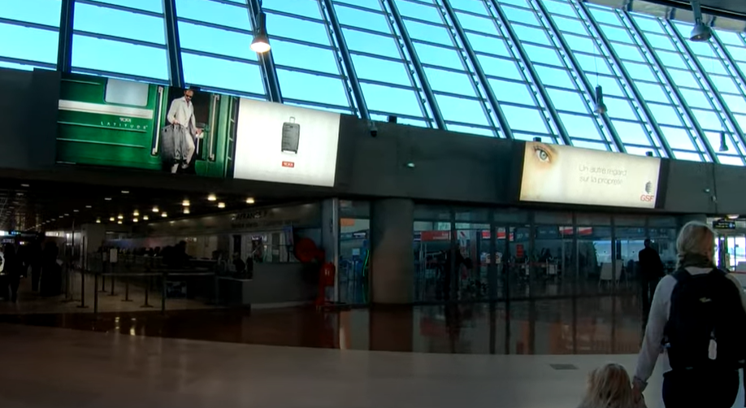
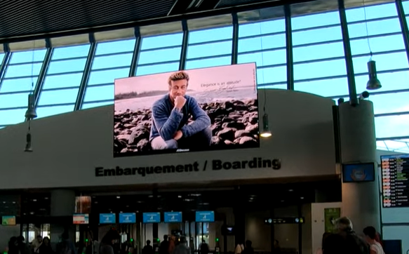
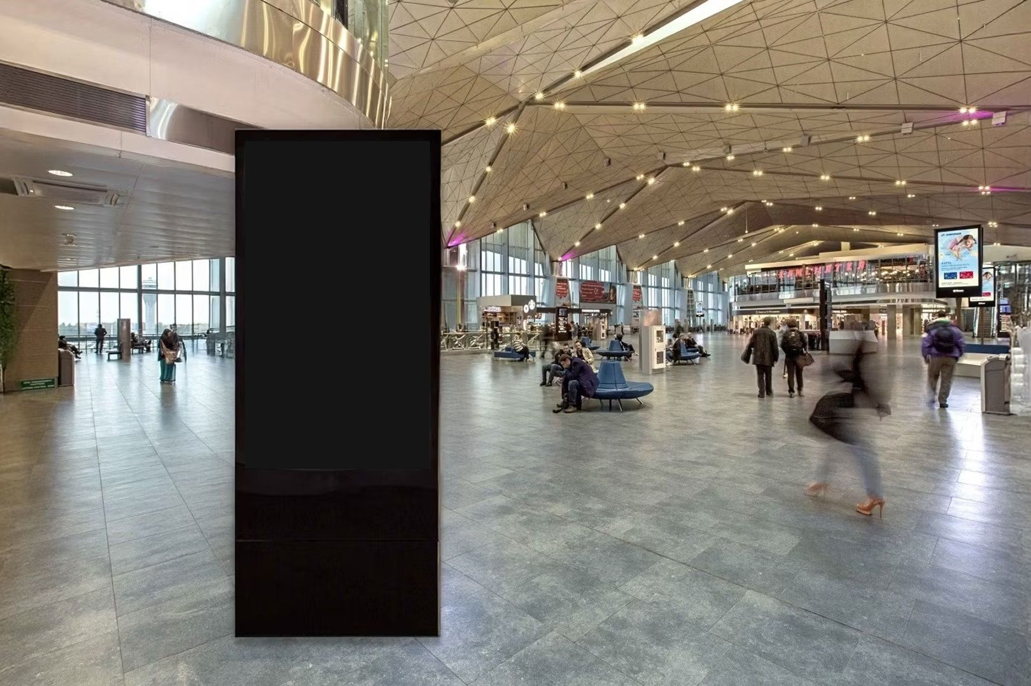
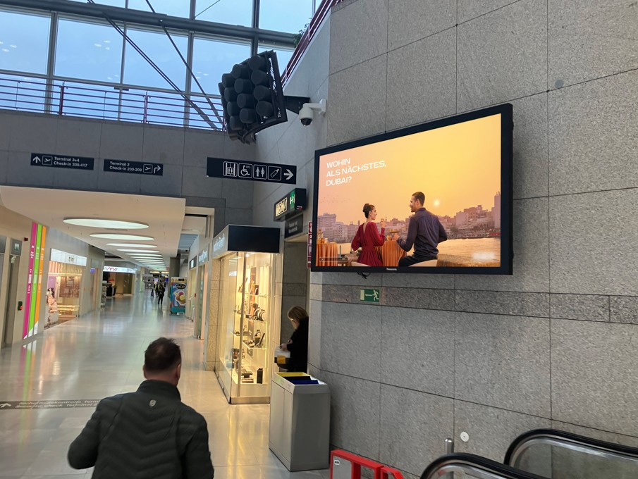
CREATIVE ENVIRONMENTS
Inventory in Context — NCE Airport
A sample of premium DOOH placements across the terminal network
Check-in hall — digital wall
Terminal corridor — wall-mounted screen
Boarding gate — digital wall
Terminal concourse — freestanding kiosk
Caution: Programmatic Digital Out-of-Home (pDOOH) campaigns do not provide full activation screen-level proof. While delivery and play logs are available, platform-level reporting does not guarantee visibility on every individual screen at every moment.
MASSCOM GLOBAL | Monaco Yacht Show 2026 PDOOH Proposal
10

Slide 11
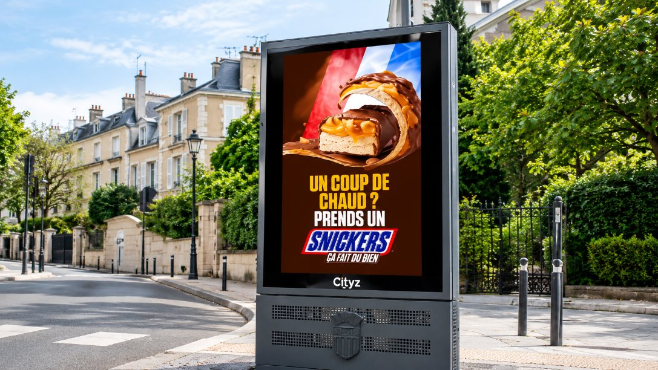
CREATIVE ENVIRONMENTS
Inventory in Context — Monaco City
A sample of premium DOOH placements along the Port Hercule approach
Street-level kiosk — urban panel format
Additional placement photography for the Monaco City network — building-scale screens, roadside panels and neighbourhood kiosks along La Condamine and the Casino Square approach — can be supplied ahead of trafficking.
MASSCOM GLOBAL | Monaco Yacht Show 2026 PDOOH Proposal
11

Slide 12
WHY MASSCOM GLOBAL
The Masscom Global Standard
1
Verified inventory & audience data
2
Transparent delivery reporting
Every terminal, screen count and passenger figure is checked against current operator data, not published estimates.
Proof of play, placement documentation and post-campaign reporting so you see exactly where and when creative ran.
3
Benchmarked recommendations
4
We absorb the complexity
Terminal mix and city weighting set against comparable campaigns across our 1,000+ airport network.
Negotiation, trafficking, creative specs and delivery are on us; you approve the plan and see the results.
MASSCOM GLOBAL | Monaco Yacht Show 2026 PDOOH Proposal
12

Slide 13
Monaco Yacht Show 2026 Runs Once a Season.
Port Hercule and Monte Carlo see their heaviest show-week traffic in a fixed four-day window — a campaign confirmed after 23 September misses the arrival wave entirely.
Explore · $250/hr · $20,000/wk min.
01
02
03
Confirm budget & dates
Finalize creative specs
Approve & traffic
Lock the 9/23–9/26/2026 window across NCE and city inventory — $20,000/week total.
We supply full spec sheets per venue type and screen size.
Masscom Global handles negotiation, trafficking and delivery reporting.
Book Expert Consultation — calendly.com/masscomgx/15min
Masscom Global — Wealth in motion intelligence. | 1,000+ airports, 180+ countries
Also planning October? Ask about Milan Fashion Week, London Fashion Week, Paris Fashion Week, Oktoberfest & SF Dreamforce — the full Masscom Global Combo Menu.

