Slide 1
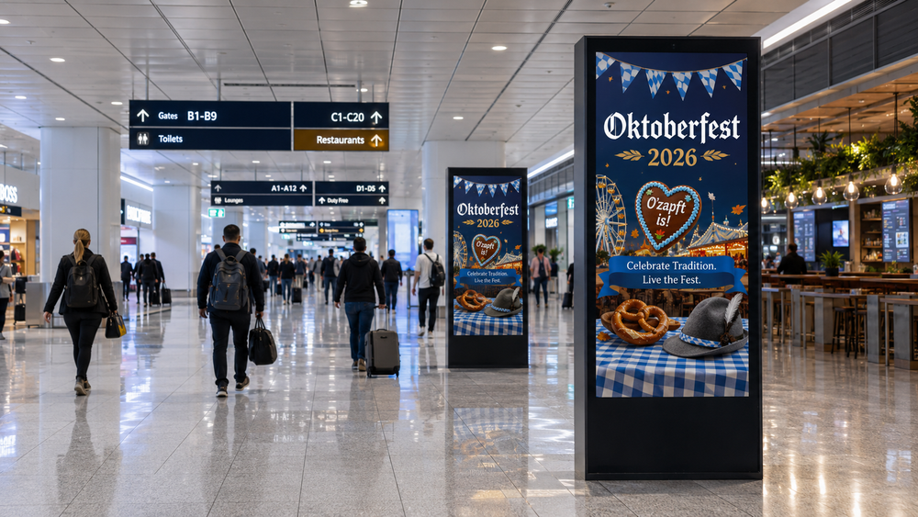
PROGRAMMATIC DOOH PROPOSAL
Oktoberfest 2026
Reaching Beer Tents, Locals & International Visitors Across Munich & Germany's Gateway Airports
Frankfurt (FRA) + Berlin (BER) Airports + Munich Metropolitan City DOOH · 19 September – 4 October 2026
THE EXPLORE PACKAGE — $250/hr · $20,000/wk min.
Prepared by Masscom Global — Wealth in motion intelligence.

Slide 2
THE OPPORTUNITY
Sixteen Days Where a Bavarian Festival Becomes
a National Media Moment
19 Sep – 4 Oct
7.2M+
Visitors, record 2023
Oktoberfest edition
440+
Digital screens across airport & city network
237.9M
Estimated weekly impressions available
2026, Munich · Theresienwiese
Oktoberfest draws visitors from across the world into Munich's Theresienwiese — but the reach opportunity extends beyond the fairground. International guests land through Germany's two largest gateway airports, Frankfurt and Berlin, before connecting on to Munich, while local and regional traffic moves through the city's own outdoor and office-building network.
HOW THE SIXTEEN DAYS SHAPE A FLIGHTING PLAN
Week 1 (1–18 Sep)
Recommended flighting window — media live before the opening weekend, per Masscom Global market intelligence.
Week 3 (19–27 Sep)
Opening weekend surge — arrival wave across FRA & BER as international visitors land.
Weeks 4–5 (28 Sep–4 Oct)
Closing-weekend peak & departure wave, as the festival winds down toward 4 October.
MASSCOM GLOBAL | Oktoberfest 2026 PDOOH Proposal
2

Slide 3
MEDIA INTELLIGENCE
The Reachable Audience
Derived from Masscom Global's September–October 2026 Germany media-planning window
7.2M+
Visitors, record 2023
Oktoberfest edition
440+
Digital screens across
FRA, BER & Munich
$1,500
Per day, entry
package pricing
237.9M
Estimated weekly
impressions
Daily-rate pricing and a flexible activation window mean the plan can be weighted precisely — toward the gateway airports early in the flighting window, or toward Munich's city network as the festival itself opens and locals & visitors converge on the Theresienwiese.
THREE REACHABLE ZONES
Frankfurt Airport (FRA)
Berlin Brandenburg Airport (BER)
Munich Metropolitan City
233 screens
65 screens
142 screens
MASSCOM GLOBAL | Oktoberfest 2026 PDOOH Proposal
3

Slide 4
MEDIA INTELLIGENCE
How the Sixteen Days Actually Shape a Campaign
Daily-rate flexibility lets the plan follow the audience through the festival window
Wk 1
Wk 2
Wk 3
Wk 4
Wk 5
1–6 Sep
7–13 Sep
14–20 Sep
21–27 Sep
28 Sep–4 Oct
Pre-flight
Flighting window opens
Opening weekend (19–20 Sep)
Peak festival traffic
Closing weekend & departure
Despite the festival name, most of Oktoberfest 2026 falls within September — Masscom Global's market intelligence recommends gateway media be live before the opening weekend (19 Sep) rather than launched in October. Weighting can shift from the FRA/BER arrival wave early, to Munich's city network as the fairground fills.
CONFIRMED FESTIVAL WINDOW
19 September – 4 October 2026
Confirmed Oktoberfest 2026 dates — campaign line items align to this window across all three zones.
MASSCOM GLOBAL | Oktoberfest 2026 PDOOH Proposal
4

Slide 5
MEDIA INTELLIGENCE
Germany's Gateways vs. the World's Airport Hubs
Screen density and passenger volume at comparable European hubs
Hub
Digital Screens
Monthly Passengers
Frankfurt (FRA)
★ This Campaign
233
5.27M / mo
Berlin (BER)
★ This Campaign
65
2.17M / mo
London Heathrow
567
6.6M / mo
Paris Charles de Gaulle
274
5.6M / mo
Milan Malpensa
150+
2.76M / mo
Zurich
219
1.3M / mo
Frankfurt and Berlin together carry fewer screens than London Heathrow alone — meaning less clutter and a lower cost of entry, while still reaching a combined 440+ screen, three-zone footprint concentrated around a single national festival moment.
Source: Masscom Global network data (FRA/BER/Munich inventory files). Comparison hub figures are drawn from public airport traffic reports and the same network dataset; pricing and activation timeline are current rate-card estimates, not guarantees.
MASSCOM GLOBAL | Oktoberfest 2026 PDOOH Proposal
5

Slide 6
CAMPAIGN INVESTMENT
Campaign Summary
The Explore Package — FRA + BER Airports + Munich Metropolitan City, balanced weekly investment
440
Targetable Screens
8
Venue Types
$20,000
Total Weekly
Budget
237.9M
Weekly
Impressions
Line Item
Start
End
# Screens
Weekly Budget
Daily Budget
Frankfurt Airport (FRA)
9/19/2026
10/4/2026
233
$6,666.67
$952.38
Berlin Brandenburg Airport (BER)
9/19/2026
10/4/2026
65
$6,666.67
$952.38
Munich Metropolitan City
9/19/2026
10/4/2026
142
$6,666.67
$952.38
Campaign window spans the confirmed 19 September – 4 October 2026 Oktoberfest dates, split evenly across FRA, BER and Munich City — a total investment of $20,000 per week. Weekly impressions: ~152.9M across FRA, ~51.8M across BER and ~33.2M across Munich City — 237.9M total per week, per Masscom Global's Germany inventory files.
Caution: Programmatic Digital Out-of-Home (pDOOH) campaigns do not provide full activation screen-level proof. While delivery and play logs are available, platform-level reporting does not guarantee visibility on every individual screen at every moment.
MASSCOM GLOBAL | Oktoberfest 2026 PDOOH Proposal
6

Slide 7
CAMPAIGN PLAN
Venue Type Mix
440 screens across airport transit and city outdoor/office formats
FRANKFURT AIRPORT (FRA) — 233 SCREENS
BERLIN BRANDENBURG AIRPORT (BER) — 65 SCREENS
MUNICH METROPOLITAN CITY — 142 SCREENS
Transit – Airports – Baggage Claim
149
Transit – Airports – Departures Hall
42
Office Buildings – Lobby
74
Transit – Airports – Shopping Area
62
Transit – Airports – Baggage Claim
9
Office Buildings
45
Transit – Airports – Arrival Hall
22
Transit – Airports – Arrival Hall
6
Outdoor – Urban Panels
23
Transit – Airports – Shopping Area
6
Transit – Airports (general)
2
Airport inventory across FRA and BER is weighted to Baggage Claim and Departures Hall — the zones where international arrivals dwell longest. Munich's city network leans on office-lobby and outdoor urban-panel formats reaching locals and business travelers throughout the festival window.
Caution: Programmatic Digital Out-of-Home (pDOOH) campaigns do not provide full activation screen-level proof. While delivery and play logs are available, platform-level reporting does not guarantee visibility on every individual screen at every moment.
MASSCOM GLOBAL | Oktoberfest 2026 PDOOH Proposal
7

Slide 8
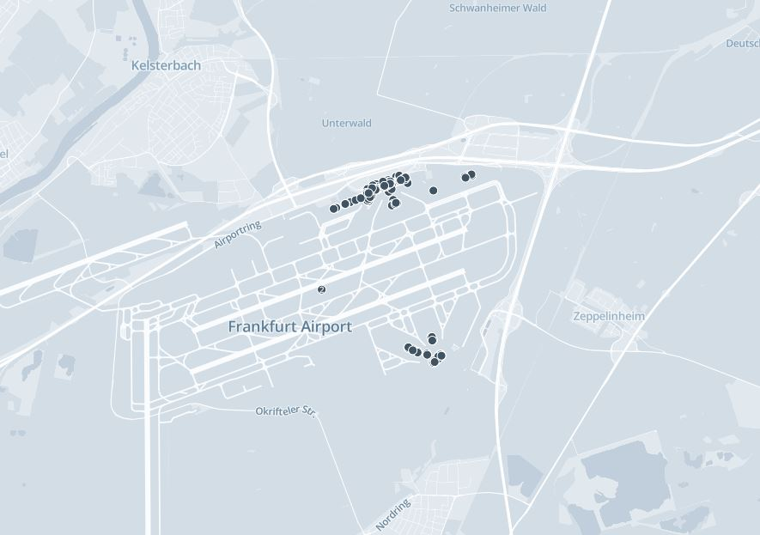
AIRPORT COVERAGE
Frankfurt Airport (FRA)
233 available screens across arrivals, baggage claim & shopping zones
233
Available screens
3
Venue types across the zone
152.9M
Weekly impressions (FRA)
Frankfurt is Germany's principal international gateway and Europe's busiest airport by traffic — carrying 63M+ passengers a year. Screens are weighted to the baggage-claim and shopping-area journey where inbound Oktoberfest visitors first land.
Caution: Programmatic Digital Out-of-Home (pDOOH) campaigns do not provide full activation screen-level proof. While delivery and play logs are available, platform-level reporting does not guarantee visibility on every individual screen at every moment.
MASSCOM GLOBAL | Oktoberfest 2026 PDOOH Proposal
8

Slide 9
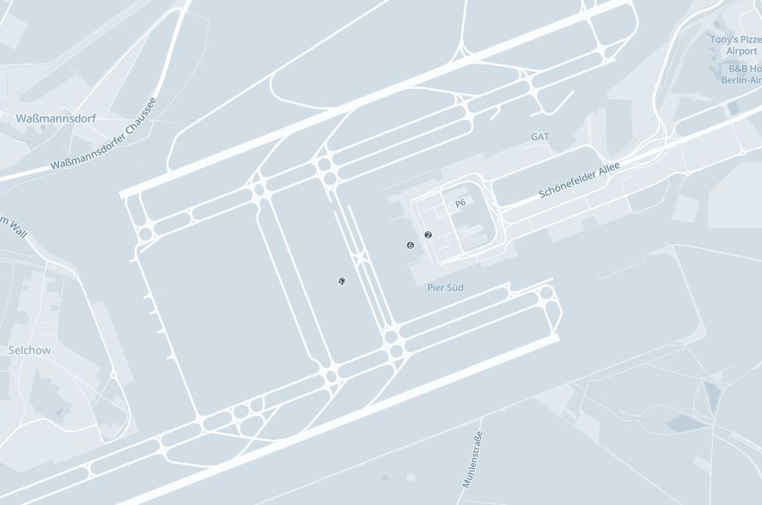
AIRPORT COVERAGE
Berlin Brandenburg Airport (BER)
65 available screens across departures, arrivals & shopping zones
65
Available screens
5
Venue types across the zone
51.8M
Weekly impressions (BER)
Berlin Brandenburg is Germany's third-busiest airport and a key secondary gateway for international visitors. Screens span the departures hall and connecting zones, capturing both inbound arrivals and onward domestic connections toward Munich.
Caution: Programmatic Digital Out-of-Home (pDOOH) campaigns do not provide full activation screen-level proof. While delivery and play logs are available, platform-level reporting does not guarantee visibility on every individual screen at every moment.
MASSCOM GLOBAL | Oktoberfest 2026 PDOOH Proposal
9

Slide 10
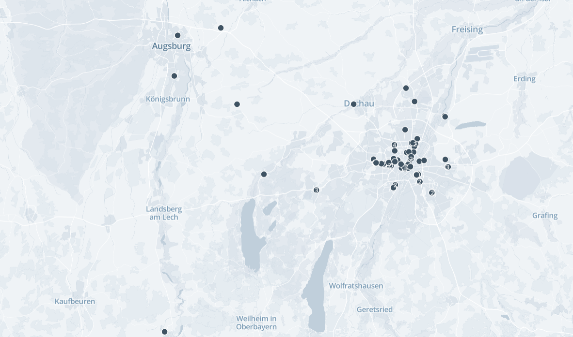
CITY COVERAGE
Munich Metropolitan City
142 available screens across office buildings and outdoor urban panels
142
Available screens
3
Venue types across the zone
33.2M
Weekly impressions (city)
Coverage concentrates on Munich's commercial core — office-building lobbies and outdoor urban panels reaching daily commuters, local residents and business travelers throughout the sixteen-day festival window.
Caution: Programmatic Digital Out-of-Home (pDOOH) campaigns do not provide full activation screen-level proof. While delivery and play logs are available, platform-level reporting does not guarantee visibility on every individual screen at every moment.
MASSCOM GLOBAL | Oktoberfest 2026 PDOOH Proposal
10

Slide 11
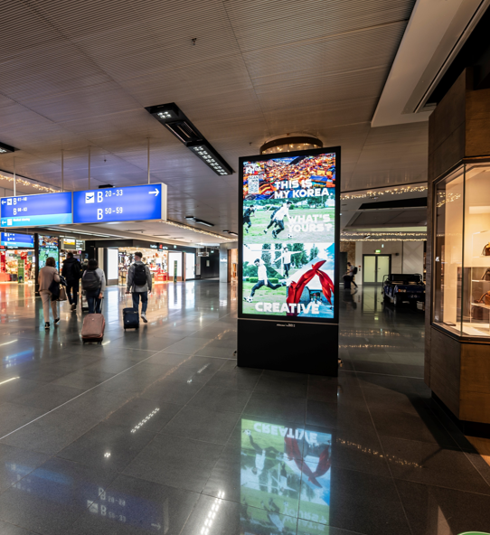
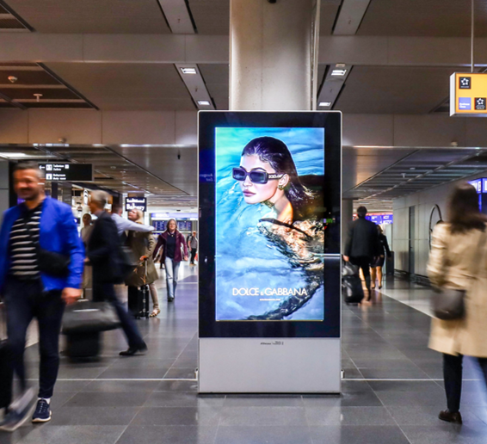
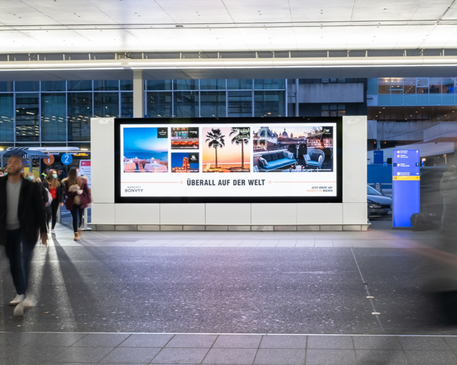
CREATIVE ENVIRONMENTS
Inventory in Context — Frankfurt Airport (FRA)
A sample of premium DOOH placements across the terminal network
Terminal concourse — digital totem
Arrivals corridor — digital wall
Departures lounge — spectacular screen
Caution: Programmatic Digital Out-of-Home (pDOOH) campaigns do not provide full activation screen-level proof. While delivery and play logs are available, platform-level reporting does not guarantee visibility on every individual screen at every moment.
MASSCOM GLOBAL | Oktoberfest 2026 PDOOH Proposal
11

Slide 12
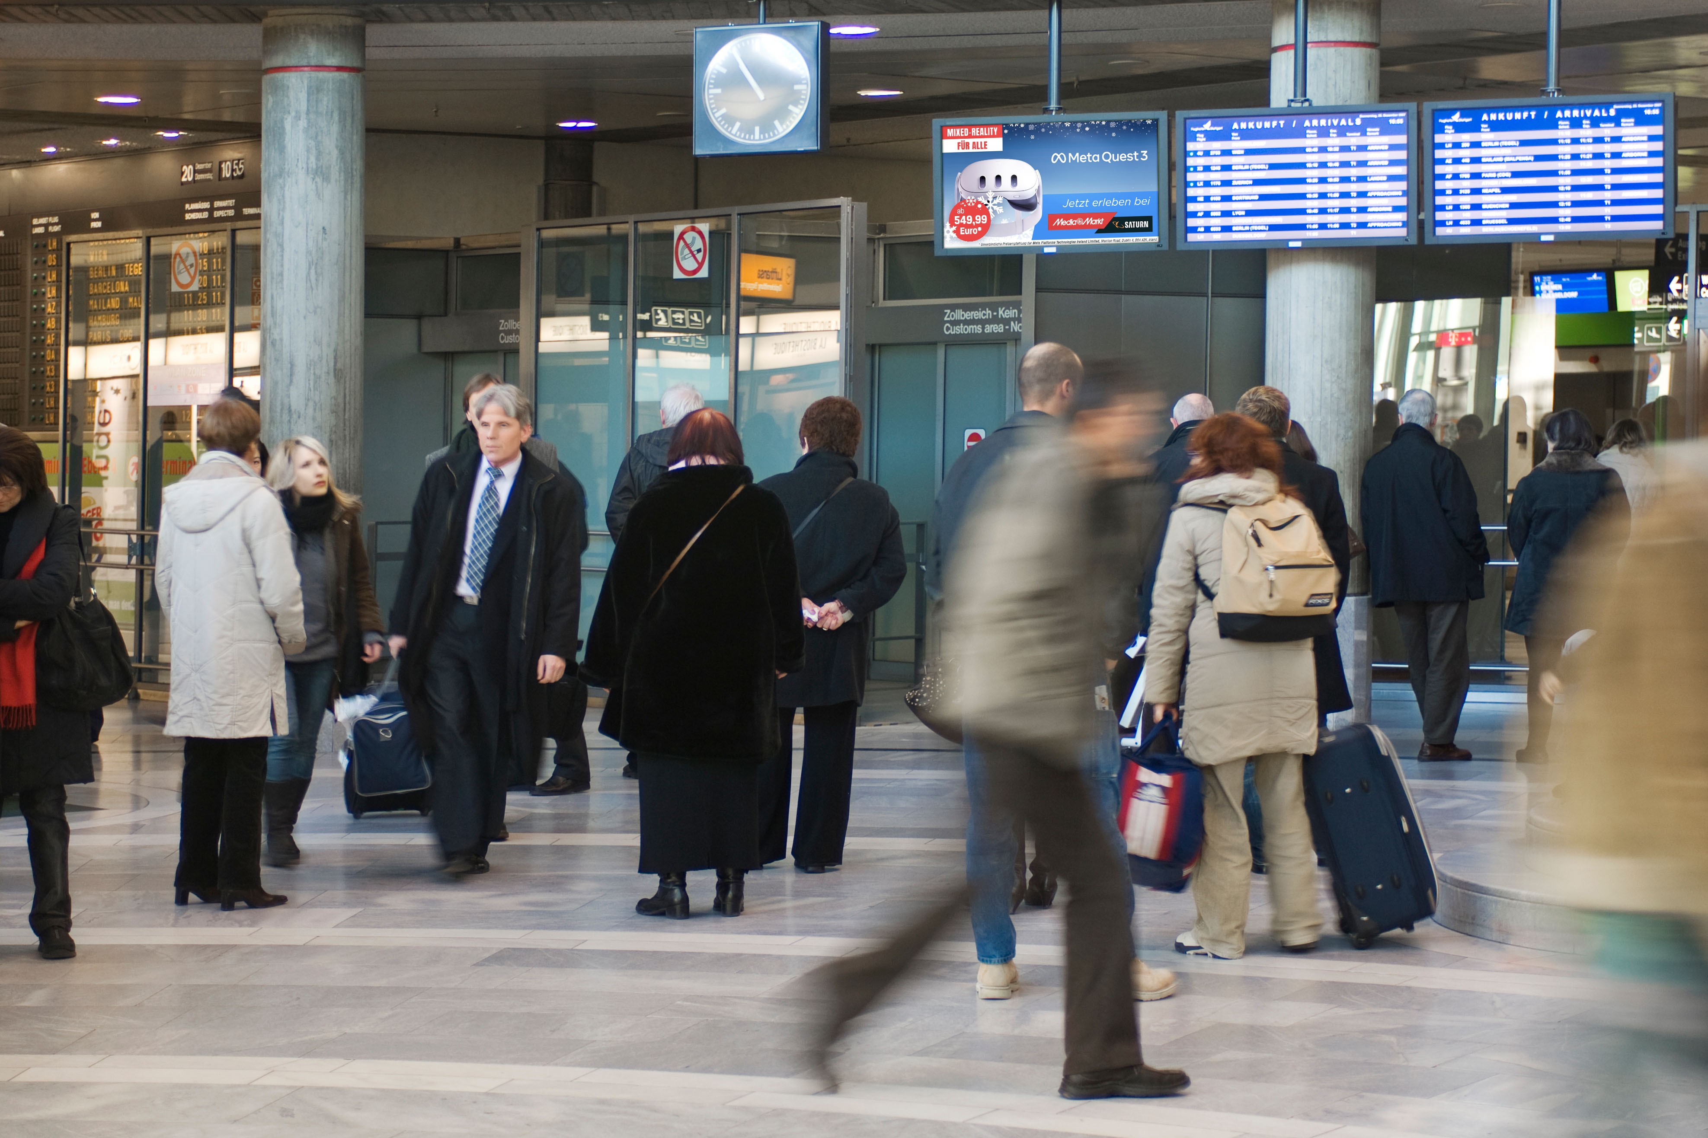
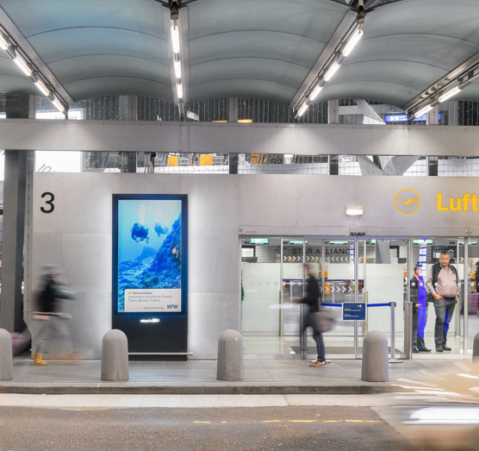
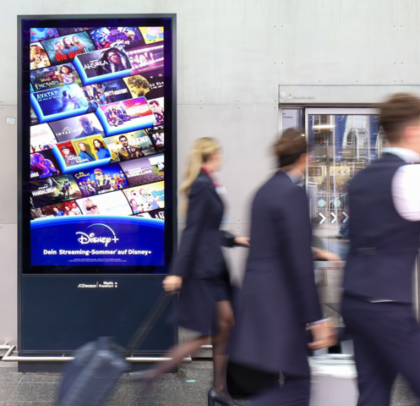
CREATIVE ENVIRONMENTS
Inventory in Context — Berlin Brandenburg Airport (BER)
A sample of premium DOOH placements across the terminal network
Baggage claim — terminal pillar screen
Curbside — freestanding digital panel
Terminal concourse — digital wall
Caution: Programmatic Digital Out-of-Home (pDOOH) campaigns do not provide full activation screen-level proof. While delivery and play logs are available, platform-level reporting does not guarantee visibility on every individual screen at every moment.
MASSCOM GLOBAL | Oktoberfest 2026 PDOOH Proposal
12

Slide 13
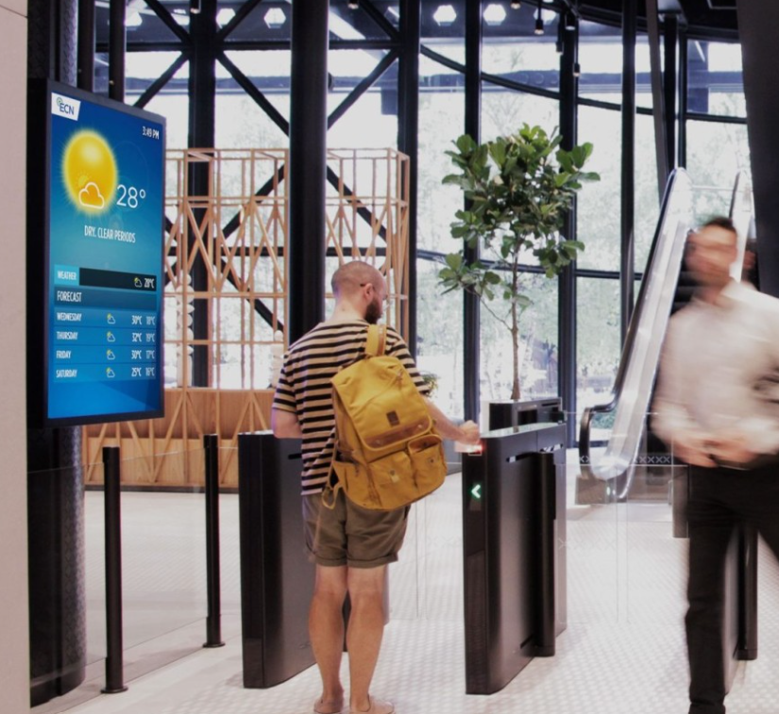
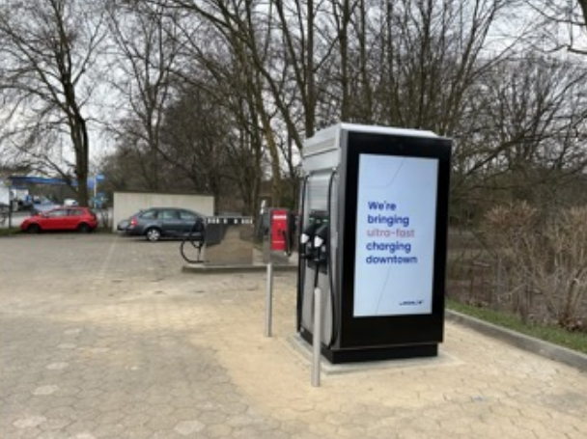
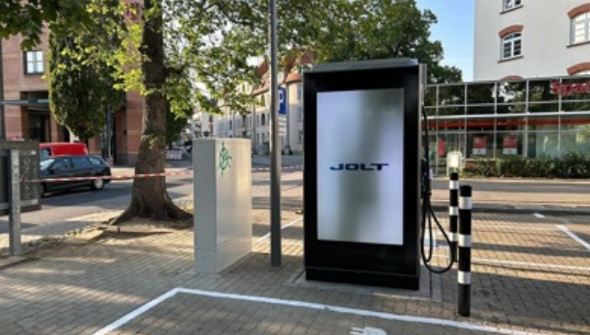
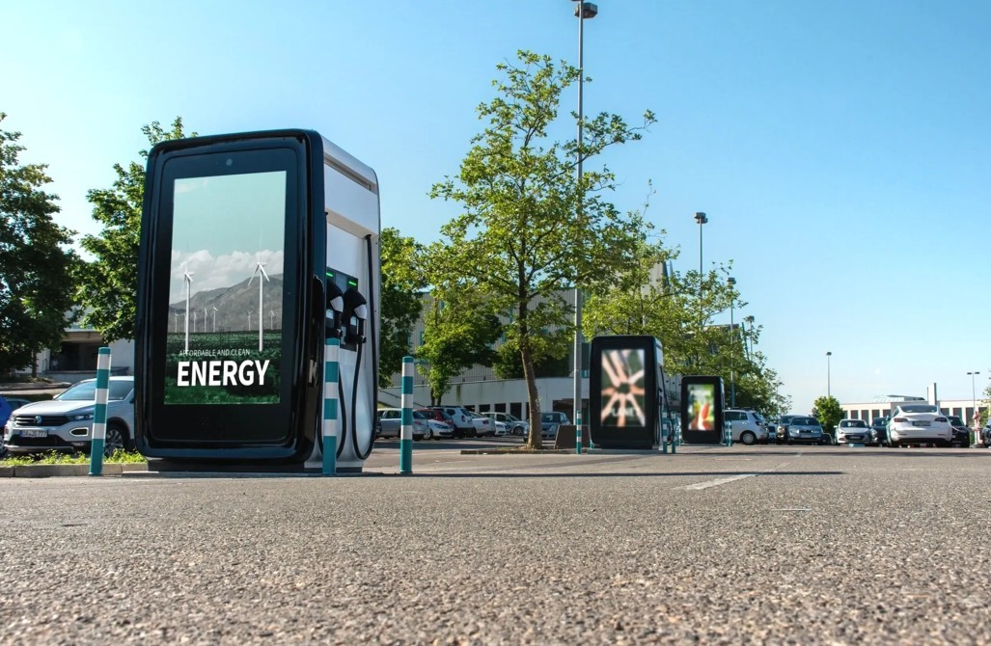
CREATIVE ENVIRONMENTS
Inventory in Context — Munich Metropolitan City
A sample of premium DOOH placements across office and outdoor formats
Building lobby — weather/info kiosk
Urban panel — EV charging screen
Street-level — charging kiosk display
Urban panel cluster — outdoor charging bay
Caution: Programmatic Digital Out-of-Home (pDOOH) campaigns do not provide full activation screen-level proof. While delivery and play logs are available, platform-level reporting does not guarantee visibility on every individual screen at every moment.
MASSCOM GLOBAL | Oktoberfest 2026 PDOOH Proposal
13

Slide 14
WHY MASSCOM GLOBAL
The Masscom Global Standard
1
Verified inventory & audience data
Every terminal, screen count and passenger figure is checked against current operator data, not published estimates.
2
Transparent delivery reporting
Proof of play, placement documentation and post-campaign reporting so you see exactly where and when creative ran.
3
Benchmarked recommendations
Terminal and city weighting set against comparable campaigns across our 1,000+ airport network.
4
We absorb the complexity
Negotiation, trafficking, creative specs and delivery are on us; you approve the plan and see the results.
MASSCOM GLOBAL | Oktoberfest 2026 PDOOH Proposal
14

Slide 15
Oktoberfest 2026 Runs Once a Year.
FRA, BER and Munich's city network see their heaviest festival-driven traffic in a fixed sixteen-day window — a campaign confirmed after 19 September misses the arrival wave entirely.
Explore
$250/hr · $20,000/wk min.
01
02
03
Confirm budget & dates
Finalize creative specs
Approve & traffic
Lock the 9/19–10/4/2026 window across FRA, BER and Munich City inventory — $20,000/week total.
We supply full spec sheets per venue type and screen size.
Masscom Global handles negotiation, trafficking and delivery reporting.
Book Expert Consultation — calendly.com/masscomgx/15min
Masscom Global — Wealth in motion intelligence. | 1,000+ airports, 180+ countries
Also planning Q4? Ask about Paris Fashion Week, Monaco Yacht Show & SF Dreamforce — the full Masscom Global Combo Menu.

