Slide 1
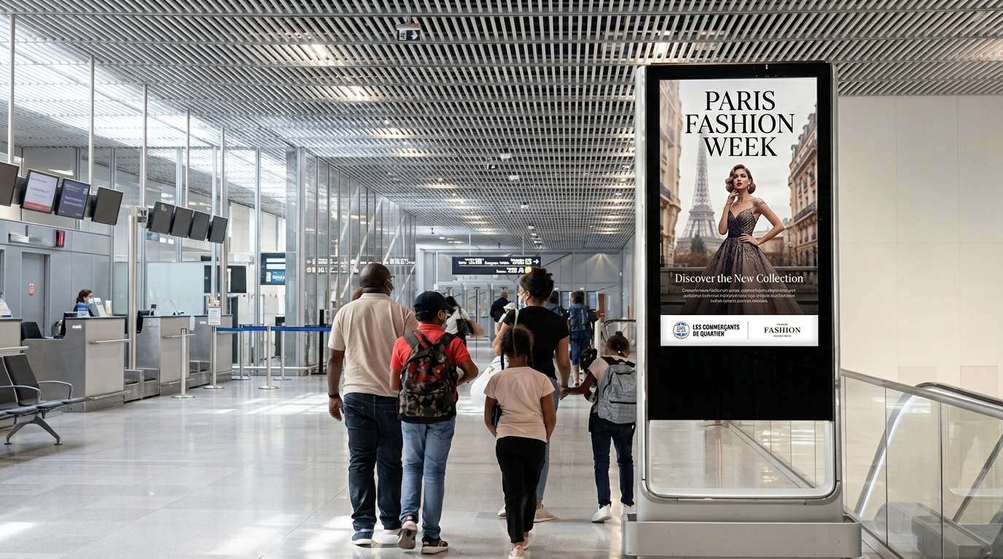
PROGRAMMATIC DOOH PROPOSAL
Paris Fashion Week 2026
Reaching Buyers, Press & Private Clients Across Paris
Paris–CDG + Paris–Orly Airports + Metropolitan City DOOH · 28 September – 6 October 2026
Three investment tiers — Explore, Reach & Domination
Prepared by Masscom Global — Wealth in motion intelligence.

Slide 2
THE OPPORTUNITY
Nine Days Where the Season Closes at
the Centre of Global Luxury Buying
Paris Fashion Week closes the season circuit after New York, London and Milan — drawing buyers, press and private clients into Avenue Montaigne, Place Vendôme and the Rue Saint-Honoré retail spine, arriving through Charles de Gaulle and Orly for nine dense show days.
28 SEP–6 OCT
2026, Paris
795+
3
Right Bank & the
Quadrilatère du Luxe
Digital screens across
airport & city network
Venue types across
airport & city network
HOW THE NINE DAYS SHAPE THE SEASON'S CLOSE
Mon–Tue (28–29 Sep): Arrival weight — buyers & press land, already carrying NY/London/Milan budgets
Wed–Sat (30 Sep–3 Oct): Peak working calendar — wholesale orders, licensing terms, private-client hosting
Sun–Tue (4–6 Oct): Closing-house weight, as remaining budget concentrates on the season's final shows
Caution: Programmatic Digital Out-of-Home (pDOOH) campaigns do not provide full activation screen-level proof. While delivery and play logs are available, platform-level reporting does not guarantee visibility on every individual screen at every moment.
MASSCOM GLOBAL | Paris Fashion Week 2026 PDOOH Proposal
2

Slide 3
MEDIA INTELLIGENCE
The Reachable Audience
Derived from Masscom Global's September–October 2026 Paris media-planning window
Late Sep–
Early Oct
795+
$1,500
3–5 days
795
Nine-day season-
closing window
Digital screens in
multiple formats
Per day, entry
package pricing
From brief to
live screens
Total targetable
screens, this campaign
Daily-rate pricing and a three-to-five-day activation window mean CDG and Orly placements can be weighted precisely — to the early arrivals wave, the mid-week working-calendar peak, or the closing-house weight as the season wraps.
Caution: Programmatic Digital Out-of-Home (pDOOH) campaigns do not provide full activation screen-level proof. While delivery and play logs are available, platform-level reporting does not guarantee visibility on every individual screen at every moment.
MASSCOM GLOBAL | Paris Fashion Week 2026 PDOOH Proposal
3

Slide 4
MEDIA INTELLIGENCE
How the Nine Days Actually Shape the Season's Close
Daily-rate flexibility lets the plan follow the audience through the working week
Mon
28 Sep
Tue
29 Sep
Wed
30 Sep
Thu
1 Oct
Fri
2 Oct
Sat
3 Oct
Sun
4 Oct
Mon
5 Oct
Tue
6 Oct
Arrival weight · buyers & press
Peak working calendar · wholesale & private-client hosting
Closing-house weight · season wraps
Daily rates and a three-to-five-day activation mean CDG, Orly and the city network can be weighted to arrivals early, to the working-calendar peak mid-week, and to the closing-house weight as the season wraps.
Caution: Programmatic Digital Out-of-Home (pDOOH) campaigns do not provide full activation screen-level proof. While delivery and play logs are available, platform-level reporting does not guarantee visibility on every individual screen at every moment.
MASSCOM GLOBAL | Paris Fashion Week 2026 PDOOH Proposal
4

Slide 5
MEDIA INTELLIGENCE
Paris vs. the World's Fashion Capitals
Screen density and passenger volume at comparable European hubs
Paris CDG + Orly
London Heathrow
Frankfurt
Milan Malpensa
Zurich
★ This Campaign
795+
digital screens
567
digital screens
359
digital screens
150+
digital screens
219
digital screens
3.0M+ / mo
6.6M / mo
5.0M / mo
2.76M / mo
1.3M / mo
Paris combines two gateway airports with dense Right Bank city coverage — reaching a passenger and audience base on par with the largest European hubs, concentrated around a single, season-closing nine-day window.
Source: Masscom Global network data. Comparison hub figures are drawn from the same network dataset; pricing and activation timeline are current rate-card estimates, not guarantees.
MASSCOM GLOBAL | Paris Fashion Week 2026 PDOOH Proposal
5

Slide 6
INVESTMENT OPTIONS
Choose Your Package
Three standardized tiers — transparent pricing, no negotiation required
MOST POPULAR
EXPLORE
REACH
DOMINATION
Test the market
Expand your share-of-voice
Own the conversation
$250/hr
$500/hr
$1,000/hr
Starting rate
Starting rate
Starting rate
$20,000
$45,000
$80,000
Minimum weekly booking
Minimum weekly booking
Minimum weekly booking
Entry-tier access to validate Paris Fashion Week as a channel before scaling up.
Priority placement weighting and expanded daypart coverage across the network.
Maximum share-of-voice across every venue type, with dedicated account management.
BEST FOR
BEST FOR
BEST FOR
Brands new to airport/city DOOH
Brands scaling proven campaigns
Category leaders wanting full market presence
MASSCOM GLOBAL | Paris Fashion Week 2026 PDOOH Proposal
6

Slide 7
INVESTMENT OPTIONS
Every Package, Same Premium Network
All three tiers draw from the identical 795-screen CDG + Orly + Paris footprint — the difference is share-of-voice
795
3
3
Targetable Screens
Venue Types
Markets — CDG, Orly
& Paris Metropolitan City
Package | Weekly Investment | CDG /wk | ORY /wk | City /wk | Daily Budget (each)
Explore Package | $20,000 | $6,667 | $6,667 | $6,666 | $952.38
Reach Package | $45,000 | $15,000 | $15,000 | $15,000 | $2,142.86
Domination Package | $80,000 | $26,667 | $26,667 | $26,666 | $3,809.52
Line items span the confirmed 28 September–6 October 2026 Paris Fashion Week dates. Weekly budget is split evenly across the CDG, Orly and city line items at every tier.
Caution: Programmatic Digital Out-of-Home (pDOOH) campaigns do not provide full activation screen-level proof. While delivery and play logs are available, platform-level reporting does not guarantee visibility on every individual screen at every moment.
MASSCOM GLOBAL | Paris Fashion Week 2026 PDOOH Proposal
7

Slide 8
CAMPAIGN PLAN
Venue Type Mix
795 screens across two airport gateways and premium city office/outdoor formats
PARIS – CHARLES DE GAULLE (CDG) — 334 SCREENS
PARIS – ORLY (ORY) — 137 SCREENS
PARIS METROPOLITAN CITY — 324 SCREENS
Venue Type | Screens
Transit – Airports (general) | 334
Venue Type | Screens
Transit – Airports (general) | 137
Venue Type | Screens
Office Buildings – Lobby | 313
Outdoor – Billboards – Roadside | 11
CDG (334 screens) and Orly (137 screens) run identical Transit – Airports coverage across their departure and arrival concourses. City inventory concentrates on Office Buildings – Lobby placements (313 screens) across the Right Bank business and retail spine, supplemented by roadside billboards (11 screens) on arterial routes.
Caution: Programmatic Digital Out-of-Home (pDOOH) campaigns do not provide full activation screen-level proof. While delivery and play logs are available, platform-level reporting does not guarantee visibility on every individual screen at every moment.
MASSCOM GLOBAL | Paris Fashion Week 2026 PDOOH Proposal
8

Slide 9
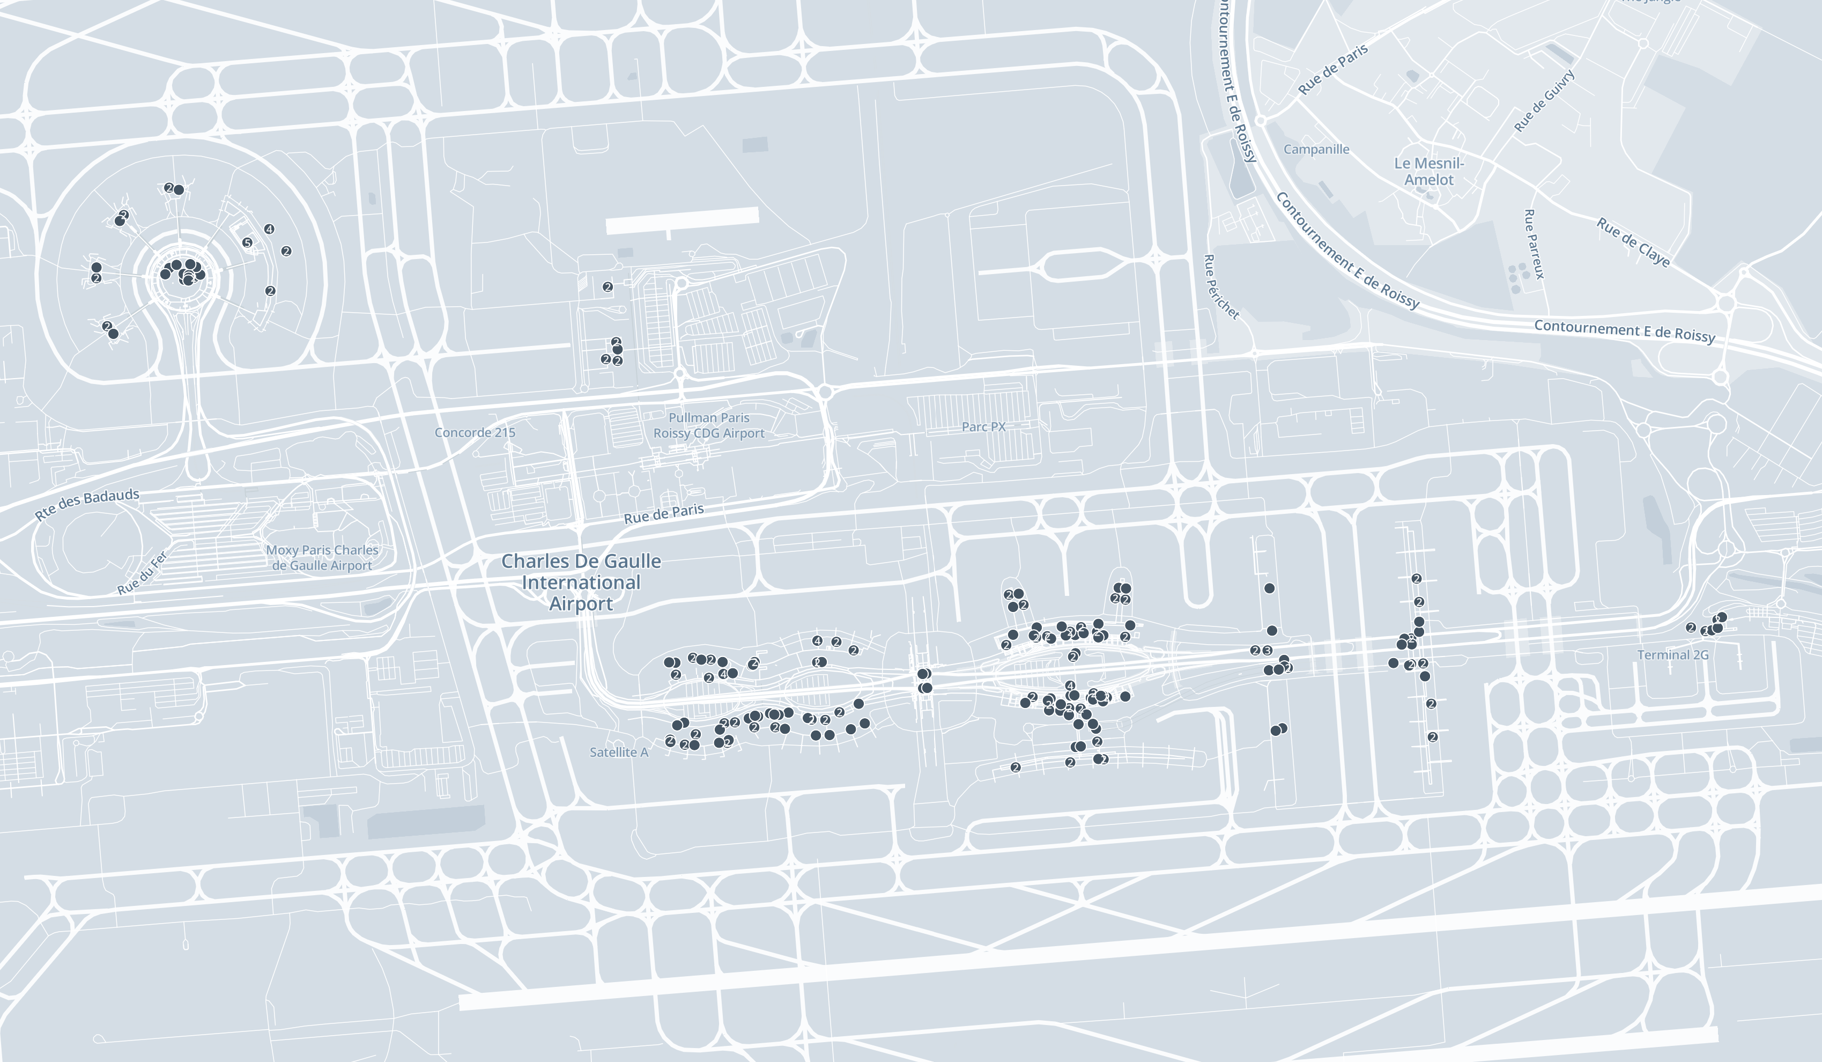
AIRPORT COVERAGE
Paris – Charles de Gaulle (CDG)
334 available screens across CDG's international terminal network
334
Available screens
1
Venue type across the terminals
Charles de Gaulle takes essentially all intercontinental season traffic — the principal gateway for buyers and press arriving from outside Europe. Screens span the terminal network's departure and transit concourses, weighted to the highest-dwell zones on the arrivals-to-connection journey.
Caution: Programmatic Digital Out-of-Home (pDOOH) campaigns do not provide full activation screen-level proof. While delivery and play logs are available, platform-level reporting does not guarantee visibility on every individual screen at every moment.
MASSCOM GLOBAL | Paris Fashion Week 2026 PDOOH Proposal
9

Slide 10
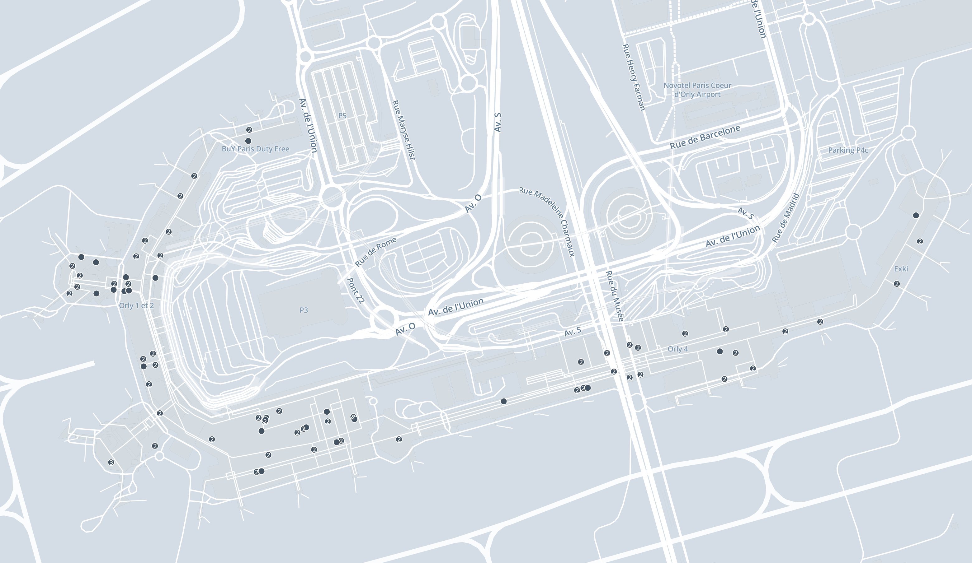
AIRPORT COVERAGE
Paris – Orly (ORY)
137 available screens across Orly's domestic and regional terminals
137
Available screens
1
Venue type across the terminals
Orly adds domestic and diaspora reach closer to the city centre, complementing CDG's intercontinental volume with a shorter transfer into central Paris for regional buyers and press.
Caution: Programmatic Digital Out-of-Home (pDOOH) campaigns do not provide full activation screen-level proof. While delivery and play logs are available, platform-level reporting does not guarantee visibility on every individual screen at every moment.
MASSCOM GLOBAL | Paris Fashion Week 2026 PDOOH Proposal
10

Slide 11
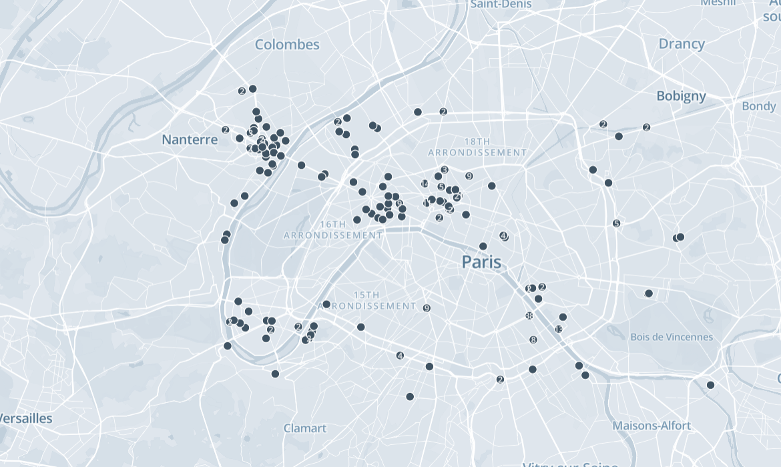
CITY COVERAGE
Paris Metropolitan City
324 available screens across the Right Bank luxury spine and arterial routes
324
Available city screens
2
Formats — office lobby &
roadside billboard
Coverage concentrates on the Right Bank — Avenue Montaigne, Place Vendôme, Rue Saint-Honoré and the Metro-fed office corridors feeding the fashion district — with roadside billboard reach on arterial routes into the wider 16th and 18th arrondissements and Nanterre for commuter and event-day traffic during the show week.
Caution: Programmatic Digital Out-of-Home (pDOOH) campaigns do not provide full activation screen-level proof. While delivery and play logs are available, platform-level reporting does not guarantee visibility on every individual screen at every moment.
MASSCOM GLOBAL | Paris Fashion Week 2026 PDOOH Proposal
11

Slide 12
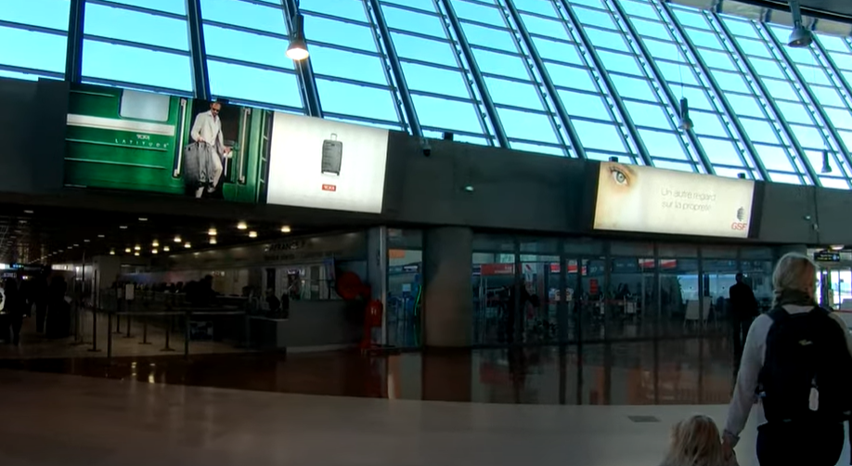
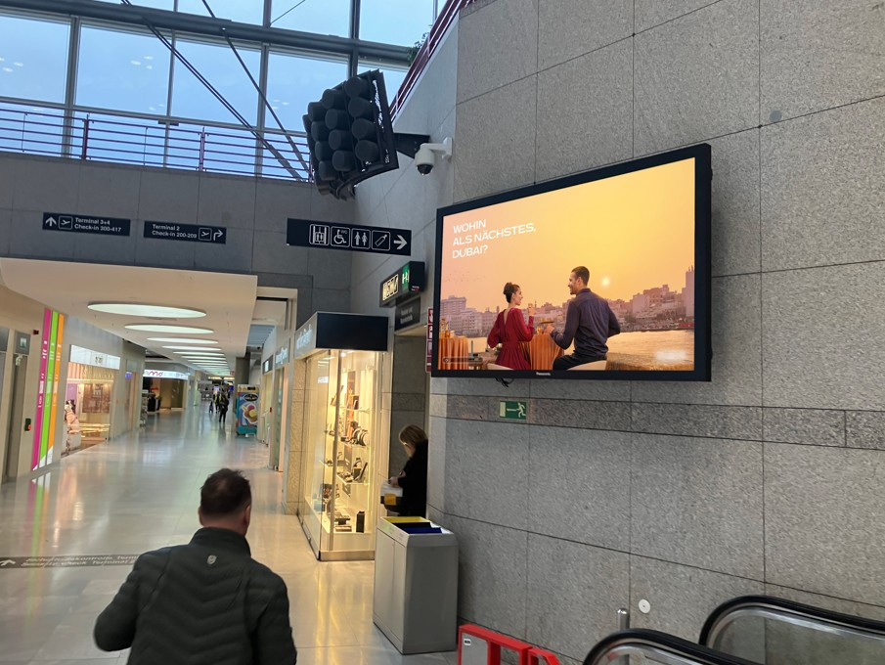
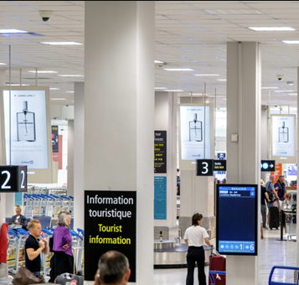
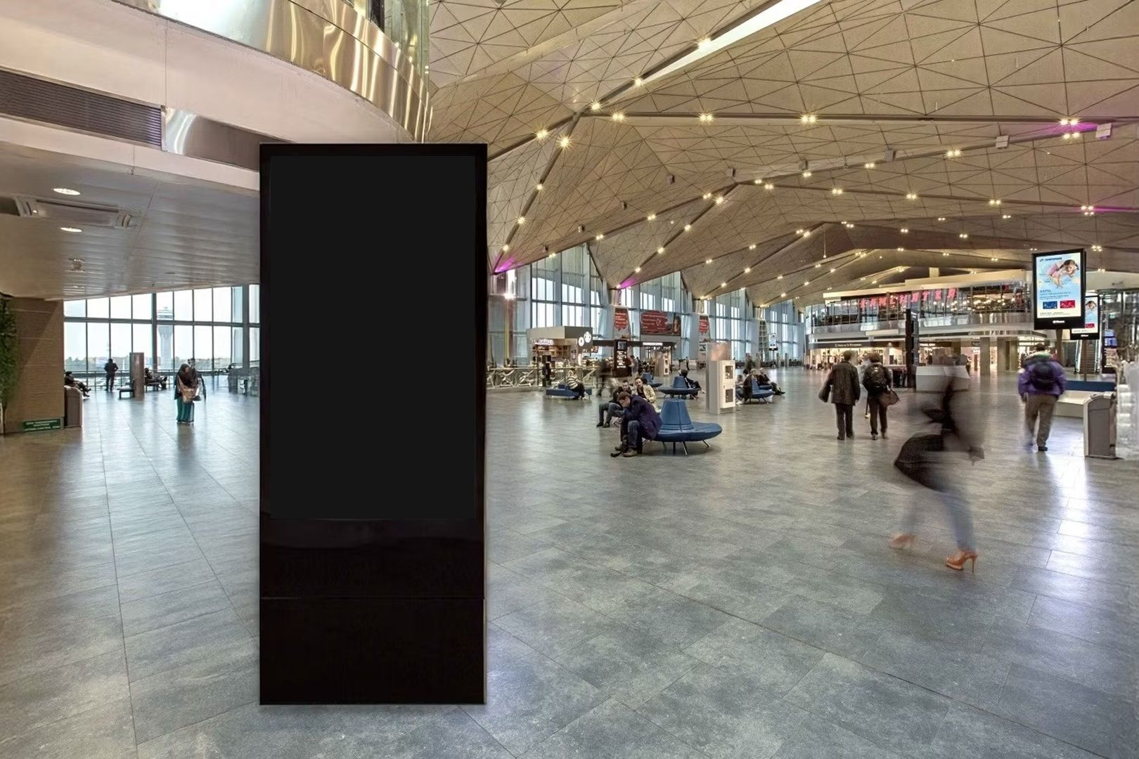
CREATIVE ENVIRONMENTS
Inventory in Context — CDG & Orly
A sample of premium DOOH placements across both airport terminal networks
CDG — terminal digital wall, departures concourse
CDG — terminal corridor digital wall
CDG — baggage claim tourist-information screen
CDG — terminal freestanding kiosk
Caution: Programmatic Digital Out-of-Home (pDOOH) campaigns do not provide full activation screen-level proof. While delivery and play logs are available, platform-level reporting does not guarantee visibility on every individual screen at every moment.
MASSCOM GLOBAL | Paris Fashion Week 2026 PDOOH Proposal
12

Slide 13
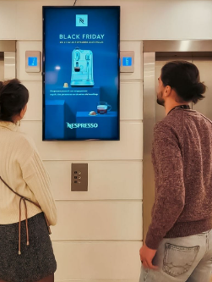
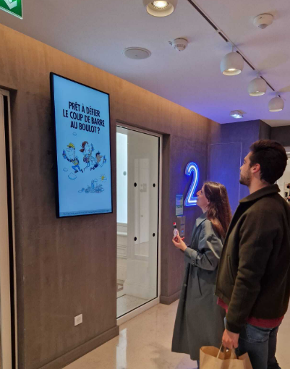
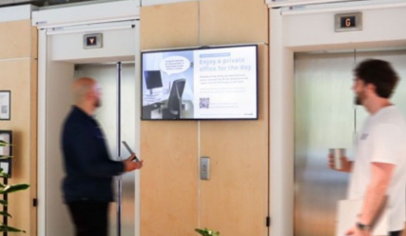
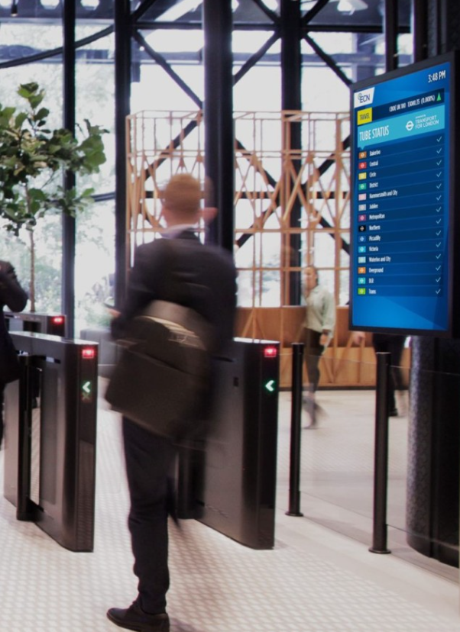
CREATIVE ENVIRONMENTS
Inventory in Context — Paris Metropolitan City
A sample of premium DOOH placements across Right Bank office lobbies and arterial routes
Office lobby — elevator-bank digital screen
Office lobby — entrance digital screen
Office lobby — private-suite digital screen
Office lobby — turnstile-entrance digital screen
Caution: Programmatic Digital Out-of-Home (pDOOH) campaigns do not provide full activation screen-level proof. While delivery and play logs are available, platform-level reporting does not guarantee visibility on every individual screen at every moment.
MASSCOM GLOBAL | Paris Fashion Week 2026 PDOOH Proposal
13

Slide 14
WHY MASSCOM GLOBAL
The Masscom Global Standard
1
2
Verified inventory & audience data
Transparent delivery reporting
Every terminal, screen count and passenger figure is checked against current operator data, not published estimates.
Proof of play, placement documentation and post-campaign reporting so you see exactly where and when creative ran.
3
4
Benchmarked recommendations
We absorb the complexity
Terminal mix and city weighting set against comparable campaigns across our 1,000+ airport network.
Negotiation, trafficking, creative specs and delivery are on us; you approve the plan and see the results.
MASSCOM GLOBAL | Paris Fashion Week 2026 PDOOH Proposal
14

Slide 15
Paris Fashion Week Closes the Season.
CDG, Orly and the Right Bank luxury spine see their heaviest fashion-week traffic in a fixed nine-day window — a campaign confirmed after 28 September misses the arrival wave entirely.
Explore $250/hr · $20,000/wk min.
Reach $500/hr · $45,000/wk min.
Domination $1,000/hr · $80,000/wk min.
01
02
03
Choose your package
Finalize creative specs
Approve & traffic
Explore, Reach, or Domination — based on your budget and ambition.
We supply full spec sheets per venue type and screen size.
Masscom Global handles negotiation, trafficking and delivery reporting.
Book Expert Consultation — calendly.com/masscomgx/15min
Masscom Global — Wealth in motion intelligence. | 1,000+ airports, 180+ countries
Also planning October? Ask about Milan Fashion Week, London Fashion Week, Monaco Yacht Show, Oktoberfest & SF Dreamforce — the full Masscom Global Combo Menu.

