Slide 1
Thomas Aquinas on Law
Dr. Ashok Karra
Lecturer, Missouri Science & Technology

Slide 2
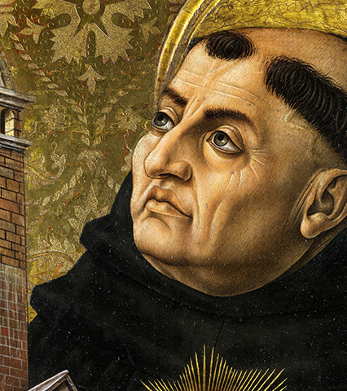
Lesson Objectives
What does Aquinas mean by "law?" How does this differ from a more modern understanding?
Explain "natural law;" describe the "basic goods" and how they function. Are these ideas you have thought about before?
Can the ideas of a 13th century monk speak to us, even if we disagree?
This Photo by Unknown author is licensed under CC BY-SA-NC.

Slide 3
Aquinas Defines Law
"an ordinance of reason for the common good, made by him who has care of the community, and promulgated." (ST Q 90, Article 4)
"ordinance of reason"
"common good" / "care of the community"
"promulgated"

Slide 4
Law: An "Ordinance of Reason for the Common Good"
"common good" / "care of the community" — our starting point. What are the political implications of this rhetoric?
Contrast with the Declaration of Independence: "We hold these truths to be self-evident, that all men are created equal, that they are endowed, by their Creator, with certain unalienable rights, that among these are life, liberty, and the pursuit of happiness."
Consider 13th century Europe. The Catholic Church provides a moral law for everyone. What is important for people at that time?
Consider 1776 in the colonies. What is important to the Framers? What do they envision the political and moral order resting upon?
Do you feel people appeal to the "common good" nowadays?

Slide 5

"Ordinance of Reason"
How does reason create order? This leads to Aquinas' teaching of "natural law."
"Natural law:" you lean toward the good. When you apply your reason, you can articulate the moral law. It doesn't matter if you believe in God: you can still see what to avoid and what to promote.
"Basic goods:" life (self-preservation), reproduction, education, seeking God, being social, avoiding offense, avoiding ignorance. (h/t Hank Green's "Crash Course: Natural Law Theory")
Hank's example: "life" as not just avoiding death but feeding the homeless, etc.

Slide 6
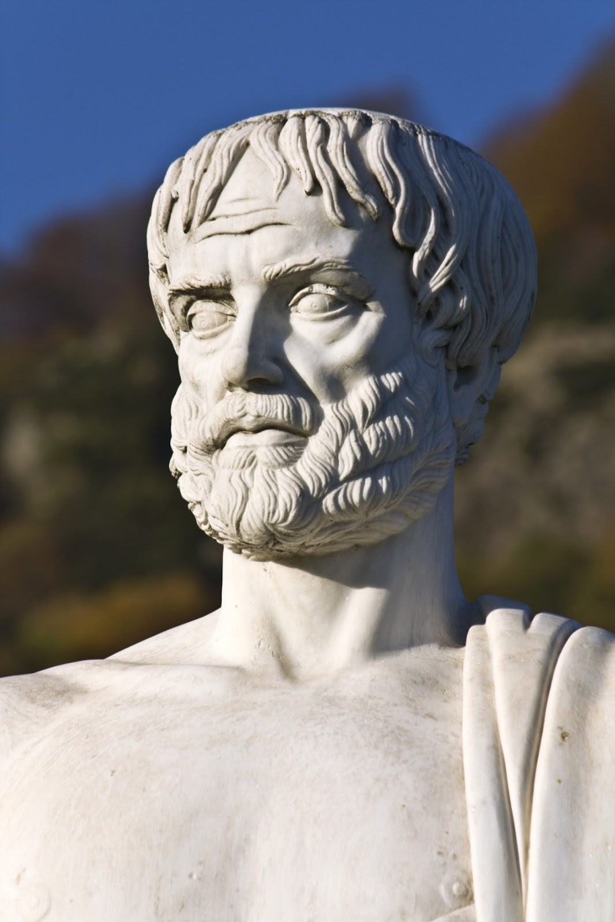
Complications
Does natural law reconcile reason and morality?
"Natural law," for Aquinas, is one of 4 types of law.
"Eternal," "Divine," and "Human" are the others.
Does Aquinas believe we are reasonable, or does he believe God made us reasonable? Is there a difference?
How do we understand the political implications of "natural law?"
"Natural law" is tied to other ideas of reason and freedom. Aristotle in NE V: "what [the law] does not expressly sanction, it forbids."
Can "natural law" be reconciled with our ideas about rights?
N.B. the need for the "common good"
This Photo by Unknon author is licensed under CC BY.

Slide 7

Complications (cont.)
Historically, Aquinas's emphasis on self-preservation and his ideas about property were used to break from his morality.
Locke ("life, liberty, property;" a right to revolution; a major influence on the Framers): you mix your labor with a natural resource and obtain private property.
Private Property + Self-Preservation lend themselves to Constitutionalism.
Aquinas seems to endorse these concerns in a very different spirit: virtue, summum bonum, the common good.

Slide 8
Review & Resources
Law, reason, and freedom are very different for our world and Aquinas' thought.
However, can we use reason to think about what positive changes we want? Is a notion of a "common good" helpful?
Is this too religious to be useful?
Also see:
Hank Green, "Crash Course: Natural Law Theory" (YouTube): https://www.youtube.com/watch?v=r_UfYY7aWKo
Aquinas, "Treatise on Law:" http://fs2.american.edu/dfagel/www/Class%20Readings/Aquinas/Aquinas-Summa_On%20Law.pdf
Aquinas on Private Property: http://www.howardischwartz.com/aquinass-answer-to-the-question-whether-it-is-natural-for-man-to-possess-external-things/

